Slide 1
BIT 33603 : DATA MINING LECTURE 7 : NEURAL NETWORKS

Slide 2


Slide 9
Neural Network is a set of connected INPUT/OUTPUT UNITS, where each connection has a WEIGHT associated with it.
Neural Network learning is also called CONNECTIONIST learning due to the connections between units.
Neural Network learns by adjusting the weights so as to be able to correctly classify the training data and hence, after testing phase, to classify unknown data.

Slide 14
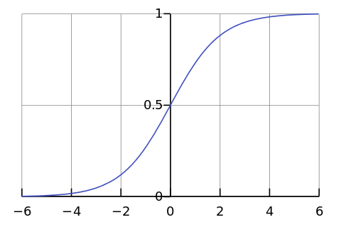

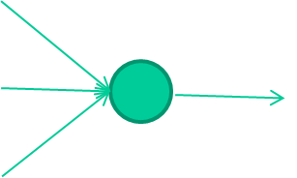
-0.06
W1
W2
f(x)
-2.5
W3
1.4

Slide 15
-0.06
2.7
-8.6
f(x)
-2.5
0.002
x = -0.06×2.7 + 2.5×8.6 + 1.4×0.002 = 21.34
1.4

Slide 18
Perceptron
Single Layer Perceptron
Multilayer Perceptron

Slide 20
MLP
INPUT: records without class attribute with normalized attributes values.
INPUT VECTOR: X = { x1, x2, …. xn}
where n is the number of (non class) attributes.
INPUT LAYER – there are as many nodes as non-class attributes i.e. as the length of the input vector.
HIDDEN LAYER – the number of nodes in the hidden layer and the number of hidden layers depends on implementation.
OUTPUT LAYER – corresponds to the class attribute.
There are as many nodes as classes (values of the class attribute).
k= 1, 2,.. #classes

Slide 21
Neural Network Learning
2 MAJOR PROCESSES INVOLVE :-
Forward propagation
Back- Propagation
- The inputs are fed simultaneously into the input layer.
- The weighted outputs of these units are fed into hidden layer.
- The weighted outputs of the last hidden layer are inputs to units making up the output layer.

Slide 22
Back Propagation learns by iteratively processing a set of training data (samples).
For each sample, weights are modified to minimize the error between network’s classification and actual classification

Slide 23
Steps in training the MLP
STEP ONE: initialize the weights and biases.
The weights in the network are initialized to random numbers from the interval [-1,1] or [0,1]
Each unit has a BIAS associated with it
The biases are similarly initialized to random numbers from the interval [-1,1].
STEP TWO: feed the training sample.
STEP THREE: Propagate the inputs forward; we compute the net input and output of each unit in the hidden and output layers.
STEP FOUR: back propagate the error.
STEP FIVE: update weights and biases to reflect the propagated errors.
STEP SIX: terminating conditions.

Slide 24
Terminating Conditions
When to stop the training ….
All
in the previous epoch are below some threshold, or
The percentage of samples misclassified in the previous epoch is below some threshold, or
a pre specified number of epochs has expired.
In practice, several hundreds of thousands of epochs may be required before the weights will converge.
Training a neural network with backpropagation learning algorithm usually requires that all representations of the input set (called one epoch) are presented many times. For examples, the ANN may use hundreds to thousands epochs.

Slide 26
Backpropagation Formulas
Output vector
Output nodes
Hidden nodes
w_{ij}
Input nodes
Input vector: x_{i}

Slide 27
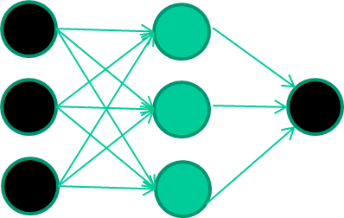
A dataset:
Inputs class
1.4 2.7 1.9 0
3.8 3.4 3.2 0
6.4 2.8 1.7 1
4.1 0.1 0.2 0
etc …

Slide 28
Training the neural network
Inputs class
1.4 2.7 1.9 0
3.8 3.4 3.2 0
6.4 2.8 1.7 1
4.1 0.1 0.2 0
etc …

Slide 29
Training data
Inputs class
1.4 2.7 1.9 0
3.8 3.4 3.2 0
6.4 2.8 1.7 1
4.1 0.1 0.2 0
etc …
Initialise with random weights

Slide 30
Training data
Inputs class
1.4 2.7 1.9 0
3.8 3.4 3.2 0
6.4 2.8 1.7 1
4.1 0.1 0.2 0
etc …
Present a training pattern
1.4
2.7
1.9

Slide 31
Training data
Inputs class
1.4 2.7 1.9 0
3.8 3.4 3.2 0
6.4 2.8 1.7 1
4.1 0.1 0.2 0
etc …
Feed it through to get output
1.4
2.7 0.8
1.9

Slide 32
Training data
Inputs class
1.4 2.7 1.9 0
3.8 3.4 3.2 0
6.4 2.8 1.7 1
4.1 0.1 0.2 0
etc …
Compare with target output
1.4
2.7 0.8
0
1.9 error 0.8

Slide 33


Training data
Inputs class
1.4 2.7 1.9 0
3.8 3.4 3.2 0
6.4 2.8 1.7 1
4.1 0.1 0.2 0
etc …
Adjust weights based on error
1.4
2.7 0.8
0
1.9 error 0.8

Slide 34
Training data
Inputs class
1.4 2.7 1.9 0
3.8 3.4 3.2 0
6.4 2.8 1.7 1
4.1 0.1 0.2 0
etc …
Present a training pattern
6.4
2.8
1.7

Slide 35
Training data
Inputs class
1.4 2.7 1.9 0
3.8 3.4 3.2 0
6.4 2.8 1.7 1
4.1 0.1 0.2 0
etc …
Feed it through to get output
6.4
2.8 0.9
1.7

Slide 36
Training data
Inputs class
1.4 2.7 1.9 0
3.8 3.4 3.2 0
6.4 2.8 1.7 1
4.1 0.1 0.2 0
etc …
Compare with target output
6.4
2.8 0.9
1
1.7 error -0.1

Slide 37
Training data
Inputs class
1.4 2.7 1.9 0
3.8 3.4 3.2 0
6.4 2.8 1.7 1
4.1 0.1 0.2 0
etc …
Adjust weights based on error
6.4
2.8 0.9
1
1.7 error -0.1

Slide 38
Training data
Inputs class
1.4 2.7 1.9 0
3.8 3.4 3.2 0
6.4 2.8 1.7 1
4.1 0.1 0.2 0
etc …
And so on ….
6.4
2.8 0.9
1
1.7 error -0.1
Repeat this thousands, maybe millions of times – each time taking a random training instance, and making slight weight adjustments
Algorithms for weight adjustment are designed to make
changes that will reduce the error

Slide 39
The decision boundary perspective…
Initial random weights

Slide 40
The decision boundary perspective…
Present a training instance / adjust the weights

Slide 41
The decision boundary perspective…
Present a training instance / adjust the weights

Slide 42
The decision boundary perspective…
Present a training instance / adjust the weights

Slide 43
The decision boundary perspective…
Present a training instance / adjust the weights

Slide 44
The decision boundary perspective…
Eventually ….

Slide 45
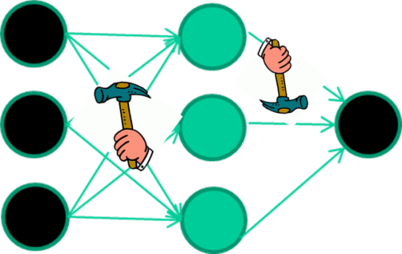
The points are:
weight-learning algorithms for NNs are somehow a tedious process
they work by making thousands and thousands of tiny adjustments, each making the network do better at the most recent pattern, but perhaps a little worse on many others
but, eventually this tends to be good enough to
learn effective classifiers for many real applications

Slide 46
Some other points
If f(x) is non-linear, a network with 1 hidden layer can, in theory, learn perfectly any classification problem. A set of weights exists that can produce the targets from the inputs. The problem is finding them.

Slide 47
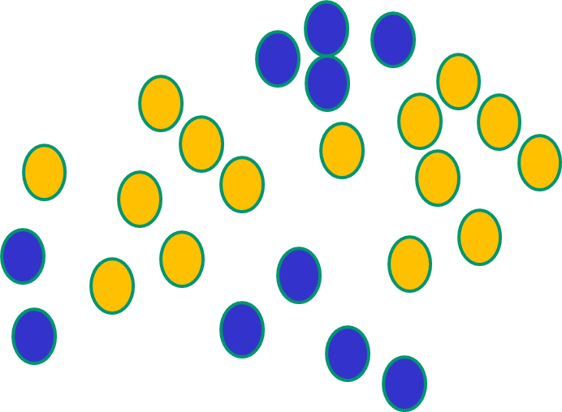
Some other ‘by the way’ points
If f(x) is linear, the NN can only draw straight decision boundaries (like a single layer of perceptron- SLP)

Slide 48
Some other ‘by the way’ points
NNs with a hidden layer use nonlinear f(x) so they can draw complex boundaries, but keep the data unchanged

Slide 49
Some other ‘by the way’ points
NNs use nonlinear f(x) so they SVMs only draw straight lines,
can draw complex boundaries, but they transform the data first
but keep the data unchanged in a way that makes that OK

Slide 50
So how the NN weights are adjusted?
Training data
Inputs class
1.4 2.7 1.9 0
3.8 3.4 3.2 0
6.4 2.8 1.7 1
4.1 0.1 0.2 0
etc …
And so on ….
6.4
2.8 0.9
1
1.7 error -0.1
Repeat this thousands, maybe millions of times – each time
taking a random training instance, and making slight
weight adjustments
Algorithms for weight adjustment are designed to make
changes that will reduce the error

Slide 52
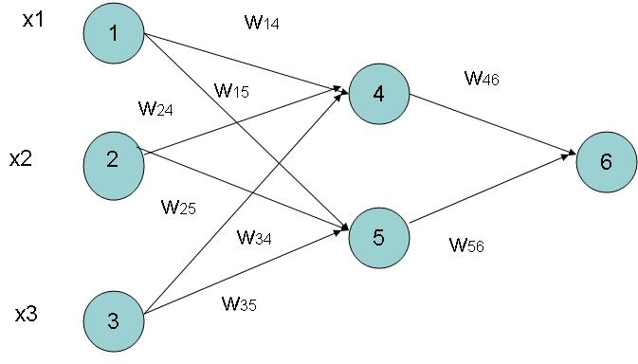
Example of Back propagation
Input = 3,
Hidden Neuron = 2
Output =1
Initialize weights and bias :
To random numbers from -1.0 to 1.0
Initial Input and weight
x1 | x2 | x3 | w14 | w15 | 24 | 25 | 34 | 35 | 46 | 56
1 | 0 | 1 | 0.2 | -0.3 | 0.4 | 0.1 | -0.5 | 0.2 | -0.3 | -0.2
Initial bias :
θ4 | θ5 | θ6
-0.4 | 0.2 | 0.1

Slide 53
Net Input and Output Calculation
Unitj | Net Input Ij | Output Oj
4 | 0.2 + 0 - 0.5 -0.4 = -0.7
5 | -0.3 + 0 + 0.2 + 0.2 =0.1
6 | (-0.3)0.332-(0.2)(0.525)+0.1= -0.105
= 0.332
= 0.525
= 0.475

Slide 54
Calculation of Error at Each Node
Unit j | Error j
6 | 0.475(1-0.475)(1-0.475) =0.1311 We assume T 6 = 1 , where is T is target output, O is the current output
5 | 0.525 x (1- 0.525)x 0.1311x (-0.2) = 0.0065
4 | 0.332 x (1-0.332) x 0.1311 x (-0.3) = -0.0087

Slide 55
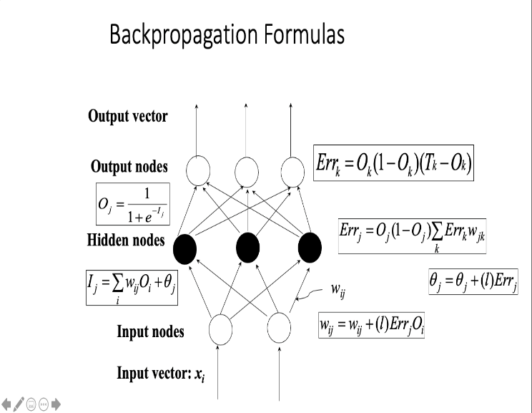
Calculation of weights and Bias Updating
Let say the Learning Rate l =0.9
Weight | New Values
w46 | -0.3 + 0.9(0.1311)(0.332) = -0.261
w56 | -0.2 + (0.9)(0.1311)(0.525) = -0.138
w14 | 0.2 + 0.9(-0.0087)(1) = 0.192
w15 | -0.3 + (0.9)(-0.0065)(1) = -0.306
……..similarly | ………similarly
θ6 | 0.1 +(0.9)(0.1311)=0.218
……..similarly | ………similarly

Slide 56
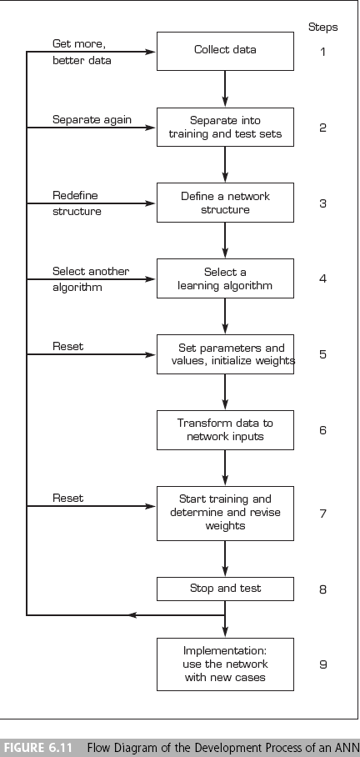
Developing a Neural Network–Based System

Slide 57
Application
Forecasting/Market Prediction: finance and banking
Manufacturing: quality control, fault diagnosis
Medicine: analysis of electrocardiogram data, RNA & DNA sequencing, drug development without animal testing
Control: process, robotics

Slide 58
Time Series Prediction
Time series prediction: given an existing data series, we observe or model the data series to make accurate forecasts
Example time series
Financial (e.g., stocks, exchange rates)
Physically observed (e.g., weather, sunspots, river flow)
Why is it important?
Preventing undesirable events by forecasting the event, identifying the circumstances preceding the event, and taking corrective action so the event can be avoided (e.g., inflationary economic period)
Forecasting undesirable, yet unavoidable, events to preemptively lessen their impact (e.g., solar maximum w/ sunspots)
Profiting from forecasting (e.g., financial markets)

Slide 59
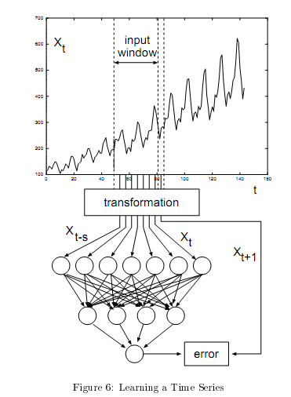

Slide 60
