Slide 1
πengine
THE COMPUTER
ENGINEERING
DESIGN

Slide 2
πengine
INDEX
Idea
Parts
Algorithm
Algorithm
We are

Slide 3
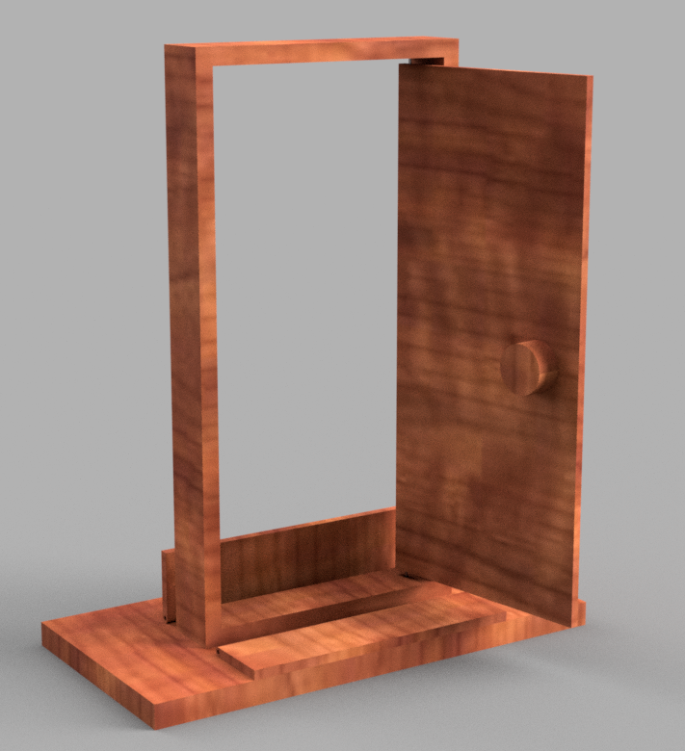
πengine
Idea

Slide 4
πengine
Parts

Slide 5
πengine
Document

