Slide 1
Validation Experiments

Slide 2
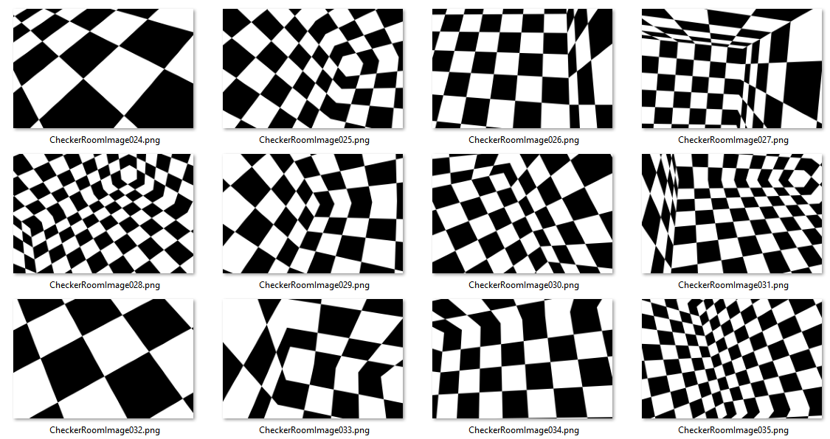
Experiment to Validate Photogrammetric Accuracy
Scene: 10m square cube with 10x10 checkerboard on each wall
Sensor: 5 sensor parameters with/without distortion (10 experiments)
Trajectory: 100 images rendered for each experiment at random
Translation in meters: Tx, Tx, Tz = [-4 4]
Rotation in degrees: Rx, Rz = [0 360], Ry = [0 180]

Slide 3
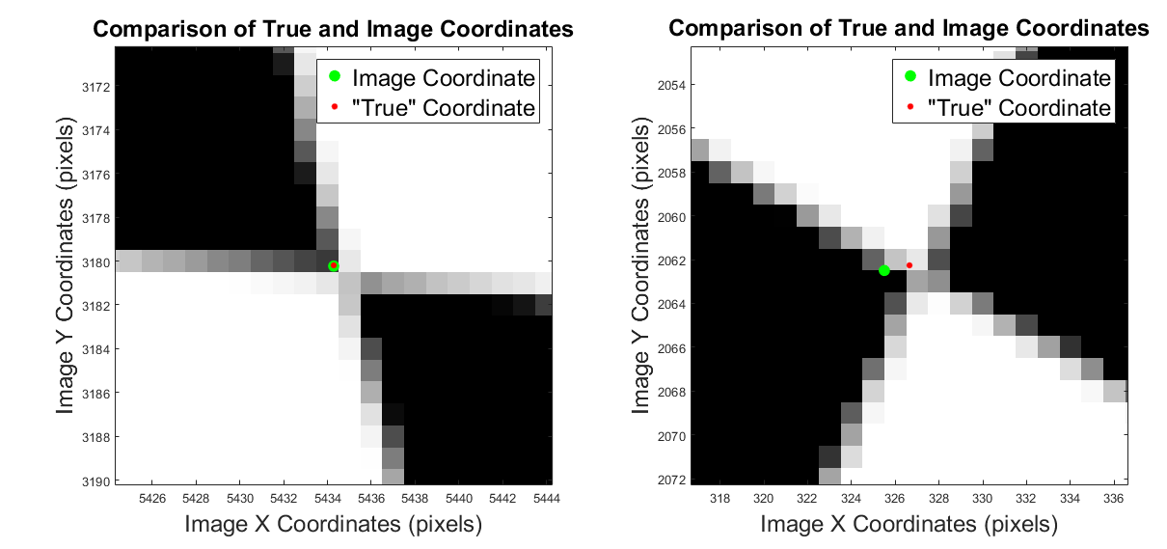
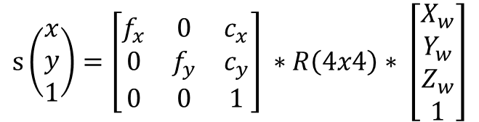
Methodology to Validate Photogrammetric Accuracy
Calculate coordinate of checkerboard corners using image processing (Harris Corner)
Calculate “true” coordinate of projected points using:
Known Sensor parameters (Interior Orientation)
Known Camera Pose (Exterior Orientation)
Known XYZ of corner in World Coordinates
Determine Correspondence
nearest neighbor with a 5 pixel threshold
Calculate Δx Δy for each coordinate
$$s\left(\begin{matrix}x \\ y \\ 1\end{matrix}\right)=\left[\begin{matrix}f_{x} & 0 & c_{x} \\ 0 & f_{y} & c_{y} \\ 0 & 0 & 1\end{matrix}\right] ∗R\left(4x4\right)∗ \left[\begin{matrix}X_{w} \\ Y_{w} \\ \begin{matrix}Z_{w} \\ 1\end{matrix}\end{matrix}\right]$$

Slide 4
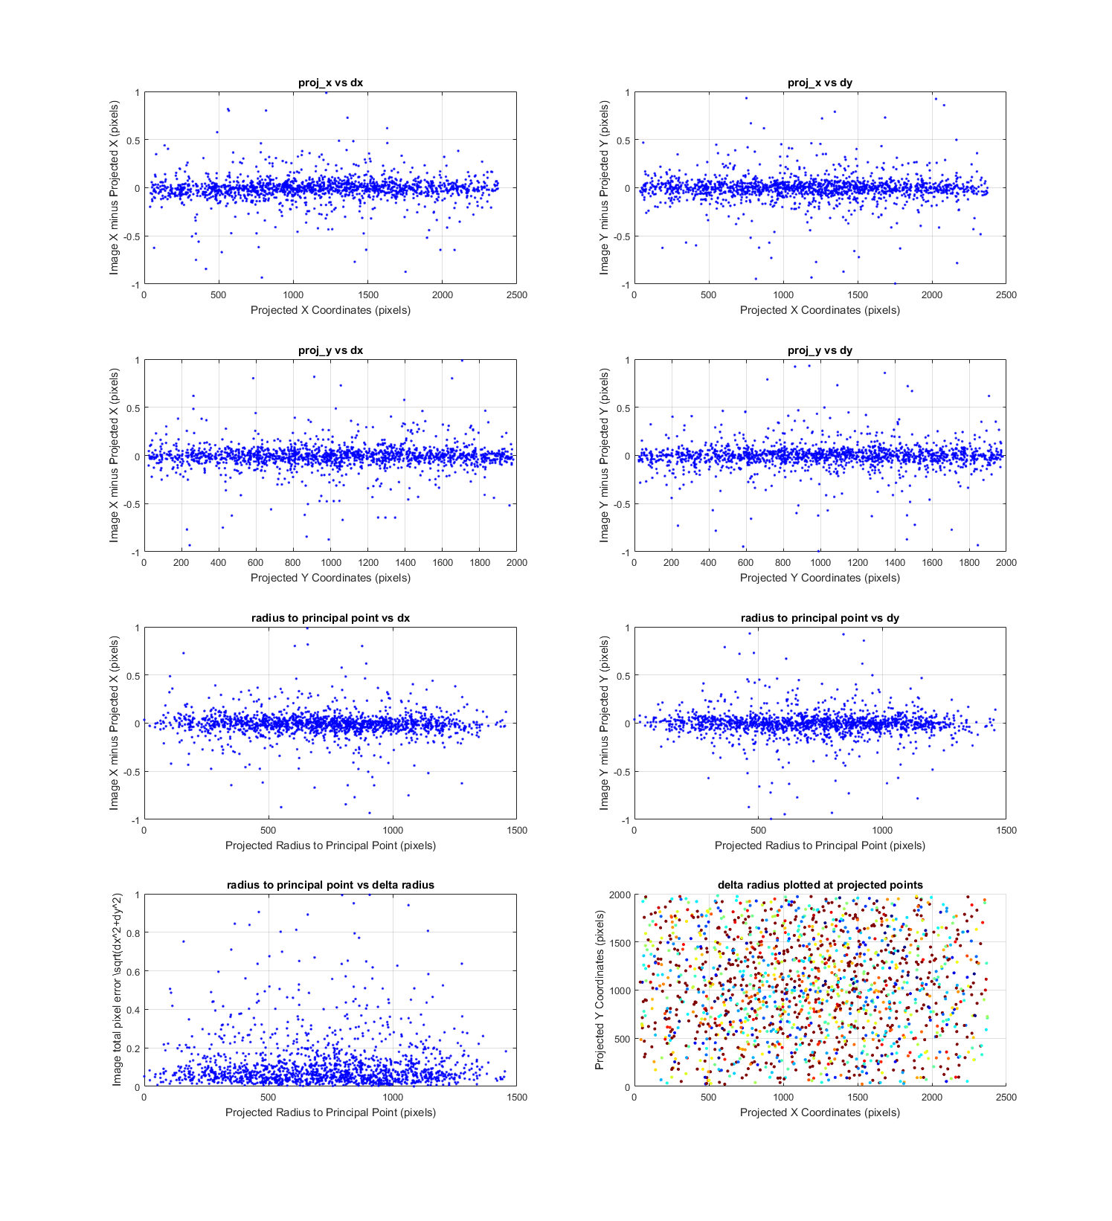
Is Δx Δy spatially correlated

Slide 5
Is Δx Δy spatially correlated (cont)

Slide 6
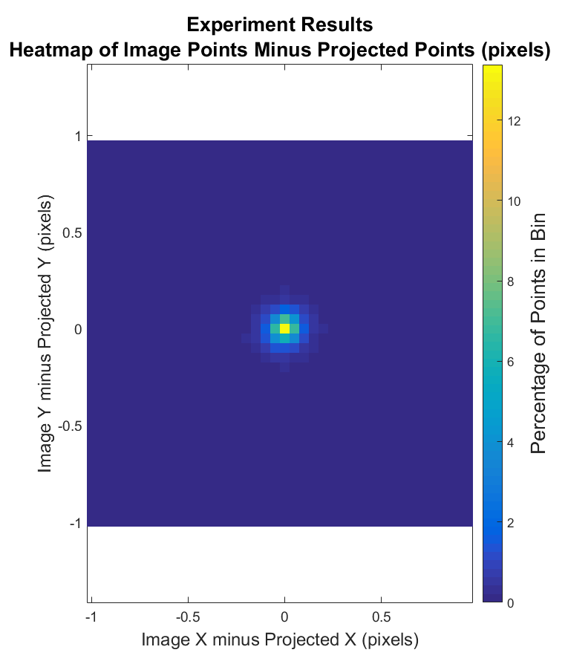
Results
The Δx and Δy are all subpixel
Tests
Mean is statistically “0”
Std is due to harris corner detection
No spatial correlation (previous plots)
Is the “noise” due to
1) Image rendering
2) Harris Corner extraction
Need to determine Harris corner accuracy

Slide 7
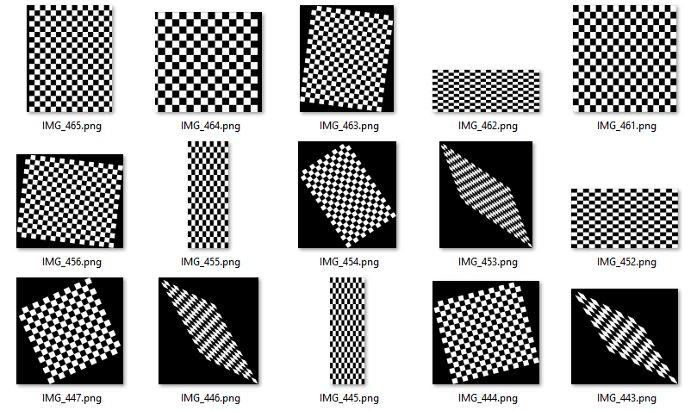
Harris Corner Accuracy Experiment (Simulated Checkerboards)
Simulate 500 checkerboards of random sizes with known coordinates
random checkerboard square pixel size (20-100 pixels)
Random x, y number of checkerboards (10-20)
Randomly either:
Rotate in degrees = [0 360]
Translate in Pixles = [-50 50]
Affine Transformation
Shear x and shear y = [0.25 0.75]
Scale x and Scale y = [0.5 3]
Compare Truth vs Harris Points

Slide 8
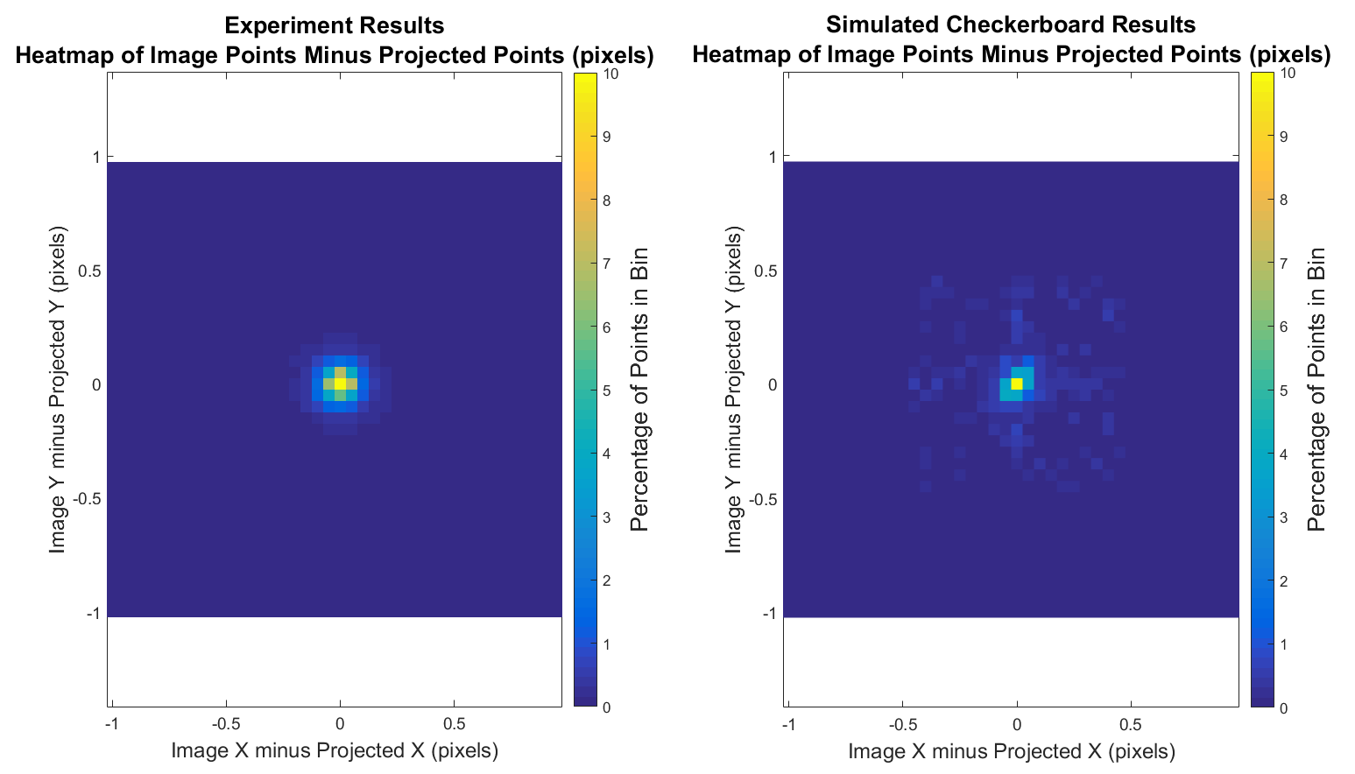
Rendered Images vs Simulated Checkerboards
The difference between the two appears to be negligible…
What statistical test should I do for a 2D distribution??

Slide 9
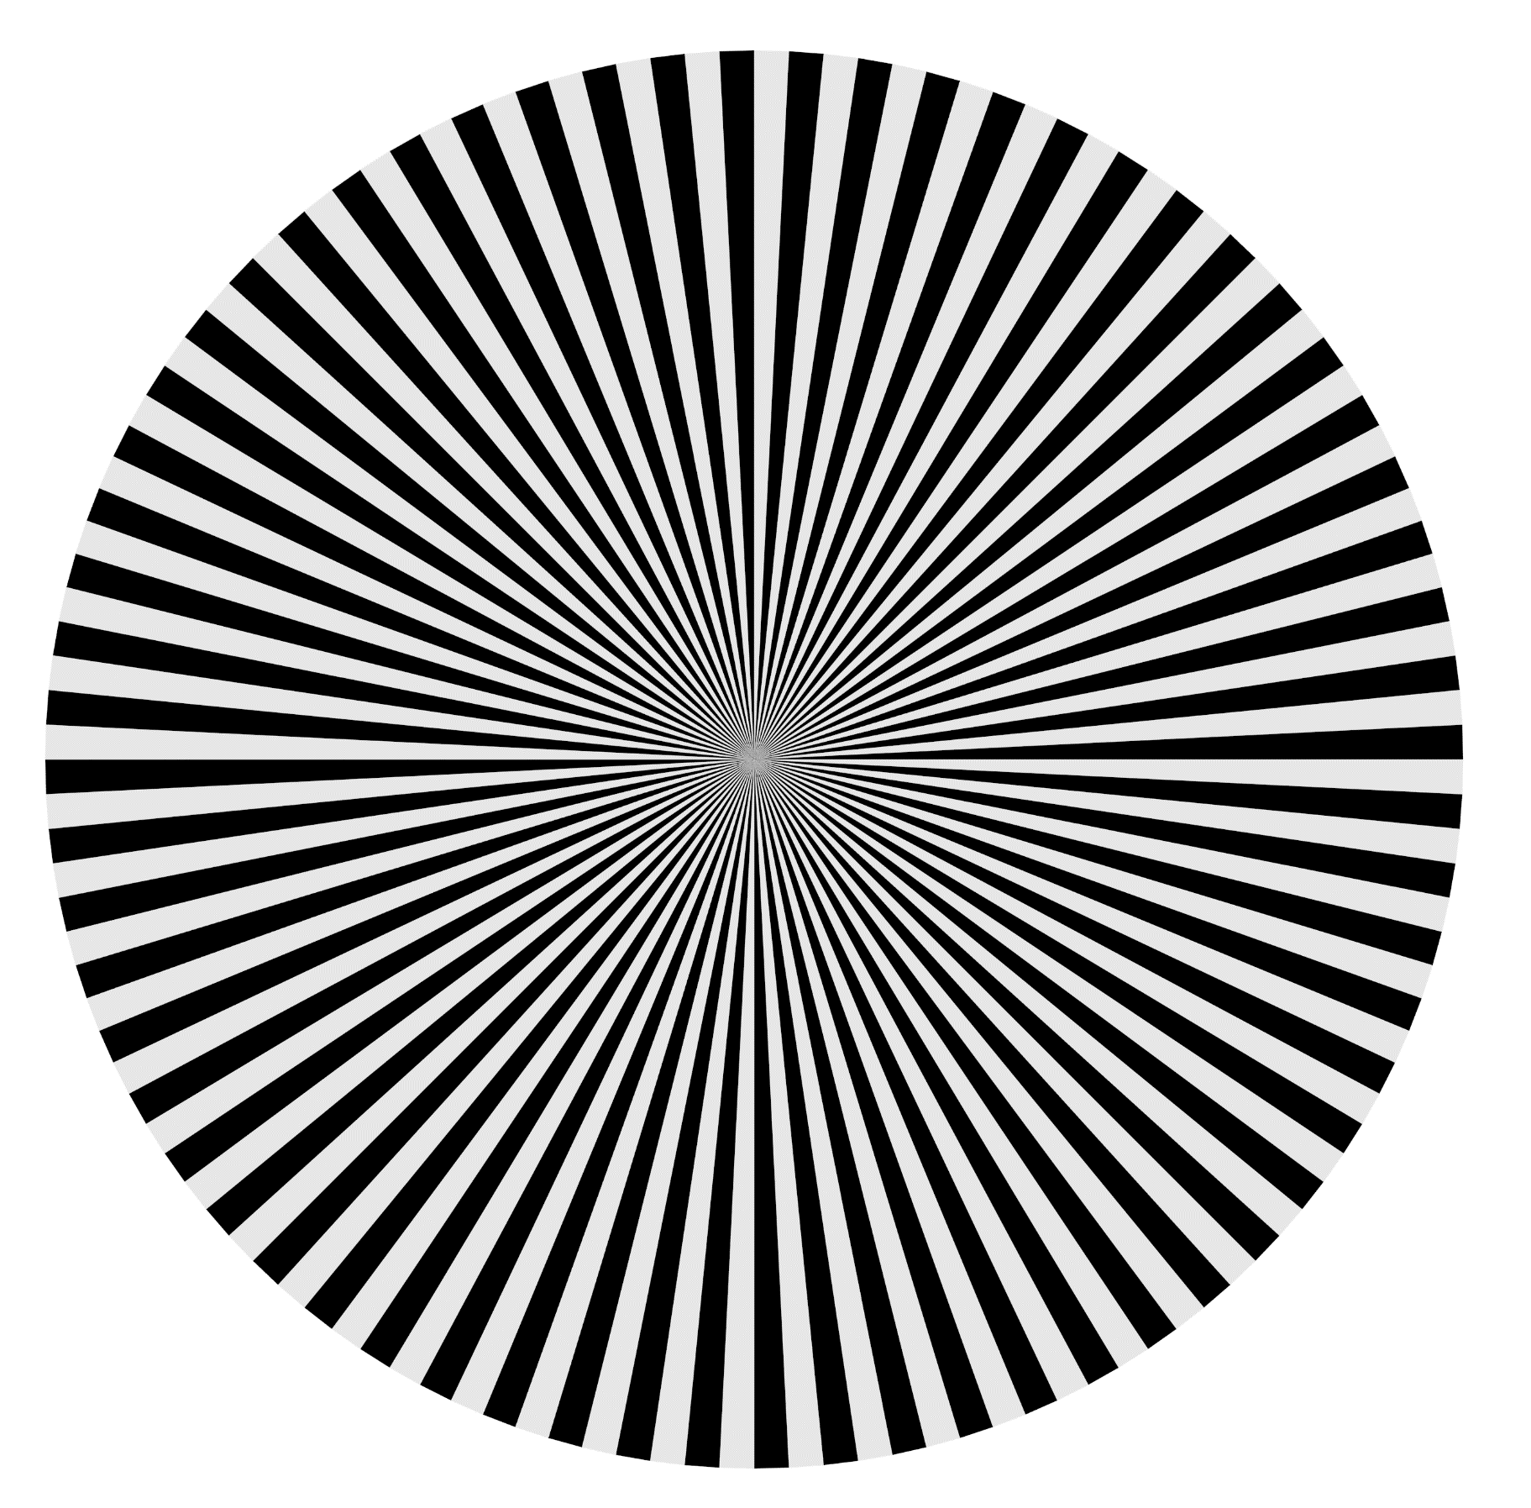

Validation of Sharpness
Hypothesis: Optical Transfer Function of rendered image = unit impulse (2D dirac delta) (Is there another term for this?)
Experiment: Render images from camera pointing directly at target as the range varies from 1-100 meters away.
How to best quantify and validate this?
Seimens Star Target
Tribar Target

Slide 10

Validate Texture Resolution
Render checkerboard where each checker is one pixel?
Ensure the texture isn’t smeared together and the texture GSD is accurate and not smoothed
1 pixel

