Slide 1
simUAS update
3/1/2018

Slide 2
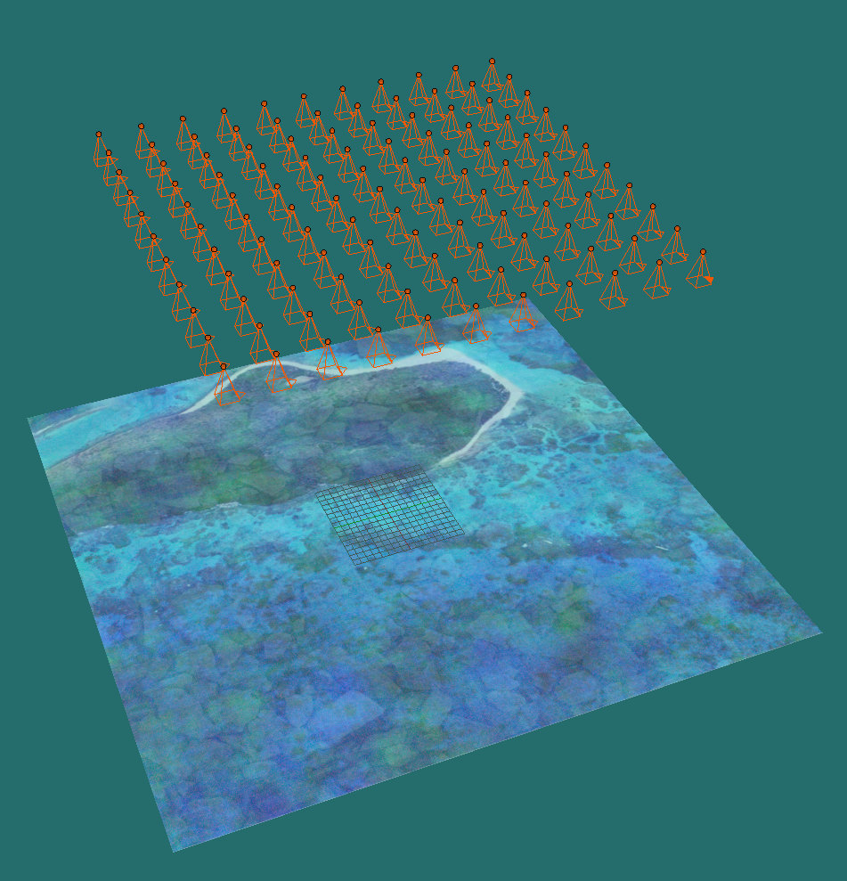
GPS Accuracy Experiment Constants
Nadir Imagery on Perfect Grid
75% Overlap + Sidelap
2000 x 2000 pixel, 60 degree hFOV, pinhole camera
Flat Water Surface and Seafloor
Transparent Water with Index of Refraction = 1.33

Slide 3
GPS Accuracy Experiment Independent Variables
Depth
[0, 1, 2, 3, 4] (meters)
Noise Added to Reported Trajectory
[0, 0.01, 0.03, 0.05, 0.1, 0.5, 2] (meters)
Iterations of noise added to trajectory
10
* This experiment simulates a UAS which takes imagery on a perfect grid with exact overlap/sidelap, but reports inaccurate trajectories
* Standard Deviation of the Bias is much more important than the Bias, due to the fact that the bias is correctable, whereas random deviations from the bias are not correctable

Slide 4
Pointcloud accuracy is broken into 3 regions
Each Dot represents a camera position
Visual arrangement here represents:
80% overlap
80% sidelap
Square Image
*Experiments use 75% Overlap
80% here is just to visualize regions
Region C:
All Data
Northing
Region B:
Clip with Flight Lines
Region A:
Clip by Full Viewing Geometry
Image FOV
FOLLOWING RESULTS ARE ALL REGION A
Easting

Slide 5
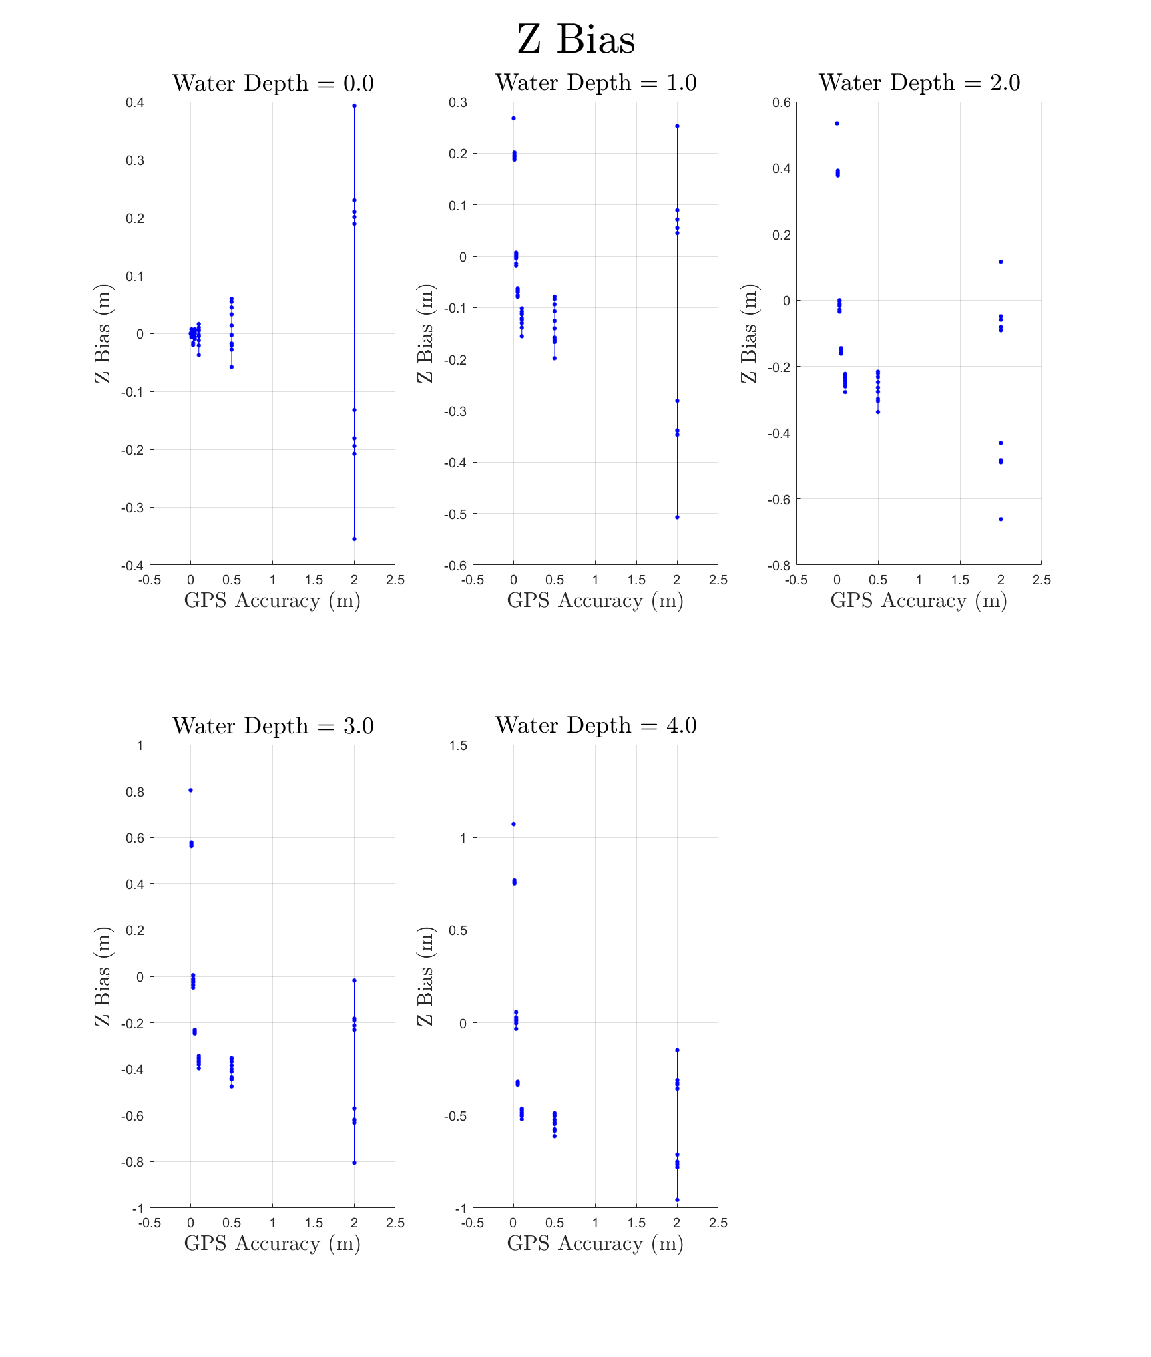
Mean bias of each simulation
Note that the variance of the bias increases as the GPS accuracy gets worse

Slide 6
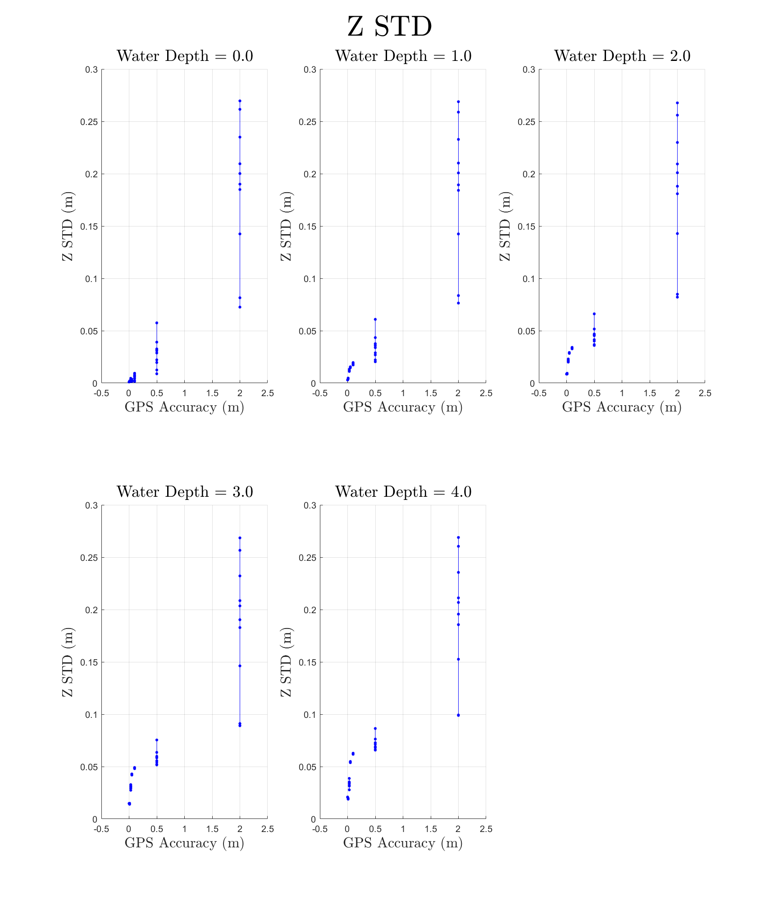
Mean standard deviation of each simulation
Note mean of the standard deviation increases as GPS accuracy gets worse
Note that the variance of the standard deviation also increases as the GPS accuracy gets worse

Slide 7
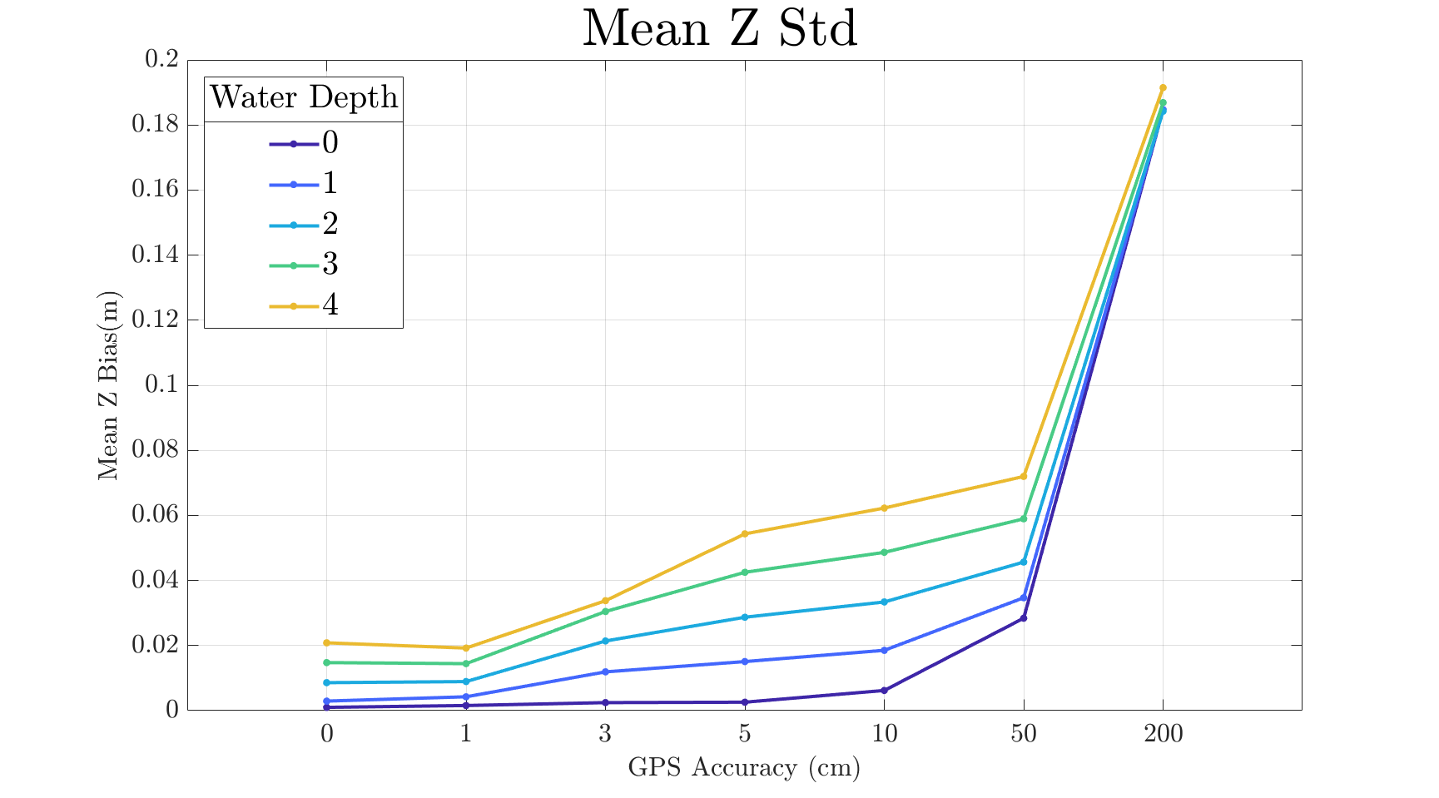
NOTE X AXIS IS NOT LINEAR/LOG…THIS SHOULD PROBABLY BE A BAR GRAPH

Slide 8
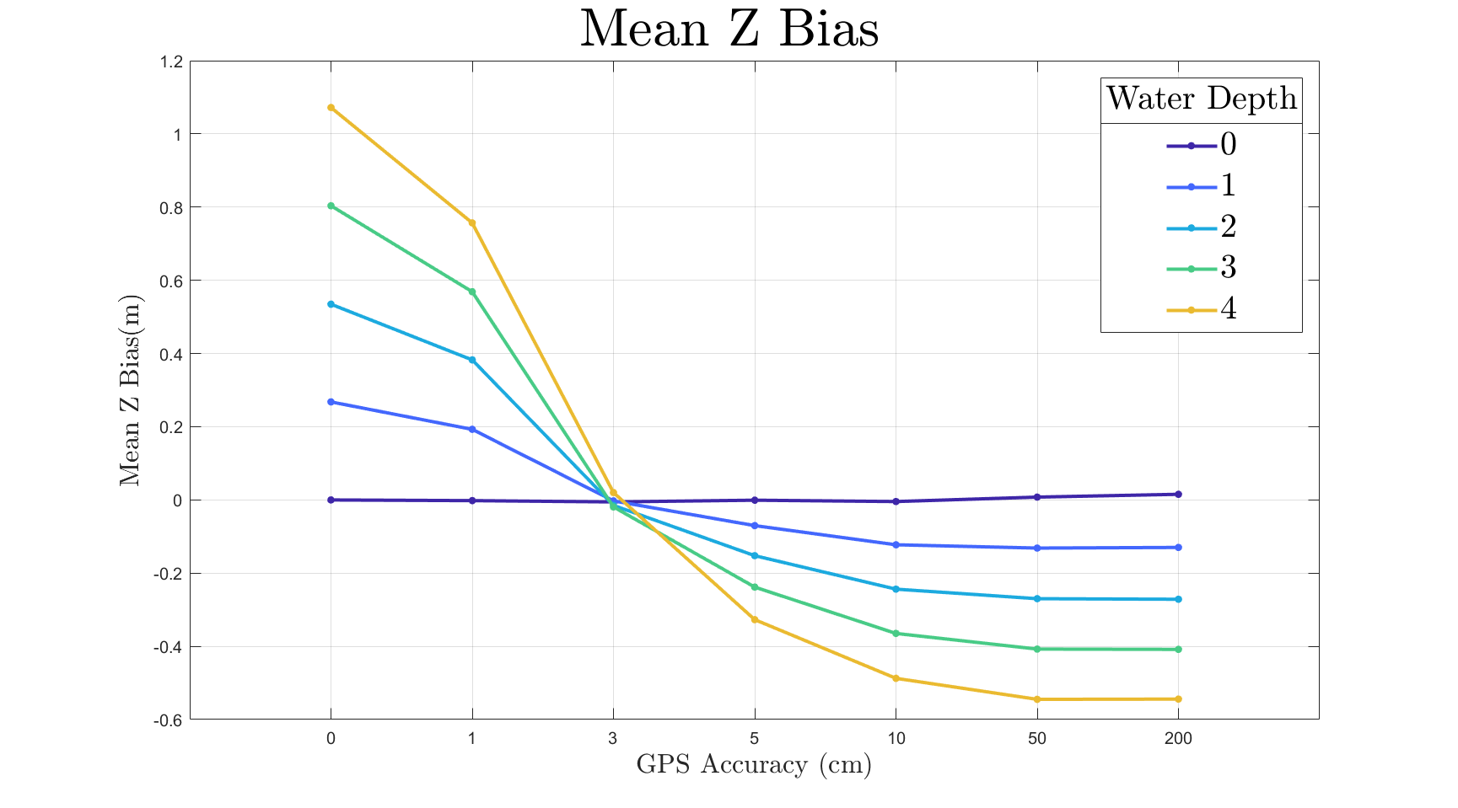
Just make your GPS accuracy 3cm, and there’s 0 bias???
NOTE X AXIS IS NOT LINEAR/LOG, THIS SHOULD PROBABLY BE A BAR GRAPH

Slide 9
GPS Accuracy Results Summary
3cm = No Bias??
This is very specific to this experiment
It’s not actionable as we can’t specify “3cm accuracy” in our GPS
RTK GPS will give less standard deviation for each experiment
We can compare this to processing data in the USVI with different GPS
Less standard deviation is more important than less bias, as we can correct for bias via some methods that are out there (eg. Dietrick)
Will be interesting to see if Dietrick also reduces the std, as it’s correcting for each ray
As expected, deeper water = more error

Slide 10
More Overlap = Better Accuracy… Right?
Initial results depict no correlation between overlap/sidelap and error
See plots on next page. Same basic experiment as described in previous slides.
Hypothesis
This could be due to the idealized experiments I am running. Overlap/Sidelap help overcome noise in the tiepoint selection and help constrain the solution for the nonlinear lens distortion. If I add a lower quality texture, and some lens distortion, this correlation will be more apparent.
Working on testing this hypothesis now
In the field, we are going to do multiple flights with various overlap/sidelap to see how the results compares to simUAS
I think these results will be very useful for the final report, as right now the common practice is “75-80% is good”, with no real quantification of “good”

Slide 11
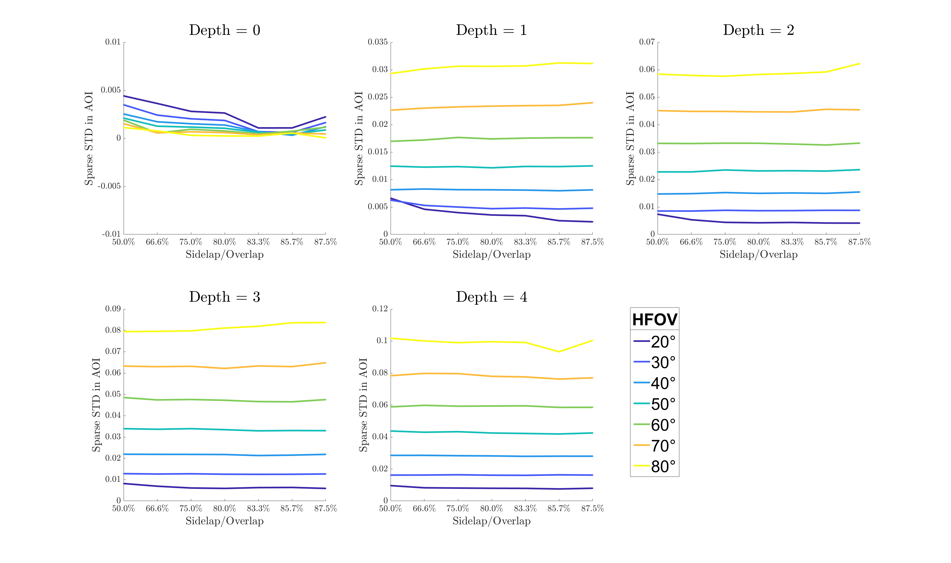
Standard Deviation

Slide 12
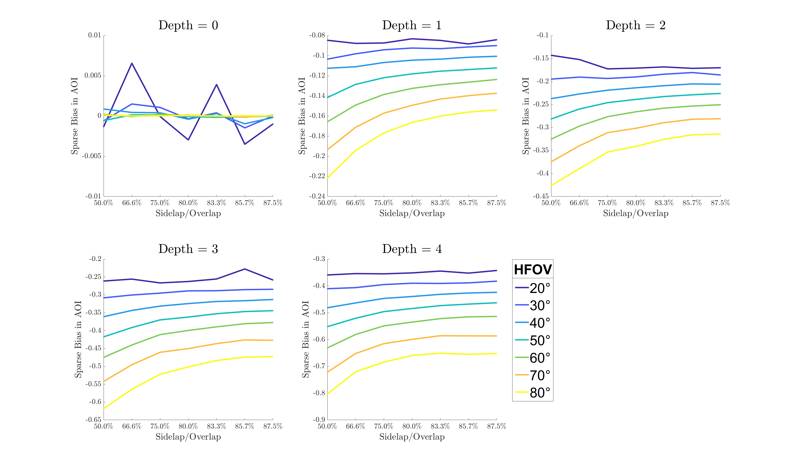
Bias

