Slide 1
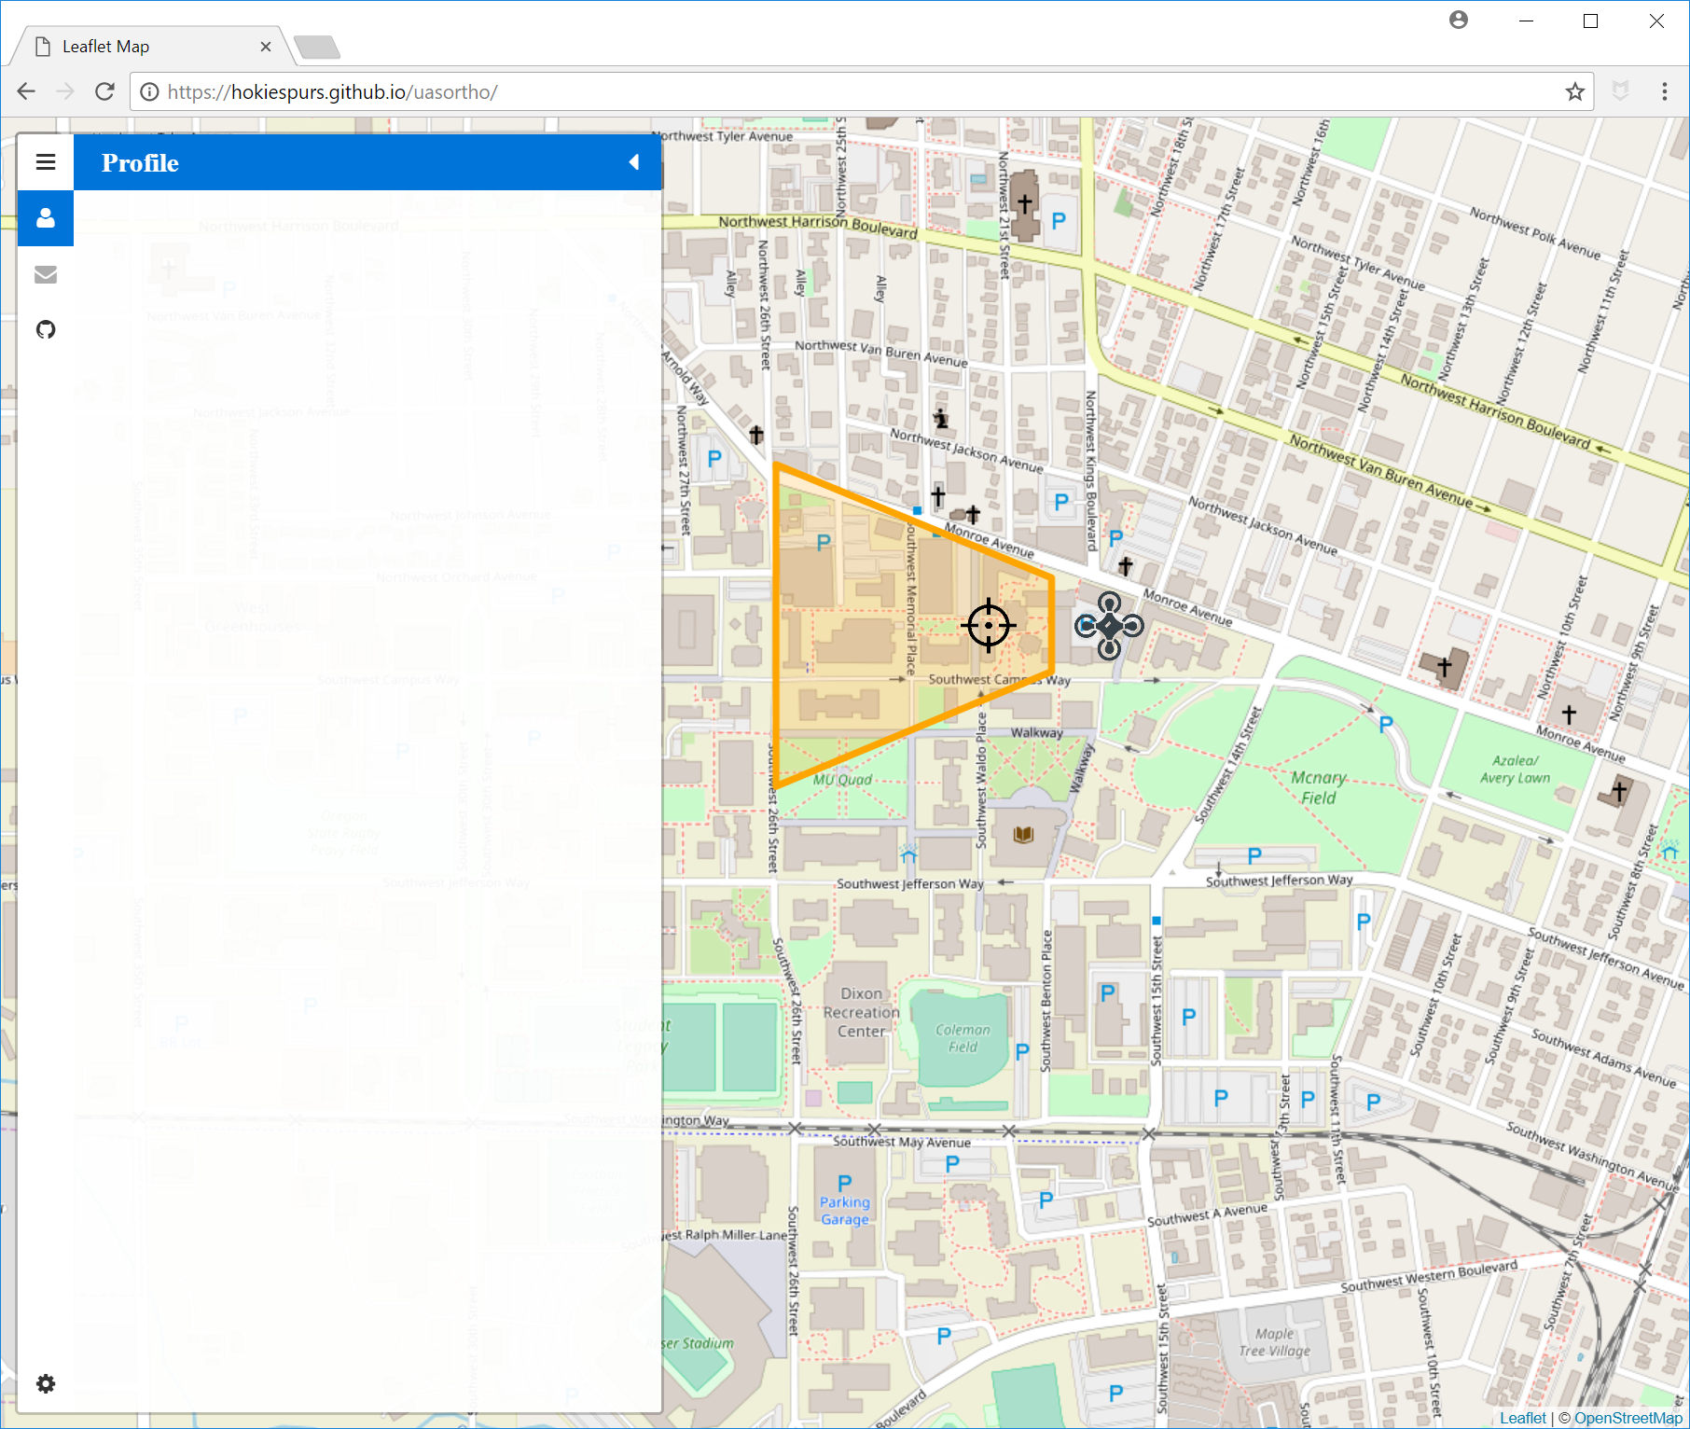
layers
Camera
Dropdown
{if custom}
hfov, pixx, pixy
A
EO
Button to Place Camera
Altitude + slider
Btn to click position, E, N
Roll + slider
Pitch + slider Yaw + slider
Sky visibility
B
E
D
C
Appearance
Toggle Visible Footprint
Toggle Camera Marker
Toggle Pointing Marker
Pick Colors (line, fill, marks)
TPU
GCPs
Add GCP
- x,y,z
- sx,sy,sz

