Slide 1
Data Sources

Slide 2
DataSource
servidor de aplicaciones
DataSource
APP
pool
BD

Slide 3
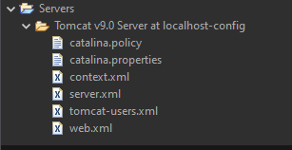
server.xml
context.xml
<Resource driverClassName="com.mysql.jdbc.Driver" name="jdbc/contactosds" password="root" type="javax.sql.DataSource" url="jdbc:mysql://localhost:3306/agenda" username="root"/>
<ResourceLink type="javax.sql.DataSource" name="refcontactos" global="jdbc/contactosds" />

Slide 4
static DataSource ds;
static {
try {
Context ctx= new InitialContext();
ds=(DataSource)ctx.lookup("java:comp/env/refcontactos");
}catch(NamingException ex){
ex.printStackTrace();
}
}
try (Connection con = ds.getConnection();) {

