Slide 1
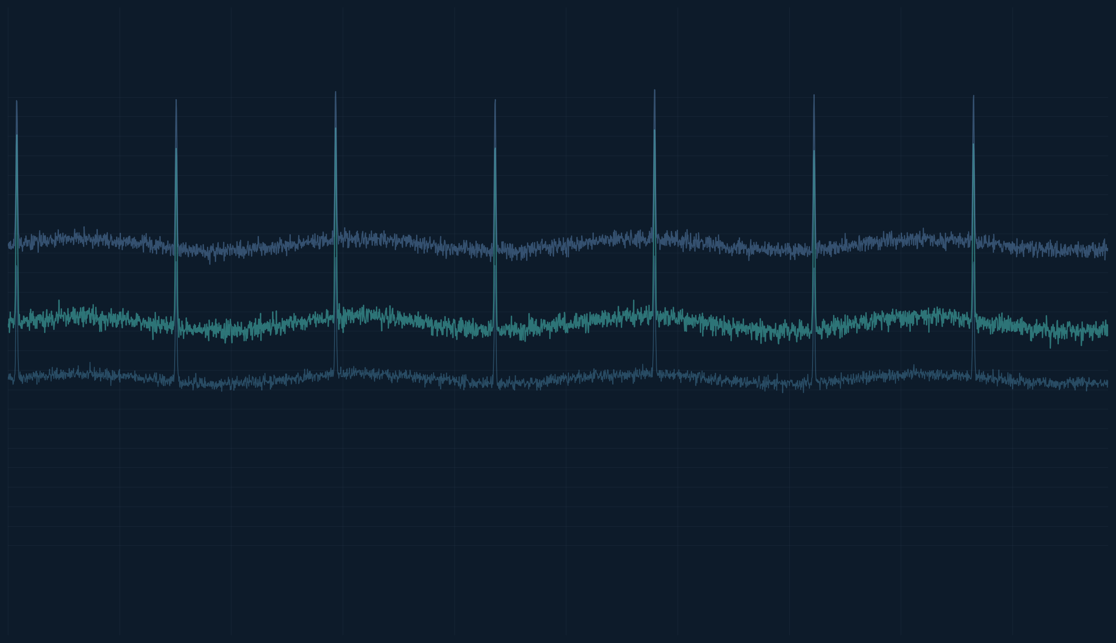
AI-Based ECG Analysis for Early Detection of Acute Myocardial Infarction (AMI) and Revascularization Need
CardioSense · Clinical decision support platform (production-style stack)
Major Project — ecg-ami-cds
Bhavya Saxena · Jiya Bajaj · Harmeet Kaur
Faculty Guide: Dr. Renuka Nagpal
Amity School of Engineering and Technology
Amity University

Slide 2
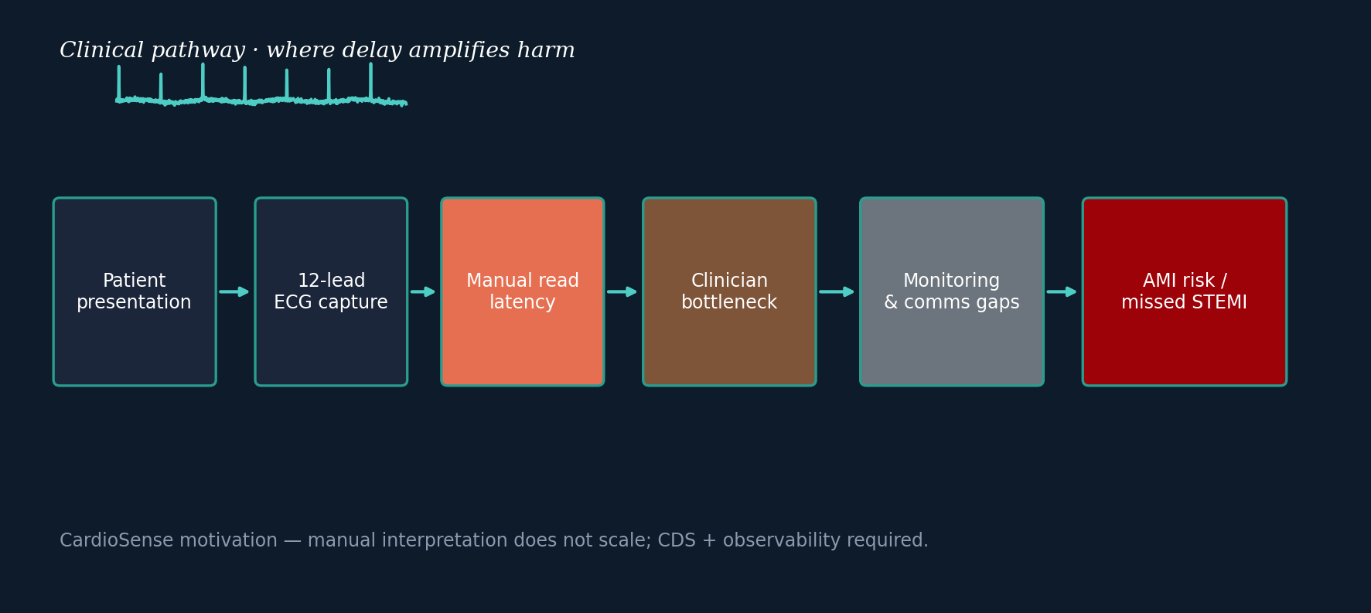
Problem statement — clinical workflow friction
Real-world delays and gaps motivating instrumented CDS + monitoring.

Slide 3
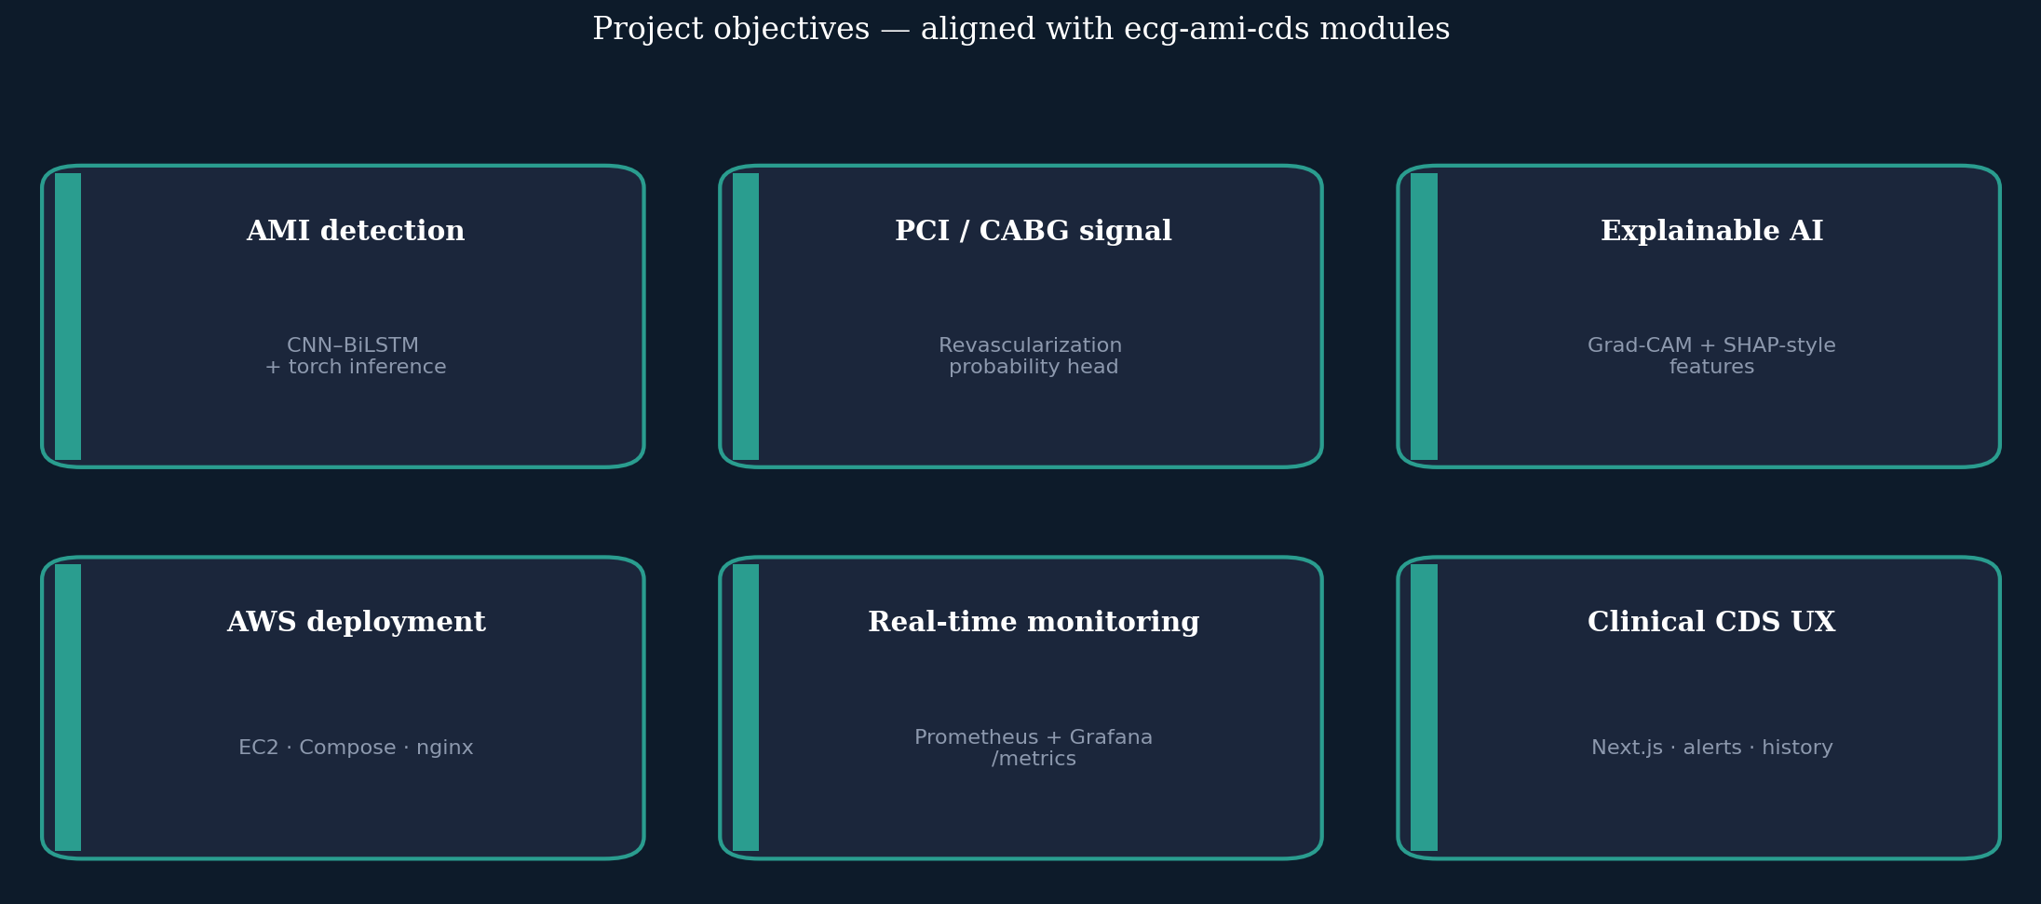
Project objectives
Six capability pillars implemented across FastAPI, Next.js, PyTorch, and the compose stack.

Slide 4
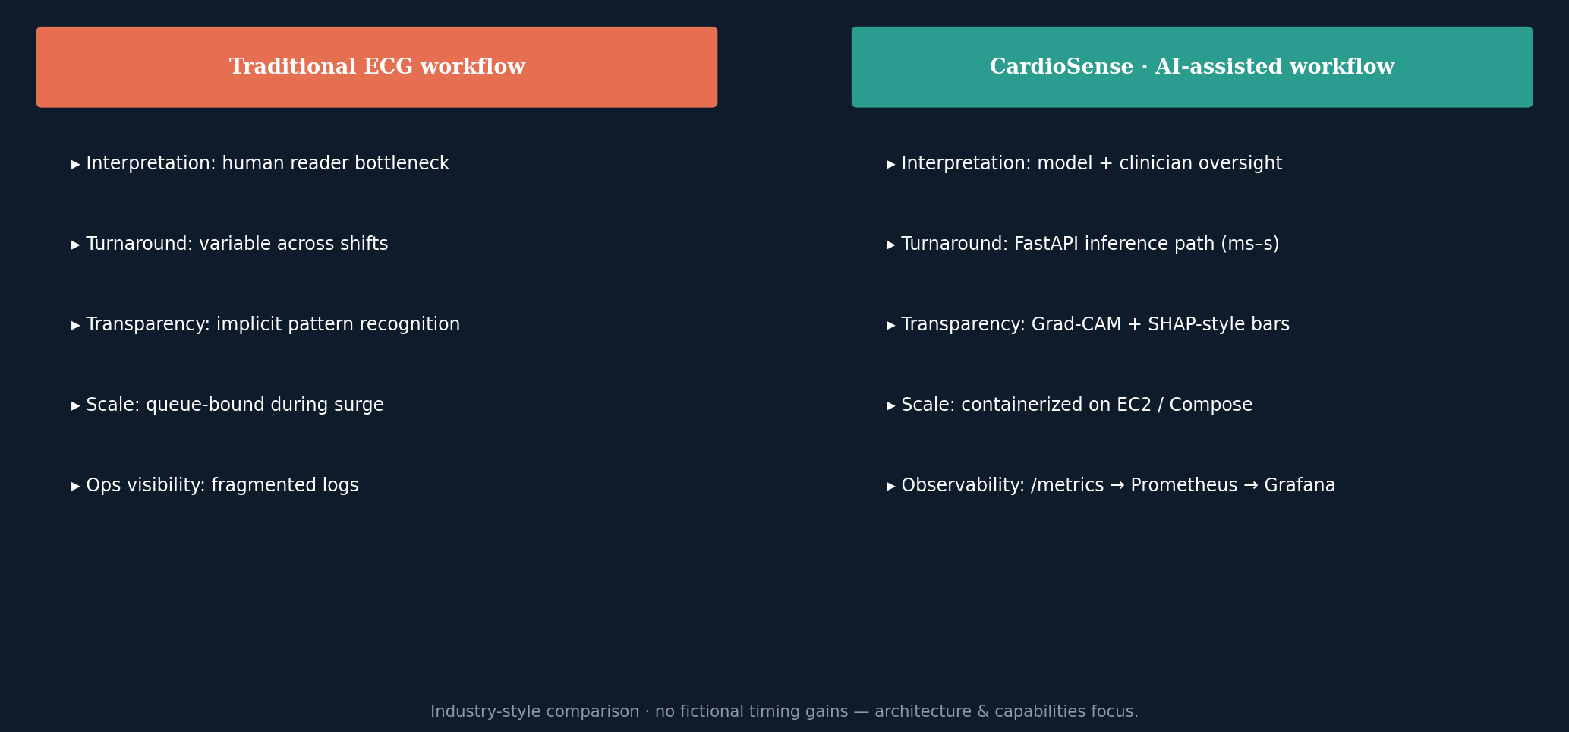
Traditional vs CardioSense workflow
Capability comparison grounded in repository features — not speculative performance claims.

Slide 5
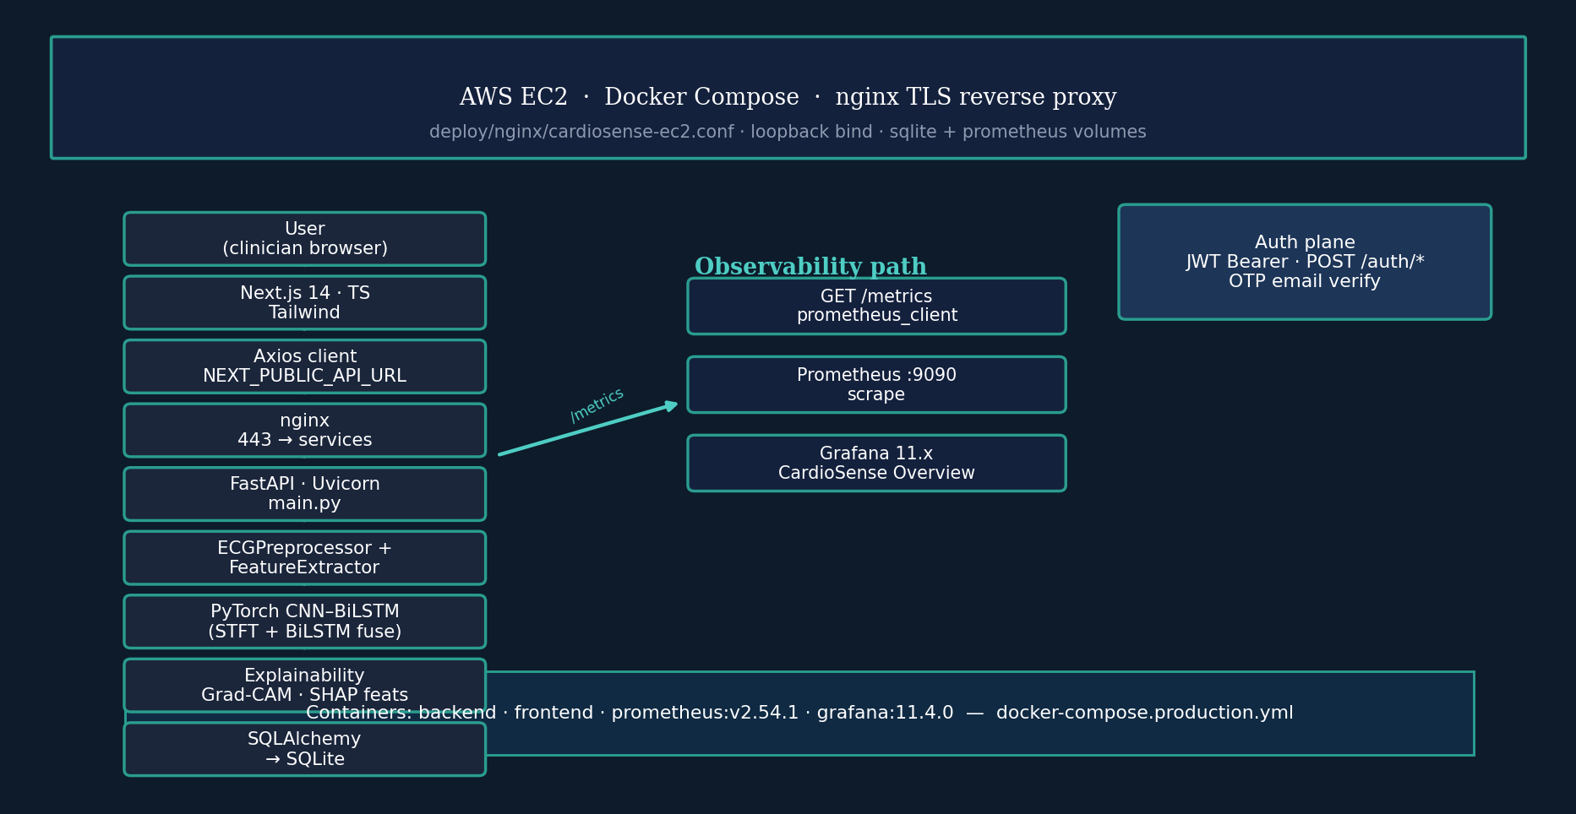
System architecture — deployed CDS topology
Single coherent diagram: user path, inference stack, auth, observability, and container footprint.

Slide 6
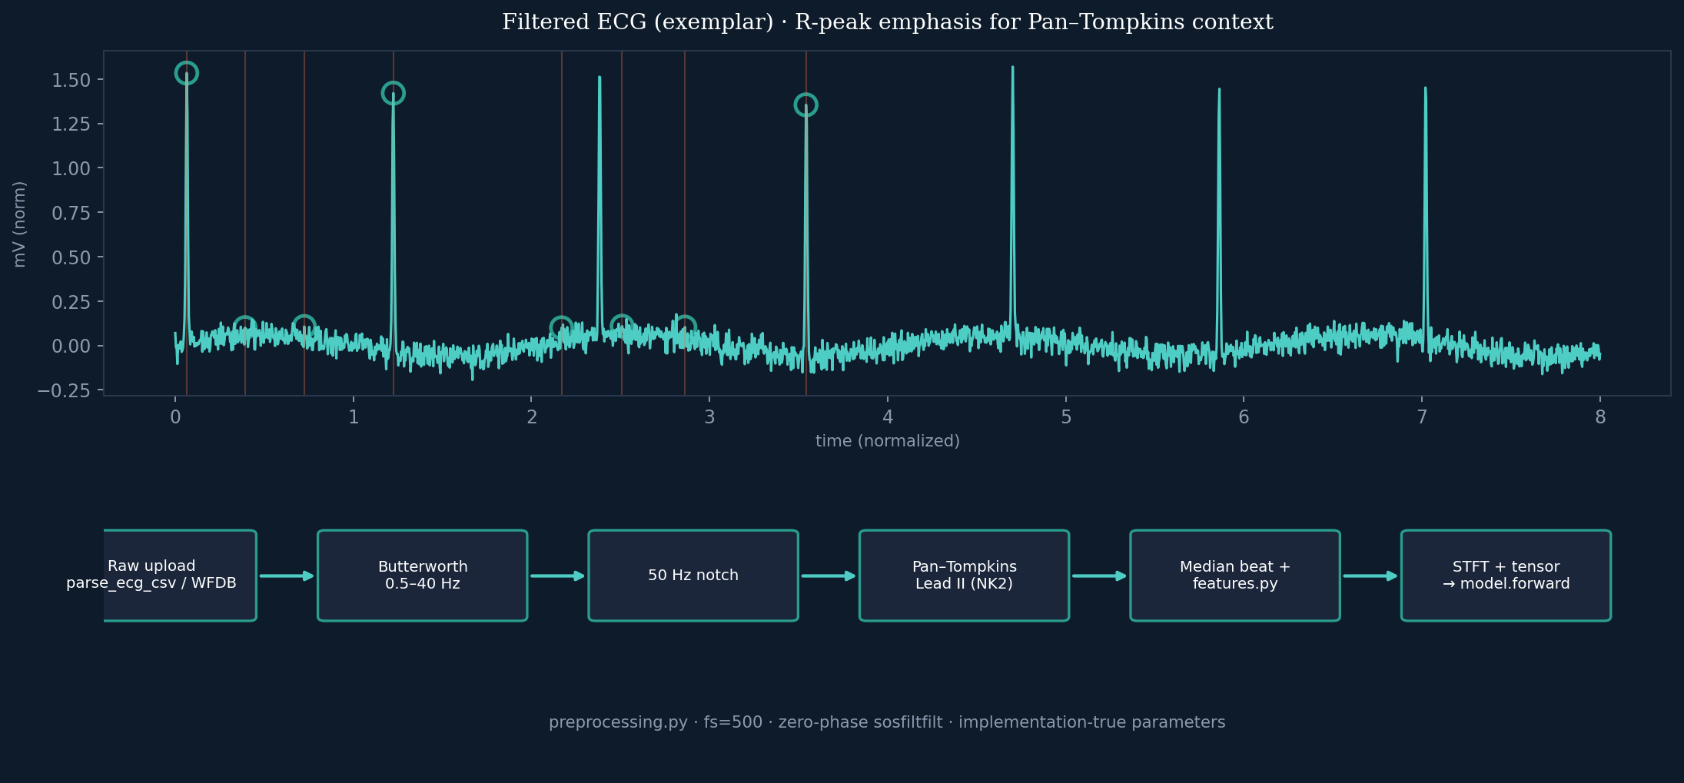
ECG signal processing & model inputs
Pan–Tompkins · bandpass/notch · median beat · Daubechies features — matches backend/preprocessing.py and features.py.

Slide 7
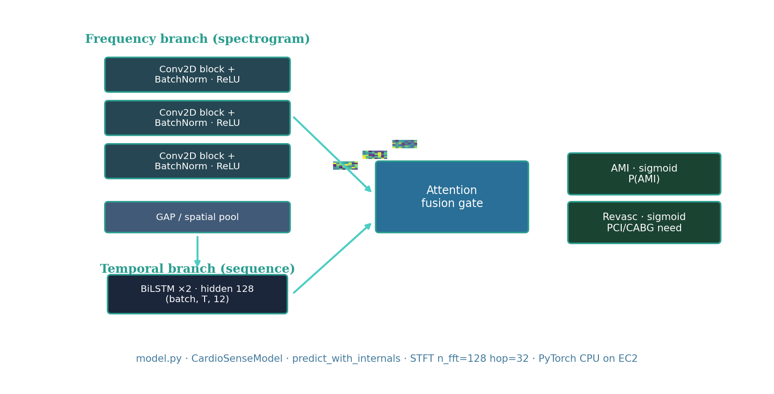
CNN–BiLSTM inference graph
research-grade view of CardioSense dual-branch fusion with concrete STFT hyper-parameters.

Slide 8
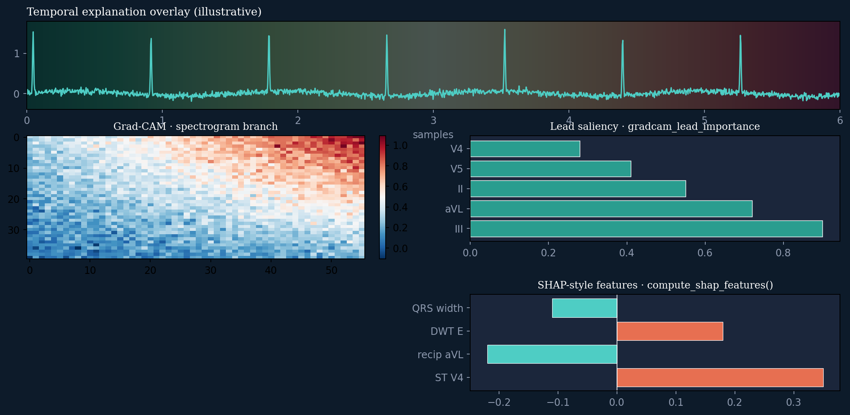
Explainable AI — Grad-CAM & SHAP-style outputs
Illustrative only — API keys: gradcam_lead_importance, shap_features · explain.py + Next.js visualisation.

Slide 9
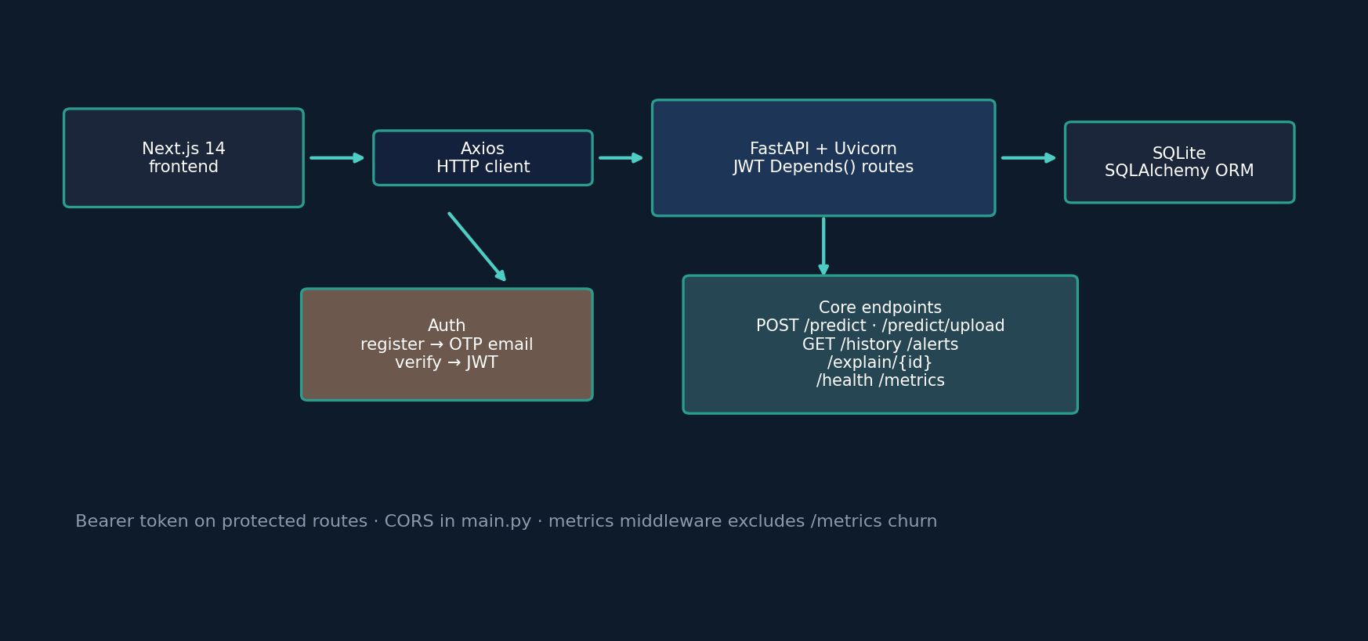
FastAPI backend, Axios client & auth plane
JWT + OTP registration + protected predict/history/alerts/explain routes as implemented in main.py.

Slide 10
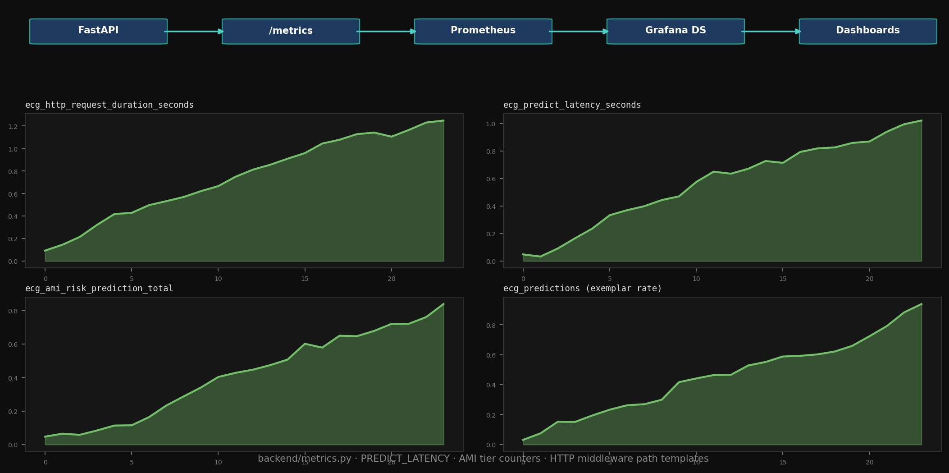
Monitoring & observability
Grafana-style time-series + Prometheus scrape chain reflecting backend/metrics.py instrumentation.

Slide 11
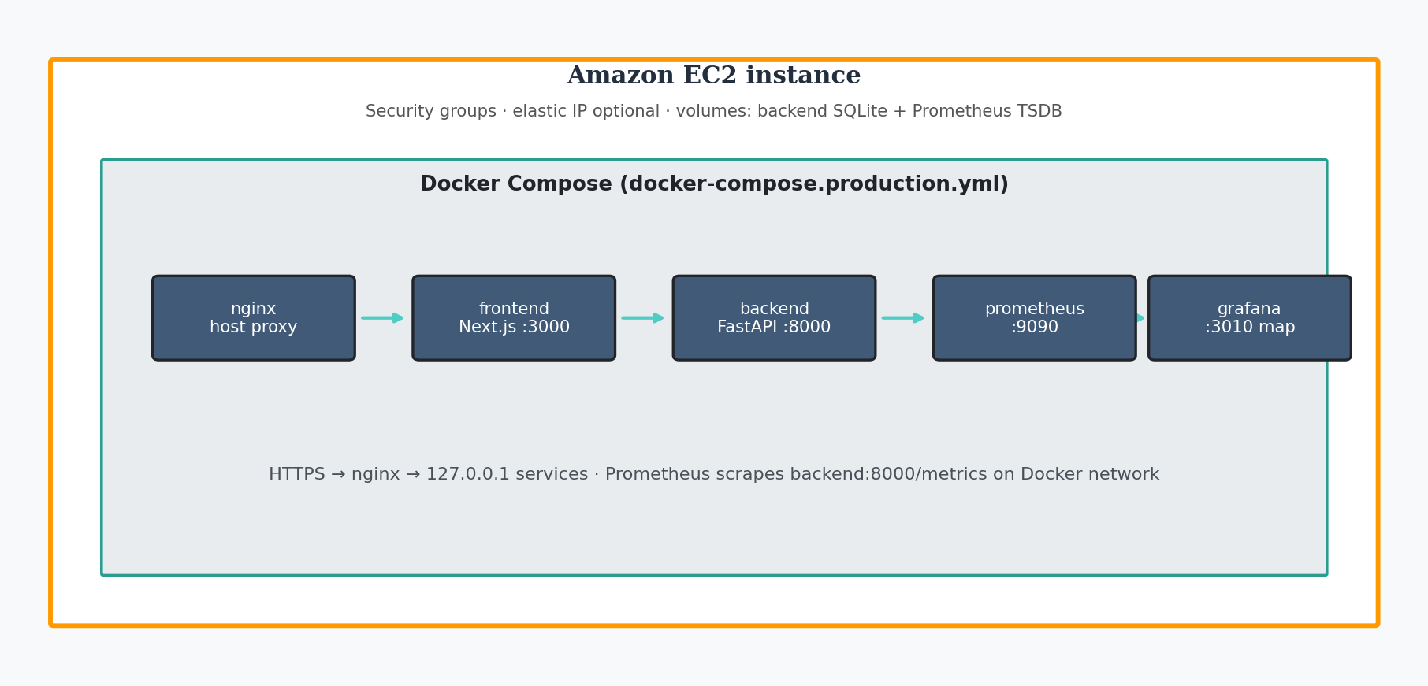
AWS EC2 deployment — Docker & nginx ingress
Light theme cloud diagram · maps to docker-compose.production.yml + EC2 host nginx TLS.

Slide 12
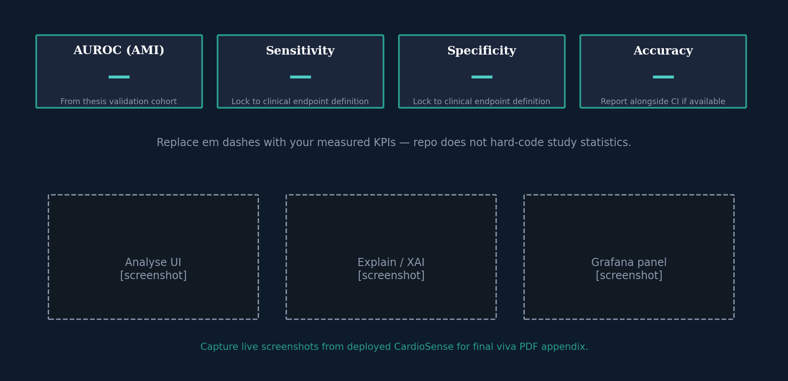
Results, KPIs & evidence slots
Placeholders for thesis metrics + replace wireframes with your capture of the live UI and Grafana.

Slide 13
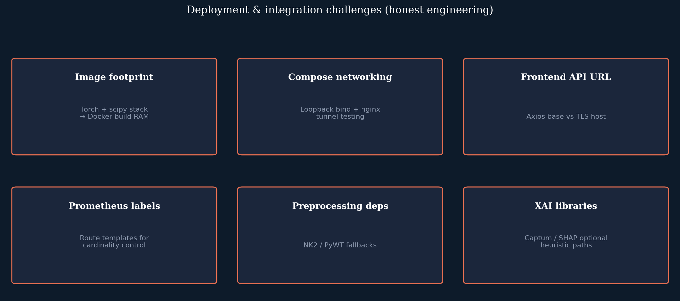
Engineering challenges
Practical constraints encountered integrating ML + observability + full-stack deployment.

Slide 14
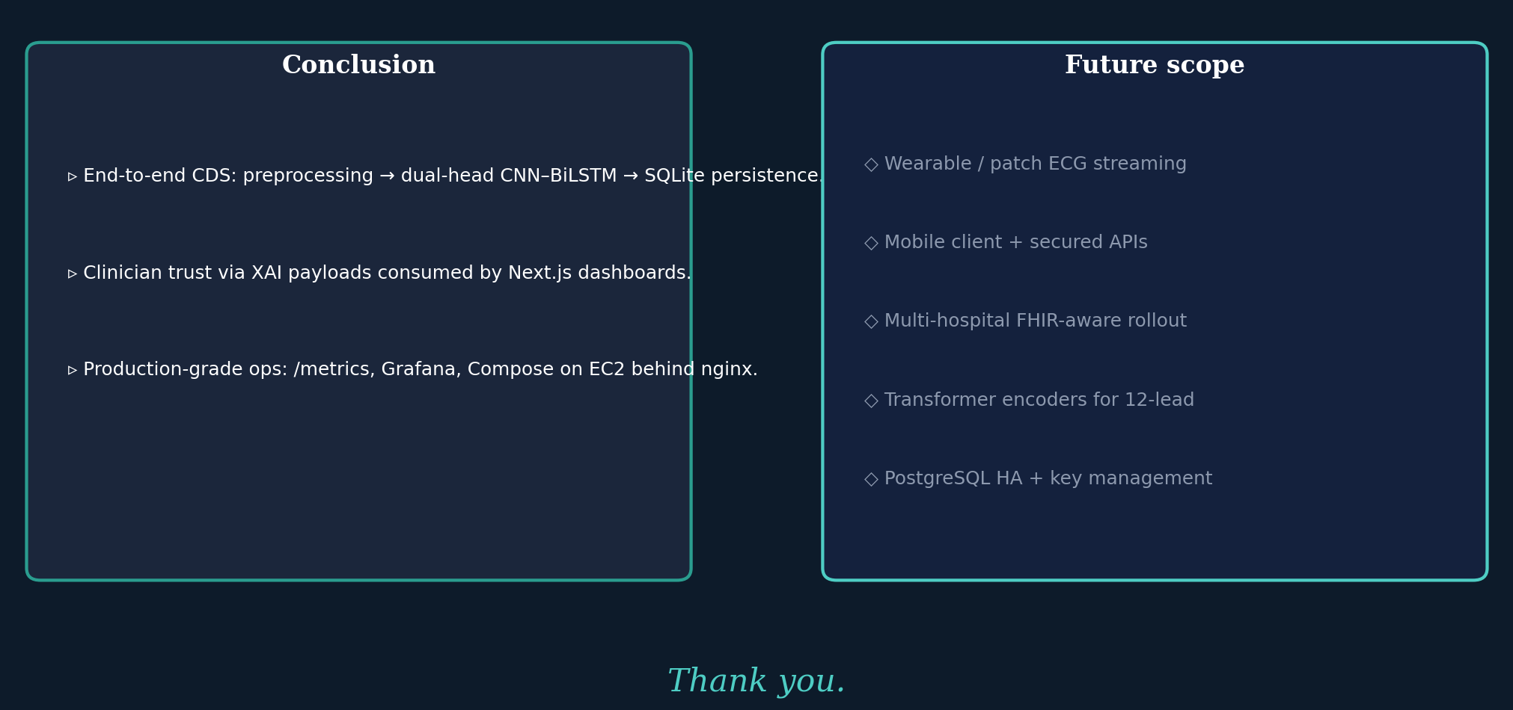
Conclusion & future scope

