Slide 1
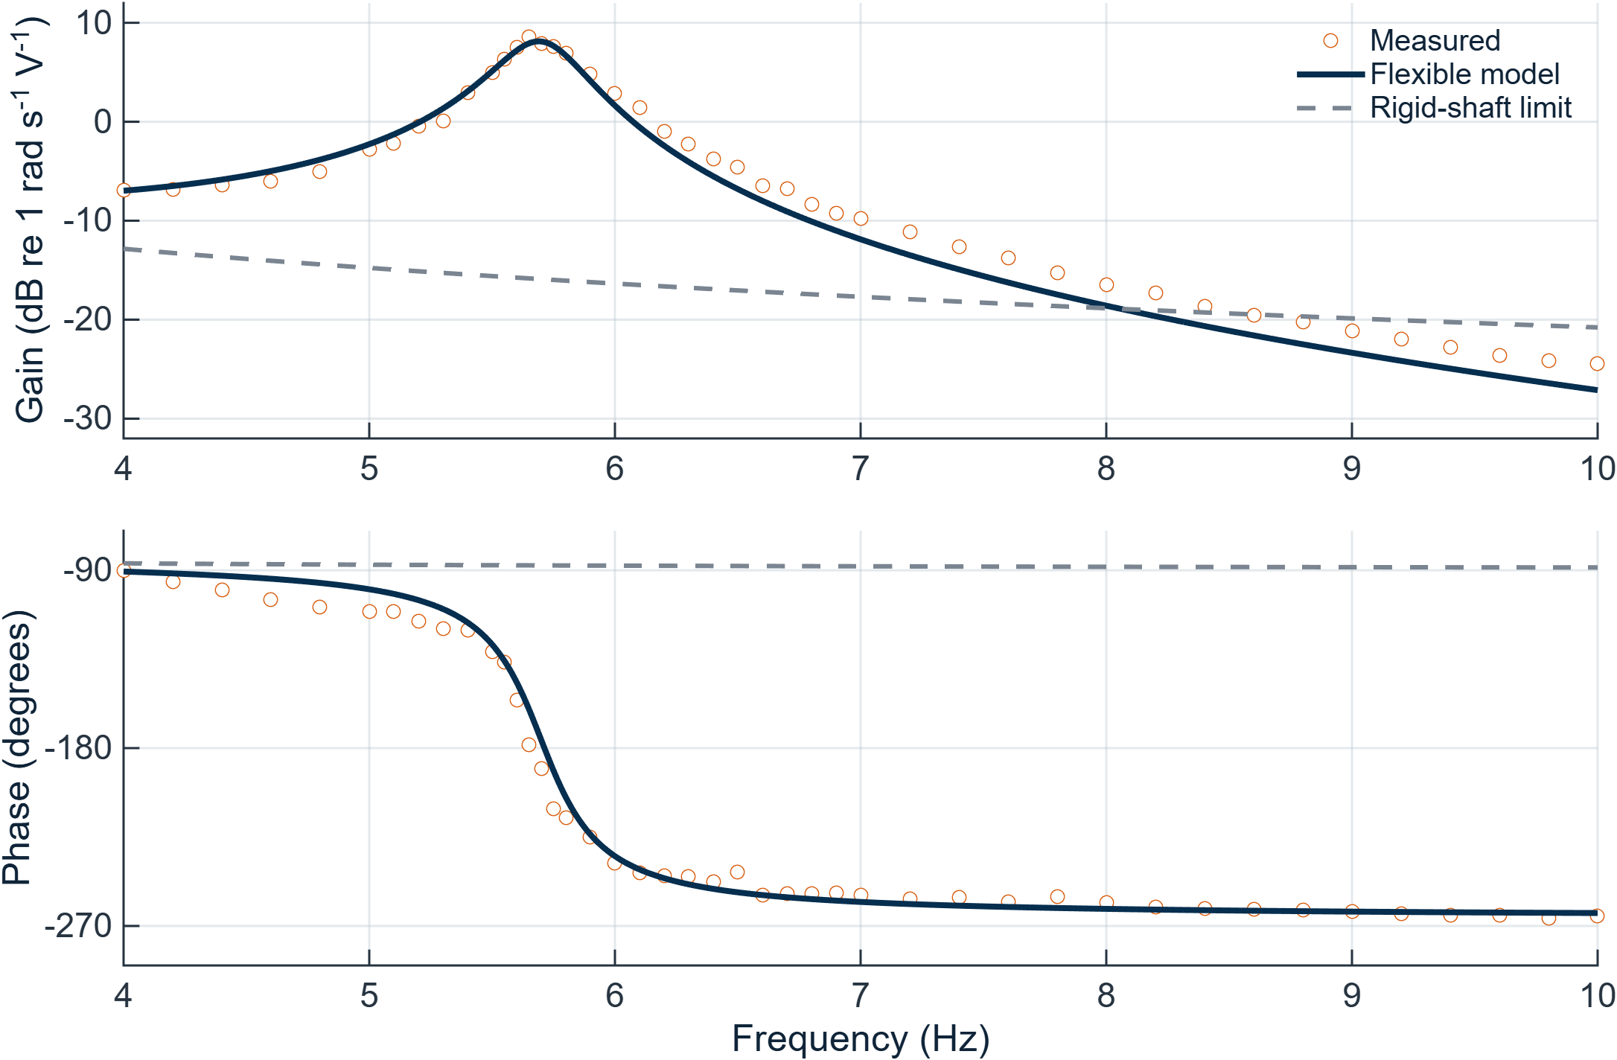
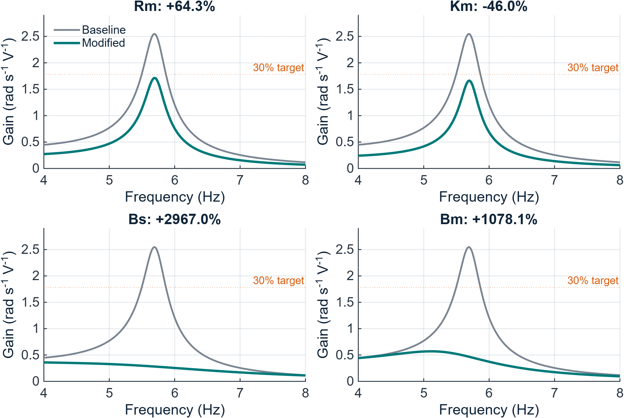
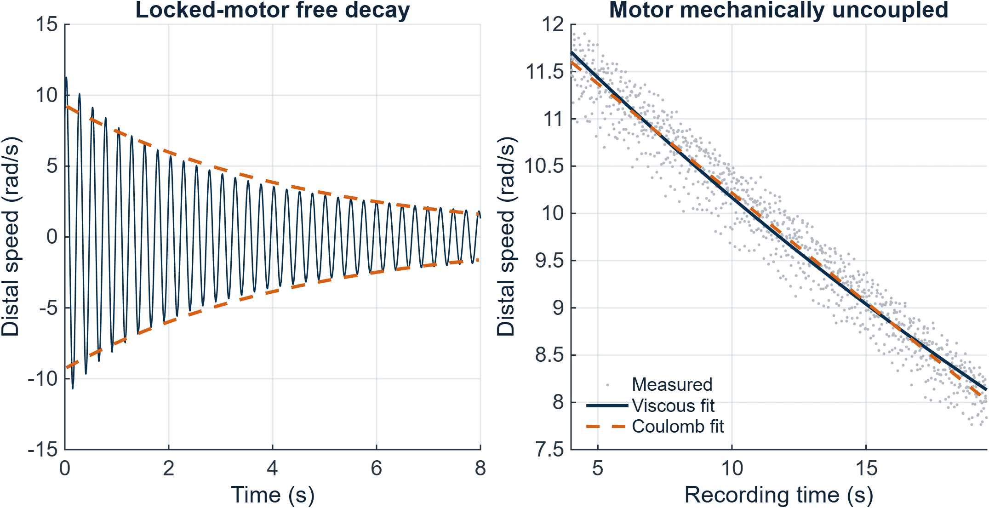
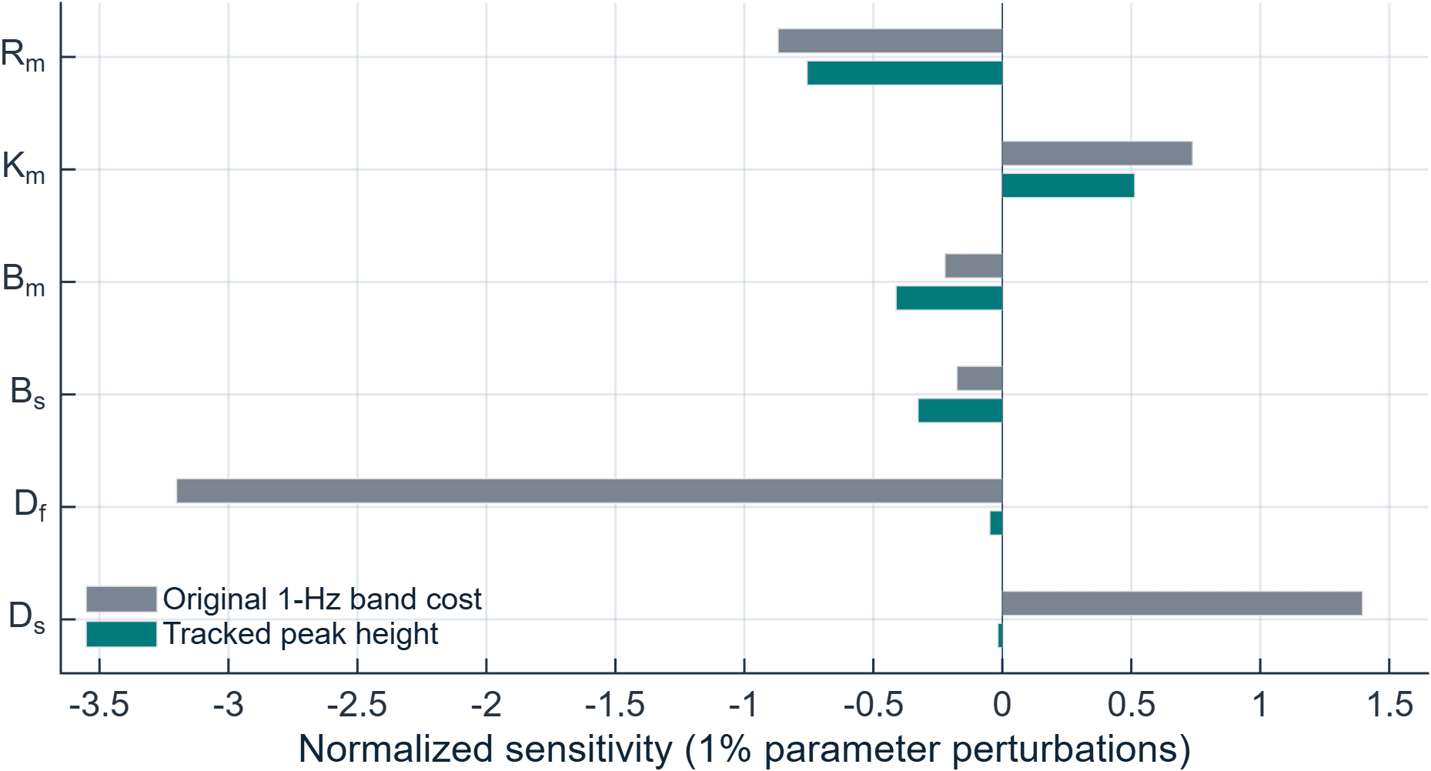
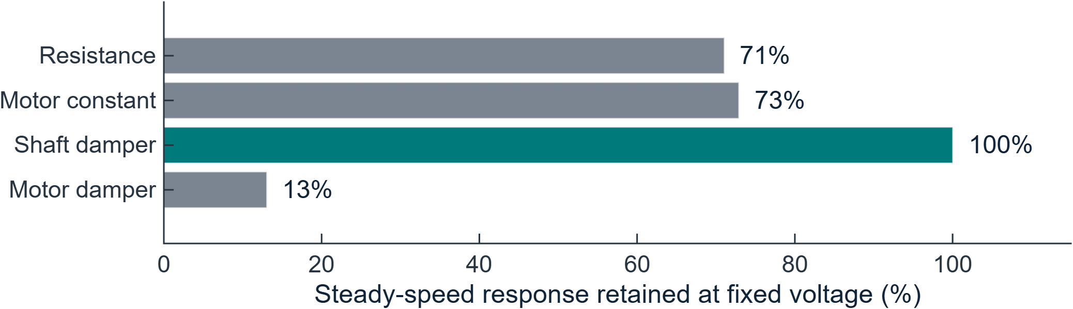
Four passive changes can cut modeled vibration by ≥30%
Gulo 3000 | Experimental model + design simulations | Powertrain Dynamics Group | ME 495
First prototype to investigate: a shaft-path damper that preserves modeled steady-speed response.
1 Measure and model the shaft
2 The flexible model explains resonance
3 Four quantified design alternatives
Motor switching excites torsional vibration.
Goal: validate its source and identify four ≥30% solutions.
PHOTO TO TAKE — physical test rig
Take a clear front/oblique photo. Label the motor, flywheels 1 and 2, shaft, distal bearing and both tachometers.
CAD / SCHEMATIC TO ADD — two-inertia system
Capture a simplified CAD assembly or draw a clean schematic. Label Jc, Jf, K, Bs, Bm, Bb, voltage input Vin and speed output ω2.
Parameters come from measurements and mechanics
Parameter
Identified value
Motor resistance Rm
2.495 Ω
Resonance: 5.65 Hz measured / 5.69 Hz model
4–10 Hz fit error: 1.65 dB magnitude; 7.02° phase
Change
Target value
Gain ↓
Pulse ↓
Motor constant Km
0.0982 V·s/rad
Resistance
4.10 Ω
32.7%
38.5%
Combined damping Btr / Btl
0.00143 / 0.00781 N·m·s/rad
Motor constant
0.053 V·s/rad
34.7%
45.0%
Effective shaft stiffness K
2.203 N·m/rad (refined)
Sensitivity separates attenuation from detuning
Shaft damping
0.039 N·m·s/rad
85.9%
32.2%
Motor damping
0.077 N·m·s/rad
77.6%
32.2%
Shaft damper: no local peak; gain assessed over 4–10 Hz.
All four reduce the 1-Hz response cost by ≥30%.
3 sweeps + 28 time records. Free decay identifies damping; the uncoupled-motor test estimates external loss.
All 12 parameters were screened. Diameter strongly shifts the peak; Rm, Km, Bm and Bs most strongly change its height.
Prioritize the shaft damper. Its large damping increase needs hardware testing; the other options sacrifice steady-speed response.
Predictions at fixed voltage, not modified-hardware test results. Pulse: +1 V for 4 s, then driven to 0 V. Sources: task letter; Lab 1_1 / 1_2; student guide. See three-page handout.
Notes:
Suggested 10-minute delivery: 0:00–1:00 problem and recommendation; 1:00–3:00 measurements and damping; 3:00–5:00 model validation and rigid-shaft comparison; 5:00–6:15 sensitivity and detuning; 6:15–8:30 four alternatives and fixed-voltage tradeoffs; 8:30–10:00 shaft-damper recommendation and limits. Use the red boxes to add a rig photo and a labeled CAD/schematic before presenting. A rigid shaft means zero relative motion / infinite stiffness, not zero damping. The shaft-damping design has no local response peak; the table reports its maximum gain in the measured 4–10 Hz band. Do not claim that four designs were physically tested, or that vehicle comfort was measured. At equal final speed, the shaft damper retains its pulse benefit; the others lose much of their advantage.

