Slide 1
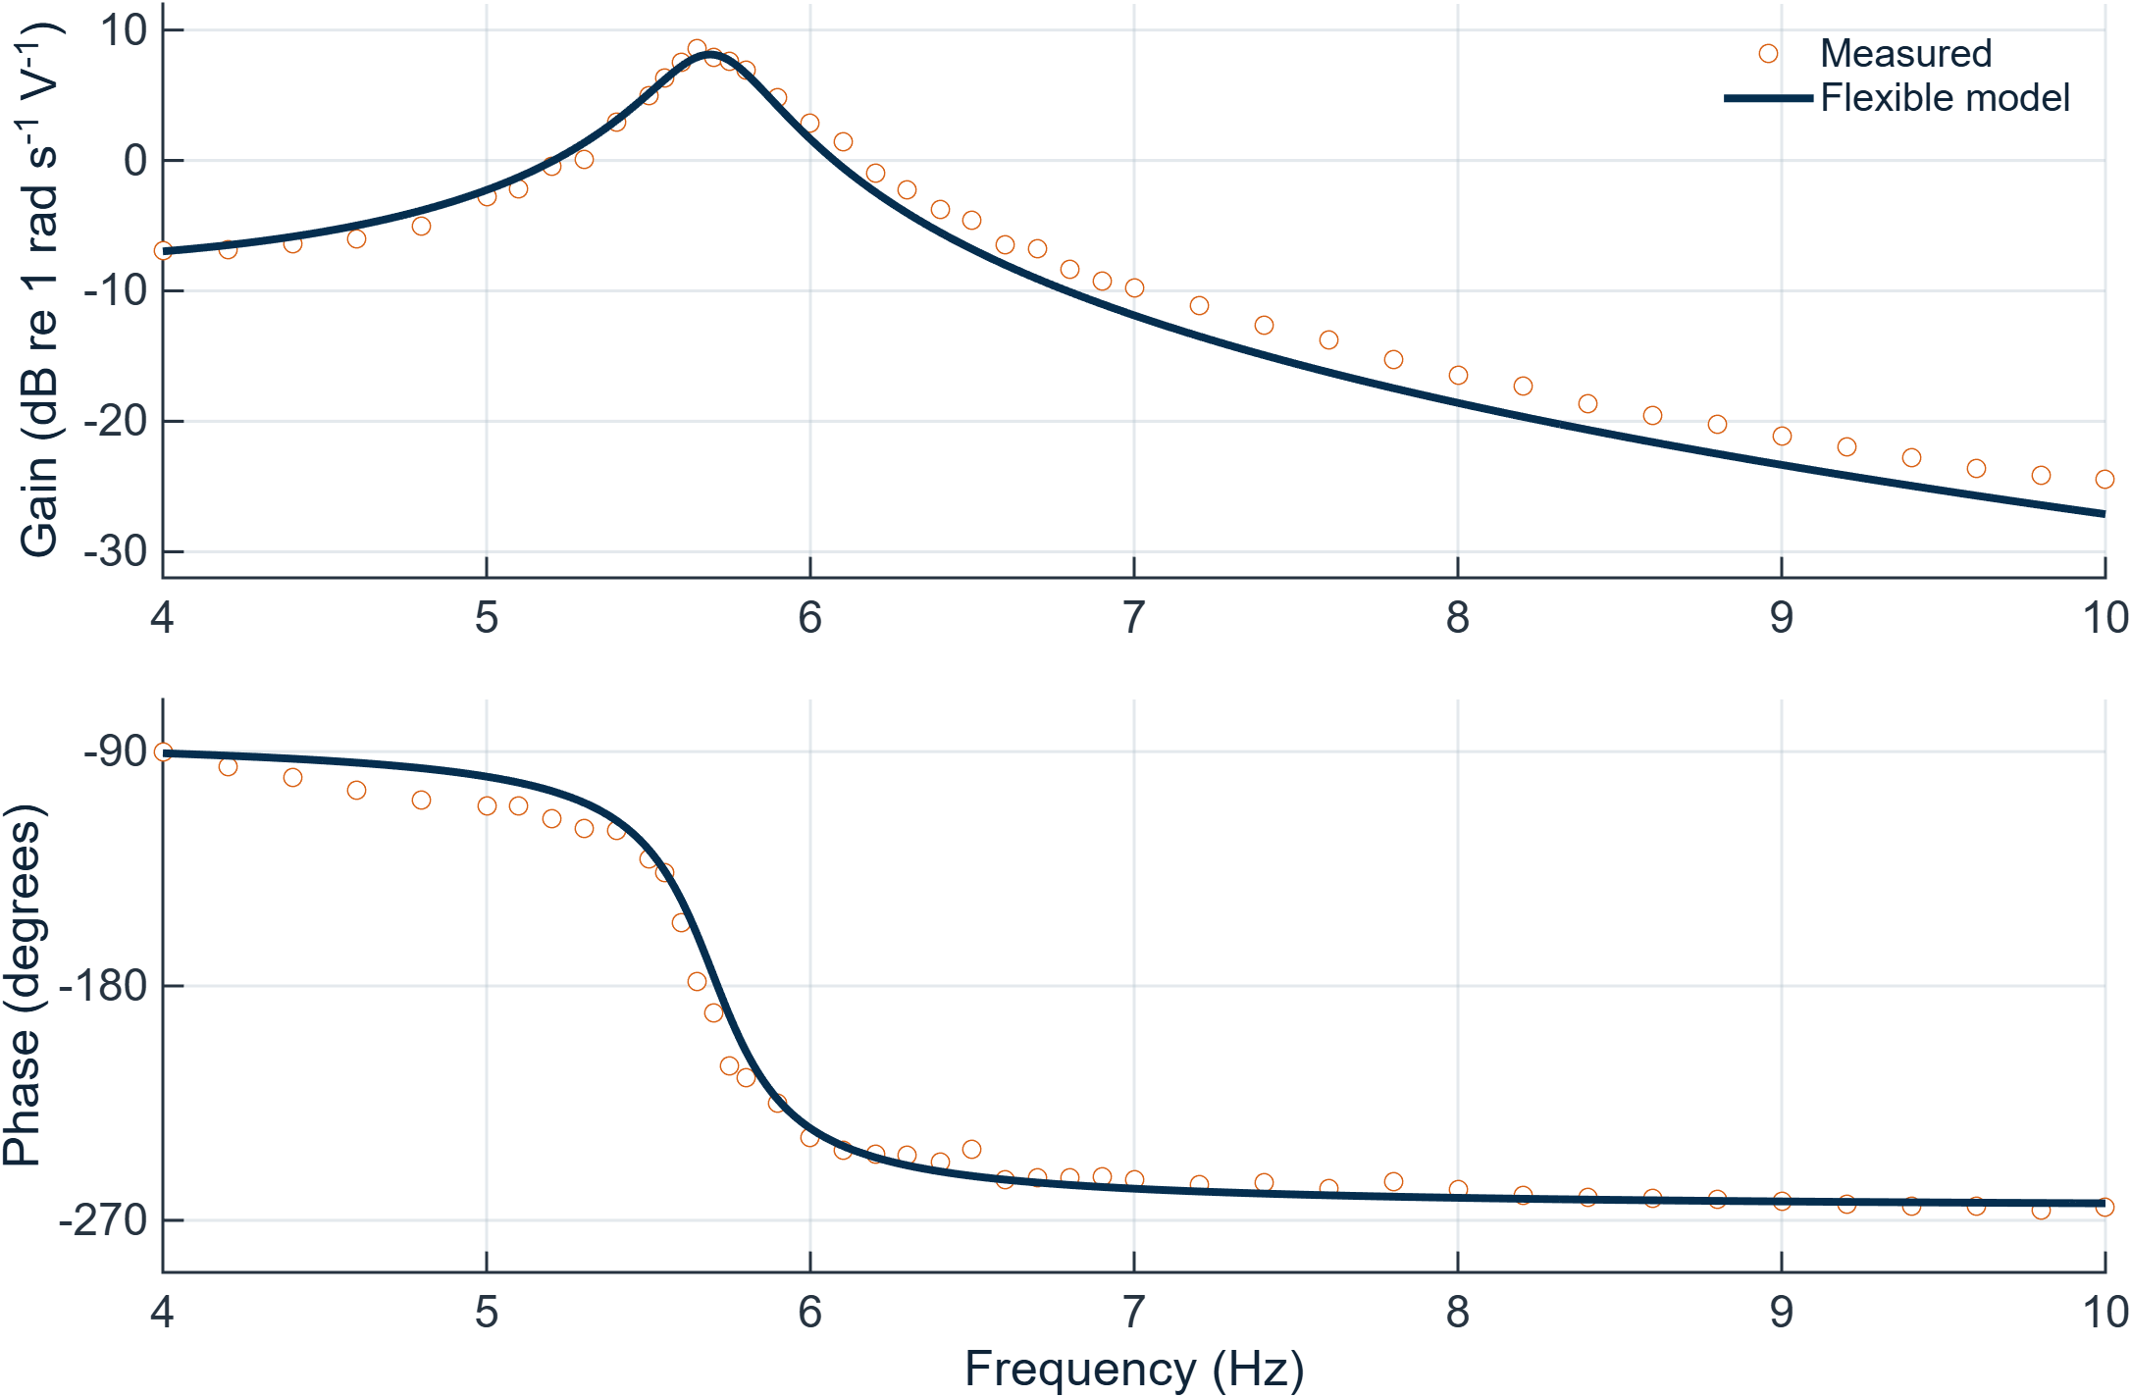
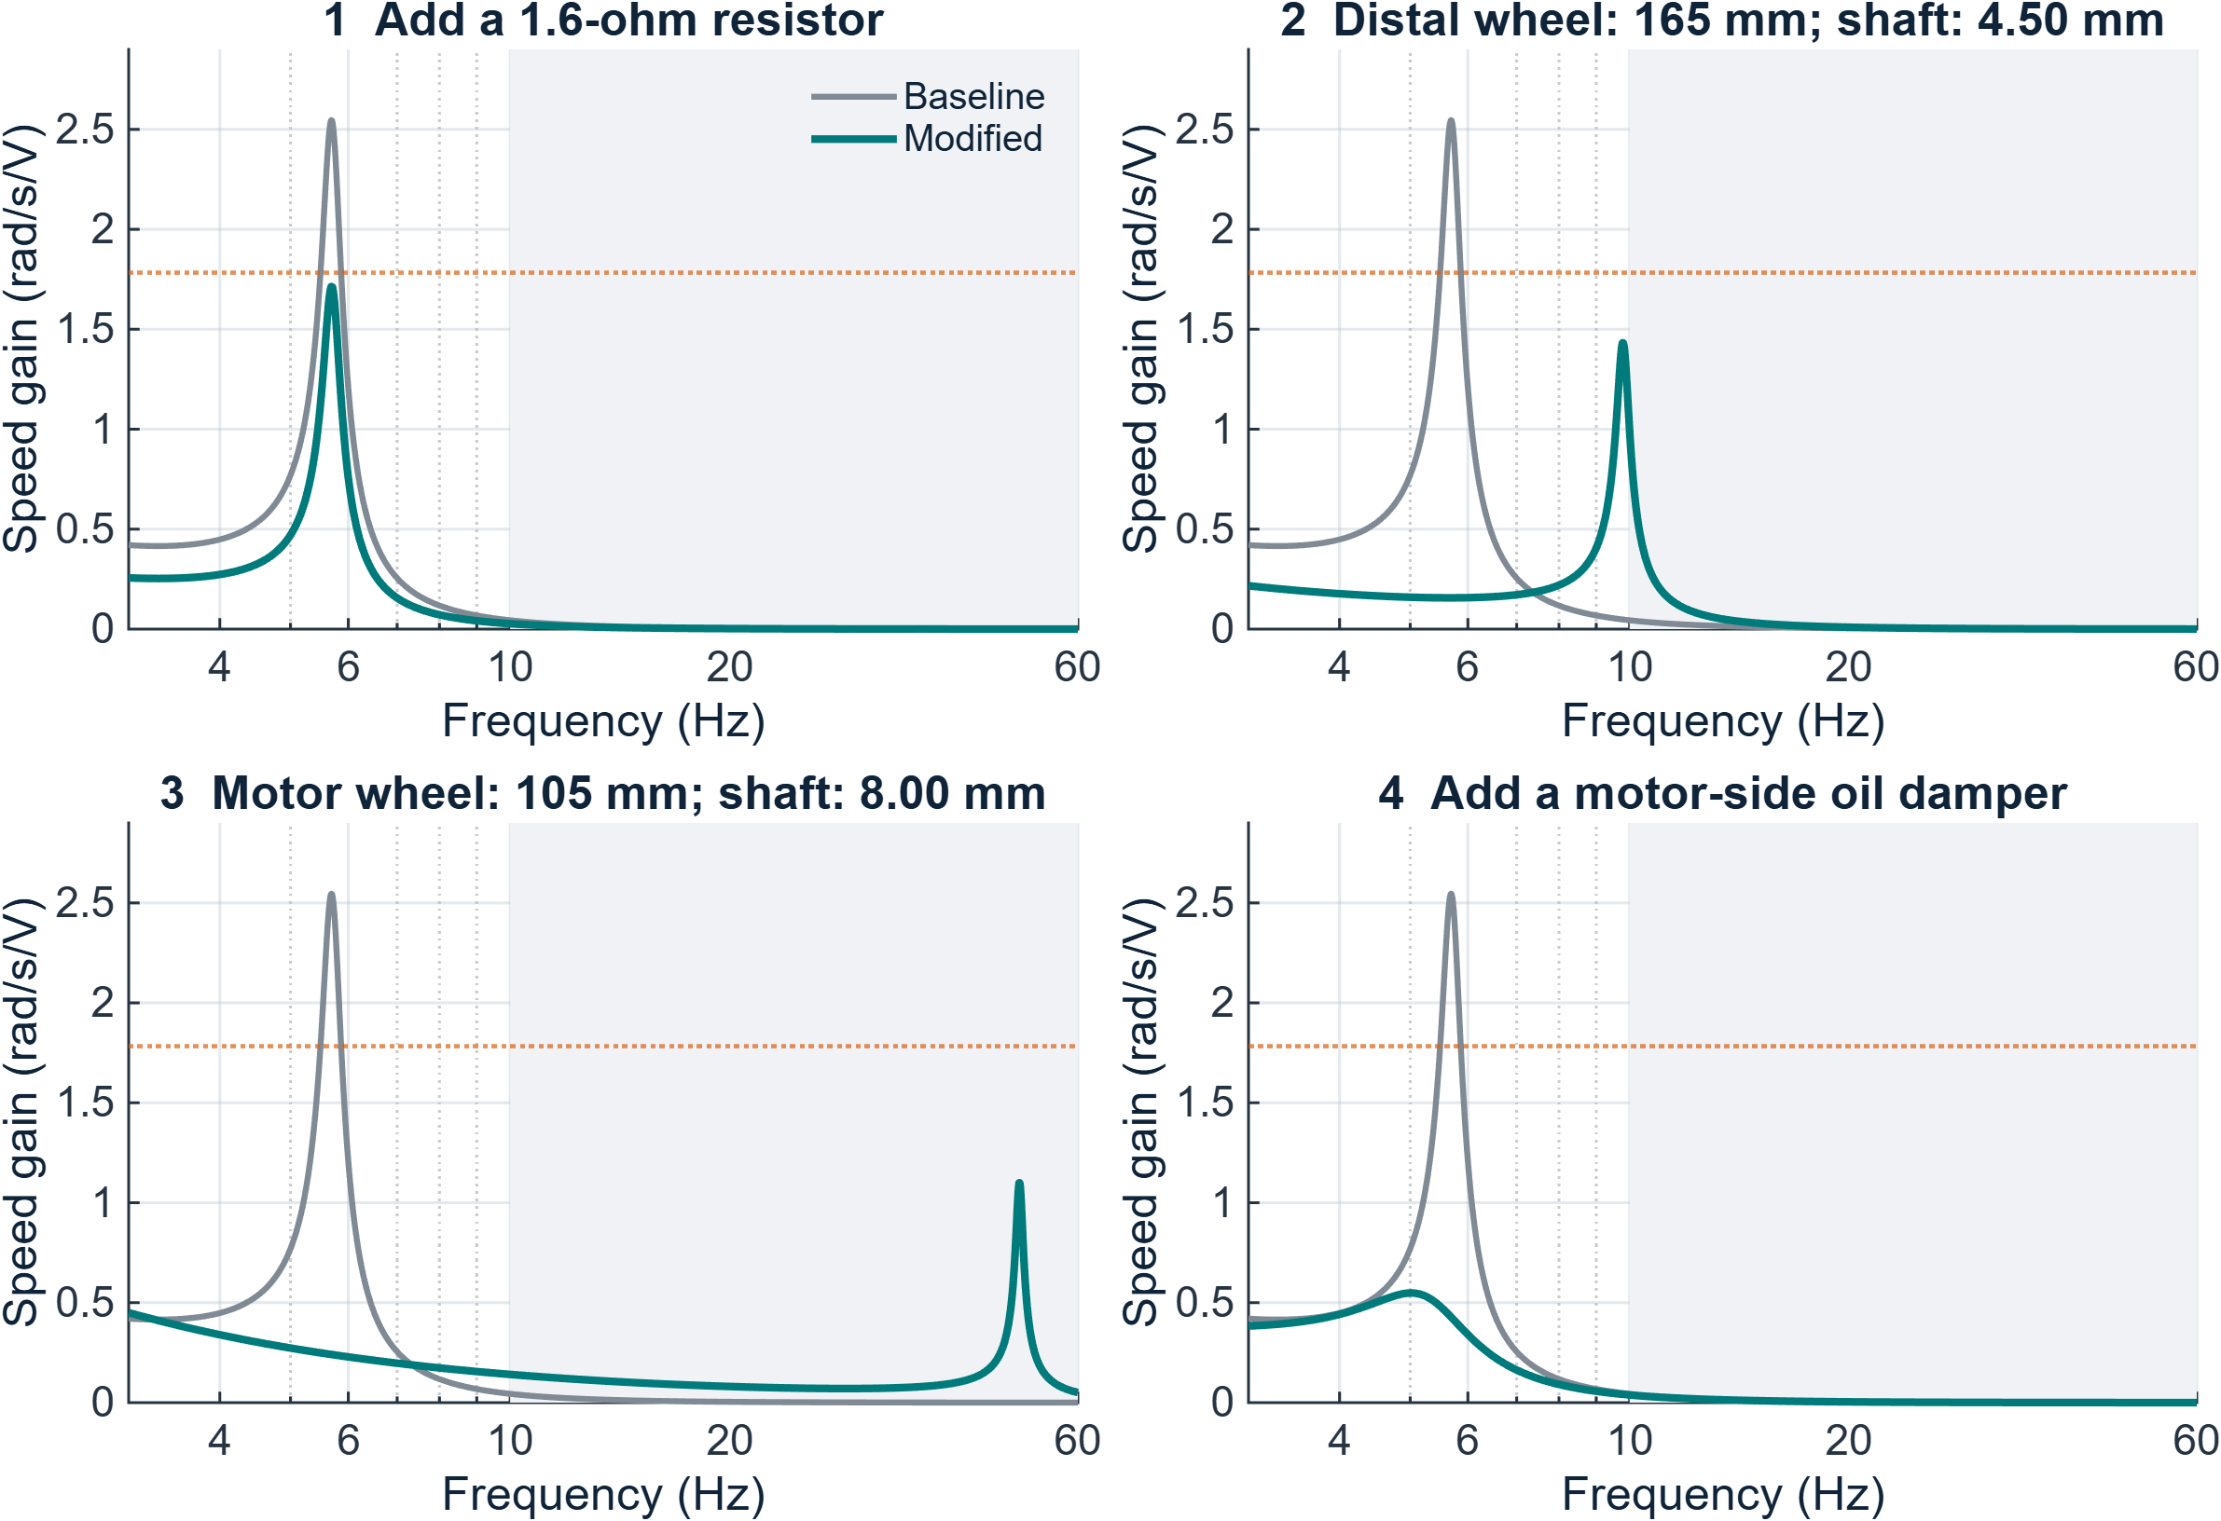
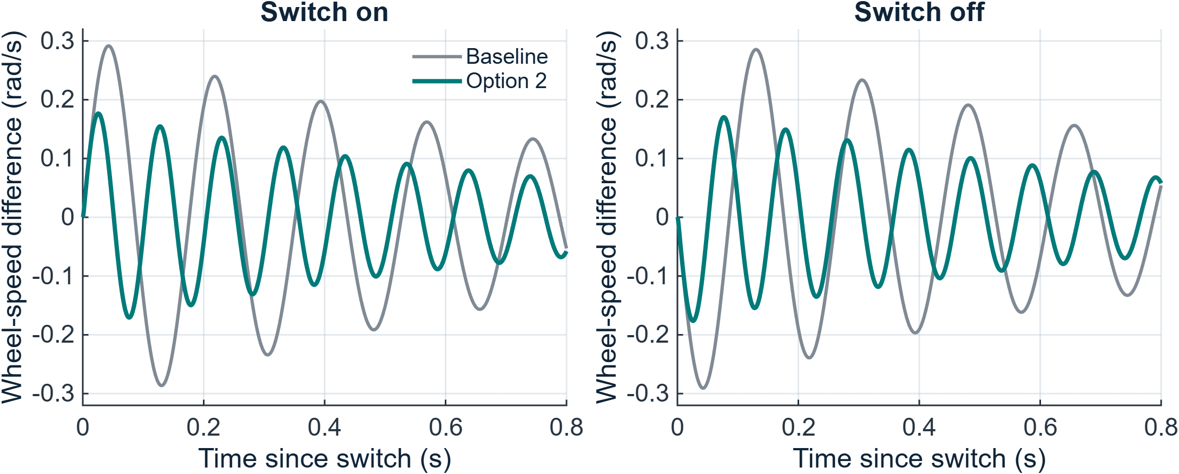
Physical changes to reduce flexible-shaft vibration
Gulo 3000 | Powertrain Dynamics Group | ME 495 | Experimental characterization and passive design
Prototype first: 165 mm distal flywheel + 4.50 mm shaft | 44% lower peak; 39% less switching motion
1 Problem and experimental approach
2 The flexible model matches the data
3 Four physical design alternatives
Motor switching excites twist between the flywheels.
Task: explain the vibration and find four ≥30% solutions.
PHOTO TO TAKE — complete test rig
Take a clear front/oblique photo. Label the motor, motor-side flywheel, flexible shaft, distal flywheel and both speed sensors. Keep all components visible.
CAD SCREENSHOTS TO ADD — physical changes
Show the baseline assembly beside option 2: a 165 mm distal wheel and 4.50 mm shaft. Dimension both. Add a small section view of option 4: an 80 mm oil-damper rotor, 1 mm gaps on each face, and a casing fixed to the frame.
Validation metric
Measured
Model
Dotted line: 30% peak reduction. Shading: beyond measured data.
Resonance frequency
5.65 Hz
5.69 Hz
Alternative
Peak ↓
Motion ↓
MEASURE
IDENTIFY
VALIDATE
COMPARE
Peak gain (rad/s/V)
2.69
2.55
1 Series resistor
33%
38%
3 frequency sweeps + 28 time recordings
4–10 Hz fit error: 1.65 dB in gain; 7.02° in phase.
2 Larger distal wheel + shaft
44%
39%
Option 2 also reduces switching motion
3 Smaller motor wheel + shaft
57%
67%
Steady runs identify the motor. Free-decay and coastdown tests estimate losses. Sweep data refine shaft stiffness and check the flexible model.
4 Motor-side oil damper
78%
35%
All four also reduce the 1-Hz response cost by ≥30%.
Measured / identified
Baseline value
1 Wire a 1.6 Ω power resistor in series; steady speed falls 29%.
2 Fit a 165 mm distal wheel + 4.50 mm shaft; preserves speed.
3 Fit a 105 mm motor wheel + 8.00 mm shaft; retest to 60 Hz.
4 Add an oil rotor in a fixed casing; steady speed falls 88%.
Resonance
5.65 Hz
Motor resistance
2.495 Ω
Effective shaft stiffness
2.203 N·m/rad
Coastdown: motor physically uncoupled; both flywheels stayed linked by the shaft.
Simulation: +1 V for 4 s, then 0 V. Motion = difference between the two wheel speeds.
Full dimensions, mounting details and limitations: handout p. 3.
Model predictions at equal voltage; modified hardware has not been tested. Geometry changes stiffness/inertia; extra damping needs a physical dissipater. Sources: task letter; Lab 1_1 / 1_2; handout references.
Notes:
10-minute talk: problem and prototype recommendation (1 min), experiments (2 min), model/data comparison (2 min), physical alternatives and switching evidence (3 min), tradeoffs and next tests (2 min). Sensitivity screened all course parameters, then treated the two flywheels separately. Both-wheel diameter changes mainly shift resonance; independent wheel sizes can reduce peak height. The thicker shaft reduces switching motion while the changed wheel inertia lowers the tracked peak. Option 3 predicts a 49.9 Hz mode, beyond the measured 4–10 Hz range: it needs a wider sweep. The oil damper uses two-face Newtonian shear at 25°C, with rotor inertia included; seal and edge drag need measurement. All four are separate alternatives starting from baseline. Percent reductions use linear gain, never dB. Input voltage is upstream of the added resistor. At equal final speed, the resistor and oil damper lose much of their benefit. Red boxes specify the photo/CAD to add.

