Slide 1
From Zero to Notebook at Lightning Speed
Steve Holden
CTO, Global Stress Index (Felix)
sh@felix.com

Slide 2
Nothing Up My Sleeves
$PATH contains only /usr/local/bin /usr/bin /bin /usr/sbin /sbin /opt/X11/bin

Slide 3
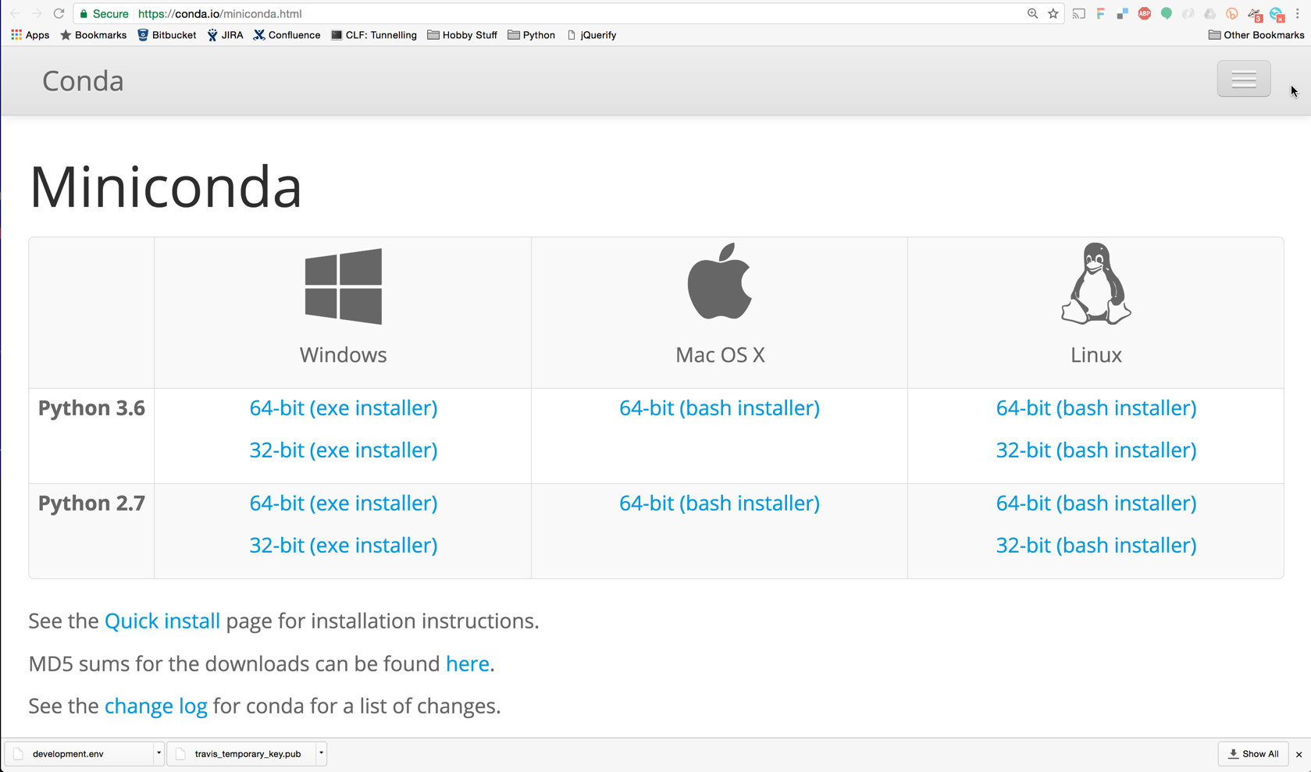

Slide 4
Installation is Simple
Summary:
Download the installer (a shell script)
Execute the installer
Create an environment
Install Jupyter into it
Run the notebook server

Slide 5
As a Shell Script
export PATH=/usr/local/bin:/usr/bin:/bin:/usr/sbin:/sbin:/opt/X11/bin
wget https://repo.continuum.io/miniconda/Miniconda3-latest-MacOSX-x86_64.sh
bash Miniconda3-latest-MacOSX-x86_64.sh # user input
export PATH=/tmp/m3/bin:$PATH
conda create -n demo python
source activate demo
conda install jupyter jupyter notebook

Slide 6
Here We Go!
Keep Your Fingers Crossed

Slide 7
Thank You
A (rather less frenetic) YouTube Demonstration of miniconda installation is available at https://www.youtube.com/watch?v=y5uOASEqn6Q
Slides and script for this talk at
https://github.com/holdenweb/PyDataLondon2017
Steve Holden
@holdenweb
steve@holdenweb.com

