Slide 1

DDSAnalytics
Improving Operating Income by Reducing Workforce Attrition
Senior Consultants: Rob Hazell & Jim Holdnack
XYZ Consulting Inc
Finding the Missing Values for a Better Workforce

Slide 2

High Cost of Job Turnover
• Meta-Analysis performed by the Center for American Progress (2012)
• Jobs that require very specific skills average cost of turnover was 21 percent of an employee’s annual salary
• Most workers earn $75,000 or less, the cost is roughly 20% or $15,000 at the higher end
• Low wage earners of $30,000 or less cost 16% of their income to replace roughly $4800
Link to study: https://www.americanprogress.org/wp-content/uploads/2012/11/CostofTurnover.pdf

Slide 3
Factors Predicting Turnover - Research
Heavey, Holwerda& Haudknecht (2013) Meta-Analysis
HR-inducements related to less turnover
Benefits, internal mobility, relative pay, rates of promotion, and training opportunities
Attitudes-related to less turnover
Job Satisfaction
Relationships-reduce turnover
Supervisor relationship
Other factors
Average age of employees – older indicates less turnover, average age of years working at employer-longer indicates less turnover
Higher numbers of female employees associated with more overall turnover
Turnover impact
Lower customer satisfaction, lower profit margin, reduced efficiency (sales/production), and increased errors
Heavey, Holwerda& Haudknecht (2013) Causes and Consequences of Collective Turnover: A Meta-Analytic Review. http://digitalcommons.ilr.cornell.edu/articles

Slide 4
DDSAnalytics Study
Collaboration with a large biotechnology firm to identify factors related to workforce attrition
Study of 1470 individuals
Current rate of attrition is 16% per year
Average estimated salary of employees leaving the company is about 50,000.
Estimated cost to replace employee is 10,000
Total estimated annual cost of attrition is 2.4 million dollars per year

Slide 5
DDSAnalytics Study
Variables considered in this study
Person variables
Sex, marital status, age, commute distance, education level, education field, number of previous employers, total years working, years at company
Job factors
Business travel, department, job level, job role, over time worked, years in current role, years with current manager
Benefits and Inducements
Monthly income, percent salary hike, stock option level, training opportunities, years since last promotion
Attitude Toward Job/Employer
Satisfaction with work environment, job involvement, job satisfaction, satisfaction with work relationships, work life balance
Other
Daily rate, monthly rate, performance rating

Slide 6
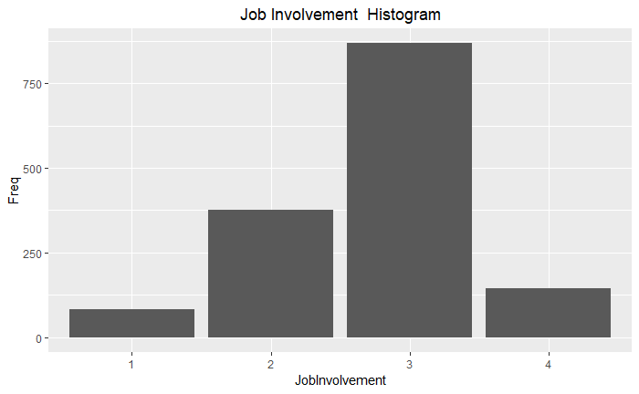
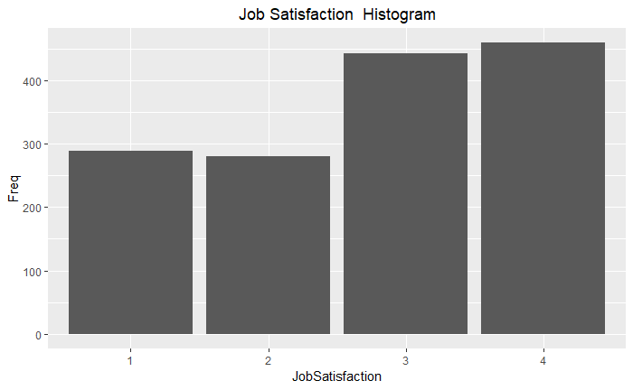
General Impressions of Company
Most workers (79%) report being engaged or very engaged in their job
Most workers (61%) are somewhat or mostly satisfied with their job

Slide 7
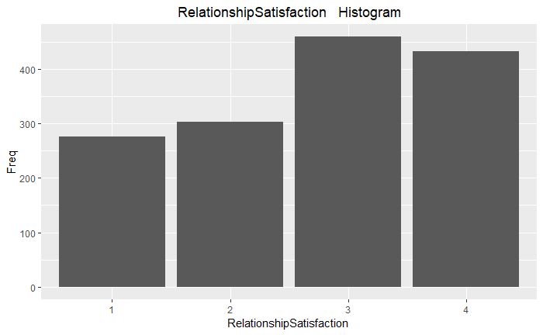
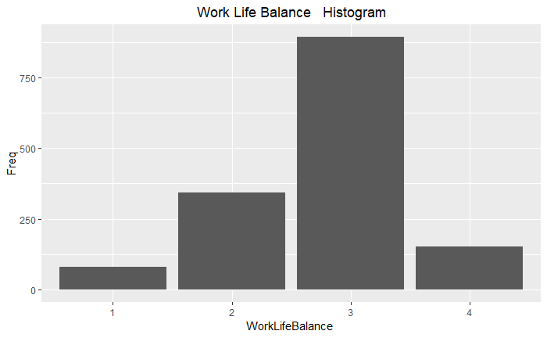
General Impressions of Company
Most workers (61%) report being satisfied or very satisfied with their relationships at work
Most workers (71%) are somewhat or mostly satisfied with the work life balance provided by the company

Slide 8
Predictors of Attrition-Based on Logistic Regression
Variable | Values | z-value | p value
Over Time Worked | Yes = 1, No=0 | 8.53 | < .0001
Sales Representative Job | Yes=1, No=0 | 5.62 | < .0001
Laboratory Technician Job | Yes=1, No=0 | 5.24 | < .0001
Identifies as “Single” | Yes=1, No=0 | 4.72 | < .0001
Job Involvement | 1,2,3,4 from none or little to very involved | -4.72 | < .0001
Job Satisfaction | 1,2,3,4 not at all satisfied to very satisfied | -4.59 | < .0001
Years in current role | Range 0 to 18 years, mean = 4.2, sd=3.6 | -4.26 | < .0001
Frequent Travel | Frequent Travel = 1, Travel Rarely=0 Non travel=0 | 3.79 | < .001
Work Environment Satisfaction | 1,2,3,4 not at all satisfied to very satisfied | -3.58 | < .001
Work Relationship Satisfaction | 1,2,3,4 not at all satisfied to very satisfied | -3.19 | < .01
Number of Training Times Last Years | Range 0 to 6 times, mean=2.8, sd=1.3 | -2.84 | < .01
Work Distance from Home | Range 1 to 29 miles, mean=9.3, sd=8.1 | 2.53 | < .05
Work Life Balance | 1,2,3,4 not at all satisfied to very satisfied | -2.48 | < .05
Medical Degree | Yes=1, No=0 | -2.14 | < .05
Married | Yes=1, No=0 | 2.10 | < .05
Profile of Attrition
Works over-time
Works as a sales rep
Works as a lab tech
Is single
Has little job involvement
Is not satisfied with job
New to current role
Travels frequently
Not satisfied with work environment
Not satisfied with work relationship
Received few trainings
Had a long-commute
Not satisfied with work life balance
Does not have a medical degree
Married

Slide 9
DDSAnalytics Study
Recommendations
Review over-time policies
Train supervisors to minimize over-time, hire part-time workers to reduce over-time requirements
Manage travel requirements particularly for sales reps
Review working environment for lab technicians
Train managers to support workers in new roles
Provide more training opportunities particularly for workers in new roles, lab technicians, and sales reps
Provide opportunities for workers to engage each other in fun activities (e.g. games and prizes during “national lab week”)

Slide 10
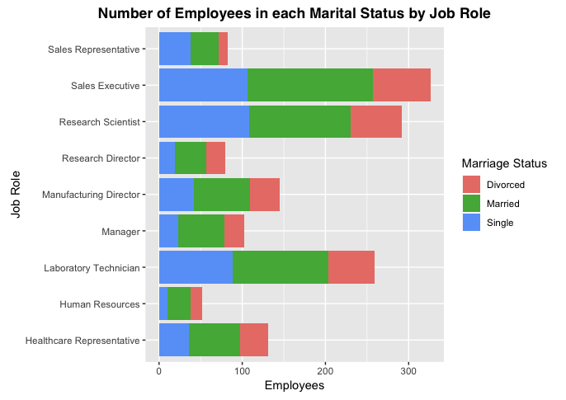
Trends – Marriage Status by Job Role
Sales Execs and Research Scientists roles with highest number of single, married, and divorced employees

Slide 11
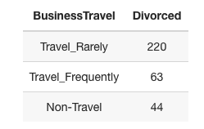
Trends – Business Travel and Divorce
No causal inferences!

Slide 12
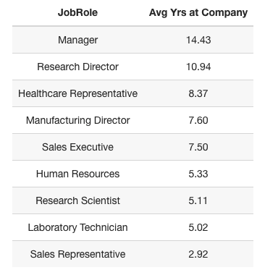
Trends – Highest Avg. Employment Length

Slide 13
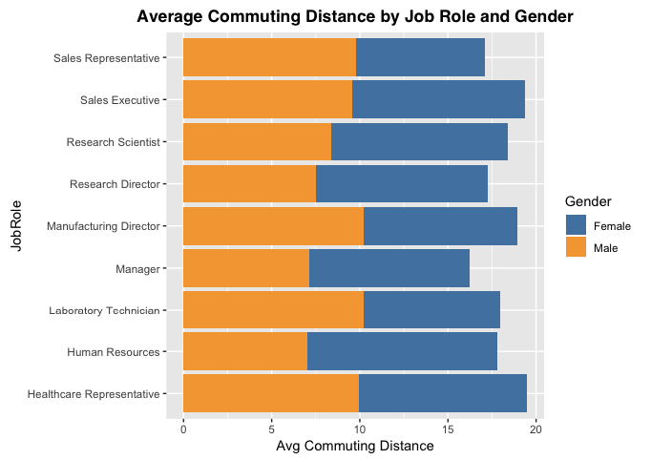
Trends – Commuting Distance and Gender

Slide 14
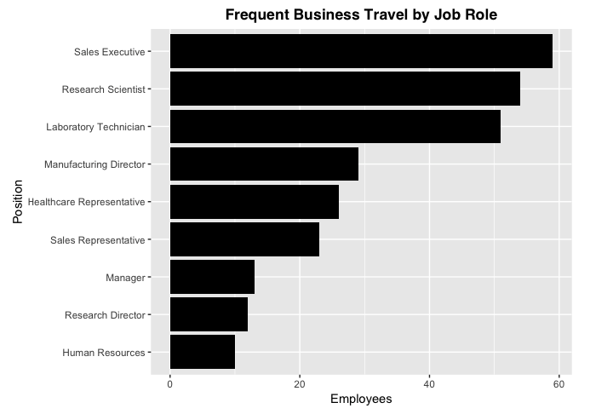
Trends – Business Travel
Scientists present at and attend research symposiums and conferences
Uncertain why Lab technicians travel so often (travel to many different labs?)

Slide 15
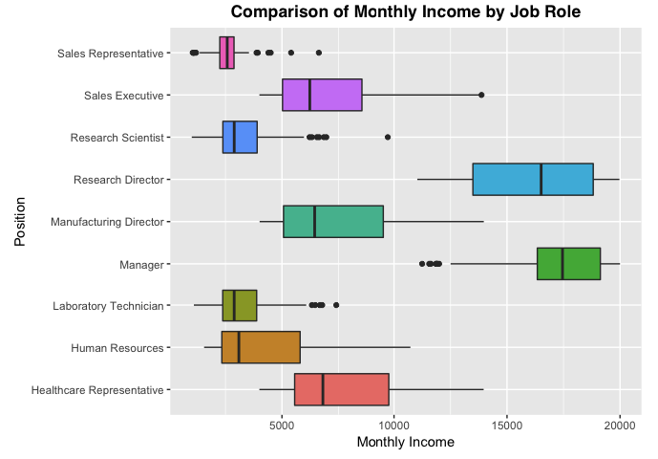
Trends – Job Roles and Income
Sales Execs make less than Research Directors!
Sales Execs and Manufacturing Directors have same right skew
Research Directors and Managers have the same left skew

Slide 16
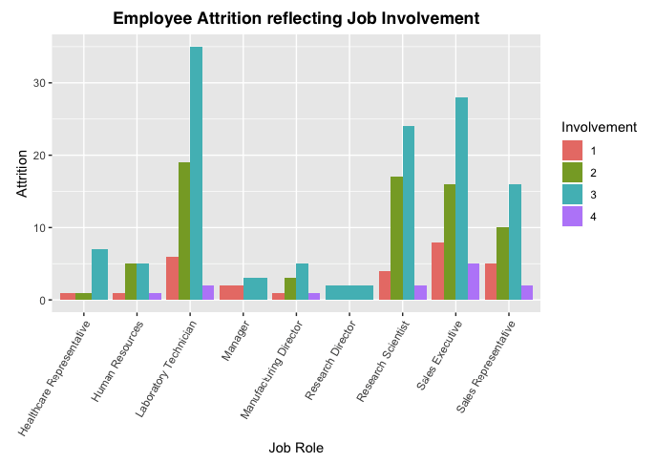
Trends – Attrition and Job Involvement
Most who quit are moderately engaged (2-3)
Those heavily engaged (4) can’t really afford quitting (without repercussion)

