Slide 1
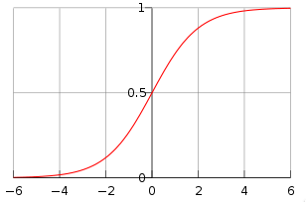

What is the definition of the
Logistic function?

Slide 2

What is the logit function?
The logit function is the inverse of the "sigmoid", or "logistic" function

Slide 3

What is the Jaccard Index?
measures similarity between sample sets, and is defined as the size of the intersection divided by the size of the union of the sample sets

Slide 4

What is cosine similarity? Domain?
a measure of similarity between two vectors of n dimensions by finding the cosine of the angle between them
Domain: [-1, 1]; 0 == same direction
Dot product
magnitude

Slide 5
What is a manifold?
a manifold is a mathematical space that on a small enough scale resembles the Euclidean space of a specific dimension

