Slide 1
Fruits
A selection of fruits sampled from
http://en.wikipedia.org/wiki/Fruit_tree

Slide 2
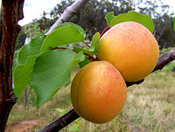
Apricot

Slide 3
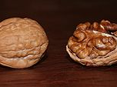
Walnut

Slide 4
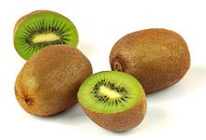
Kiwi

Slide 5
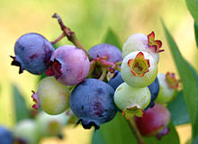
Blueberry

Slide 6
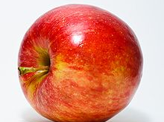
Apple

Slide 7
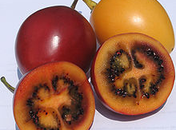
Tamarillo

Slide 8
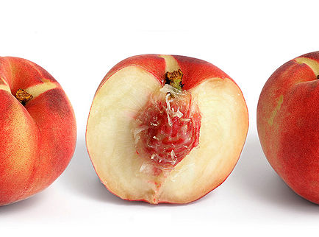
Peach

Slide 9
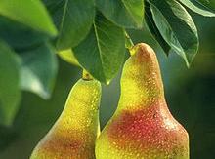
Pear

Slide 10
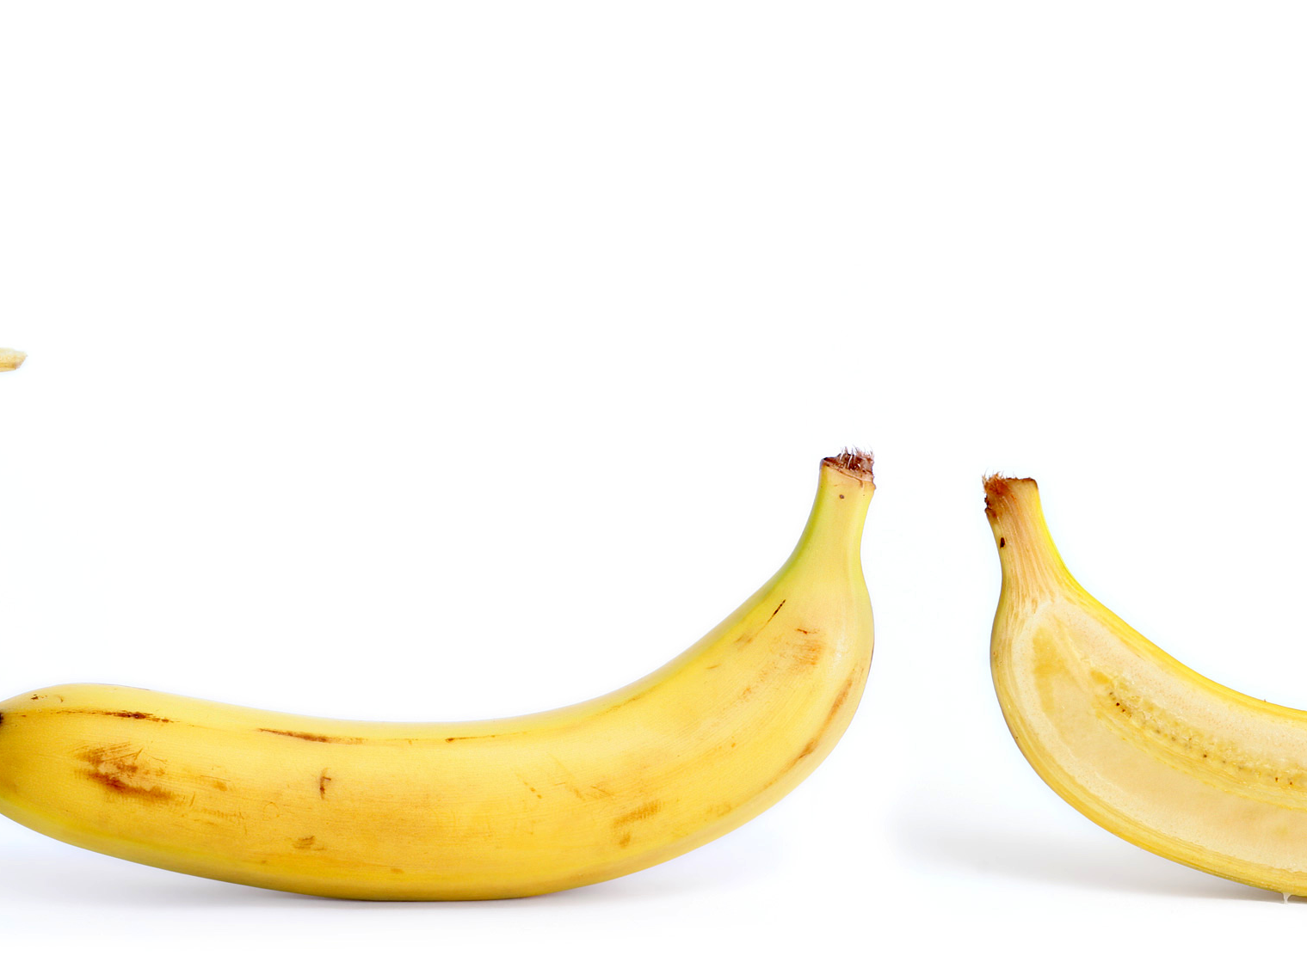
Banana

