Slide 1
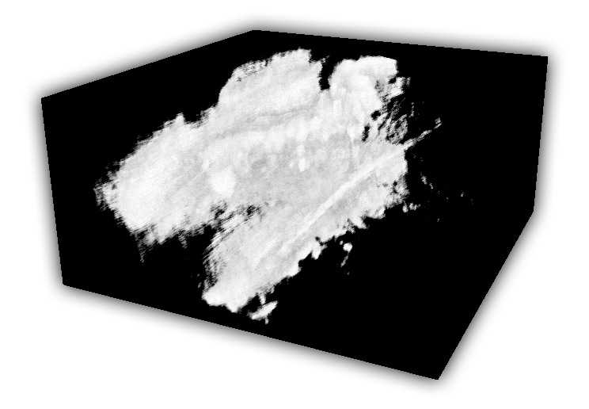

Holger Ludvigsen
Real-Time GPU-Based 3D Ultrasound Reconstruction and Visualization
Trondheim, June 2010
Master´s thesis
NTNU
Norwegian University of
Science and Technology
Faculty of Information Technology,
Mathematics and Electrical Engineering
Department of Computer and Information Science

