Slide 1


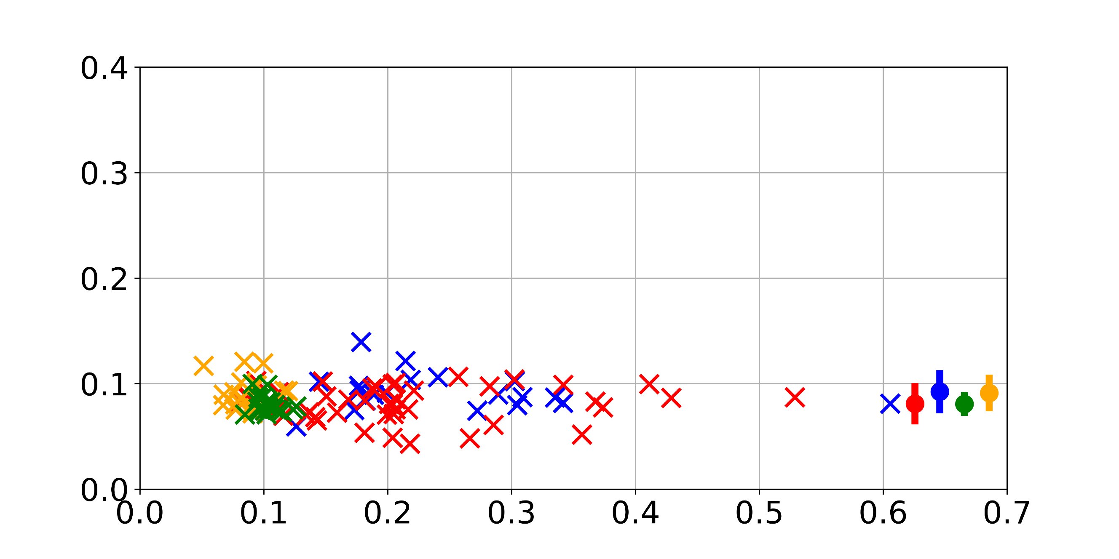
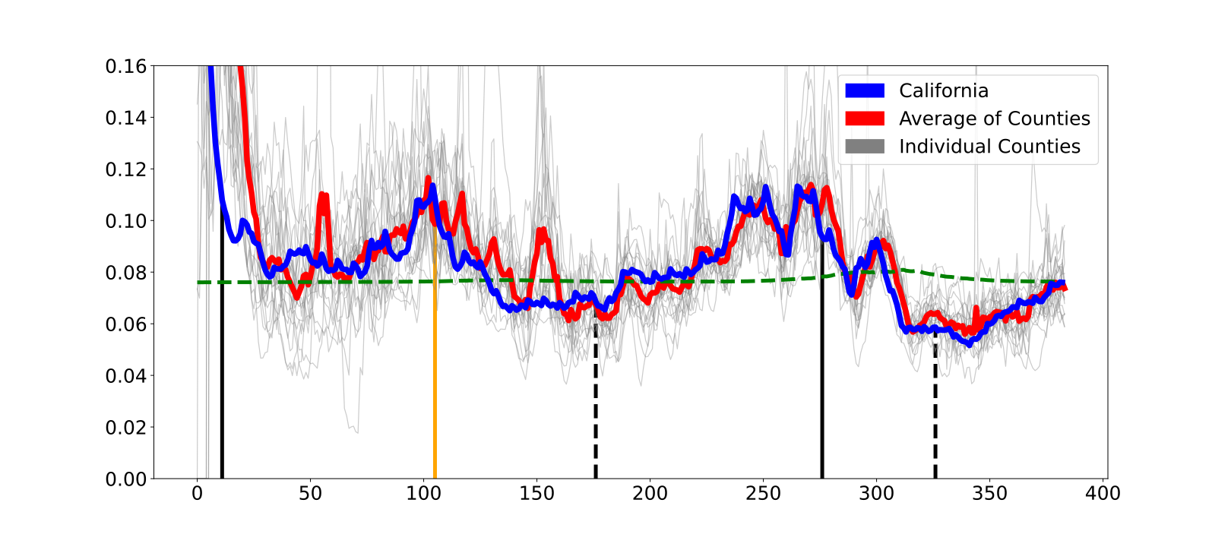
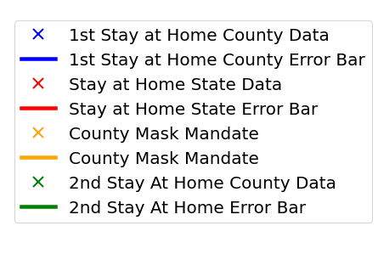
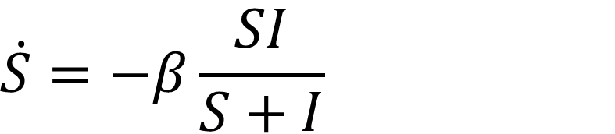
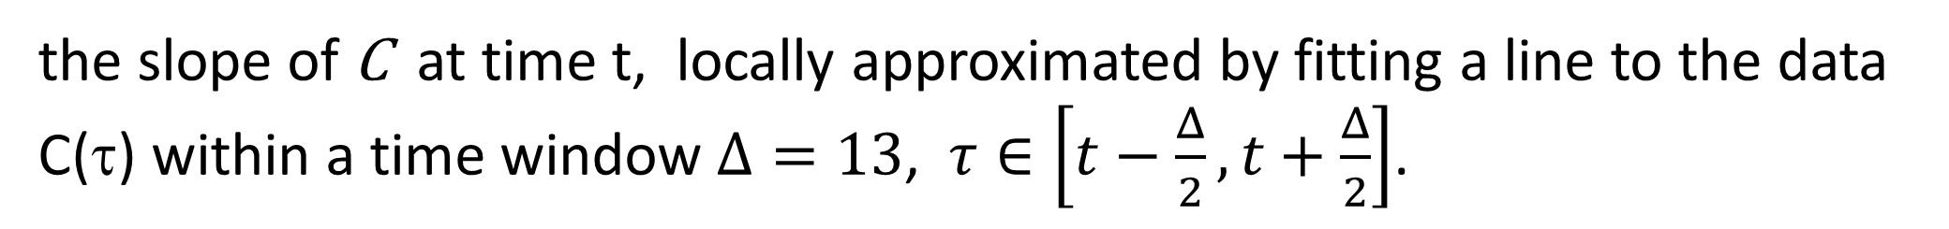

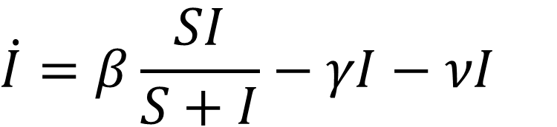


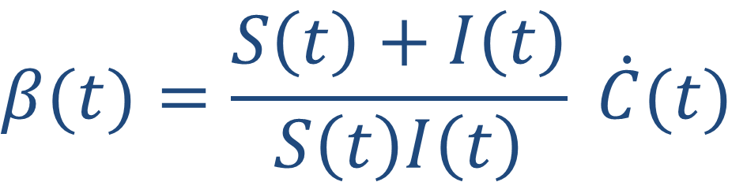
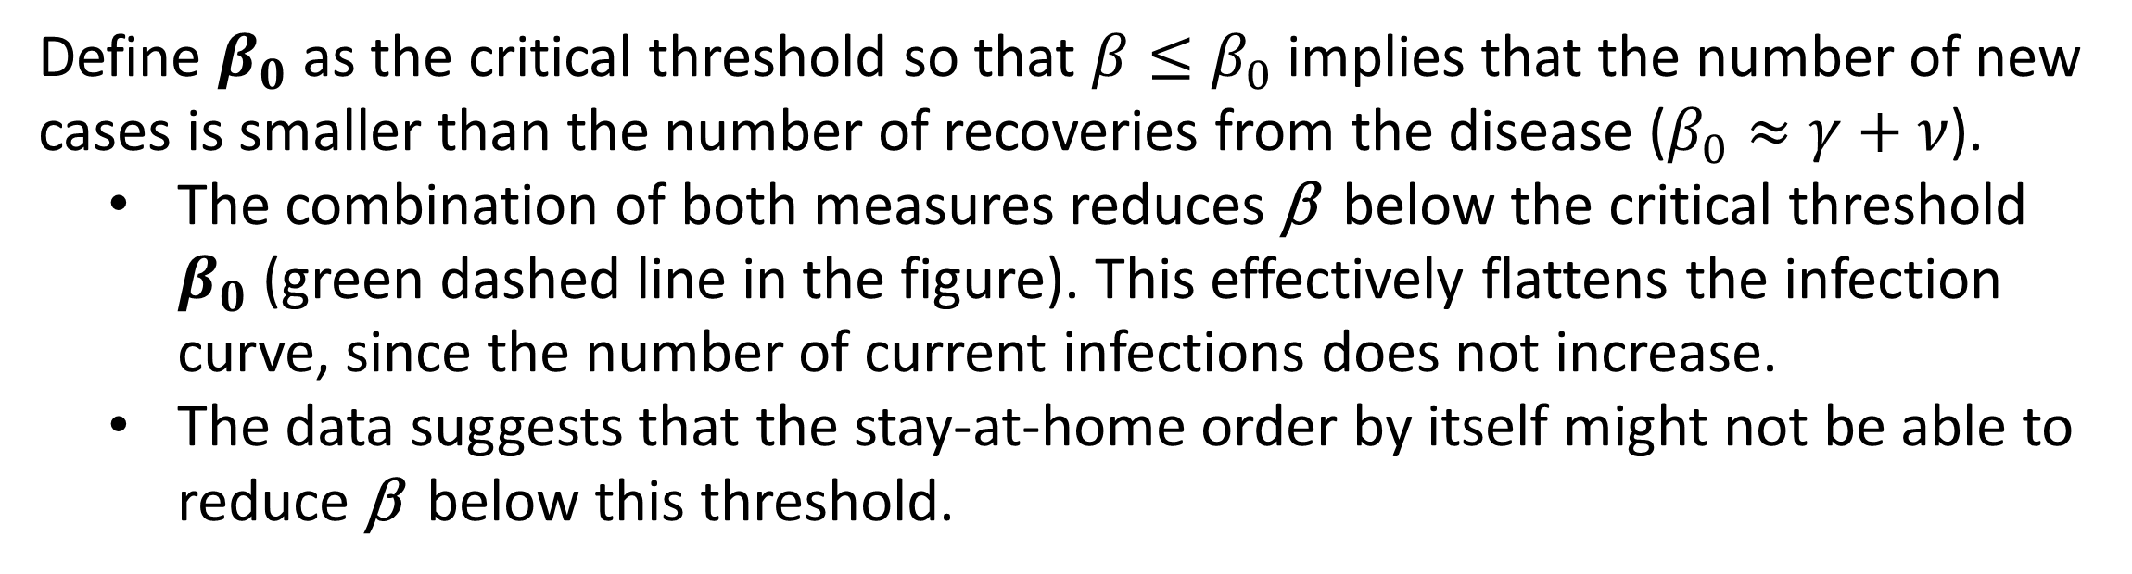


Non-Pharmaceutical Interventions Help Effectively Control COVID-19 Transmission Rates Jeston Bond¹, Holiday Pettijohn¹, Rachael Combes¹, Daniel March¹, Don Galbadage² and Genti Buzi¹ ¹Department of Mathematics and Computer Science, Biola University ²Department of Kinesiology and Public Health, Biola University
Abstract
Results
Reducing Transmission Rates to a Baseline Level
In response to the COVID-19 pandemic, the U.S. implemented several broad-scale public health interventions, including non-pharmaceutical interventions (NPIs) such as staying-at-home orders, mass gathering restrictions, mask mandates, business closures, and school closures. The timing and intensity of the implementation of such NPIs varied at state and county levels and generally in response to infection rates. It is unclear whether such interventions were effective or even what the best way to measure their effectiveness is. In this study we examine the effectiveness of several NPIs in controlling COVID-19 transmission rates. Using a SIRD model and publicly available data to determine these rates at state and county level, we show that several NPIs were very effective in reducing the rates to a baseline level (irrespective of the starting rate levels). This points to both the limitations and the effectiveness of these NPIs in mitigating the cost of the pandemic by controlling disease transmission rates. If used appropriately, such NPIs could be both cost-effective and help flatten the curve and prevent overwhelming the health care system.
We looked at the effectiveness of several NPIs in controlling β : staying-at-home orders, school closures and mask mandates. The school closure measure was implemented within a few days of the stay-at-home order, so we considered them together. We considered data from the 21 highest populated counties in California as well as state data from all US states.
These NPIs reduce β to a baseline level independent of the its starting values before the measure.
Effect of NPIs on Transmission Rate Levels
Effectiveness in Reducing Transmission Rates
Timeline of transmission rate levels in the 21 highest populated counties in California suggests that these NPI were effective in reducing the transmission rate. The implementation of these measures is followed by a drop in β, and the lifting of such measures is followed by an increase in β.
β_{after}
Timeline of Transmission Rate Levels
β_{before}
Methods and Data
NPI | Average β_{after} | Standard Deviation
County level data
1st stay at home/school closure | 0.0946 | 0.01712
Mask mandate | 0.0908 | 0.01407
2nd stay at home order | 0.0808 | 0.00804
State level data
Stay at home order | 0.0809 | 0.01626
SIRD Model
γ
R
β
$$β_{0}$$
S(t) – population proportion that is susceptible
I(t) – population proportion that is infected
R(t) – population proportion that has recovered
D(t) – population proportion that has died
γ – the rate at which infected recover
ν – the rate at which infected die
S
β
I
η
D
$$\begin{matrix}\dot{S}=−β\frac{SI}{S+I}\end{matrix}$$
$$\begin{matrix}\dot{I}=β\frac{SI}{S+I}−γI−νI\end{matrix}$$
School closure
Days since March 5
Stay at home order lifted
For the second stay-at-home order, the mask mandate is still in effect. More consistent testing/reporting and standardization of measure implementations later on might account for the much smaller variability in β_{after} across counties for the second stay at home order.
β (t) – the transmission rate
(the rate at which infected infect susceptibles)
$$\begin{matrix}\dot{R}=γI\end{matrix}$$
Stay at home order
NPI | β_{before} | β_{after}
County level data
1st stay-at-home/school closure | 0.2495 | 0.0946
Mask mandate | 0.0927 | 0.0908
2nd stay-at-home order | 0.1033 | 0.0808
State level data
Stay-at-home order | 0.1033 | 0.0809
NPIs directly target β, making it time varying
$$\begin{matrix}\dot{D}=νI\end{matrix}$$
Data
Mask mandate
Conclusions
The data for this project was extracted from publicly available databases.
US State data was acquired from the CDC and includes the numbers for daily total infections and deaths [1].
County data was acquired from John Hopkins University and includes the numbers for daily total infections and deaths [2].
The county measures came from local government sites, news sites, and other collaborative sources [3].
We showed that NPIs were very effective in reducing the COVID-19 transmission rates (β) to levels that effectively flatten the curve. Theses measures were able to bring β to a baseline level below the critical threshold for flattening the curve.
This highlights both the effectiveness and the limitations of such measures:
When correctly utilized (especially at high β), these NPI could help mitigate the cost of the disease by controlling transmission rates. Specific cut-off of β could be used to determine when these measures are cost-effective to be established. Thus, these NPIs could be both cost-effective and help flatten the curve and prevent overwhelming the health care system.
On the other hand, the existence of a baseline value for β indicates that these measure by themselves can only slow down the disease and have limited benefit when β is already low.
To quantify the effect of the different measures, we calculated
β_{before} - the average β over the 14 days prior to the implementation of the measure
(β_{after}) - the average β over the next 14 days following a delay of 8 days[4] after the measure implementation.
The table shows the average (across the CA counties) of β_{before} and β_{after} for different NPIs. The data clearly shows that the implementation of both measures contributed to a reduction of β. These results are consistent with what we observe with state level data for the US states we considered.
Calculating transmission rate β
$$\begin{matrix}β(t)=\frac{S\left(t\right)+I\left(t\right)}{S\left(t\right)I\left(t\right)} \dot{C}(t)\end{matrix}$$
$$C(t)≜I(t)+R(t)+D(T)$$
is the cumulative infections at time t
Flattening the Infection Curve
References
$$S\left(t\right)=Population−qC(t)$$
q is the proportion of infections/deaths captured by the data.
Define $β_{0}$ as the critical threshold so that $β≤β_{0}$ implies that the number of new cases is smaller than the number of recoveries from the disease ($β_{0}≈γ+ν$).
The combination of both measures reduces β below the critical threshold $β_{0}$ (green dashed line in the figure). This effectively flattens the infection curve, since the number of current infections does not increase.
The data suggests that the stay-at-home order by itself might not be able to reduce β below this threshold.
https://data.cdc.gov/Case-Surveillance/United-States-COVID-19-Cases-and-Deaths-by-State-o/9mfq-cb36
https://github.com/govex/COVID-19
https://github.com/holiday-pettijohn/COVID-Tracking-Biola-Summer
Castex, G., Dechter, E. & Lorca, M. COVID-19: The impact of social distancing policies, cross-country analysis. EconDisCliCha 5, 135–159 (2021).
$$\dot{C}(t)$$
the slope of C at time t, locally approximated by fitting a line to the data C(τ) within a time window $Δ=13$, $τ∈\left[t−\frac{Δ}{2},t+\frac{Δ}{2}\right]$.
$$R\left(t\right), I(t)$$
estimated using average 14 days recovery rate for the infections

