Slide 1
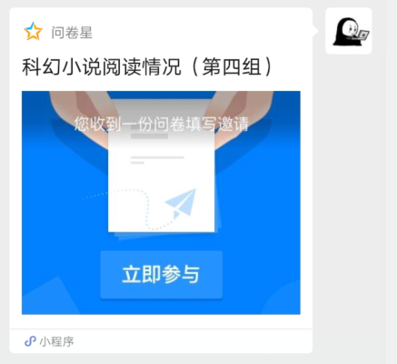
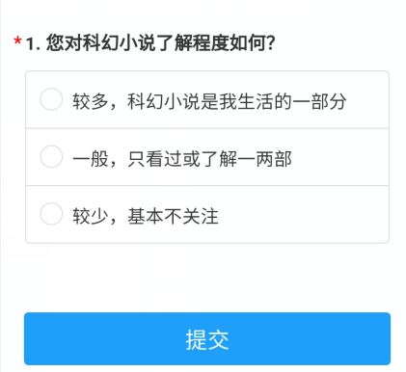
A small questionnaire (30s)

Slide 2
Before we begin
How much do you know about sci-fi
Student 1(excited):
Chinese science fiction The Three-Body Problem has won the Hugo Award !!!
Student 2:
Hugo Award ?
Student 3:
Chinese science fiction??
Student 4:
Problem? What's the problem???

Slide 3
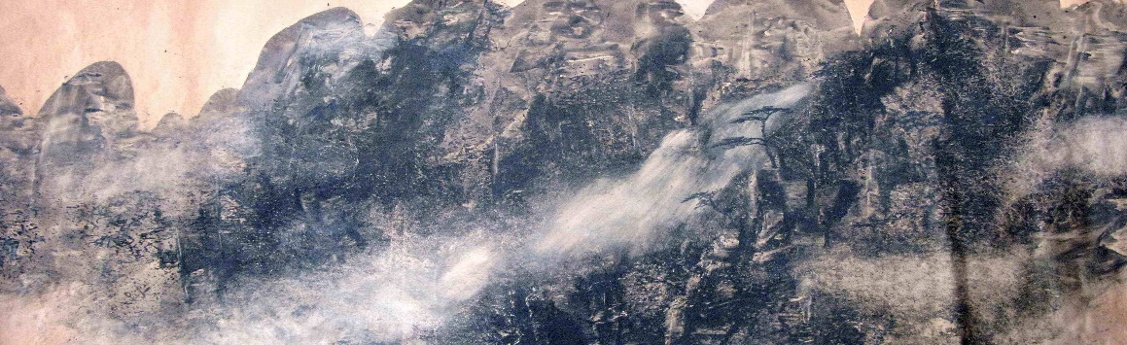
What makes
Chinese science fiction
A brief comparison
Group 4:
陈禹潼(无97)
欧阳润生(物理62)
张鸿琳(物理92)
张嘉桐(新雅93)

Slide 4
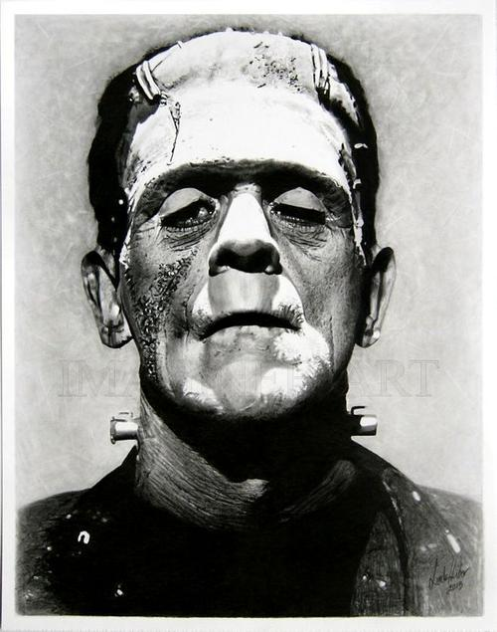
How Sci-fi came into being
Introduction
Imagination：
Dream by Johannes Kepler(1571-1630).
Utopia by St. Thomas More(1478-1535).
Development of science：
The British Industrial Revolution in 1760s.
Frankenstein
by Mary Shelley (1797-1851) in 1818

Slide 5
How Sci-fi came into being
Introduction
What science us?
What science us?
has brought
will bring

Slide 6
Sci-fi in western world
Introduction
1985-
Space
1960-1975
Cyberpunk
Monster
1938—1946
New Tide
War
Golden Age
Catastrophe
Time Travel
Main theme

Slide 7
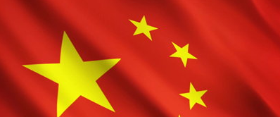
Introduction
So what about
?

Slide 8
CONTENTS
01.
Introduction
What is science fiction & Why this topic.
02.
Comparison
PartA: Culture, history, religion differences.
PartB: The changing attitude to technology in Chinese sci-fi.
03.
Data analysis
Publishing of Chinese and Western Sci-fi.
04.
Conclusion
Advantages & Disadvantages for Chinese sci-fi.
How to develop Chinese own science fiction

Slide 9
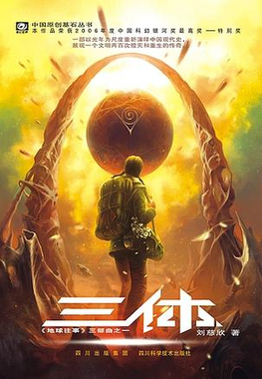
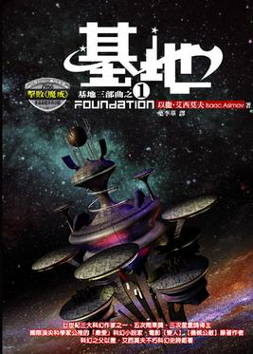
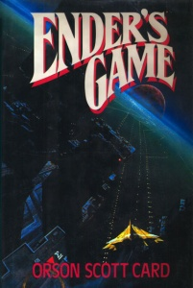
Differences in Sci-fi
Culture, history and Religion
Comparison:Part A
Books
The Three-Body Problem
Foundation
Ender' s
Game
Plot
Culture
Religion
History
Human vs. alien
Collectivism
Survival over freedom and individual rights
Atheism
Cultural revolution
Famine
Part I: Empire is falling apart
Future is determined
Galactic Empire vs.
Roman Empire
A child is trained to become a military commander in order to thwart an alien invasion
Heroism
Ender's dad was Catholic，mom was a Mormon. The writer is also from Utah and is a Mormon.
Liu cixin
Issac Asimov
Orson Scott Card

Slide 10
Technology in Chinese Sci-fi
Comparison:Part B
The writers' view on technology
[
[
Admire
Criticize
When our motherland is at war, we hope that technology can bring victory and promote people's life.
Development of Technology will damage our environment, weaken social connection and cause ethical problems.

Slide 11
Worship of technology
Comparison:Part B
In early times, Sci-fi writers wish technology will give China a rosy future.
徐迟昌《割掉鼻子的大象》
1955
A new species of pig,
which weigh more than 12500kg, saved people's life in famine
During the anti-Japanese war, scientist Lei invented a new technology “铁鱼底鳃”, which was vital to the war.
An artificial sun was built on the land of China, which can adapt the climate. Therefore, Wide land can be used for cultivation.
1940
2001
许地山《铁鱼底鳃》
刘慈欣《中国太阳》

Slide 12
Criticism for Technology
Comparison:Part B
Later, Sci-fi writers suspect that Technology can also bring big problems to human civilization.
韩松《红色海洋》
2004
A nuclear war destoryed the environment. The rest of people adapted themselves for living.
A scientist called Liu Xin invented a new technique for coal industry. But his experiment caused a disaster.
The development of technology may change people's relationship.
2000
2006
刘慈欣《地火》
何夕《我是谁》

Slide 13
Publishing
Data analysis
270+
Average Sci-fi books published in 2004-2013
130+
80+
63+
17+
Chinese Short&Medium Sci-fi
Chinese original Sci-fi
Chinese Long Sci-fi
Introduced Sci-fi
America original Sci-fi

Slide 14






Advantages & Disadvantages
Conclusion
The road of Chinese Sci-fi.
Distinct
culture core
Rich expression
Good
vitality
Advantages
Disadvantages
Short
period
Immature industry chain
Not enough readers

Slide 15
Advice
Conclusion
The road of Chinese Sci-fi.
[
[
Internationalization
Nationalization
Learn from western country
Transmedia storytelling
Learn from traditional culture
Related with Chinese society

Slide 16
References
Conclusion
[1]汤黎. 民族性和国际化的共同观照:中国当代科幻小说如何讲述"中国故事"[J]. 西南民族大学学报:人文社科版, v.41;No.343(03):185-191.
[2]李晓. 论中国科幻小说中的科技观[D]. 山东师范大学.
[3]刘畅. 21世纪以来中国科幻小说出版现状分析[D]. 北京印刷学院.

Slide 17
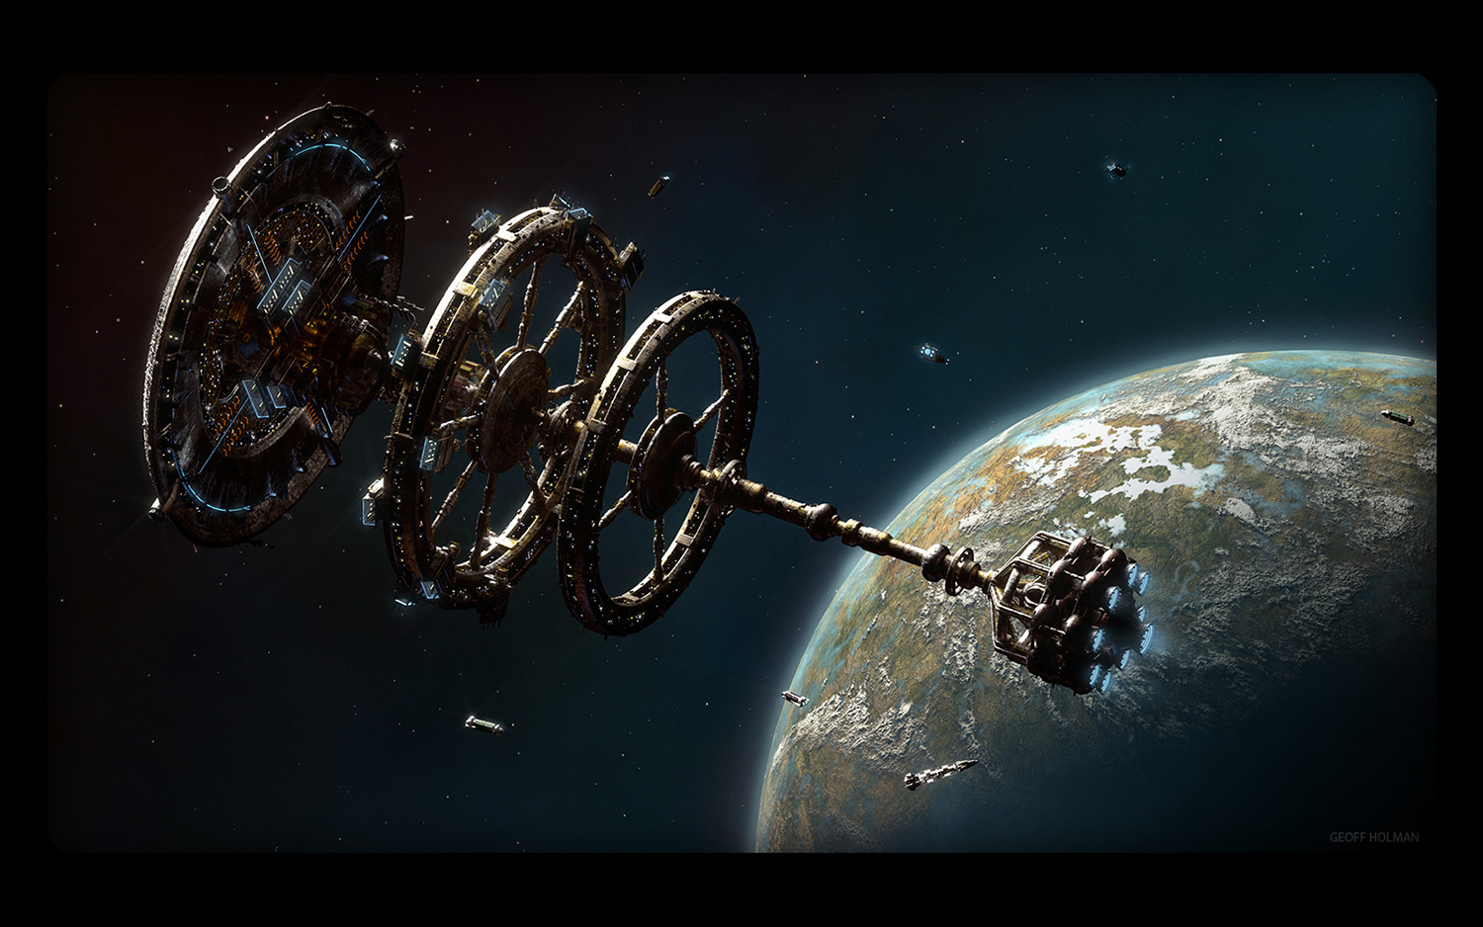
Thank you
for
listening.

