Slide 1

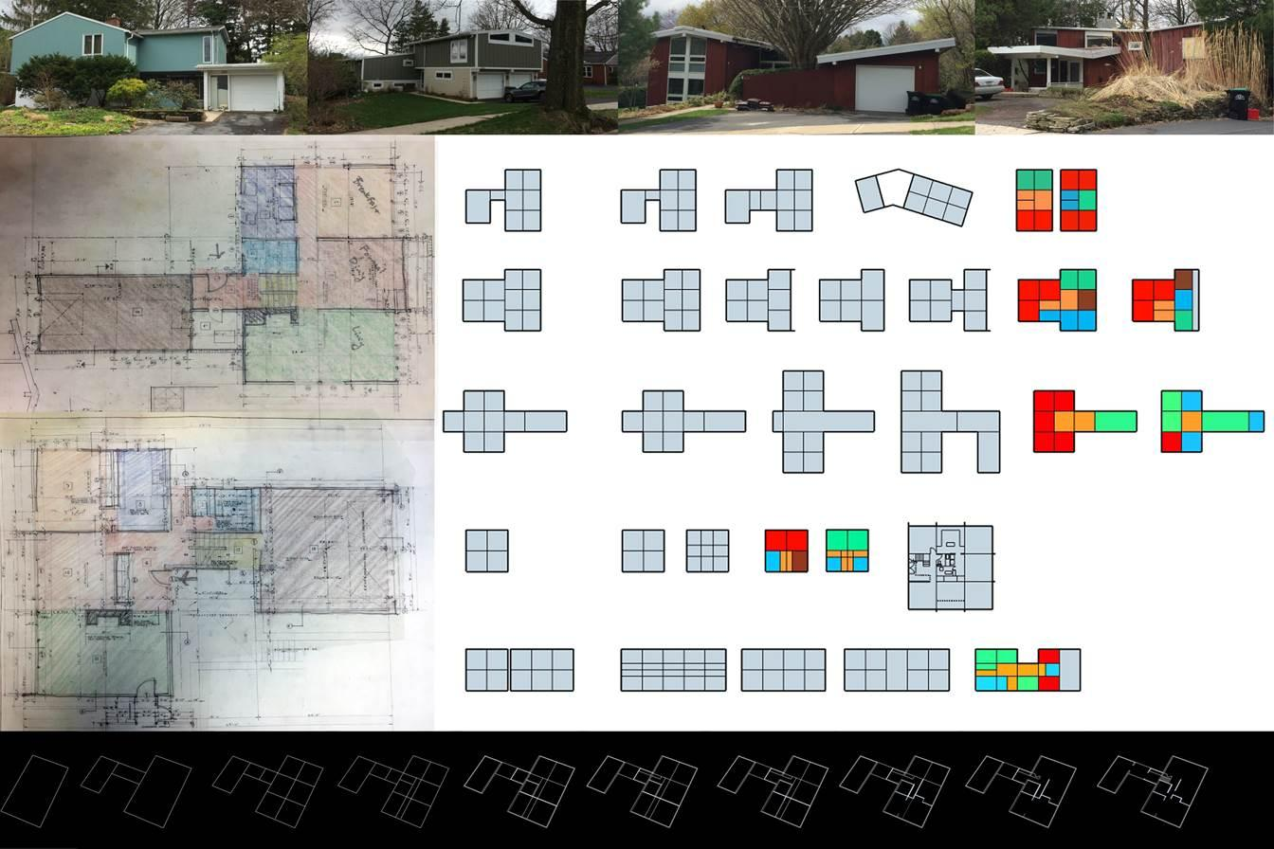
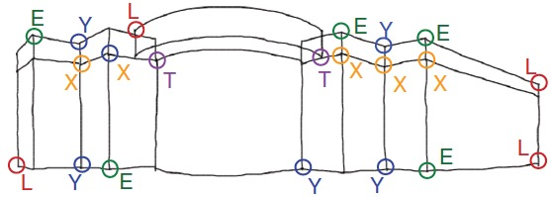
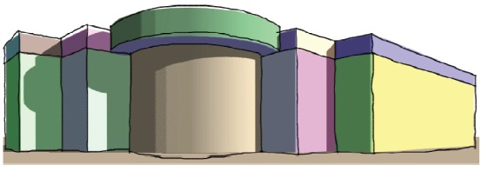
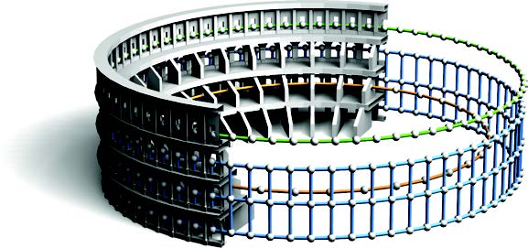
Image Source: Chen et al., 2007; Pauly et al., 2008
Image Source: https://stuckeman.psu.edu/adapting-modern-architecture-local-context

