Slide 1
Hello! I’m Tom Wallis, and
you’re about to hear me talk about
my paper with Tim Storer, titled
Process Fuzzing as an Approach for Genetic Programming

Slide 2
Confession Time
I’m not a GP person!

Slide 3
Confession Time
I’m not a GP person!
I just work with system simulation, but it turns out some of our methods are potentially kind of useful in your area.

Slide 4
Confession Time
I’m not a GP person!
I just work with system simulation, but it turns out some of our methods are potentially kind of useful in your area.
We’re from different worlds, so if I’m not making sense and you have questions, ask!

Slide 5
“Process Fuzzing”
If I’m going to talk about Process Fuzzing as an approach for Genetic Programming, I should explain what that actually is.
High-level: when you call a function / method, we intercept the method call and replace your code with a modified version.

Slide 6
“Process Fuzzing”
Fuzzers are functions applied to other functions, which manipulate their ASTs before they’re executed.

Slide 7
“Process Fuzzing”
Fuzzers are functions applied to other functions, which manipulate their ASTs before they’re executed.
When a fuzzer produces some new function based on a previous one, we call the new one a variant.

Slide 8
“Process Fuzzing”
Fuzzers are functions applied to other functions, which manipulate their ASTs before they’re executed.
When a fuzzer produces some new function based on a previous one, we call the new one a variant.
We apply fuzzers using aspect orientation.

Slide 9
A little bit of AOP
Actually, to get this to work properly, we’ve written our own AOP library in Python, called ASP.

Slide 10
A little bit of AOP
Actually, to get this to work properly, we’ve written our own AOP library in Python, called ASP.
ASP lets us represent our fuzzers as callable objects, which turns out to be rather useful.

Slide 11
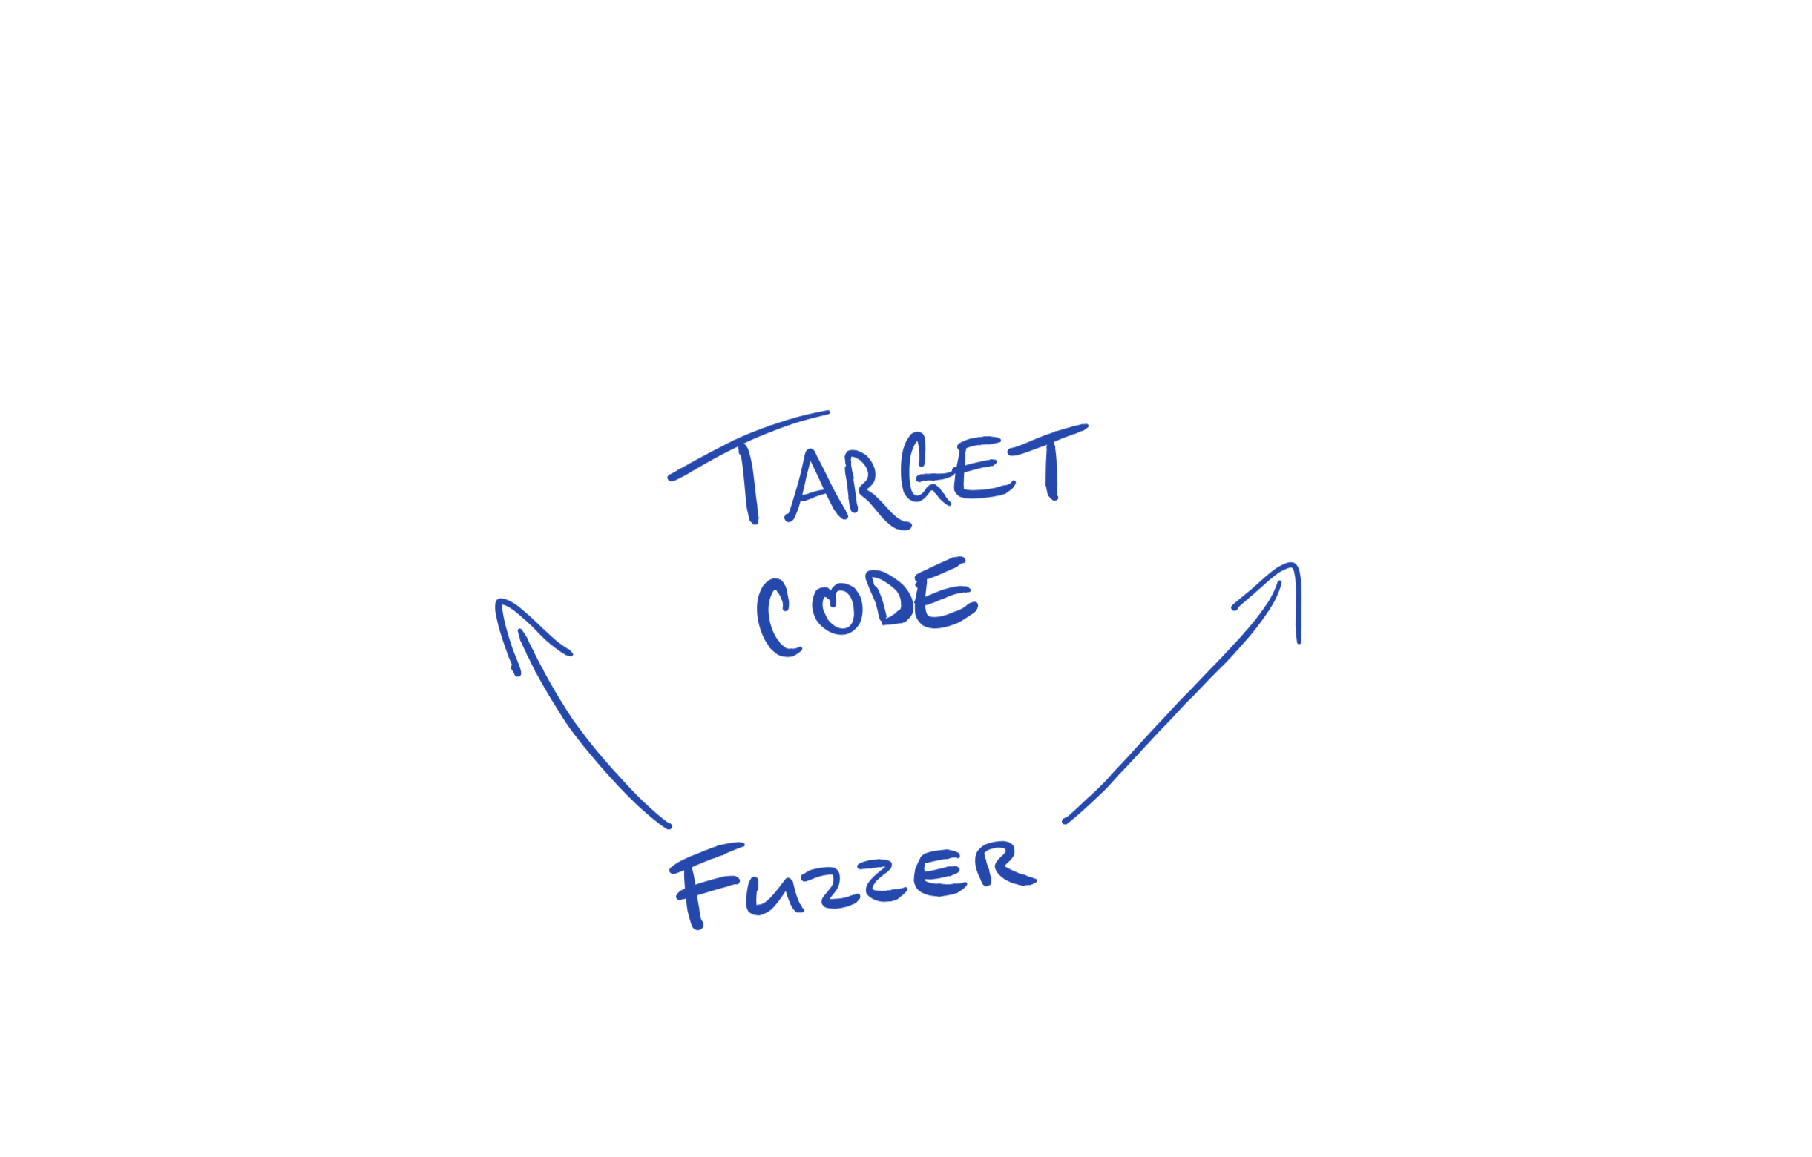

Slide 12
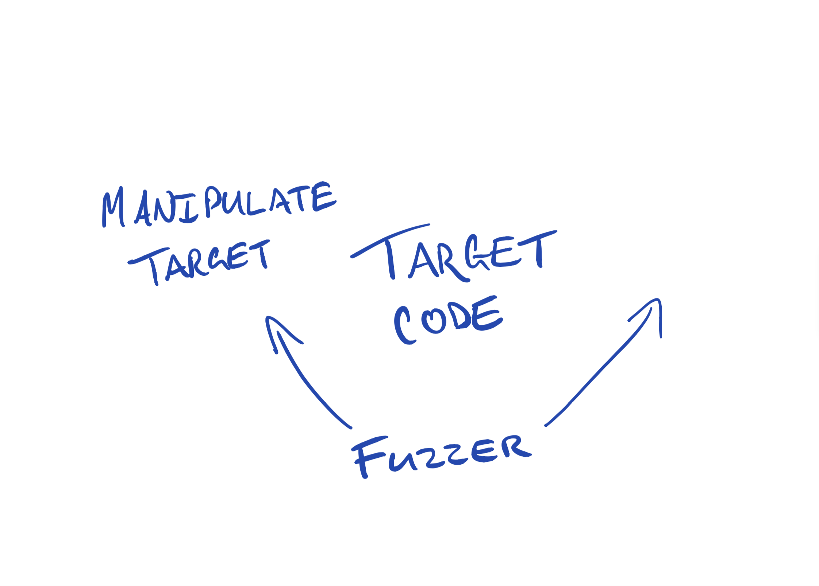

Slide 13
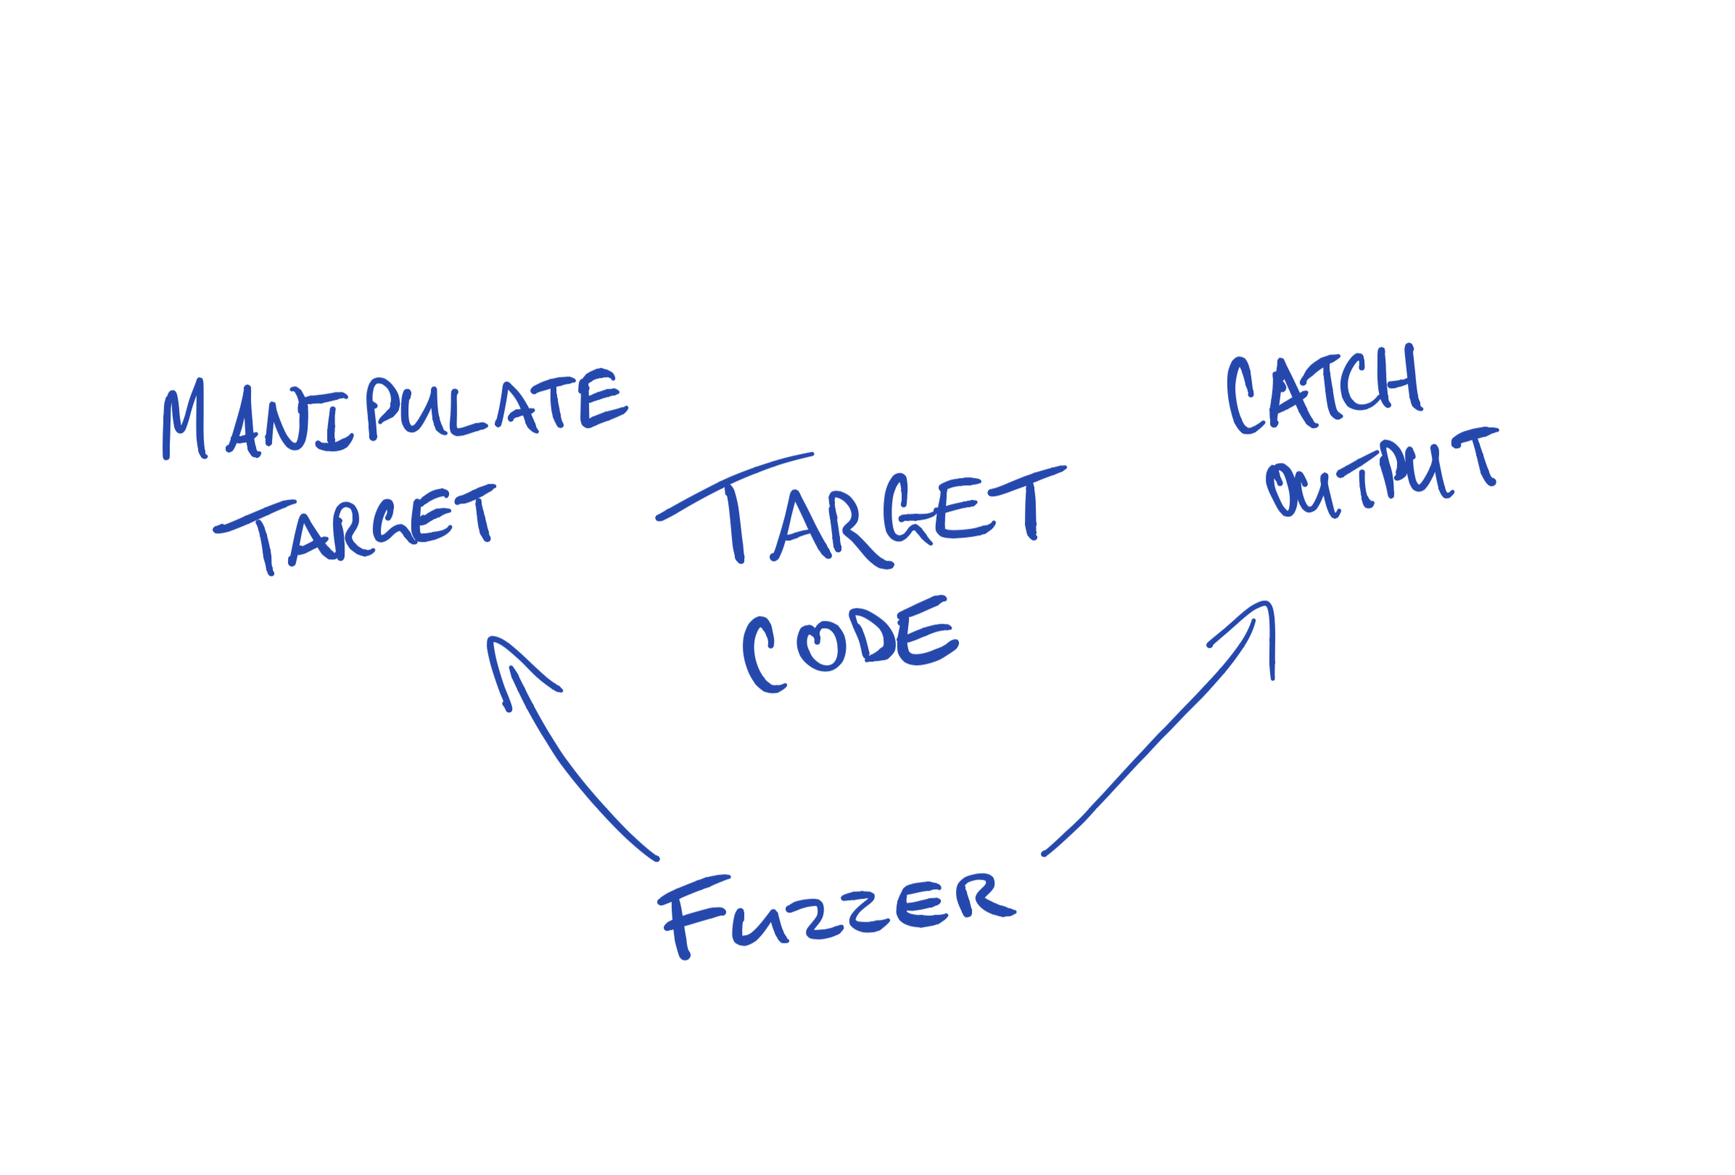

Slide 14
Dangerous Ideas
…if we’re recording the variants we produce…
…and we’re recording their outcomes…
…say we introduce some kind of fitness function…
…well, eventually we could stop mutating the original function we were looking at, and begin mutating successful variants instead…

Slide 15
Polishing up some GP
We’re nearly at an implementation of GP, really.

Slide 16
Polishing up some GP
We’re nearly at an implementation of GP, really.
Our fuzzer would need some fitness function, so we can pass that in at initialization or as a method of the fuzzer’s class…

Slide 17
Polishing up some GP
We’re nearly at an implementation of GP, really.
Our fuzzer would need some fitness function, so we can pass that in at initialization or as a method of the fuzzer’s class…
…then, all we need to do is make new generations from previously successful variants.

Slide 18
Why would we willingly do this?!
This is cool, but a little strange! Why perform mutations at this level?

Slide 19
Why would we willingly do this?!
This is cool, but a little strange! Why perform mutations at this level?
Mutating an AST lets us manipulate state, as well as minute detail

Slide 20
Why would we willingly do this?!
This is cool, but a little strange! Why perform mutations at this level?
Mutating an AST lets us manipulate state, as well as minute detail
This kind of approach could lead to interesting angles for genetic improvement!

Slide 21
Why would we willingly do this?!
This is cool, but a little strange! Why perform mutations at this level?
Mutating an AST lets us manipulate state, as well as minute detail
This kind of approach could lead to interesting angles for genetic improvement!
Process fuzzing is a cross-domain concept

Slide 22
“Cross-domain”
Process fuzzing came out of building realistic socio-technical simulations, and it has applications in information systems research too.

Slide 23
“Cross-domain”
Process fuzzing came out of building realistic socio-technical simulations, and it has applications in information systems research too.
That should mean easier integration between GP and other fields, like socio-technical simulation, which might lead to exciting research opportunities, like evolving domain models.

Slide 24
Other benefits?
Whether process fuzzing is better than traditional approaches, I can’t say. We should find out!
What I’m here to report is that you can use process fuzzing to implement GP solutions. We’ve got a symbolic regression written with our library, and I don’t believe something this general is out there to build things like genetic improvement on.

Slide 25
Thanks!
I’m probably out of time by this point, so let’s answer some questions!
There’s some code at:
github.com/twsswt/pydysofu
github.com/probablytom/asp
(check the branches)

