Slide 1
F1 Pit Stop Strategy
Driver Delta and Lap Time Recovery

Slide 2
Background: 2019 Hungarian GP
Lap | VER | HAM | Comments
1 | 1 | 2 | Max Verstappen maintains pole position, MEDIUM tires Lewis Hamilton started at P3 and gains a position by end of Lap 1, MEDIUM tires
25 | 2 | 1 | Verstappen undercuts and pits early, switching to HARD tires.
31 | 1 | 2 | Hamilton pits, switching to HARD tires.
48 | 1 | 2 | Hamilton pits again, switching to MEDIUM tires.
67 | 2 | 1 | Hamilton closes gap to Verstappen. Verstappen pits, giving Hamilton pole position.

Slide 3
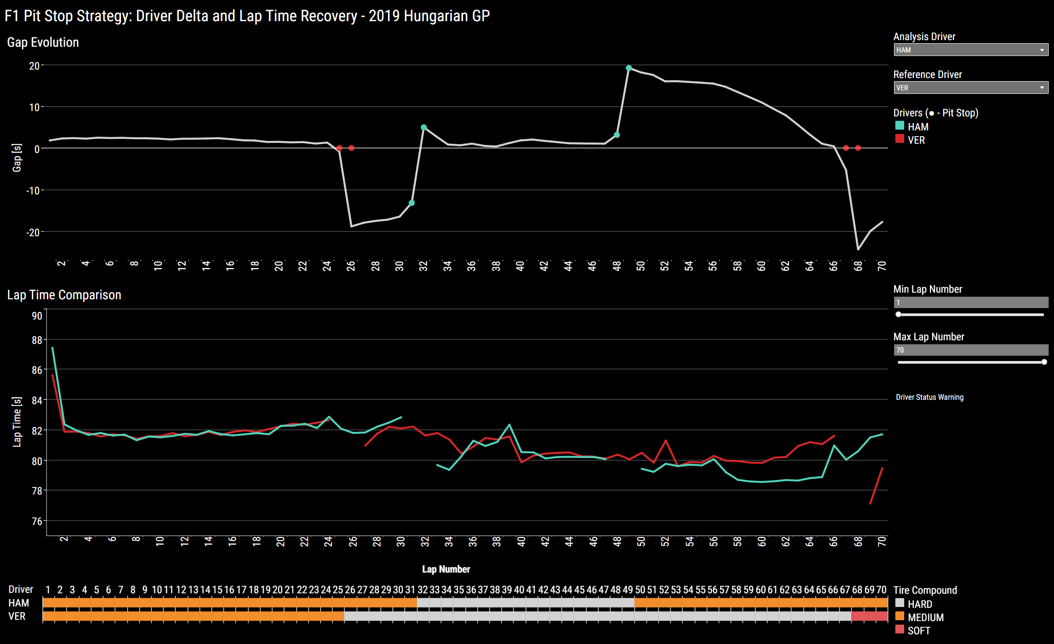

Slide 4
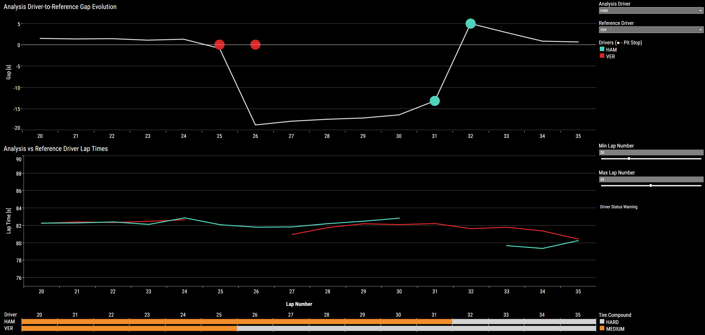
Lap 25: VER undercuts and maintains lead
HAM gap to VER
VER
undercut pit stop
HAM
pit stop

Slide 5
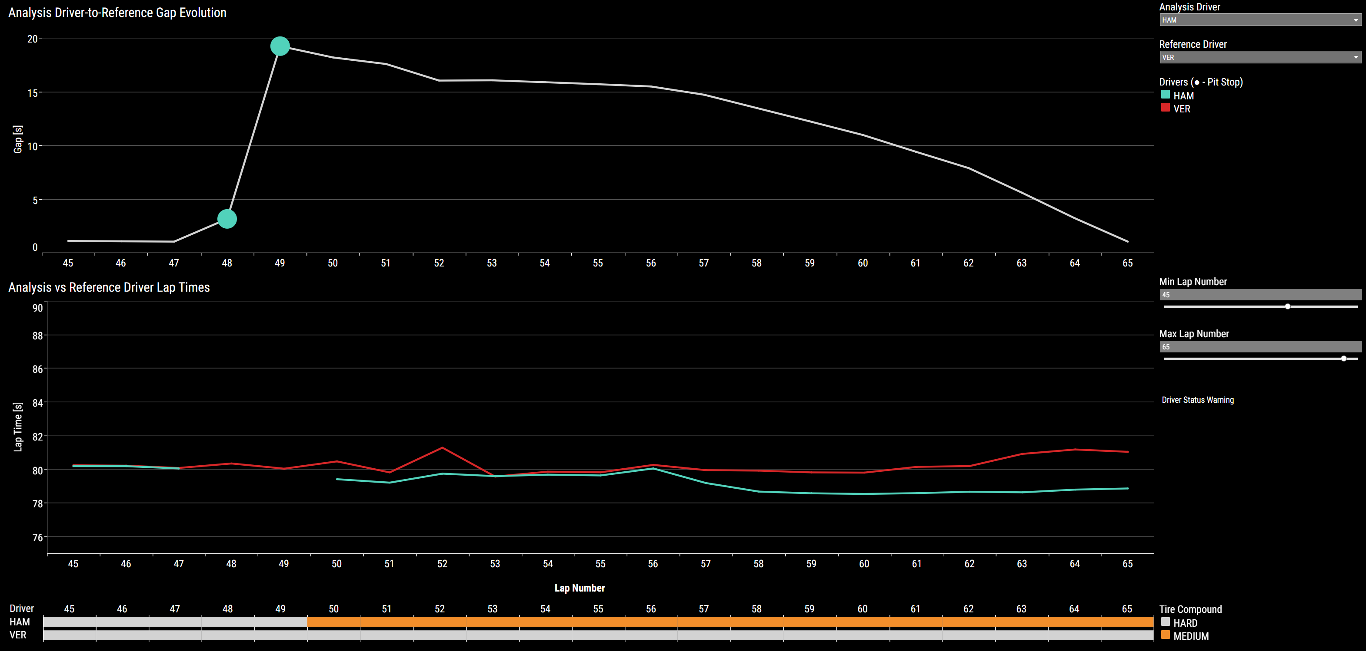
Lap 48: HAM pits again and closes gap to VER
HAM
pit stop
HAM gap to VER
Growing lap time difference

Slide 6

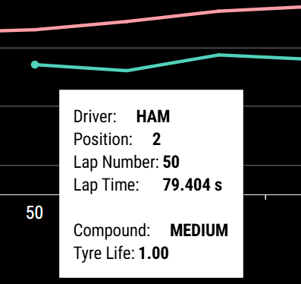
Lap 48: HAM free pit stop against LEC
HAM gap to LEC
~40s
HAM doesn’t lose position = “free pit stop”

Slide 7
