Slide 1


Slide 2


Replace placeholder with logo.png
All grey colored elements change to this color
#FFEECF
All black text
should now have a dark brown color
#462D00
All white colored elements change to this color
#FEF5E5
Change to this color #546B8E

Slide 3

All black text
should now have a dark brown color
#462D00
All white colored elements change to this color
#FEF5E5

Slide 4


Slide 5




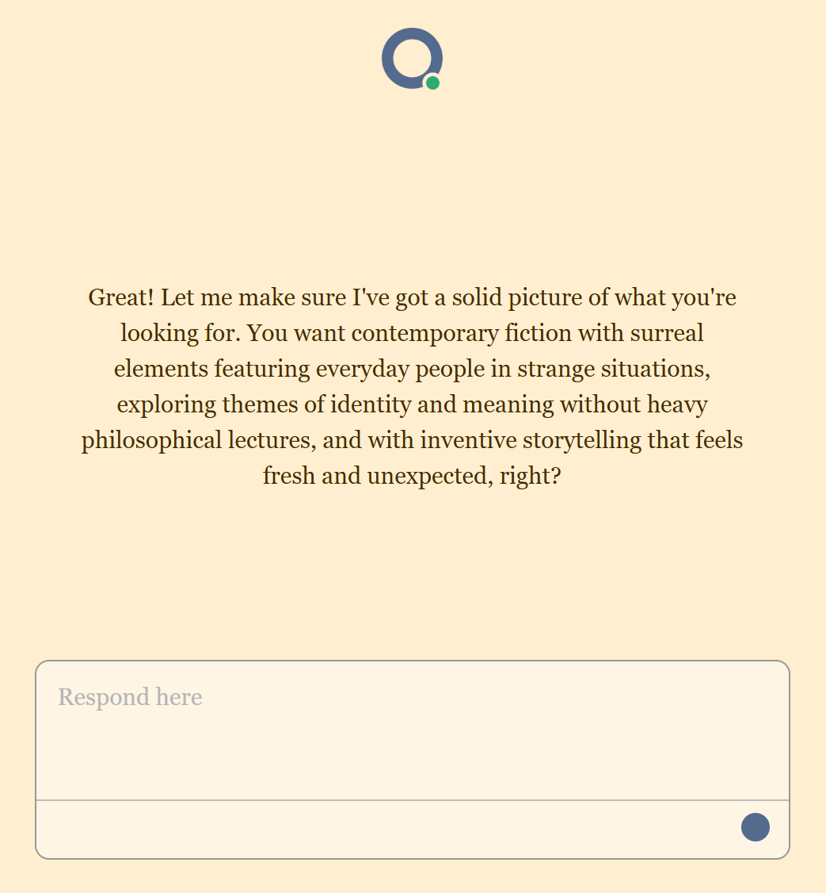

Slide 6
Yep!

