Slide 1
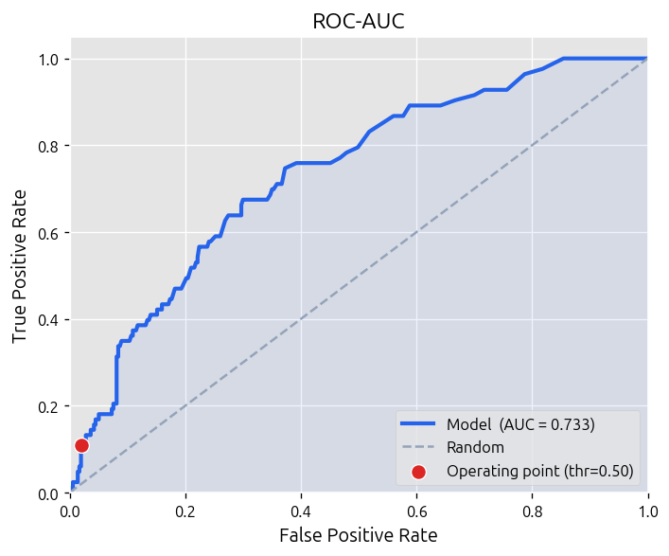
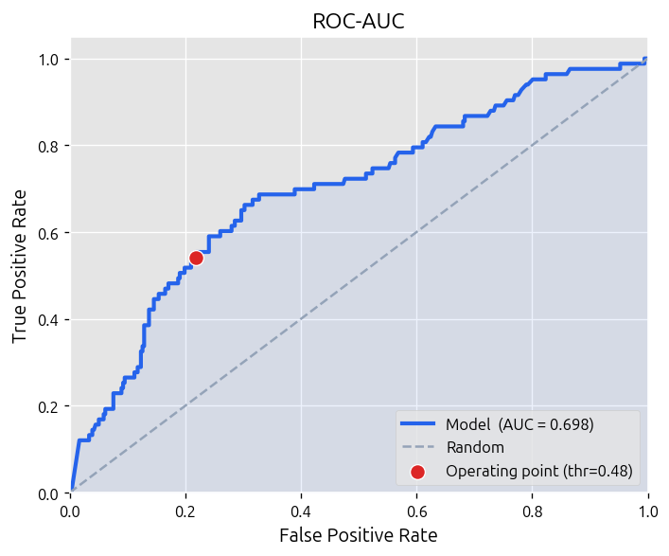
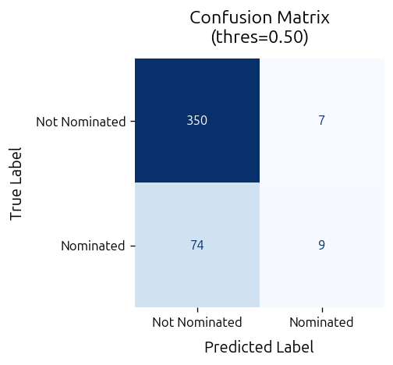
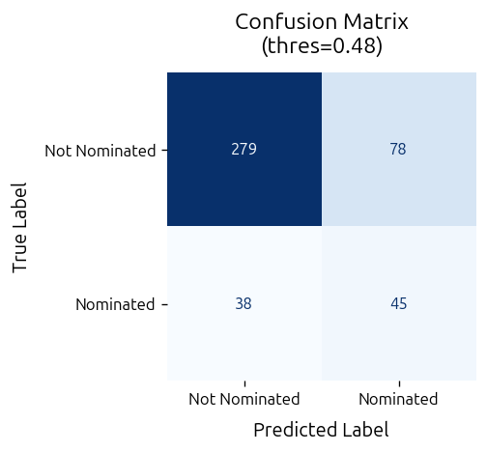
Mean-Pool Transformer Model
GPT-2 Emb Transformer Model
Confusion Matrix
(thres=0.50)
Confusion Matrix
(thres=0.48)

Slide 2


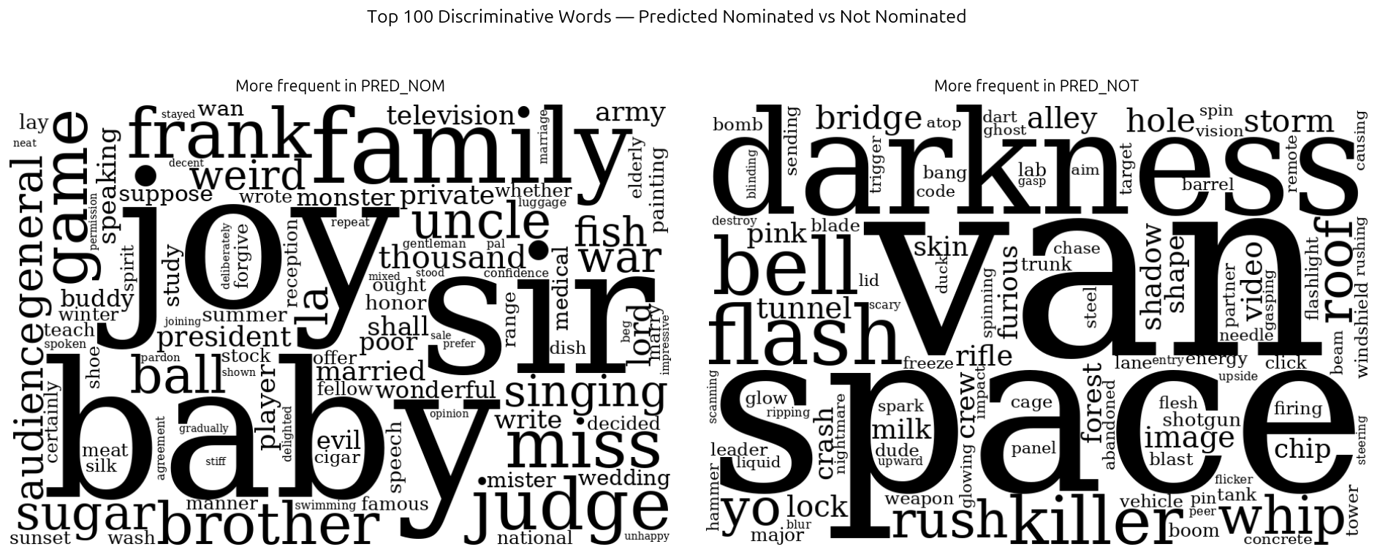
Test Dataset
Mean-Pool Transformer Model Predictions
GPT-2 Emb Transformer Model Predictions

