Slide 1
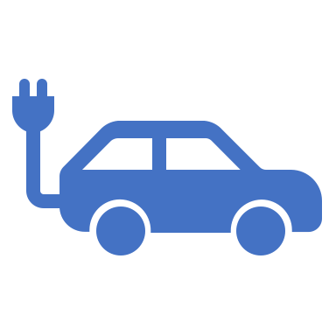
Electric Vehicle Charging in Tennessee Holland Griffis DA-5 Nashville Software School

Slide 2
Context and Motivation
EV sales are on the rise. 2.5% of vehicle sales in the US this year were EV and that rose to 20% + over the summer of 2021.
Many early adopters of EV’s have home based chargers in their garage, but more people are starting to look at EV’s who don’t have access to home charging.
I wondered about the state of charging for the average person who doesn’t have access to home charging. Like an apartment or condominium dweller.
The hallmark of vehicle “fueling” convenience is the petroleum station network that has been growing for over a century. How does the nascent EV charging infrastructure compare and what will it take to make it as convenient as the gas station network?

Slide 3
Analysis
Questions:
What is the current state of public charging networks in this state and how are they growing
How does that compare to the existing gas station network
What needs to happen to bring parity for EV charging in terms of availability and ease of access
Technology Used:
Python/Pandas - for exploration and aggregation of the Data as well as creation of charts
PostgreSQL/SQL - to serve as a repository for the data used and to do initial exploration of the Data
SQLAlchemy - python package was used to interface between Python and PostgreSQL
Geopandas and Folium - used for mapping

Slide 4
Terms
Level 1 charging – Your basic 120V outlet with a charging cable. Can add around 30 miles of range over night
Level 2 charging – 240V up to 60 Amps. Can add a full charge to most EV’s in 9-10 hours
Level 3 charging – Also known as DC fast charging. From 50 – 300 kW. Can fully charge most EV’s in less than an hour at the high end. 150kW and 250kW are the most common and can give 40-50% charge in 15-20 minutes.
3 main connectors in use for level 3 charging are Tesla, CCS-1, and CHAdeMO. Tesla and CHAdeMO are proprietary to Tesla and Nissan respectively. CCS in an international standard.

Slide 5
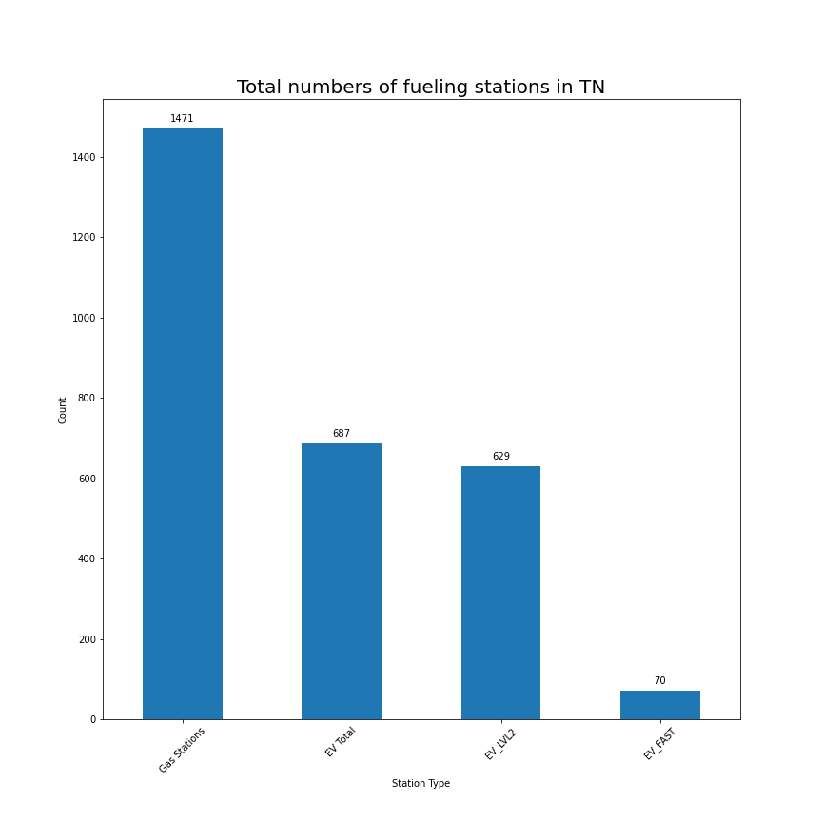
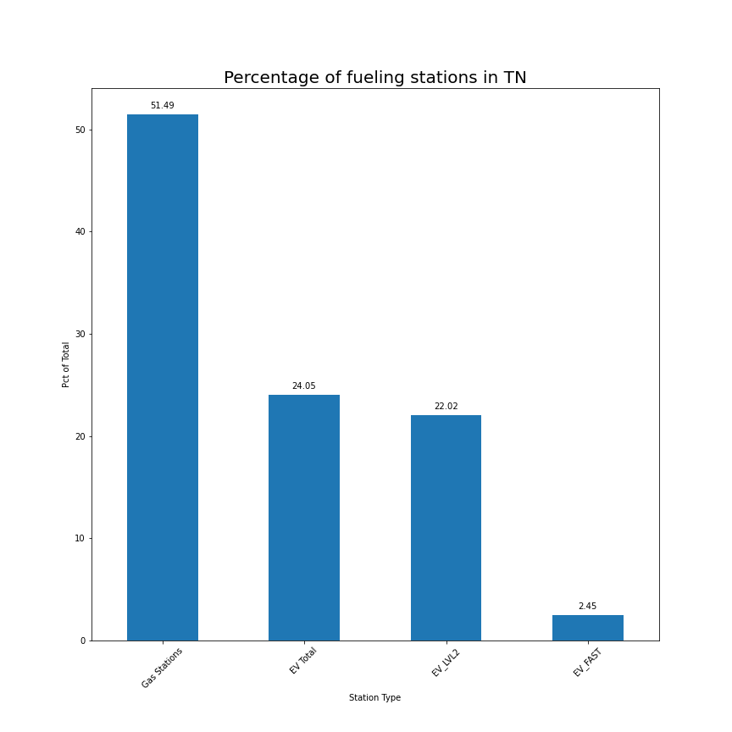
Gas VS Electric

Slide 6
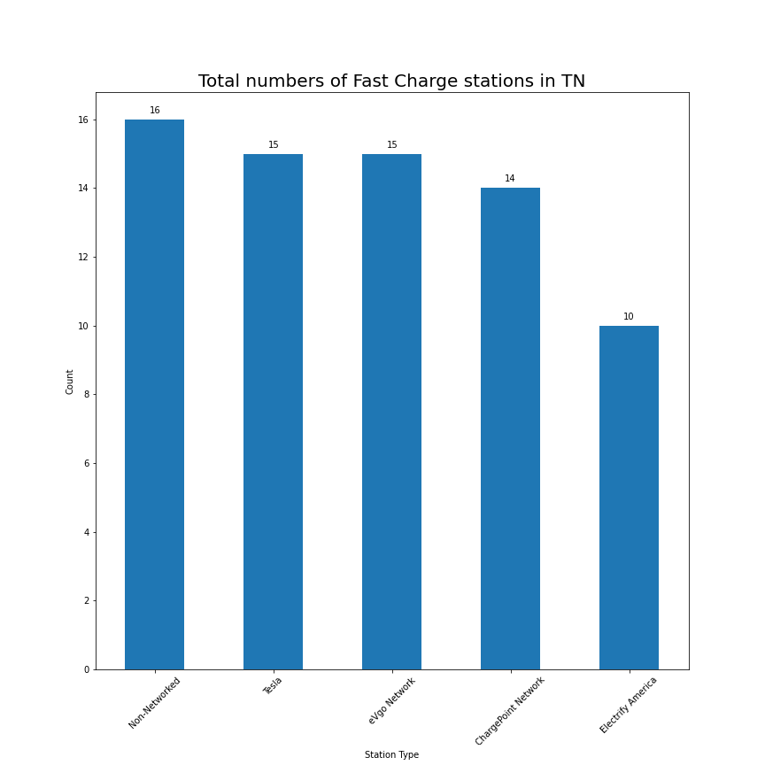
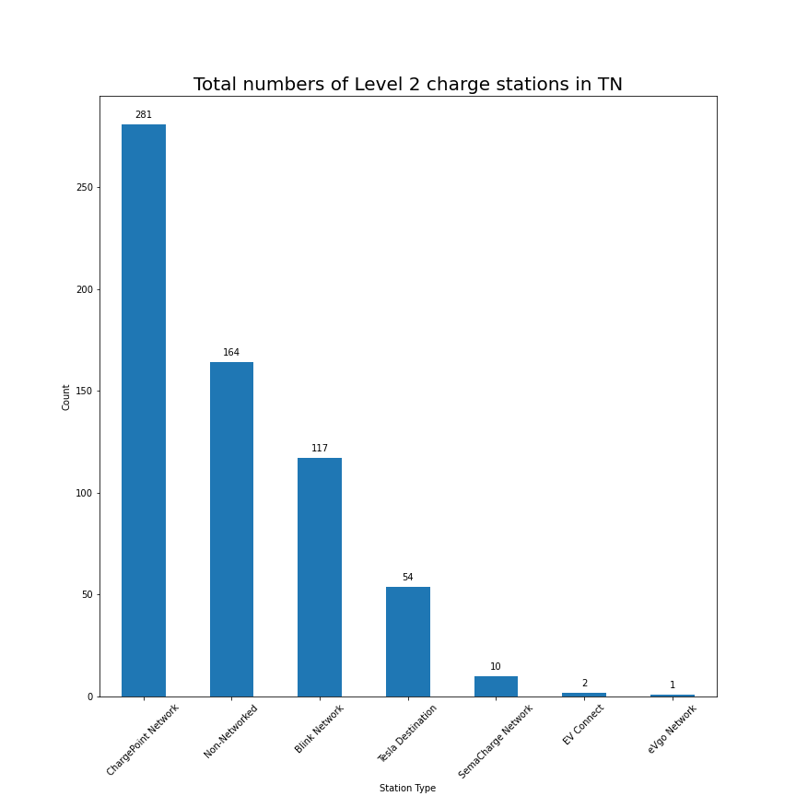
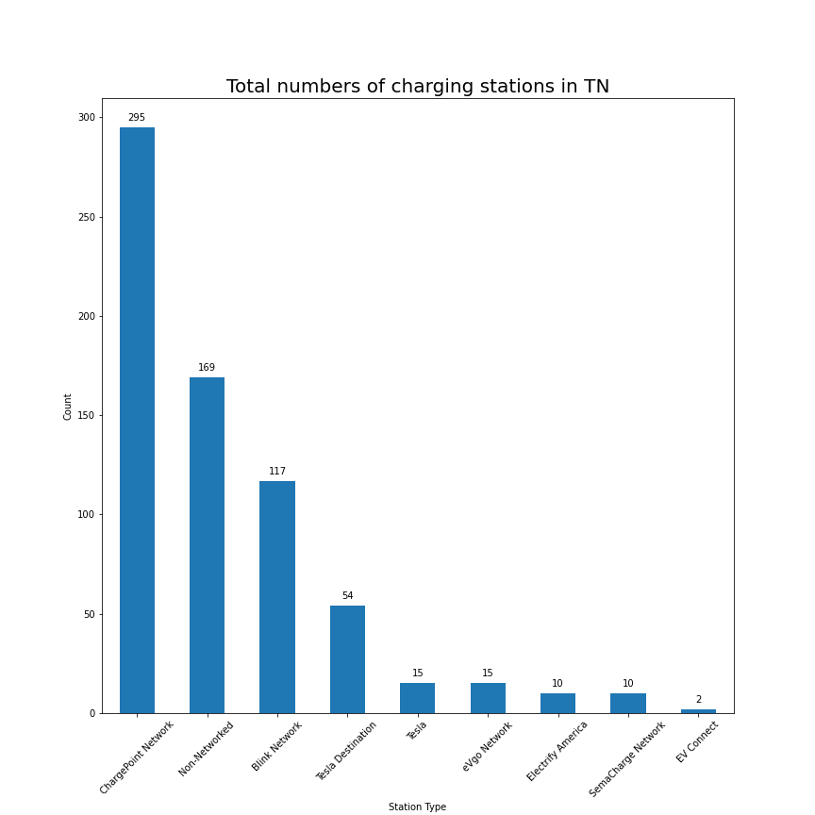
Electric Only

Slide 7
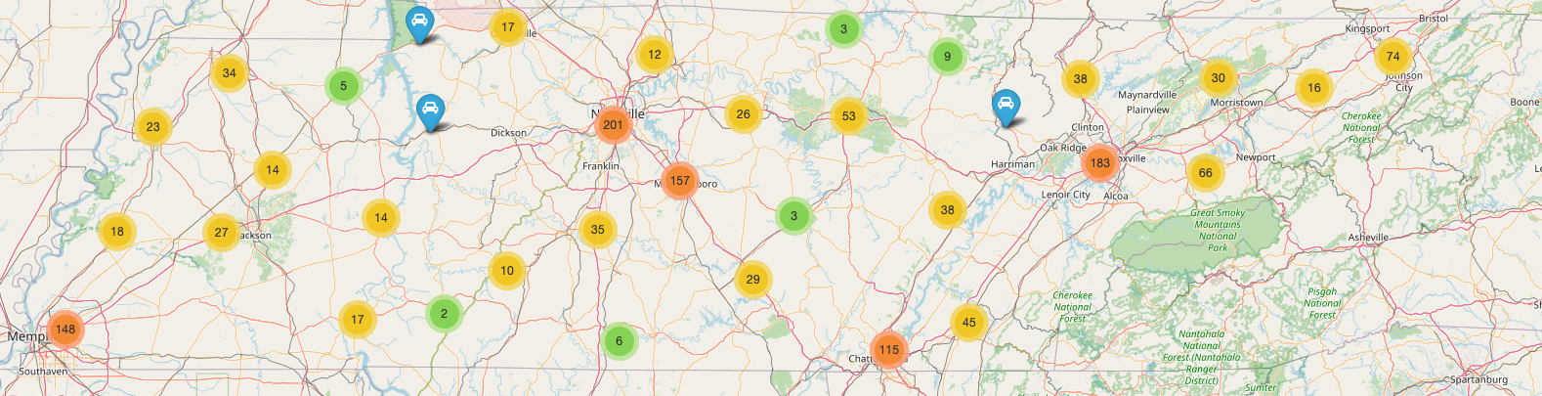
Map of Tennessee Gas Stations

Slide 8
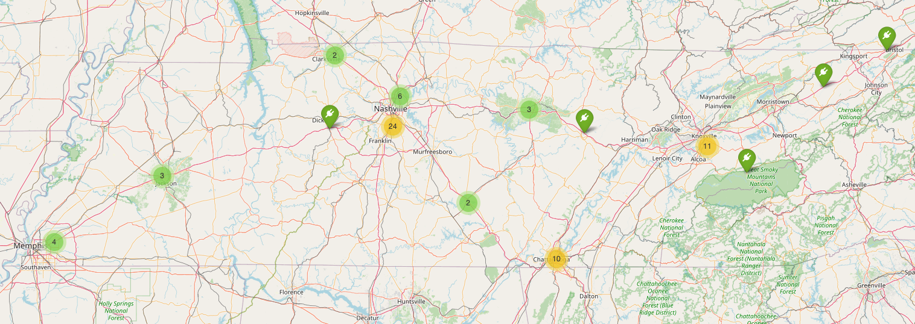
Map of Tennessee EV High Speed Chargers

Slide 9
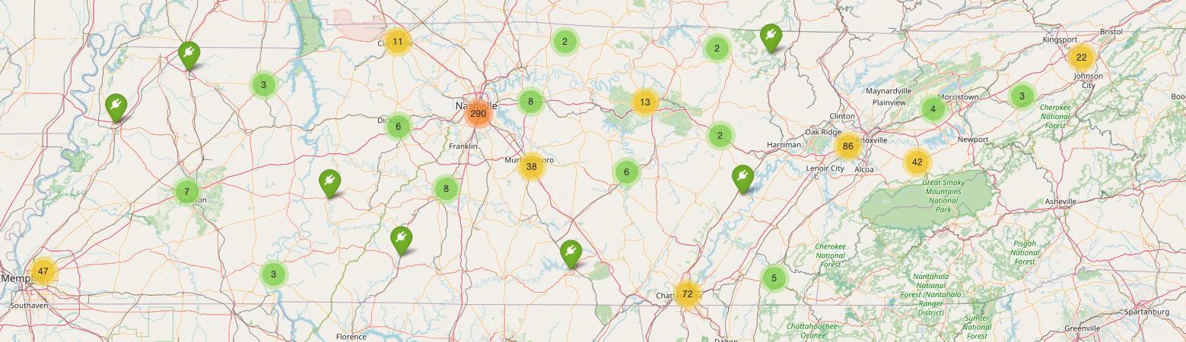
Map of Tennessee EV Chargers

Slide 10
Conclusions
If you live in or near a major urban area things are fairly good already and look like they are keeping track with the rate of growth in the over all car market.
If you live in a rural area and don’t have access to your own garage charging, your best bet currently is to either find a nearby level 2 charger, make do with very slow level 1 charging, or figure out how to convince your landlord to let you install a 240 outlet outside to charge from.
The “in between” areas need to be filled in with more chargers as the major networks like Tesla and Electrify America expand.
More needs to be done to standardize plug to a standard, probably CCS, so that all cars can use all chargers without adapters.

Slide 11

Live Map Demo

Slide 12
References and Sources

