Slide 1
Network Layer:
Logical Addressing
19.<number>

Slide 2
19-1 IPv4 ADDRESSES
An IPv4 address is a 32-bit address that uniquely and universally defines the connection of a device (for example, a computer or a router) to the Internet.
Topics discussed in this section:
Address Space
Notations
Classful Addressing
Classless Addressing
Network Address Translation (NAT)

Slide 3

Note
An IPv4 address is 32 bits long.

Slide 4
Note
The IPv4 addresses are unique
and universal.

Slide 5
Note
The address space of IPv4 is
2³² or 4,294,967,296.

Slide 6

Figure 19.1 Dotted-decimal notation and binary notation for an IPv4 address

Slide 7


Example 19.1
Change the following IPv4 addresses from binary notation to dotted-decimal notation.
Solution
We replace each group of 8 bits with its equivalent decimal number (see Appendix B) and add dots for separation.

Slide 8
Example 19.2
Change the following IPv4 addresses from dotted-decimal notation to binary notation.
Solution
We replace each decimal number with its binary equivalent (see Appendix B).

Slide 9
Note
In classful addressing, the address space is divided into five classes:
A, B, C, D, and E.

Slide 10

Figure 19.2 Finding the classes in binary and dotted-decimal notation

Slide 11
Example 19.4
Find the class of each address.
a. 00000001 00001011 00001011 11101111
b. 11000001 10000011 00011011 11111111
c. 14.23.120.8
d. 252.5.15.111
Solution
a. The first bit is 0. This is a class A address.
b. The first 2 bits are 1; the third bit is 0. This is a class C
address.
c. The first byte is 14; the class is A.
d. The first byte is 252; the class is E.

Slide 12
Note
In classful addressing, a large part of the available addresses were wasted.

Slide 13
Classless Addressing

Slide 14
Note
In classful addressing, a large part of the available addresses were wasted.
Classful addressing, which is almost obsolete, is replaced with classless addressing.

Slide 15
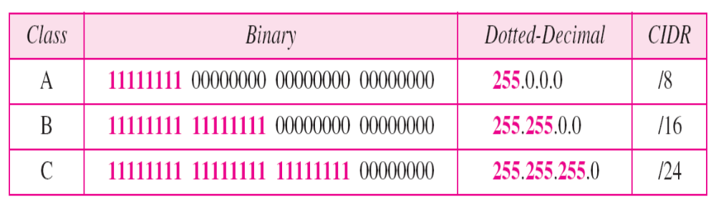
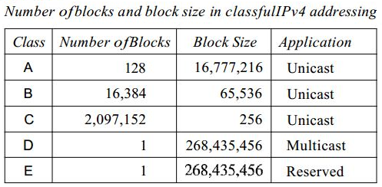
Default masks for classful addressing

Slide 16
In IPv4 addressing, a block of addresses can be defined as –
x.y.z.t /n
in which x.y.z.t defines one of the addresses and the /n defines the mask.

Slide 17
Note
The number of addresses in the block can be found by using the formula
2^{32−n}.

Slide 18
Example 19.8
Find the number of addresses 205.16.37.39/28 of Example 19.6.

Slide 19
Example 19.8
Find the number of addresses 205.16.37.39/28 of Example 19.6.
Solution
The value of n is 28, which means that number
of addresses is 2 ³²⁻²⁸ or 16.

Slide 20
The first address in the block can be found by setting the rightmost 32 − n bits to 0s.
The last address in the block can be found by setting the rightmost 32 − n bits to 1s.

Slide 21
Example 19.6
A block of addresses is granted to a small organization. We know that one of the addresses is 205.16.37.39/28. What is the first address in the block?

Slide 22
Example 19.6
A block of addresses is granted to a small organization. We know that one of the addresses is 205.16.37.39/28. What is the first address in the block?
Solution
The binary representation of the given address is
11001101 00010000 00100101 00100111
If we set 32−28 rightmost bits to 0, we get
11001101 00010000 00100101 0010000
or
205.16.37.32.
This is actually the block shown in Figure 19.3.

Slide 23
Example 19.7
A block of addresses is granted to a small organization. We know that one of the addresses is 205.16.37.39/28. What is the last address in the block?

Slide 24
Example 19.7
A block of addresses is granted to a small organization. We know that one of the addresses is 205.16.37.39/28. What is the last address in the block?
Solution
The binary representation of the given address is
11001101 00010000 00100101 00100111
If we set 32 − 28 rightmost bits to 1, we get
11001101 00010000 00100101 00101111
or
205.16.37.47
This is actually the block shown in Figure 19.3.

Slide 25
Subnetting with class-C address – 192.168.100.0/25

Slide 26
Subnetting with class-C address – 192.168.100.0/25
Number of N/W bits: 25
Number of host bits: 7
N/W bits used from host : 1
Number of subnets: 2¹=2

Slide 27
Subnetting with class-C address – 192.168.100.0/25
Number of N/W bits: 25
Number of host bits: 7
N/W bits used from host : 1
Number of subnets: 2¹=2
Subnet Mask: 255.255.255.128
11111111. 11111111. 11111111.10000000

Slide 28
Subnetting with class-C address – 192.168.100.0/25
Number of N/W bits: 25
Number of host bits: 7
N/W bits used from host : 1
Number of subnets: 2¹=2
Subnet Mask: 255.255.255.128
11111111. 11111111. 11111111.10000000
Number of addresses in a subnet: 2⁷ = 128
Number of hosts in a subnet: 2⁷-2 = 126

Slide 29
Subnetting with class-C address – 192.168.100.0/25
Number of addresses in a subnet: 2⁷ = 128
Number of hosts in a subnet: 2⁷-2 = 126
Subnet ID / Network ID of subnet | Last Octet in Binary | Broadcast ID | Number of Hosts | First address in network | Last address in network
192.168.100.0 | 192.168.100.00000000 | 192.168.100.01111111 192.168.100.127 | 126 | 192.168.100.00000001 192.168.100.1 | 192.168.100.01111110 192.168.100.126
192.168.100.128 | 192.168.100.10000000 | 192.168.100.11111111 192.168.100.255 | 126 | 192.168.100.10000001 192.168.100.129 | 192.168.100.11111110 192.168.100.254

Slide 30
Example 19.9
Another way to find the first address, the last address, and the number of addresses is to represent the mask as a 32-bit binary (or 8-digit hexadecimal) number. This is particularly useful when we are writing a program to find these pieces of information. For 205.16.37.39/28 the /28 can be represented as
11111111 11111111 11111111 11110000
(twenty-eight 1s and four 0s).
Find
a. The first address
b. The last address
c. The number of addresses.

Slide 31

Example 19.9 (continued)
Solution
a. The first address can be found by ANDing the given
addresses with the mask. ANDing here is done bit by
bit. The result of ANDing 2 bits is 1 if both bits are 1s;
the result is 0 otherwise.

Slide 32

Example 19.9 (continued)
b. The last address can be found by ORing the given
addresses with the complement of the mask. ORing
here is done bit by bit. The result of ORing 2 bits is 0 if
both bits are 0s; the result is 1 otherwise. The
complement of a number is found by changing each 1
to 0 and each 0 to 1.

Slide 33

Figure 19.4 A network configuration for the block 205.16.37.32/28

Slide 34
Note
The first address in a block is
normally not assigned to any device;
it is used as the network address that represents the organization
to the rest of the world.

Slide 35

Figure 19.6 A frame in a character-oriented protocol

Slide 36
Note
Each address in the block can be considered as a two-level
hierarchical structure:
the leftmost n bits (prefix) define
the network;
the rightmost 32 − n bits define
the host.

Slide 37

Figure 19.7 Configuration and addresses in a subnetted network

Slide 38

Figure 19.8 Three-level hierarchy in an IPv4 address

