Slide 1
GAN and game

Slide 2
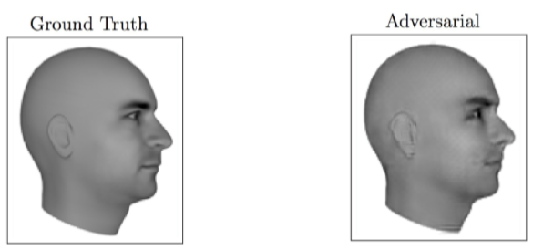
Magic of GANs

Slide 3
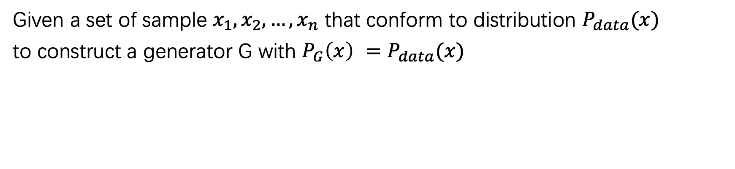
Objective
Given a set of sample $x_{1},x_{2}, …,x_{n}$ that conform to distribution $P_{data}(x)$
to construct a generator G with ${P_{G}\left(x\right) =P}_{data}(x)$

Slide 4
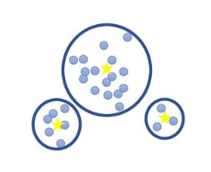
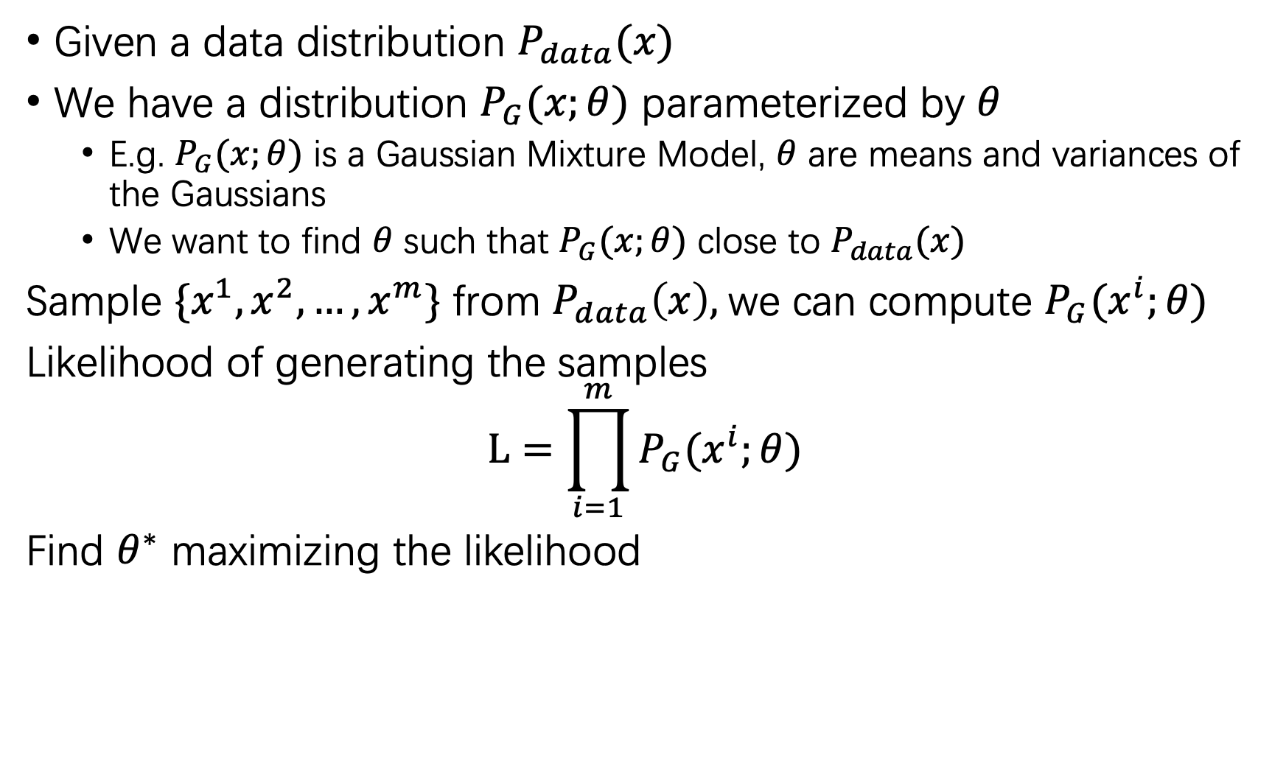
Maximum Likelihood Estimation
Given a data distribution $P_{data}(x)$
We have a distribution $P_{G}(x;θ)$ parameterized by $θ$
E.g. $P_{G}(x;θ)$ is a Gaussian Mixture Model, $θ$ are means and variances of the Gaussians
We want to find $θ$ such that $P_{G}(x;θ)$ close to $P_{data}(x)$
Sample $\{x^{1}, x^{2}, …, x^{m}\}$ from $P_{data}\left(x\right),$we can compute $P_{G}(x^{i};θ)$
Likelihood of generating the samples
$$L=\prod_{i=1}^{m}{P_{G}(x^{i};θ) }$$
Find $θ^{∗}$ maximizing the likelihood

Slide 5
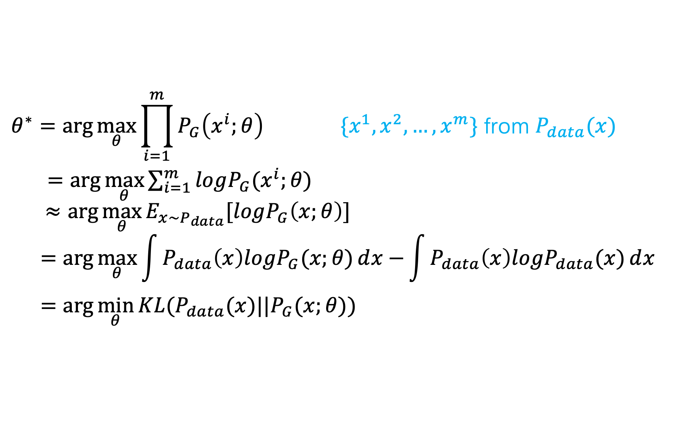
Maximum Likelihood Estimation
$$θ^{∗}=\arg{\max_{θ}{\prod_{i=1}^{m}{P_{G}\left(x^{i};θ\right)}}} \{x^{1}, x^{2}, …, x^{m}\} \text{from} P_{data}(x)$$
$=\arg{\max_{θ}{\sum_{i=1}^{m}{logP_{G}(x^{i};θ)}}}$
$$≈\arg{\max_{θ}{E_{x\sim P_{data}}[logP_{G}\left(x;θ\right)]}}$$
$$=\arg{\max_{θ}{\int{P_{data}\left(x\right)logP_{G}(x;θ)ⅆx}−}}\int{P_{data}\left(x\right)logP_{data}(x)ⅆx}$$
$$=\arg{\min_{θ}{KL(P_{data}(x)||P_{G}(x;θ))}}$$

Slide 6
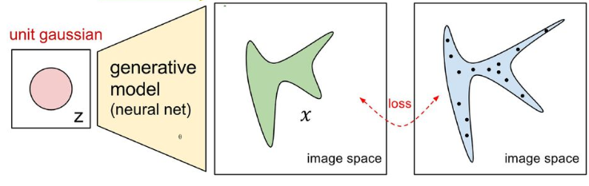
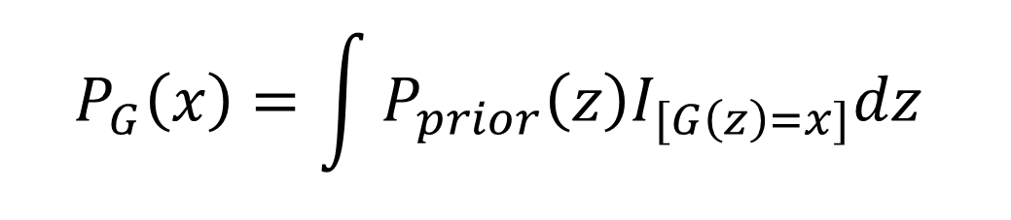




Now $P_{G}(x;θ)$ is a NN
$$P_{G}(x;θ)$$
Generated distribution
$$P_{data}(x)$$
True data distribution
$$G\left(z\right)=x$$
$$P_{G}\left(x\right)=\int{P_{prior}\left(z\right)I_{[G\left(z\right)=x]}dz}$$
It is difficult to compute the likelihood.

Slide 7
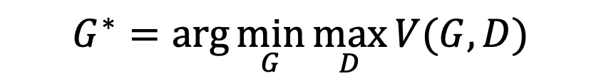
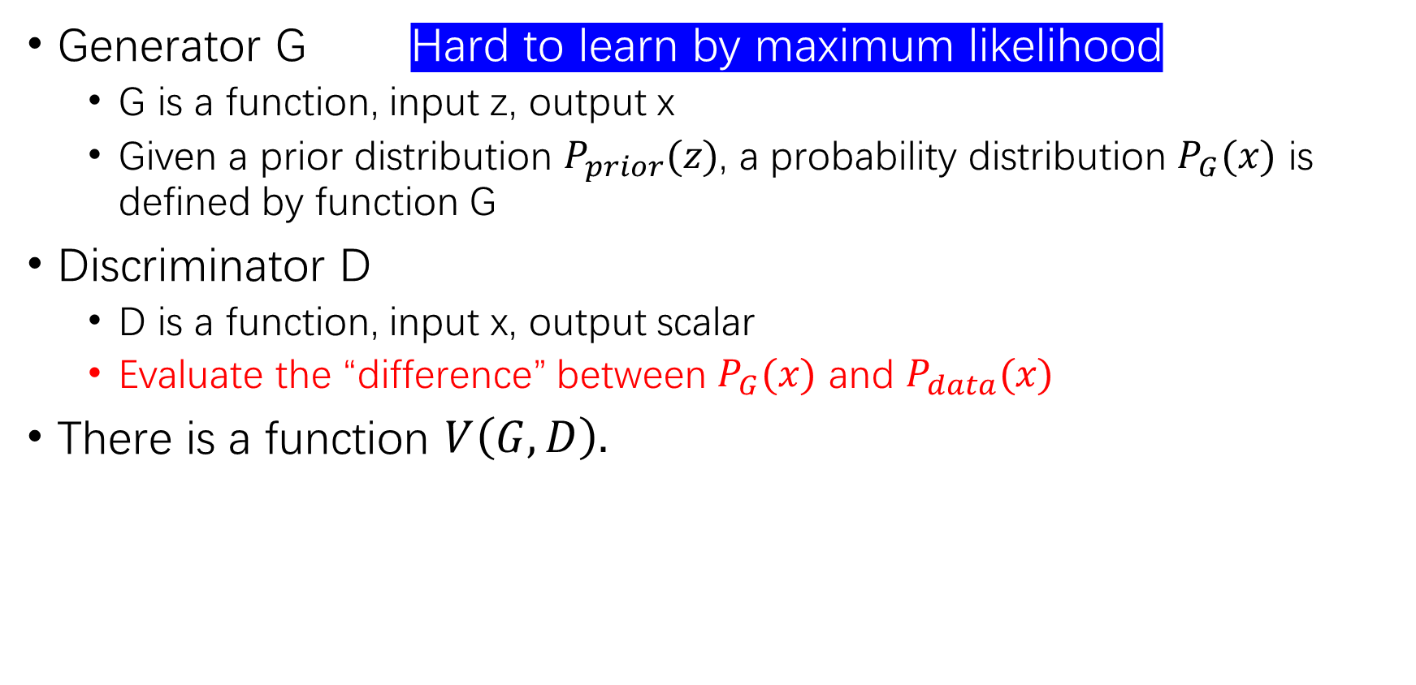
Basic Idea of GAN
Generator G Hard to learn by maximum likelihood
G is a function, input z, output x
Given a prior distribution $P_{prior}(z)$, a probability distribution $P_{G}(x)$ is defined by function G
Discriminator D
D is a function, input x, output scalar
Evaluate the “difference” between $P_{G}(x)$ and $P_{data}(x)$
There is a function $V\left(G, D\right).$
$$G^{∗}=\arg{\min_{G}{\max_{D}{V(G, D)}}}$$
$$V(G,D)=E_{x\sim P_{data}}\left[logD\left(x\right)\right]+E_{x\sim P_{G}}[\log\left(1−D\left(x\right)\right)]$$

Slide 8
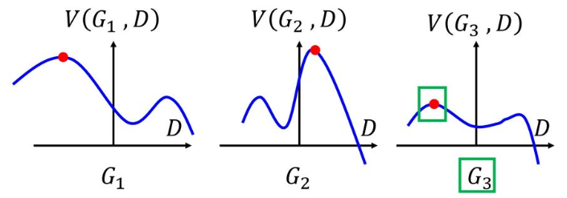
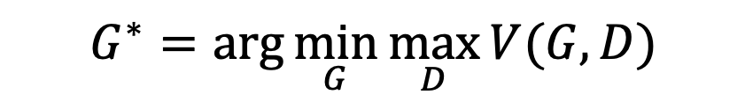
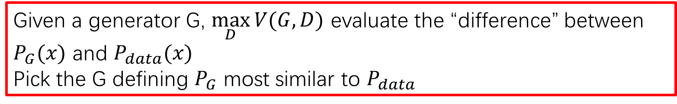
Basic Idea
$$G^{∗}=\arg{\min_{G}{\max_{D}{V(G, D)}}}$$
$$V(G,D)=E_{x\sim P_{data}}\left[logD\left(x\right)\right]+E_{x\sim P_{G}}[\log\left(1−D\left(x\right)\right)]$$
Given a generator G, $\max_{D}{V(G, D)}$ evaluate the “difference” between $P_{G}(x)$ and $P_{data}(x)$
Pick the G defining $P_{G}$ most similar to $P_{data}$

Slide 9
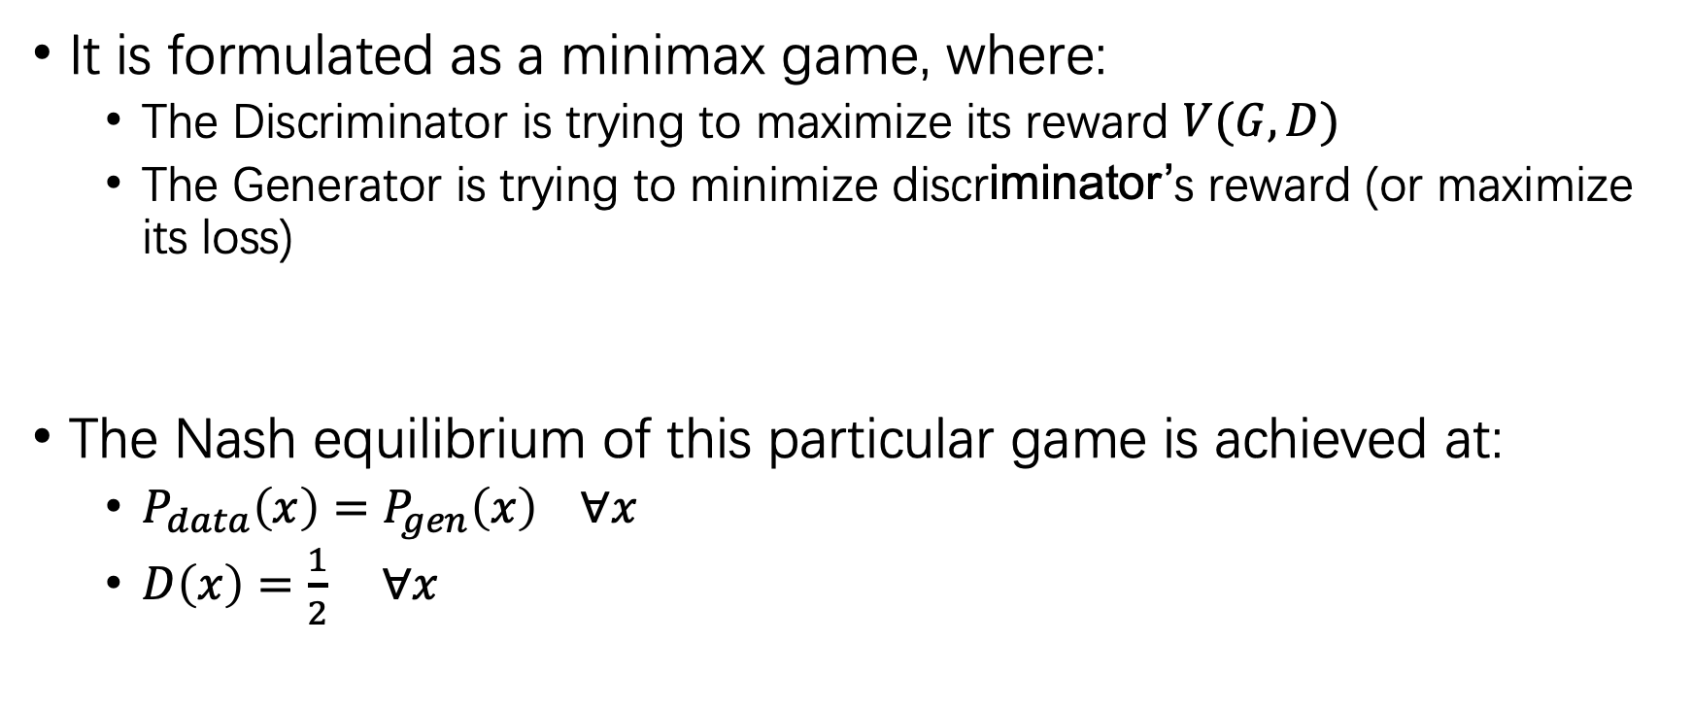

Basic idea
$$G^{∗}=\arg{\min_{G}{\max_{D}{V(G, D)}}}$$
It is formulated as a minimax game, where:
The Discriminator is trying to maximize its reward $V(G, D)$
The Generator is trying to minimize discriminator’s reward (or maximize its loss)
The Nash equilibrium of this particular game is achieved at:
$P_{data}\left(x\right)=P_{gen}\left(x\right) ∀x$
$D\left(x\right)=\frac{1}{2}$ $∀x$
$$V=E_{x\sim P_{data}}\left[logD\left(x\right)\right]+E_{x\sim P_{G}}[\log\left(1−D\left(x\right)\right)]$$

Slide 10
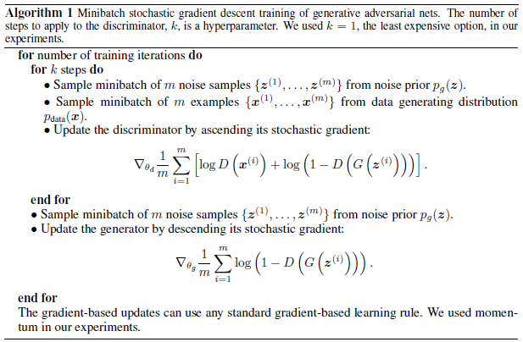
Discriminator updates
Generator updates

Slide 11
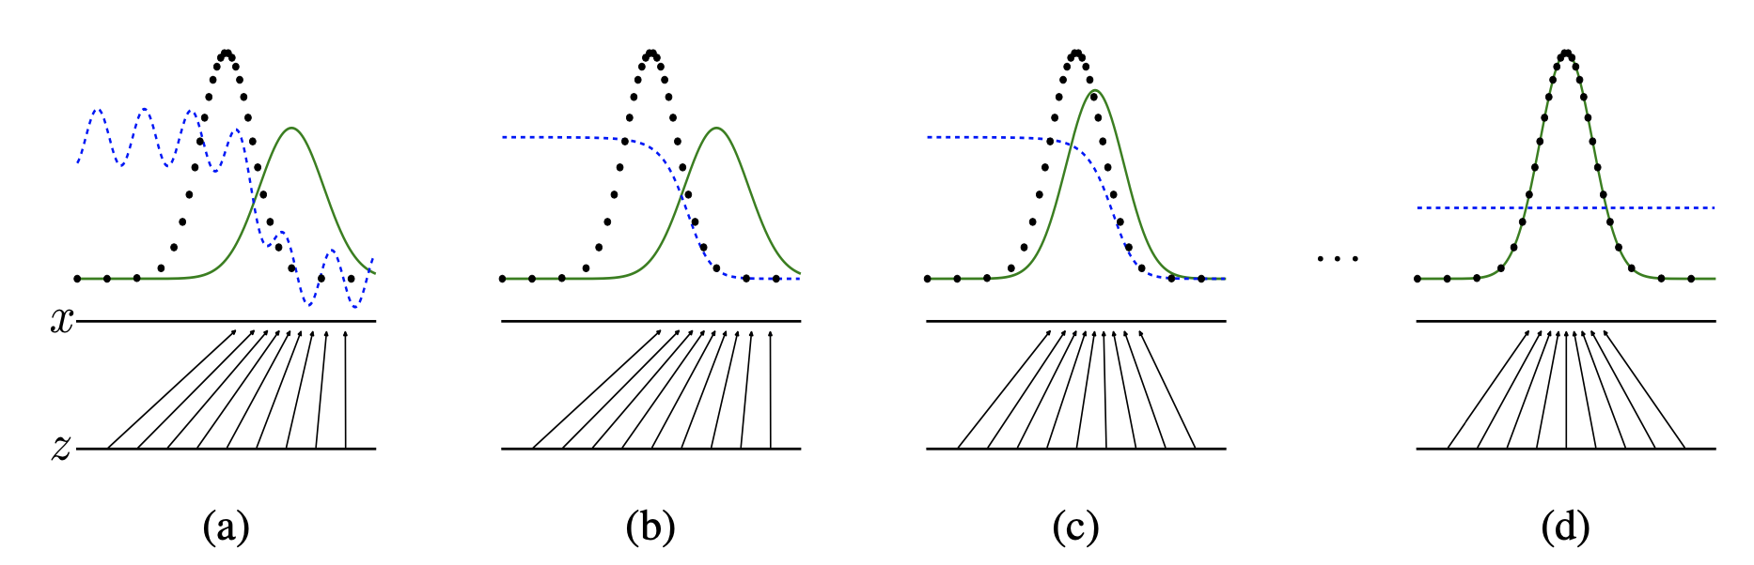




Diagram
$P_{data}(x)$
$P_{G}(x)$
$D(x)$
$$G(z)$$

Slide 12
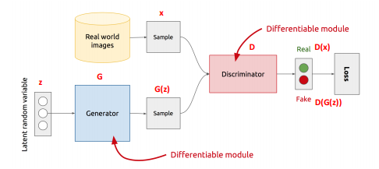
GAN’s Architecture
z is some random noise (Gaussian/Uniform)
z can be thought as the latent representation of the image.

Slide 13
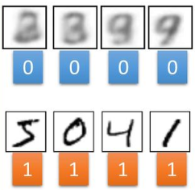
GAN – Training Discriminator
Randomly
Sample a vector
NN Generator v1
Something like Decoder in VAE
Real images:
Discriminator
v1
image
1/0 (real or fake)
According to label

Slide 14

GAN – Training Generator
Randomly
Sample a vector
Updating
the parameters of generator
NN Generator v1
v2
The output of generator should be classified as “real” as possible
Generator + Discriminator
= a net work
Discriminator v1
Using gradient descent to update the parameters in the generator, but fix the discriminator
0.13
1.0

Slide 15
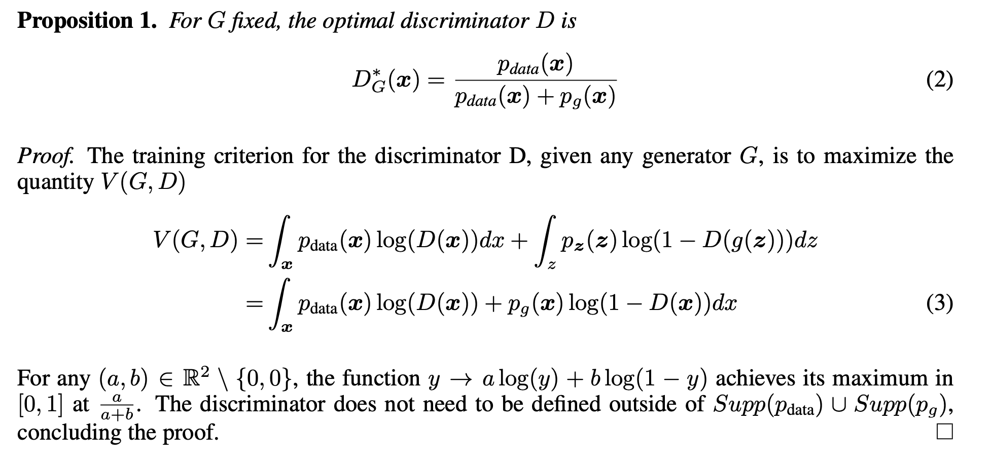
Theoretical results

Slide 16
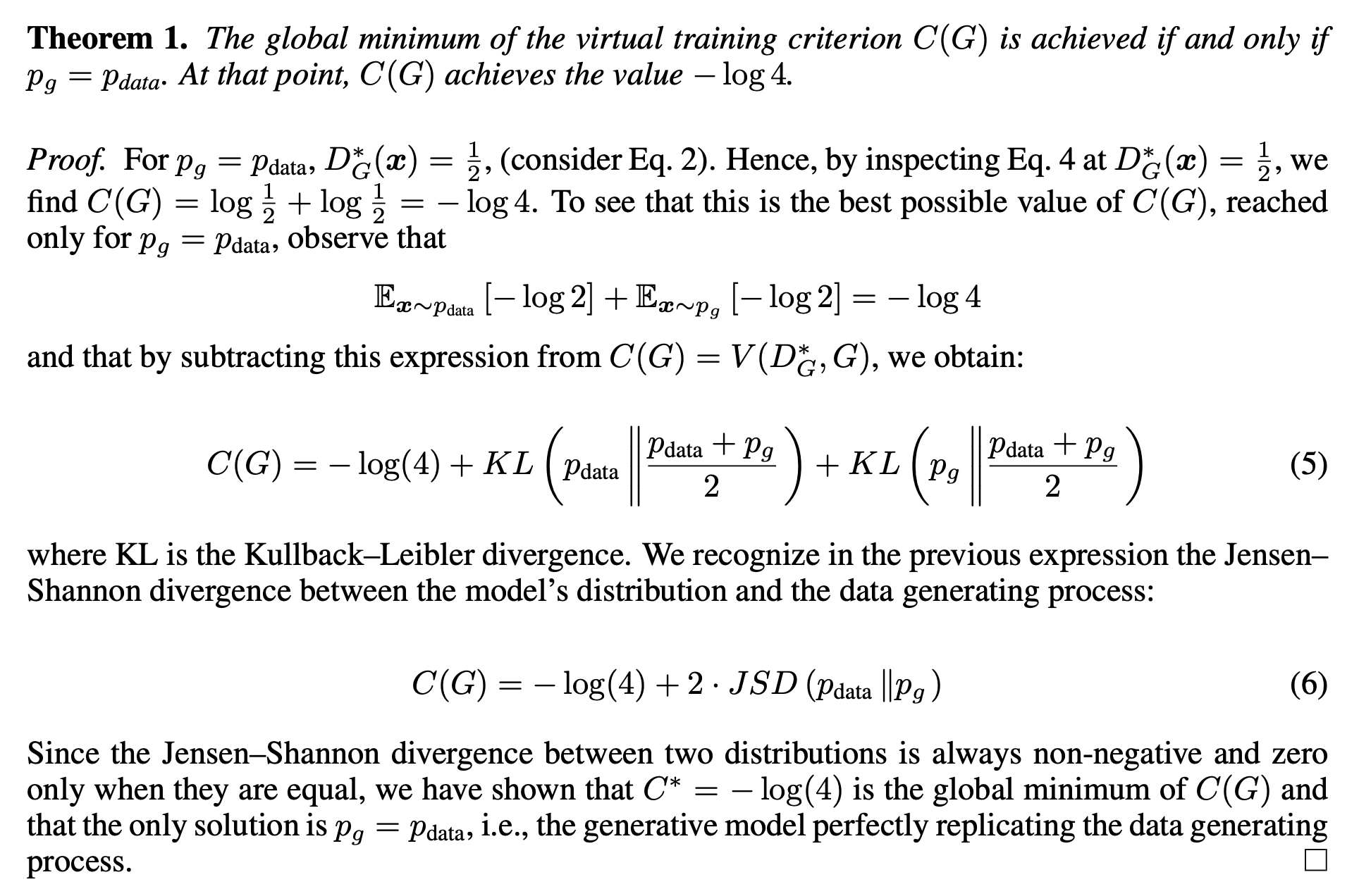

Slide 17
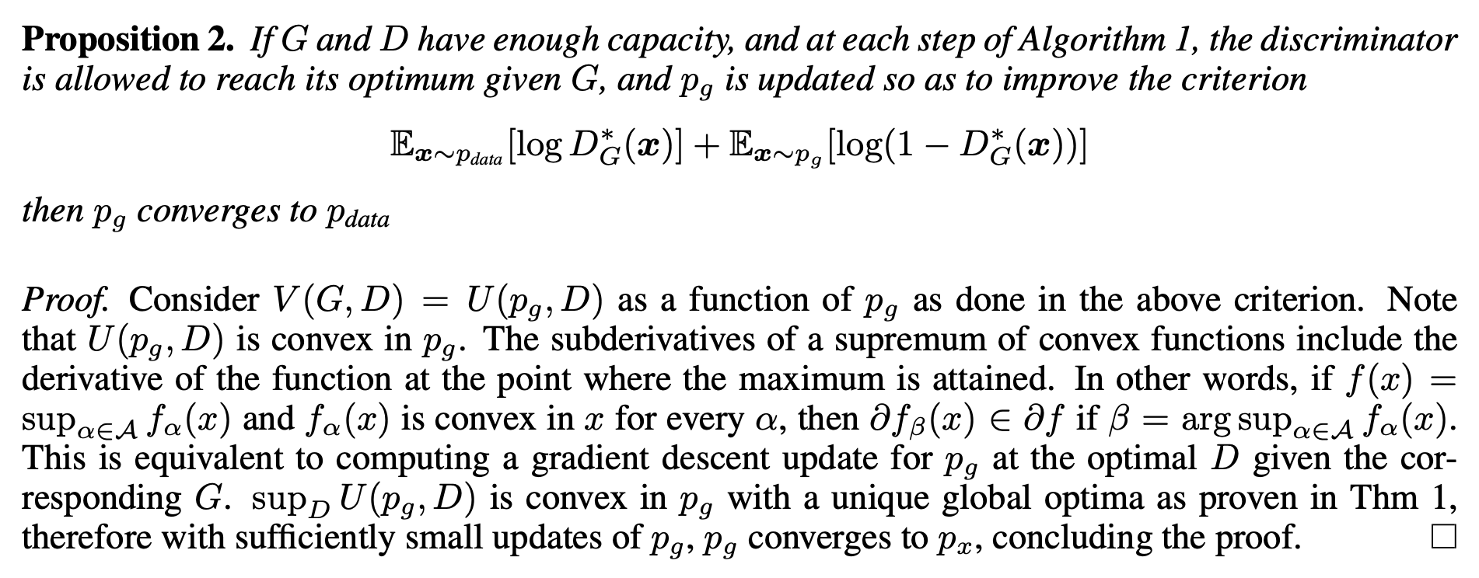
Convergence of the algorithm

Slide 18

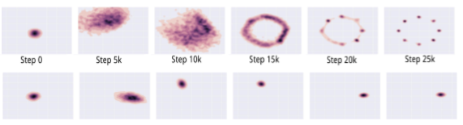
Mode-Collapse
Generator fails to output diverse samples
Target
Expected
Output

Slide 19
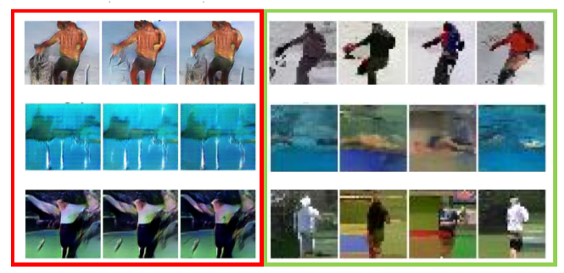
Some real examples

