Slide 1
Can you save the Republic of Koyash/Kingdom of Tiamat?
Game theory through role play

Slide 2
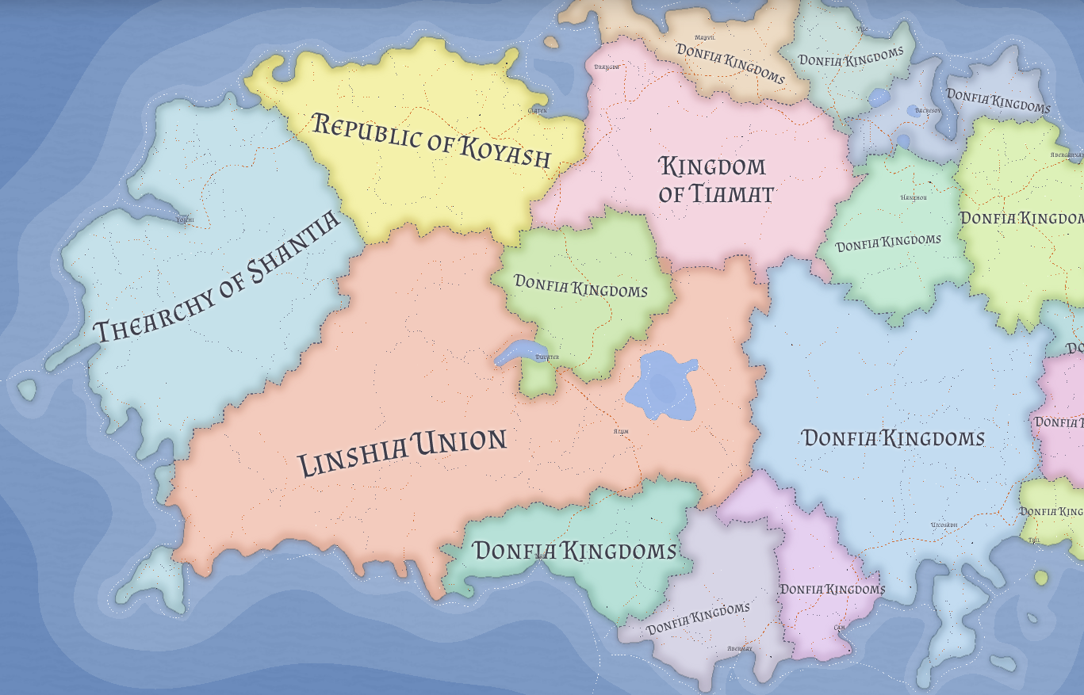

Slide 3
Republic of Koyash/Kingdom of Tiamat
The death of empires leaves chaos in their wake. The downfall of the Megiddoin Empire was no different
Foolish overseas military adventure lead to the collapse of the government and a decade long civil war
The international community stepped in and carved the dying empire into new countries following geographic lines.
It falls to you, the new government, to lead your country. But will you achieve greatness or repeat the mistakes of your ancestors?

Slide 4
Republic of Koyash/Kingdom of Tiamat
Both countries are
  Economically poor
  Low levels of female empowerment
  Outdated educational facilities
  Lack of democratic principals
  Highly discriminatory laws based on ethnic and religious identity.

Slide 5
Your Neighbours
Linshia Union
  Atheistic autocracy, centered around a strong leader and cabinet that controls most of the state.
  While controlled at home they offer military and economic assistance to other countries with no additional upfront requirements
Thearchy of Shantia
  Part of the Maastricht Khaganate – a group of states that have agreed to sacrifice some of the autonomy in order to cooperate on common economic and security goals
  Secular and progressive
  Offer significant economic and social aid, but in exchange for systematic reforms to align your politics with theirs
Donfia Kingdoms
  A collection of tribal kingdoms, mostly secular and moving towards The Maastricht Khaganate for economic growth and cultural standards
  Represents multiple ethic identities that became independent when the Megiddoin Empire collapsed

Slide 6
The games
There will be a series of events that happen to both countries, you as a group will need to decide the direction of your country.
The games are split into 2 phases
  These start with a blind bidding game
  This is followed by a series of events that effect the future of your country.
    The outcomes of these events will depend on your decisions for the blind bidding game at the beginning. Of the phase
There is 1 additional choice of international partners. The choice in phase 1 will have an impact on political points for phase 2

Slide 7
Blind Bidding
You start with 15 points of political power.
This power can be spent in the following categories:
  Economy
  Military
  Security
  Welfare
  Education
Each category can have a maximum of 10 power spent
You will need to decide as a group how to spend that power
Some decisions will be locked out by the amount you send on categories
If any category drops below 0 you lose

Slide 8
Events
In each event there will be a series of options
Some options are restricted by your spending on political points
You can choose the “worst” option in exchange for the other country to take a “worst” option later on – but they do not have to…
Some choices may have effects on later events…
The early events will have restricted on your options, later events will allow you to be more dynamic with your decisions

Slide 9
Event 1 – Linshia Union has attacked our neighbouring Donfia Kingdom, Refugees are heading towards our boarders, what do you do?
Place the military on the boarder (military score >= 6 points) This forces refugees to go to the other country (Koyash/Tiamat)
Allow all the refugees into your country (large impacts on welfare, education, economy, and security) – welfare spending will influence the result.
Negotiate with other country (Koyash/Tiamat) to take half the refugees each (lower impact on welfare, education, economy, and security)
Negotiate with other country (Koyash/Tiamat) for them to take all the refugees in exchange for some economic support

Slide 10
Refugee results
-1 in Military points
  Get 2 new political power points to spend – force other team to choose option 2
IF welfare < 5,
  -2 in welfare, education, economy, and security points
  Get 1 new political power point to spent
  Else
  -1 welfare
(successful) -1 in welfare, education, economy, and security points
  Get 2 new political power points to spend from cooperation.
(successful) your country – 1 economy, other country -1 welfare
Get 2 new political power points to spend from cooperation.

Slide 11
Event 2 – Oil has been discovered, but the deposit sits in the middle of both Koyash's and Tiamat's EEZ
Try to take all the resources for yourself (will lead to either a conflict with other country if they also choose this option)
Seek to cooperate with the other country and share the construction costs and profits equally
Seek cooperation but only to share profits, only apply minimal input into the construction costs

Slide 12
Cooperation payout
Koy/Tia | Cooperate | Defect
Cooperate | +1 econ, -1 sec + 1 PPP / +1 econ, -1 sec + 1 PPP | + 2 econ + 2 PPP / +1 econ, -1 sec
Defect | +1 econ, -1 sec / + 2 econ, + 2 PPP | -2 econ / -2 econ

Slide 13
Refugee Bonus round!
When taking in refugees, there is always a chance that there is a proportion of highly educated or skilled workers who want to support their host country
Dice roll boosts
If you took all the refugees on a 3+ dice roll get + 3 PPP
If you took some refugees on a 5+ dice roll get + 2 PPP

Slide 14
Conflict decider
Military x2 of other country | -1 Mil, + 2 econ, +2 PPP / - 2 Mil, +1 PPP
Military x1.5 of other country | -1 Mil, - 1 econ, + 2 PPP (both)
Military less than 1.5 of other county | -2 Mil, -2 econ, + 1 PPP (both)

Slide 15
Event 3 – Disease outbreak in Koyash
A virulent disease has broken out in Koyash and threatens to spread into Tiamat
01
If Koyash's Welfare is > 6 they can control the disease without assistance
02
Otherwise, Tiamat needs to decide if they are going to support (high or low) Koyash with their healthcare needs or abandon them to their fates
03

Slide 16
Disease results
 | Koyash effects | Tiamat effects
Tiamat decides to fully help | -1 welfare, + 1 PPP | -1 welfare, + 1 PPP
Tiamat provides some aid | -2 welfare, + 1 PPP | + 1 PPP
Tiamat refuses all aid | -3 welfare, - 1 sec, -1 econ | + 2 PPP roll dice: 2+ disease flows over the boarder – 1 welfare, 4+ major outbreak – 3 welfare, -1 sec, -1 econ

Slide 17

Event 4 – Armed militant group in Tiamat
Riots have broken out in Tiamat, a regional group is unhappy about the lack of representation in Government and has turned violent
If Tiamat's Security is > 6 they can control the riots without assistance
Otherwise, Koyash needs to decide if they are going to support Tiamat with their militant groups, abandon them to their fates, or support militant groups

Slide 18
Armed militant results
 | Tiamat effects | Koyash effects
Koyash decides to fully help | -1 Mil, -1 sec, + 2 PPP | -1 Mil, + 1 PPP
Koyash provides some aid | -2 Mil, -2 sec, + 1 PPP | + 1 PPP
Koyash refuses all aid | -3 Mil, - 1 welfare, - 1 sec, -1 econ | + 2 PPP roll dice: 4+ major attacks – 2 Mil, -1 welfare, -1 sec, -1 econ
Koyash supports Militants | 3 Mil, - 3 sec, - 2 econ | Access to new resources + 1 econ, + 2 PPP

Slide 19
Event 5 – Reseach Program
The Thearchy of Shantia has offered a joint research program with investment into your education system, however there are some strings attached at the funding is being provided by the Maastricht Khaganate
If you agree to cooperate with one of these options, costs will be halved.

Slide 20
Joint Reseach Options
Enter into research project unilaterally (education score >=6 )
Full scale reform of education system with universal education for children of all genders until age 18
Economic reforms with market liberalisations
Governmental reforms with anti corruption methods institutions pushing for democratic reforms
Reject research proposal

Slide 21
JR results
+ 2 Edu, + 2 PPP
1
-2 Mil, - 2 Econ, + 3 Edu, + 1 PPP
(-1 Mil, -1 Econ, + 3 Edu, + 2 PPP if jointly agreed)
2
+ 1 Econ, + 1 Edu, - 2 Welfare + 1 PPP
(+ 1 Econ, + 1 Edu, -1 Welfare, + 1PPP if jointly agreed)
3
+ 1 Edu, + 1 Sec, + 1 Welfare, - 2 Mil, - 2 Econ + 1 PPP
(+ 1 Edu, + 1 Sec, + 1 Welfare, -1 Mil, - 1 Econ, + 1 PPP if jointly agreed)
4
- 1 Edu, - 1 Econ, + 2 Mil, + 1 Sec
5

Slide 22
End of Phase 1
So far decisions have been restricted to a series of options. Which should have helped guide you through the ideas of cooperation vs non-cooperation
As we enter phase 2, decision making processes will be up to you, do you cooperate or betray?
This section will also be more narrative focus, as you guide your country through
And the scores? Country with the highest combined score at the end of Phase 2 wins

Slide 24
Phase 2 story
You thought the militant uprising in Tiamat was an isolated event. But rebellion and revolutions have been spreading like wildfire through the Donfia Kingdoms. Formally secular regimes have been replaced by regressive dictatorships.
Linshia Union has increased its military spending, seeking to disrupt the interests of Thearchy of Shantia by sending older military equipment to support these new regimes.

Slide 25
Event 6 - Choosing sides
Work together or apart – will you seek to cooperate with each other for protection or align yourself with Thearchy of Shantia, Linshia Union, or the Donfia Kingdoms?

Slide 26
Choosing Sides Results
Cooperate with each other (both must agree) | + 5 PPP
Thearchy of Shantia | + 1 Econ, + 1 Welfare, + 1 Edu, - 2 Mil If you have JRP: + 1 PPP
Linshia Union | + 2 Mil, + 1 Econ, + 1 Welfare, - 1 Edu If you have refugees: -2 Sec with protests
Donfia Kingdoms | -3 Edu, + 1 Mil, -2 Econ
No cooperation | +2 PPP

Slide 27
Event 7 – Airport Shooting
Koyash's international airport was attacked by unknown forces elements. Several civilians and security officers were killed in the attack. Devise a response based on your current scores in each category.
Koyash – 2 Sec

Slide 28
Event 7 Results
Any act in isolation leads to –2 in that category as resources are expended. Gain + 1 PPP
If the action is done jointly –1 to that category and + 2 PPP

Slide 29
Event 8 - Thearchy of Shantia invades Dofnia Kingdoms
Koyash wasn't the only country to be attacked. Multiple attacks happened across the Maastricht Khaganate, leading the Thearchy of Shantia to launch an invasion of several Dofnia Kingdoms.
Devise a response based on your stats and which side you chose previously.

Slide 30
Outcomes
Aligned with Dofina
  Join war –2 mil, econ, sec, + 3 PP
  Support indirect –1 econ, sec. + 1PP
  Ignore - + 2 PP
  Defect and join Maastrict - + 3 PP
Aligned with Maastrict
  Support + 1 mil, + 2 PP
  Don’t support – 2 mil, - 1 edu, -1 sec
Aligned Linshia Union
  Support indirectly –1 econ, sec. + 1PP
  Don't support - -1mil
Aligned to each other
  Join war with Maastrict –2 mil, - 2 econ + 3 PP
  Join war with Dofina - 4 mil, - 2 econ + 5 PP

Slide 31
Event 9 - Earthquake
Kingdom of Tiamat suffers a strength 9 earthquake, causing 2 major cities to collapse
Tiamat – 2 Econ.

Slide 32
Earthquake response
Koy/Tia | Cooperate | Defect
Cooperate | +1 econ, + 1 PPP / +1 econ, + 1 PPP | + 2 econ + 1 PPP / -2 econ, -1 sec
Defect | +1 econ / + 2 econ, + 2 PPP | -2 econ / -2 econ

Slide 33
Event 10 – Military coup attempt in both countries
Military officers are unhappy with the direction with your Government's actions calling for a return to the Megiddoin Empire.
The attack appears coordinated
They have taken control of a major bridge in the capital city of each country and troops are heading towards the governmental buildings.
If education > 6 AND welfare > 6 the coup attempt will automatically fail as the military won't be able to pursued the population to join its revolt
  Otherwise both countries lose – 2 sec and – 2 Mil

Slide 34
Coup Results
Koy/Tia | Cooperate | Defect
Cooperate | +1 Mil, + 1 PPP / +1 Mil, + 1 PPP | + 2 Mil + 2 PPP / -2 Mil, -1 sec
Defect | -2 Mil/ + 2 Mil, + 2 PPP | -2 Mil, -1 Edu, - 2 Econ / -2 Mil, -1 Edu, - 2 Econ

Slide 35
Who Won?

