Slide 1

R in Real Life:
Evidence from Kelli’s Job Market Paper

Slide 2

Context
Data: digitized clinical texts
Method: Text Analysis & Natural Language Processing (NLP)
But how do I implement this in practice?

Slide 3
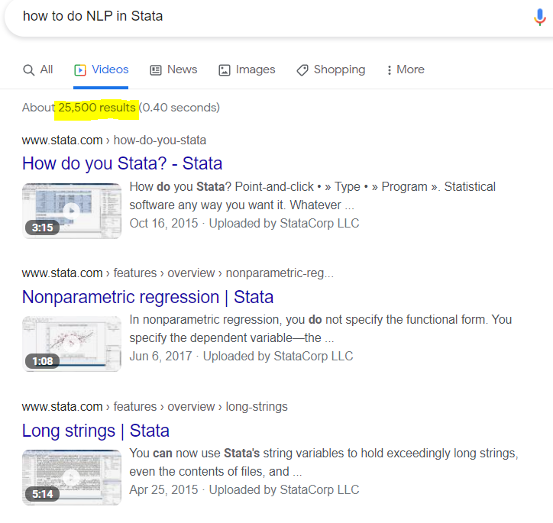
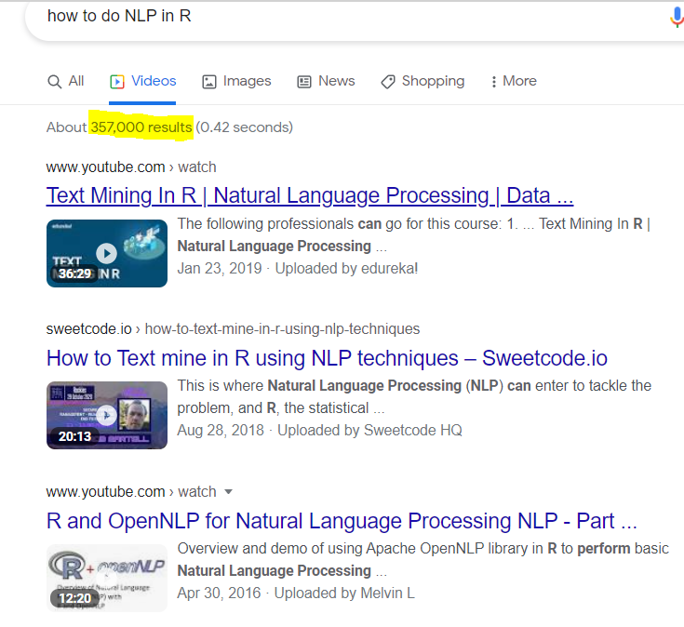

Slide 4
Learn by Example!
Text Mining with R by Julia Silge and David Robinson
www.tidytextmining.com

Slide 5
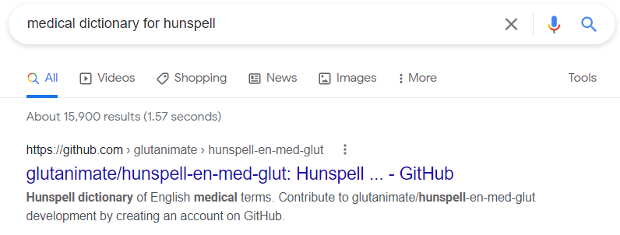
Obstacles along the way- 1
Spell check doesn’t recognize medical words/abbreviation!
“Hunspell” Package
Fix?
> hunspell_check("ADHD")
[1] FALSE
> hunspell_suggest("ADHD")
[[1]] [1] "ADD" "ADHARA"
hunspell_check("ADHD")
[1] TRUE
> hunspell_suggest("ADHD")
[[1]] [1] "ADHD" "ADD"

Slide 6
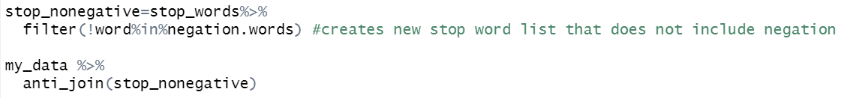
Obstacles along the way- 2
I want to remove “stop words” but keep negation!
Traditional text cleaning code
but stop_words include “no”, “not” , “doesn’t”,…
Fix?
“qdap” package contains negation.words

Slide 7
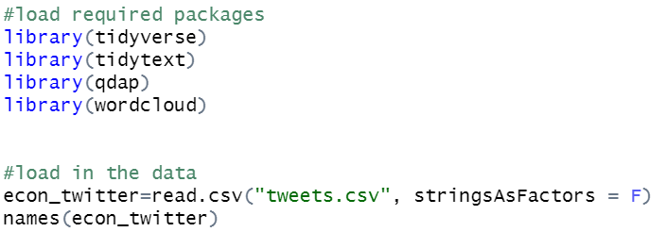
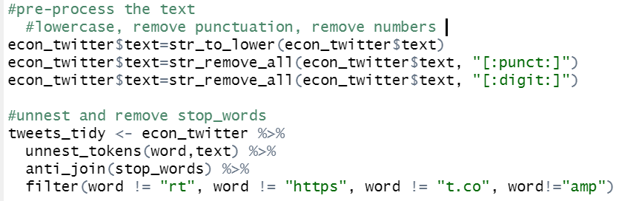
NLP Example: EconTwitter
Get the data!
Twitter API and “rtweet” package
many tutorials on webscraping in general
Pre-process the text
Lowercase, remove punctuation, filter stop words, unnest tokens

Slide 8
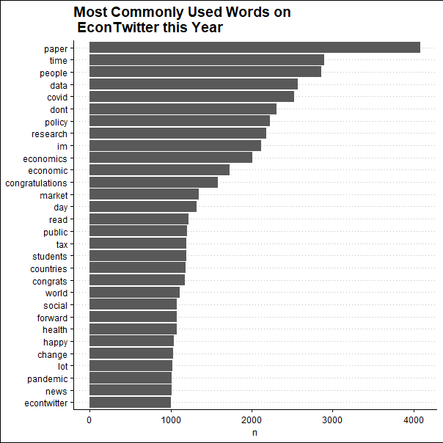
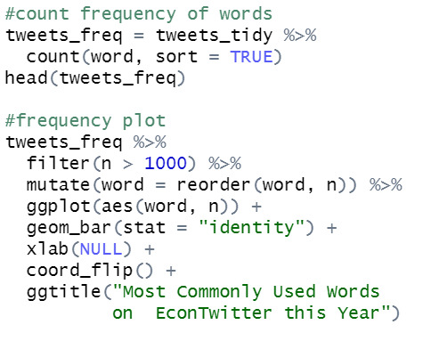
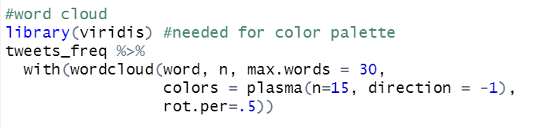
Word Frequency

Slide 9

Word Frequency

Slide 10
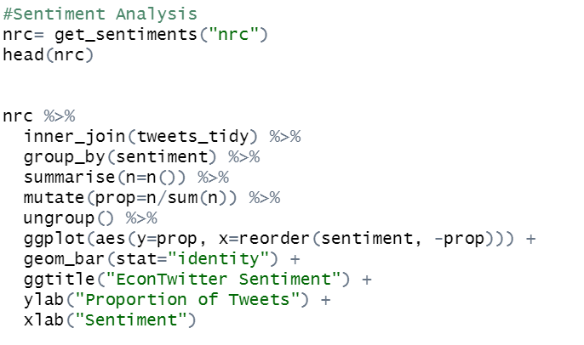
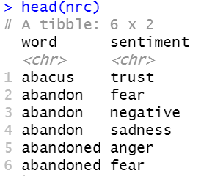
Sentiment Analysis

Slide 11
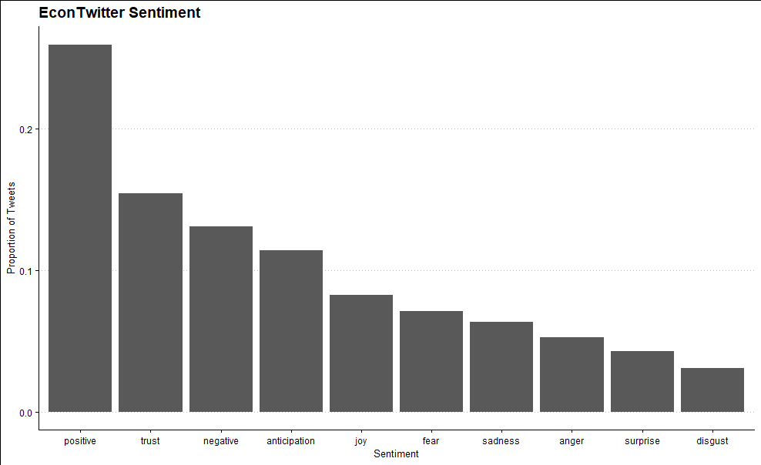
Sentiment Analysis

Slide 12
Questions? Comments?
Kelli.marquardt16@gmail.com

