Slide 1

Master’s Thesis Defense
International Master Program in Mechanical and Automation Engineering
TOPOLOGY THAT LEARNS:
A BIO-INSPIRED STREAMING FORECASTER FOR TIME SERIES UNDER CATEGORICAL DRIFT
Researcher: Susannah Hollister Cutler
Advisor: Chih-Hung G. Li, Ph.D
July 2026
1

Slide 2
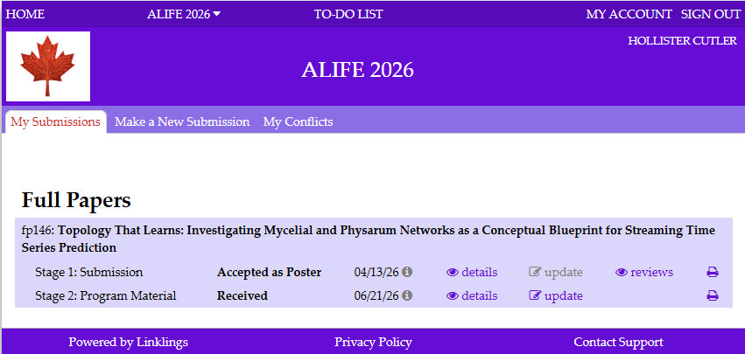
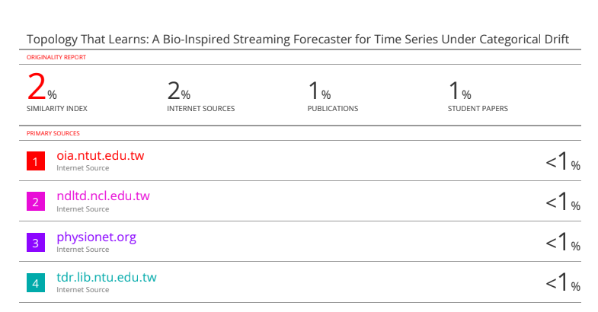
QUALIFICATIONS FOR DEFENSE
Acceptance to ALIFE 2026 Conference in Waterloo, Canada (Aug 17th-21st)
2% Similarity Score Report Results
2

Slide 3
PRESENTATION ROADMAP
01
Motivation & Research Gap
Why categorical drift challenges fixed forecasting models
02
Biological Inspiration
Properties of biological flow networks that translate to network design
03
MycoMorph Architecture
Front end, base graph, cycle layer, meta-graph, prediction, and per-timestep operation
04
Evaluation Protocol
Baselines, synthetic signals, real-world records, structural analysis, and ablation design
05
Results & Structural Memory
Synthetic results, real-world results, error trajectories, emergent topology, and ablations
06
Discussion, Limitations, Applications, & Future Work
Interpretation, boundaries, practical uses, next steps, and broader implications
2

Slide 4
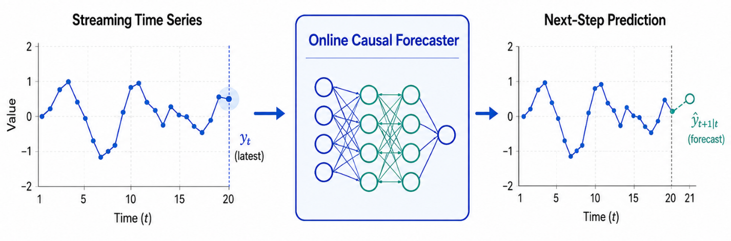
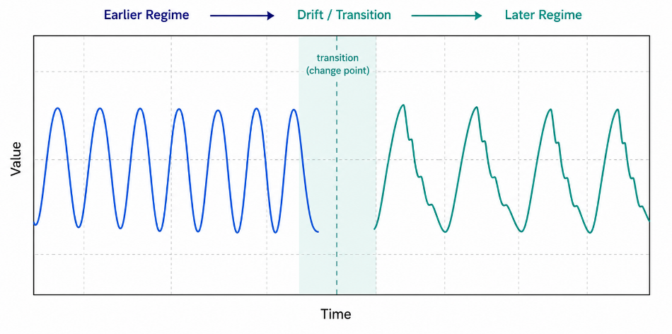
TIME-SERIES FORECASTING
Real-time · Streaming · Causal · Adaptive · Sequential · Online · Nonstationary
Online causal time-series prediction uses patterns in sequential measurements to estimate future values as new data arrive, while relying only on observations available up to the present moment.
Where It Is Useful
Key Challenge: Categorical Drift
Maintenance and machine monitoring
Robotic and autonomous control
Wearable sensors
Energy, environmental, and industrial systems
Real-time anomaly detection
Signal dynamics may change after deployment
Cycles can lengthen, shorten, disappear, or return
Predictions must remain accurate with limited time, memory, and computation

Slide 5
RESEARCH GAP
Most modern forecasting models are loosely inspired by the brain.
Recurrent neural networks, linear decomposition, transformer-based models all employ interconnected units, distributed representations, and learned connection strengths to process temporal information
However, they differ from biological neural systems in important ways:
Biology | Implementation
Evolving topology | Fixed topology
Local adaptation | Global optimization
Pathway growth | Weight updates
Reinforcement / decay | Loss minimization
Dormancy / reactivation | Forgetting / retraining
Distributed memory | Shared parameters
Structure = computation | Structure ≠ learning
Core Problem: Limited capacity for structural adaptation

Slide 6
RESEARCH QUESTIONS
What if computation were organized around network topology, rather than only the accuracy of an input–output mapping?
What if adaptive forecasting were inspired not only by the brain, but by other distributed biological networks whose physical structure continuously grows, strengthens, weakens, and reorganizes in response to the environment?

Slide 7
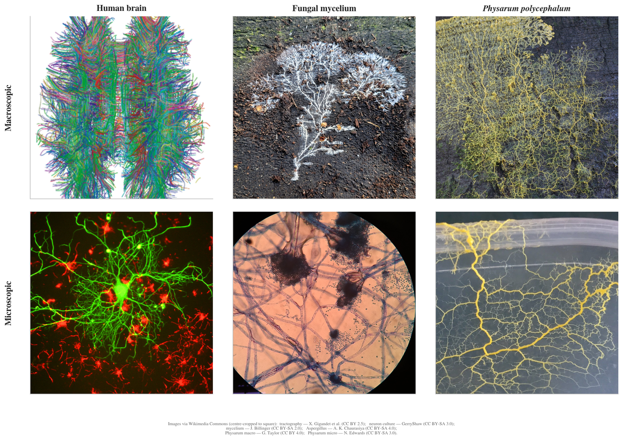
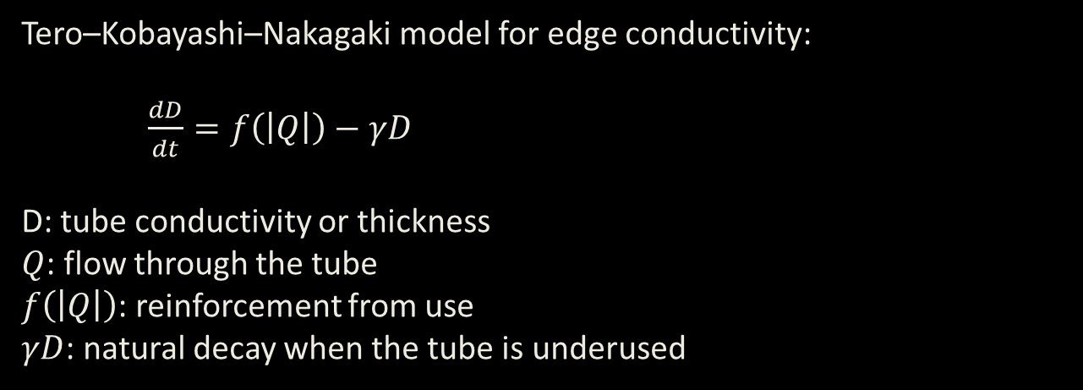
BIOLOGICAL INSPIRATION
Decentralized, Adaptive, Self-organizing
Transport Networks
Fungal mycelium: branching vegetative network of a fungus
Physarum polycephalum: slime mold forming adaptive transport tubes
Prior Computational Uses
Shortest-path and network optimization
Adaptive transport-network design
Robust routing and infrastructure modeling
Differentiable and neural-network formulations
Tero–Kobayashi–Nakagaki model for edge conductivity:
$\frac{dD}{dt}=f\left(\left|Q\right|\right)−γD$
D: tube conductivity or thickness
$Q$: flow through the tube
$f\left(\left|Q\right|\right)$: reinforcement from use
$γD$: natural decay when the tube is underused
Figure 2.1: Functional comparison of distributed adaptive networks
5

Slide 8
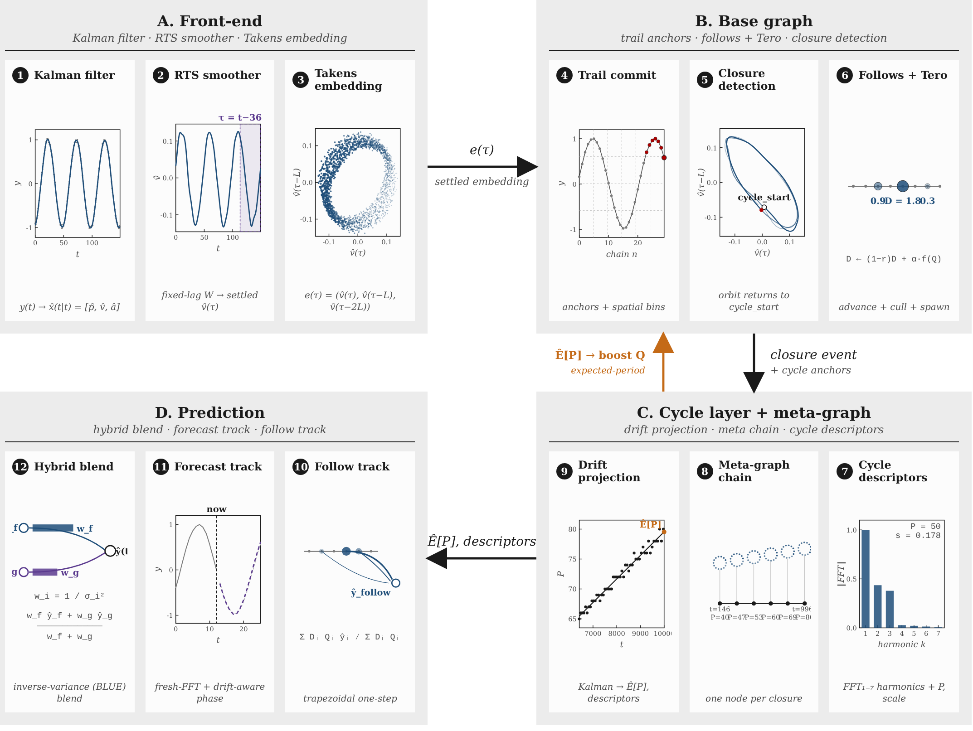
MYCOMORPH ARCHITECTURE
Four Architectural Components
1. Causal Front End
Matérn-5/2 · Kalman filter · RTS · Takens embedding
2. Base Graph
Pathway growth · conductivity · reinforcement · decay
3. Cycle Layer / Meta-Graph
Cycle detection · consolidation · regime memory
4. Hybrid Prediction
Follow track: pathway continuation
Forecast track: projected cycle timing
Inverse-variance blending
Figure 3.1: MycoMorph Four Stage Architecture

Slide 9
FRONT END
The front end transforms a noisy scalar observation stream into a causal, denoised, locally phase-corrected trajectory of temporal motion, providing the graph with stable geometric states that encode how the signal is changing rather than merely its current amplitude.
Matérn-5/2 State-Space Model
3. Fixed-Lag RTS Smoother
Models the latent signal and derivatives
Smooths noise without over-smoothing dynamics
Chosen for stable first-derivative estimation
Refines recent state and derivative estimates
Reduces derivative noise and phase lag
Chosen as a balance between accuracy and causality
2. Forward Kalman Filter
4. Takens Delay Embedding
Updates the state one sample at a time
Provides causal, uncertainty-weighted denoising
Chosen for real-time streaming efficiency
Converts the derivative trace into a trajectory Represents direction and local temporal motion Reduces sensitivity to absolute signal level
Chosen to expose recurring dynamical patterns

Slide 10
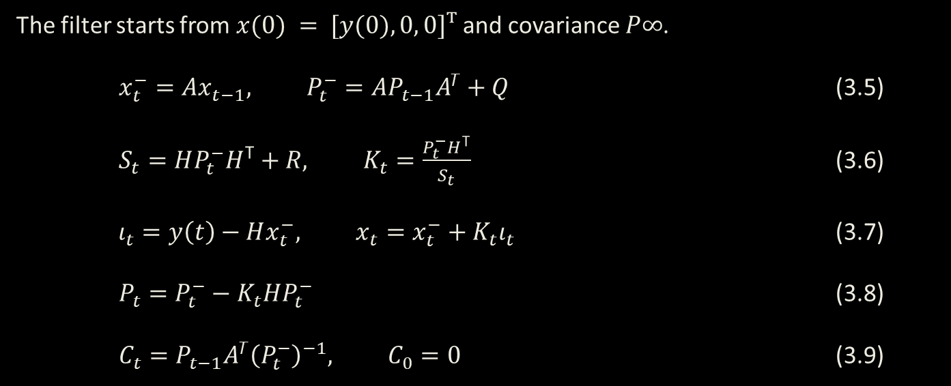
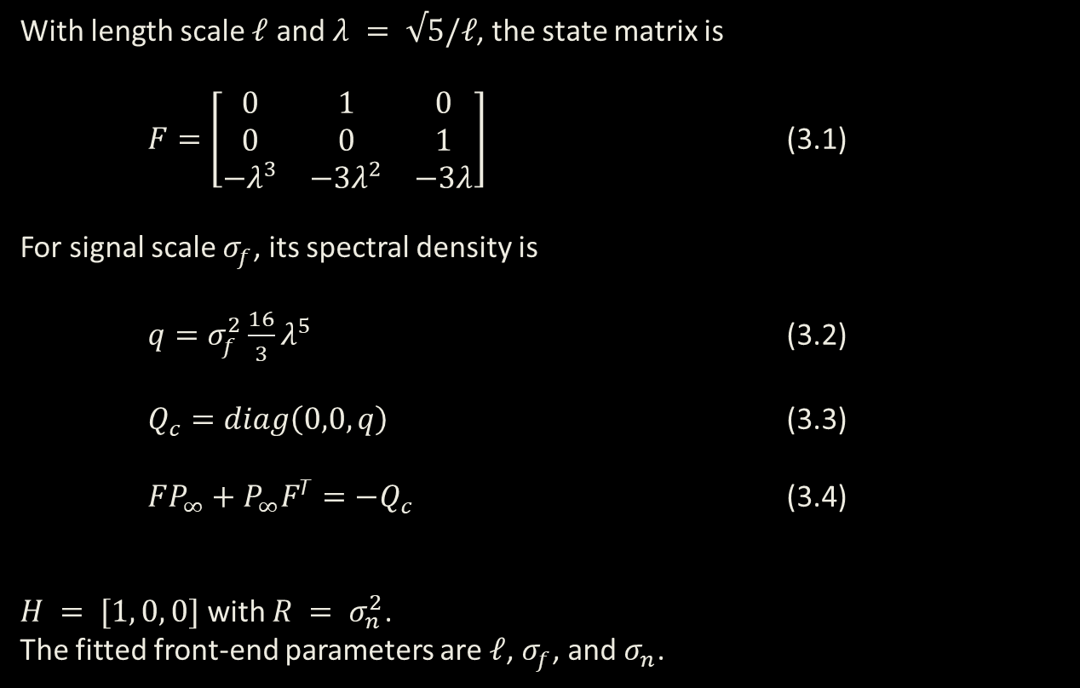
MATÉRN-5/2 & KALMAN & RTS SMOOTHER
Individual stages are well established -- Matérn + Kalman + RTS is a known GP pipeline.
1. Matérn-5/2 State-Space Model
2. Forward Kalman Filter
With length scale $𝓁$ and $λ = √5/𝓁$, the state matrix is
$F=\left[\begin{matrix}0 & 1 & 0 \\ 0 & 0 & 1 \\ −λ^{3} & −3λ^{2} & −3λ\end{matrix}\right]$ (3.1)
For signal scale $σ_{f}$, its spectral density is
$q=σ_{f}^{2}\frac{16}{3}λ^{5}$ (3.2)
$Q_{c}=diag\left(0,0,q\right)$ (3.3)
$FP_{∞}+P_{∞}F^{T}=−Q_{c}$ (3.4)
$H = [1, 0, 0]$ with $R = σ_{n}^{2}$.
The fitted front-end parameters are $𝓁$, $σ_{f}$, and $σ_{n}$.
The filter starts from $x(0) = [y(0), 0, 0]ᵀ$ and covariance $P∞$.
$x_{t}^{−}=Ax_{t−1}, P_{t}^{−}=AP_{t−1}A^{T}+Q$ (3.5)
$S_{t}=HP_{t}^{−}H^{T}+R, K_{t}=\frac{P_{t}^{−}H^{T}}{S_{t}}$ (3.6)
$ι_{t}=y\left(t\right)−Hx_{t}^{−}, x_{t}=x_{t}^{−}+K_{t}ι_{t}$ (3.7)
$P_{t}=P_{t}^{−}−K_{t}HP_{t}^{−}$ (3.8)
$C_{t}=P_{t−1}A^{T}{\left(P_{t}^{−}\right)}^{−1}, C_{0}=0$ (3.9)
3. Fixed-Lag RTS Smoother
$\hat{x}\left(j∣j+d\right)=x_{filt}\left(j\right)+C_{j+1}\left[\hat{x}\left(j+1∣j+d\right)−x^{−}\left(j+1\right)\right]$ (3.10)

Slide 11
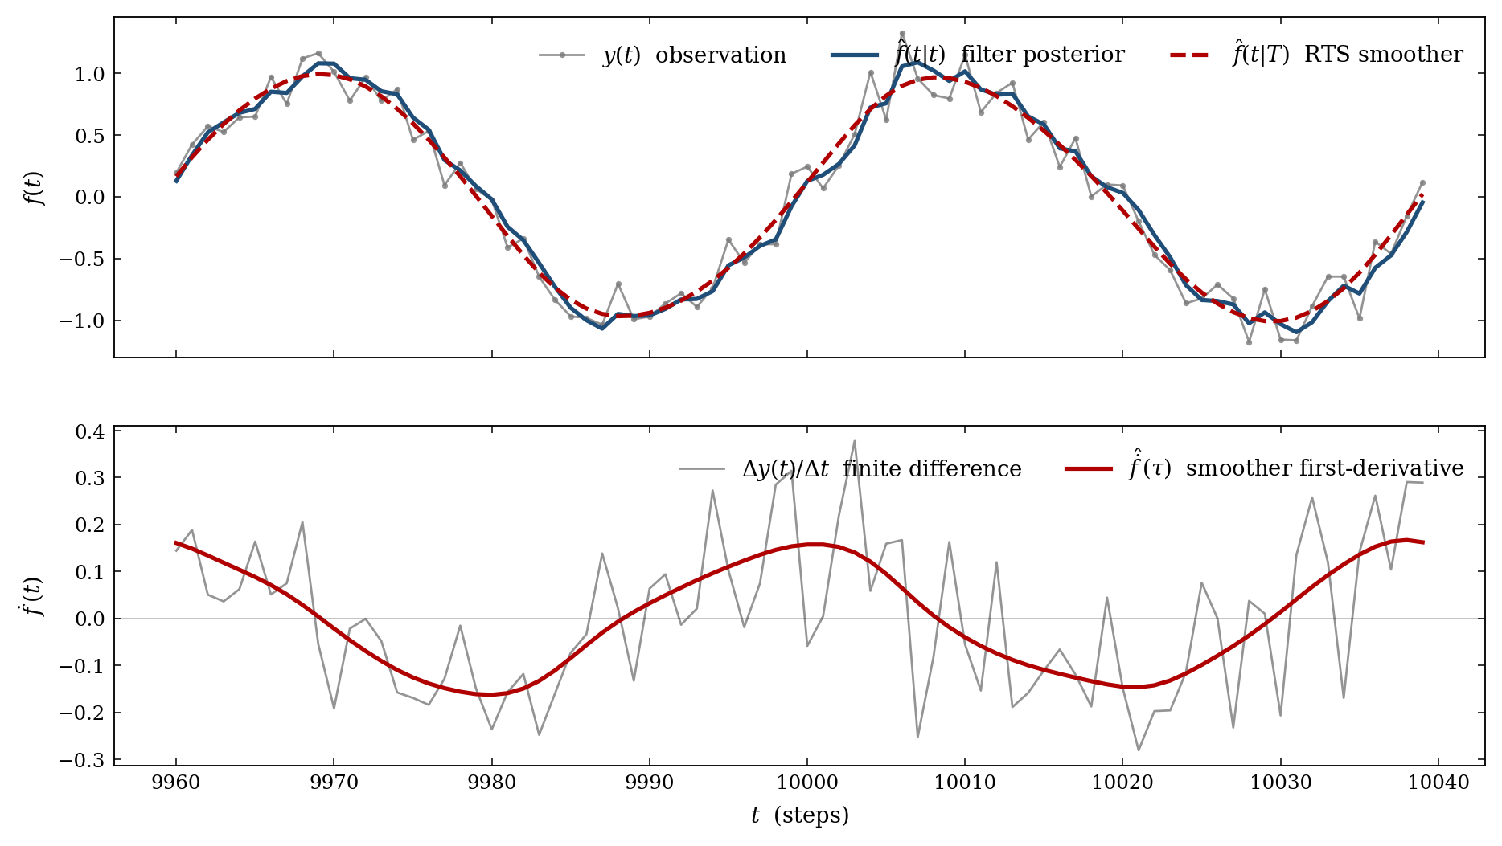
DE-NOISING EFFECT OF FRONT END
Figure 3.2 Matérn-5/2 Kalman filtering and fixed-lag Rauch–Tung–Striebel smoothing of a noisy periodic signal

Slide 12
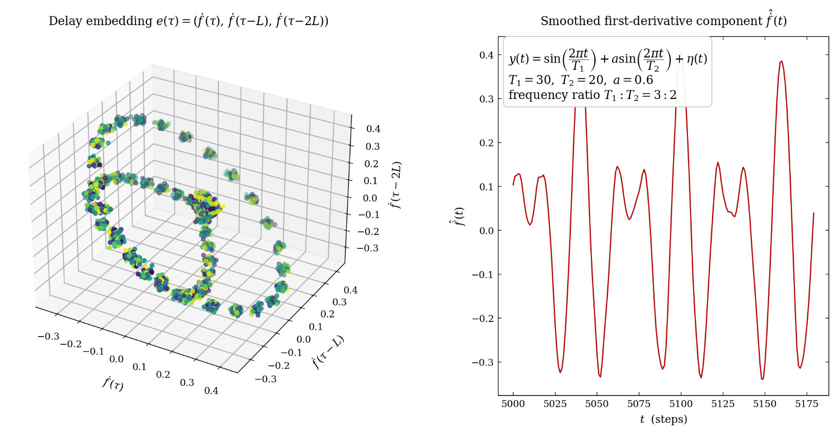
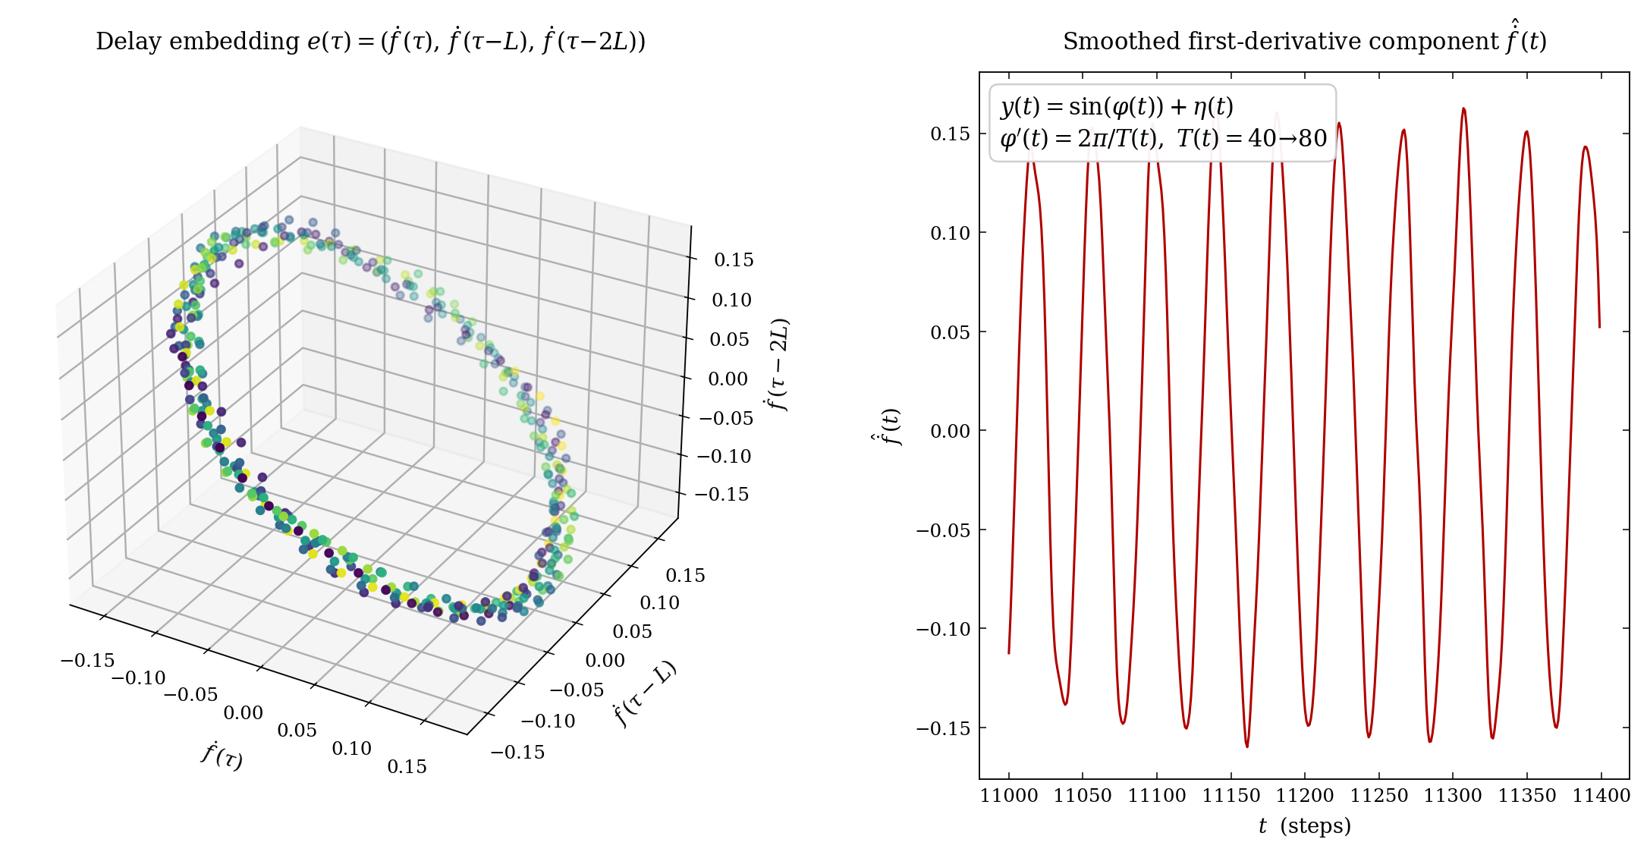
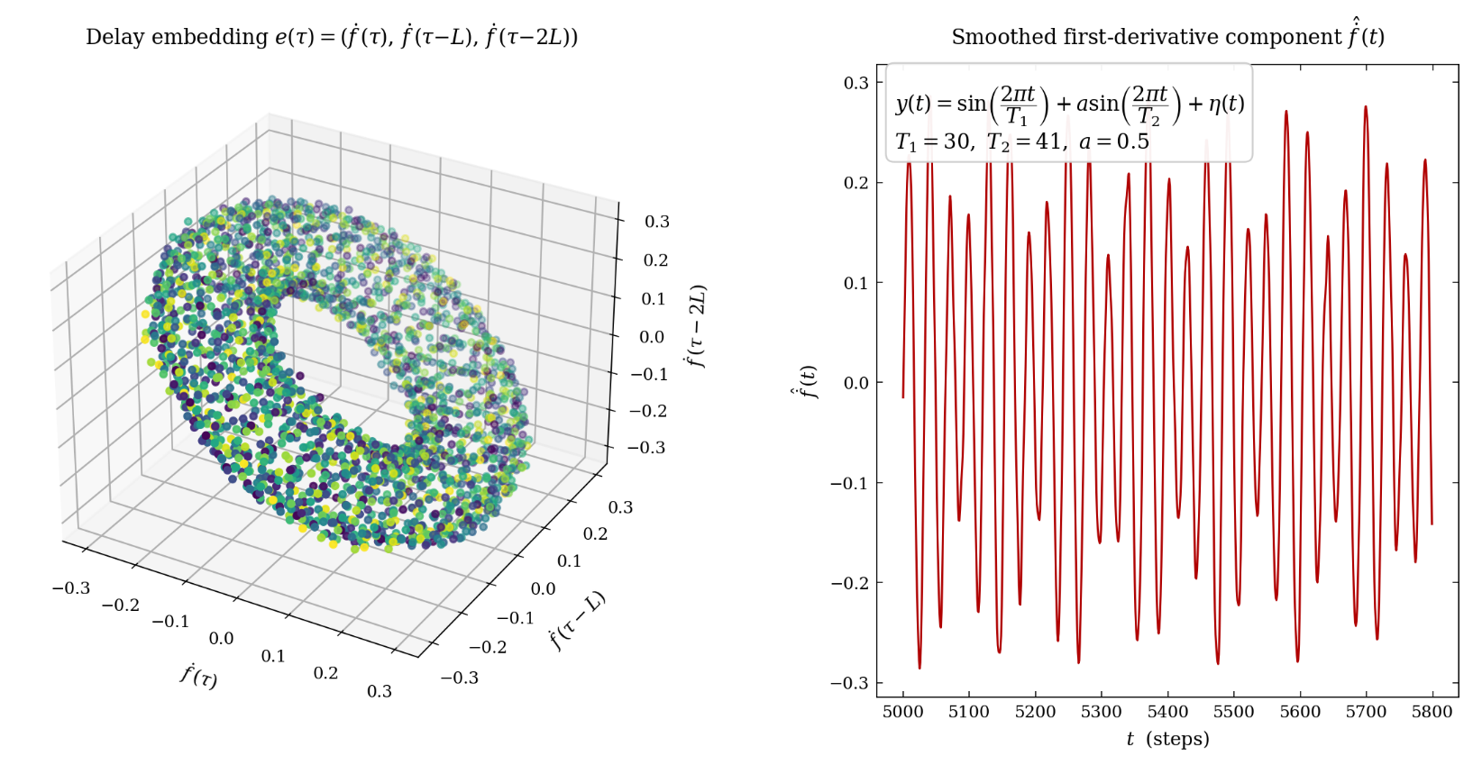
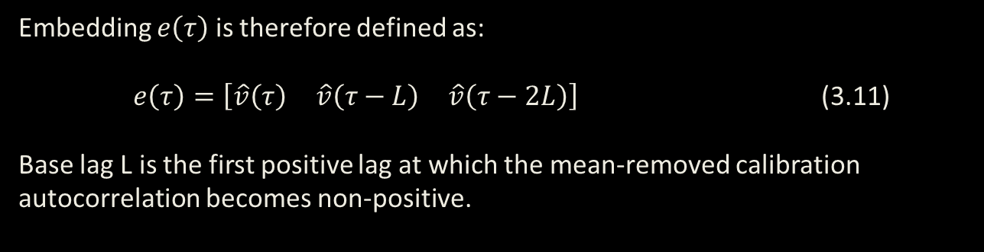
TAKENS EMBEDDING
Takens embedding turns a single time-series signal into a multidimensional trajectory by stacking delayed versions of the signal.
Embedding $e\left(τ\right)$ is therefore defined as:
$e\left(τ\right)=\left[\begin{matrix}\hat{v}\left(τ\right) & \hat{v}\left(τ−L\right) & \hat{v}\left(τ−2L\right)\end{matrix}\right]$ (3.11)
Base lag L is the first positive lag at which the mean-removed calibration autocorrelation becomes non-positive.
Figure 3.5 Delay-coordinate embedding of a rational-frequency-ratio periodic signal
Figure 3.4 Delay-coordinate embedding of quasi-periodic two-frequency signal
Figure 3.3 Delay-coordinate embedding of a sinusoid with increasing period
0

Slide 13
BASE GRAPH
Which dynamical states have occurred • Which states tend to follow one another • What signal change usually occurs during each transition • Which temporal pathways recur • Which pathways are currently most relevant
What the MycoMorph Base Graph Represents
Node = Embedded Dynamical State
Each node is one Takens delay embedding
Represents the signal’s recent pattern of motion
Describes the current dynamical state, not just one signal value
Edge = Temporal Transition
connects one embedding to the embedding observed next
Represents how the signal moved from one state to another
Stores the signal change associated with that transition
The result is a directed map of the signal’s learned dynamics.

Slide 14
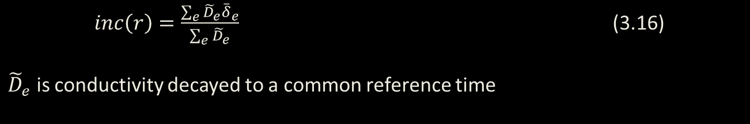
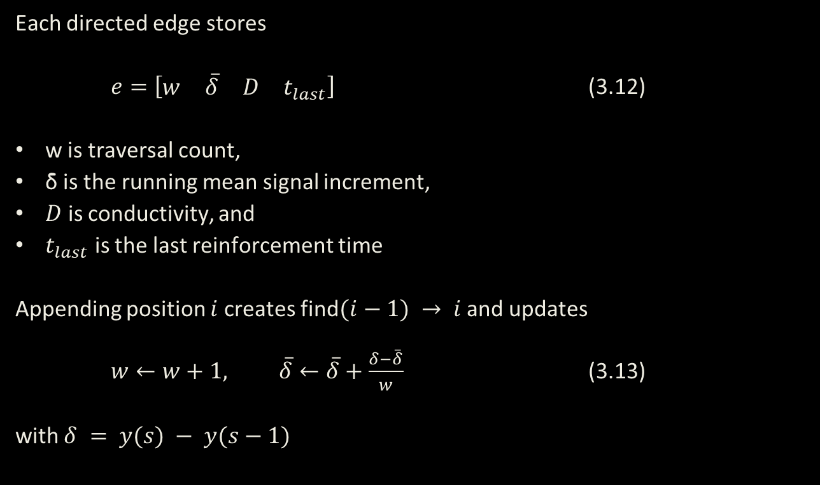
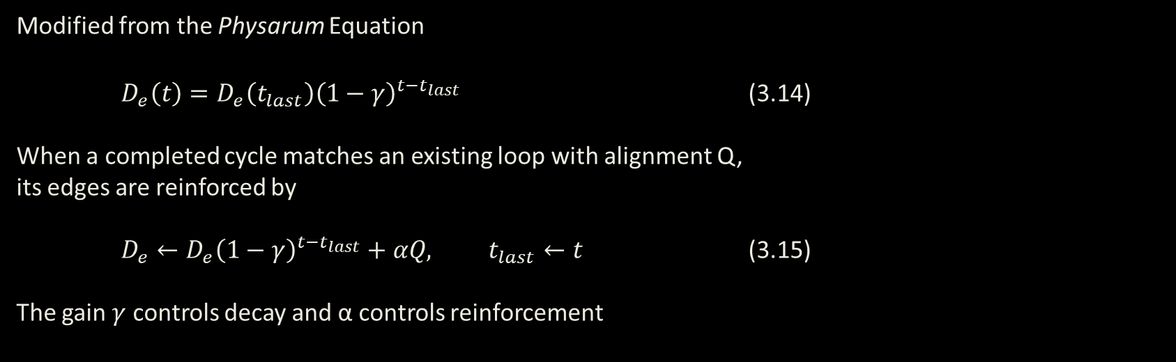
BASE GRAPH
Conductivity is an edge strength that reflects how recently and reliably a transition has been used, allowing relevant pathways to influence prediction more strongly while inactive pathways gradually weaken without being erased.
Graph Edges
Tero Conductivity
Each directed edge stores
$e=\left[\begin{matrix}w & \overset{‾}{δ} & D & t_{last}\end{matrix}\right]$ (3.12)
w is traversal count,
δ̄ is the running mean signal increment,
$D$ is conductivity, and
$t_{last}$ is the last reinforcement time
Appending position $i$creates find$(i−1) → i$ and updates
$w←w+1, \overset{‾}{δ}←\overset{‾}{δ}+\frac{δ−\overset{‾}{δ}}{w}$ (3.13)
with $δ = y(s) − y(s−1)$
Modified from the Physarum Equation
$D_{e}\left(t\right)=D_{e}\left(t_{last}\right){\left(1−γ\right)}^{t−t_{last}}$ (3.14)
When a completed cycle matches an existing loop with alignment Q,
its edges are reinforced by
$D_{e}←D_{e}{\left(1−γ\right)}^{t−t_{last}}+αQ, t_{last}←t$ (3.15)
The gain $γ$ controls decay and α controls reinforcement
Conductivity Forward Increment
$inc\left(r\right)=\frac{\sum_{e}^{​}{{\tilde{D}}_{e}}{\overset{‾}{δ}}_{e}}{\sum_{e}^{​}{{\tilde{D}}_{e}}}$ (3.16)
${\tilde{D}}_{e}$ is conductivity decayed to a common reference time

Slide 15
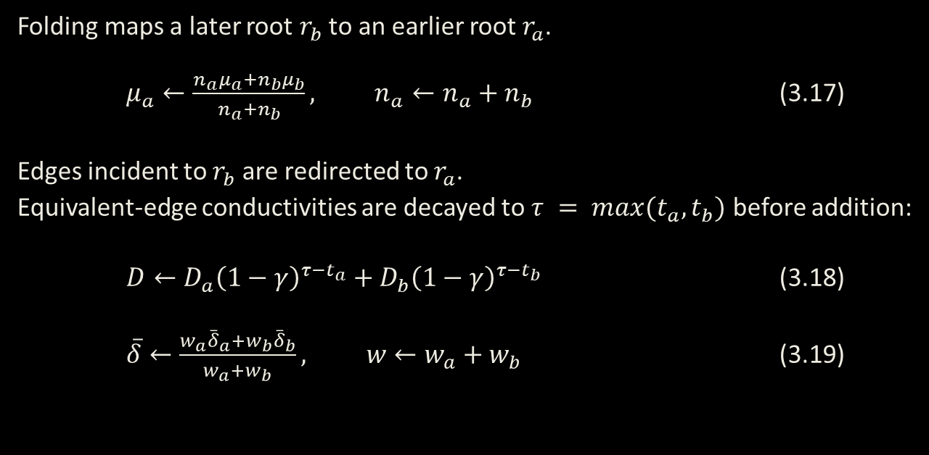
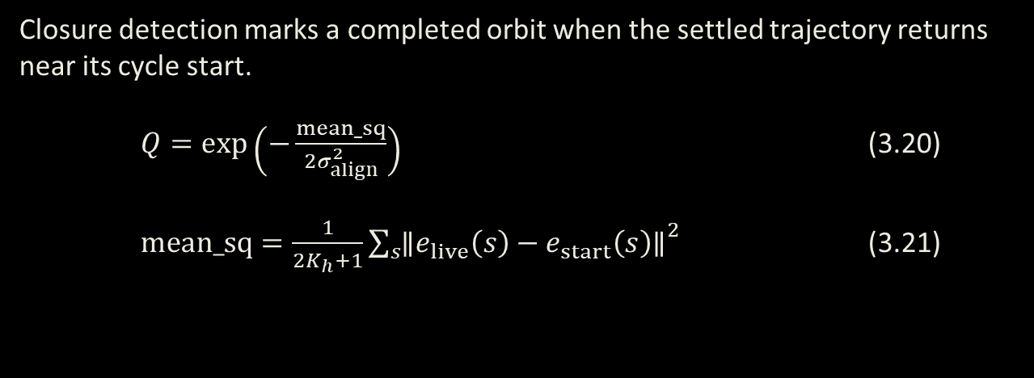
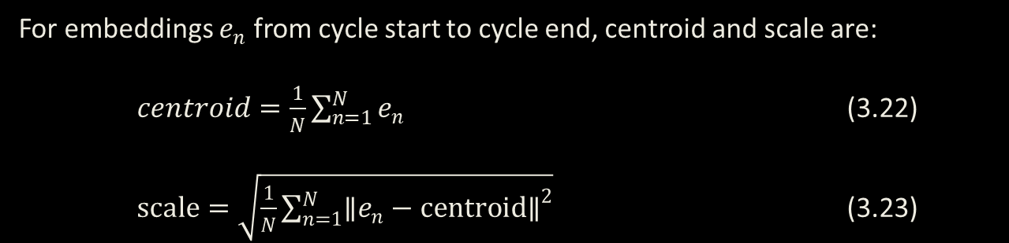
BASE GRAPH
Closure detection identifies recurring cycles, folding and merging consolidate repeated trajectories into shared graph structure, and descriptors summarize each cycle for later comparison and reuse.
Node Folding and Edge Merging
Closure Detection
Folding maps a later root $r_{b}$ to an earlier root $r_{a}$.
$μ_{a}←\frac{n_{a}μ_{a}+n_{b}μ_{b}}{n_{a}+n_{b}}, n_{a}←n_{a}+n_{b}$ (3.17)
Edges incident to $r_{b}$ are redirected to $r_{a}$.
Equivalent-edge conductivities are decayed to $τ = max(t_{a}, t_{b})$ before addition:
$D←D_{a}{\left(1−γ\right)}^{τ−t_{a}}+D_{b}{\left(1−γ\right)}^{τ−t_{b}}$ (3.18)
$\overset{‾}{δ}←\frac{w_{a}{\overset{‾}{δ}}_{a}+w_{b}{\overset{‾}{δ}}_{b}}{w_{a}+w_{b}}, w←w_{a}+w_{b}$ (3.19)
Closure detection marks a completed orbit when the settled trajectory returns near its cycle start.
$Q=exp\left(−\frac{mean_sq}{2σ_{align}^{2}}\right)$ (3.20)
$mean_sq=\frac{1}{2K_{h}+1}\sum_{s}^{​}{{∥e_{live}\left(s\right)−e_{start}\left(s\right)∥}^{2}}$ (3.21)
Cycle Descriptors
For embeddings $e_{n}$ from cycle start to cycle end, centroid and scale are:
$centroid=\frac{1}{N}\sum_{n=1}^{N}{e_{n}}$ (3.22)
$scale=\sqrt{\frac{1}{N}\sum_{n=1}^{N}{{∥e_{n}−centroid∥}^{2}}}$ (3.23)
Closure detection and descriptors are base graph operations, that directly feed into the meta-graph layer

Slide 16
CYCLE LAYER & META GRAPH
The cycle layer represents recurring behaviors as whole units, rather than as individual embedded states and transitions.
What the MycoMorph Meta Graph Represents
Cycle Node = one consolidated recurring orbit
Summarizes period, geometry, and signal behavior
Higher level representation of base graph nodes
Cycle Edge = Temporal Transition
Show the signal moves between broader regimes
Tracks drift on a larger scale
In simple terms: the base graph remembers the path within a cycle, while the cycle layer remembers the cycle itself.

Slide 17
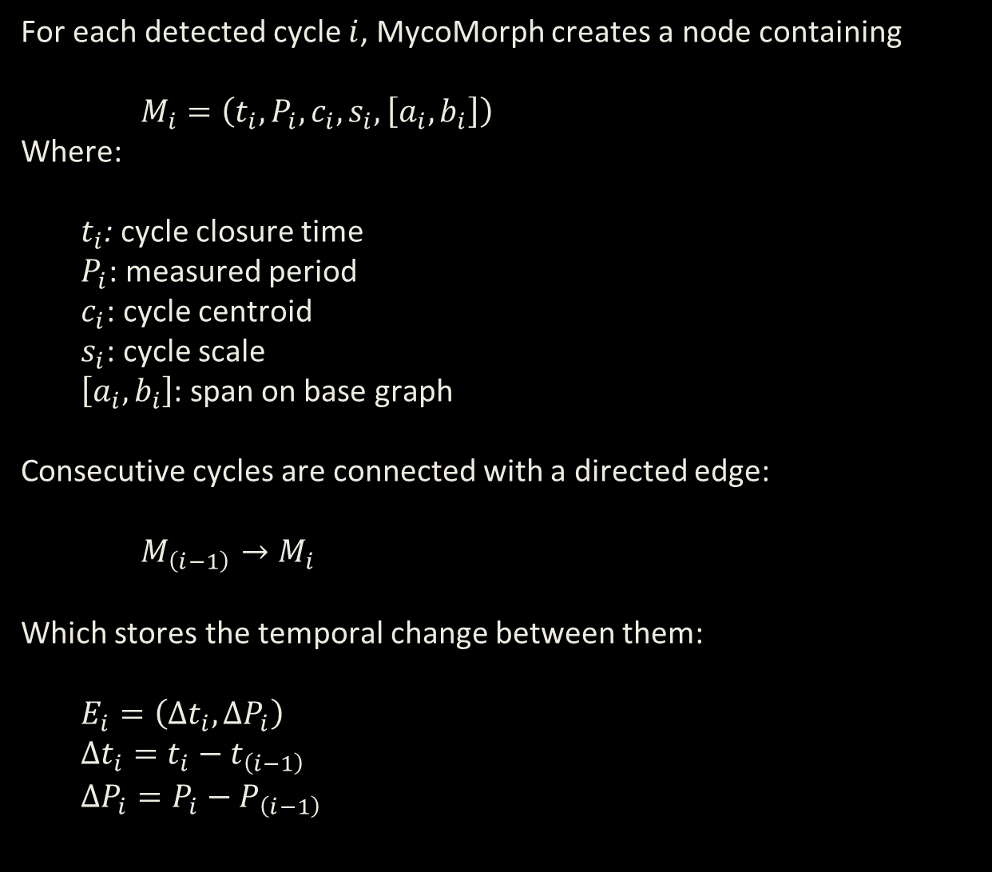
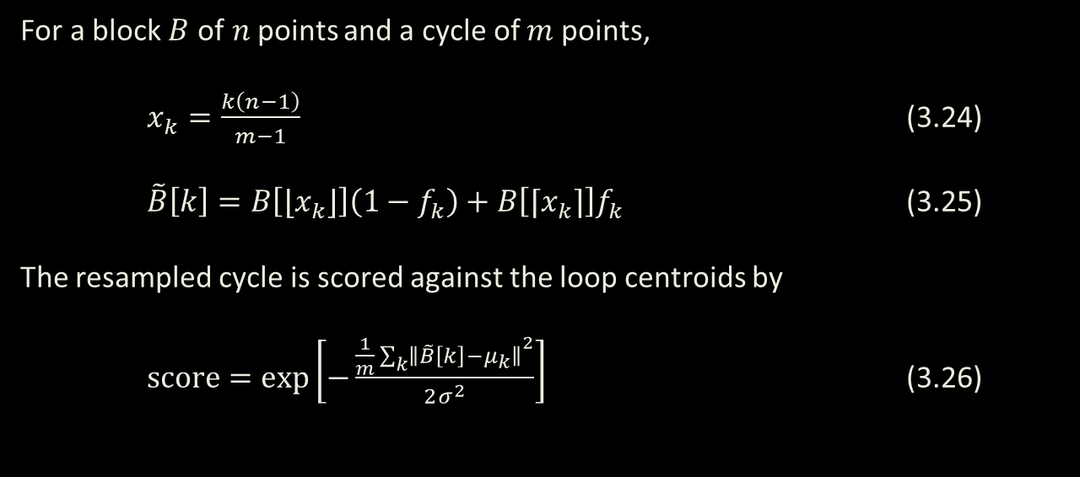
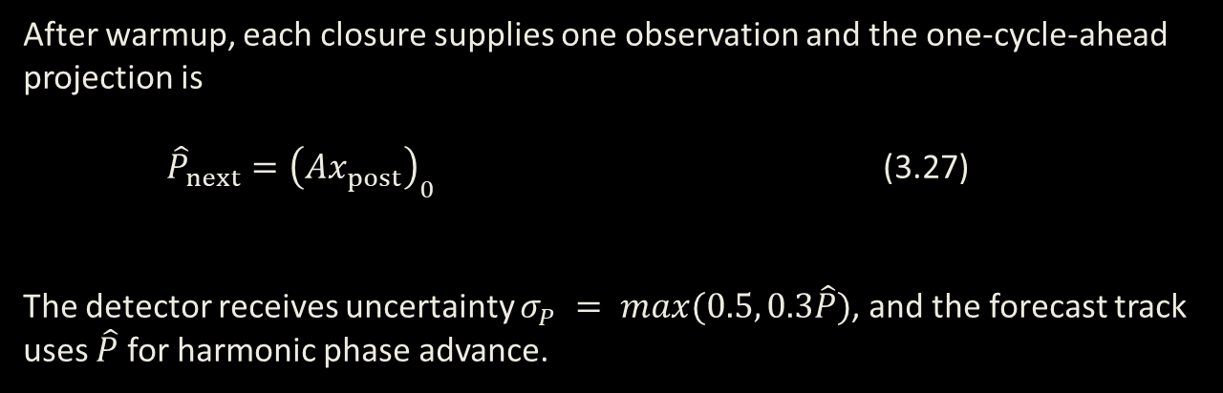
CYCLE LAYER & META GRAPH
Meta-graph properties summarize each cycle, consolidation by folding groups similar cycles into shared representations, and period projection uses their evolving relationships to estimate the next cycle’s duration.
For each detected cycle $i$, MycoMorph creates a node containing
$M_{i}=\left(t_{i},P_{i},c_{i},s_{i},\left[a_{i},b_{i}\right]\right)$
Where:
  $t_{i}$: cycle closure time
  $P_{i}$: measured period
  $c_{i}$: cycle centroid
  $s_{i}$: cycle scale
  $\left[a_{i},b_{i}\right]$: span on base graph
Consecutive cycles are connected with a directed edge:
$M_{\left(i−1\right)}→M_{i}$
Which stores the temporal change between them:
  $$E_{i}=\left(Δt_{i},ΔP_{i}\right)$$
  $$Δt_{i}=t_{i}−t_{\left(i−1\right)}$$
  $$ΔP_{i}=P_{i}−P_{\left(i−1\right)}$$
Consolidation by Folding
For a block $B$ of$n$points and a cycle of $m$ points,
$x_{k}=\frac{k\left(n−1\right)}{m−1}$ (3.24)
$\tilde{B}\left[k\right]=B\left[⌊x_{k}⌋\right]\left(1−f_{k}\right)+B\left[⌈x_{k}⌉\right]f_{k}$ (3.25)
The resampled cycle is scored against the loop centroids by
$score=exp\left[−\frac{\frac{1}{m}\sum_{k}^{​}{{∥\tilde{B}\left[k\right]−μ_{k}∥}^{2}}}{2σ^{2}}\right]$ (3.26)
Meta Graph Projection
After warmup, each closure supplies one observation and the one-cycle-ahead projection is
${\hat{P}}_{next}={\left(Ax_{post}\right)}_{0}$ (3.27)
The detector receives uncertainty $σ_{P} = max(0.5, 0.3\hat{P})$, and the forecast track uses $\hat{P}$ for harmonic phase advance.

Slide 18
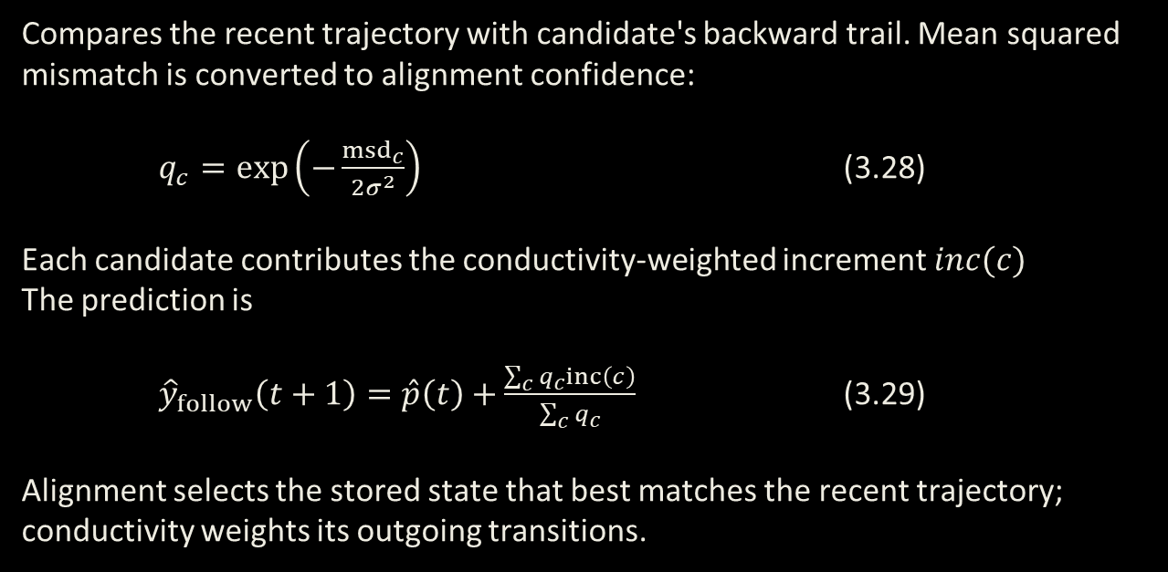
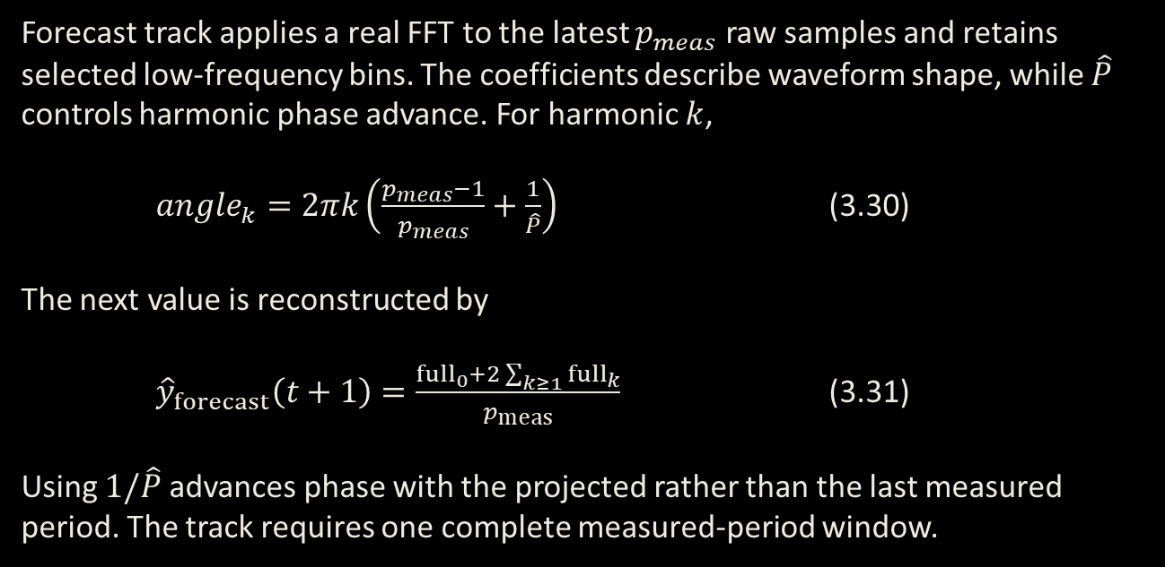
PREDICTION
The follow track predicts by continuing along the strongest learned graph pathway, while the forecast track projects the next cycle’s period and reconstructs the expected signal value.
Follow Track (Base Graph)
Forecast Track (Meta Graph)
Compares the recent trajectory with candidate's backward trail. Mean squared mismatch is converted to alignment confidence:
$q_{c}=exp\left(−\frac{{msd}_{c}}{2σ^{2}}\right)$ (3.28)
Each candidate contributes the conductivity-weighted increment $inc(c)$
The prediction is
${\hat{y}}_{follow}\left(t+1\right)=\hat{p}\left(t\right)+\frac{\sum_{c}^{​}{q_{c}}inc\left(c\right)}{\sum_{c}^{​}{q_{c}}}$ (3.29)
Alignment selects the stored state that best matches the recent trajectory; conductivity weights its outgoing transitions.
Forecast track applies a real FFT to the latest $p_{meas}$ raw samples and retains selected low-frequency bins. The coefficients describe waveform shape, while $\hat{P}$ controls harmonic phase advance. For harmonic $k$,
${angle}_{k}=2πk\left(\frac{p_{meas}−1}{p_{meas}}+\frac{1}{\hat{P}}\right)$ (3.30)
The next value is reconstructed by
${\hat{y}}_{forecast}\left(t+1\right)=\frac{{full}_{0}+2\sum_{k≥1}^{​}{{full}_{k}}}{p_{meas}}$ (3.31)
Using $1/\hat{P}$ advances phase with the projected rather than the last measured period. The track requires one complete measured-period window.

Slide 19
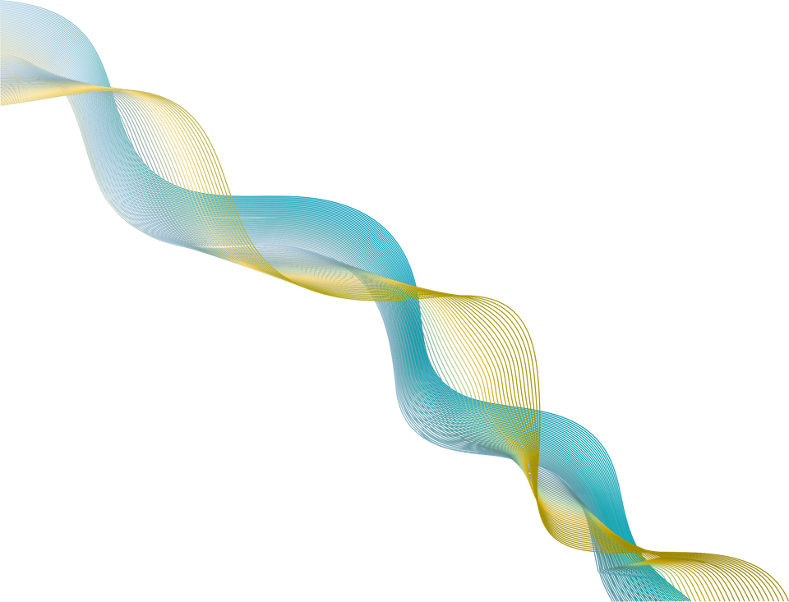
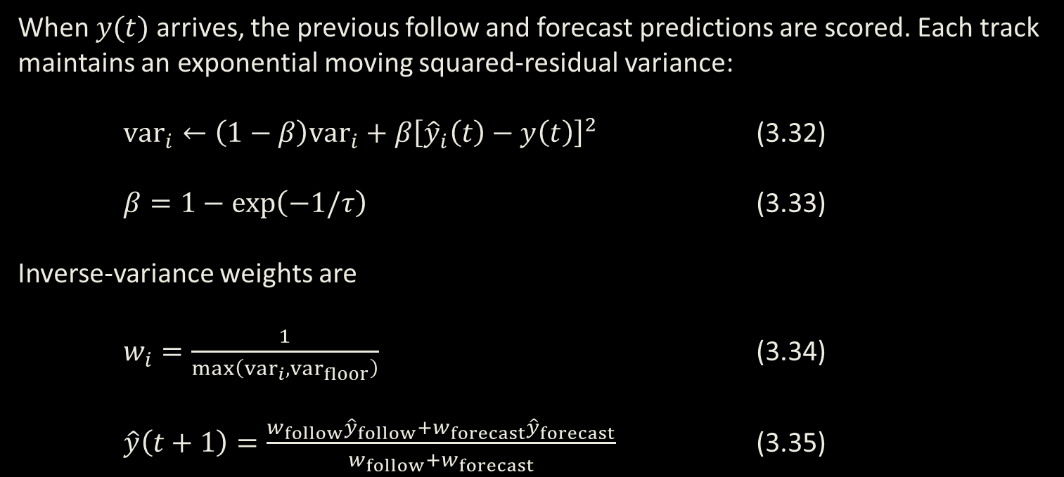
PREDICTION
The final prediction combines both tracks using inverse-variance weighting, so the more confident track contributes more while the blend remains robust when either pathway-based or cycle-based prediction is uncertain.
Hybrid Inverse-Variance Blend
When $y(t)$ arrives, the previous follow and forecast predictions are scored. Each track maintains an exponential moving squared-residual variance:
${var}_{i}←\left(1−β\right){var}_{i}+β{\left[{\hat{y}}_{i}\left(t\right)−y\left(t\right)\right]}^{2}$ (3.32)
$β=1−exp\left(−1/τ\right)$ (3.33)
Inverse-variance weights are
$w_{i}=\frac{1}{max\left({var}_{i},{var}_{floor}\right)}$ (3.34)
$\hat{y}\left(t+1\right)=\frac{w_{follow}{\hat{y}}_{follow}+w_{forecast}{\hat{y}}_{forecast}}{w_{follow}+w_{forecast}}$ (3.35)

Slide 20
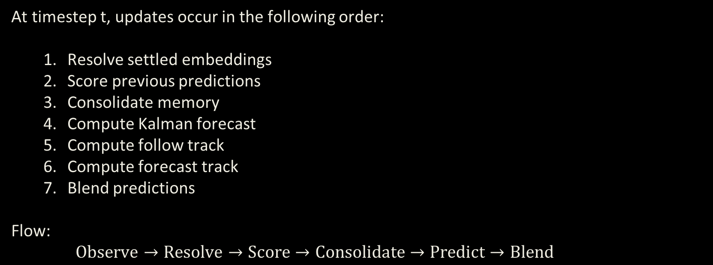
PER TIMESTEP ORDER OF EVENTS
Causal guarantee: the prediction $\hat{y}\left(t+1\right)$ uses only observations available through $y\left(t\right)$; Future information never enters the current forecast.
Order of Operations
At timestep t, updates occur in the following order:
  Resolve settled embeddings
  Score previous predictions
  Consolidate memory
  Compute Kalman forecast
  Compute follow track
  Compute forecast track
  Blend predictions
Flow:
$\text{Observe}→\text{Resolve}→\text{Score}→\text{Consolidate}→\text{Predict}→\text{Blend}$

Slide 21
EVALUATION
The evaluation aims to determine whether MycoMorph can remain accurate under categorical drift while adapting online, preserving prior regimes, and avoiding costly retraining.
Synthetic Signal Panel
10 Synthetic signals, spanning 4 categories of drift type
3 seeds x 3 noise levels for each signal
Real World Signal Panel
15 real-world datasets spanning 5 different environments
Medical signals, electricity, weather data, bearing vibration, and motor speed
Structural Analysis
Analysis of internal graph structure and statistics for temperature signal
Reactivation of pathways, node counts, and alignment scores
Ablation Testing
Examination of individual graph components
Contributions of each component during hybrid prediction

Slide 22
BASELINE MODELS
The baselines span classical state-space, recurrent, linear decomposition, and transformer-based forecasting families, allowing MycoMorph to be evaluated against a broad range of modeling assumptions rather than a single architecture type.
Model | Family | Calibration or training
Persistence | Naive reference | None (next value = current value)
Constant-velocity Kalman | Local linear state-space model | Fits process and observation noise by innovation likelihood
DLinear | Linear decomposition forecaster | Trained once on calibration interval
LSTM | Recurrent neural forecaster | Trained once on calibration interval
PatchTST | Patch-based transformer forecaster | Trained once on calibration interval
MycoMorph | Topology-adaptive streaming forecaster | Front-end parameters and period-derived settings calibrated on training interval
3

Slide 23
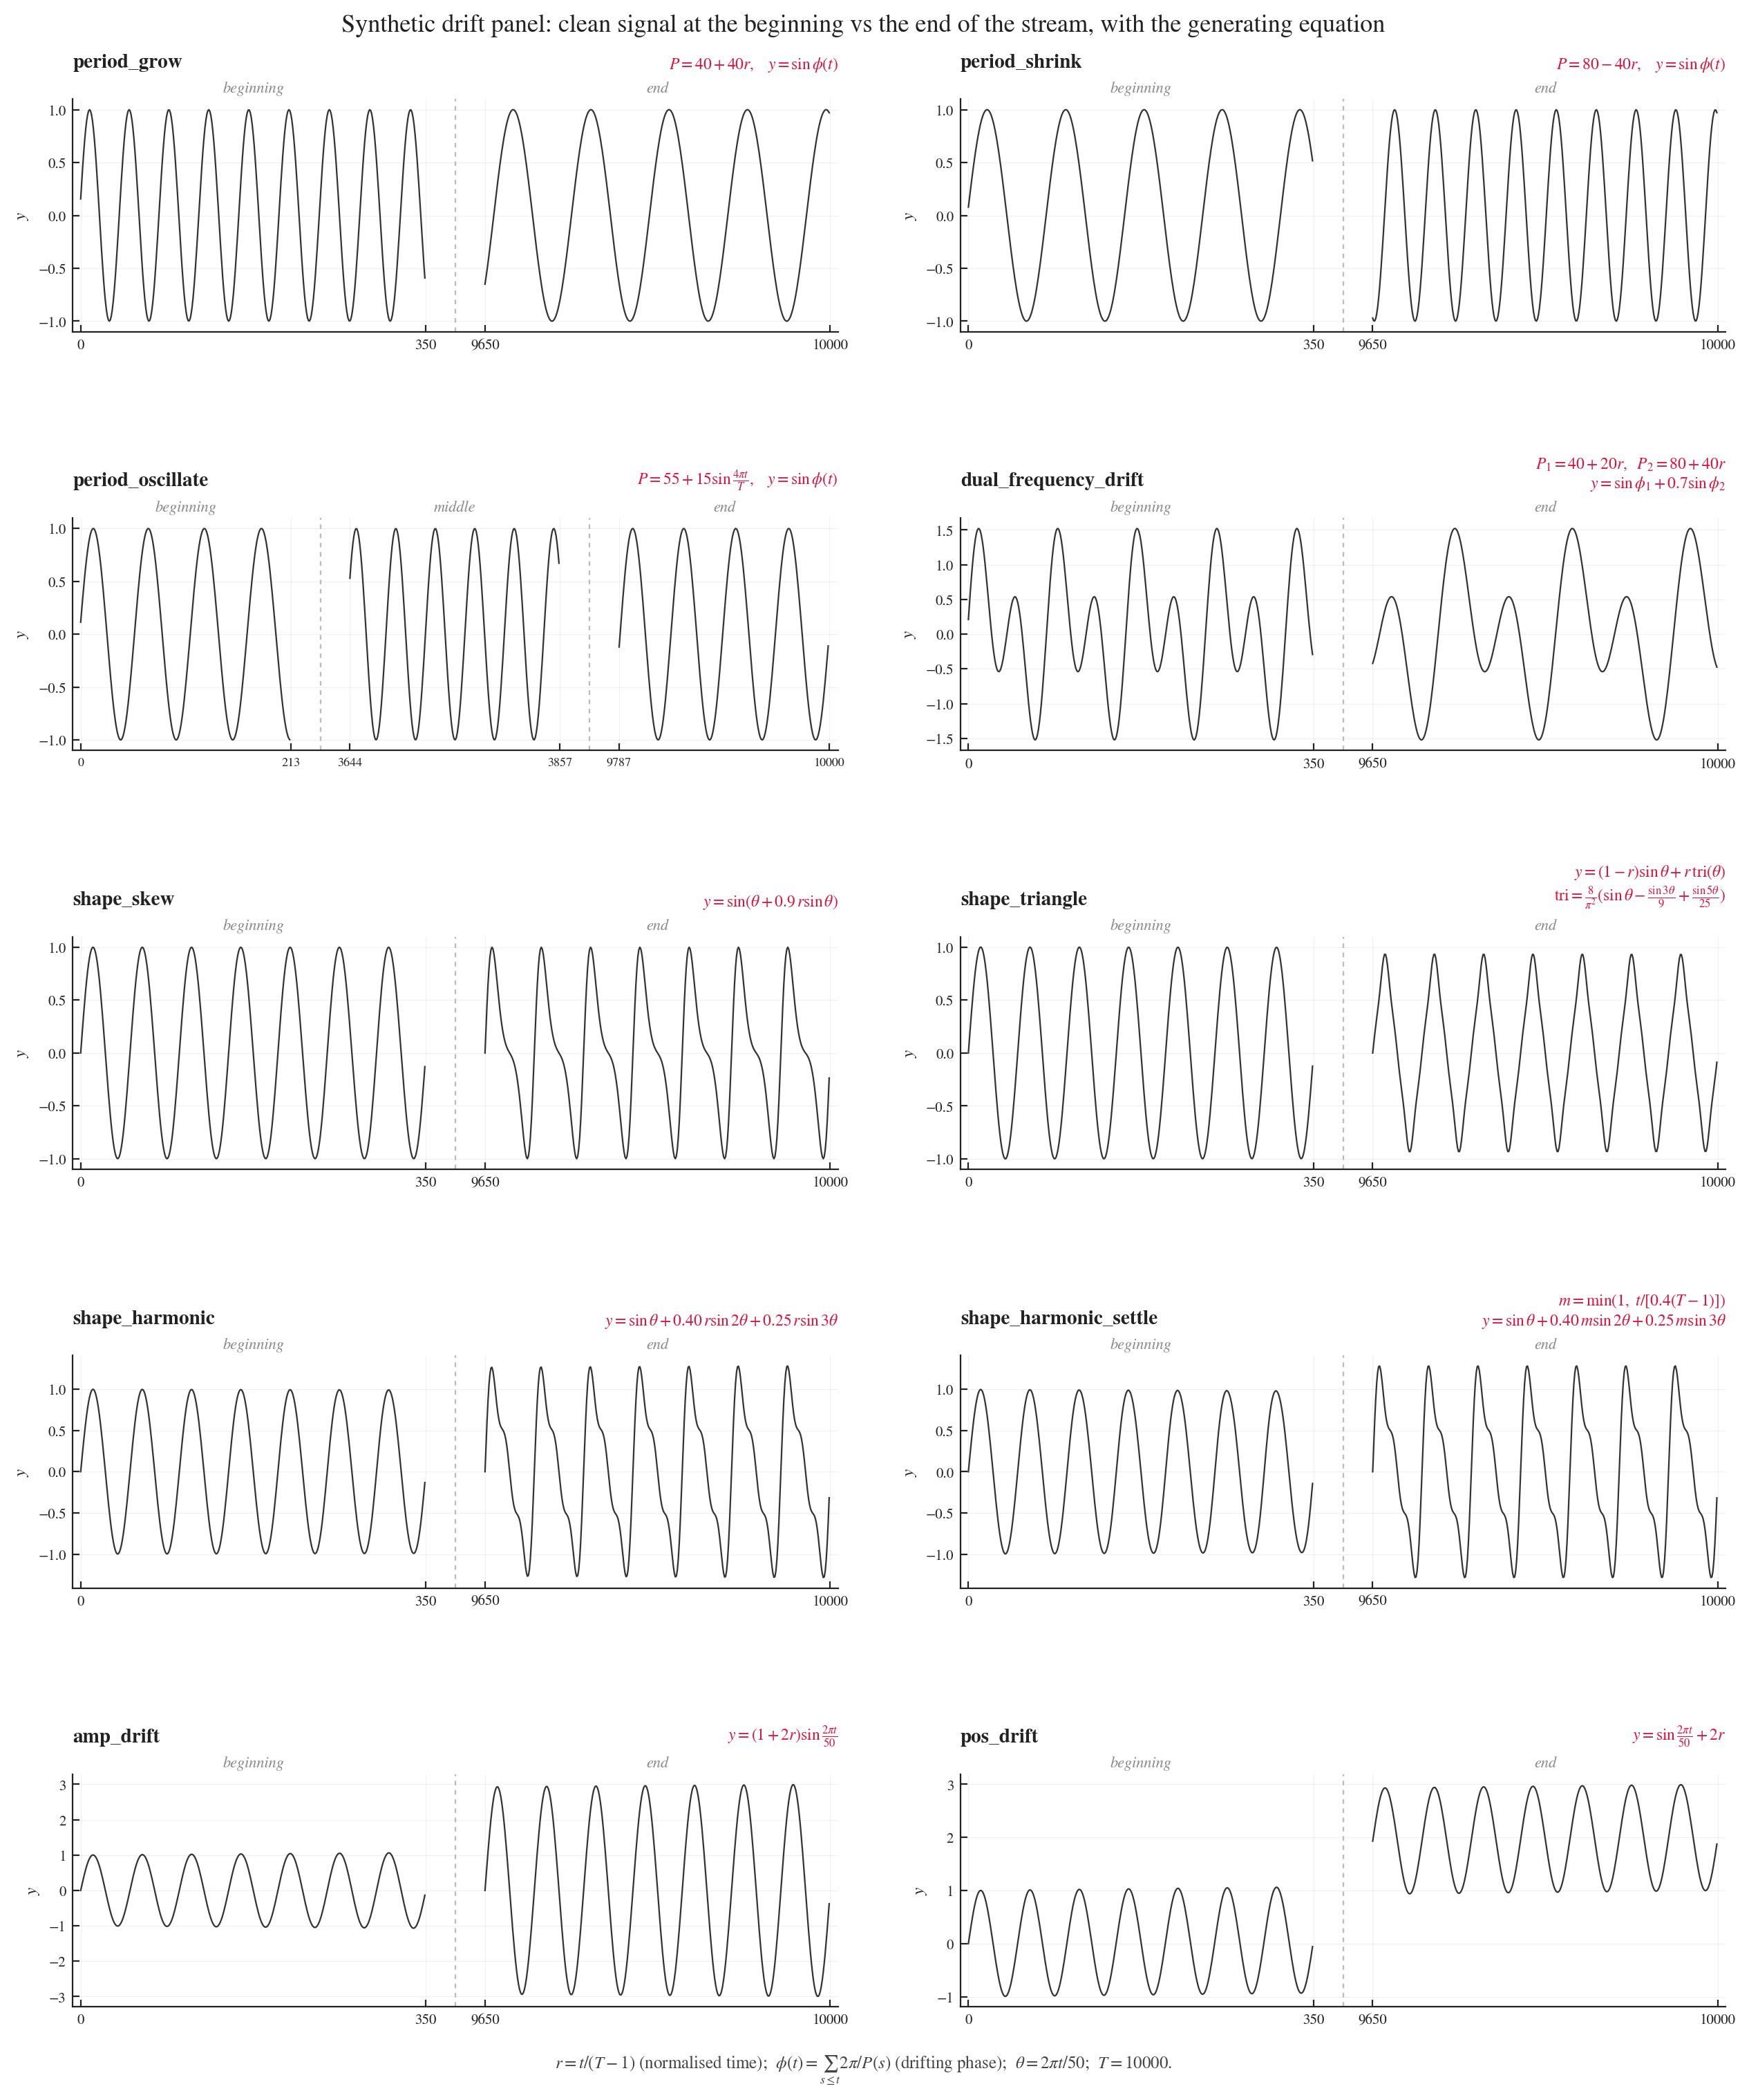
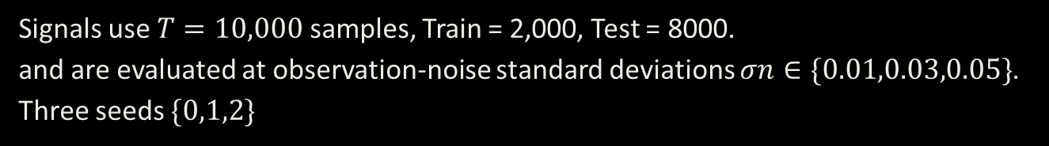
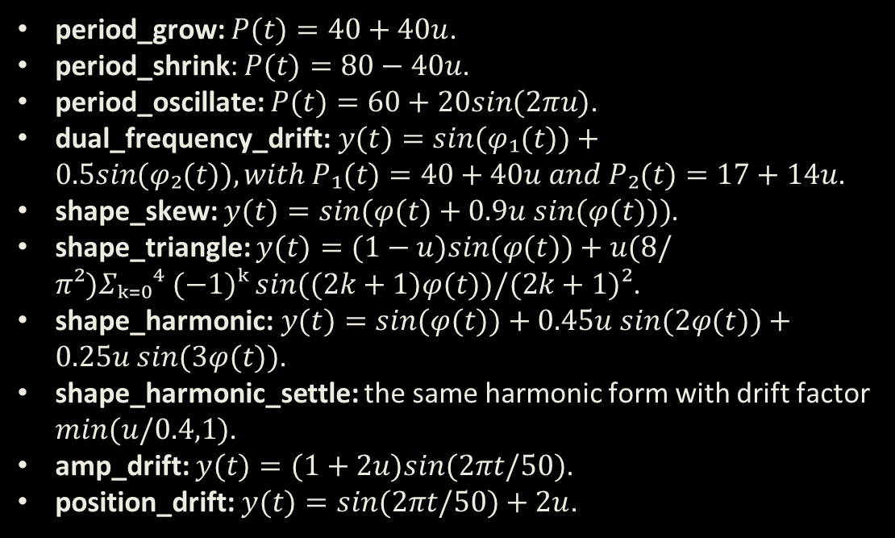
SYNTHETIC SIGNAL PANEL
Signals use $T=10,000$ samples, Train = 2,000, Test = 8000.
and are evaluated at observation-noise standard deviations $σn∈\{0.01,0.03,0.05\}$. Three seeds $\{0,1,2\}$
period_grow: $P(t)=40+40u$.
period_shrink: $P(t)=80−40u$.
period_oscillate: $P(t)=60+20sin(2πu)$.
dual_frequency_drift:$y(t)=sin(φ₁(t))+0.5sin(φ₂(t)), with P₁(t)=40+40u and P₂(t)=17+14u$.
shape_skew: $y(t)=sin(φ(t)+0.9u sin(φ(t)))$.
shape_triangle: $y(t)=(1−u)sin(φ(t))+u(8/π²)Σₖ₌₀⁴ (−1)ᵏ sin((2k+1)φ(t))/(2k+1)²$.
shape_harmonic:$y(t)=sin(φ(t))+0.45u sin(2φ(t))+0.25u sin(3φ(t))$.
shape_harmonic_settle: the same harmonic form with drift factor $min(u/0.4,1)$.
amp_drift: $y(t)=(1+2u)sin(2πt/50)$.
position_drift:$y(t)=sin(2πt/50)+2u$.
13
Figure 4.1 Ten-signal synthetic evaluation panel grouped by drift axis

Slide 24
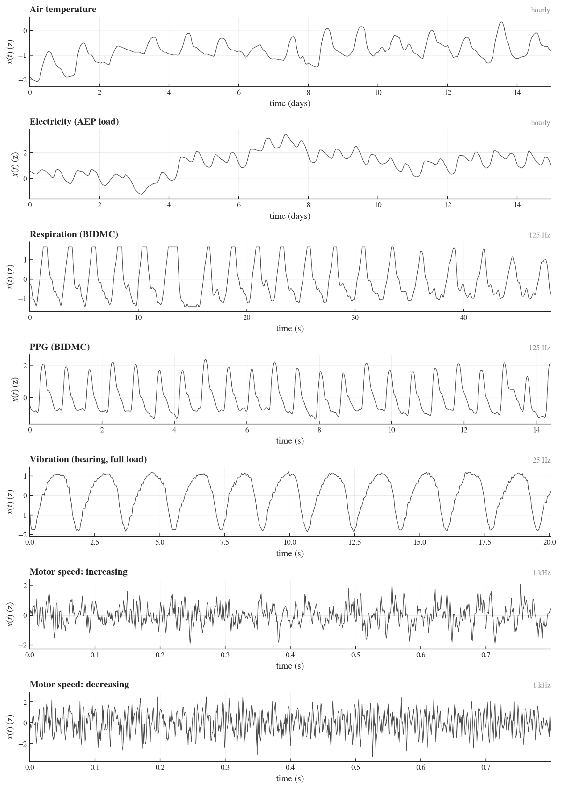
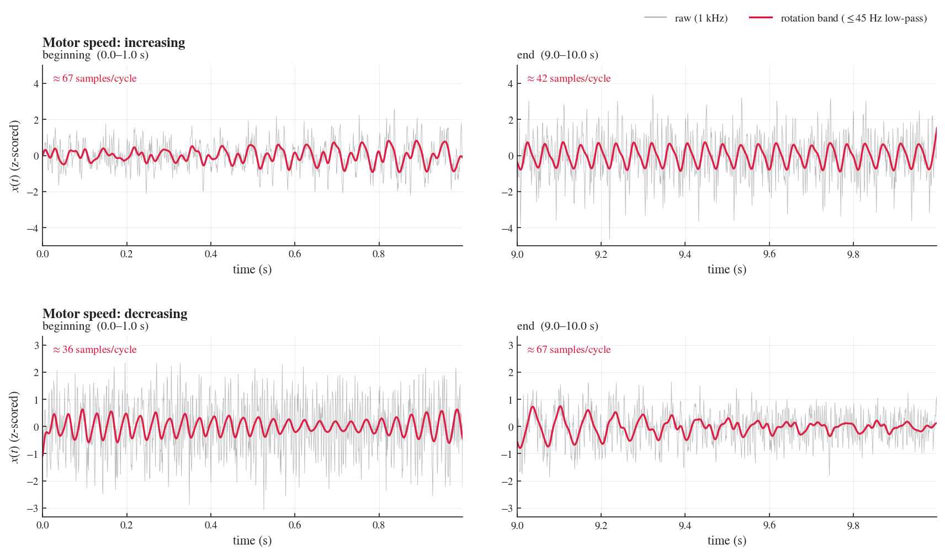
REAL WORLD SIGNAL PANEL
The real-world panel was selected to span biological, environmental, energy, and mechanical streams, including PPG, respiration, electricity demand, air temperature, bearing vibration, and changing-speed motor signals with naturally mixed and imperfectly observed dynamics.
Figure 4.3 Initial and final segments of the increasing- and decreasing-speed motor records
13
Figure 4.2 Representative measured records from the real-world evaluation panel

Slide 25
SYNTHETIC SIGNAL RESULTS
Signal | Persist | Kalman | Dlinear | PatchTST | LSTM | MycoMorph
period_grow | 0.0722 | 0.0406 | 0.737 | 0.171 | 0.0512 | 0.0303
period_shrink | 0.0807 | 0.0452 | 0.5183 | 0.2137 | 0.0758 | 0.0319
period_oscillate | 0.0859 | 0.0454 | 0.3727 | 0.1202 | 0.0801 | 0.0349
dual_freq_drift | 0.087 | 0.0428 | 0.454 | 0.1726 | 0.0515 | 0.0358
shape_skew | 0.0866 | 0.0473 | 0.0425 | 0.0369 | 0.0709 | 0.0291
shape_triangle | 0.082 | 0.043 | 0.0312 | 0.0326 | 0.0428 | 0.0292
shape_harmonic | 0.0946 | 0.0539 | 0.0288 | 0.0379 | 0.0857 | 0.029
harmonic_settle | 0.1067 | 0.0622 | 0.0314 | 0.028 | 0.0635 | 0.0292
amp_drift | 0.1788 | 0.0569 | 0.0285 | 0.029 | 0.0343 | 0.029
pos_drift | 0.0865 | 0.0421 | 0.0262 | 0.0259 | 0.0274 | 0.0292
6/10 lowest errors: MycoMorph
Mean error: 0.0308
Median error: 0.0292
Error range: 0.0290–0.0358
Period-drift wins: 4/4
Shape-drift wins: 2/4
Period-drift reduction vs ML models: 30.5%–57.9%
Baseline wins: DLinear 2/10; PatchTST 2/10
Table 5.1 Mean absolute error across the synthetic evaluation panel by signal.

Slide 26
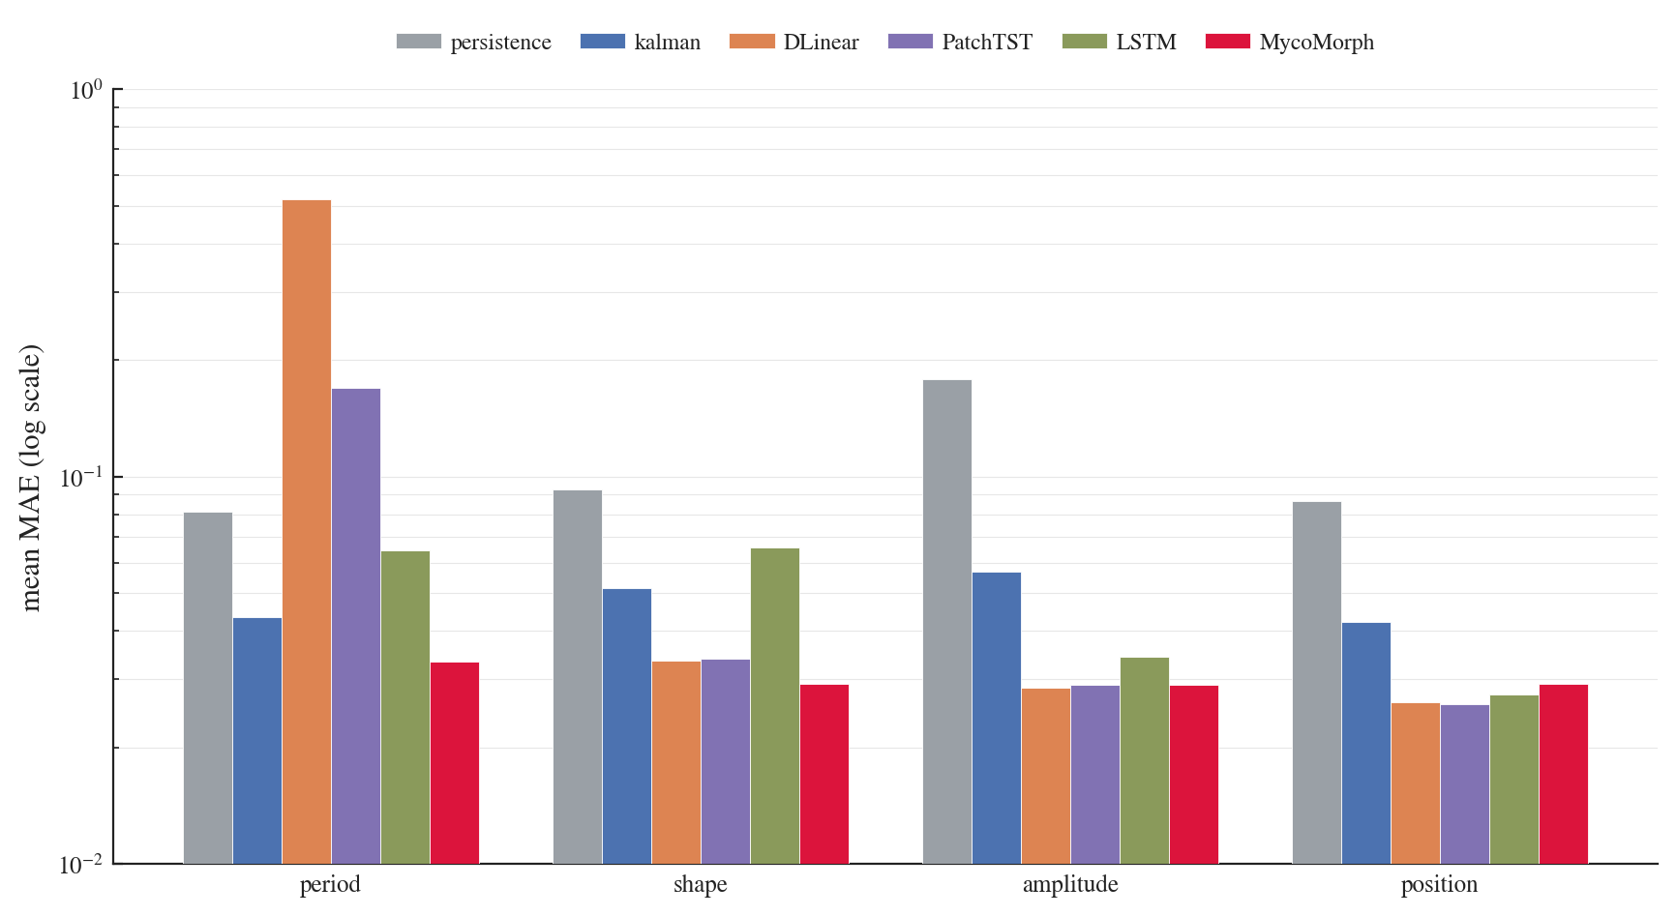
SYNTHETIC SIGNAL RESULTS
Figure 5.1 Synthetic-panel MAE by drift axis on a logarithmic scale.
Averaged over all signals, noise levels, and seeds within each category

Slide 27
REAL WORLD SIGNAL RESULTS
Signal | Persist | Kalman | Dlinear | PatchTST | LSTM | MycoMorph
bidmc01_pleth | 0.0047 | 0.0012 | 0.0026 | 0.0012 | 0.0013 | 0.0008
bidmc11_pleth | 0.0076 | 0.0014 | 0.0041 | 0.0016 | 0.0011 | 0.001
bidmc21_pleth | 0.0075 | 0.0014 | 0.0072 | 0.0019 | 0.002 | 0.0011
bidmc31_pleth | 0.0067 | 0.0011 | 0.003 | 0.0023 | 0.0016 | 0.0008
bidmc41_pleth | 0.0043 | 0.001 | 0.0057 | 0.0015 | 0.001 | 0.0008
bidmc01_resp | 0.0057 | 0.0007 | 0.0055 | 0.0013 | 0.0012 | 0.0007
bidmc11_resp | 0.0031 | 0.0011 | 0.0029 | 0.0013 | 0.0012 | 0.0011
bidmc21_resp | 0.0065 | 0.0009 | 0.0077 | 0.0019 | 0.0023 | 0.0009
bidmc31_resp | 0.0052 | 0.0007 | 0.0036 | 0.001 | 0.002 | 0.0007
bidmc41_resp | 0.0057 | 0.0011 | 0.0051 | 0.0017 | 0.0043 | 0.0012
aep_electricity | 0.1622 | 0.09 | 0.0708 | 0.0423 | 0.057 | 0.0674
air_temperature | 0.1238 | 0.0574 | 0.0557 | 0.0347 | 0.0427 | 0.0468
vibration_fullload | 0.1684 | 0.1234 | 0.2395 | 0.1327 | 0.1399 | 0.097
motorspeed_increasing | 0.7982 | 1.0116 | 0.8966 | 0.7833 | 0.7568 | 0.6892
motorspeed_decreasing | 0.7499 | 0.7422 | 0.8154 | 0.7773 | 0.9873 | 0.7245
Outright lowest error: MycoMorph 8/15
Lowest or tied-lowest error: 12/15
Best deep-learning comparison: MycoMorph 13/15
Reduction vs best deep model on wins: 6.8%–52.6%
Mean reduction vs best deep model on wins: 27.6%
Median reduction vs best deep model on wins: 29.4%
BY SIGNAL GROUP
Plethysmography: outright best 5/5
Respiration: tied best 4/5; second-best 1/5
Vibration: outright best 1/1
Changing motor speed: outright best 2/2
Electricity and air temperature: PatchTST best 2/2
Table 5.5 Mean absolute error on the fifteen real-world records.
9

Slide 28
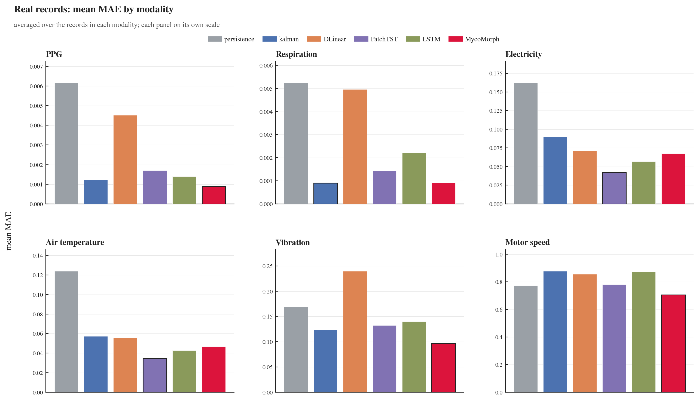
REAL WORLD SIGNAL RESULTS
Figure 5.2 Real-world MAE by signal modality.

Slide 29
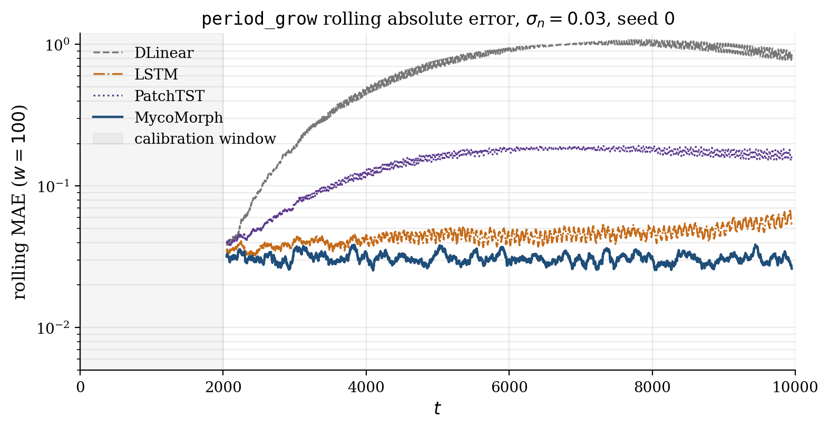
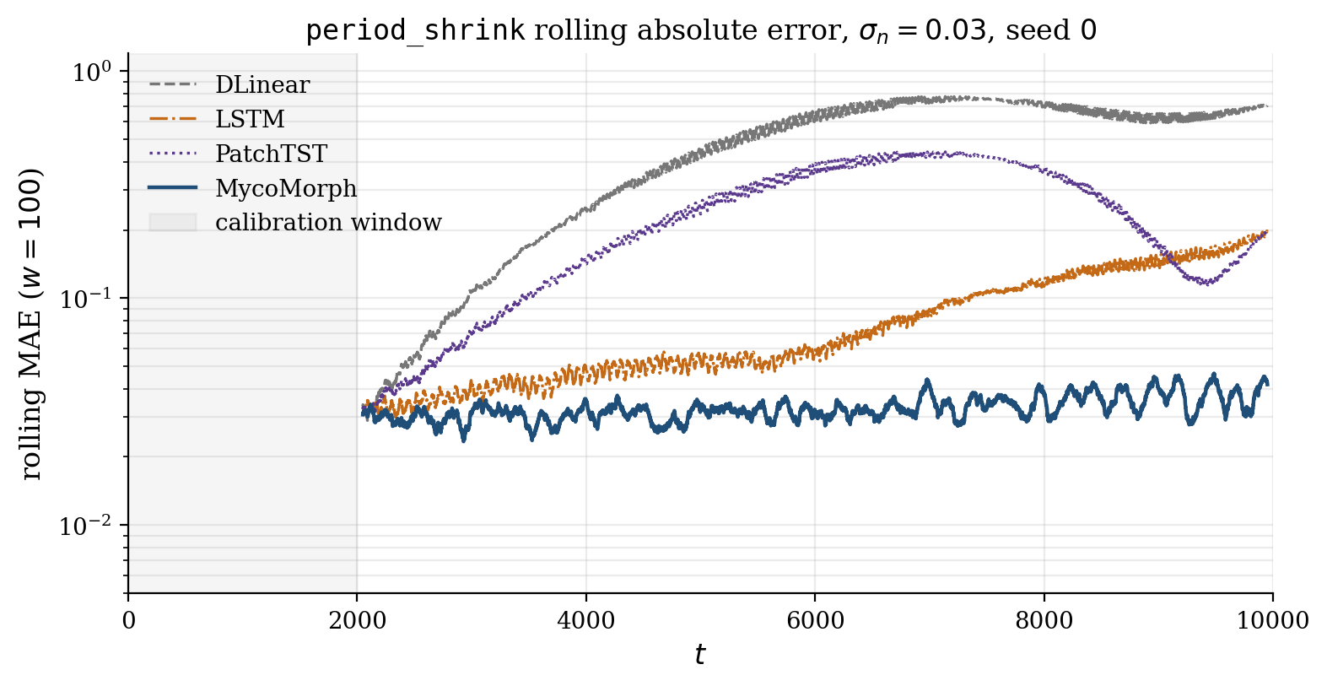
RESULTS: ERROR TRAJECTORIES
Figure 5.3 Rolling absolute error for period_grow and period_shrink at seed 0 and observation-noise level $σ_{n} = 0.03$.

Slide 30
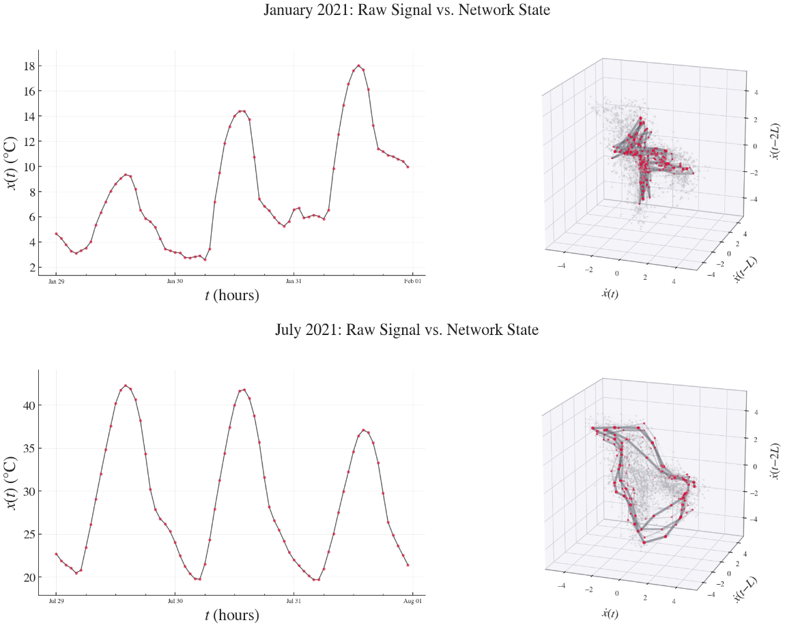
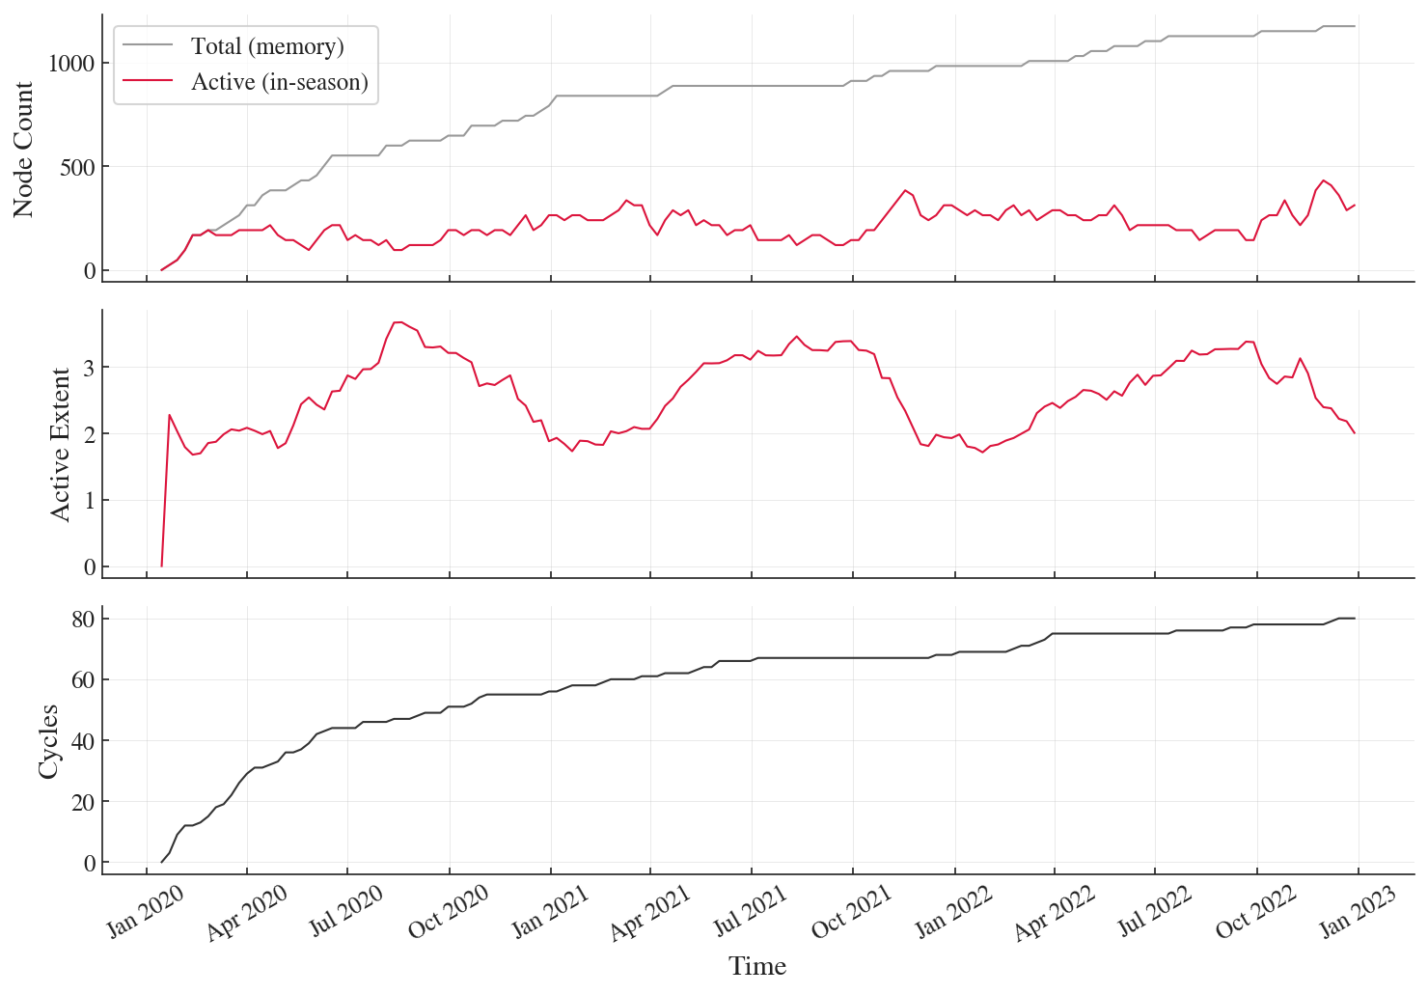
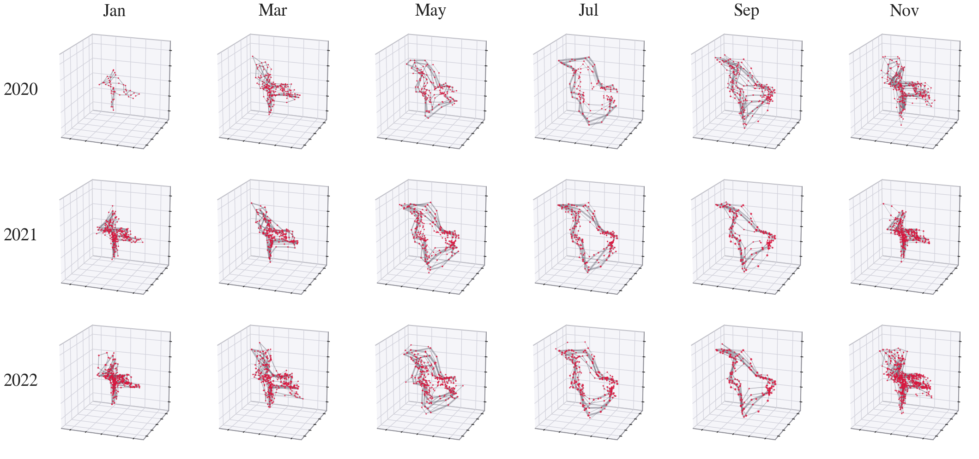
EMERGENT TOPOLOGY & STRUCTURAL MEMORY
Figure 5.4 Active graph topology at selected times in the air-temperature record
Figure 5.6 Total graph nodes, active nodes, and meta-graph cycles over the air-temperature stream
Figure 5.5 Recurrence of related pathways across three years of the air-temperature record.

Slide 31
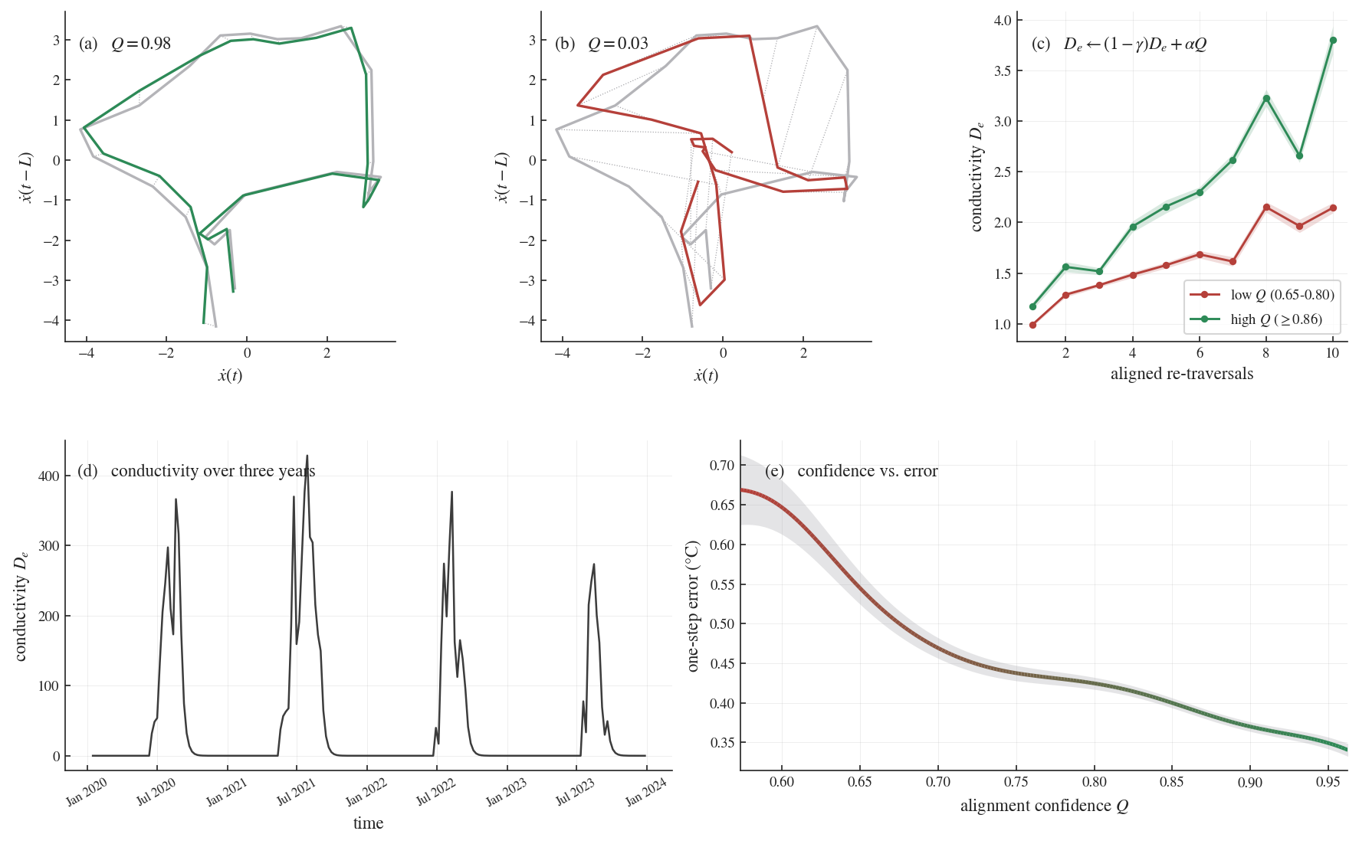
EMERGENT TOPOLOGY & STRUCTURAL MEMORY
Figure 5.7 Alignment-dependent pathway reinforcement in the air-temperature record.

Slide 32
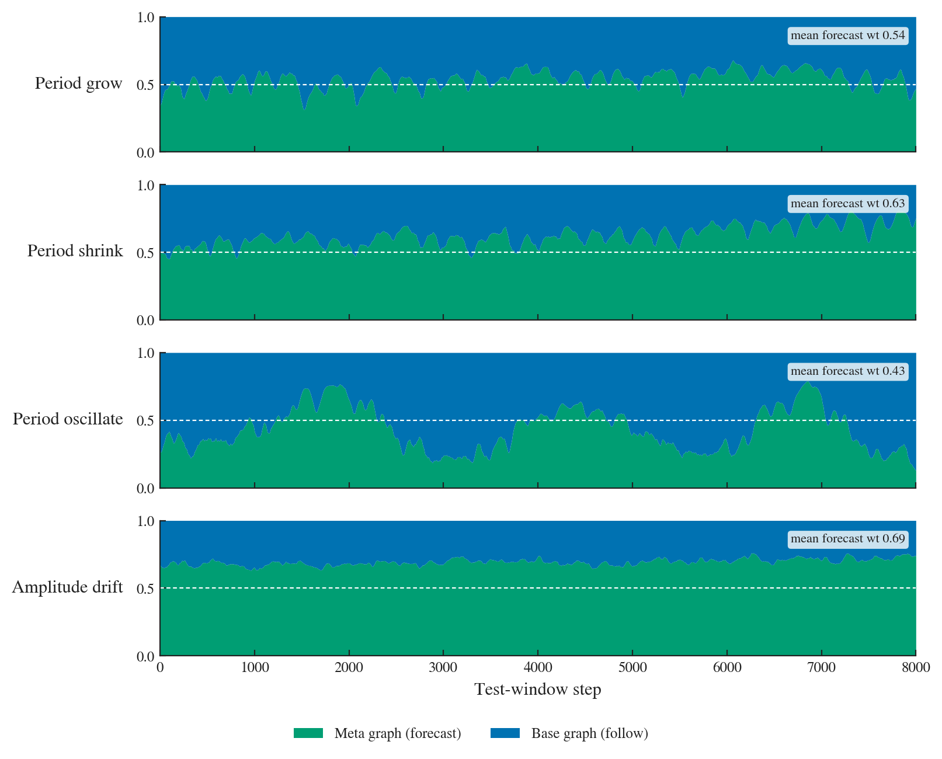
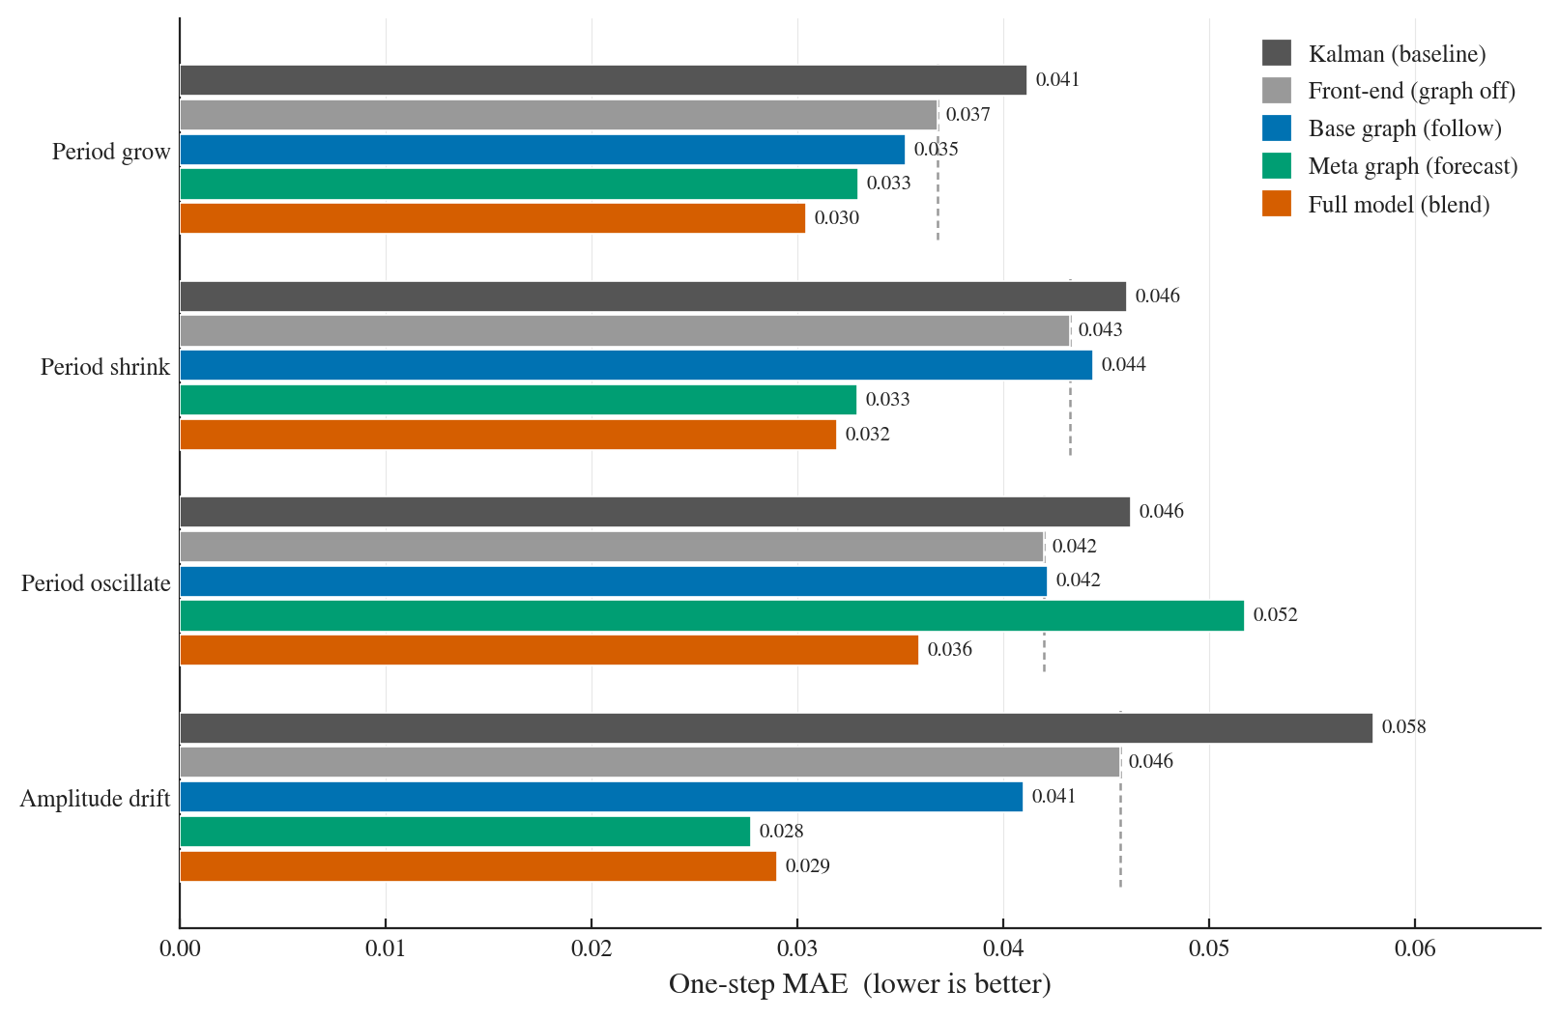
ABLATION TESTING
Ablation testing isolates each architectural component to determine which stages of the pipeline contribute to prediction

Slide 33
DISCUSSION
Synthetic Panel Results: Interpretation
Real World Results: Interpretation
Period drift favors structural tracking
Shape drift requires new pathways
Noise reveals the role of geometry
Deep models learn averaged mappings
Fixed parameters blur incompatible regimes
Strongest on locally recurrent signals
Robust biological forecasting
Advantage under changing dynamics
Not universally dominant
Consistent deep-learning advantage
Structural Analysis: Interpretation
Ablation Testing: Interpretation
Topology grows selectively
Consolidation limits expansion
Conductivity records use
Memory remains reusable
Structure reflects regime complexity
Front end alone improves the Kalman baseline,
Meta graph drives smooth trend adaptation
Base graph supports irregular recurrence
Blending improves robustness
Notes:
Synthetic panel – time warping
Transfers directly real world panel results

Slide 34
LIMITATIONS, APPLICATIONS, FUTURE WORK
Potential Applications
Robotics
Condition monitoring
Edge sensing
Physiological monitoring
Infrastructure sensing
Limitations
Future Work
Evaluation scope
Forecasting scope
Untested conditions
Calibration dependence
Deployment gap
Biological abstraction
Return-to-regime studies
Broader continual-learning comparisons
Architectural extensions
Bounded memory
Hybrid forecasting
Embedded deployment

Slide 35
CONCLUSION
Core contributions of this thesis
01 Novel Architecture for Continuous Streaming Forecasting
    Matérn state-space model → Kalman filter → RTS smoother → Takens first-derivative delay embedding
    Two-layer temporal graph architecture with hybrid prediction
02 Unique Implementation of Biological Network Properties
    Direct reinterpretation of Physarum equation for temporal alignment
    Conceptual principles of reinforcement, decay, consolidation, and reactivation
03 Holistic Evaluation and Structural Diagnostics
    10 synthetic signals, 15 real world datasets
    Network analysis and ablation testing of individual mechanisms
    Direct correspondence with mechanical and robotic use cases
04 Broader Implications of Adaptive Network Design
    Initial evidence of the advantages and limitations of evolving structure and local pathway dynamics
    Bridge to unconventional computing

