Slide 1
Churn Modeling
by Hollis Nolan

Slide 2
Why Model Churn?
Often cheaper to retain a customer than acquire a new one
Needed for accurate growth prediction
Identifies customers most at risk
Identifies features that most contribute to customers leaving

Slide 3
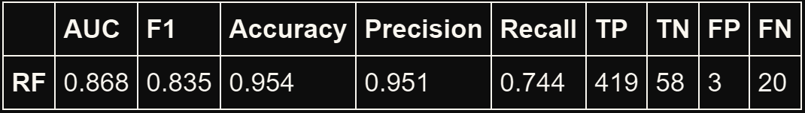
The Results: Extremely Random Forest tuned with Recall

Slide 4
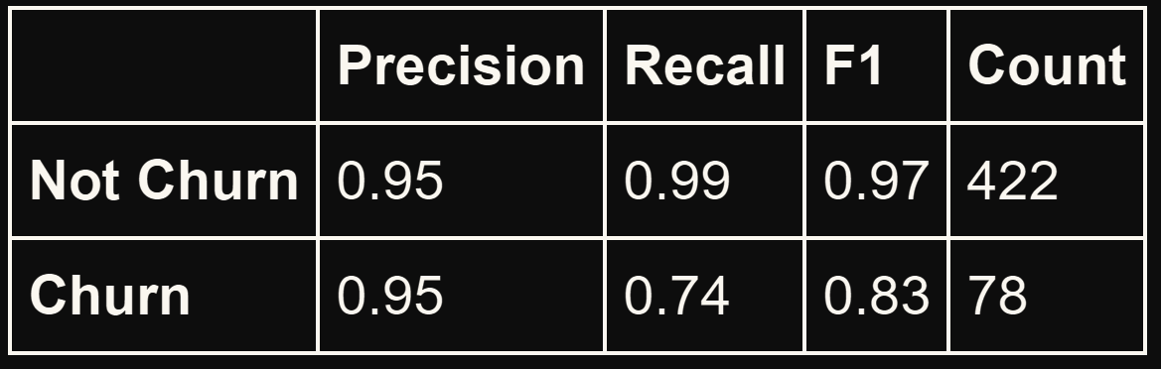
The Results: Extremely random forest tuned with recall

Slide 5
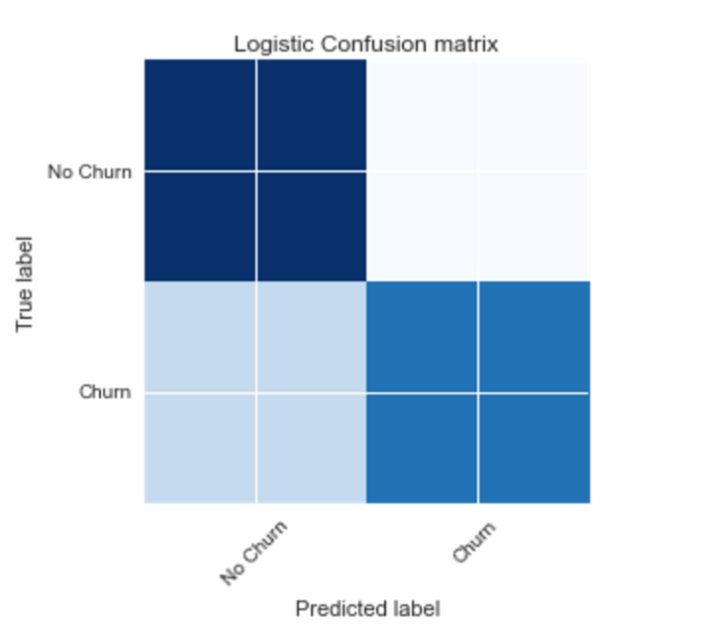
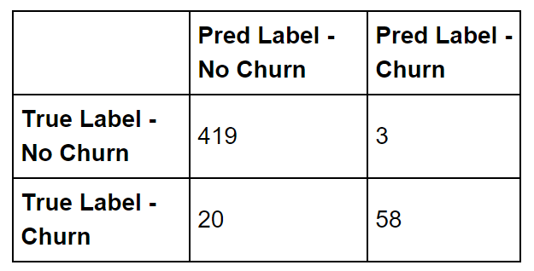
The Results: Confusion Plots

Slide 6
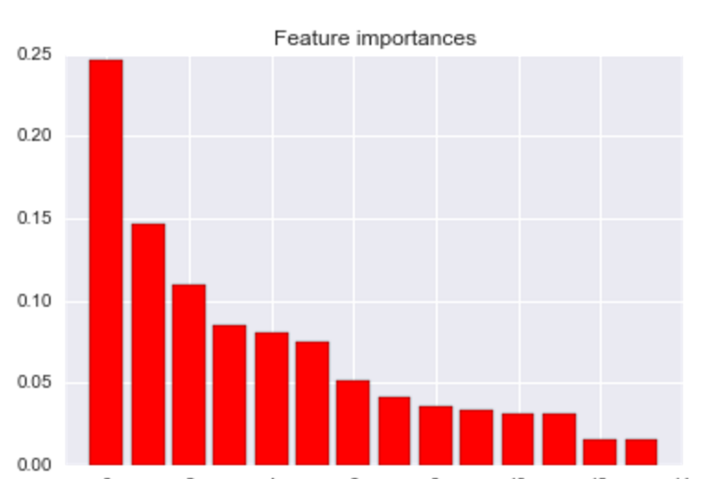
The Results: Feature Ranking
Account Length (0.246606)
Account Length (.24)
Vmail Messages (.14)
Day Mins (.10)
Day Calls (.09)
Eve Mins (.08)

Slide 7
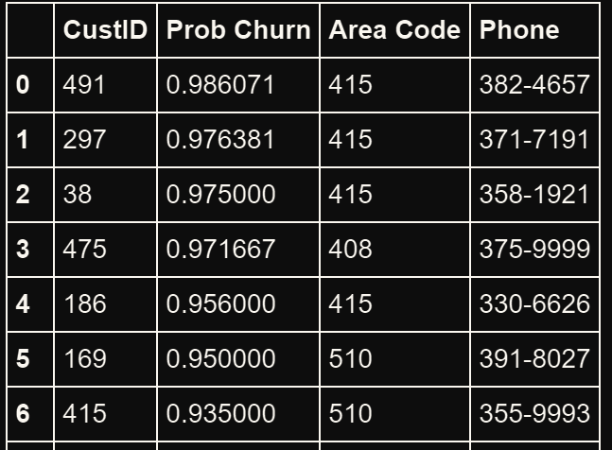
The Results: Most at Risk Customers

Slide 8
Time For Some Code

Slide 9
Thank You
Code available at https://github.com/hollisn/GU-Churn-Model

