Slide 1

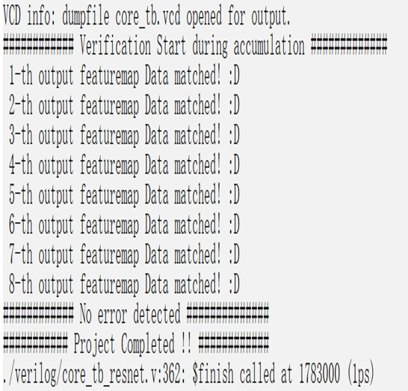
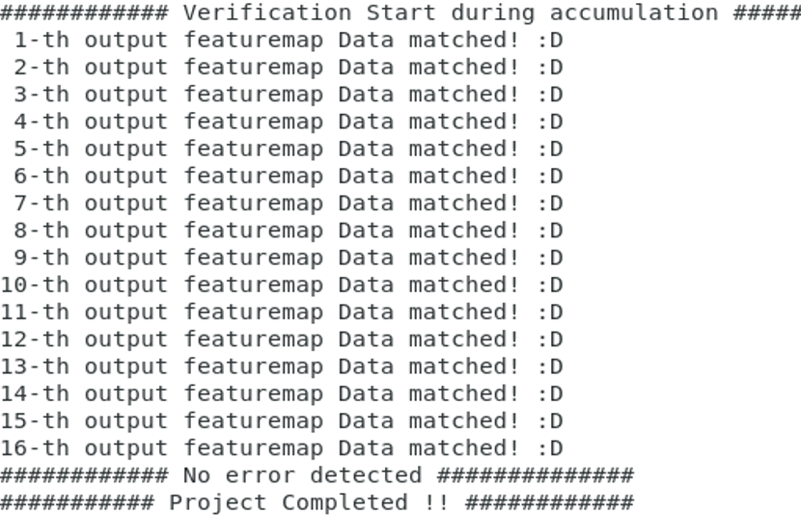
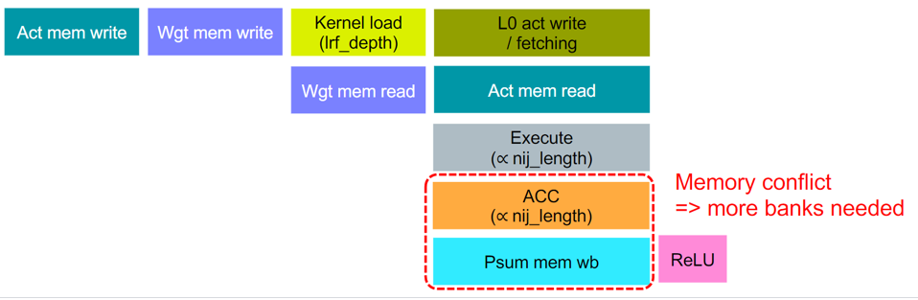
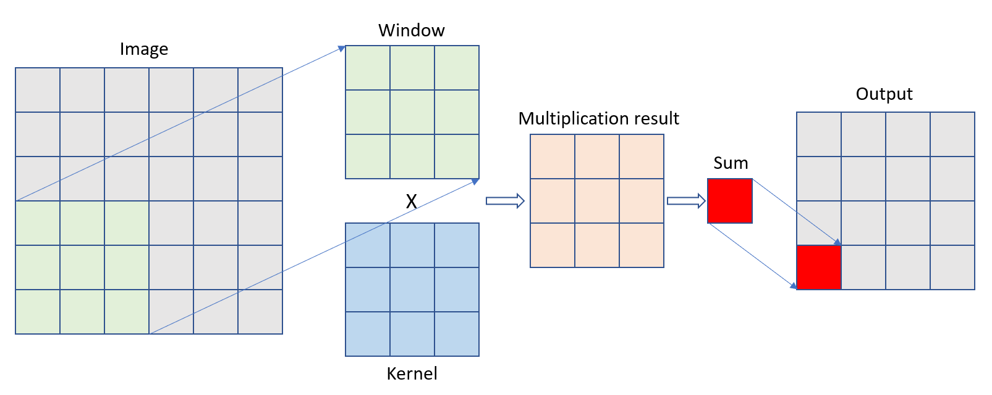
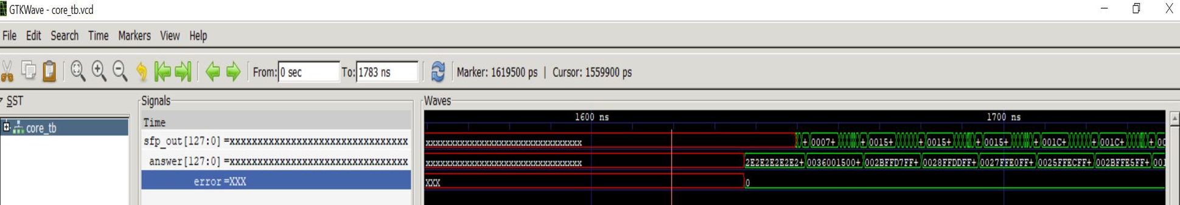
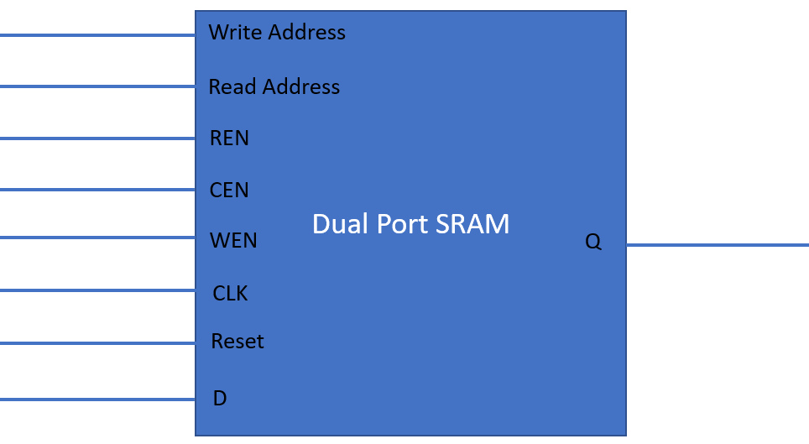
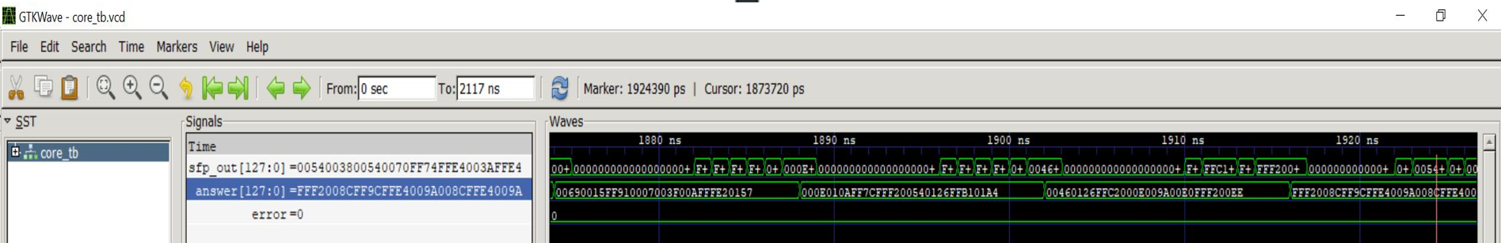
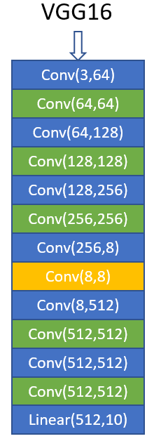
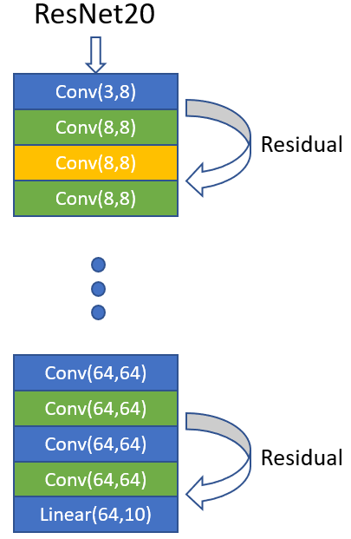
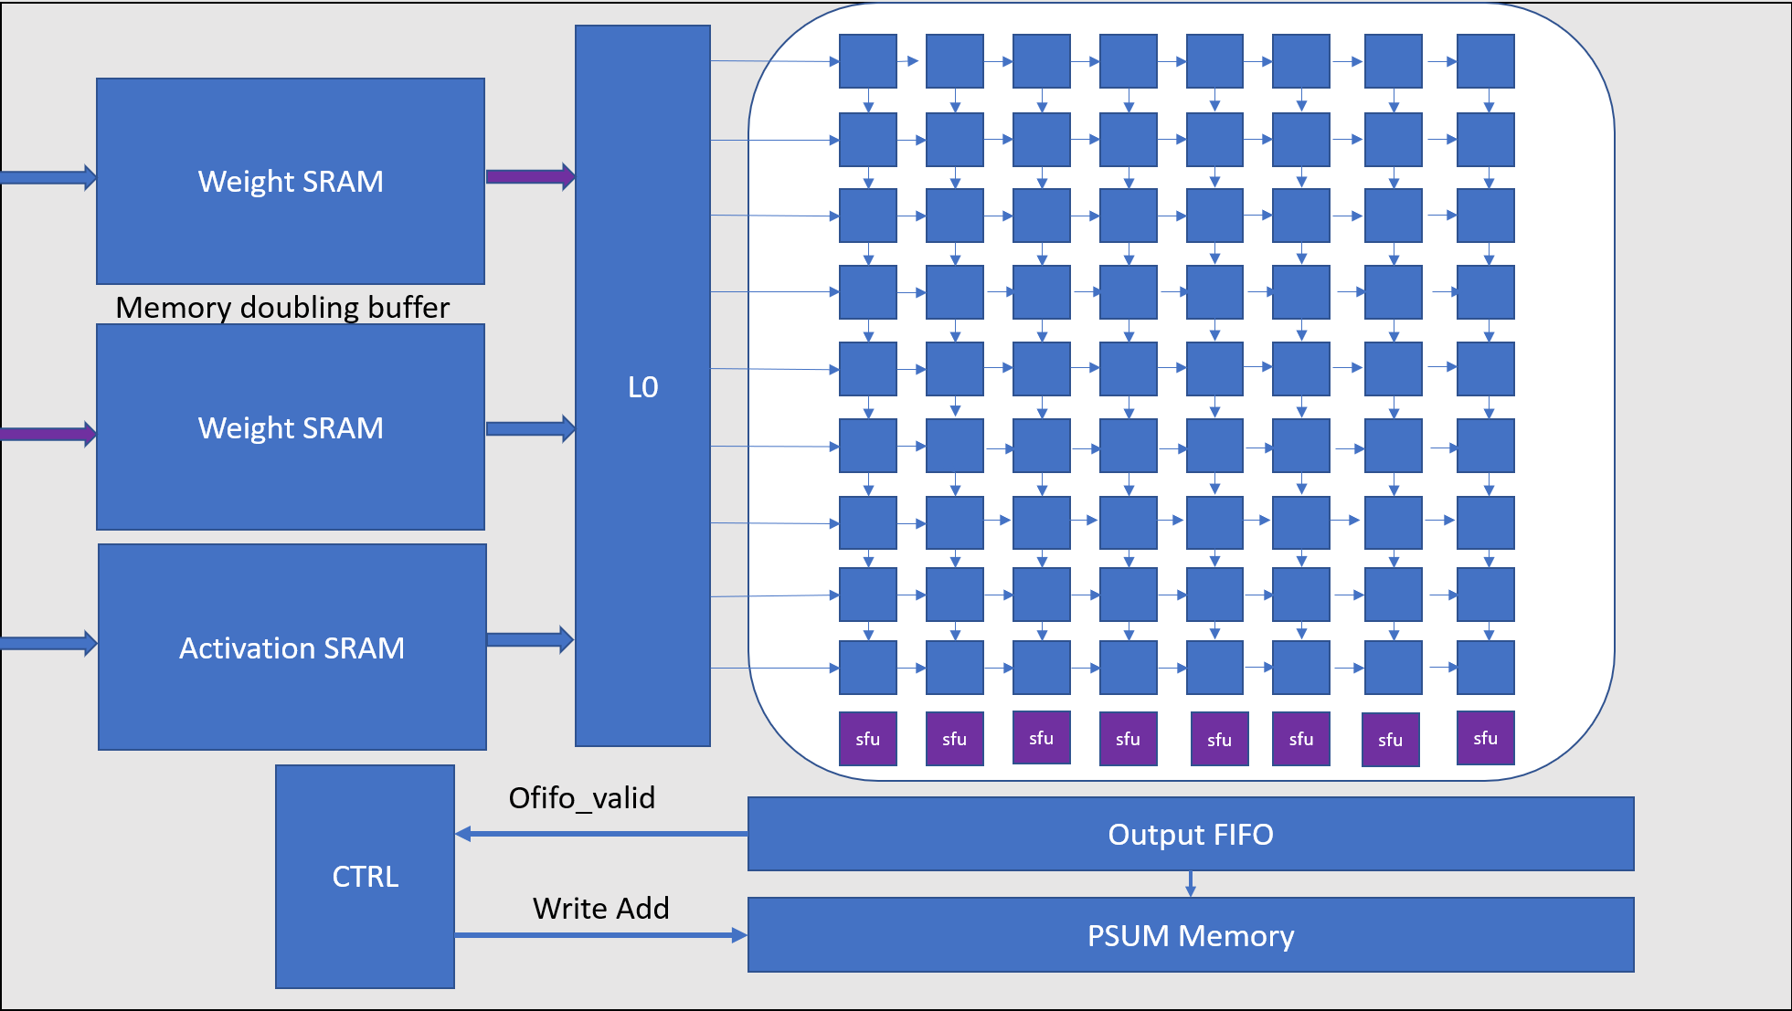
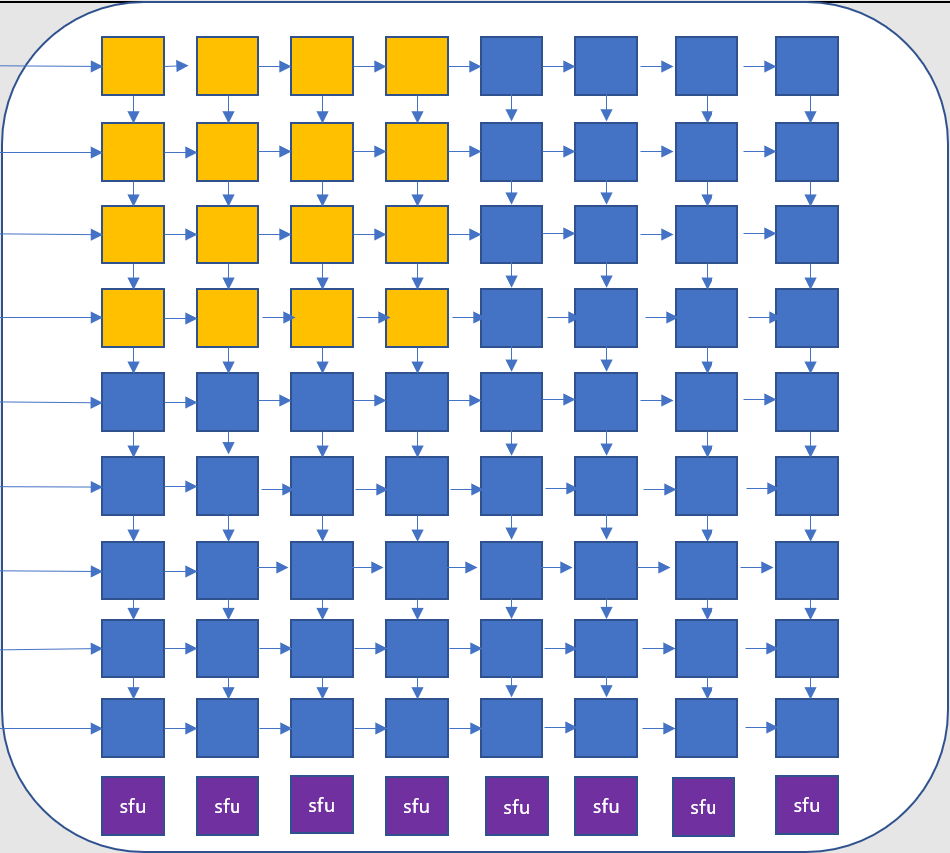
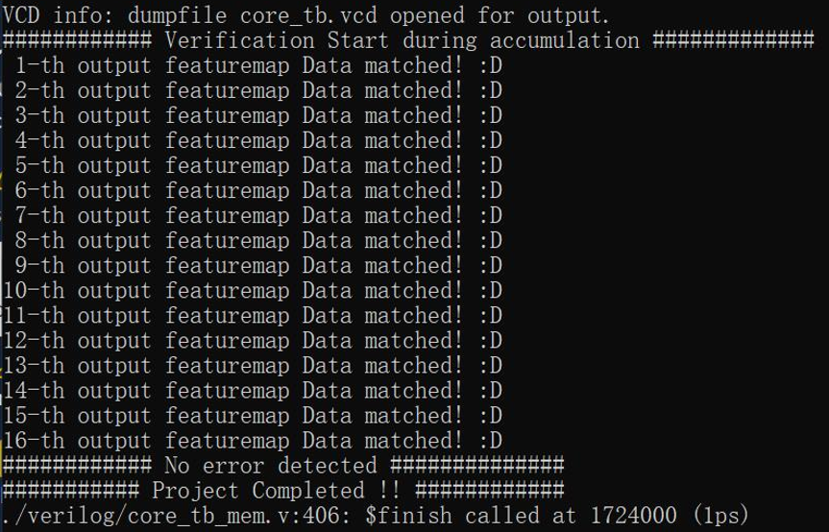
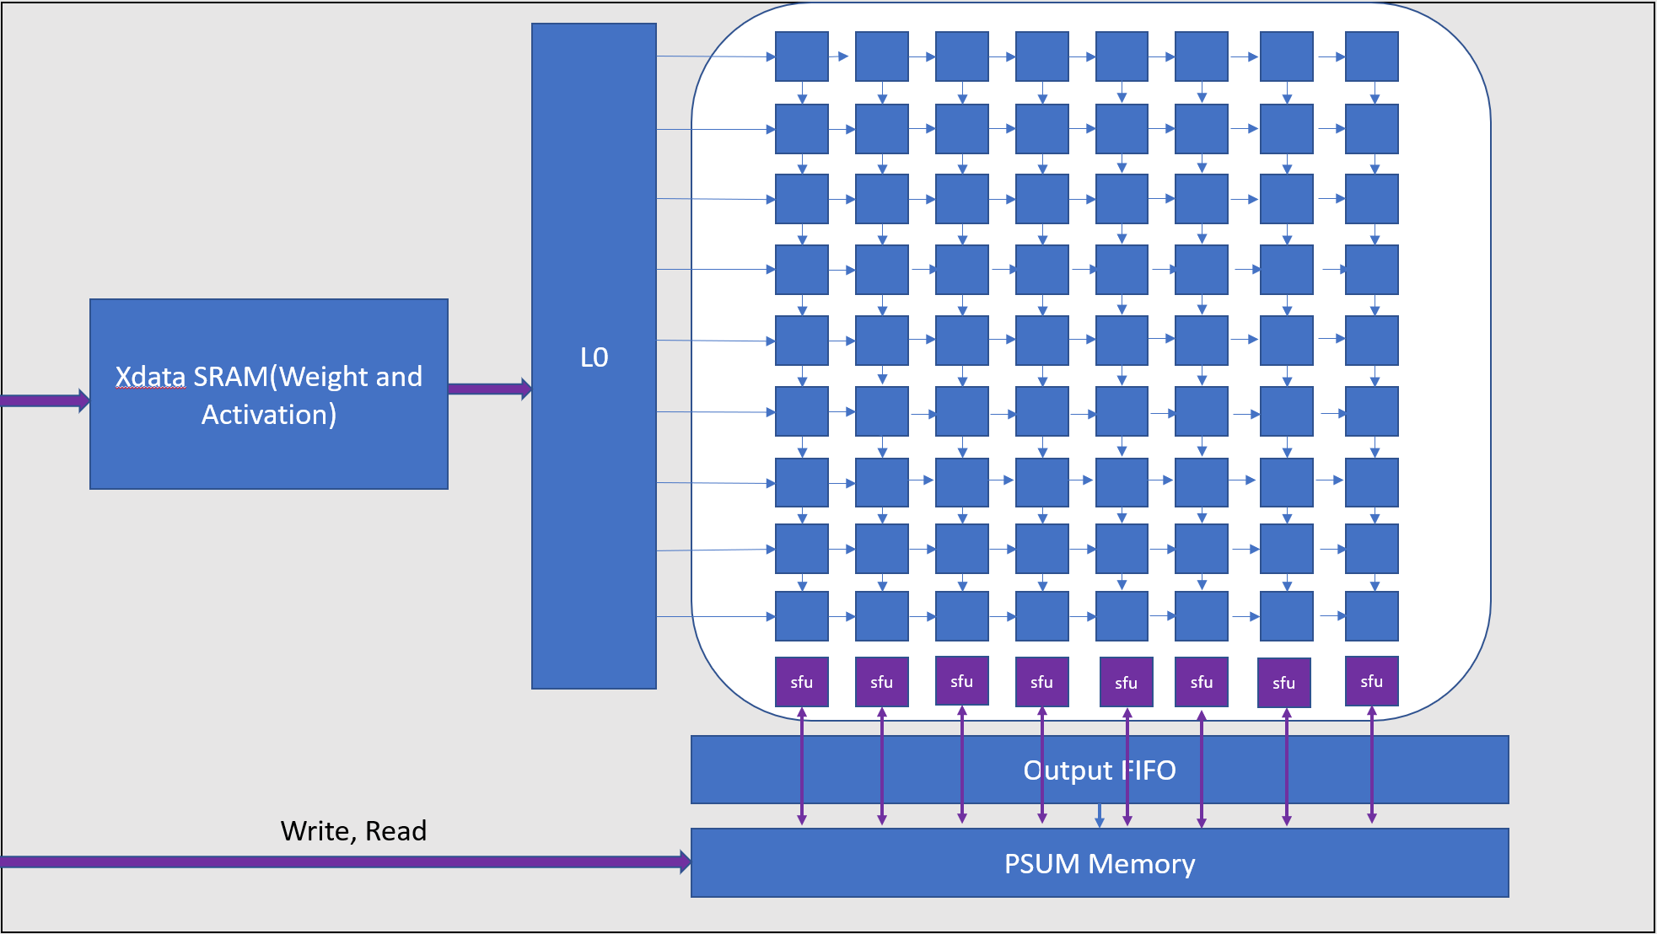
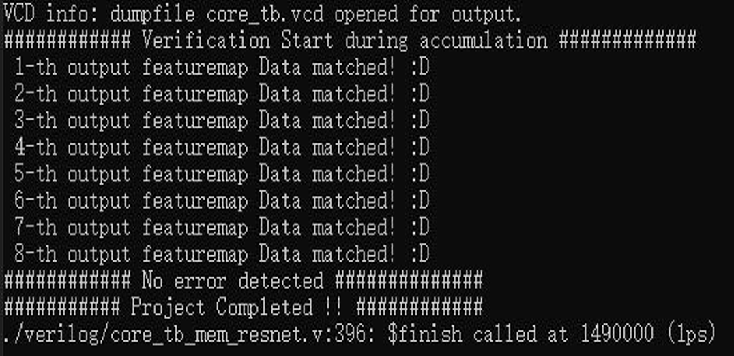
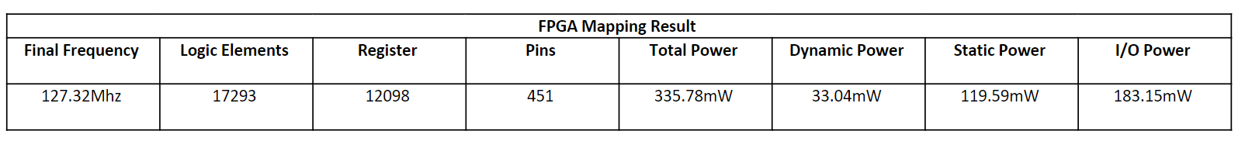
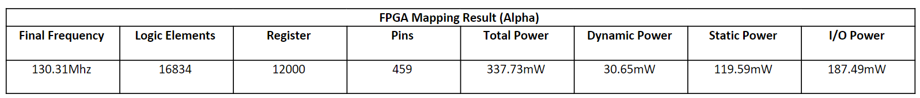
ECE284: VGGNet and ResNet on 2D Systolic Array
Chenyu Wu, Haoliang Wei, Yizheng Yu, Zian Wang
{chw080,h5wei,yiy003,ziw080}@ucsd.edu
Introduction
Verification
Optimization
In this project, a 2D systolic array computing architecture is implemented and optimized for accelerating convolution in various CNN models. Both software and hardware verifications are done for the design, as well as mapping it onto Cyclone IV GX FPGA.
CNN Models
VGG16 Model Accuracy: 90.63%
Psum Error:
2.2645*10-7
Alpha Version Design and Verification
ResNet20 Model Accuracy: 89.87%
Psum Error:
3.4376*10-7
After we added the extra parts, we tested the VGG and ResNet data. The results show no error. We also tested our design with (4, 4) channels model.
Base Design
FPGA Mapping

