Slide 1


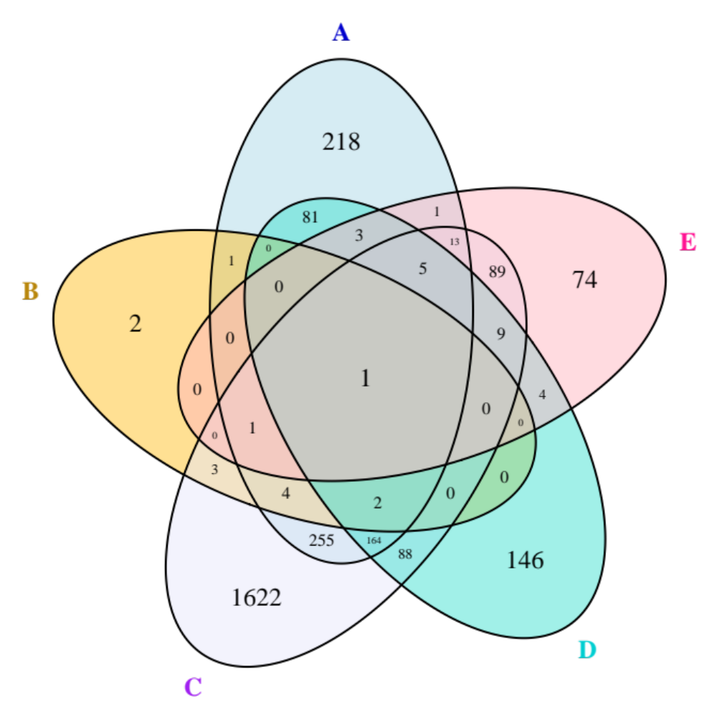
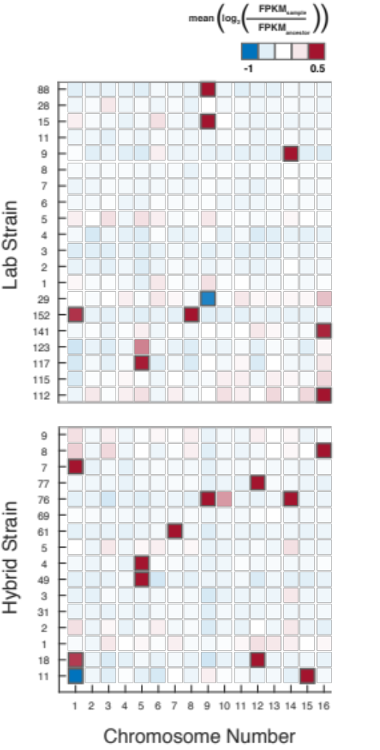
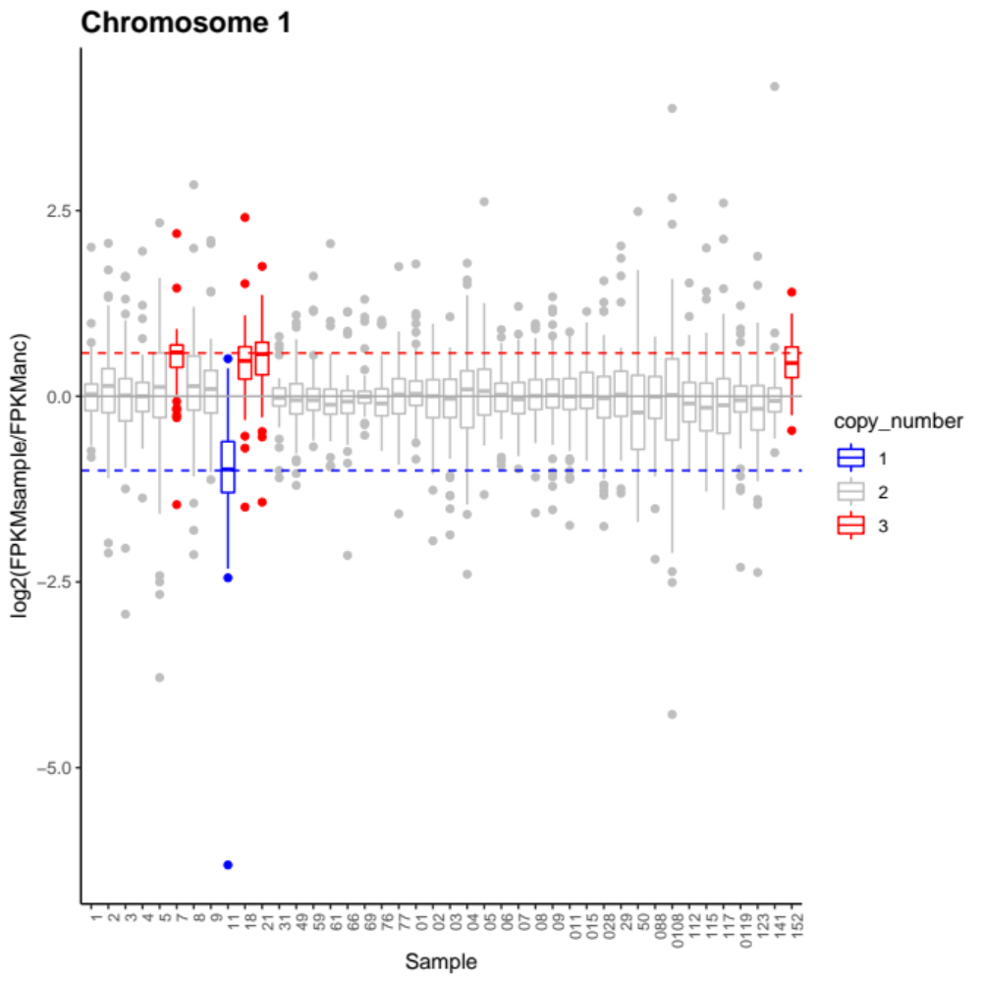
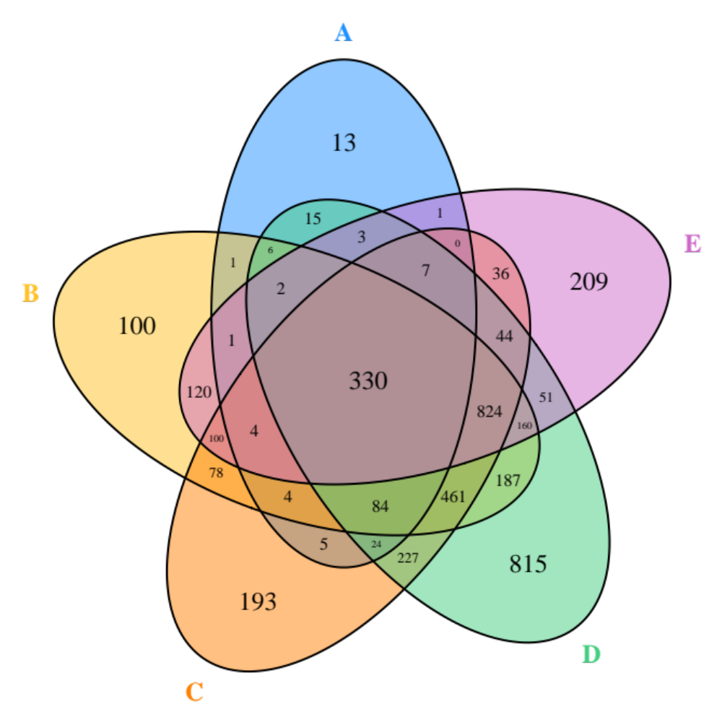
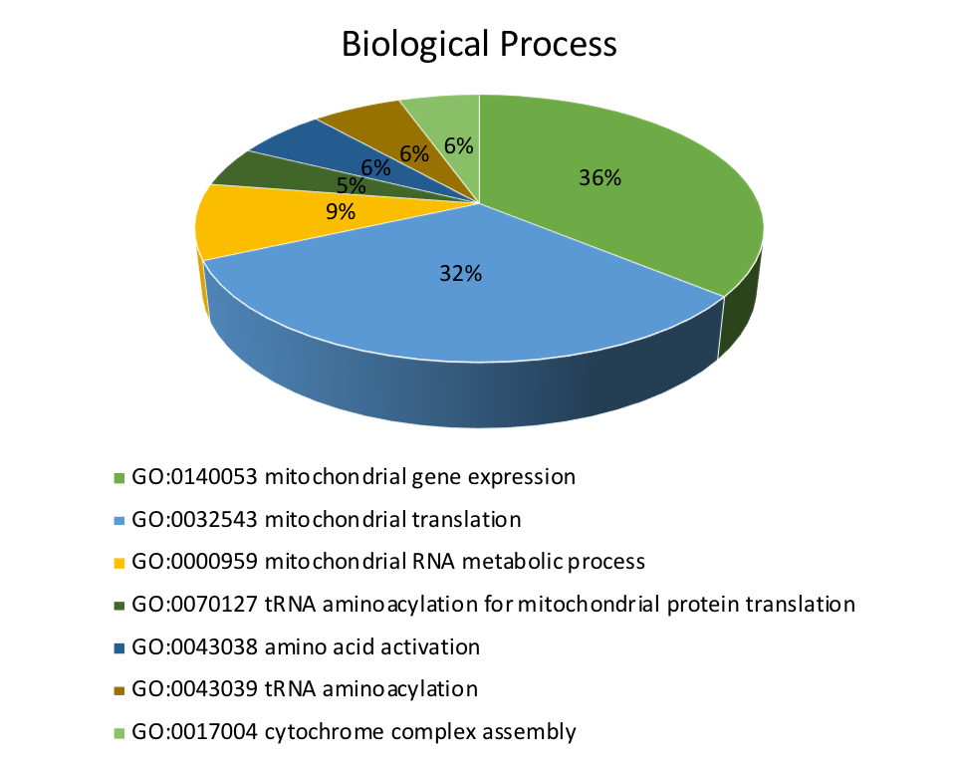
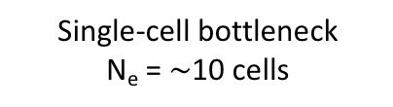
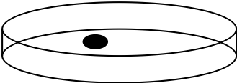


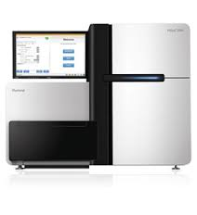
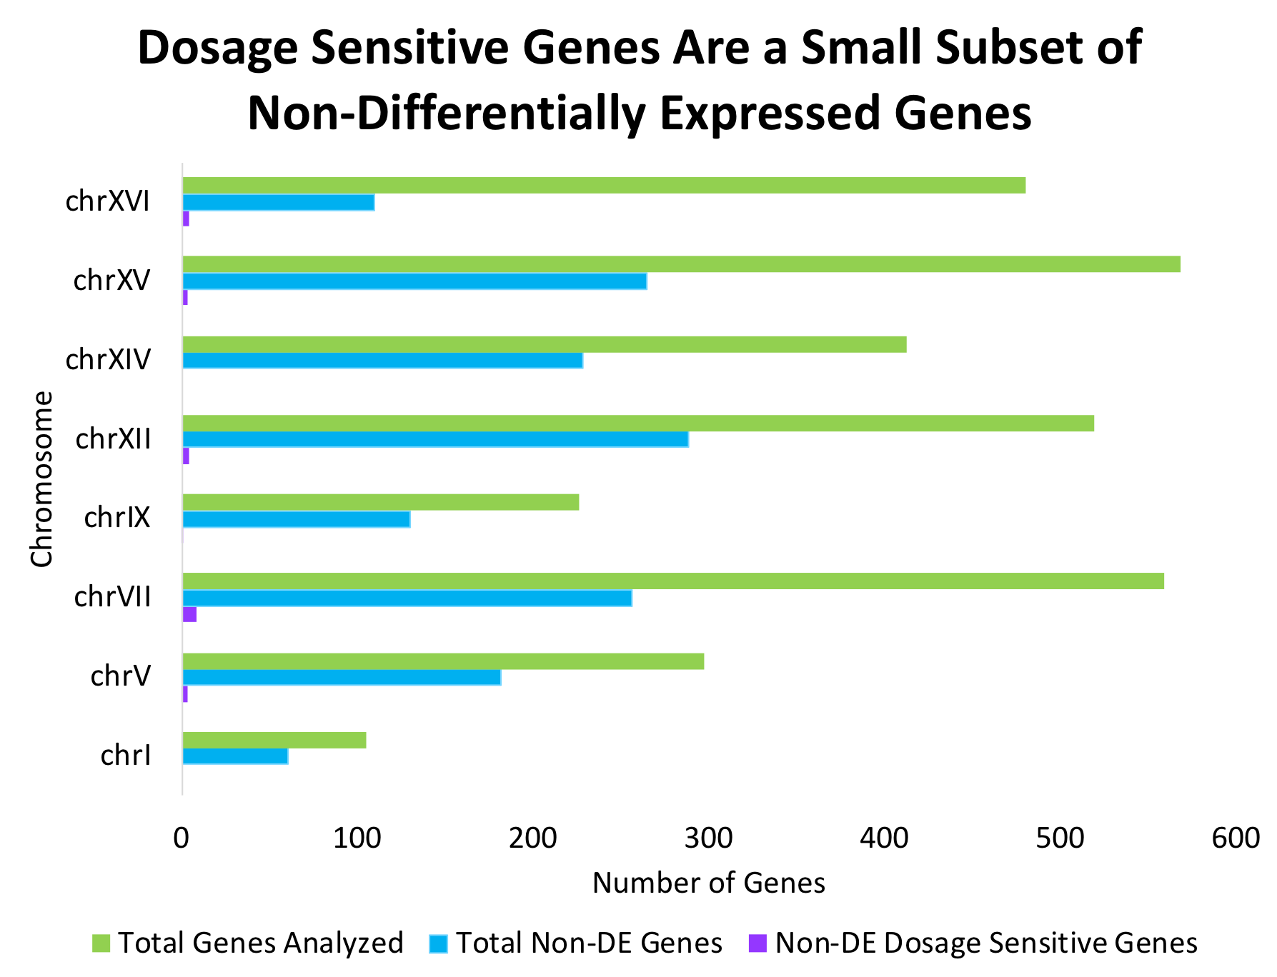
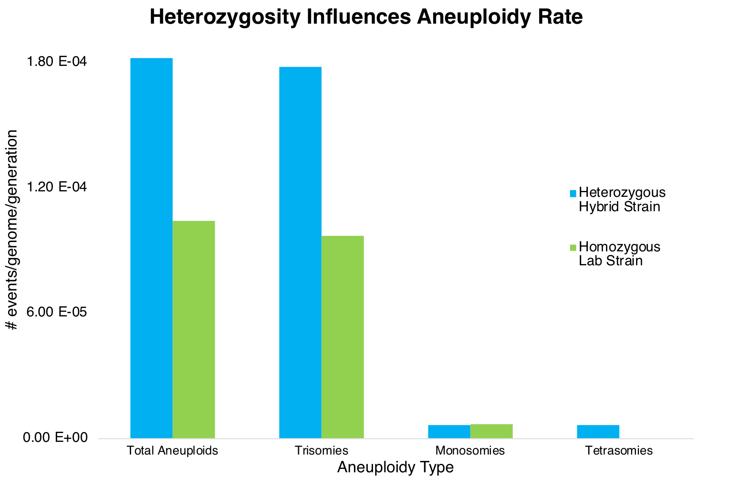
Effects on Gene Expression of Spontaneous Aneuploidy in Yeast Mutation Accumulation Lines
Holly McQueary and Dave Hall
Department of Genetics, University of Georgia, Athens, GA
Motivation
Studies have claimed that wild yeast show evidence for an intrinsic dosage compensation mechanism at the whole chromosome level (1, 2)
This finding has been contested, with the criticism that wild yeast cultures are unstable and may have reverted to euploid states (3)
Other studies have investigated the effect of aneuploidy on gene expression, but generated aneuploid strains artificially, which may not be indicative of natural isolates
We investigated whether there is an innate dosage compensation response in spontaneously aneuploid yeast that have been put through a 2000-generation mutation accumulation (MA) experiment with a single-cell bottleneck every 20 generations (4).
MA ensures that there is little to no selection, therefore our samples are free of any selection for or against aneuploidy.
No evidence for whole-chromosome dosage compensation
Aneuploids share differential expressed genes located on euploid chromosomes
Venn diagram showing overlap of differentially expressed genes on euploid chromosomes shared between aneuploid samples
A: Trisomy Chr V
B: Trisomy Chr I
C: Trisomy Chr I, XII
D: Trisomy Chr VII
E: Trisomy Chr XII
Mutation Accumulation Causes Common Changes in Gene Expression
RNAseq data reflects patterns of aneuploidy seen in DNA sequencing coverage
Above: average log2ratio on chromosome I. Boxplot color indicates copy number from DNA coverage results. Red dotted line: expected log2 ratio of a trisomic chromosome. Blue dotted line: expected log2 ratio of a monosomic chromosome.
Left: Samples determined to be aneuploid by DNA sequencing coverage show differential expression. Black square = aneuploid chromosome
Methods
Ancestor
96-152 lines are produced from a single progenitor line (Anestor)
L₁
L₂
L₃
L₉₆
…
Left: Venn diagram depicting overlap of differentially expressed genes in five different euploid lines (heterozygous hybrid strain). Right: GO enrichment of the 330 shared genes.
Single-cell transfer every 20 generations
330 genes were found to be commonly differentially expressed in every euploid line.
Most GO terms found were related to mitochondrial gene expression or translation.
x 100
DNA and RNA sequencing of the last colony transferred
Cufflinks
Cuffdiff
R (custom scripts)
Conclusion
The rate of aneuploidy is affected by level the of heterozygosity
Whole-chromosome average gene expression correlates nearly perfectly with the expected ratio of an aneuploid chromosome
Dosage sensitive genes were found to be not significantly differentially-expressed on aneuploid chromosomes
Our findings conclude that there is no whole-chromosome dosage compensation in spontaneously-aneuploid yeast, but there is some compensation or attenuation of genes that are highly dosage-sensitive.
Tophat
HTseq-count
DESeq2
GO analysis (YeastMine)
References
1. James Hose, C.M.Y., Maria Sardi, Zhishi Wang, Michael A Newton, Audrey P Gasch, Dosage compensation can buffer copy-number variation in yeast. eLIFE, 2015. 4: p. 1-27.
2. Audrey P Gasch, J.H., Michael A Newton, Maria Sardi, Mun Yong, Zhishi Wang, Further support for aneuploidy tolerance in wild yeast and effects of dosage compensation on gene copy-number evolution. eLIFE, 2016. 5: p. 1-12.
3. Eduardo M Torres, M.S., Angelika Amon, No current evidence for widespread dosage compensation in S. cerevisiae. eLIFE, 2016. 5: p. 1-19.
4. Zhu, Y.O., et al., Precise estimates of mutation rate and spectrum in yeast. Proceedings of the National Academy of Sciences, 2014. 111(22): p. E2310-E2318.
5. Vilardell, J. and J.R. Warner, Ribosomal protein L32 of Saccharomyces cerevisiae influences both the splicing of its own transcript and the processing of rRNA. Mol Cell Biol, 1997. 17(4): p. 1959-65.
6. Gasch, A.P., et al., Genomic expression programs in the response of yeast cells to environmental changes. Molecular biology of the cell, 2000. 11(12): p. 4241-4257.
Makanae, K., et al., Identification of dosage-sensitive genes in Saccharomyces cerevisiae using the genetic tug-of-war method. Genome research, 2013. 23(2): p. 300-311.
Acknowledgements
Thanks to Michael Judge for help with the figures, and Karen Bobier for reviewing the final poster.
Special thanks to the Society for the Study of Evolution for funding this work through the Rosemary Grant Award.
Dosage sensitive genes found in a previous study are not differentially expressed in this study, adding further evidence that they are dosage-sensitive
Notably, some of these dosage-sensitive genes are either ribosomal subunits or related to ribosomal biosynthesis. Previous studies have found certain ribosomal genes to regulate their own gene expression, and downregulation of ribosomal genes has been shown to be a characteristic of the environmental stress response in yeast (5,6).
Rate of aneuploidy is twice as high in hybrid strain, implying an effect of heterozygosity
Notes:
Figure: plot log2 ratio of gene expression vs copy number (DNA) for each gene, color by chromosome
We looked at average gene expression across the whole chromosome and found that it
scales nearly perfectly with gene dosage. Given this result we then looked at gene
Expression at the individual gene level and found that a subset of genes on the
Aneuploid chromosome were not differentially expressed, which was surprising given
the average gene expression was highly differentially expressed.
Gene-level dosage compensation
Types of analyses tried:
Findings:

