Slide 1
Dosage compensation in yeast
Lab Meeting
9/29/17

Slide 2
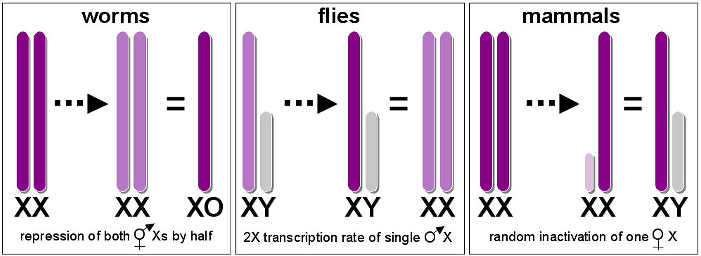
Dosage compensation (DC)
Phenomenon in which differential gene expression corrects the imbalance of gene dosage
Examples
Downregulation of both X chromosomes in C. elegans
X chromosome upregulation in Drosophila
X chromosome inactivation in mammals
http://www.wormbook.org/chapters/www_dosagecomp/dosagecomp.html
Notes:
Different methods of dosage compensation have arisen multiple times throughout evolutionary history
The amount of dosage compensation a species has is likely to have important consequences for the evolution of sex chromosomes and gene duplicates.

Slide 3
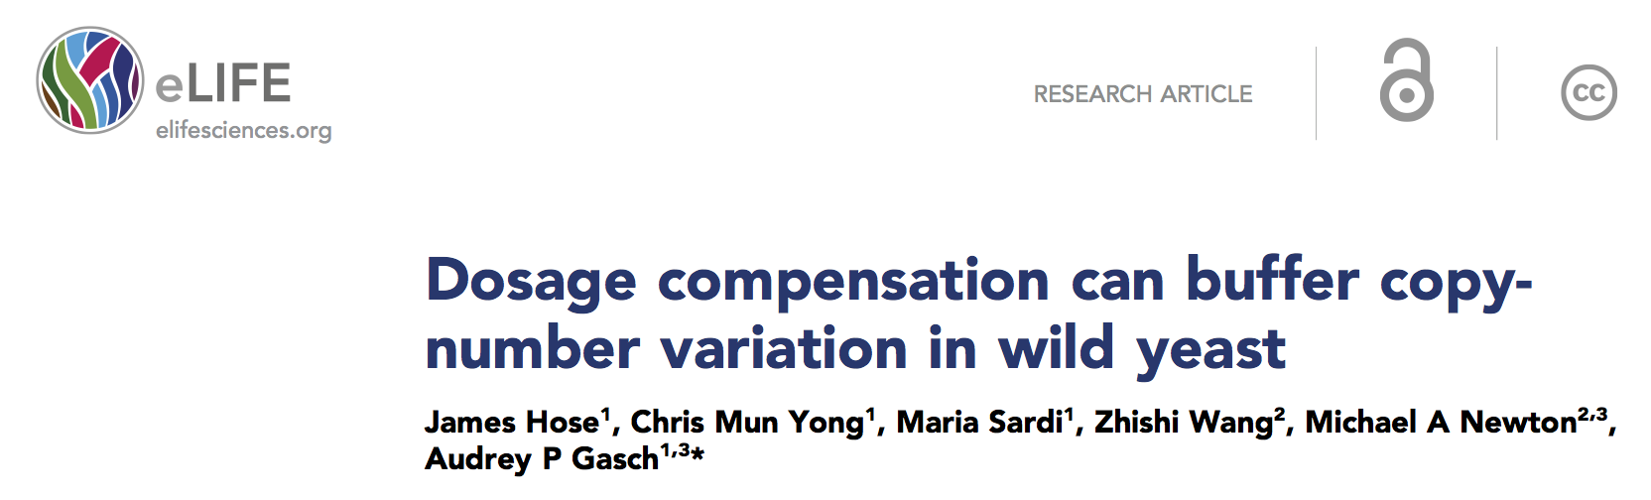
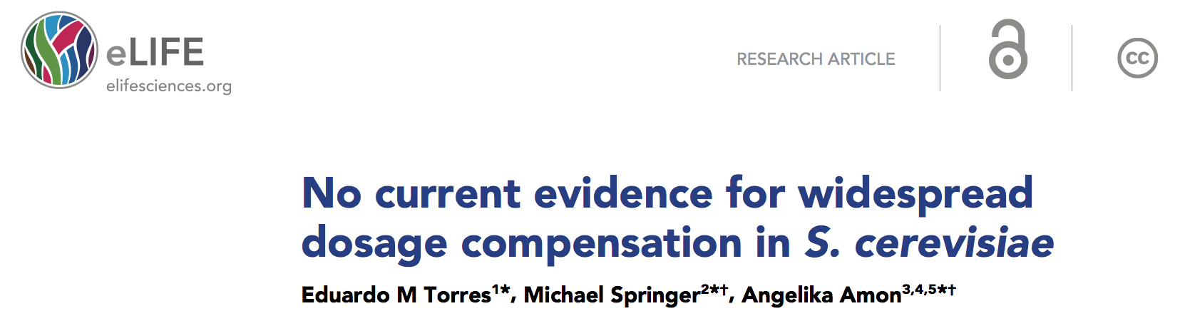
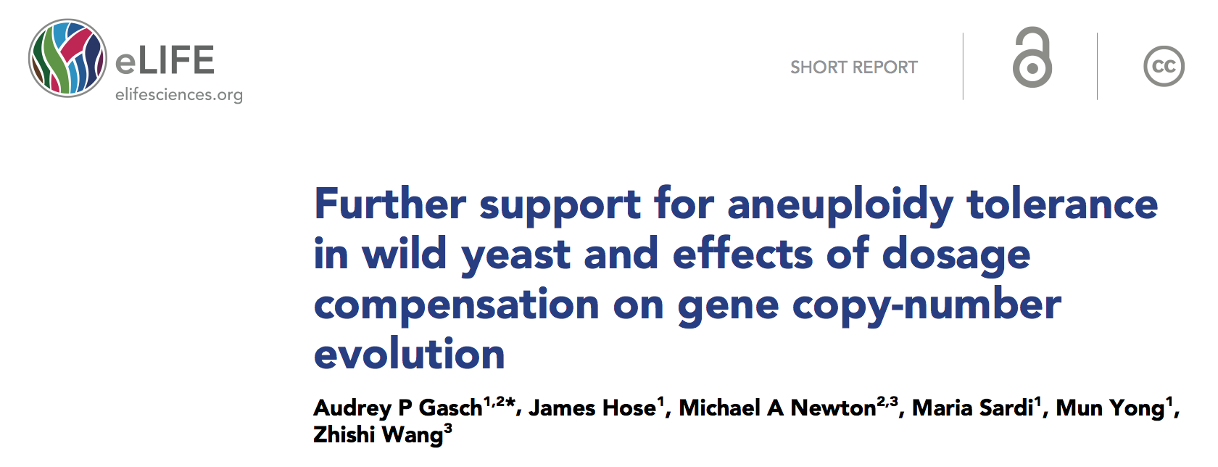
Yeast debate!

Slide 4
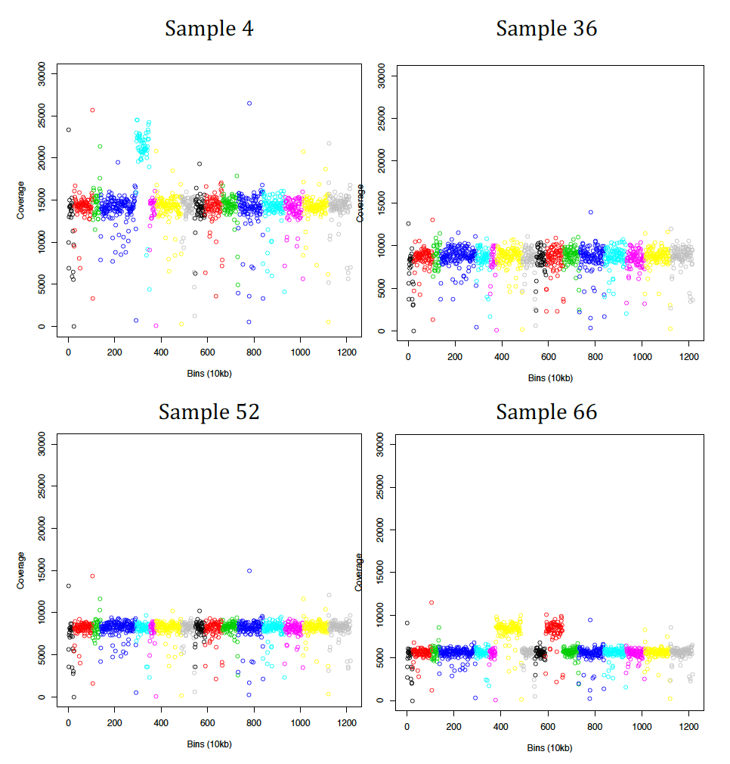
Experimental design
2 data sets
1 from mutation accumulation experiment
highly homozygous ancestor
1 from gene conversion MA experiment
highly heterozygous ancestor
Each had a number of spontaneous aneuploids

Slide 5
Analysis methods
RNA-seq on lines from both: 3 biological replicates
7 euploid lines
21 aneuploid lines
both ancestors
Transcriptome assembly: TopHat
FPKM values: Cufflinks, Cuffdiff and Cuffnorm
R
home-brew codes for distributions, boxplots, etc
edgeR to find differentially expressed genes

Slide 6
MA Results: Gene expression per chromosome
*Line 50 should be trisomic at chromosome 5
*Line 115 should be trisomic at chromosome 7

Slide 7
MA Line Results: Gene expression per chromosome

Slide 8
MA Results: Gene expression distributions per chromosome
Notes:
need to make the bar width uniform across distributions?

Slide 9
MA Results: Gene expression distributions per chromosome

Slide 10
MA Results: Gene expression relative to disomic average
Used non-parametric test (Mann-Whitney U test) because data not normally distributed
Use cutoff of p < 0.05 to determine if it’s significantly different?

Slide 11
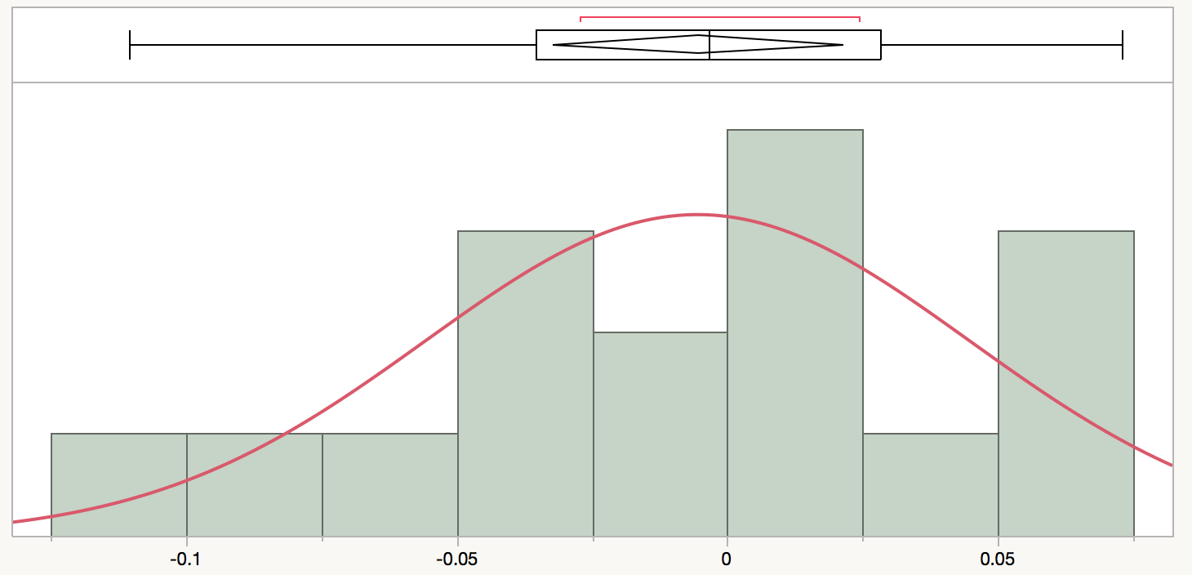
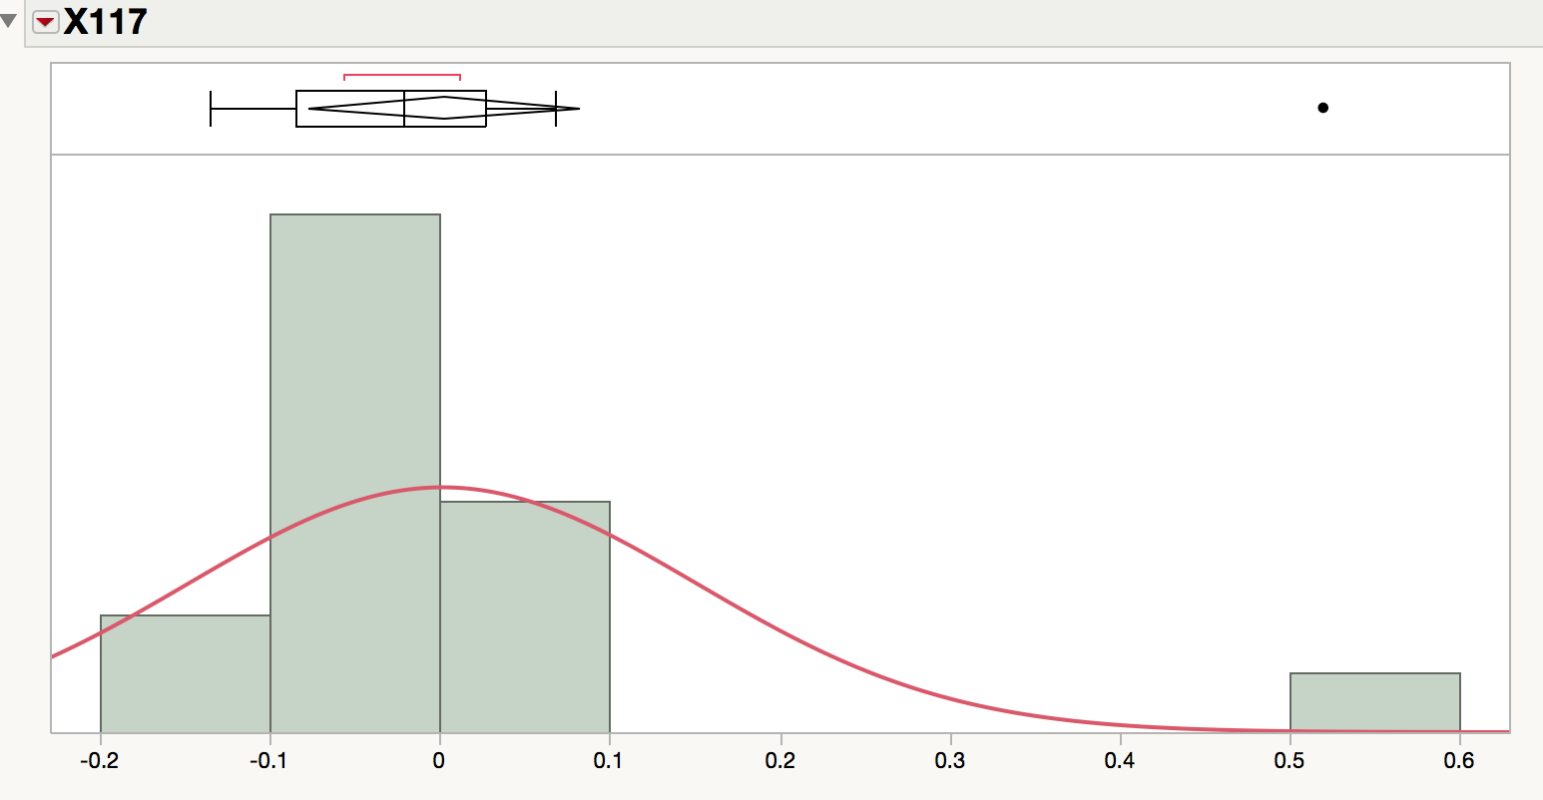
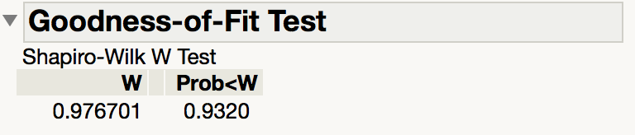
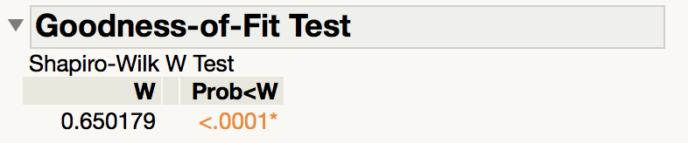
Distributions of log2 ratios look more normal in lines that look more disomic (OR dosage-compensated)
Line 115
Line 117
Notes:
Because there is the outlier at 0.5 for the aneuploid chromosome
the others are all clustered around 0

Slide 12
ESR genes
Common environmental stress response genes that are activated during ESR
Are they activated during aneuploidy?
Notes:
Looks like they’re not
but this is just one line
Next goal: create pipleline to look at these individual genes across all of the lines

Slide 13
to conclude…
Looks like there is no whole-chromosome dosage compensation happening in our yeast strains
Next steps:
Verify the strains we have are the correct ones
i.e. some look disomic, are they really aneuploid?
Run same analysis on GC and older datasets
Find significantly differentially expressed genes
Look at ESR genes, histone genes, ribosomal genes, and genes that are known to be dosage-sensitive

