Slide 1




Slide 2
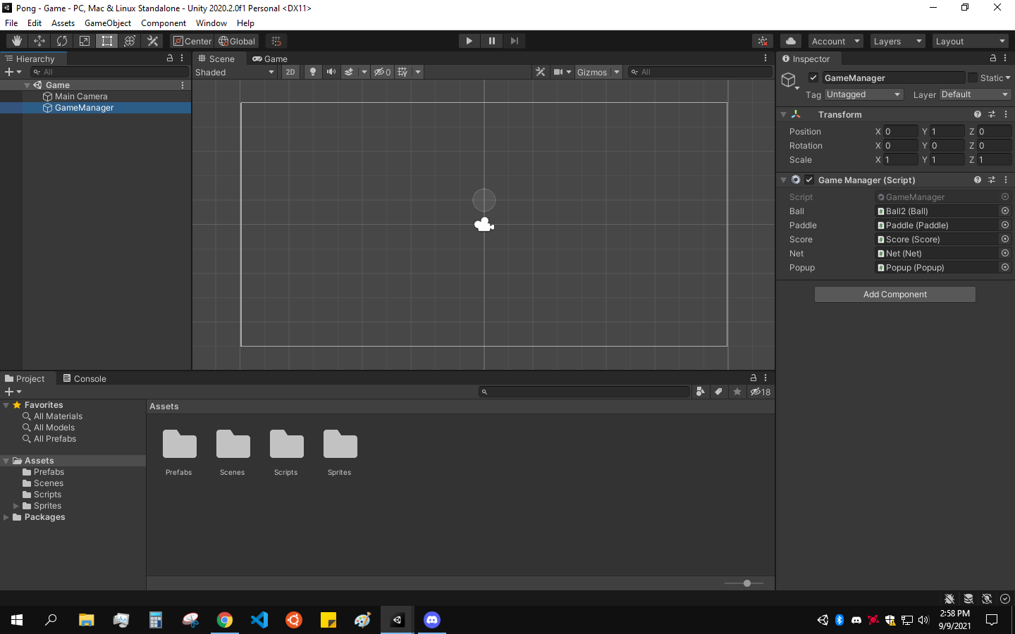
Menu Bar
Toolbar
Windows
Status Bar
Hierarchy
Window
Scene View
(or Game View)
Inspector Window
Project Window
(or Console Window)

Slide 3
UI > Overview
Menu Bar
Tabs that allow you to quickly view key features of the editor
File > Build
Windows
Toolbar
Status Bar
Gives easy access and information about various tasks

Slide 4
UI > Overview
Hierarchy Window
Scene View
Game View
Inspector Window
Project Window
Console Window

Slide 5
UI > Overview
Animation Window
A way to create and modify animation clips to build smooth transitions and animations
Profiler Window
Tracks the performance of your game while it’s running and gives information about what parts are affecting optimization

Slide 6
UI > Hierarchy Window
Scene
A setting for your game that contains the current GameObjects
EX: Each level in the game could be a separate scene
GameObject
A single object within your scene
There are many different types of GameObjects, each with different components and properties
EX: Main Camera

Slide 7
UI > Scene View
Scene View Camera
Used to examine the current scene from different views
Different from Main Camera
Arrow keys for movement
Hand Tool
Scene Gizmo
Perspective vs Isometric

Slide 8
UI > Scene View
Toolbar – Tools
Allows you to easily explore the scene and modify GameObjects
Hand Tool
Move Tool
Rotate Tool
Scale Tool
Rect Tool
Transform Tool

Slide 9
UI > Game View
Toolbar – Play Mode
Shows what screen will display for the running game
Uses Main Camera
Play
Pause
Step

Slide 10
UI > Inspector Window
Inspecting GameObjects and Assets
Gives information about the different parts of your project
Component
A distinct attribute for a selected GameObject
Adding Components
EX: Transform
EX: C# Script

Slide 11
UI > Project Window
Asset
Any file or resource that you’ve created for your project
Creating an asset or folder
EX: 2D Sprite
EX: C# Script
Package
Folders included in any Unity project, containing useful premade assets

Slide 12
UI > Console WIndow
Warnings and Errors
Any mistakes in a C# script, your assets or GameObjects, etc. will create warnings or errors that will appear in the console
Debug Class
Provides functions that help with debugging, mainly by logging messages to the console
EX: Debug.Log(“Message”);

Slide 13
Inheritance > Parenting
Parent GameObject
Contains the child GameObject(s)
Moving, rotating, scaling, or changing the transform of the parent also affects all of its children
Child GameObject
Inherits properties from its parent
Can be modified individually

Slide 14
Inheritance > Class Inheritance
Subclass and Superclass
Parent = Superclass, Child = Subclass
Subclass inherits methods and variables from the superclass
Overriding methods
Uses the “virtual” and “override” keywords
If a virtual method is called in the superclass but it’s overridden in the subclass, the subclass method is called instead

Slide 15
UI and Inheritance > More Info
UI and Terminology
Unity Manual > Working in Unity > Unity’s Interface
https://docs.unity3d.com/2020.2/Documentation/Manual/UsingTheEditor.html
Overriding Methods with “virtual”
Microsoft Docs > Virtual (C# Reference)
https://docs.microsoft.com/en-us/dotnet/csharp/language-reference/keywords/virtual

Slide 16
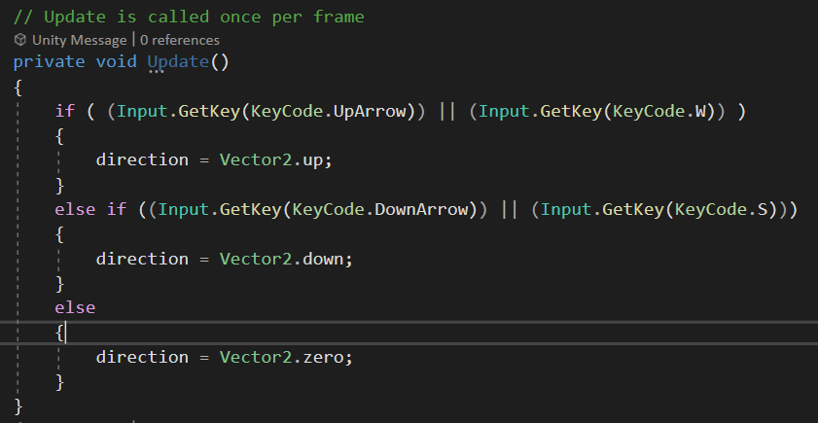
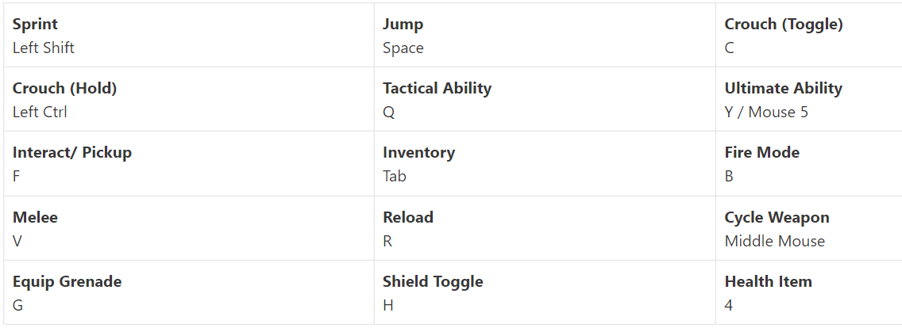
Inputs > Why Even Switch Systems?
This works … fine … kind
If (key for moving right) else if (other key) else if (another key) else if (key for jumping) else if (maybe placing an object?) else if (we also want to move left) else if (and down) else if (and maybe up too?) else if (you get the idea)
+ regular movement keys > easily 20+ keys

Slide 17
Inputs > Why Even Switch Systems?
Expandability / Portability
Creating objects in script tied to various input schemes
Demo – manip(enable/disable)
Easily implement additional input schemes for all types of input devices!
Demo

Slide 18
Prefabs
Prefabs are a stored or template object
A change to a prefab will change it anywhere it is linked to
Prefabs can have variants
EX: Prefab for a generic dog, and a variant of a Labrador
Works like code inheritance: Has its own unique characteristics but takes defaults from its parent
A change to an object in a scene that was created with a prefab, will not update the prefab unless you tell it to
EX: Generic NPC prefab, can safely be turned into a unique character in the scene while being attached to all NPCs

Slide 19
Cloning > Overview
Why clone?
Prevents tedious work
Can create variable number of clones
How it’s done:
Create spawner
Link prefab to spawner
Instantiate
Destroy (optional)

Slide 20
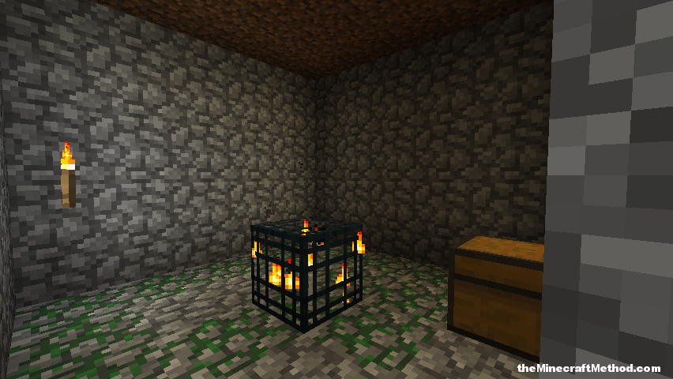

Cloning > Step 1
Create a spawner
Needs to be currently running
Either object or GameManager will do

Slide 21




Cloning > Step 2
Link the desired prefab to the spawner

Slide 22
Cloning > Step 3
Instantiate
Call the Instantiate() function
New clone’s Start() function will then be called
Setup can be handled there

Slide 23

Cloning > Step 4
Destroy (optional)
Call the destroy function on the GameObject

Slide 24
Collisions > Overview
3 Types of collision handling functions
OnEnter()
OnStay()
OnExit()
2 forms of each of those functions
OnCollision()
OnTrigger()

Slide 25
Collisions > OnEnter()
Is called the moment a collision occurs
OnCollisionEnter2D(Collision2D name)
OnTriggerEnter2D(Collider2D name)

Slide 26
Collisions > OnStay()
Is called every frame that object is touching another object
Called multiple times of the object is touching more than 1 thing
OnCollisionStay2D(Collision2D name)
OnTriggerStay2D(Collider2D name)

Slide 27
Collisions > OnExit()
Is called the moment a collision with another object ends
OnCollisionExit2D(Collision2D name)
OnTriggerExit2D(Collider2D name)

Slide 28
Collisions > OnCollision() vs OnTrigger()
OnCollision()
Unity automatically stops the objects from going through each other
Allows you to use premade Unity physics events (bounciness, friction, etc.)
Gives more data about the collision
(Relative velocity, points of contact, etc.)
OnTrigger()
Only calls the function, objects will phase through each other by default
You get to handle the physics manually
Useful for activating a sound or some event when an object enters a collider
Gives less data about the collision
Only links you to what you collided with

Slide 29
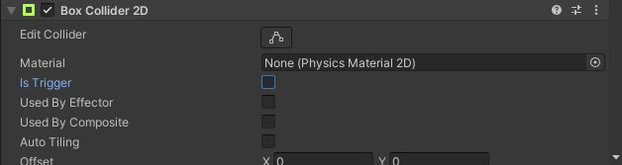
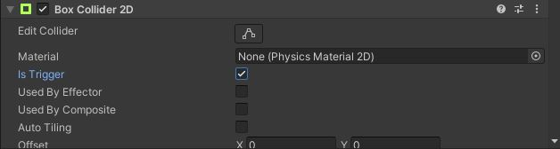
Collisions > OnCollision() vs OnTrigger()
Important Note:
For OnCollision() to work, the “Is Trigger” field must be set to “false”
For OnTrigger() to work, the “Is Trigger” field must be set to “true”

Slide 30
Collisions > What Did you Collide With?
2 ways to tell:
Tags
Names

Slide 31
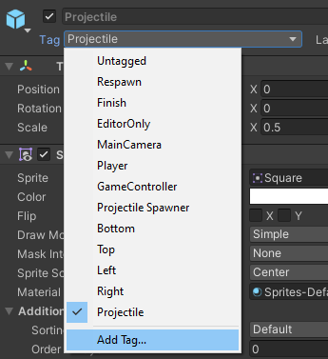
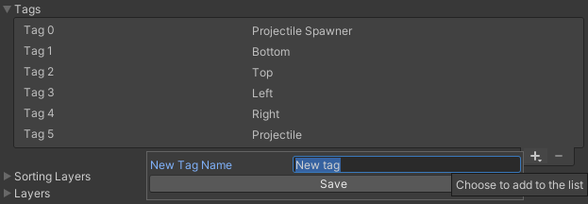
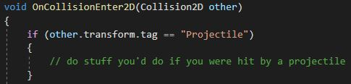
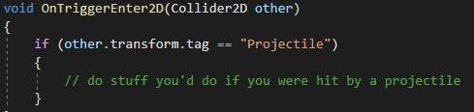
Collisions > What Did You Collide With?
Tags

Slide 32
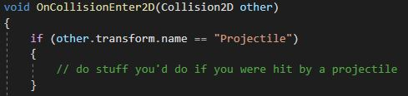
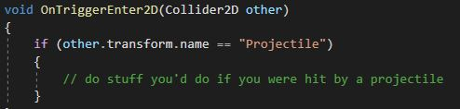
Collisions > What Did You Collide With?
Names

Slide 33
Tilemaps
Tilemaps allow easy 2D map creation
Draw on a grid with sprites
Unity 2D extras package allows for smarter, more customizable tiles
Tiles with animation, GameObjects, randomization, and placement behavior
Unity documentation for tilemaps: https://docs.unity3d.com/Manual/class-Tilemap.html
Unity documentation for 2D extras: https://docs.unity3d.com/Packages/com.unity.2d.tilemap.extras@1.6/manual/index.html

Slide 34
UI Creation / Animation

Slide 35
Combined Concepts Demo

