Slide 1
DELTA RESERVATIONS · CAPSTONE
Optimizing ATL Reservations Staffing
for Service & Cost
A forecast-driven, simulation-validated staffing plan for Delta's largest hub
$845K
87.8%
0.4 pts
saved in 30 days vs fixed 8-hour shifts
of calls answered within 20 s (target 80%)
largest gap between simulation and the Erlang C math
Frank An · Synthetic data — a student project, not official Delta material
Notes:
Open with the answer: staffing each half-hour to the forecast saves about $845K over 30 days versus fixed 8-hour shifts, while 87.8% of calls are still answered within 20 seconds — and a simulation independently confirms the staffing math. All data is synthetic; real contact logs are confidential.

Slide 2
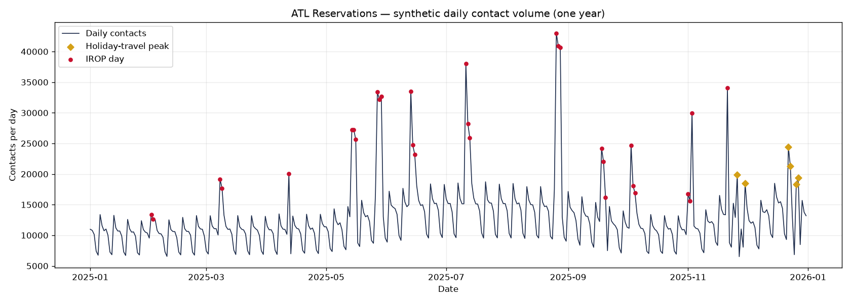
Demand swings hard — flat staffing either strands customers or pays for idle time
Understaffed
Long holds and abandoned calls — worst during weather disruptions, exactly when customers need Delta most.
Overstaffed
11,561
42,997
3.7×
Paying agents to sit idle. Sizing every hour to the daily peak wastes most of the day's paid time.
contacts on a typical day
on the busiest day of the year
busiest vs typical day
Daily contacts, 2025 (synthetic). Red dots = IROP (irregular operations) days; gold diamonds = holiday-travel peaks.
Delta ATL Reservations capstone · synthetic data
2
Notes:
ATL is Delta's largest hub. Contact volume follows weekly and seasonal rhythms, but weather disruptions (IROPs) spike it far above a normal day. Staffing flat either leaves customers waiting when volume spikes or pays idle agents when it's quiet — the plan has to follow demand half-hour by half-hour.

Slide 3
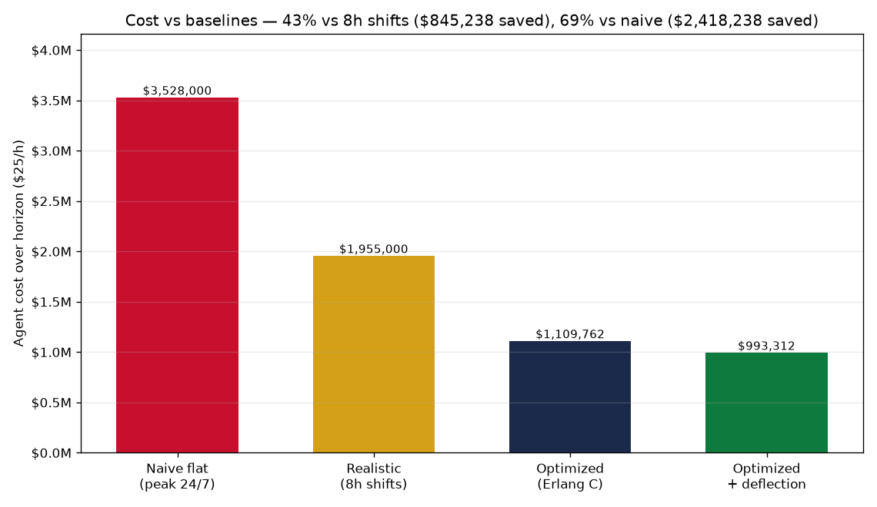
Recommendation: staff each half-hour to the forecast — save $845K in 30 days and still beat the service target
$845,238
saved over 30 days vs fixed 8-hour shifts (43% fewer agent-hours)
87.8%
of calls answered within 20 s — target 80%, met in every half-hour
7.9 s
average wait to answer; agents 87% busy (cap 90%)
Same forecast, four ways to staff it. Naive = peak headcount (196 agents) around the clock; 8h shifts = each shift staffed to its busiest half-hour.
Delta ATL Reservations capstone · synthetic data
3
Notes:
Lead with the answer. Compared with a center running fixed 8-hour shifts, each staffed to its busiest half-hour, interval-level Erlang C staffing cuts agent-hours by 43% — $845,238 over 30 days at $25/hour — while 87.8% of calls are answered within 20 seconds. Against naive peak staffing 24/7 the saving would be 69% ($2,418,238), but no real center runs that way, so the realistic comparison is the headline.

Slide 4
How: four steps, each checked before the next
1
2
3
4
Forecast
Size
Validate
Optimize & price
Prophet learns weekly and holiday patterns from a year of contacts; an intraday profile splits each day into 48 half-hours.
Erlang C, the standard call-center formula, finds the fewest agents that answer 80% of calls in 20 s; +30% covers breaks and training.
A discrete-event simulation replays hundreds of thousands of calls and measures the waits directly — no formula involved.
Agent-hours × $25/h versus naive and fixed-shift baselines, plus IROP and self-service scenarios.
9.7% error on normal days
5 Erlangs → 8 agents → 12 scheduled
within 0.4 pts of Erlang C
−43% vs 8-hour shifts
Validated two independent ways: the forecast is scored on held-out data, and the staffing math is confirmed by simulation.
Delta ATL Reservations capstone · synthetic data
4
Notes:
Four steps. (1) Forecast daily volume and split it into half-hours. (2) Erlang C — the queueing formula real contact centers use — turns volume and handle time into the minimum agents for 80/20, then shrinkage grosses that up to scheduled headcount. (3) A simulation imitates calls and agents one event at a time and measures service level independently. (4) Convert the curve to agent-hours and dollars against two baselines.

Slide 5
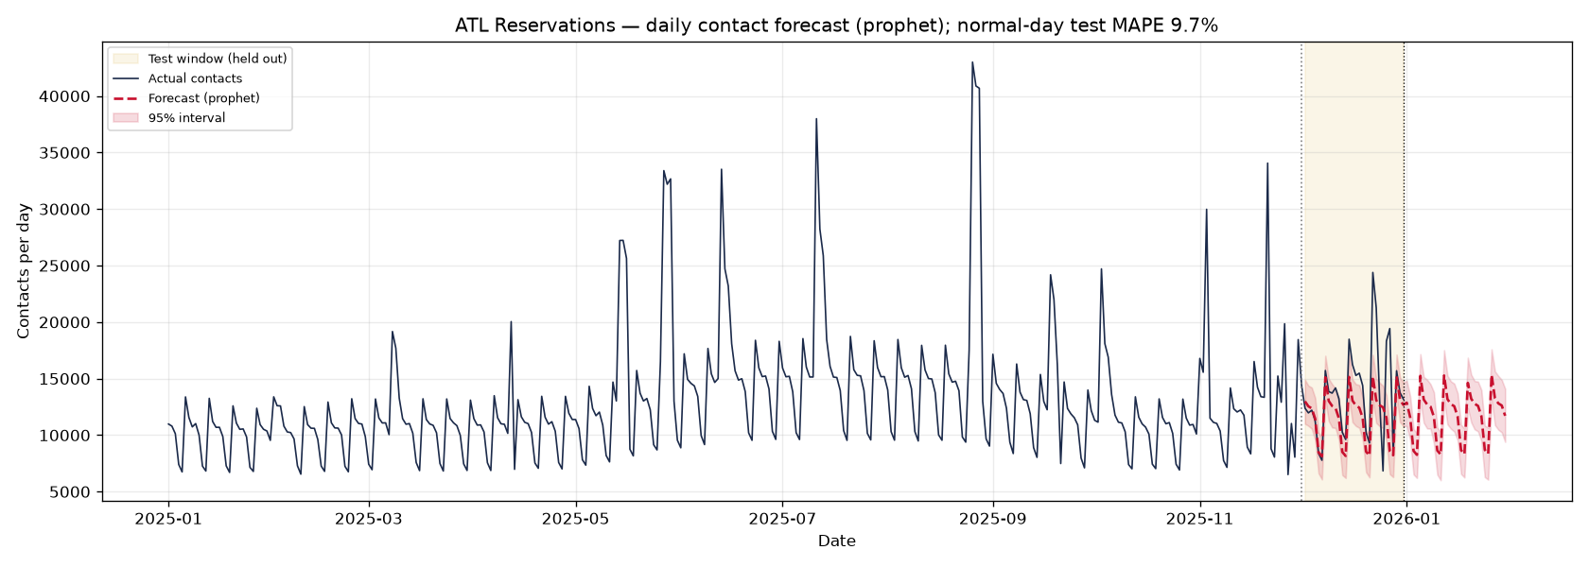
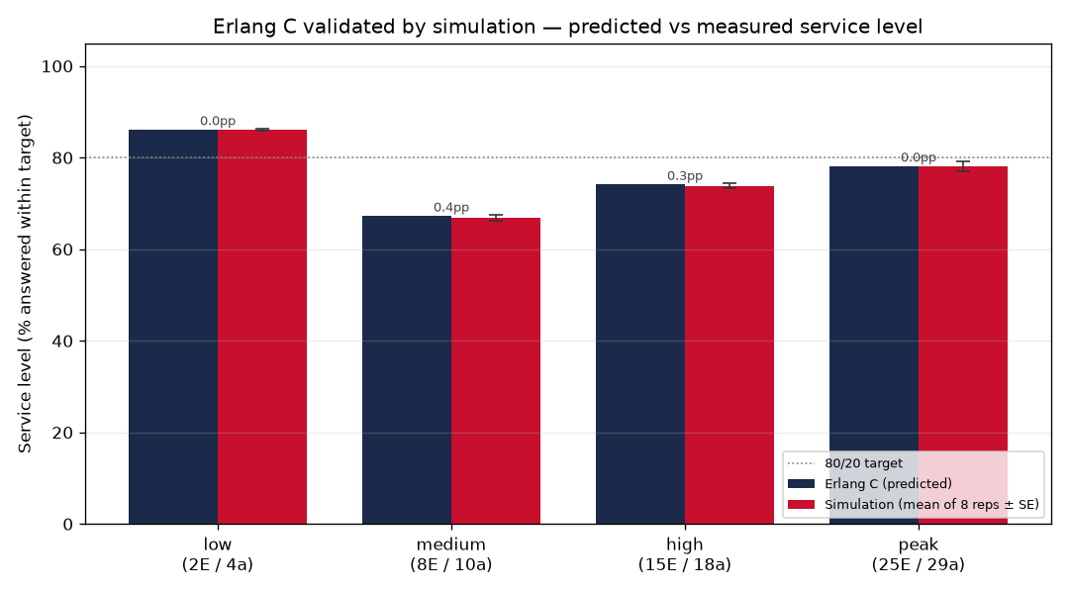
Evidence: the forecast tracks reality, and simulation confirms the staffing math
9.7%
average error on normal days (held-out December; target under 10%)
0.4 pts
largest service-level gap vs Erlang C across 4 load levels (tolerance 3 pts)
All test days: 16.2% — the Christmas spike can't be learned from one year of history. Weather (IROP) days are left out of training and handled as a stress scenario instead.
SimPy M/M/c simulation: 8 replications × 50,000 calls per load level, compared with the Erlang C prediction.
Delta ATL Reservations capstone · synthetic data
5
Notes:
Two independent checks. The forecast is scored on a held-out month: 9.7% average error on normal days, under the 10% target; the all-days figure (16.2%) includes Christmas, which one year of history can't teach. The simulation imitates the queue call by call; across 4 load levels its service level lands within 0.4 points of the Erlang C prediction.

Slide 6
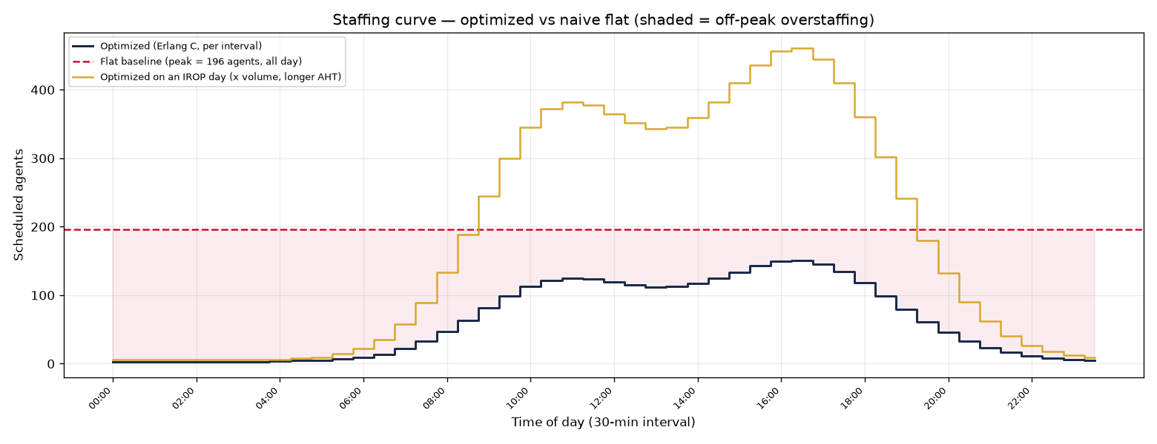
Disruption days need ~3× the agents — plan flex capacity before the storm
150 → 461
scheduled agents at the afternoon peak; IROP-day agent-hours ×3.0
1
Flex capacity
An on-call pool of cross-trained agents, activated when a weather disruption is forecast.
Average forecast day (navy) vs an IROP day at 2.5× volume with longer rebooking calls (gold). Dashed red = naive flat staffing.
2
Self-service deflection
Move 20% of app-friendly contacts (bookings, seats, SkyMiles) to the Fly Delta app: −11% volume, ~$116K per 30 days.
Delta ATL Reservations capstone · synthetic data
6
Notes:
On a disruption day, volume runs about 2.5× normal and rebooking calls run longer (about 337 s). Peak scheduled agents go from 150 to 461. You can't hire for that on the day, so the recommendation is a pre-positioned flex pool plus pushing simple contacts to the app — the deflection figure is a volume-only upper bound.

Slide 7
Impact and next steps
$845K
Next steps
per 30 days vs fixed 8-hour shifts
1
Pilot at ATL: run interval-based schedules for one month against a control group.
+$116K
2
Turn half-hour requirements into real shift rosters (shift lengths, breaks, labor rules).
more with Fly Delta app deflection
3
Extend to chat and app channels, with intraday re-forecasting.
80/20
4
Swap in real contact logs — the pipeline and its tests run unchanged.
service target met in every half-hour of the plan
Interactive dashboard: https://public.tableau.com/app/profile/frank.an5089/viz/DeltaATLReservationsStaffingOptimizer/Dashboard
Notes:
Impact: the savings and service figures above. Next steps: pilot the schedule at ATL against a control group; turn the half-hour requirement curve into real rosters (out of scope here); add other channels and intraday re-forecasting; and plug in real contact data — the pipeline doesn't change.

Slide 8
Appendix: assumptions and data notes
Assumption | Value (config.py)
Service target | 80% of calls answered within 20 s
Max occupancy | 90%
Shrinkage | 30% of paid time (breaks, training, meetings)
Loaded agent cost | $25 per hour
Interval / horizon | 30 min · 30 days (Jan 1–Jan 30, 2026)
Realistic baseline | 8h shifts, each staffed to its busiest half-hour
IROP scenario | 2.5× volume, 337 s average handle time
Self-service deflection | 20% of Booking Change, Seat Upgrade, SkyMiles
Data | 4.7M synthetic contacts (2025), seeded
Synthetic data
Real Delta contact logs are confidential, so every contact is generated from documented assumptions. The method — not the dataset — is the deliverable; real data plugs into the same pipeline.
Known caveat
The January forecast averages 11,785 contacts/day, 18% above last January's 9,974: one year of history can't teach the model January's seasonal dip. Absolute dollars are likely overstated; the percentage savings are more robust.
Delta ATL Reservations capstone · synthetic data
8
Notes:
Every business assumption lives in config.py — change one number and re-run the pipeline and this deck. The data is synthetic by design. The main caveat is the January forecast level, which one year of history can't correct.

