Slide 1


Mission Statement
To provide quality recreational soccer programming for K-8th graders, foster a love of soccer, and create opportunities for adults in the community to coach and support our youth.
2018-19 HOLLYWOOD SC
Annual General Meeting

Slide 2
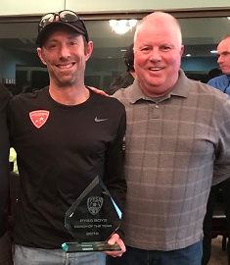
2018 Highlights for HWSC
Marc Poris, Coach of U13 Hornets and Director of Coaches Honored as Portland Youth Soccer Association BOYS COACH OF THE YEAR
U11 Girls- Flying Pickles with Brad Vasel, Coach, won their second Fall PYSA Tournament!

Slide 3
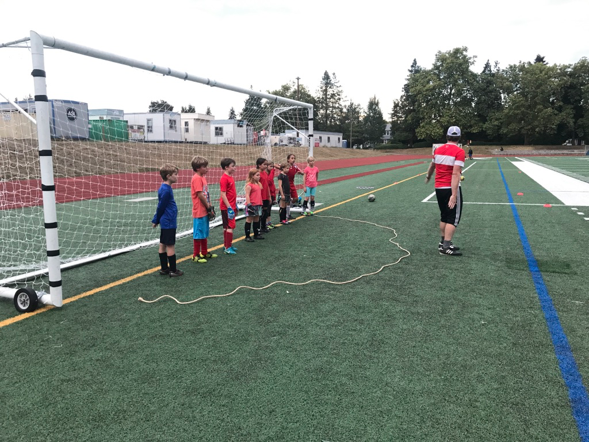
HWSC Participation
Fall 2018
24 teams
60 Head and Assistant Coaches
330 Young players on the Field

Slide 4
HWSC Board Goals for 2018-2019
Focus support/development for coaches especially at U7/U8
Create a clear Mission Statement
Provide training coaches on Positive Coach Alliance philosophy
Focus on recruiting additional players for the Kinderkick program
Provide clear communication about the needs of the Club to families and coaches

Slide 5
Changes in 2019 for HWSC
Transition from Volunteer Registrar to a Contracted Registrar
New registration platform - Blue Sombrero
Increase Registration Fees for Spring from $45 to $65
Loss of Rose City Elementary as a feeder to HWSC
New uniform vendor - Tursi’s Soccer Store

Slide 6
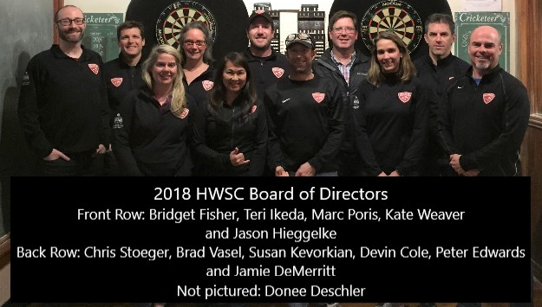
HWSC Needs for 2019
Open Positions:
Vice President: Responsibilities include: Setting up practice schedules, runs meetings if President is not available.
Communications Chair: Responsibilities cover communicating to families and coaches about opportunities for the HWSC community.

Slide 7
HWSC Fields Update
Fields Usage for 2018
Feedback from Coaches- Coaches felt cramped for space (4 teams on Grant Bowl was too much) but also appreciated the use of Grant Bowl.
Grant Bowl HS Coaches did not always honor the 6 PM cut off.
Coaches appreciated being scheduled with other similar teams to run drills and scrimmage with.
Teams will continue to be cramped if they request 6PM slots on Tuesday/Thursday.

Slide 8
HWSC Fields Update
Fields Availability Issues for 2018
Temporary loss of practice fields around Grant High School (Grant Lawn- next to the baseball field), Grant Lawn and Hollyrood Field.
PYSA is now charging HWSC exclusively for Grant Bowl at $100 hour rate= $500 per week on fall.
Hollyrood Field was not properly seeded or watered. Five coaches help “rope off” the seeded area from pets and park users.
PYSA let us use Wilshire Park temporarily for practices.

Slide 9
HWSC Fields Update
Upcoming Changes/Challenges
Hollyrood: dogs and owners have taken complete control of the field. The condition and the safety of the field is really an issue.
Will the upper “Turfed” Baseball Field be accessible for Fall Sports?
Will the front lawn be reopened in similar condition? The principle promised our past President but not sure this is still the case.

Slide 10
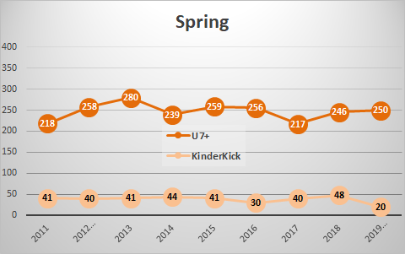
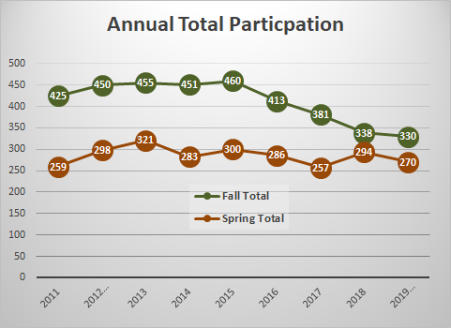
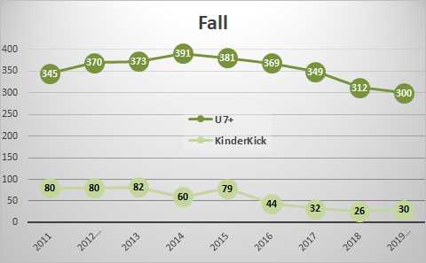
HWSC Financials

Slide 11
HWSC Financials - 2019
Revenue projected to increase in 2019 due to increase in registration fees - $48,800
Expense projected at ($52,300)
Still projecting a loss of $3500 for the year due to increasing costs and lower numbers of registrations overall
Large increase outsourced registration processing fees, modest increase in field fees.
Coach training, credit card processing fees and equipment costs neutral or lower for the coming year.

Slide 12
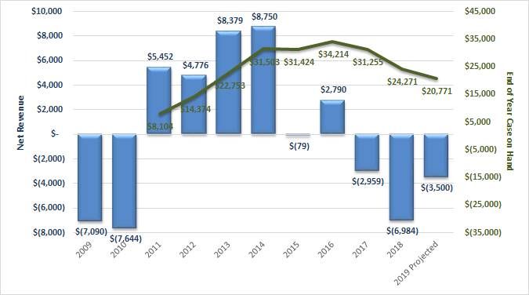
HWSC Financials - Trends Over Time

Slide 13
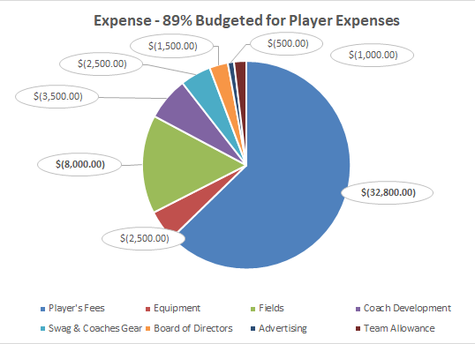
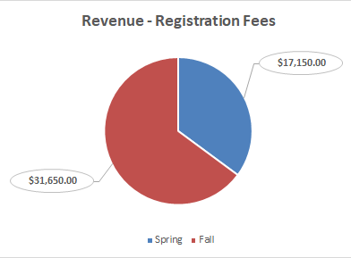
HWSC Financials - 2019 Budget

Slide 14
HWSC Coach Survey - Summary
The Positives- In General, very positive experiences for the coaches whom responded to survey.
Nice work Board, for all of your time supporting these coaches and players!
Coaches loved getting Coach Marc’s Saturday morning emails
Good support for coaches from the Board, a lot of thank you’s!
Coaches appreciated the Goalie Workshop and the Positive Coaches Alliance Workshop
50% of coaches like the idea of keeping the same team but would like more help with parental management

Slide 15
HWSC Coach Survey - Summary
Areas for additional improvement to support our Coaches.
Supporting Coaches with more help with practice plans
Balancing the amount of teams using fields in Grant Bowl and Wilshire Park
Giving more skilled focused workshops on tactical plans for field play
More Friday trainings opportunities like the Goalie Workshop!
Build in the expectations to have a Parent Manager
Help coaches come up with a plan to “encourage players to come a few minutes early for games to warm up (create warm up routines?)

Slide 16
HWSC Parent Survey - Summary
Parents and Guardians overwhelming said: Great experience for their kids, great club support with a clear culture of positive minded coaches, players and parents.
Thank you coaches for all of your time and expertise!
Parent/Guardians said when creating teams it was most important to be on teams with friends.
Coaches and parents of HWSC did a good job of rewarding effort more than results, and helping players bounce back from mistakes .
Coaches maintained a positive experience for players and coaches
PCA (Positive Coaches Alliance) is an worthwhile program HWSC should continue to invest in.
....Overall very good responses with their children’s experience!

Slide 17
HWSC Parent Survey - Summary
Ideas for improving our Families/Players Experiences
Coaches clearly explaining expectations for the team before the season
Coaches working to promote team unity
More relevant information posted on its Facebook page
Helping coaches with behavior management
U7/U8 Coaches reading a shortened Code of Conduct to Players before games.

Slide 18
HWSC Board Q&A
What should the main focus for the Board this year?
Brainstorm
The Board will pick three main focuses for the year to work towards

Slide 19
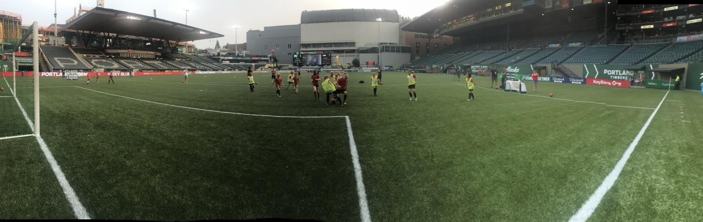
Thank you for supporting HWSC!

