Slide 1
Async
Async Patterns in C#

Slide 2
Scaling & Performance
Avoid blocking calls
ASP.NET Core apps should be designed to process many requests simultaneously. Asynchronous APIs allow a small pool of threads to handle thousands of concurrent requests by not waiting on blocking calls. Rather than waiting on a long-running synchronous task to complete, the thread can work on another request.
A common performance problem in ASP.NET Core apps is blocking calls that could be asynchronous. Many synchronous blocking calls lead to Thread Pool starvation and degraded response times.
Do not:
Block asynchronous execution by calling Task.Wait or Task.Result.
Acquire locks in common code paths. ASP.NET Core apps are most performant when architected to run code in parallel.
Call Task.Run and immediately await it. ASP.NET Core already runs app code on normal Thread Pool threads, so calling Task.Run only results in extra unnecessary Thread Pool scheduling. Even if the scheduled code would block a thread, Task.Run does not prevent that.
Do:
Make hot code paths asynchronous.
Call data access, I/O, and long-running operations APIs asynchronously if an asynchronous API is available. Do not use Task.Run to make a synchronous API asynchronous.
Make controller/Razor Page actions asynchronous. The entire call stack is asynchronous in order to benefit from async/await patterns.
Reference: https://docs.microsoft.com/en-us/aspnet/core/performance/performance-best-practices?view=aspnetcore-5.0

Slide 3
Scaling & Performance
When the API is stressed, async action methods will give the API some much needed breathing room whereas sync action methods will deteriorate quicker.
Async code doesn’t come for free - there is additional overhead in context switching, data being shuffled on and off the heap, etc which is why async code can be a bit slower than the equivalent sync code if there is plenty of available threads in thread pool. This difference is usually very minor though.
It’s a good idea to write async action methods that are I/O bound even if the API is only currently dealing with a low amount of usage. It only takes typing an extra keyword per I/O call and the usage can grow.
Reference: https://www.carlrippon.com/scalable-and-performant-asp-net-core-web-apis-asynchronous-operations/

Slide 4
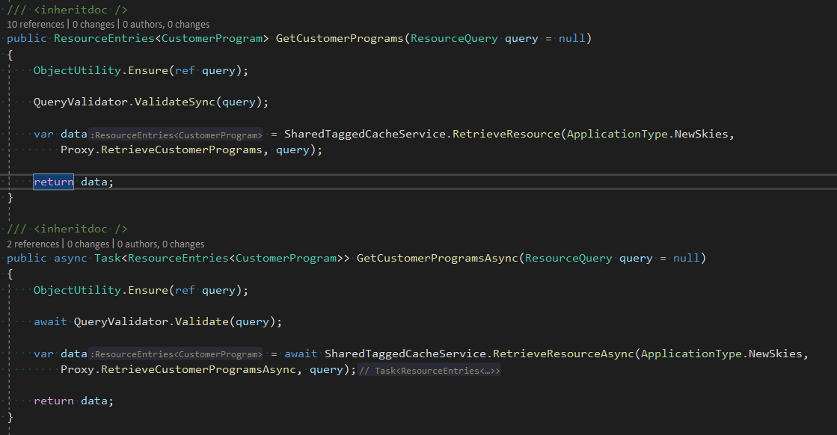
Example
Reference: https://dev.azure.com/Navitaire/dotREZApi-Scrum/_git/dotrez-nsk-api?path=/src/Navitaire.DotRez.Nsk.Resources.User/Services/ResourcesService.cs&version=GBRelease-4.5.0&_a=contents

Slide 5
Anti Patterns
Forgotten await
Ignoring tasks
Using async void methods
Blocking on tasks with .Result or .Wait
Real world example: DeltaMapper
Missing ConfigureAwait(false)
Mixing ForEach with async
Excessive parallelization
Real world example: Graph QL Dotnet
Non thread safe side effects
Try catch without await
References: https://markheath.net/post/async-antipatterns
https://devblogs.microsoft.com/dotnet/configureawait-faq/

Slide 6
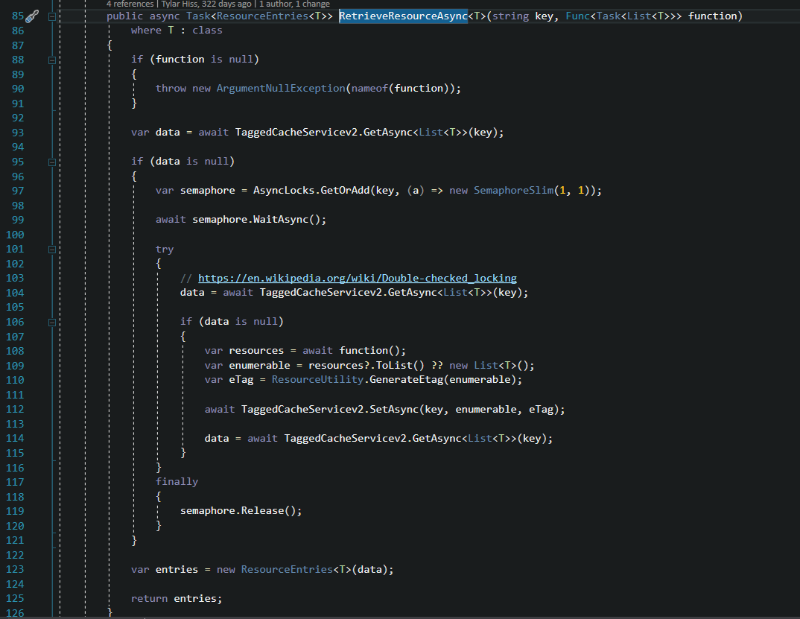
Resources ASYNC

