Slide 2
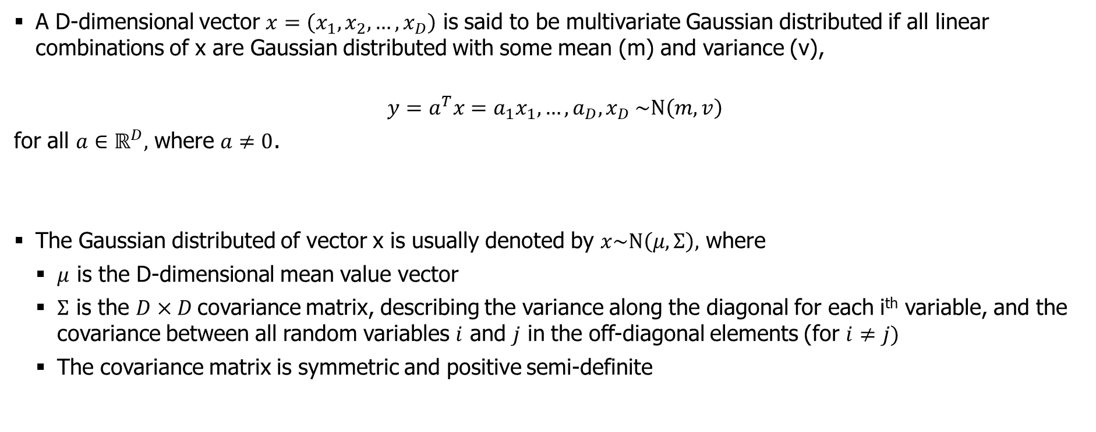
Multivariate Gaussian Distribution
A D-dimensional vector $x=\left(x_{1}, x_{2},…,x_{D}\right)$ is said to be multivariate Gaussian distributed if all linear combinations of x are Gaussian distributed with some mean (m) and variance (v),
$$y=a^{T}x=a_{1}x_{1},…,a_{D},x_{D} \sim Ν\left(m,v\right)$$
for all $a∈ℝ^{D},$ where $a≠0$.
The Gaussian distributed of vector x is usually denoted by $x\sim Ν\left(μ,Σ\right),$ where
$μ$ is the D-dimensional mean value vector
$Σ$ is the $D×D$covariance matrix, describing the variance along the diagonal for each i^{th} variable, and the covariance between all random variables $i$ and $j$ in the off-diagonal elements (for $i≠j)$
The covariance matrix is symmetric and positive semi-definite

Slide 3
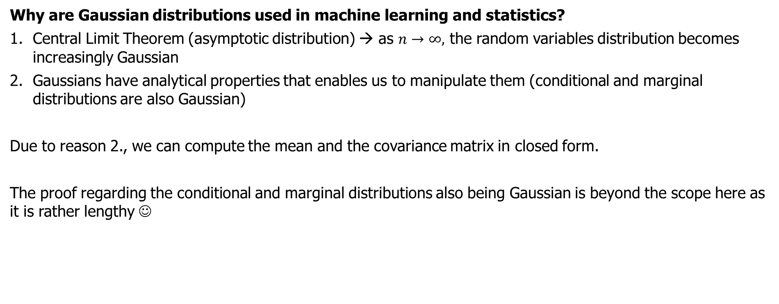
Multivariate Gaussian Distribution
Why are Gaussian distributions used in machine learning and statistics?
Central Limit Theorem (asymptotic distribution) → as $n→∞,$ the random variables distribution becomes increasingly Gaussian
Gaussians have analytical properties that enables us to manipulate them (conditional and marginal distributions are also Gaussian)
Due to reason 2., we can compute the mean and the covariance matrix in closed form.
The proof regarding the conditional and marginal distributions also being Gaussian is beyond the scope here as it is rather lengthy ☺
Notes:
conditional probability of two independent random variables is equal to the unconditional distribution of the non-conditioned variable.

Slide 4
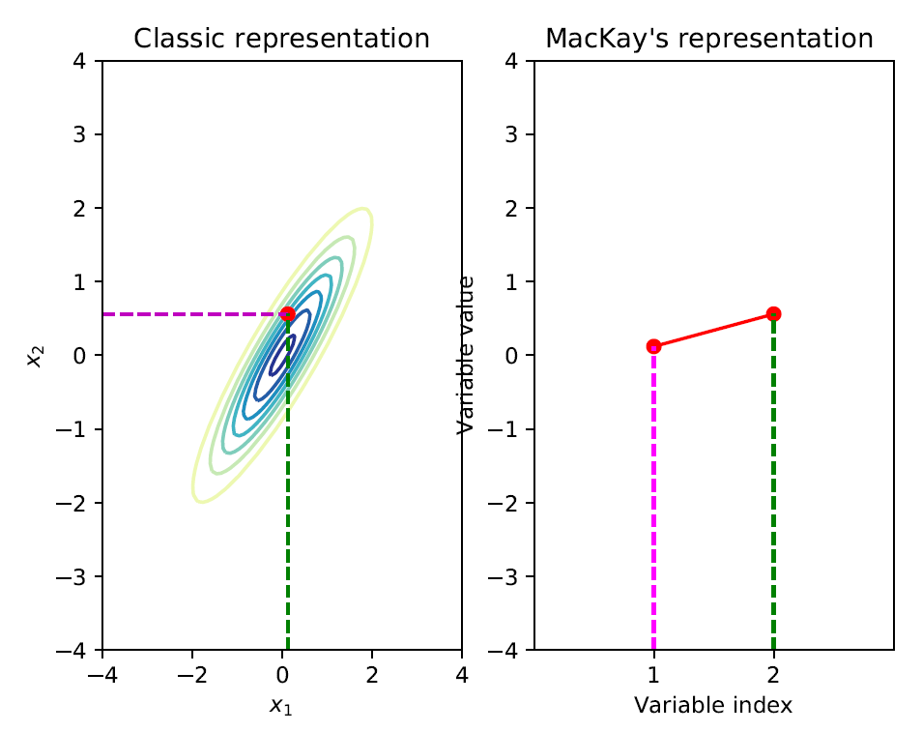

Multivariate Gaussian Distribution
Consider a bi-variate Gaussian distribution
$N\left(x | μ,Σ\right),$ where the mean $μ$ is a vector in $ℝ^{2}$
and the covariance matrix $Σ$ is a 2x2 matrix
If we sample from this distribution we get a
2-dimensional vector $x=\left[x_{1}, x_{2}\right]$
We can visualize this by plotting the value of $x_{1}$
and $x_{2}$ and index 1 and 2, as shown in the figure
here
Notes:
conditional probability of two independent random variables is equal to the unconditional distribution of the non-conditioned variable.

Slide 5
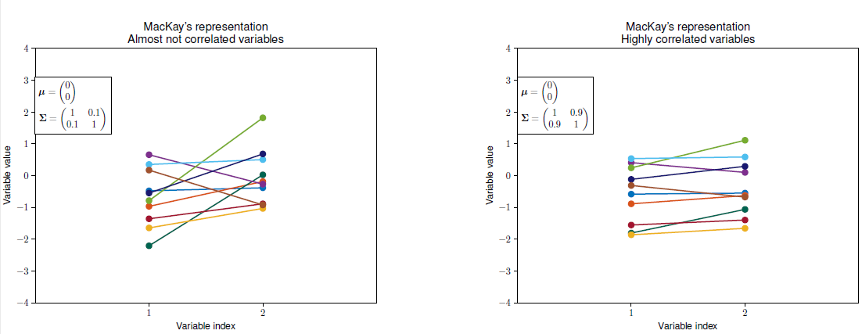
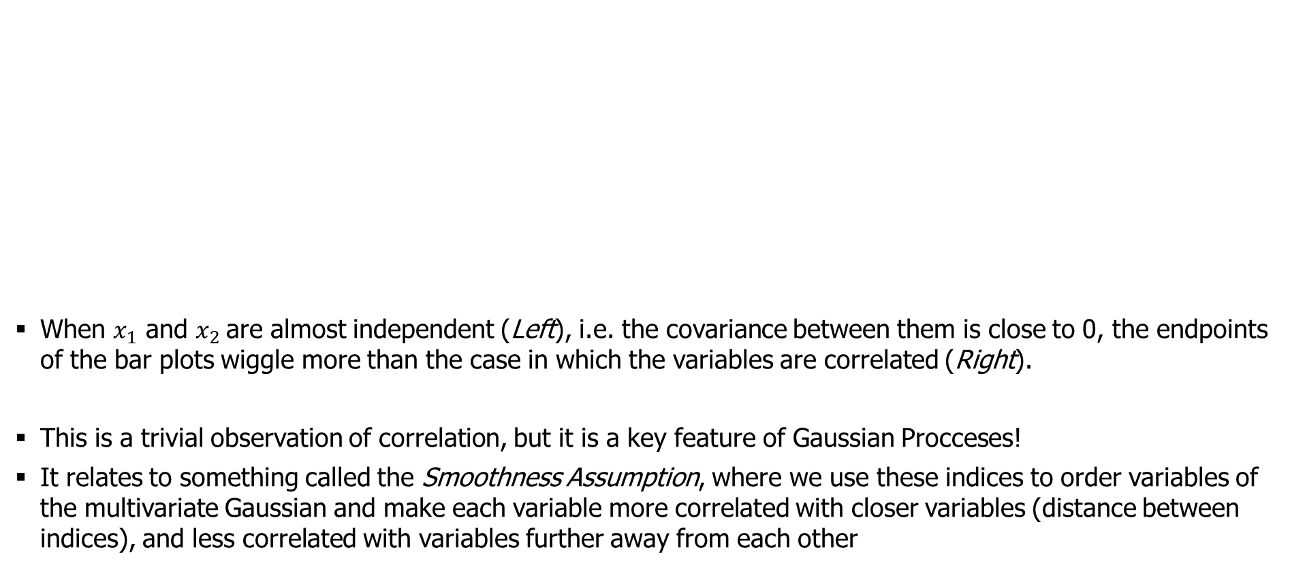
Multivariate Gaussian Distribution
When $x_{1}$ and $x_{2}$are almost independent (Left), i.e. the covariance between them is close to 0, the endpoints of the bar plots wiggle more than the case in which the variables are correlated (Right).
This is a trivial observation of correlation, but it is a key feature of Gaussian Procceses!
It relates to something called the Smoothness Assumption, where we use these indices to order variables of the multivariate Gaussian and make each variable more correlated with closer variables (distance between indices), and less correlated with variables further away from each other
Notes:
conditional probability of two independent random variables is equal to the unconditional distribution of the non-conditioned variable.

Slide 6
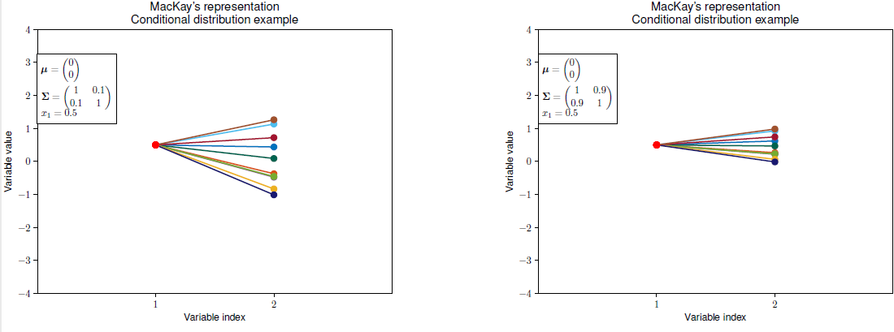
Multivariate Gaussian Distribution
Now we are getting closer to Gaussian Proccesses!
Samples from the conditional distribution in case of almost independent (Left) and highly correlated (Right) variables
This simple representation allows us to represent high-dimensional Gaussian samples in a 2D plot.
This is the key point to see the connection between multivariate Gaussian and the Gaussian Process regression
Notes:
conditional probability of two independent random variables is equal to the unconditional distribution of the non-conditioned variable.

Slide 7
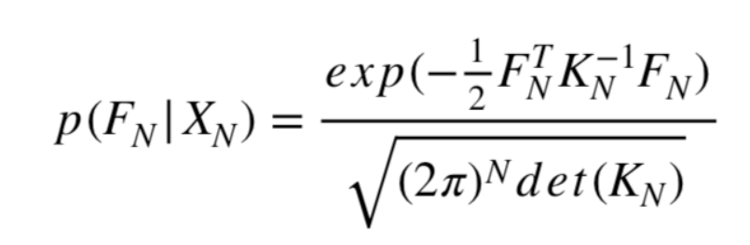
Multivariate Gaussian Distribution
Gaussian Processes (GPs) provide a rich and flexible class of non-parametric statistical models over function spaces with domains that can be continuous, discrete, mixed, or even hierarchical in nature. Furthermore, the GP provides not just information about the likely value of f, but importantly also about the uncertainty around that value.
The idea behind Gaussian Process Regression is for a set of observed values FN at some points XN we assume that these values correspond to the realisation of a multivariate Gaussian Process with a prior distribution:
where KN is a NxN covariance matrix and its coefficients are expressed in terms of a correlation function (or kernel) Kmn =K(xm,xn,θ). The hyper- parameters θ of the kernel are calibrated according to a maximum likelihood principle.
Kernel is chosen to reflect a prior assumption of the function and therefore the choice of the kernel will have a significant impact on the correctness of the regression.
Notes:
conditional probability of two independent random variables is equal to the unconditional distribution of the non-conditioned variable.

Slide 8
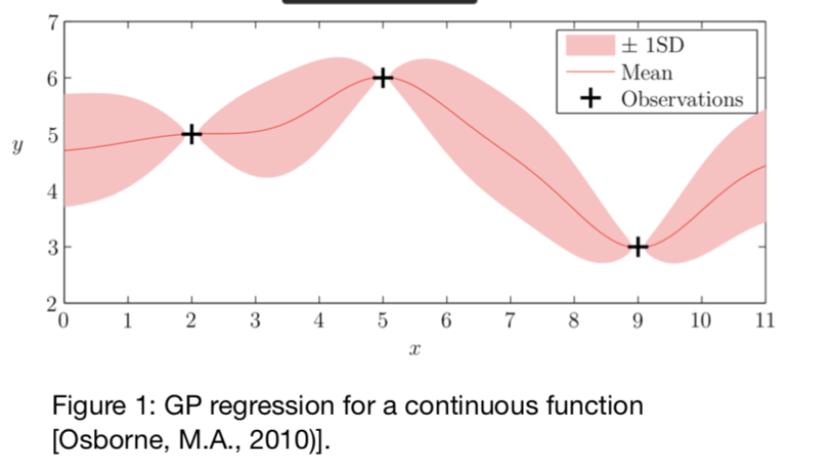
Multivariate Gaussian Distribution
Through mathematical transformations and using the conditional probability rule it is possible to estimate the posterior distribution p( f N+1|FN , XN+1 ) and express f ̂N+1as a function of KN and FN with an uncertainty. This allows us to construct a probabilistic surrogate from our observations as illustrated in Figure 1:
conditional probability of two independent random variables is equal to the unconditional distribution of the non-conditioned variable.,
Notes:
conditional probability of two independent random variables is equal to the unconditional distribution of the non-conditioned variable.

Slide 9
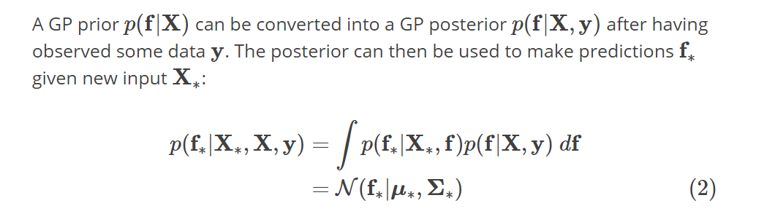
Multivariate Gaussian Distribution
We can treat our observed data and the data we want to predict as a joint distribution and then transform this into a conditional, where we condition on our labelled data.
Cholesky decomposition = square root of a matrix
Instead of inferring a distribution over the parameters of a parametric function Gaussian processes can be used to infer a distribution over functions directly. A Gaussian process defines a prior over functions. After having observed some function values it can be converted into a posterior over functions.
http://krasserm.github.io/2018/03/19/gaussian-processes/
Notes:
conditional probability of two independent random variables is equal to the unconditional distribution of the non-conditioned variable.

Slide 10
Gaussian Process
We break it down:
Notes:
conditional probability of two independent random variables is equal to the unconditional distribution of the non-conditioned variable.

Slide 11
Gaussian Process
The definition of a Gaussian Process is a probability distribution over functions
Comparing with “normal” supervised learning models, where we infer a distribution over the parameters of a parametric function, Gaussian processes can be used to infer a distribution over functions directly.
More formally, it is a collection of random variables, any finite number of which have a joint Gaussian distribution. This makes it a generalization of the multivariate Gaussian distribution dealing with infinitely many variables.
That is, we treat our observed data and the data we want to predict as a joint distribution, and then we transform this into a conditional probability, where we condition on our labelled data.
In GPs the number of parameters grow with the number of data points, thus making it a (infinitely) non-parametric approach
Notes:
conditional probability of two independent random variables is equal to the unconditional distribution of the non-conditioned variable.

Slide 12
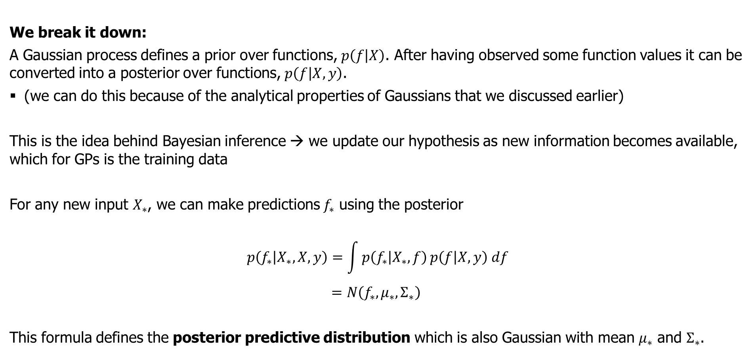
Gaussian Process
We break it down:
A Gaussian process defines a prior over functions, $p\left(f | X\right)$. After having observed some function values it can be converted into a posterior over functions, $p\left(f | X,y\right)$.
(we can do this because of the analytical properties of Gaussians that we discussed earlier)
This is the idea behind Bayesian inference → we update our hypothesis as new information becomes available, which for GPs is the training data
For any new input $X_{∗}$, we can make predictions $f_{∗}$ using the posterior
$$p\left(f_{∗} | X_{∗},X,y\right)=\int{p\left(f_{∗} | X_{∗},f\right)}p\left(f | X,y\right) df$$
$$=N\left(f_{∗},μ_{∗},Σ_{∗}\right)$$
This formula defines the posterior predictive distribution which is also Gaussian with mean $μ_{∗}$ and $Σ_{∗}$.
Notes:
conditional probability of two independent random variables is equal to the unconditional distribution of the non-conditioned variable.

Slide 13

Gaussian Process
By this definition of the GP, we can formulate the joint distributed of observed data $y$ and predictions $f_{∗}$ as
$$\left(\begin{matrix}y \\ f_{∗}\end{matrix}\right)\sim N\left(0,\left(\begin{matrix}K_{y} & K_{∗} \\ K_{∗}^{T} & K_{∗∗}\end{matrix}\right)\right)$$
for $N$training data and $N_{∗}$ new input data.
Notes:
conditional probability of two independent random variables is equal to the unconditional distribution of the non-conditioned variable.

Slide 14
Gaussian Process
more formally, "noise model" refers to anything that we're modeling as stochastic and the "mean model" refers to anything that we're modeling as deterministic.
Notes:
conditional probability of two independent random variables is equal to the unconditional distribution of the non-conditioned variable.

Slide 15
Gaussian Process
The definition of a Gaussian Process is a probability distribution over functions.
More formally, it is a collection of random variables, any finite number of which have a joint Gaussian distribution. This makes it a generalization of the multivariate Gaussian distribution dealing with infinitely many variable.
Instead of inferring a distribution over the parameters of a parametric function, Gaussian processes can be used to infer a distribution over functions directly. A Gaussian process defines a prior over functions. After having observed some function values it can be converted into a posterior over functions.
- This is the idea behind Bayesian inference → we update our hypothesis as new information becomes available, which for GPs is the training data
That is, we treat our observed data and the data we want to predict as a joint distribution, and then we transform this into a conditional probability, where we condition on our labelled data.
In GPs the number of parameters grow with the number of data points, thus making it a (infinitely) non-parametric approach
Notes:
conditional probability of two independent random variables is equal to the unconditional distribution of the non-conditioned variable.

