Slide 2
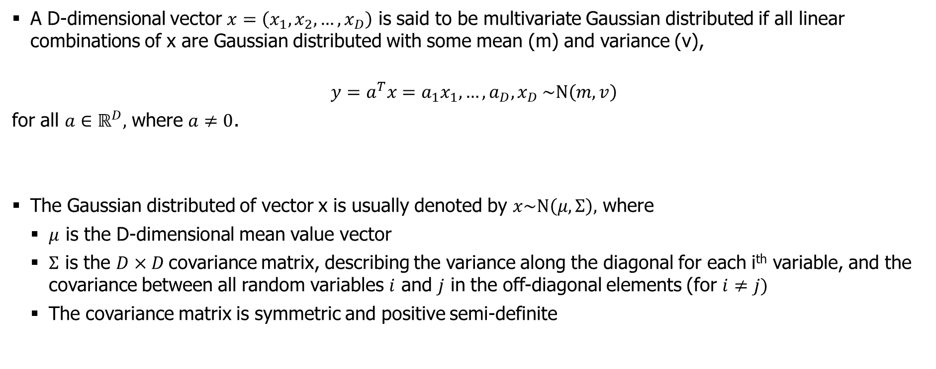
Multivariate Gaussian Distribution
A D-dimensional vector $x=\left(x_{1}, x_{2},…,x_{D}\right)$ is said to be multivariate Gaussian distributed if all linear combinations of x are Gaussian distributed with some mean (m) and variance (v),
$$y=a^{T}x=a_{1}x_{1},…,a_{D},x_{D} \sim Ν\left(m,v\right)$$
for all $a∈ℝ^{D},$ where $a≠0$.
The Gaussian distributed of vector x is usually denoted by $x\sim Ν\left(μ,Σ\right),$ where
$μ$ is the D-dimensional mean value vector
$Σ$ is the $D×D$covariance matrix, describing the variance along the diagonal for each i^{th} variable, and the covariance between all random variables $i$ and $j$ in the off-diagonal elements (for $i≠j)$
The covariance matrix is symmetric and positive semi-definite

Slide 3
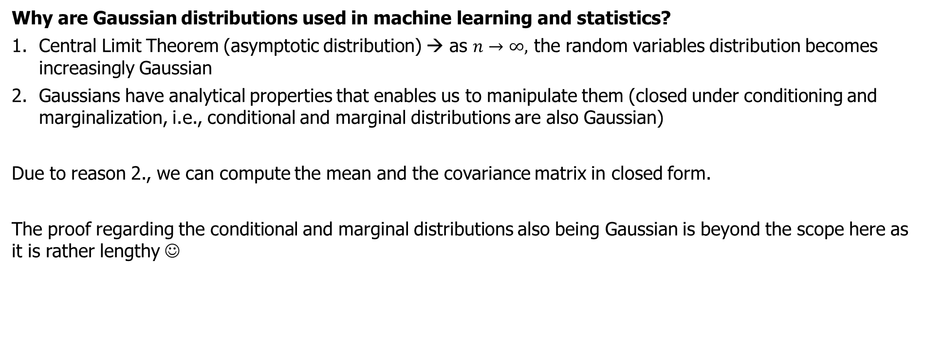
Multivariate Gaussian Distribution
Why are Gaussian distributions used in machine learning and statistics?
Central Limit Theorem (asymptotic distribution) → as $n→∞,$ the random variables distribution becomes increasingly Gaussian
Gaussians have analytical properties that enables us to manipulate them (closed under conditioning and marginalization, i.e., conditional and marginal distributions are also Gaussian)
Due to reason 2., we can compute the mean and the covariance matrix in closed form.
The proof regarding the conditional and marginal distributions also being Gaussian is beyond the scope here as it is rather lengthy ☺
Notes:
conditional probability of two independent random variables is equal to the unconditional distribution of the non-conditioned variable.

Slide 4
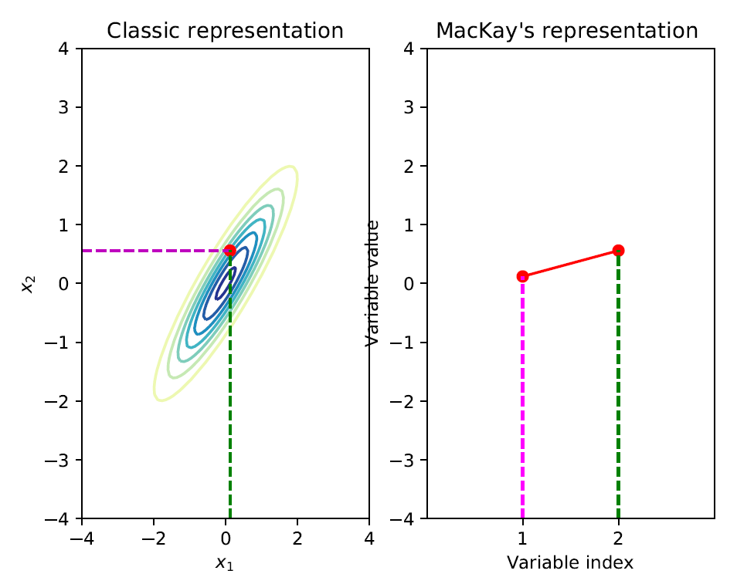

Multivariate Gaussian Distribution
Consider a bi-variate Gaussian distribution
$N\left(x | μ,Σ\right),$ where the mean $μ$ is a vector in $ℝ^{2}$
and the covariance matrix $Σ$ is a 2x2 matrix
If we sample from this distribution we get a
2-dimensional vector $x=\left[x_{1}, x_{2}\right]$
We can visualize this by plotting the value of $x_{1}$
and $x_{2}$ and index 1 and 2, as shown in the figure
here
Notes:
conditional probability of two independent random variables is equal to the unconditional distribution of the non-conditioned variable.

Slide 5
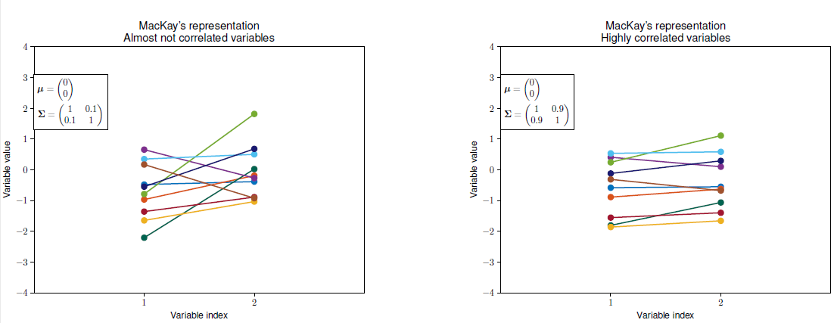
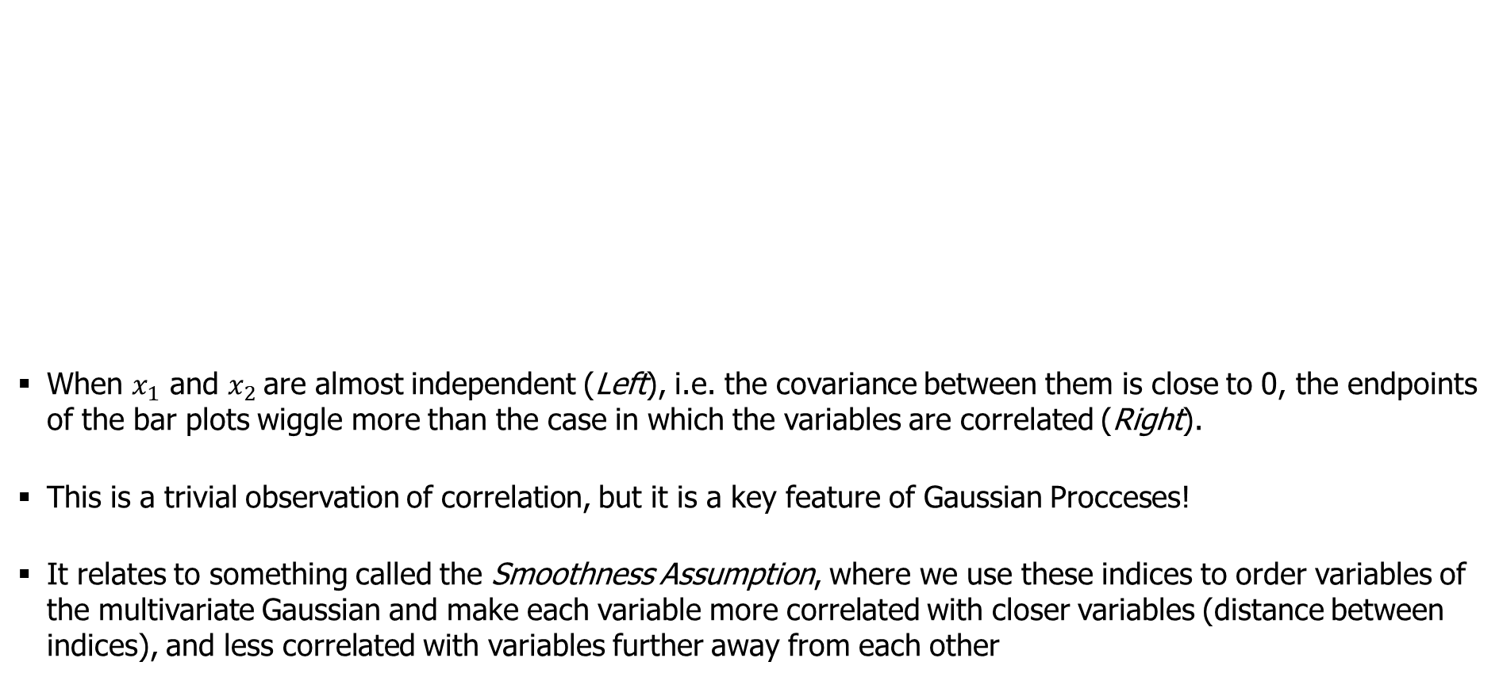
Multivariate Gaussian Distribution
When $x_{1}$ and $x_{2}$are almost independent (Left), i.e. the covariance between them is close to 0, the endpoints of the bar plots wiggle more than the case in which the variables are correlated (Right).
This is a trivial observation of correlation, but it is a key feature of Gaussian Procceses!
It relates to something called the Smoothness Assumption, where we use these indices to order variables of the multivariate Gaussian and make each variable more correlated with closer variables (distance between indices), and less correlated with variables further away from each other
Notes:
conditional probability of two independent random variables is equal to the unconditional distribution of the non-conditioned variable.

Slide 6
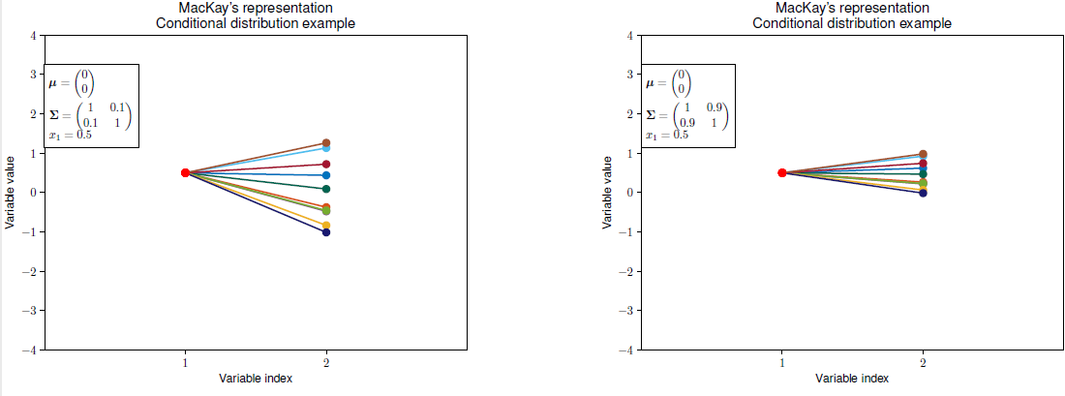
Multivariate Gaussian Distribution
Samples from the conditional distribution in case of almost independent (Left) and highly correlated (Right) variables
This simple representation allows us to represent high-dimensional Gaussian samples in a 2D plot.
This is the key point to see the connection between multivariate Gaussians and Gaussian Process regression
Notes:
conditional probability of two independent random variables is equal to the unconditional distribution of the non-conditioned variable.

Slide 7
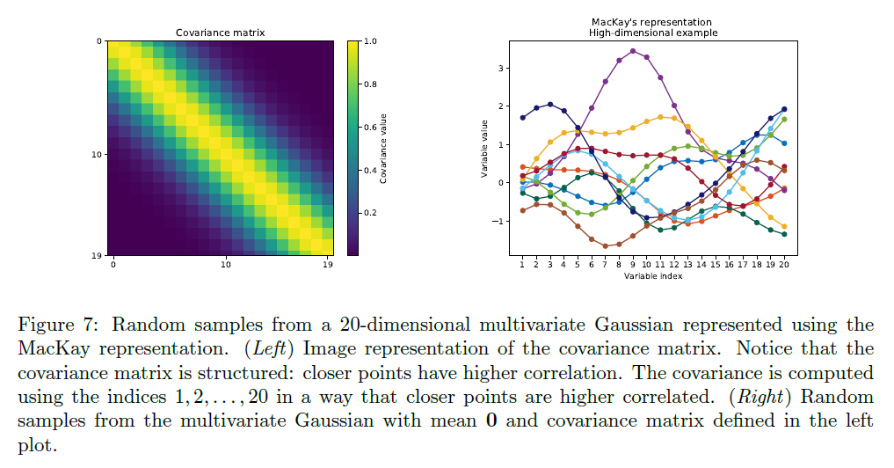

Multivariate Gaussian Distribution
Let us consider a high-dimensional $\left(ℝ^{20}\right)$ example using this MacKay representation
Notes:
conditional probability of two independent random variables is equal to the unconditional distribution of the non-conditioned variable.

Slide 8
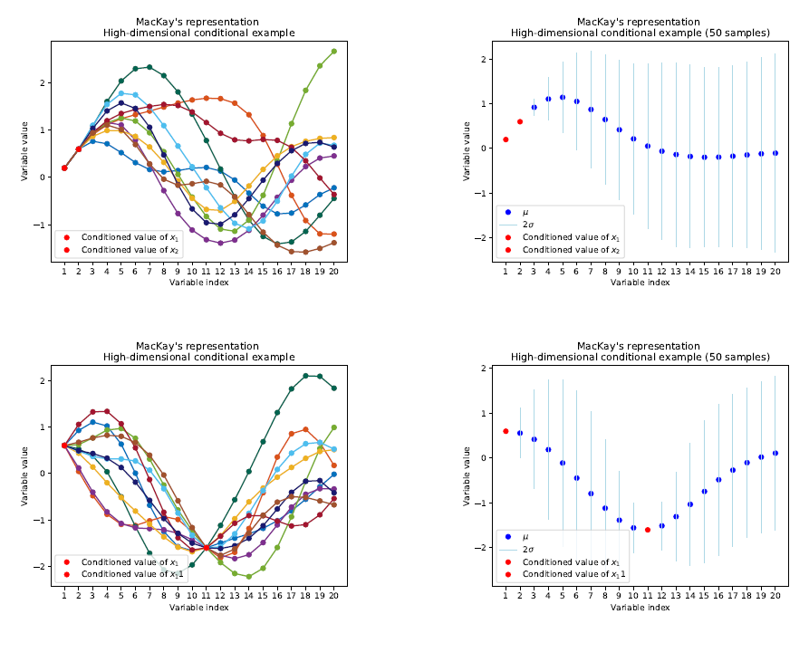
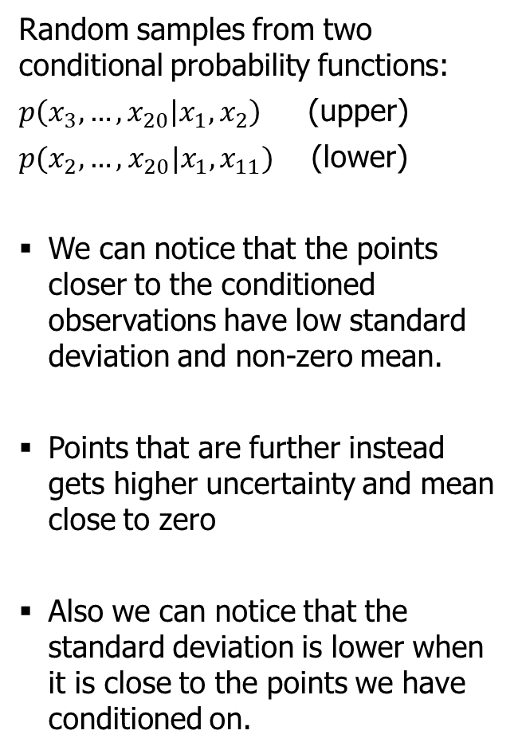
Multivariate Gaussian Distribution
Random samples from two conditional probability functions:
$p\left(x_{3},…,x_{20} | x_{1},x_{2}\right)$ (upper)
$p(x_{2},…,x_{20}|x_{1},x_{11})$ (lower)
We can notice that the points closer to the conditioned observations have low standard deviation and non-zero mean.
Points that are further instead gets higher uncertainty and mean close to zero
Also we can notice that the standard deviation is lower when it is close to the points we have conditioned on.
Notes:
Figure 8: (Upper plots) Random samples from the conditional probability p(x3; ; x20jx1; x2). (Upper
Left) The random samples are non-linear function that goes through the conditioned points. (Upper
Right) Since we can get a lot of samples from the conditional distribution, we get 50 samples and
compute the mean and the standard deviation for each variable x3; ; x20. We can notice that the
points closer to the observations x1, x2 has low standard deviation and non-zero mean. Point
that are further instead gets higher uncertainty and mean close to zero.(Bottom plots) Random
samples from the conditional probability p(x2; ; x20jx1; x11). Also in this case we can notice that
the standard deviation is lower when it is close to the points we have conditioned on.

Slide 9
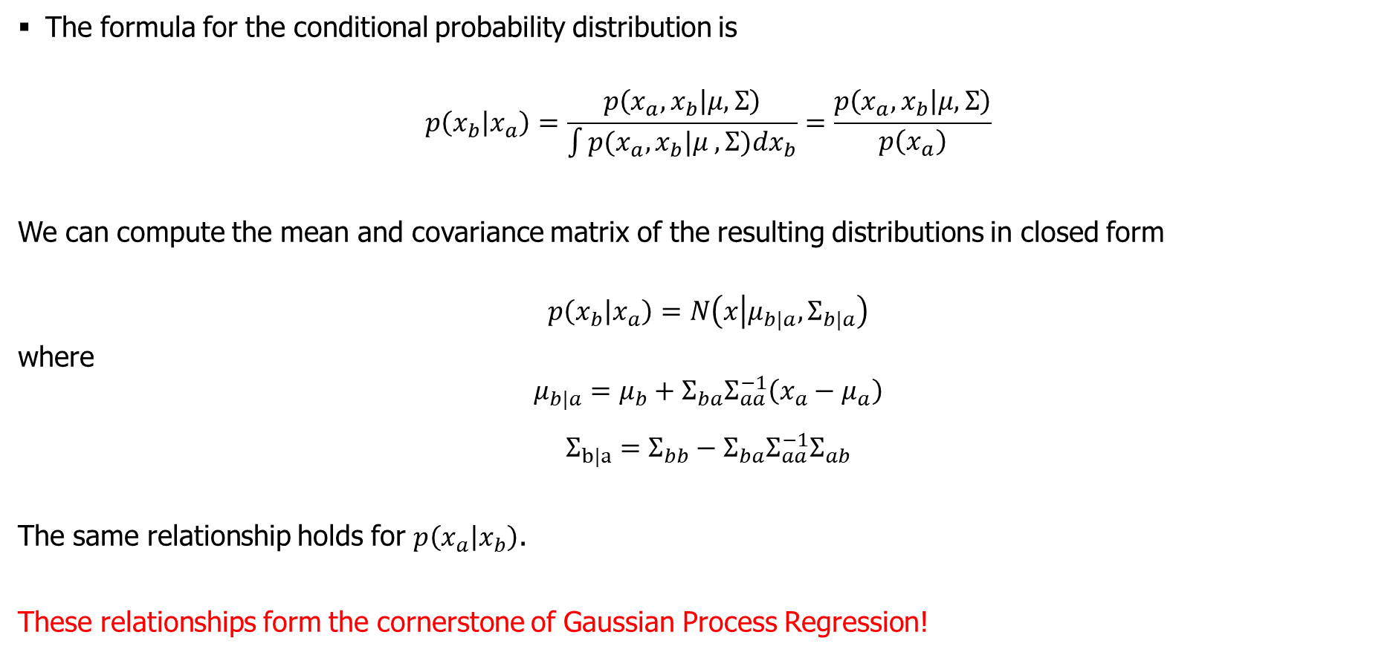
Multivariate Gaussian Distribution
The formula for the conditional probability distribution is
$$p\left(x_{b} | x_{a}\right)=\frac{p\left(x_{a},x_{b} | μ,Σ\right)}{\int{p(x_{a},x_{b}|μ ,Σ})dx_{b}}=\frac{p\left(x_{a},x_{b} | μ,Σ\right)}{p\left(x_{a}\right)}$$
We can compute the mean and covariance matrix of the resulting distributions in closed form
$$p\left(x_{b} | x_{a}\right)=N\left(x | μ_{b|a}, Σ_{b|a}\right)$$
where
$$μ_{b|a}=μ_{b}+Σ_{ba}Σ_{aa}^{−1}\left(x_{a}−μ_{a}\right)$$
$$Σ_{b|a}=Σ_{bb}−Σ_{ba}Σ_{aa}^{−1}Σ_{ab}$$
The same relationship holds for $p\left(x_{a} | x_{b}\right)$.
These relationships form the cornerstone of Gaussian Process Regression!
Notes:
conditional probability of two independent random variables is equal to the unconditional distribution of the non-conditioned variable.

Slide 10

Multivariate Gaussian Distribution
Note that this MacKay representation looks a lot like a regression problem where our training set is defined by (index, y).
For the first plots for example where we condition on $x_{1},x_{2}$, this is can be defined as having a training set $\left\{\left(1,x_{1}\right),\left(2,x_{2}\right)\right\}$, where we want to predict the $y$ values (denoted $x_{i}$) for our test set $\left[3,…,20\right].$
This is a very sample-efficient way of performing regression since overfitting is not really a problem! Could you imagine a supervised learning model performing a similar task? Not really!
We are getting awfully close to Gaussian Process Regression now!
Notes:
conditional probability of two independent random variables is equal to the unconditional distribution of the non-conditioned variable.

Slide 11

Multivariate Gaussian Distribution
Say we want to predict 10 test observations and we have zero training observations?
How do we predict the 10 test observations?
We construct a 10x10 covariance matrix that describes a 10-dimensional multivariate Gaussian
We sample from this distribution and obtain a 10-dimensional vector, where each entry is a possible prediction for that specific $x$ point
In case we have a training set, we would still create the covariance matrix but we would also compute the conditional distribution (conditioned on the training set) and then sample again.
Two questions arise here:
How do we construct a covariance matrix from the x-values to get prediction for the possible y-values?
Given this MacKay representation, it suggests we want this weird integer formulation for the x-values. But in practice we have typically have $x$observations with real values (at least in regression). This is related to point 1!
Notes:
conditional probability of two independent random variables is equal to the unconditional distribution of the non-conditioned variable.

Slide 12
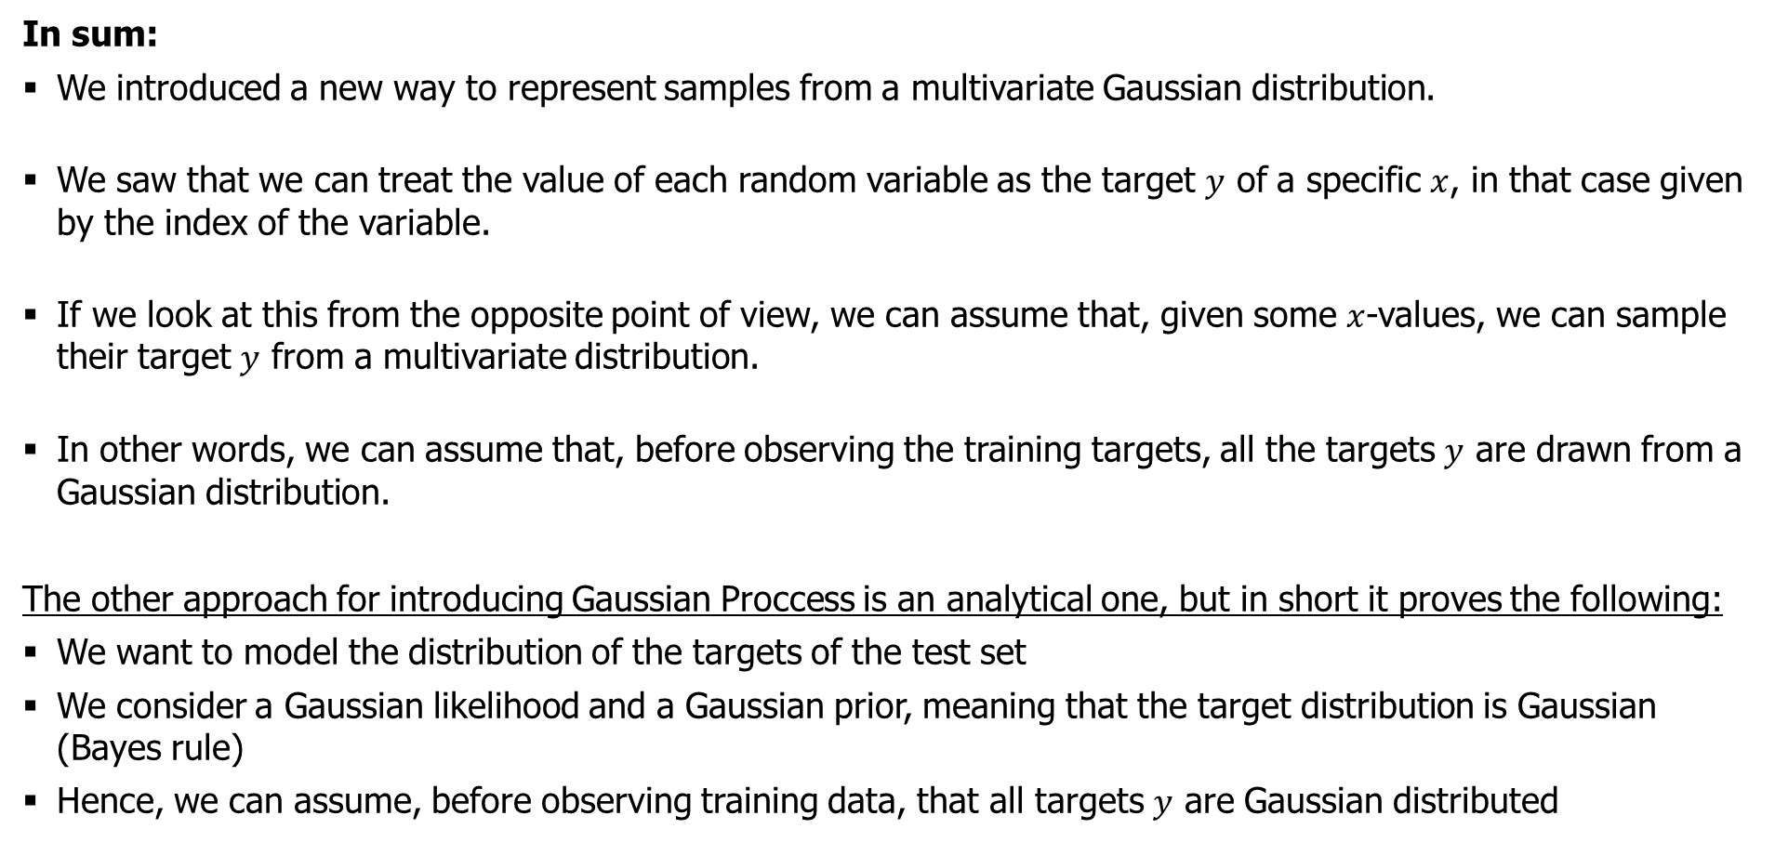
Multivariate Gaussian Distribution
In sum:
We introduced a new way to represent samples from a multivariate Gaussian distribution.
We saw that we can treat the value of each random variable as the target $y$ of a specific $x$, in that case given by the index of the variable.
If we look at this from the opposite point of view, we can assume that, given some $x$-values, we can sample their target $y$ from a multivariate distribution.
In other words, we can assume that, before observing the training targets, all the targets $y$ are drawn from a Gaussian distribution.
The other approach for introducing Gaussian Proccess is an analytical one, but in short it proves the following:
We want to model the distribution of the targets of the test set
We consider a Gaussian likelihood and a Gaussian prior, meaning that the target distribution is Gaussian (Bayes rule)
Hence, we can assume, before observing training data, that all targets $y$ are Gaussian distributed
Notes:
conditional probability of two independent random variables is equal to the unconditional distribution of the non-conditioned variable.

Slide 13
Gaussian Process
Formal definitions:
Gaussian Processes (GPs) provide a rich and flexible class of non-parametric statistical models over function spaces with domains that can be continuous, discrete, mixed, or even hierarchical in nature. Furthermore, the GP provides not just information about the likely value of f, but importantly also about the uncertainty around that value.
More formally, it is a collection of random variables, any finite number of which have a joint Gaussian distribution. This makes it a generalization of the multivariate Gaussian distribution dealing with infinitely many variables.
A Gaussian process defines a prior over functions. After having observed some function values it can be converted into a posterior over functions.
Notes:
conditional probability of two independent random variables is equal to the unconditional distribution of the non-conditioned variable.

Slide 14
Gaussian Process
In short:
The definition of a Gaussian Process is a probability distribution over functions.
Comparing with “normal” supervised learning models, where we infer a distribution over the parameters of a parametric function, Gaussian processes can be used to infer a distribution over functions directly.
In GPs the number of parameters grow with the number of data points, thus making it a (infinitely) non-parametric approach
Notes:
conditional probability of two independent random variables is equal to the unconditional distribution of the non-conditioned variable.

Slide 15

Gaussian Process
We break it down:
A Gaussian process defines a prior over functions, $p\left(f | X\right)$. After having observed some function values it can be converted into a posterior over functions, $p\left(f | X,y\right)$ (remember the previous figure)
(we can do this because of the analytical properties of Gaussians that we discussed earlier)
$\text{The} \text{intuition} \text{behind} \text{this} \text{step} \text{is} \text{that} \text{the} \text{training} \text{points} \text{constrain} \text{the} \text{set} \text{of} \text{functions} \text{to} \text{those} \text{that} \text{pass} \text{through} \text{the} \text{training} \text{points}$
This is the idea behind Bayesian inference → we update our hypothesis as new information becomes available, which for GPs is the training data
Notes:
conditional probability of two independent random variables is equal to the unconditional distribution of the non-conditioned variable.

Slide 16
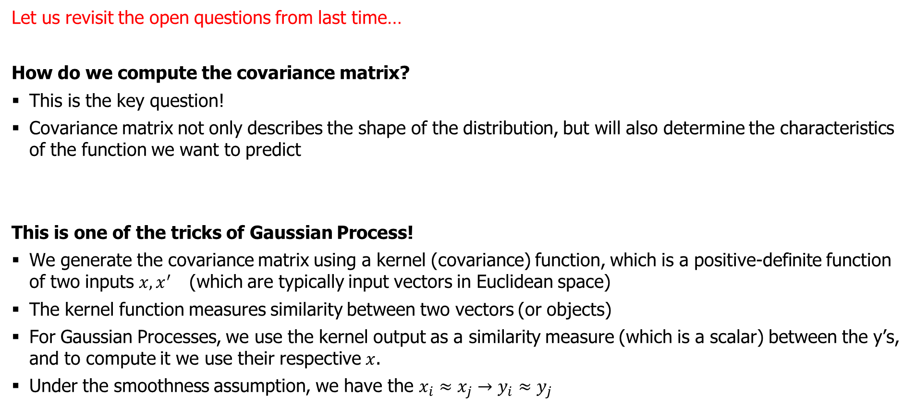
Gaussian Process
Let us revisit the open questions from last time…
How do we compute the covariance matrix?
This is the key question!
Covariance matrix not only describes the shape of the distribution, but will also determine the characteristics of the function we want to predict
This is one of the tricks of Gaussian Process!
We generate the covariance matrix using a kernel (covariance) function, which is a positive-definite function of two inputs $x, x^{′}$ (which are typically input vectors in Euclidean space)
The kernel function measures similarity between two vectors (or objects)
For Gaussian Processes, we use the kernel output as a similarity measure (which is a scalar) between the y’s, and to compute it we use their respective $x$.
Under the smoothness assumption, we have the $x_{i}≈x_{j}→y_{i}≈y_{j}$
Notes:
conditional probability of two independent random variables is equal to the unconditional distribution of the non-conditioned variable.

Slide 17
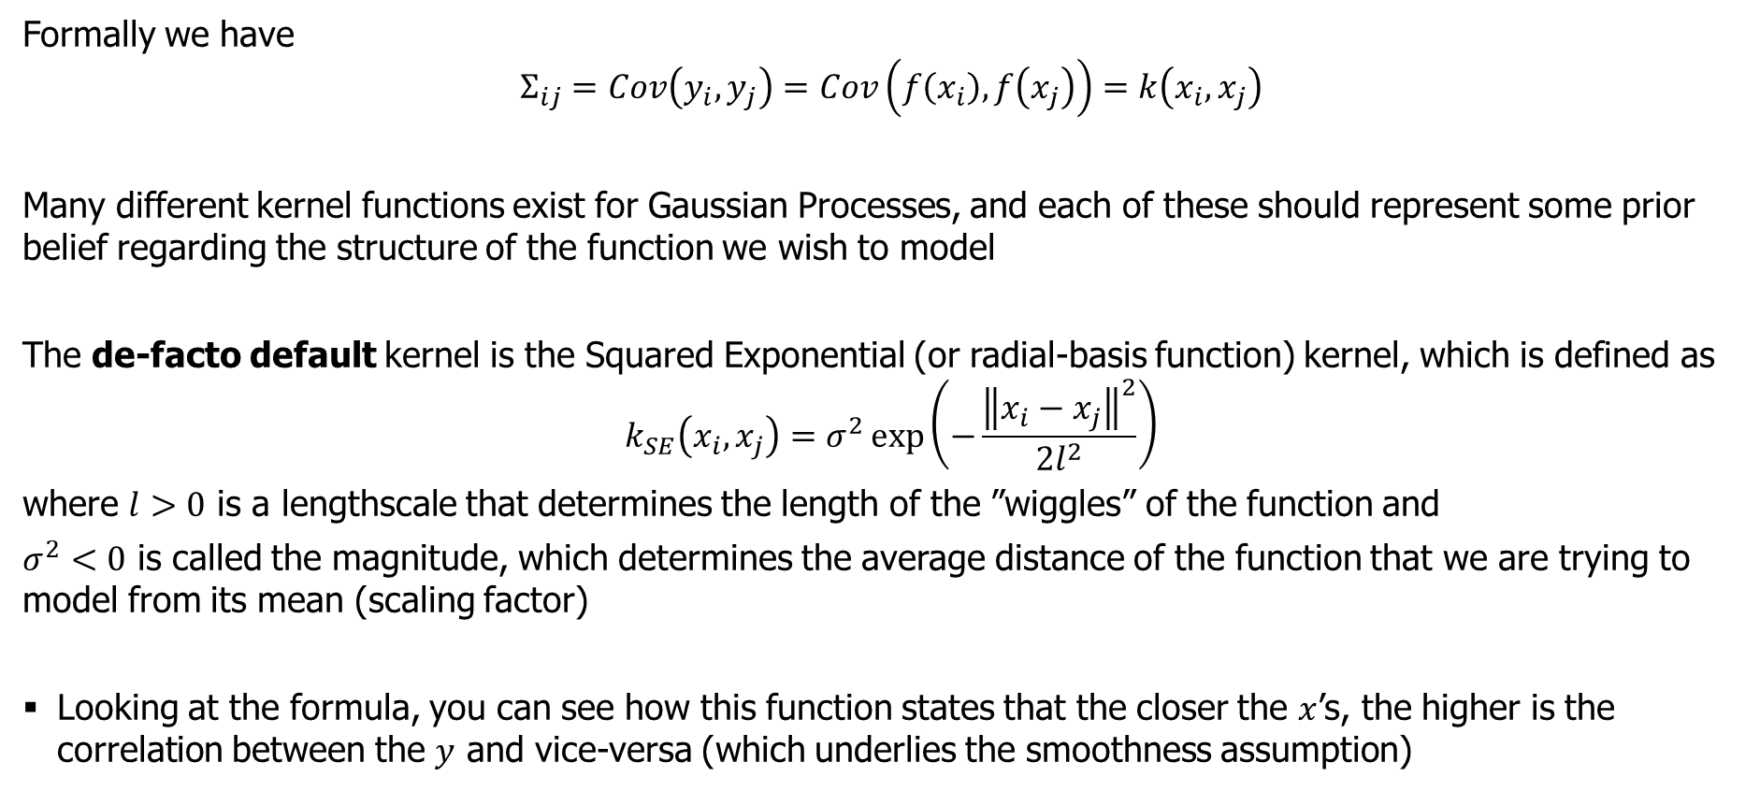
Gaussian Process
Formally we have
$$Σ_{ij}=Cov\left(y_{i},y_{j}\right)=Cov\left(f\left(x_{i}\right), f\left(x_{j}\right)\right)=k\left(x_{i},x_{j}\right)$$
Many different kernel functions exist for Gaussian Processes, and each of these should represent some prior belief regarding the structure of the function we wish to model
The de-facto default kernel is the Squared Exponential (or radial-basis function) kernel, which is defined as
$$k_{SE}\left(x_{i},x_{j}\right)=σ^{2}\exp\left(−\frac{{\left\|x_{i}−x_{j}\right\|}^{2}}{2l^{2}}\right)$$
where $l>0$ is a lengthscale that determines the length of the ”wiggles” of the function and
$σ^{2}<0$ is called the magnitude, which determines the average distance of the function that we are trying to model from its mean (scaling factor)
Looking at the formula, you can see how this function states that the closer the $x$’s, the higher is the correlation between the $y$ and vice-versa (which underlies the smoothness assumption)
Notes:
conditional probability of two independent random variables is equal to the unconditional distribution of the non-conditioned variable.

Slide 18
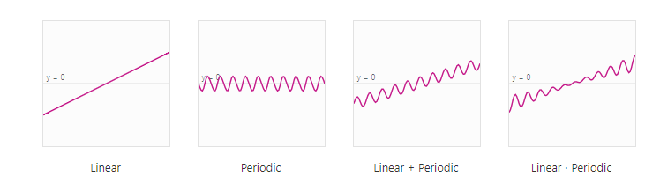
Gaussian Process
Other kernel functions:
Say we have a weather phenomena that exhibits a high degree of periodicity and stationarity (solar irradiance)
Hence, it might make sense to use a sine-based kernel function (periodic) to exploit this behavior
Notes:
conditional probability of two independent random variables is equal to the unconditional distribution of the non-conditioned variable.

Slide 19
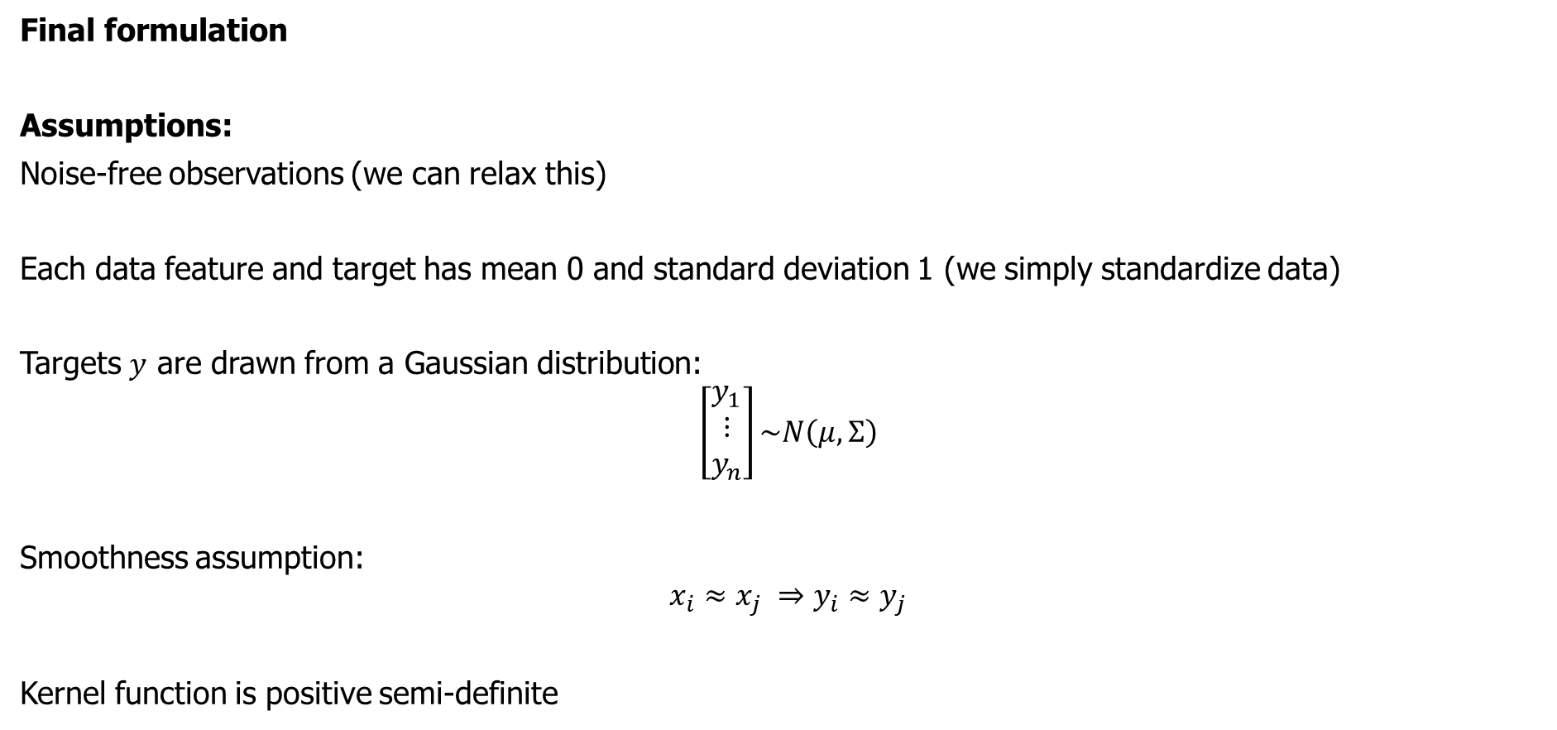
Gaussian Process
Final formulation
Assumptions:
Noise-free observations (we can relax this)
Each data feature and target has mean 0 and standard deviation 1 (we simply standardize data)
Targets $y$ are drawn from a Gaussian distribution:
$$\left[\begin{matrix}y_{1} \\ ⋮ \\ y_{n}\end{matrix}\right]\sim N\left(μ,Σ\right)$$
Smoothness assumption:
$$x_{i}≈x_{j} ⇒y_{i}≈y_{j}$$
Kernel function is positive semi-definite
Notes:
conditional probability of two independent random variables is equal to the unconditional distribution of the non-conditioned variable.

Slide 20

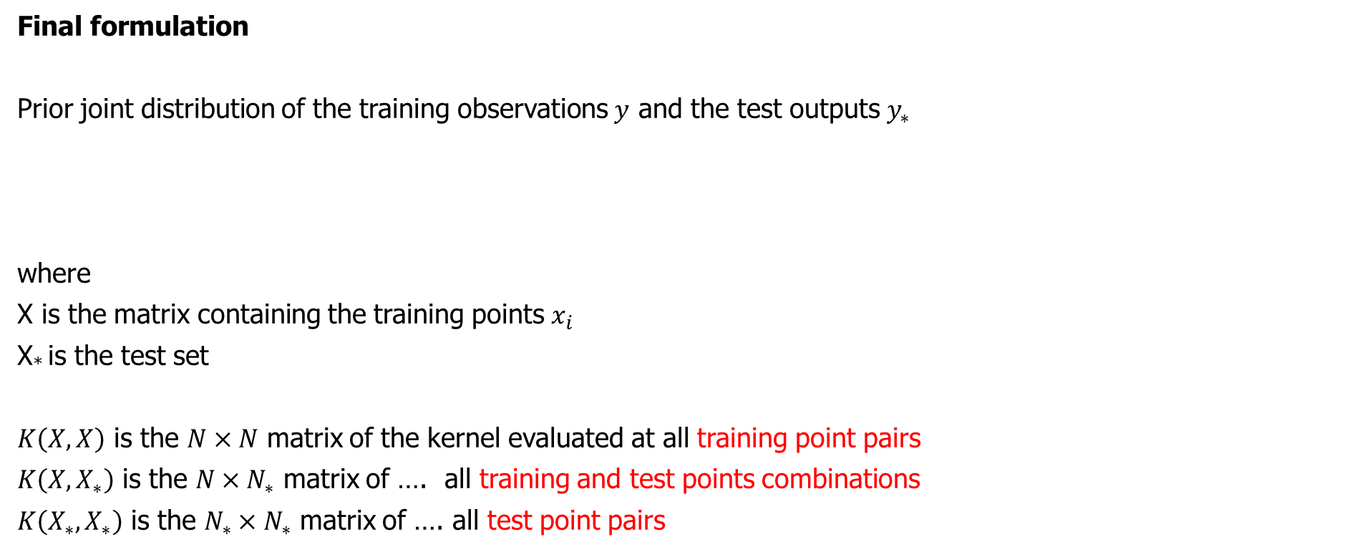
Gaussian Process
Final formulation
Prior joint distribution of the training observations $y$ and the test outputs $y_{∗}$
where
X is the matrix containing the training points $x_{i}$
X* is the test set
$K\left(X,X\right)$ is the $N×N$ matrix of the kernel evaluated at all training point pairs
$K\left(X,X_{∗}\right)$ is the $N×N_{∗}$ matrix of …. all training and test points combinations
$K\left(X_{∗},X_{∗}\right)$ is the $N_{∗}×N_{∗}$ matrix of …. all test point pairs
Notes:
conditional probability of two independent random variables is equal to the unconditional distribution of the non-conditioned variable.

Slide 21
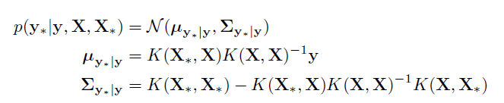
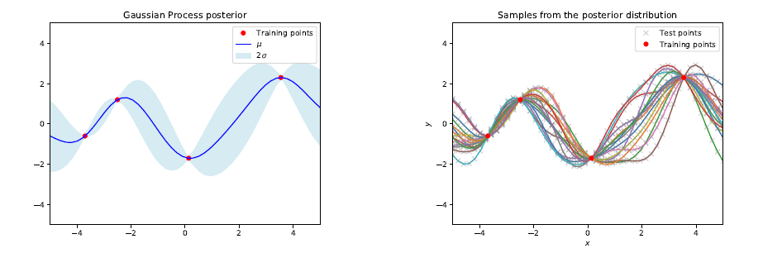
Gaussian Process
Final formulation of noise-free regression
As stated earlier, we know that we can condition the joint Gaussian prior distribution on the training observations, which also yields a Gaussian distribution
This means, we can compute its conditional mean and conditional covariance as
Notes:
conditional probability of two independent random variables is equal to the unconditional distribution of the non-conditioned variable.

Slide 22


Gaussian Process
Final formulation of noisy regression
Say we have noisy target values (which is more realistic in practical settings), then the prior becomes
where we assume the noise term is additive and independent normal distributed with mean zero and variance $σ_{n}^{2}$
Notes:
conditional probability of two independent random variables is equal to the unconditional distribution of the non-conditioned variable.

Slide 23
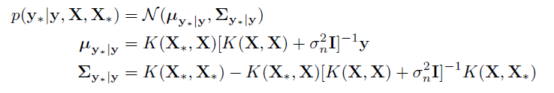
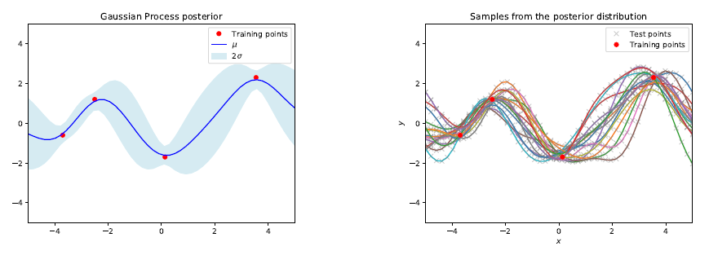
Gaussian Process
Final formulation of noisy regression
And the posterior
Notes:
conditional probability of two independent random variables is equal to the unconditional distribution of the non-conditioned variable.

Slide 24
Gaussian Process
In sum:
Gaussian processes offer a flexible framework for regression, especially in domains where uncertainty quantification is important
The power (and limitation) of Gaussian processes lies in the choice of kernel function
We can introduce domain knowledge (physical models) into the process
We can combine kernels to obtain more specialized kernels
Choice of kernel is based on prior beliefs regarding the data (stationary, global trends, etc)
The only restriction is, that the resulting covariance matrix needs to be positive semi-definite (so all kernels that satisfy this property are allowed)
Notes:
conditional probability of two independent random variables is equal to the unconditional distribution of the non-conditioned variable.

Slide 25
Gaussian Process
Motivation for weather forecasting:
"A mean function can be a good way of incorporating scientific inductive bias in a model; for example, we can concentrate the prior support around a parametric physical model, but allow a non-parametric relaxation with the Gaussian process to account for model misspecification and uncertainty."
Mean function could be a NWP model forecasting some weather phenomena (such as solar irradiance), and then we select a kernel function to incorporate our prior belief about this data (sine-based kernel)
Think of it this way:
Mean model is deterministic (such as NWP)
Covariance matrix captures the stochastic elements
Potentially we could make the model regime-switching based on the weather cluster?
Notes:
conditional probability of two independent random variables is equal to the unconditional distribution of the non-conditioned variable.

Slide 26
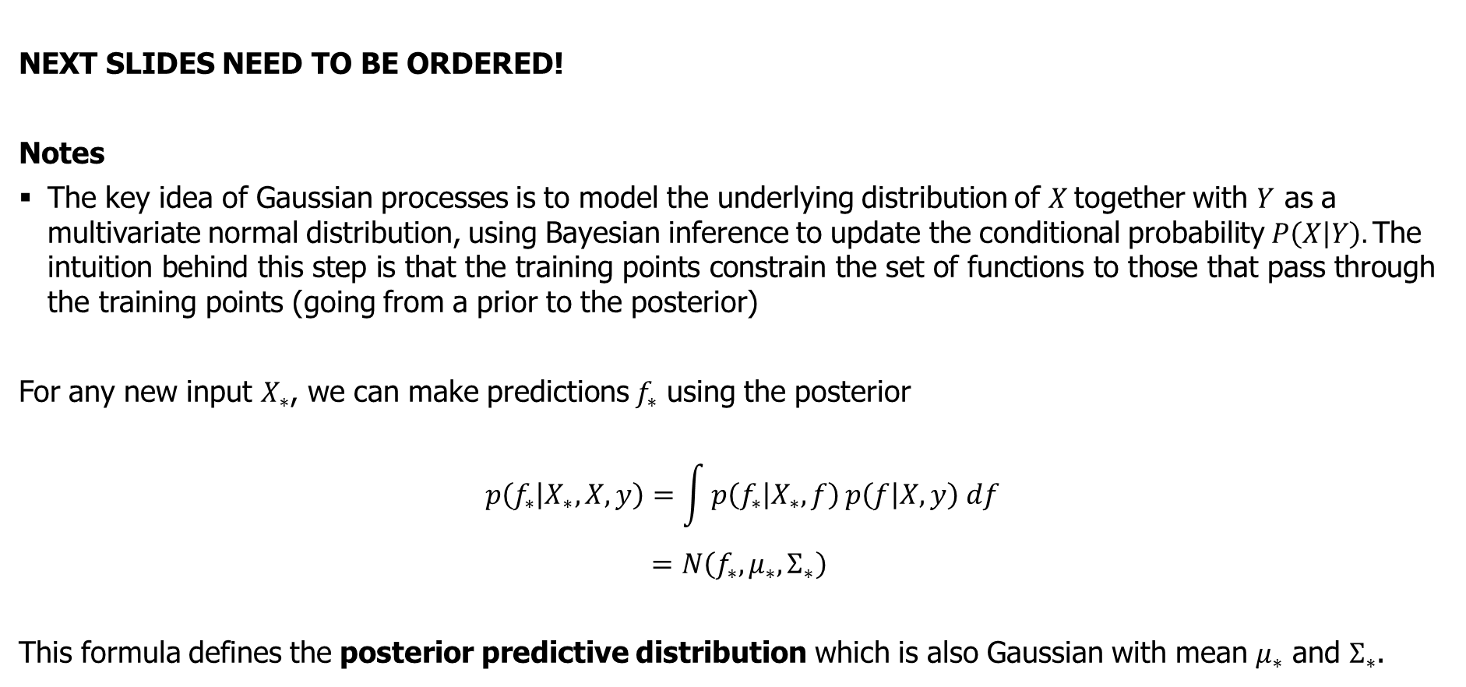
Gaussian Process
NEXT SLIDES NEED TO BE ORDERED!
Notes
The key idea of Gaussian processes is to model the underlying distribution of $X$together with $Y$ as a multivariate normal distribution, using Bayesian inference to update the conditional probability $P\left(X | Y\right).\text{The} \text{intuition} \text{behind} \text{this} \text{step} \text{is} \text{that} \text{the} \text{training} \text{points} \text{constrain} \text{the} \text{set} \text{of} \text{functions} \text{to} \text{those} \text{that} \text{pass} \text{through} \text{the} \text{training} \text{points}$ (going from a prior to the posterior)
For any new input $X_{∗}$, we can make predictions $f_{∗}$ using the posterior
$$p\left(f_{∗} | X_{∗},X,y\right)=\int{p\left(f_{∗} | X_{∗},f\right)}p\left(f | X,y\right) df$$
$$=N\left(f_{∗},μ_{∗},Σ_{∗}\right)$$
This formula defines the posterior predictive distribution which is also Gaussian with mean $μ_{∗}$ and $Σ_{∗}$.
Notes:
conditional probability of two independent random variables is equal to the unconditional distribution of the non-conditioned variable.

