Slide 1
2 The anatomy of class definitions

Slide 2
Main concepts to be covered
fields
constructors
methods
parameters
assignment statements
Notes:
Fields – instansvariabler, dataattribut
Constructors – initiering – varför?
Ungefär som i C:
parameters
assignment statements

Slide 3
Ticket machines – an external view
Exploring the behavior of a typical ticket machine.
Use the naive-ticket-machine project.
Machines supply tickets of a fixed price.
How is that price determined?
How is ‘money’ entered into a machine?
How does a machine keep track of the money that is entered?
Notes:
DEMO – nästa bild

Slide 4
Ticket machines
Demo
Notes:
Kör Naive Ticket Machine
Black Box testing vs White box
Sätt pris = 100
Inspect
Sätt in 300
Skriv ut en biljett
Den snor pengarna!
Kolla koden

Slide 5
Ticket machines – an internal view
Interacting with an object gives us clues about its behavior.
Looking inside allows us to determine how that behavior is provided or implemented.
All Java classes have a similar-looking internal view.
Notes:
White box

Slide 6
Basic class structure
The outer wrapper of TicketMachine
public class TicketMachine
{
Inner part omitted.
}
public class ClassName
{
Fields
Constructors
Methods
}
The inner contents of a class
Notes:
TAVLAN
Publika klasser läggs i filer med samma namn + .java
En klass definierar en datatyp.

Slide 7
Keywords
Words with a special meaning in the language:
public
class
private
int
Also known as reserved words.

Slide 8
Fields
Fields store values for an object.
They are also known as instance variables.
Fields define the state of an object.
Use Inspect to view the state.
Some values change often.
Some change rarely (or not at all).
public class TicketMachine
{
private int price;
private int balance;
private int total;
Further details omitted.
}
type
visibility modifier
variable name
private int price;
Notes:
TAVLAN forts.
Klasser har två typer av medlemmar:
Dataattribut (instansvariabler, datamedlemmar, eng. field) lagrar värden. Varje instans av klassen (objekt) har sin egen uppsättning av attributen som beskrivs i klassdefinitionen.
Metoder (funktioner) verkar på instanser av klassen.

Slide 9
Constructors
public TicketMachine(int cost)
{
price = cost;
balance = 0;
total = 0;
}
Initialize an object.
Have the same name as their class.
Close association with the fields.
Store initial values into the fields.
External parameter values for this.
Notes:
Alla nya objekt initieras
… jfr C
Utebliven initiering mkt vanlig felorsak

Slide 10
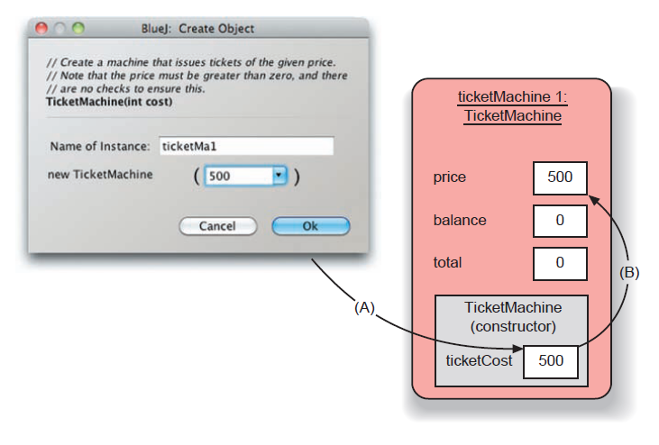
Passing data via parameters
Parameters are another sort of variable.
Notes:
TAVLAN
TicketMachine tm = new TicketMachine(500);
Tm.insertMoney(2000);
Tm.printTicket();
If ( tm.getPrice() > tm.getBalance() )
tm.refundMoney();

Slide 11
Assignment
Values are stored into fields (and other variables) via assignment statements:
variable = expression;
price = cost;
A variable stores a single value, so any previous value is lost.
Notes:
som i C …
+=
++
etc

Slide 12
Choosing variable names
There is a lot of freedom over choice of names. Use it wisely!
Choose expressive names to make code easier to understand:
price, amount, name, age, etc.
Avoid single-letter or cryptic names:
w, t5, xyz123
Notes:
Variabler, metoder
namnNamnNamn
Ok med I,j,k,… för loopräknare o.likn.
amount (of what?)
inte ‘elements’, utan ‘noOfElements’
Klasser
NamnNamnNamn

Slide 13
More concepts
methods
including accessor and mutator methods
conditional statements
string concatenation
local variables

Slide 14
Methods
Methods implement the behavior of objects.
Methods have a consistent structure comprised of a header and a body.
Accessor methods provide information about an object.
Mutator methods alter the state of an object.
Other sorts of methods accomplish a variety of tasks.

Slide 15
Method structure
The header provides the method’s signature:
public int getPrice()
The header tells us:
the name of the method
what parameters it takes
whether it returns a result
its visibility to objects of other classes
The body encloses the method’s statements.
Notes:
plus ytterligare information som gås igenom senare

Slide 16
Accessor (get) methods
return type
visibility modifier
method name
parameter list (empty)
public int getPrice()
{
return price;
}
return statement
start and end of method body (block)

Slide 17
Accessor methods
An accessor method always has a return type that is not void.
An accessor method returns a value (result) of the type given in the header.
The method will contain a return statement to return the value.
NB: Returning is not printing!

Slide 18
Test
public class TicketMachine
{
private price;
public TicketMachine()
{
price = 300
}
public int getPrice
{
return Price;
}
What is wrong here?
(there are five errors!)

Slide 19
Test
public class CokeMachine
{
private price;
public CokeMachine()
{
price = 300
}
public int getPrice
{
return Price;
}
int
What is wrong here?
;
()
^ p
(there are five errors!)
}

Slide 20
Mutator methods
Have a similar method structure: header and body.
Used to mutate (i.e., change) an object’s state.
Achieved through changing the value of one or more fields.
Typically contain assignment statements.
Often receive parameters.

Slide 21
Mutator methods
visibility modifier
return type
method name
parameter
public void insertMoney(int amount)
{
balance = balance + amount;
}
field being mutated
assignment statement

Slide 22
set mutator methods
Fields often have dedicated set mutator methods.
These have a simple, distinctive form:
void return type
method name related to the field name
single parameter, with the same type as the type of the field
a single assignment statement

Slide 23
A typical set method
public void setDiscount(int amount)
{
discount = amount;
}
We can infer that discount is a field of type int, i.e:
private int discount;
Notes:
Vilka set/get skall man ha?
class Item { private String id; // konstanrt private String descr; // konstant private String price; // kan ändras public Item(...) { ... } public String getId() { ... } public String getDescr() { ... } public String getPrice() { ... } public void setPrice(int newPrice) {...} }

Slide 24
Protective mutators
A set method does not have to assign the parameter to the field.
The parameter may be checked for validity and rejected if inappropriate.
Mutators thereby protect fields.
Mutators support encapsulation.
Notes:
Enkelriktning
Jfr C som saknar inkapsling:
struct TicketMachine {
int price; …
}
TicketMachine tm;
tm.price = -400;

Slide 25
Printing from methods
public void printTicket()
{
// Simulate the printing of a ticket.
System.out.println("##################");
System.out.println("# The BlueJ Line");
System.out.println("# Ticket");
System.out.println("# " + price + " cents.");
System.out.println("##################");
System.out.println();
// Update the total collected with the balance.
total = total + balance;
// Clear the balance.
balance = 0;
}
Notes:
out är ett objekt (jfr stdout I C)

Slide 26
Operator overloading
4 + 5
+ means integer addition
9
"wind" + "ow"
+ means string concatenation
"window"
"Result: " + 6
The integer is automatically
converted to a string
"Result: 6"
"# " + price + " cents"
"# 500 cents"
Notes:
try out in codepad

Slide 27
What is printed?
System.out.println(5 + 6 + "hello");
System.out.println("hello" + 5 + 6);
11hello
hello56
Notes:
then: write class person live

Slide 28
Method summary
Methods implement all object behavior.
A method has a name and a return type.
The return-type may be void.
A non-void return type means the method will return a value to its caller.
A method might take parameters.
Parameters bring values in from outside for the method to use.

Slide 29
Reflecting on the ticket machines
Their behavior is inadequate in several ways:
No checks on the amounts entered.
No refunds.
No checks for a sensible initialization.
How can we do better?
We need more sophisticated behavior.

Slide 30
Making choices in Java
boolean condition to be tested
‘if’ keyword
actions if condition is true
if(perform some test) {
Do these statements if the test gave a true result
}
else {
Do these statements if the test gave a false result
}
actions if condition is false
‘else’ keyword

Slide 31
Making a choice in the ticket machine
public void insertMoney(int amount)
{
if(amount > 0) {
balance = balance + amount;
}
else {
System.out.println( "Use a positive amount: " +
amount);
}
}

Slide 32
How do we write 'refundBalance'?
Notes:
write method in BlueJ;
first: do it wrong

Slide 33
Variables – a recap
Fields are one sort of variable:
They store values through the life of an object
values that determine an object’s state.
They are accessible throughout the class.
Parameters are another sort of variable:
They receive values from outside the method.
They help a method complete its task.
Each call to the method receives a fresh set of values.
Parameter values are short lived.

Slide 34
Local variables
Methods can define their own, local variables:
Short lived, like parameters.
The method sets their values.
Used for ‘temporary’ calculation and storage.
They exist only as long as the method is being executed.
They are only accessible from within the method.

Slide 35
Local variables
A local variable
public int refundBalance()
{
int amountToRefund;
amountToRefund = balance;
balance = 0;
return amountToRefund;
}
No visibility
modifier

Slide 36
Scope and lifetime
Each block defines a new scope.
Class, method and statement.
Scopes may be nested:
statement block inside another block inside a method body inside a class body.
Scope is static (textual).
Lifetime is dynamic (runtime).

Slide 37
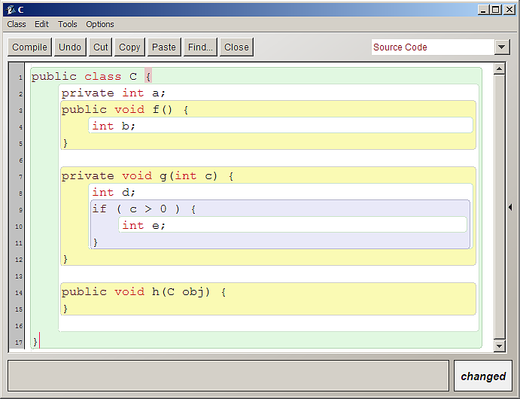
Scope highlighting

Slide 38
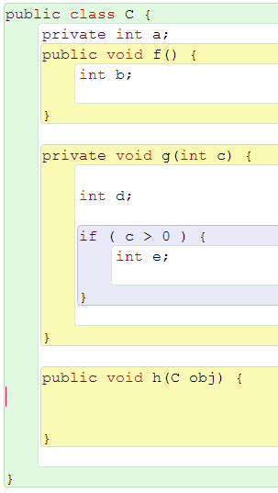
Visibility of names
C, a, f, g, h, b are visible here
C, a, f, g, h, c are visible here
C, a, f, g, h, c, d are visible here
C, a, f, g, h, c, d, e are visible here
C, a, f, g, h c, d are visible here
C, a, f, g, h, obj are visible here
and also obj.a, obj.f, obj.g, obj.h

Slide 39
Scope and lifetime
The scope of a local variable is the block in which it is declared.
The lifetime of a local variable is the time of execution of the block in which it is declared.
The scope of a field is its whole class.
The lifetime of a field is the lifetime of its containing object.

Slide 40
Review (1)
Class bodies contain fields, constructors and methods.
Fields store values that determine an object’s state.
Constructors initialize objects – particularly their fields.
Methods implement the behavior of objects.
Notes:
Om tid över – ta paketexemplet

Slide 41
Review (2)
Fields, parameters and local variables are all variables.
Fields persist for the lifetime of an object.
Parameters are used to receive values into a constructor or method.
Local variables are used for short-lived temporary storage.

Slide 42
Review (3)
Methods have a return type.
void methods do not return anything.
non-void methods return a value.
non-void methods have (at least) one return statement
a return statement must be reached during the execution of such methods.
Notes:
Return måste nås i alla programflöden.

Slide 43
Review (4)
‘Correct’ behavior often requires objects to make decisions.
Objects can make decisions via conditional (if) statements.
A true-or-false test allows one of two alternative courses of actions to be taken.

