Slide 1
Adaboost
Implement a face detector that is trained using adaboost
By,
Dakota Holmes
Joseph Mancillas
Marquiese Thompson

Slide 2
Preview
Preprocessing
Adaboost
- Explanation as to why we choose to change the total images to process to gather our metrics
Bootstrapping
- Metrics we gathered from our results, success vs nonsuccess
- Results after retraining
Skin detection
- Result images, using only images from test_face_photos
Cascades (unfortunately we did not make it to this in point)

Slide 3
Preprocessing the Data
We decided to use different image input sizes because the machine being used to compile would run the code very quickly no matter the change in rounds for adaboost. Starting with 500 face images and all of the nonface images giving us a total of 630. We would increment the total amount of face images by 500 for each compile.
Gathered the images from the training folders
Original size of images from training_faces were too large to use for testing, so we resized each image to be [50, 50]
Collected integrals for the faces and nonfaces
Created a set of 1000 random classifiers using generate_classifier

Slide 4
Adaboost
The number of rounds passed into the adaboost function each time is constant because it would produce the most consistent results.
Responses were computed by using the 1000 randomly generated classifiers and the total amount of face/nonface integrals
Run Times for adaboost:
Total Images | Compute Time (s)
630 | 10.69s
1130 | 17.13s
1630 | 24.17s
2130 | 30.95s

Slide 5
Bootstrapping
Concatenated total images being used into sample array.
Used the boosted classifier results from adaboost, in a function called “boosted_predict”. Which returns either a number below 0 (function does not think it’s a face) or above 1 (function thinks it’s a face)
Set a threshold equal to 5, and compute the metrics within that range
Retrain data using same function without a threshold to obtain best results.

Slide 6
Bootstrapping Metrics
Before Retraining After Retraining
Total Images | Correctly Identified | Incorrectly Identified
630 | 85% | 15%
1130 | 98% | 2%
1630 | 94% | 6%
2130 | 99% | 1%
Total Images | Correctly Identified | Incorrectly Identified
630 | 3% | 97%
1130 | 11% | 89%
1630 | 5% | 95%
2130 | 42% | 48%

Slide 7
Skin Detection
When preprocessing images, we resized each image to be [100 x 100]
The images processed in this function were only the test_faces_images
Instead of computing face integrals like we previously did for adaboost, we take the integral of the skin … (which is where we messed up) ☹
Created a random set of 1000 classifiers
Use the random classifiers and integrals to get the newly computed result from the adaboost function.
Skin_boosted_classifier is then used in boosted_detector_demo to find the best possible position of a face in the image passed in.

Slide 8
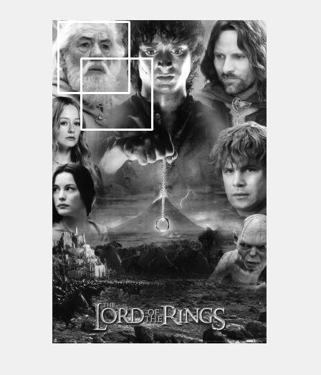
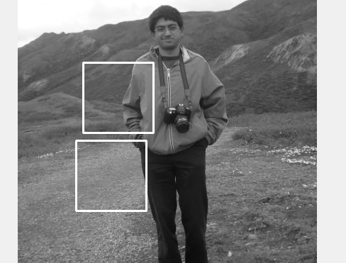
Skin Detection Results

Slide 9
Complications
Massive gap between total face images and non faces images
Using a threshold in bootstrapping to get better results
Not 100% sure, but if we could go back and correctly do this, one would think we would have to use the function detect_skin and use that result when computing the image skin integrals.
Not giving ourselves enough time to correctly do skin detection and add cascades

