Slide 1

Holochain

Slide 2
What is Holochain
An open source framework for building fully distributed, peer-to-peer applications.
Agent-Centric - agent local source chain + validating DHT
Bio-Inspired - language of biology systems for Holochain component parts
Bit-Torrent + Git + Cryptographic Signatures + Peer Validation + Gossip

Slide 3
Holochain Help People
Own their own data & control their identity
Connect Applications to suit their needs
Transact without centralized systems
Build lighter, faster, cheaper and more scalable applications (scaling out of the box)

Slide 4
Where are the Data
Each agent runs its own source chain, pushing chain aspect to the edges, similar to Git, but with signatures
DHT - agents share their public keys, source chain headers, and public entries with peers (sharding, scaling)
Nodes whose addresses are numerically nearest to the content address (content has) validate & hold copies of the data
Each app specifies its data redundancy level; agents work together to keep to the specified resilience factor

Slide 5
Application Components - Back-End
Zome (short for chromosome) - code modules with core logic of your app, functions exposed as Zome API.
DNA - 1+ zomes, establishing the ground rules of the app, like a microservice of an app
A user’s DNAs communicate via bridging, forming a full-featured application
Immune - peers monitor unwelcome activities
Membrane - ensures the integrity of information passing through the agent’s private world & the shared digital space

Slide 6
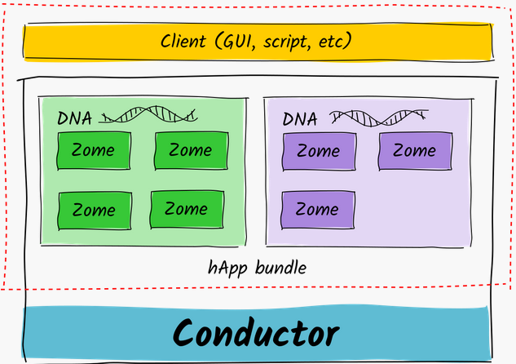
Application Architecture
Notes:
All DNAs are hosted in the user’s conductor, a runtime that sandboxes and executes DNA code, manages data flow and storage, and handles connections between components of the stack. You can think of the conductor as a web application server.
A client on the user’s device and talks to the DNAs’ APIs via a lightweight RPC interface.

Slide 7
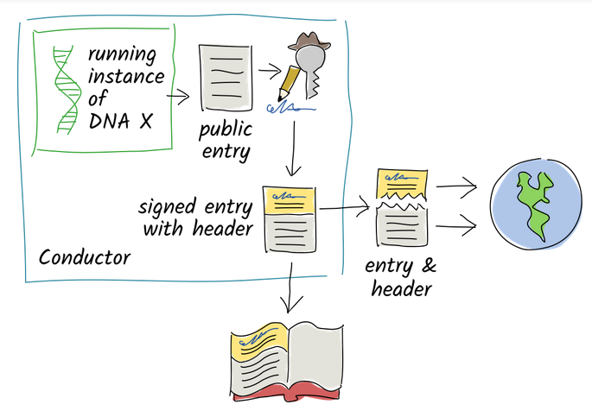
Entries in Source Chain & DHT
Notes:
Note that the entry will be published to the DHT only if it’s public; otherwise, only the header is published to DHT.

Slide 8
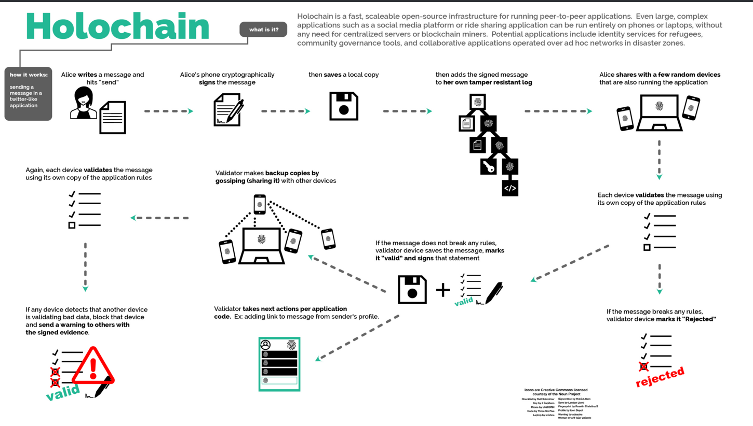

Slide 9
Holochain Development Kit (HDK)
Holochain DNAs need to be written in WebAssembly, or a language that compiles to Wasm, such as Rust.
The HDK handles some of the low-level details of Wasm execution (memory allocation, data de/serialization, shuffling data and functions in/out of wasm memory) via helper functions and Holochain-specific macros.
HDK makes writing hApps much simpler!
HDK docs: https://docs.rs/hdk/0.0.43-alpha3/hdk/

Slide 10
Holoscape
A complete end-user deployment of a Holochain conductor with UI for administration and a run-time for hApp UIs.
An electron app that you can download from Holoscape github repo: https://github.com/holochain/holoscape
Makes using hApps a piece of cake!

Slide 11
Holoscape for hApp Users
As a hApp user:
Installation of Holoscape comes with all the Holochain binaries and sets up and maintains your Holochain conductor config
Browse available hApps in the hApp Store
Install any hApps from the store, or from a bundle file
Switch between different hApps
DNA instances keep running in the conductor even when you close a hApp UI

Slide 12
Holoscape for hApp Developers
As a hApp developer:
Getting your hApp deployed has be come a lot easier
You have your user install Holoscape
You put all your DNAs and UIs into a hApp bundle
You share the hApp bundle with your users

Slide 13
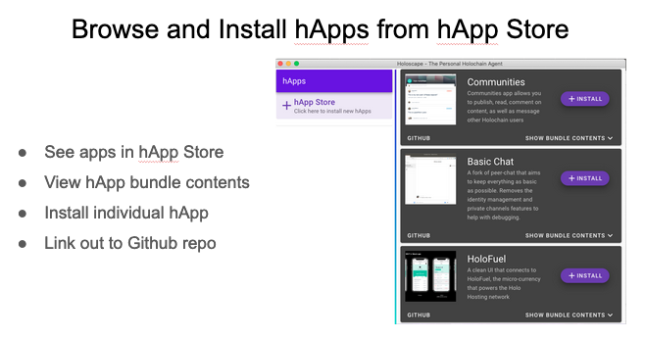

Slide 14
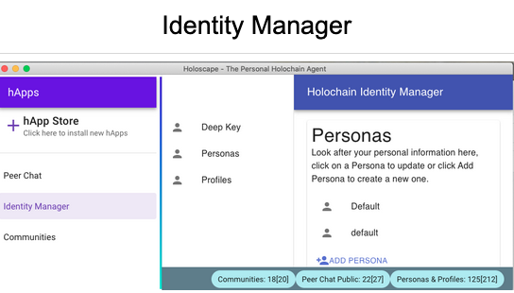

Slide 15
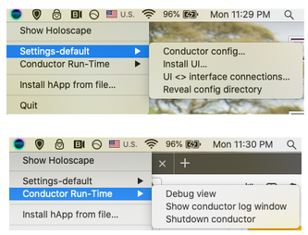
Holoscape Icon on System Tray/Menu Bar

Slide 16
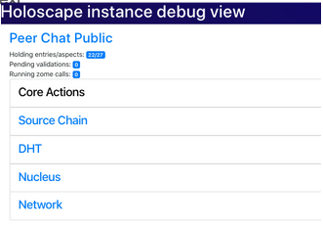
hApp Instance Debug View

Slide 17
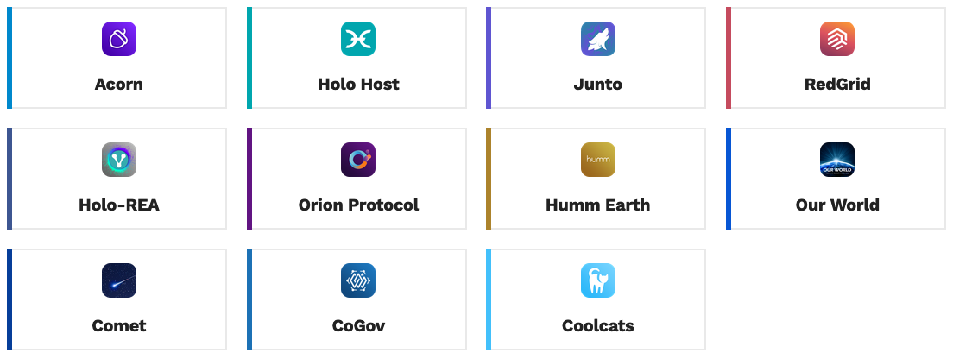
What Are People Building
Notes:
https://forum.holochain.org/c/projects/

Slide 18
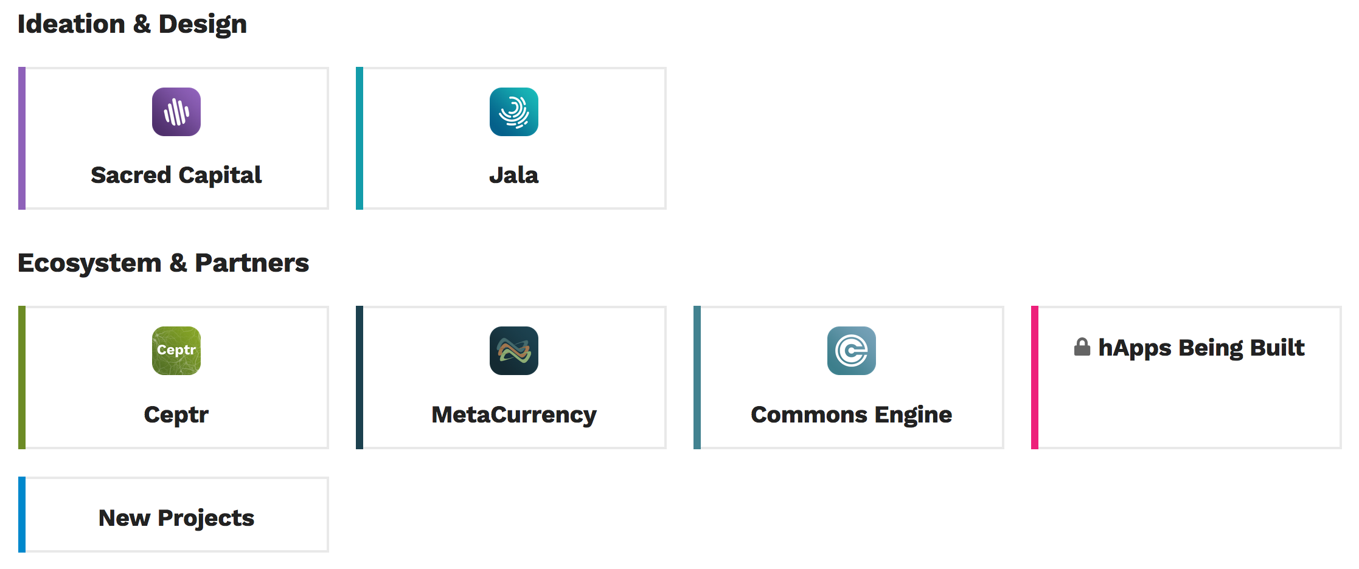
Ideas, Ecosystems & Partners

Slide 19

Holo
A distributed p2p hosting platform for Holochain apps
A bridge between the community of distributed Holochain apps and the current centralized web
Anyone can become a host by turning their computer into a source of revenue, getting paid in HoloFuel for hosting distributed applications
HoloPorts: started shipping Dec 2019

Slide 20
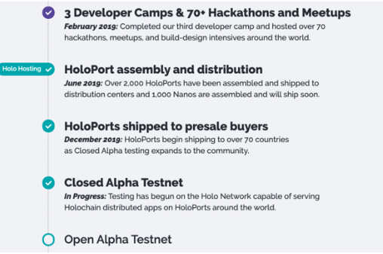
Roadmap

Slide 21
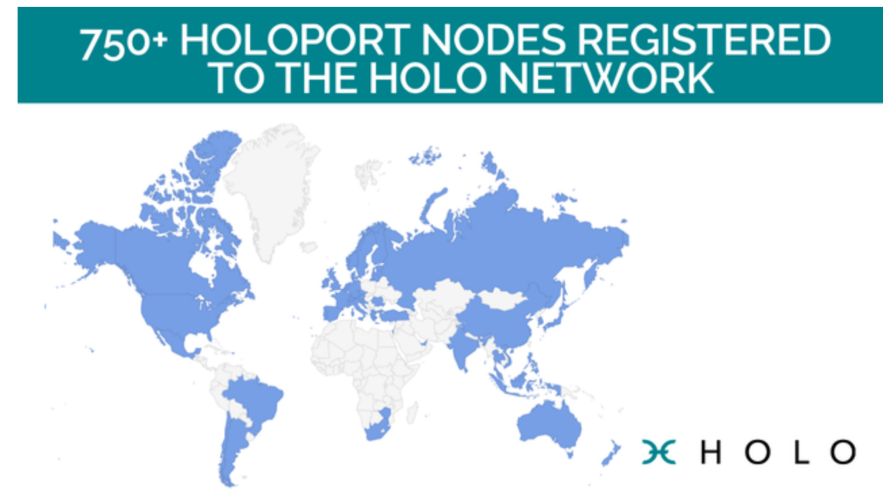

Slide 22
More Information
https://holochain.org
https://developers.holochain.org
https://forum.holochaing.org
https://holo.host/
https://youtu.be/hyCtYrHJebs - Holochain Explained

Slide 23
Meetups, DevCamps & Hackathons
https://www.meetup.com/NYC-Holochain-Meetup/
Holochain DevCamp #6 (Online) is wrapping up on Feb 19th, but more to come. Check out the forum, or follow on Twitter or Facebook!
Hackathon March 27-29 @ Bushwick Generator, Brooklyn NY. Register on EventBrite!

Slide 24

Thank You!

