Slide 1
Metabolomics analytics in the food, gut, and nutrition sector
HoloGen symposium, Barcelona, November 11th 2025
Prof Kati Hanhineva, Afekta Technologies, CoB
Food Sciences unit, Department of Life Technologies, University of Turku
Clinical Nutrition, School of Medicine, University of Eastern Finland, Kuopio

Slide 2
Afekta Technologies is a Finnish company established in 2017 that specializes in metabolomics, the analysis of small biomolecules from any biological sample.
Notes:
Pitäisin ”small biomolecules” koska mitään makromolekyylejä emme analysoi

Slide 3
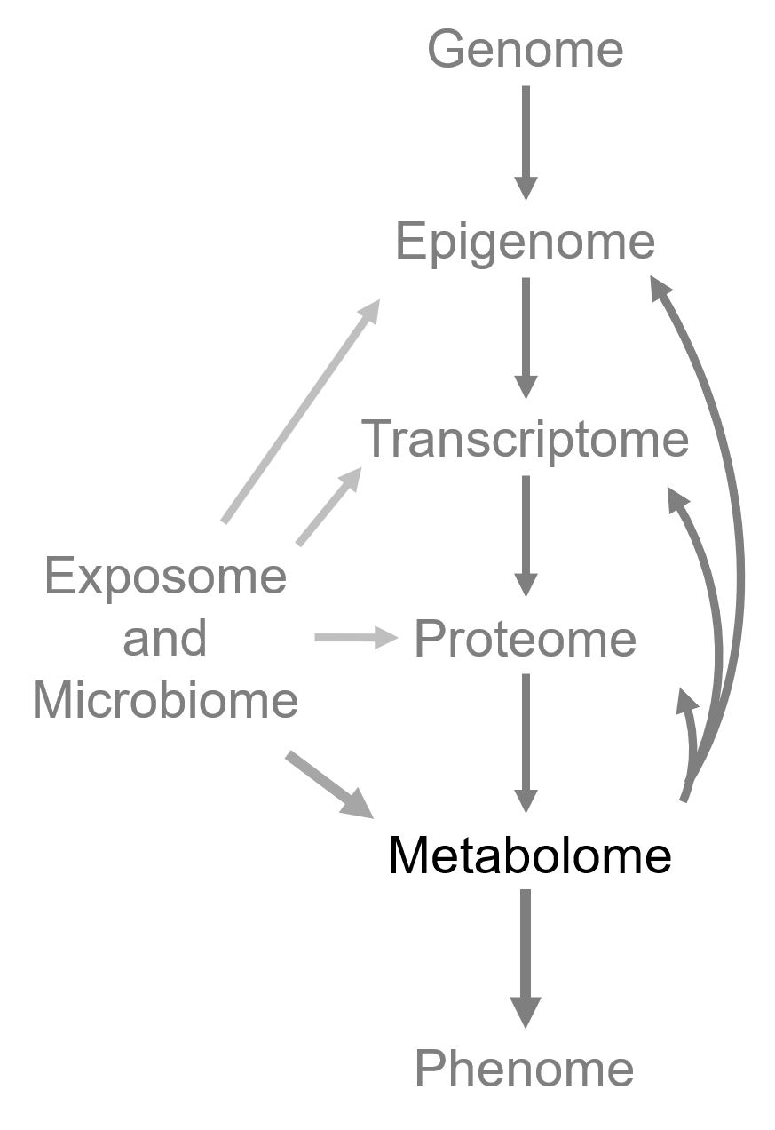
Metabolomics in a nutshell
Global analysis of metabolites from a given sample, e.g. blood, tissue, food, urine, feces
Metabolites include, for example, amino acids, vitamins, sugars,bile acids, flavonoids, phenolic acids…
The ’omics’ methodology closest to the phenotype, a snapshot of the metabolic status
Voutilainen and Kärkkäinen 2019

Slide 4
What’s the catch in metabolomics?
It gives a “functional readout” of the physiological state of an organism, tissue, or cell
Non-targeted approach allows completely novel findings, not being restricted to analyzing pre-defined molecules
  Generation of new hyphotheses
  The data also allows for inspecting pre-defined metabolites
Has a huge variety of applications ranging from medicine and biology to food science and nutrition
For example, we can measure the metabolic impact of a health intervention or the effect of processing on nutritionally important molecules in food
Notes:
Why metabolomics is important in various fields (health, food)
What's the catch in our method

Slide 5
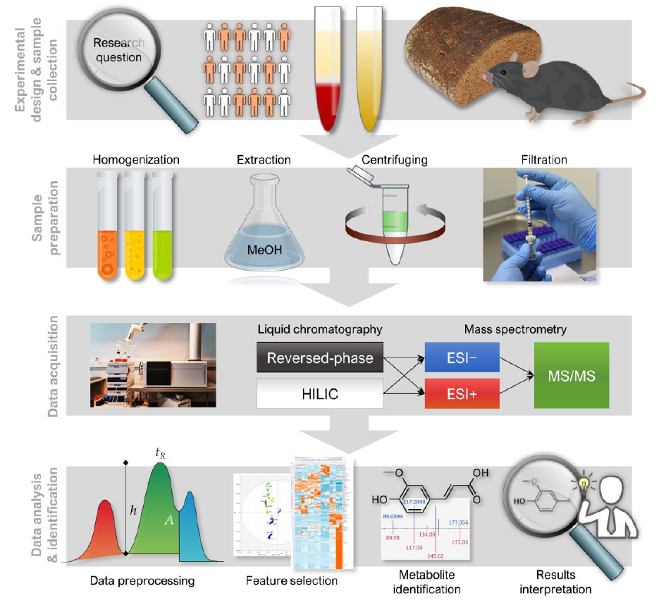
Metabolo-mics study design
Klåvus et al. 2020

Slide 6

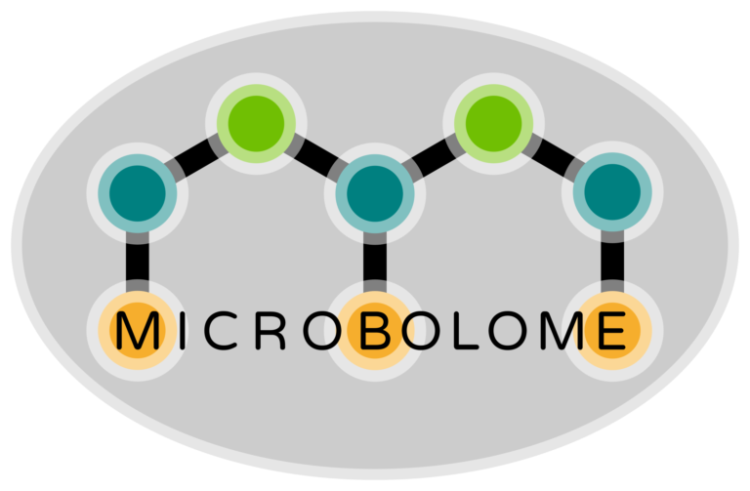
Our services
Nontargeted metabolomics services
Global analysis of metabolites from any kind of sample
Analysis of dietary phytochemicals
Analysis of microbial metabolites
Notes:
Siirrä osaksi diaa 3 tai heti sen jälkeen

Slide 7
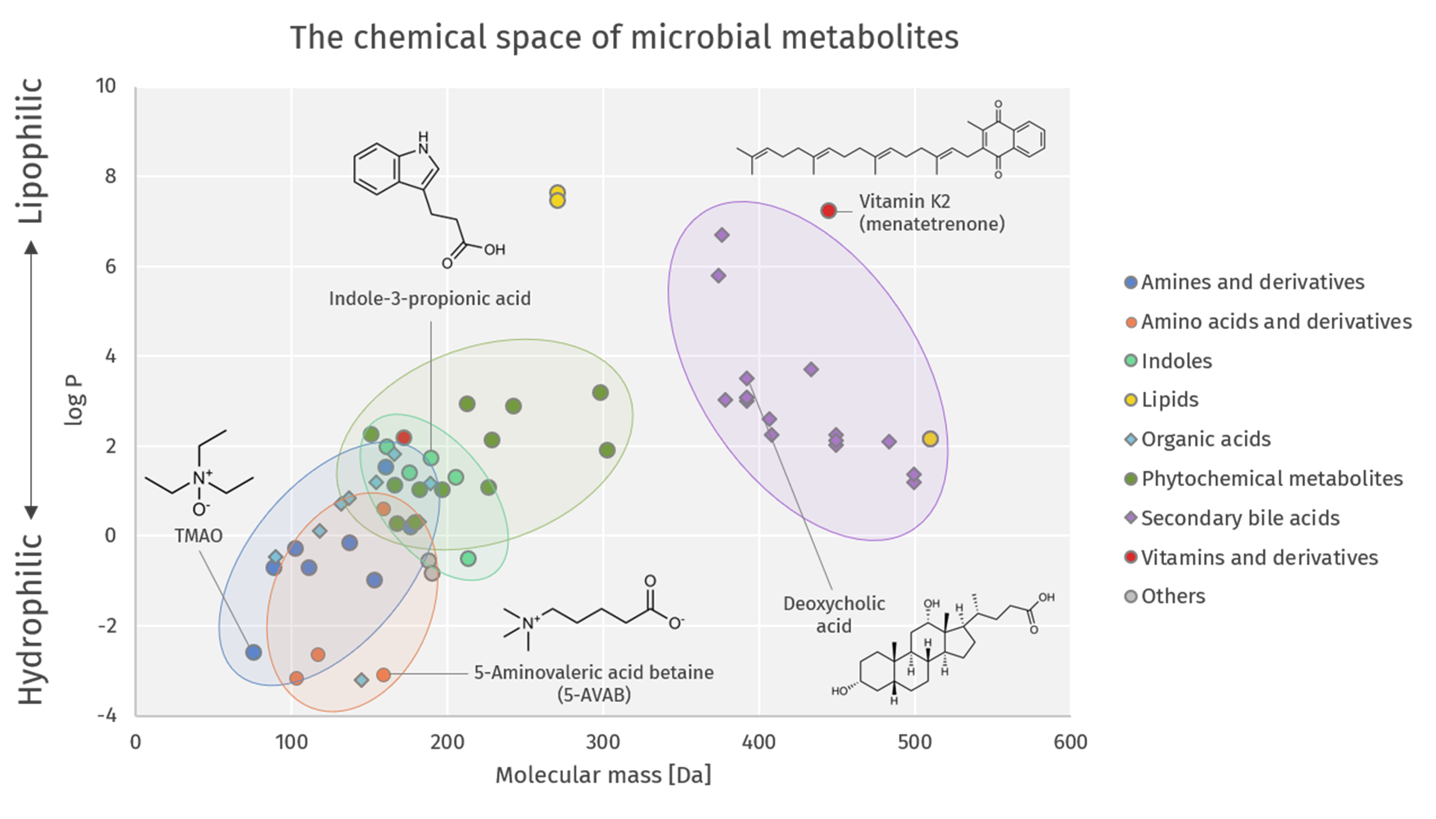
”Microbolome” Compehensive microbial metabolite analysis

Slide 8
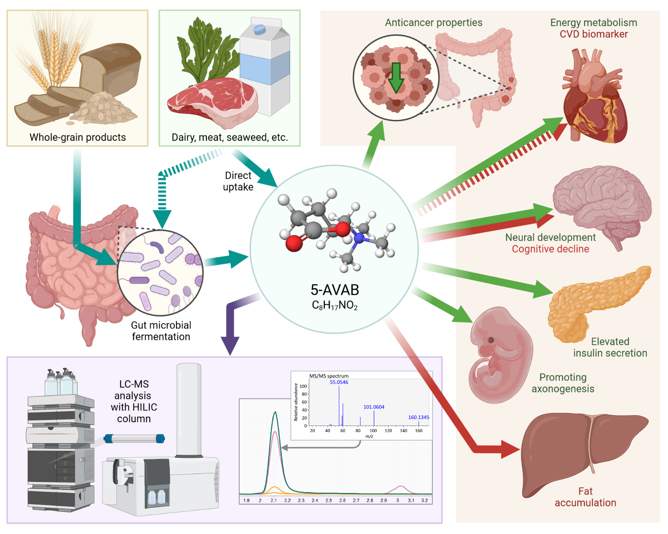
Case 5-amino valeric acid betaine (5-AVAB)
Kärkkäinen et al. 2018, AJCN
Kärkkäinen et al. 2018, Sci Rep
Koistinen et al. 2019
Tuomainen et al. 2019, AJCN
Haikonen et al. 2022, TEM

Slide 9
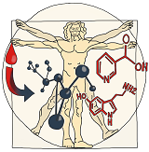



Afekta is an SME partner in large EU-funded projects related to microbiota
HOLOGEN
2025–2028
HUMAN
2023–2027
2021–2025
2018–2022
”Advancing the development and implementation of hologenomics”
Hologen-network.eu
”Harmonising and Unifying Blood Metabolomic Analysis Networks”
Human-dn.eu
”Analyzing host–microbiota metabolic interactions at the microscale”
https://3domics.eu/
”Building a gut microbiome engineering toolbox for treatment of non-alcoholic fatty liver disease”
https://www.besttreat.eu/
Notes:
What do we get from the EU projects? Replace the descriptions
3D'omics: LC-MS instrument + lab, analysing microsections
BestTreat: developing method for analysing microbial metabolites

Slide 10
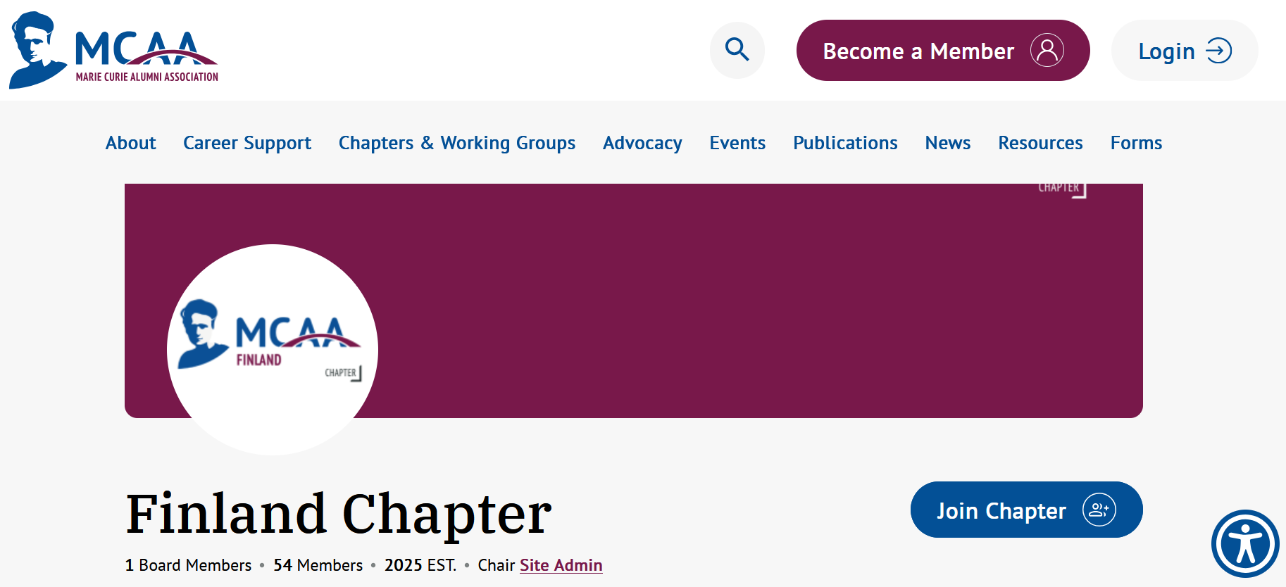
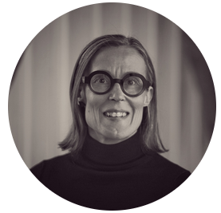

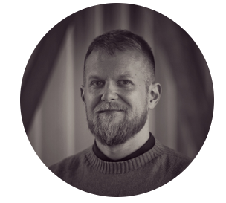
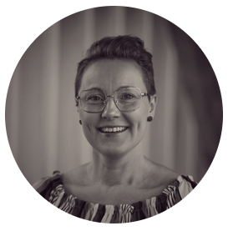
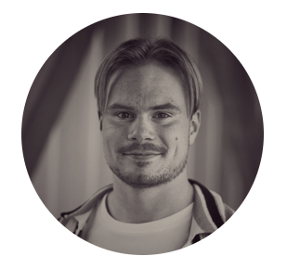

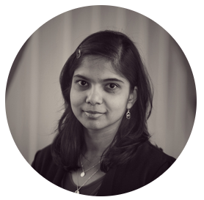
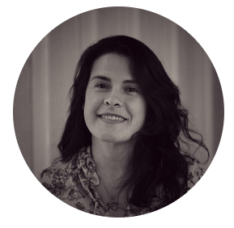
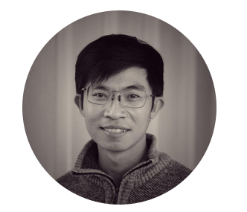
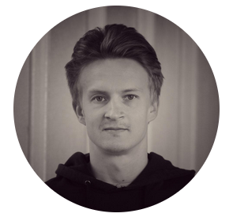
Our Team
Prof. Kati Hanhineva, PhD
Founder, co-CEO, CoB
Leading expert in food and nutrition metabolomics
Olli Kärkkäinen, PhD
CEO (part time)
Expert in metabolomics applications in health
Ville Koistinen, PhD
COO, Quality Manager
Expert in phytochemicals
Soile Rummukainen, MSc
Laboratory technician
Expert in sample
prep & analysis
Atte Lihtamo, MSc
CTO
Expert in data science
Topi Meuronen, PhD
Specialist​, PhD
Expert in lipidomics and method development
Ambrin Farizah Babu, MSc
Researcher
Expert in metabolomics applications in health
BestTreat MSCA DN alumni
Dennisse Avella, MSc
PhD student
HUMAN MSCA DN
Vu Nguyen, MSc
PhD student
HoloGen MSCA DN
Jaakko Hanhineva, MSc
Business Developer​, MSc (Tech) in Industrial Engineering and Management​

Slide 12

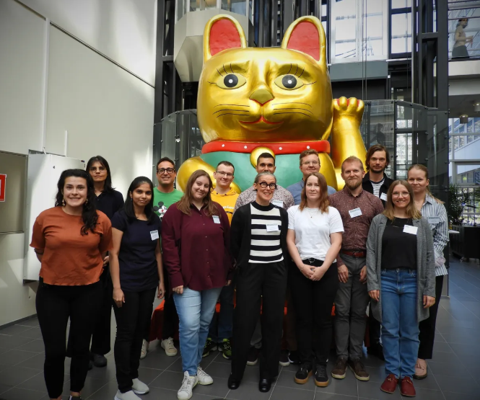











ACKNOWLEDGMENTS
Afekta Technologies
Olli Kärkkäinen
Topi Meuronen
Soile Rummukainen
Dennisse Avella
Atte Lihtamo
Vu Nguyen
University of Turku, Finland
Ville Koistinen
Topi Meuronen
Hany Ahmed
Jasmin Raita
Sara Ferreira Rocha
Artur Sannikov
Shania Saini
University of Eastern Finland
Ville Koistinen
Iman Zarei
Marjo Tuomainen
Retu Haikonen
Ambrin Babu
Collaborators
University of Eastern Finland
University of Helsinki, Finland
Senson, Viking Malt, Finland
Chalmers University of Technology, Sweden
Umeå Universitetet, Sweden
Wageningen University & Research, Wageningen, Netherlands
Federico II University of Naples, Naples, Italy
VTT Technical Research Centre of Finland Ltd, Espoo, Finland
Montpellier SupAgro-INRA, Montpellier, France
Newcastle University, UK
IARC, France
https://hanhinevalab.com/

