Slide 1


www.hologen-network.org
Advancing the development and implementation of hologenomics in biological sciences
Funded by the European Union under Grant Agreement 101169005

Slide 2
www.hologen-network.eu
A PhD student’s voyage II
Task management and organisation
Antton Alberdi
University of Copenhagen
antton.alberdi@sund.ku.dk

Slide 3
www.hologen-network.eu
Task management
Conflict management

Slide 4
www.hologen-network.eu

Slide 5
www.hologen-network.eu

Slide 6
www.hologen-network.eu

Slide 7
www.hologen-network.eu

Slide 8
www.hologen-network.eu
How should I organise
my time?

Slide 9
www.hologen-network.eu
Types of tasks
Newport 2016
Shallow work
Deep work
Tasks that are not cognitively demanding and can often be completed while distracted
Activities performed in a distraction-free concentration that push your cognitive capacities to the limit.

Slide 10
www.hologen-network.eu
Attention span
For how long you can stay focused on a specific cognitively demanding task
Task 1
Task 2
Task 3

Slide 11
www.hologen-network.eu
Attention residue
Leroy 2009
Lingering focus from a previous task that hampers full engagement with a new on
Task 1
Task 2
Task 3

Slide 12
www.hologen-network.eu
Attention span + residue
Most optimal task distribution

Slide 13
www.hologen-network.eu
Value fit
How closely a task aligns with your purpose, capturing the emotional and motivational connection you feel toward the work.
High fit
Low fit

Slide 14
www.hologen-network.eu
High fit
Low fit
Deep
work
Challenging
Difficult
Easy
Challenging
Shallow work

Slide 15
www.hologen-network.eu
High fit
Low fit
Deep
work
Challenging
Difficult
Challenging
Shallow work
Willpower

Slide 16
www.hologen-network.eu
High fit
Low fit
Deep
work
Challenging
Difficult
Concen
tration
Challenging
Shallow work

Slide 17
www.hologen-network.eu
Daily
Assess capacities
Attention span, residue
Willpower
Concentration
Energy
Classify tasks
Prioritise tasks

Slide 18
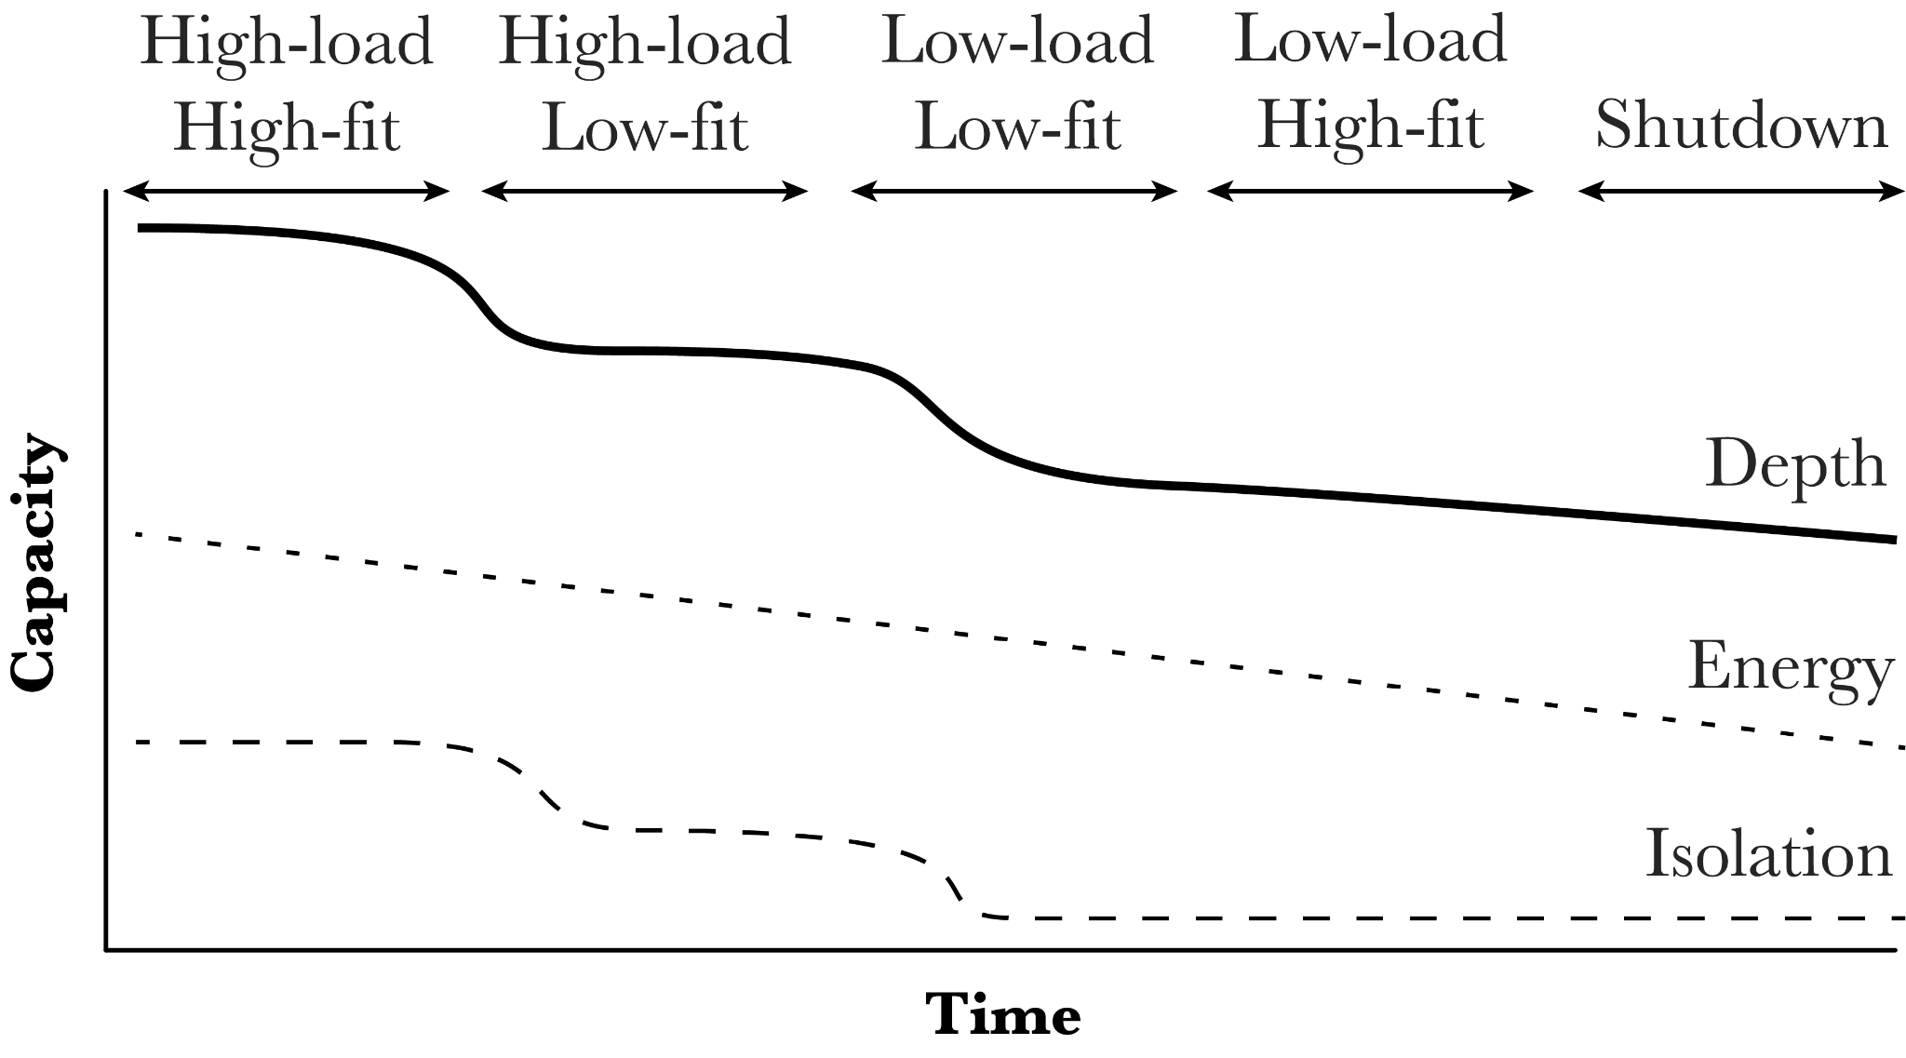
www.hologen-network.eu
Daily

Slide 19
www.hologen-network.eu
Daily shutdown
Stock unfinished tasks
Transfer to future calendar
Reassign priorities
Close

Slide 20
www.hologen-network.eu
Weekly shutdown
Stock unfinished tasks
Transfer to future week calendar
Reassign priorities
Close

Slide 21
www.hologen-network.eu
Weekly schedule
Prioritise
Courses, meetings
Assess available time-slots
Account for socialising time

Slide 22
www.hologen-network.eu
Monthly schedule
Define monthly milestones
Critically assess achievements

Slide 23
www.hologen-network.eu
Yearly schedule
Start writing ASAP
Generate a useful PhD plan
Get as much ECTSs as possible off your plate early

Slide 24
www.hologen-network.eu
Conflict
management

Slide 25
www.hologen-network.eu
Conflict types
Cognitive
Emotional
Differences in viewpoints, ideas…
Interpersonal incompatibilities…

Slide 26
www.hologen-network.eu
Conflict types
Cognitive
Emotional
Good!
Bad!

Slide 27
www.hologen-network.eu
Conflict types
?
Cognitive
Emotional
Good!
Bad!

Slide 28
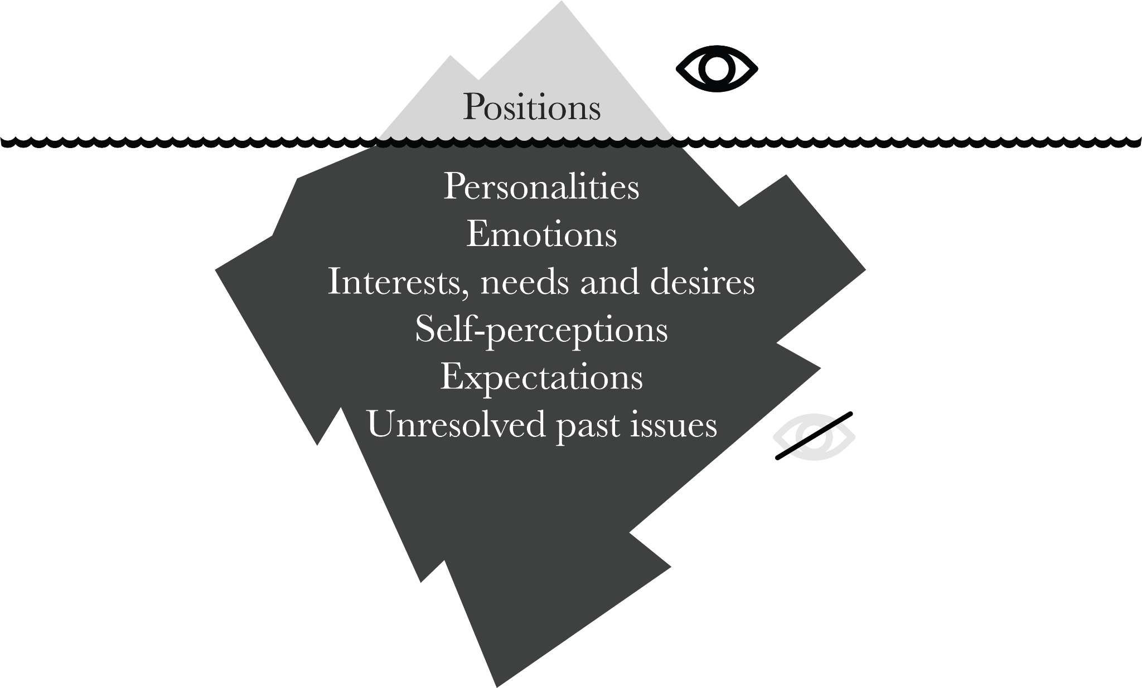
www.hologen-network.eu
Cloke & Goldsmith 2005

Slide 29
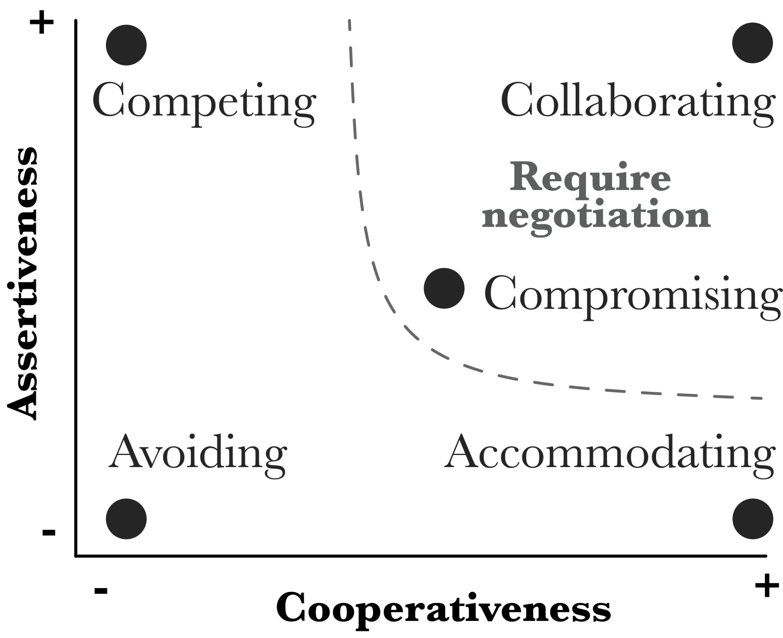
www.hologen-network.eu
Thomas & Kilmann 1974

Slide 30
www.hologen-network.eu
Assertiveness
How much effort one puts in satisfying one’s own concerns
Cooperativeness
How much effort one puts in satisfying other’s concerns

Slide 31
www.hologen-network.eu
Avoiding
Diplomatically sidestepping an issue, postponing an issue until a better time, or simply withdrawing from a threatening situation
When is it
good idea?
When is it
bad idea?

Slide 32
www.hologen-network.eu
Accommodating
Neglecting your own concerns to satisfy the concerns of the other person.
When is it
good idea?
When is it
bad idea?

Slide 33
www.hologen-network.eu
Competing
Power-oriented mode in which an individual pursues their own concerns at the other person’s expense
When is it
good idea?
When is it
bad idea?

Slide 34
www.hologen-network.eu
Compromising
Find a mutually acceptable solution that partially satisfies both parties
When is it
good idea?
When is it
bad idea?

Slide 35
www.hologen-network.eu
Collaborating
Work with the other person to find a solution that fully satisfies the concerns of both
When is it
good idea?
When is it
bad idea?

Slide 36
www.hologen-network.eu
Emotional
conflict

Slide 37
www.hologen-network.eu
Emotional conflict
Cloke & Goldsmith 2005
Difficult person
Difficult personality

Slide 38
www.hologen-network.eu
Emotional conflict
Cloke & Goldsmith 2005
Difficult person
Difficult personality
Risks of stereotyping
Misinterpreting
Rationalising

Slide 39
www.hologen-network.eu
Emotional conflict
Cloke & Goldsmith 2005
Difficult
behaviour
Difficult
relationship

Slide 40
www.hologen-network.eu
Emotional conflict
Cloke & Goldsmith 2005
Try understand the underlying reasons of the behaviour
At work we often ignore what is happening in the personal life of the other person
Difficult behaviours often come from feelings of vulnerability or threat

Slide 41
www.hologen-network.eu
Emotional conflict
Cloke & Goldsmith 2005
Reflect on why one finds that behaviour as a source of conflict
Does it affect me or people around me at all?
Do I have all the information to assess that behaviour?
What would I do differently in that situation and why?
Why do I find this behaviour difficult?
Acknowledge the power dynamic

Slide 42
www.hologen-network.eu
Emotional conflict
Cloke & Goldsmith 2005
Ensure the other party is aware of the conflict
Oftentimes/Usually the person that conducts the difficult behaviour is not aware of it

Slide 43
www.hologen-network.eu
Emotional conflict
Cloke & Goldsmith 2005
Assess pros and cons of conflict handling strategies
Avoid - stop interacting with that person
Compete - respond with another difficult behaviour
Accomodate - resist with the situation
Compromise - find a minimal agreement
Collaborate - transform the relationship

Slide 44
www.hologen-network.eu
Emotional conflict
Cloke & Goldsmith 2005
Set up a conflict addressing session (cozy breakfast)
Difficulty of finding the right moment
The session will most probable shake the status of the relationship > temporary unstability
Without or with a mediator

Slide 45
www.hologen-network.eu
Cognitive
conflict

Slide 46
www.hologen-network.eu
Cognitive conflict
Cloke & Goldsmith 2005
Disagreement
on a task,
process or
decision

Slide 47
www.hologen-network.eu
Cognitive conflict
Fisher & Ury 1981
Hellen and John share office
Hellen wants the air conditioning on
John wants the air conditioning off

Slide 48
www.hologen-network.eu
Cognitive conflict
Fisher & Ury 1981
Positional bargaining
Hellen decides one day
John decides the next day

Slide 49
www.hologen-network.eu
Cognitive conflict
Fisher & Ury 1981
Positional bargaining vs. Principled negotiation
Separate people from the problem
Focus on interests rather than positions
Think of creative solutions

Slide 50
www.hologen-network.eu
Cognitive conflict
Fisher & Ury 1981
Separate people from the problem
Hellen dislikes John because he is arrogant
John dislikes Hellen because she is very noisy

Slide 51
www.hologen-network.eu
Cognitive conflict
Fisher & Ury 1981
Interests rather than positions
Positions: what each party wants
Hellen wants the air conditioning on
John wants the air conditioning off

Slide 52
www.hologen-network.eu
Cognitive conflict
Fisher & Ury 1981
Interests rather than positions
Interests: why each party has that position
Hellen feels the room is too warm
John gets really bothered by the sound

Slide 53
www.hologen-network.eu
Cognitive conflict
Fisher & Ury 1981
Interests rather than positions
Both positions cannot be satisfied
Both interests can be satisfied

Slide 54
www.hologen-network.eu
Cognitive conflict
Fisher & Ury 1981
Think of creative solutions
Use a fan rather than the air conditioning
Open windows
Change the spatial location of people
Buy a more silent AC system

Slide 55
www.hologen-network.eu

Slide 56
www.hologen-network.eu

Slide 57
www.hologen-network.eu

Slide 58
www.hologen-network.eu

Slide 59
www.hologen-network.eu

