Slide 1
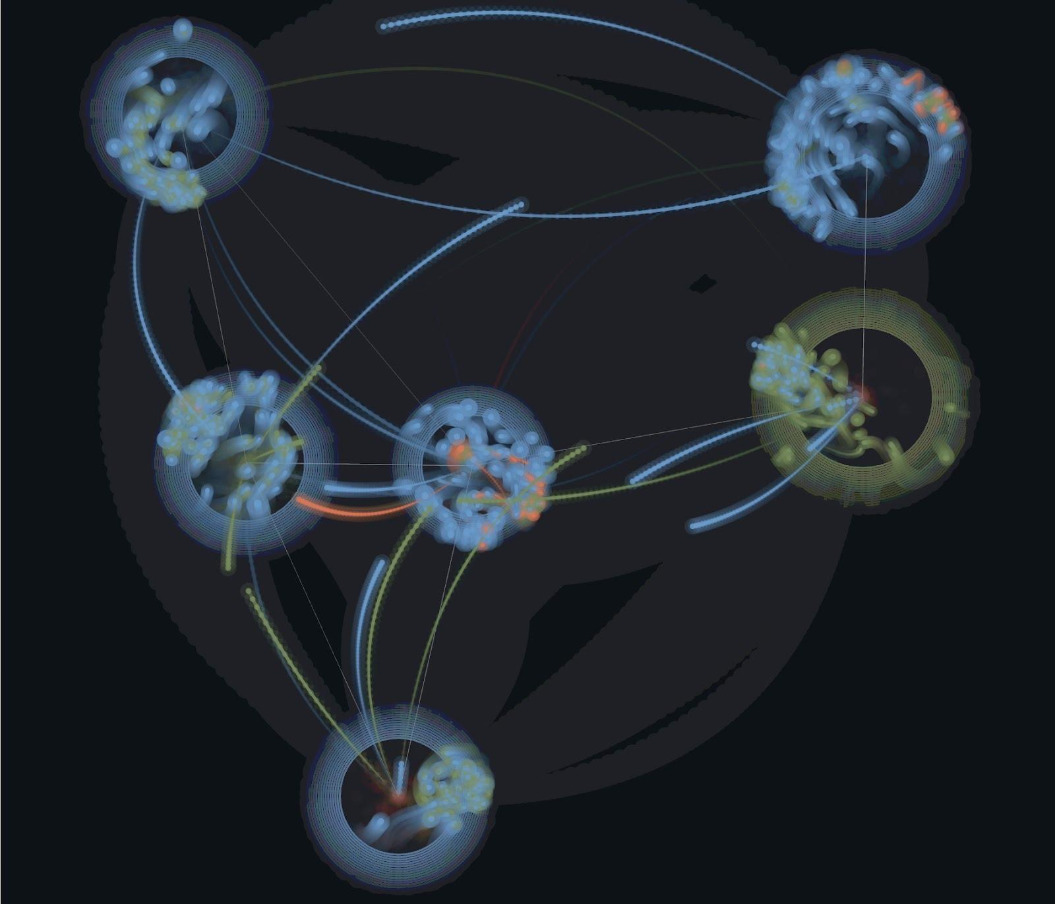
Symposium on Microbial Meta-Community Modelling
21st October 2026

Slide 2




Welcome to the Symposium
Speakers
Administrative support: Chantal Biernaux
Ksenia Guseva, University of Vienna
Lulla Opatowski, Institute Pasteur
Julien Tap, INRAE Micalis Institute

Slide 3





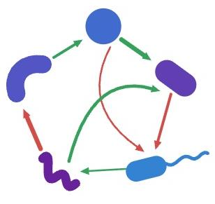
Embedding
Part of a retreat for students of the MSCA HoloGen Doctoral Network
Host: Lab of Microbial Systems Biology
  Located at the Rega institute of KU Leuven
  Bioinformatics tool development & exploration of synthetic gut microbial communities
Local organizers:
Damola
Karoline
http://msysbiology.com
Notes:
MSCA: Marie Sklodowska Curie action

Slide 4
Introduction to microbial metacommunity modeling

Slide 5








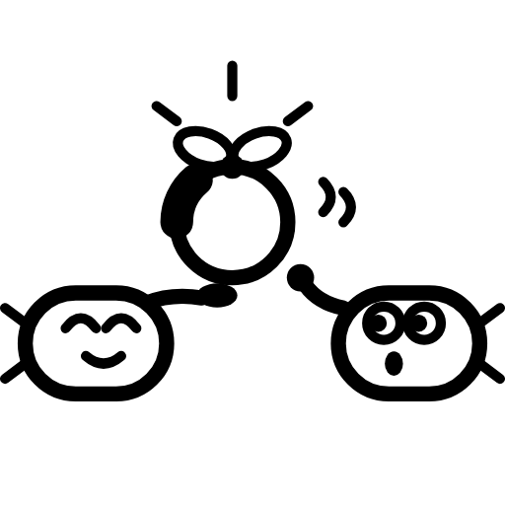

What shapes microbial community composition?
Environment
Selection
Interactions
Migration
Gene exchange/
Speciation
Stochastic events (Drift)
‹#›
Vellend (2010) “Conceptual Synthesis in Community Ecology”, The Quarterly Review of Biology 85:183-206.
Notes:
Image of microbial community: https://www.nist.gov/image/microbial-community; icons by Claude
Vellend: four classes of process: selection (interactions and environment), drift (stochasticity), speciation, and dispersal (migration)
Priority effects follow from species interactions; perturbations from changes in the environment

Slide 6


Growth in different environments
https://mgrowthdb.gbiomed.kuleuven.be
Bacteroides thetaiotaomicron type strain grown with different carbon sources in batch
Data from: Sulaiman et al. (2024) “Elucidating human gut microbiota interactions that robustly inhibit diverse Clostridioides difficile strains across different nutrient landscapes”, Nature Communications 15:7416.
‹#›
Notes:
http://mgrowthdb.gbiomed.kuleuven.be/comparison/?l=14062,14069,28370,28373,28376,28379,28382

Slide 7
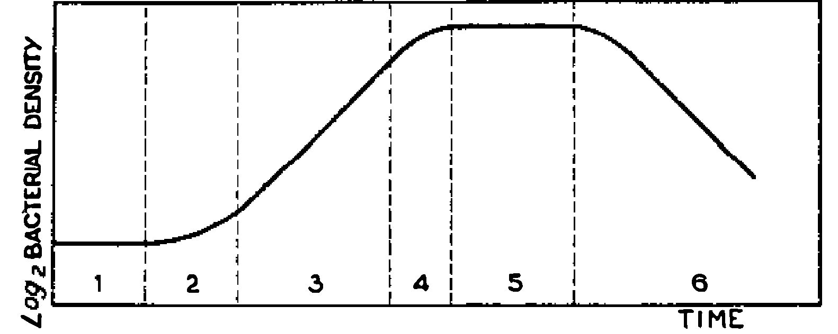
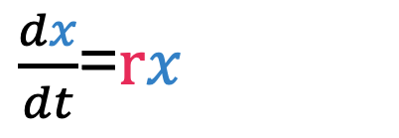
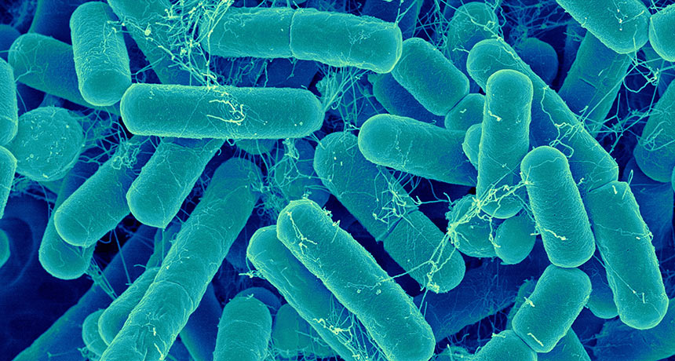
Reminder: microbial growth curve
3: Exponential (Log) phase
4: Retardation phase
5: Stationary phase
6: Phase of decline (death)
r = growth rate
1: Lag phase
2: Acceleration phase
In batch (nutrient is depleted)
Figure taken from Jacques Monod: “The Growth of Bacterial Cultures”, Annual Rev. Microbiology 1949, 371-394.
‹#›
Notes:
Retardation = deceleration
dx/dt=rx is the exponential growth
Derivation as explained here: https://www.nature.com/scitable/knowledge/library/how-populations-grow-the-exponential-and-logistic-13240157/
x(t)=2^t*x0 # population doubling in every time step (x0: initial population size)
x(t)=R^x0 # some other multiplication in every time step
For R = Euler’s constant:
x(t)=e^(r*t)*x0, assuming x0 is 1 and taking ln:
ln(x(t))=r*t
Differentiating:
d(ln(x(t)))/dt=r
Rate of change of the log of a number is the same as the “per capita” change in that number:
d(ln(x(t)))/dt=d(x(t))/(x(t)dt) =r
dx(t)/dt=r*x(t)
r=ln(R)
r: intrinsic rate; R: finite rate of increase (per capita, e.g. doubling/tripling etc.)

Slide 8
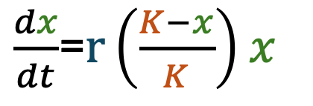
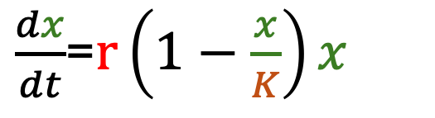

Modeling growth: Logistic equation
In batch, bacteria enter stationary phase when they run out of food
The less food they have, the slower they grow
Bacterial biomass is constrained (carrying capacity)
Logistic equation describes this behaviour:
x: Biomass
K: Carrying capacity
r: (Intrinsic) growth rate
‹#›
Notes:
- the larger x gets, the closer it is to its carrying capacity and the smaller the increase in x that is still possible
- When x equals K, dx/dt=0 and growth stops
- the larger K, the smaller the term we subtract from 1 and the larger the increase in x

Slide 9
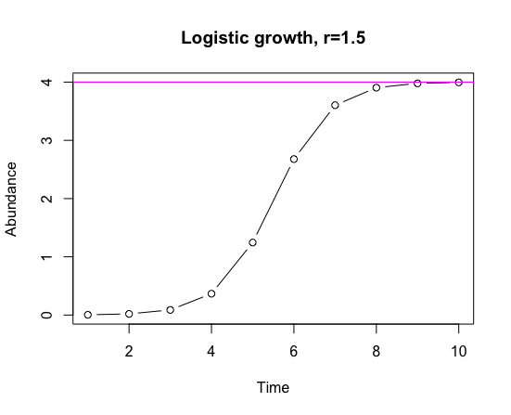
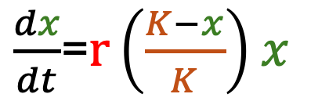
Logistic growth
S-shaped (sigmoid) curve
Carrying capacity K
Note that decline is not described
‹#›
Notes:
logistic<-function(K,r,x0,t){return(K*x0/(x0+(K-x0)*exp(-r*t)))}
plot(logistic(4,1.5,0.001,1:10),main="Logistic growth, r=1.5",type="b",xlab="Time",ylab="Abundance")
abline(h=4,col=”magenta")
# check with library(growthrates)
plot(grow_logistic(c(1:10),parms=c(y0=0.001,mumax=1.5,K=4)))

Slide 10
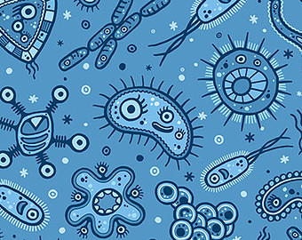
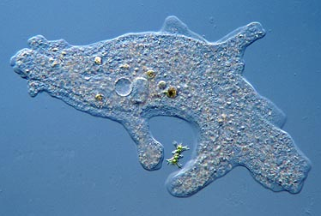
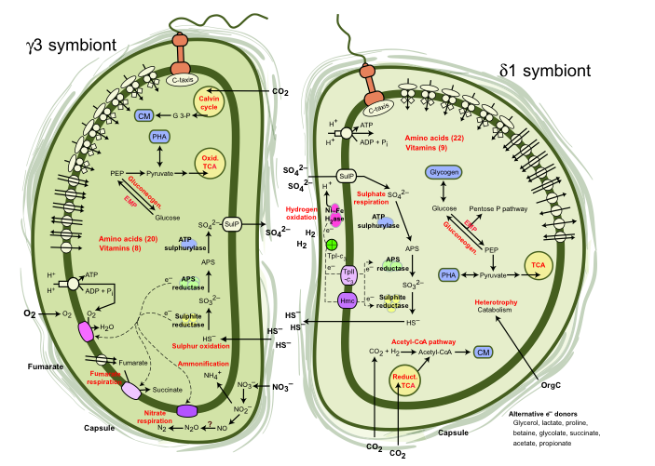

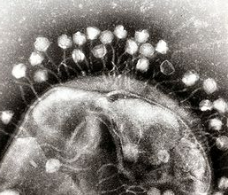
Ecological interactions….
Predator/parasite (win-loss)
Commensalism (win-neutral)
+ -
Amensalism (neutral-loss)
+ 0
0 -
+ +
Competition (loss-loss)
- -
Mutualism (win-win)
0 +
- 0
Predation & parasitism = exploitation
- +
Adapted from Lidicker, W.Z. BioScience 29, 475-477 (1979).
Prey/host (loss-win)
‹#›
Notes:
Competition: from Lyng & Kovacs; reported as such; mutualism: Tania Woyke

Slide 11
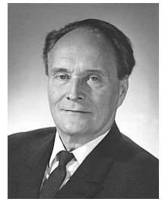
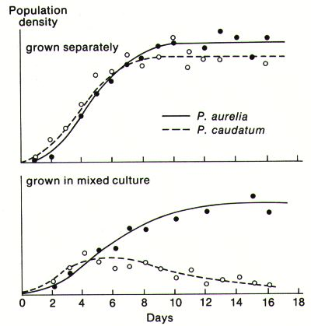
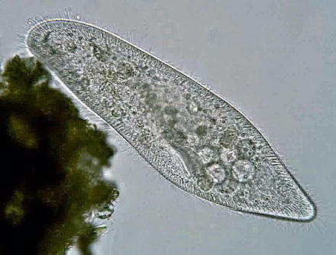
… and how to quantify them
Compare growth curve in mono- and in co-culture
Example: Paramecium aurelia and P. caudatum competition experiment, which led Gause to formulate the competitive exclusion principle (2 species competing for the same limited resource cannot coexist)
Gause (1934) “The Struggle for Existence”, Williams & Wilkins.
‹#›
Notes:
Cell: Paramecium caudatum from wiki
Competitive exclusion principle: Two species competing for the same limited resource cannot coexist at constant population values

Slide 12


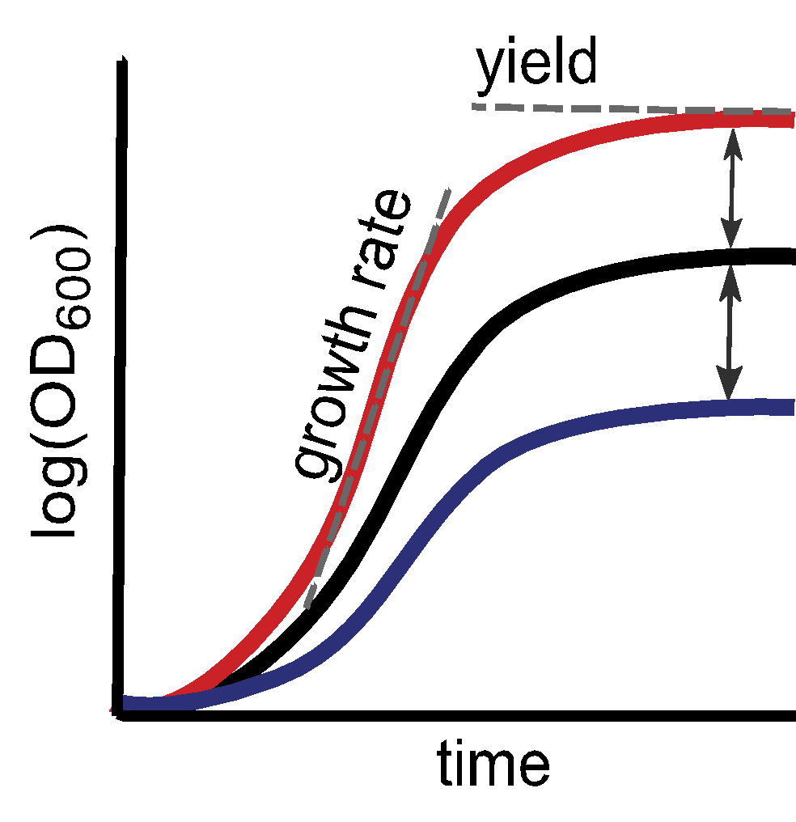


Computing interaction strength
Growth curve in co-culture - Positive impact
Reference (Mono-culture)
Growth curve in co-culture - Negative impact
area under the curve
Image adapted from de Vos et al. PNAS 10666-10671 (2017).
Interaction type
-,- = competition
-,0 = amensalism
-,+ = exploitation
Example mutualism: +,+
Species 1
Species 2
+,+ = mutualism
+,0 = commensalism
+,- = exploitation
‹#›

Slide 13
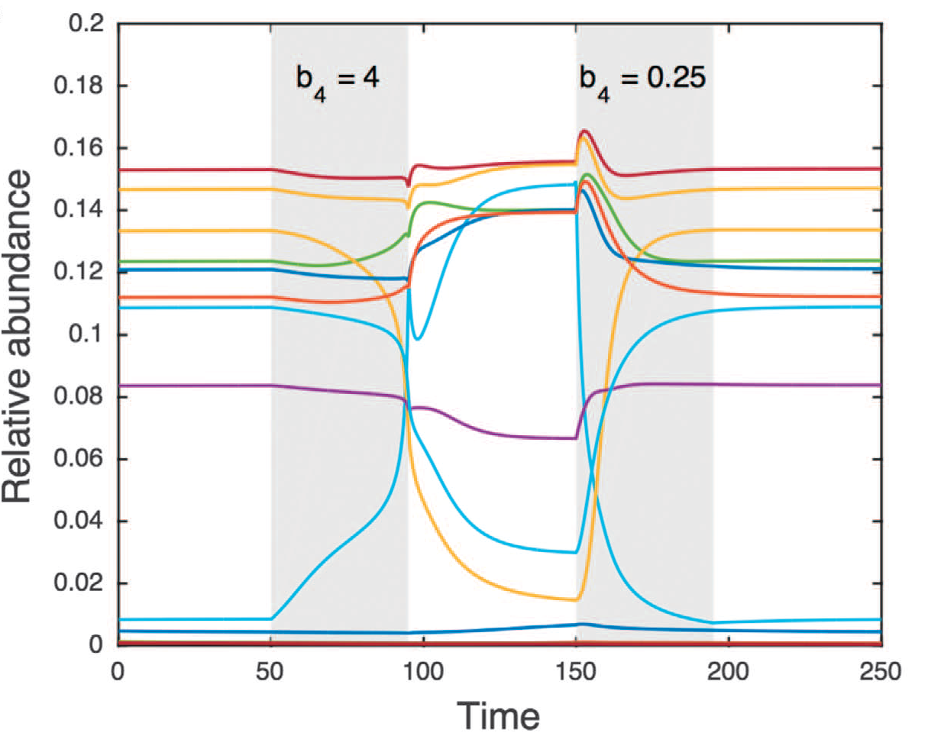

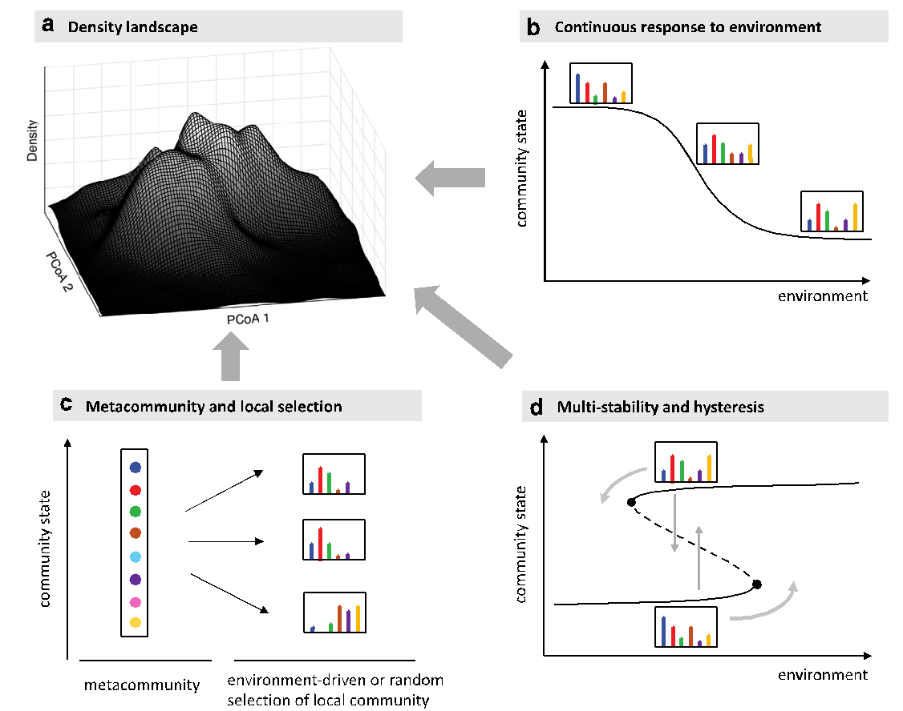
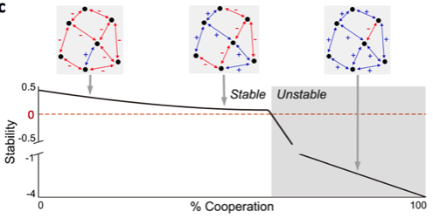
Why do we want to model microbial community dynamics?
Mathematical model: representation of our system knowledge
Identify knowledge gaps
Prediction
Example: Can the metabolic model of an organism simulate its growth?
Example: How will the community respond to perturbations?
Suggest mechanisms behind observations
Address experimentally intractable questions
Example: What is the mechanism behind alternative community types?
Example: What makes commu-nities stable?
‹#›

Slide 14
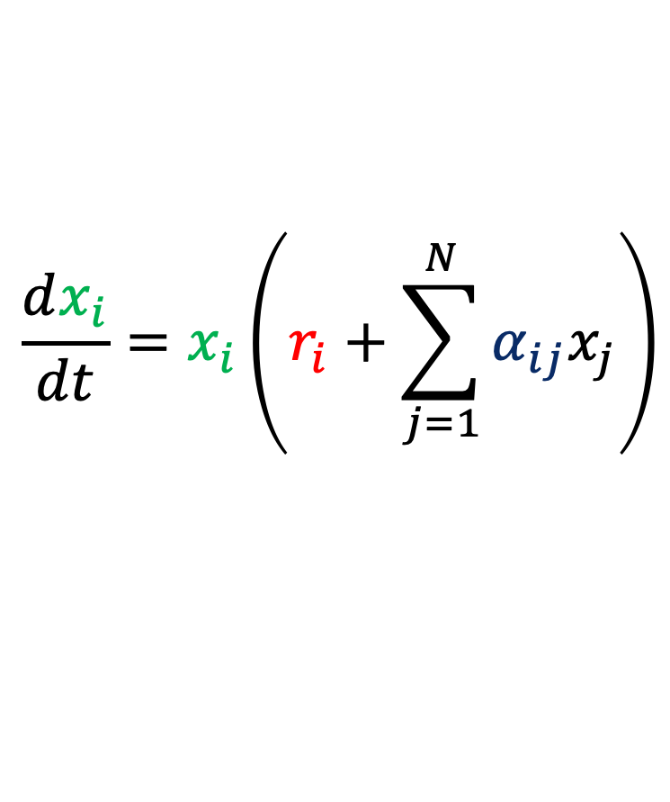


Generalized Lotka Volterra (gLV)
The change of species abundance x_{i} over time can be modeled as a function of its growth rate r_{i} and its interaction strengths a_{ij} with other species j and itself
x_{i} = abundance of species i
a_{ij} = interaction strength between species i and j
r_{i} = growth rate of species i
N = species number
Alfred James Lotka
‹#›
Vito Volterra
Notes:
Lotka and Volterra both (independently) proposed models for competing populations and predator-prey systems.

Slide 15
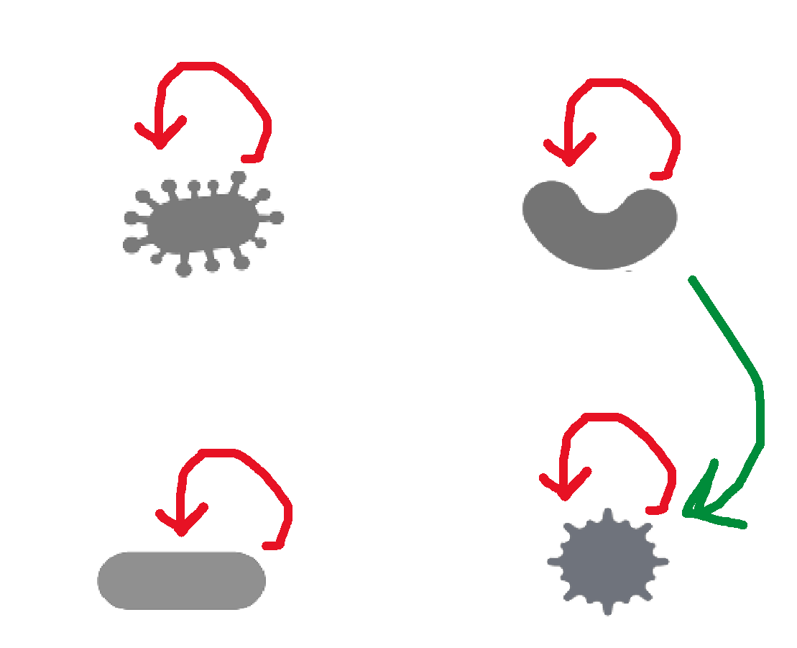
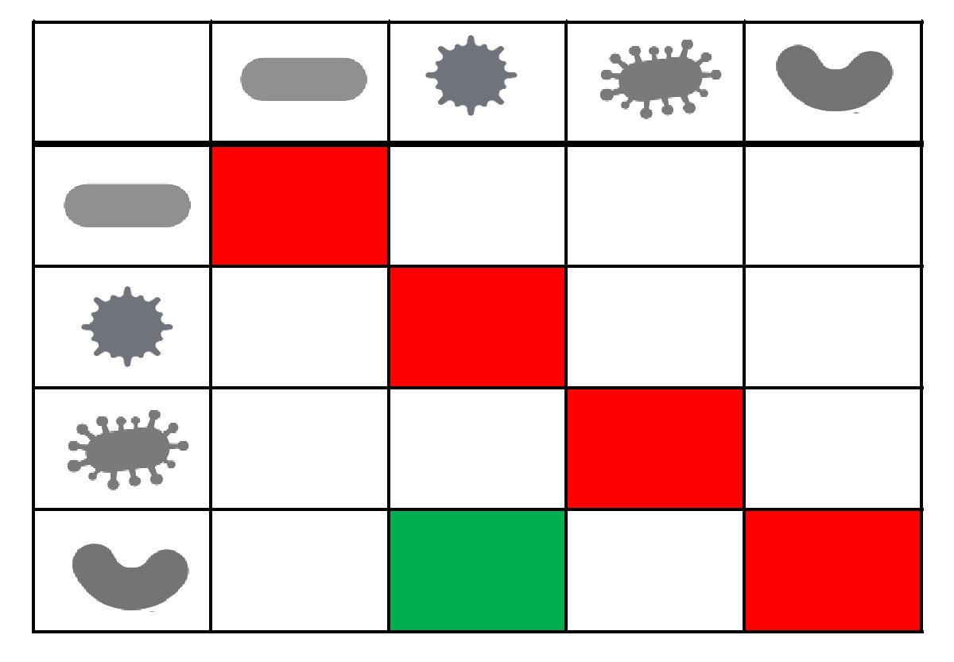




GLV continued
The species interaction matrix can be represented as a directed network; gLV takes the network and the growth rates as parameters
1 2 3 4
1
2
3
4
Negative
Positive
d
(r₃
-
dt
=
-
)

Slide 16
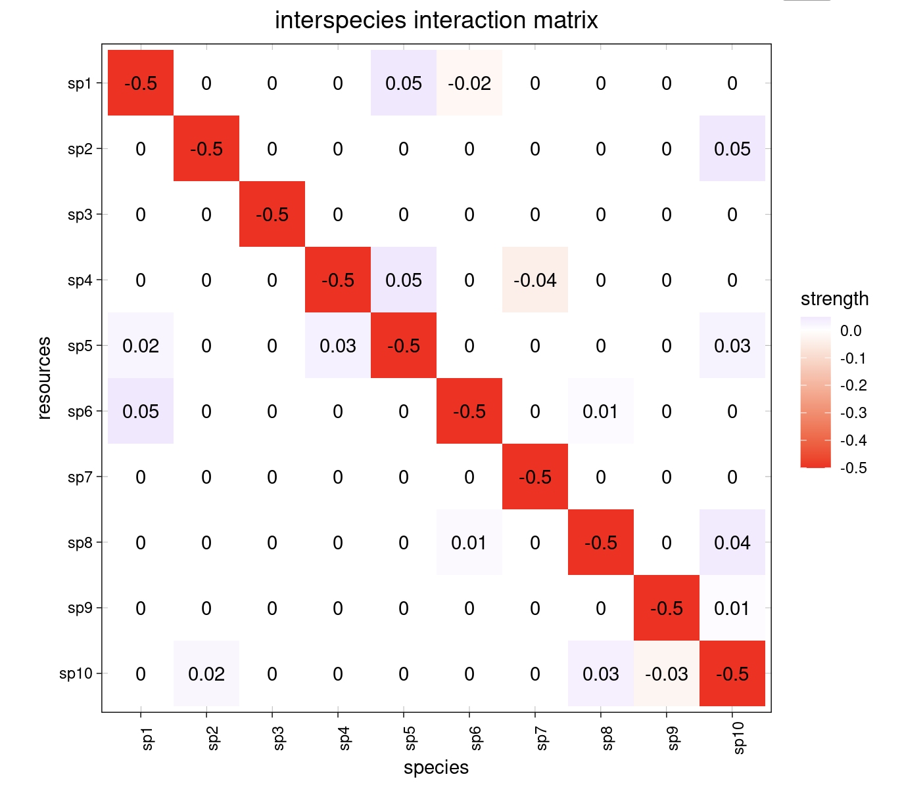
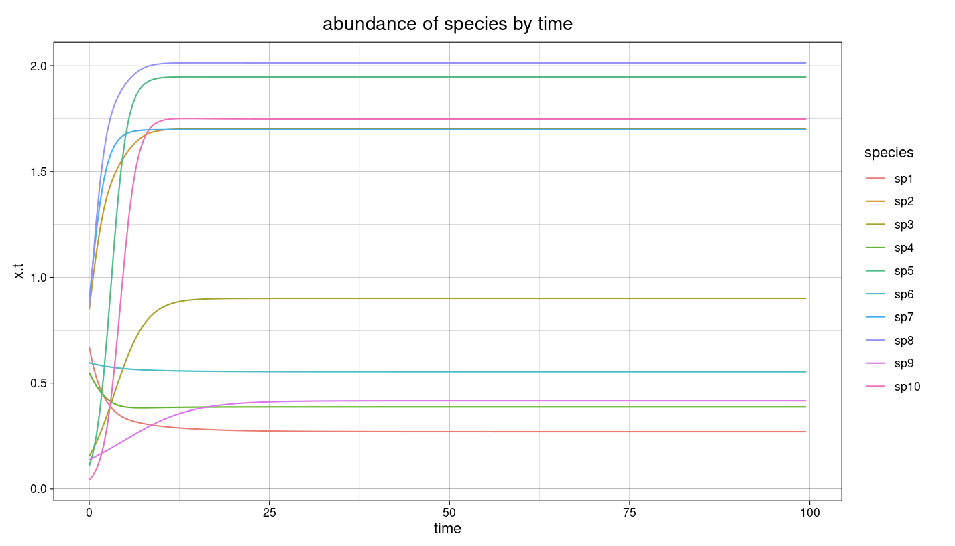
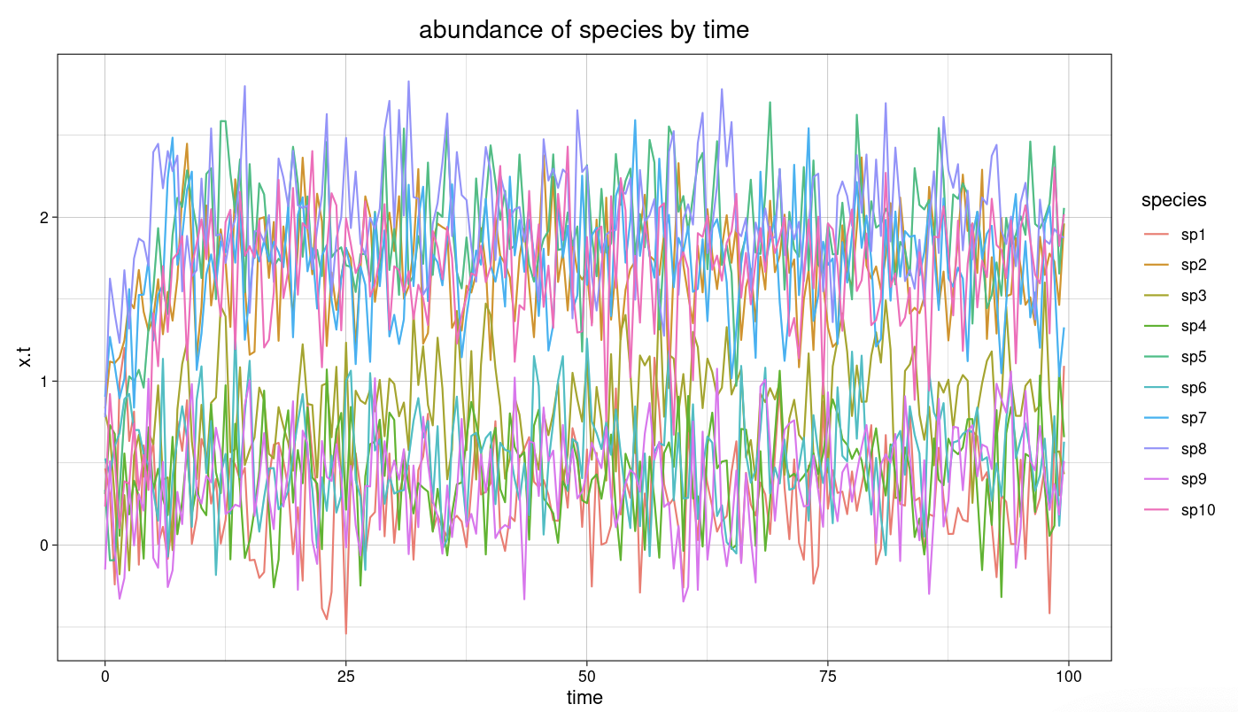
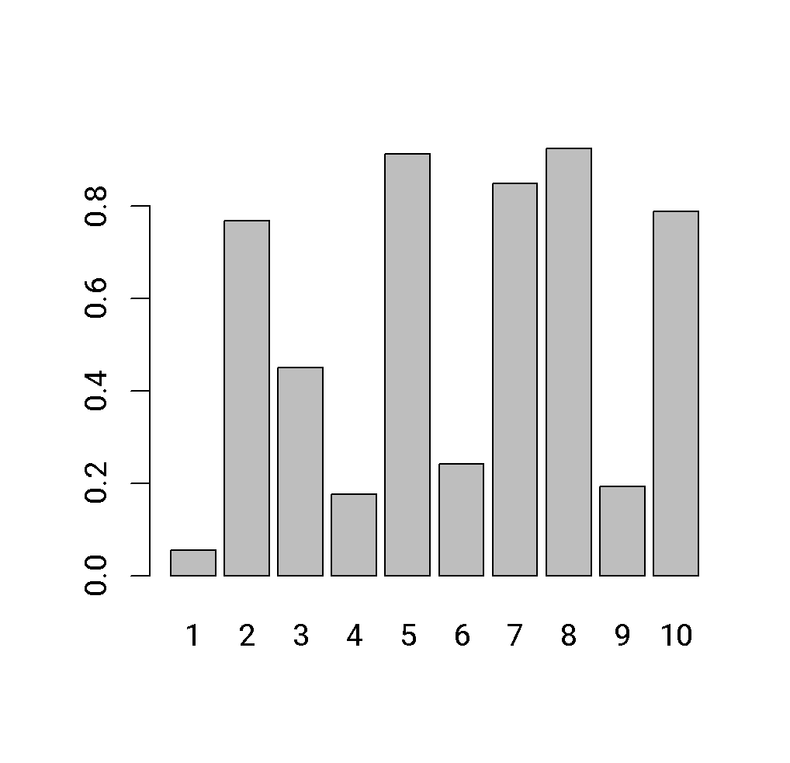
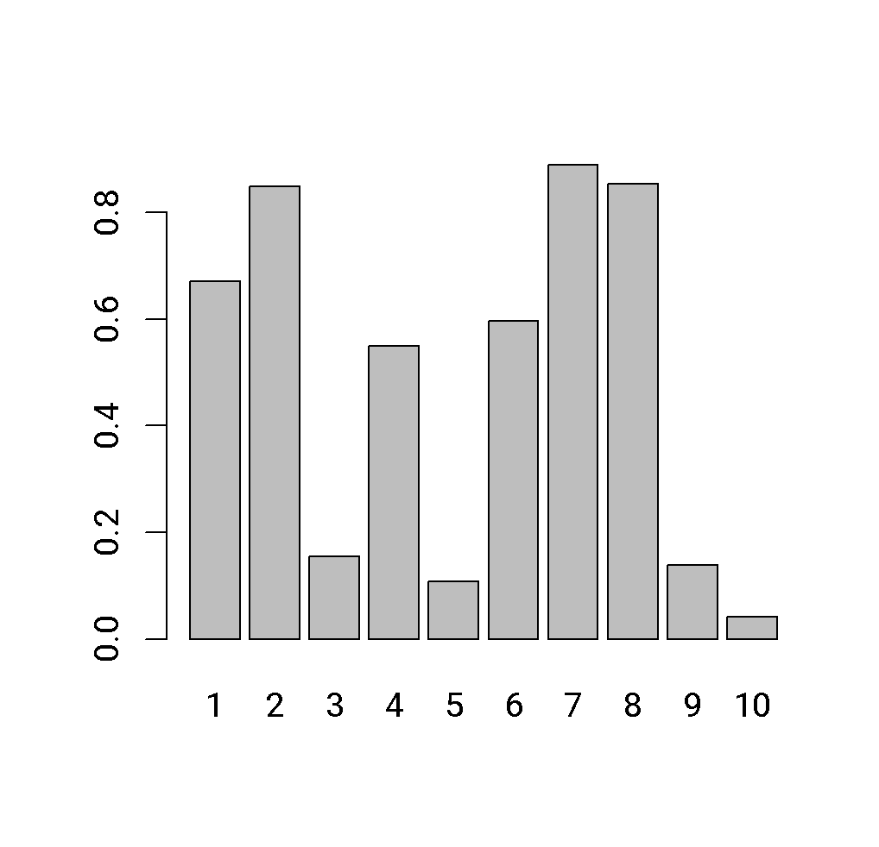
Example simulation with generalized Lotka-Volterra
Parameters
Without noise
Abundance
Transient
Steady state
Species
With noise
Species
Growth rates
Initial abundances
Abundance
Notes:
deSolve R package via miaSimShiny with normalised abundances
“apply rules iteratively for a specified number of times or until no big changes happen anymore”

Slide 17


Generalized Lotka Volterra – limitations
Example HOI
Pairwise interactions: no higher-order interactions (HOIs)
No interaction mechanisms
Linear increase of interaction strength with species abundance
Static interaction coefficients do not account for altered species behavior when environment changes
Well-mixed conditions
No migration
Static entities: new entities do not evolve

Slide 18
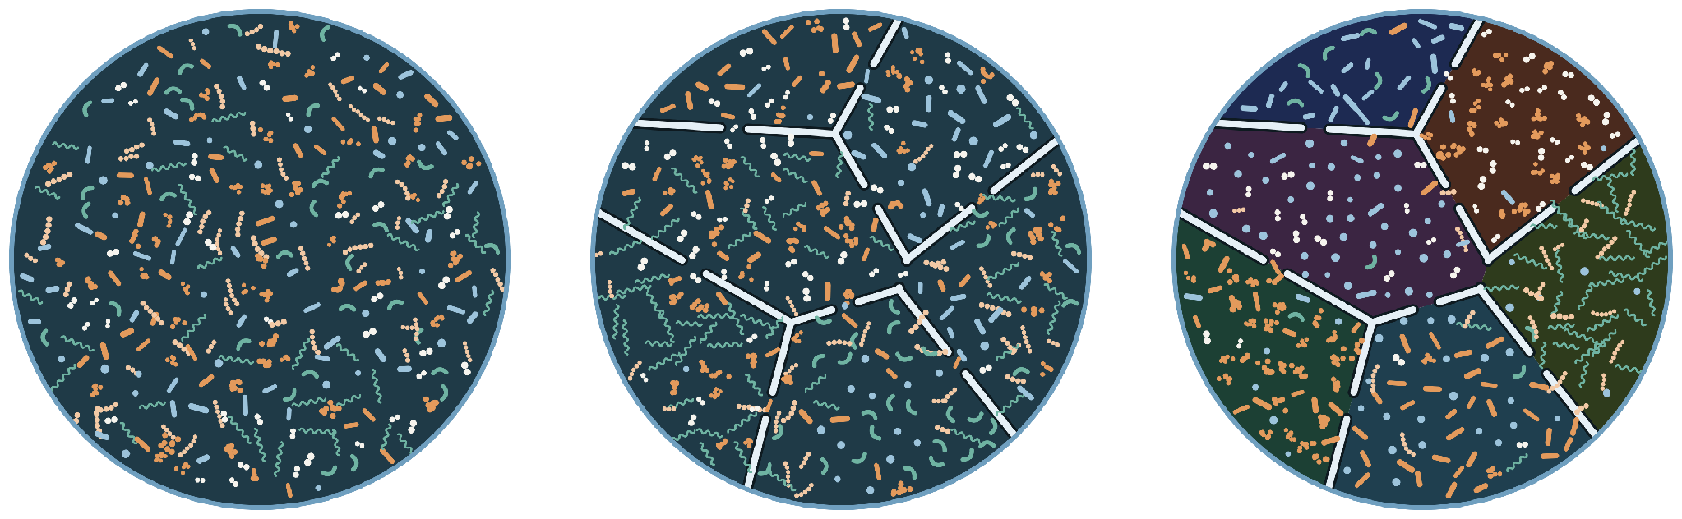
Microbial communities are not islands – the meta-community concept
What happens if a community is not well-mixed?
Spatial structure can be conceptualized as separate communities that exchange microbes (and metabolites)
Well-mixed
Spatial structure
Spatial structure with different local conditions
Image by Claude

Slide 19
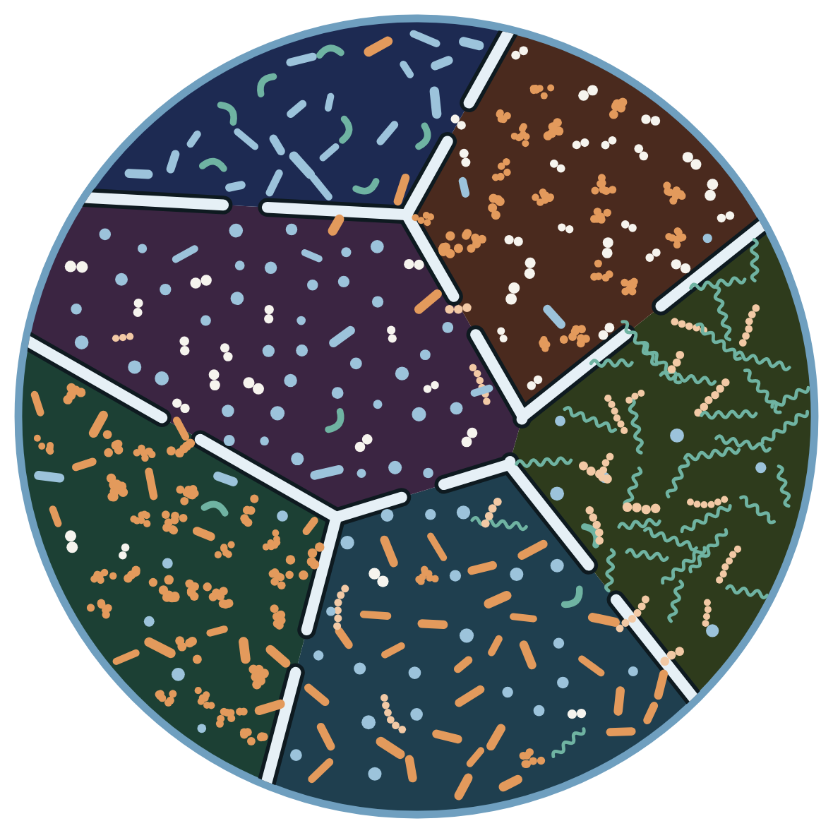
Modeling microbial meta-community dynamics
We need to represent patches
And microbes migrating between them
Patches may have different local conditions (which may result from microbial activities)
For gLV, this means:
Growth rate is specific to a patch, to account for the impact of the local conditions on species growth
Species abundance is specific to a patch too
There is migration between patches

Slide 20

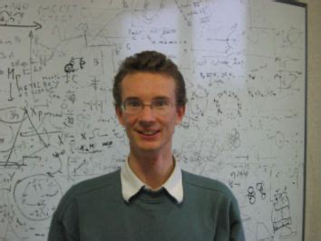
Extending gLV to model meta-community dynamics
Growth rate and abundance of species i are patch-specific (subscript k for the k^{th} patch); interactions are not
There is species-specific migration between patches, denoted by p_{i}
Patches only exchange species (no metabolites); species do not alter local conditions
Species migrating to a patch
Species migrating to any of the other n_{p}-1 patches
Flow: species are removed at a constant rate
Didier Gonze

Slide 21


Example simulation
4 species in 4 fully inter-connected patches
Migration p is the same for all species; D is set to 0.3
If patch k=i, growth rate of species i is 1.2, else 0.45 (each patch favors a different species)
Low migration: patches dominated by best-adapted species; high diversity due to heterogeneity
High migration: low diversity - species 2 wins everywhere (least suppressed by other species); approximating well-mixed case
Interaction matrix
P1
P2
P4
P3
Patch topology
Simulation and bar plot by Claude
Notes:
Initial species abundance in all patches: 0.01, does not influence results
Growth rate above dilution

Slide 22
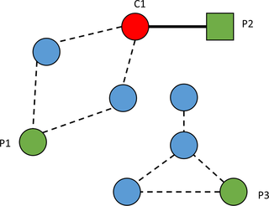
Meta-community dynamics in hospitals
Pathogens migrate between patients (=patches)
Susceptibility of a patient to a pathogen depends on its interactions with the local microbial community
Modeled with custom ordinary differential equations
Nodes: patients
Edges: transmission routes
Incident
Transmission candidates
Susceptible patients
Lulla Opatowski
Duval et al. “Close proximity interactions support transmission of ESBL-K. pneumoniae but not ESBL-E. coli in healthcare settings” PLoS Comp Bio, 2019
Smith et al. “Microbiome-pathogen interactions drive epidemiological dynamics of antibiotic resistance” eLife 10:e68764, 2021

Slide 23
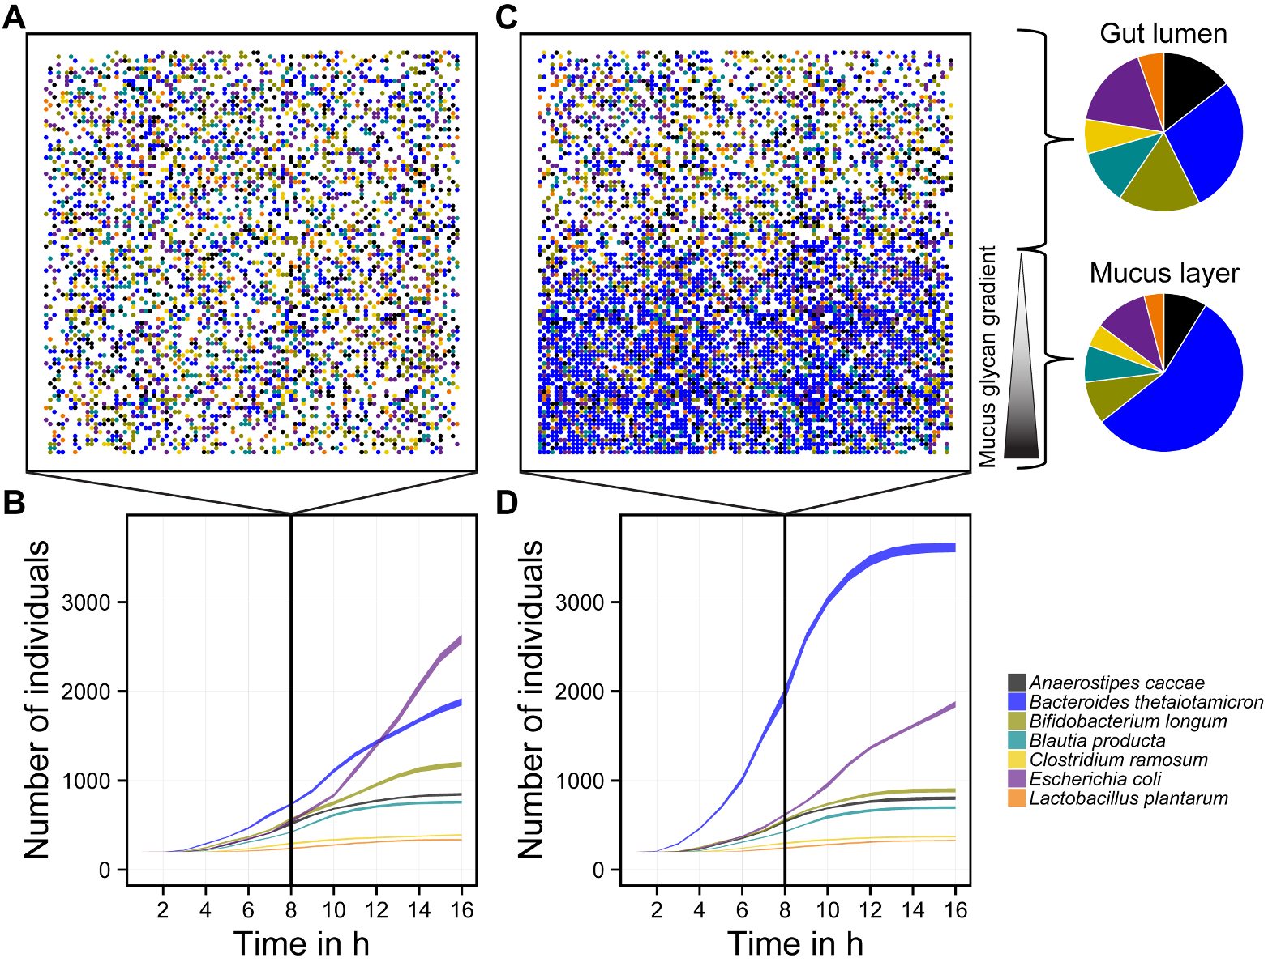
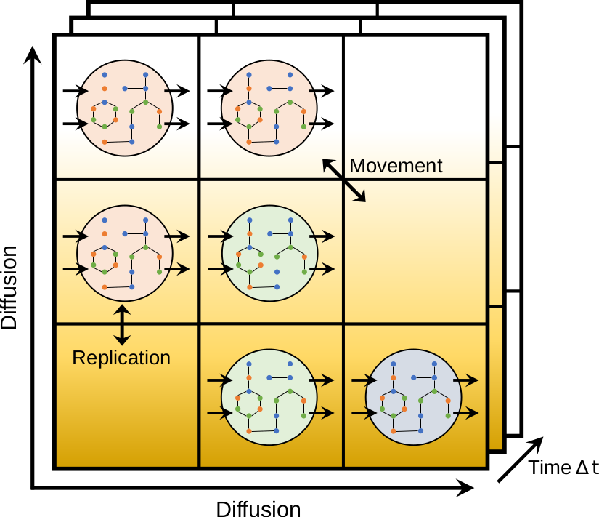
Meta-communities and IBMs
Individual-based models: instead of the entire population, model the behavior of individuals
IBMs usually work with grids to represent space, so spatial structure can be introduced through the grid
Example: BacArena; accounts for diffusion of metabolites between “patches” (grid cells)
Bauer et al. “BacArena: Individual-based metabolic modeling of heterogeneous microbes in complex communities” PLoS Computational Biology 13:5, 2017
Notes:
If bacterial invasion success depends on local community, we have a meta-community model

Slide 24
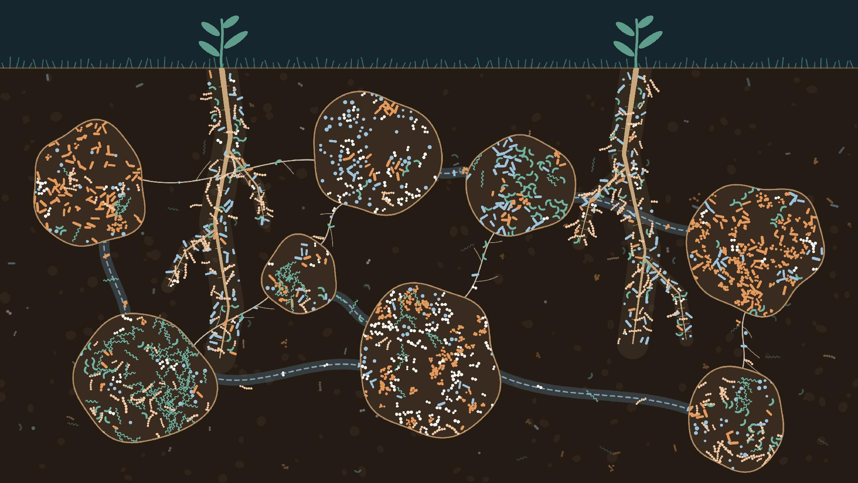
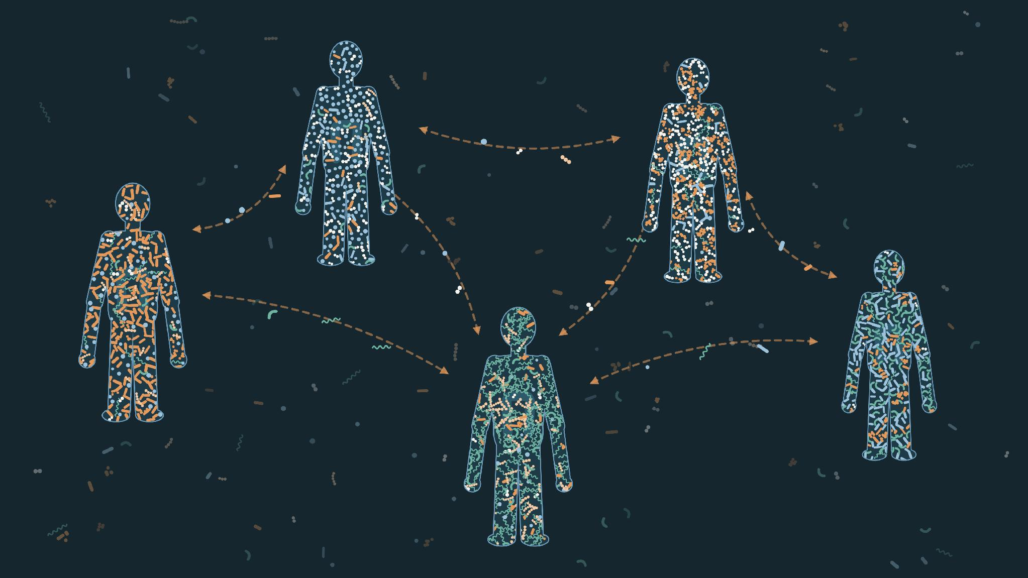
Examples being covered today
Soil patches
Ksenia Guseva
Human populations
Lulla Opatowski
Julien Tap
Notes:
Images generated with Claude Opus 5

Slide 25

Afternoon: meta-community modeling tutorial
First part: introduction to microbial community modeling with gLV
  We’ll use miaSim in a Jupyter notebook in Google Colab: https://tinyurl.com/glvTutorial
  Copy to your Google Drive to edit (File -> Save a copy in Drive)
Second part: metacommunity modeling with gLV by Ksenia Guseva
  Jupyter notebook in Colab: https://tinyurl.com/metacommglv
  Copy to your Google Drive to edit
miaSim: R package for microbial community modeling co-developed with Leo Lahti; part of the miaverse (https://microbiome.github.io/)
Yu G, Simsek Y, Gheysen E, Borman T, Li Y, Lahti L , Faust K & Garza DR (2023)” miaSim: an R/Bioconductor package to easily simulate microbial community dynamics”, Methods in Ecology and Evolution 14, 1967-1980

Slide 26

Questions?

