Slide 1

Bayesian disease mapping for hologenomics in Finland
Hologen 1st training week / Copenhagen
Aki Havulinna, University of Turku

Slide 2
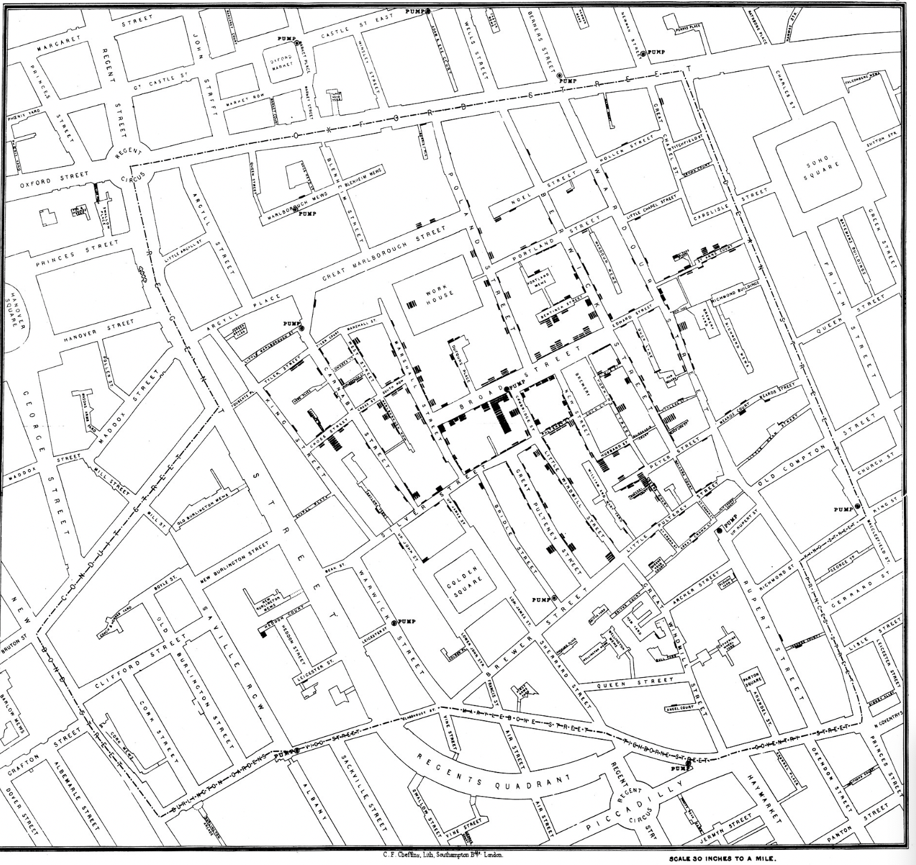
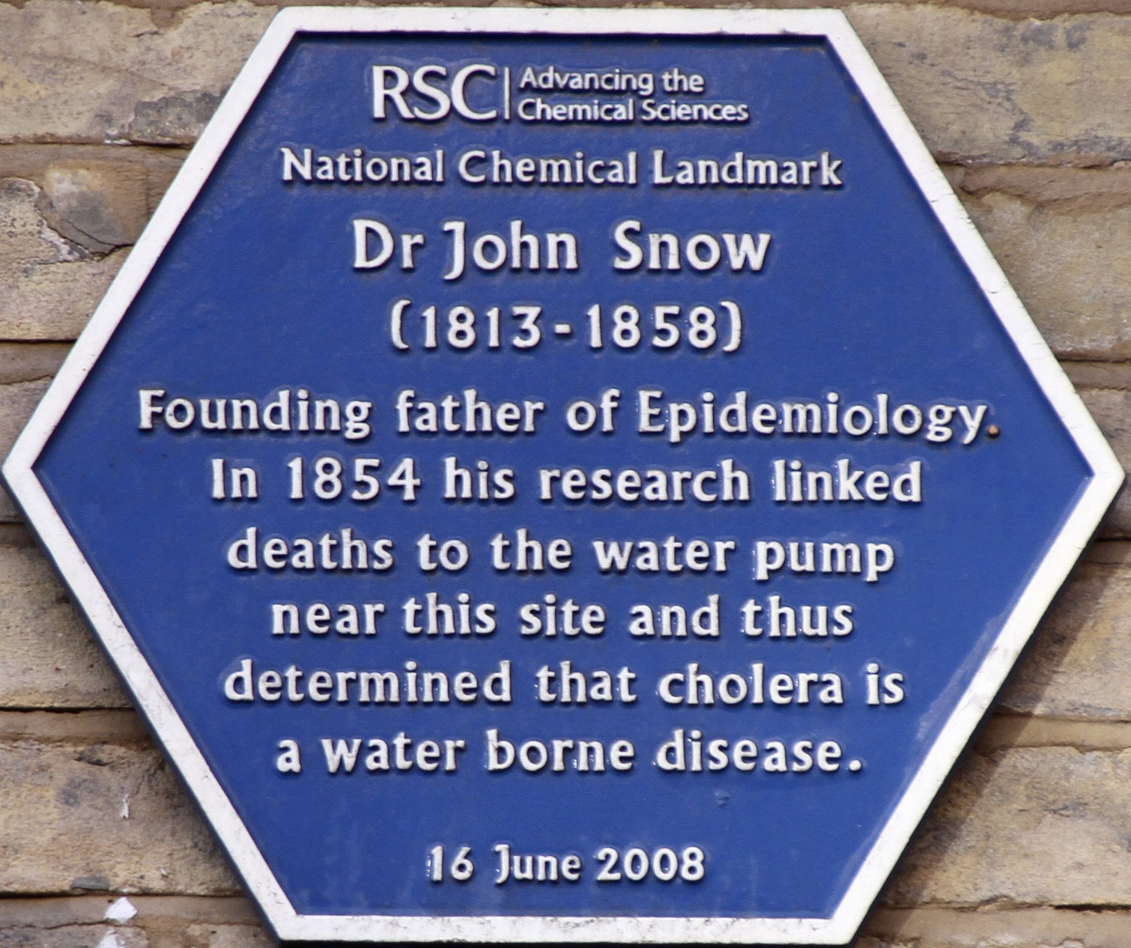
Mapping London cholera 1854
Founding work in disease mapping: Source of London cholera epidemic was pinpointed

Slide 3
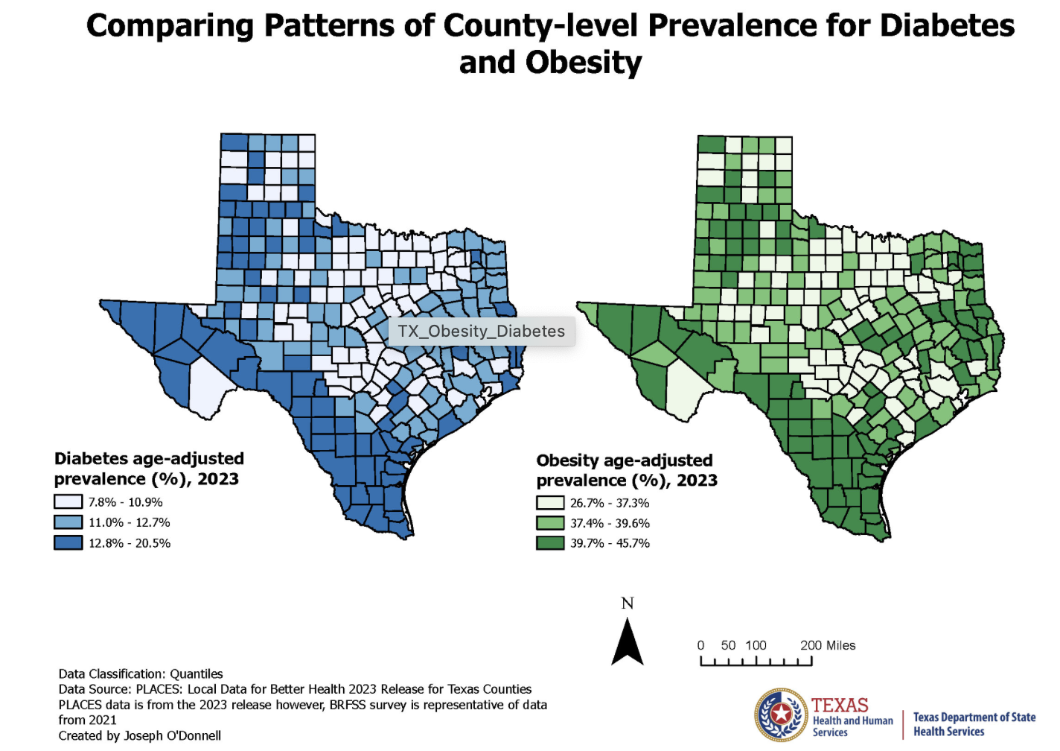
Disease mapping, regional differences
Explore specific hypotheses

Slide 4
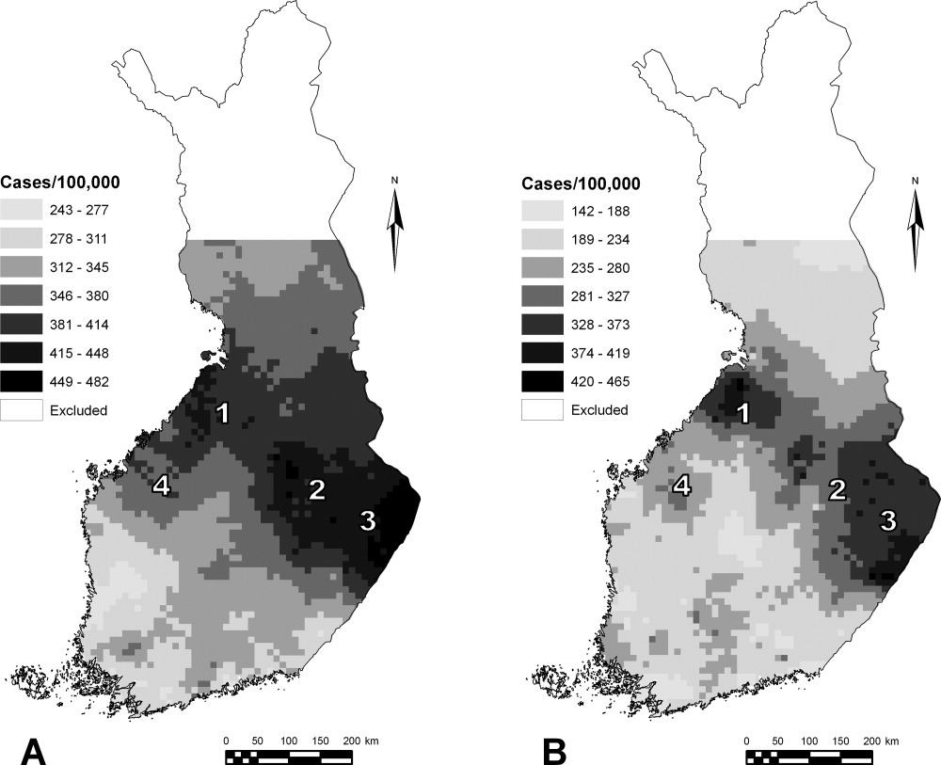
Finland: prevalence of medicated parkinsonism in the year 2000
Usage of any PD drug
(n = 10,616), age-adjusted to the European standard population. (A) Men, (B) Women.
Havulinna et al., 2008. Movement Disorders 23(7) :1024-1031.

Slide 5
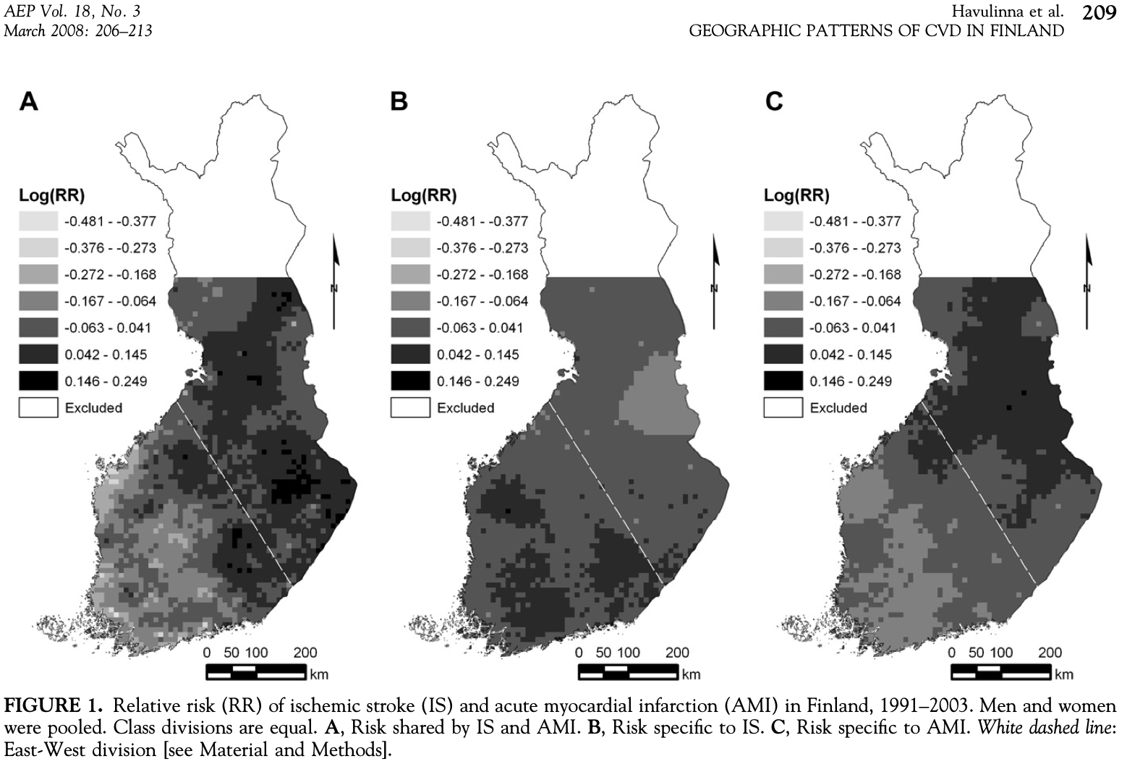
AMI and stroke, shared and independent RR

Slide 6
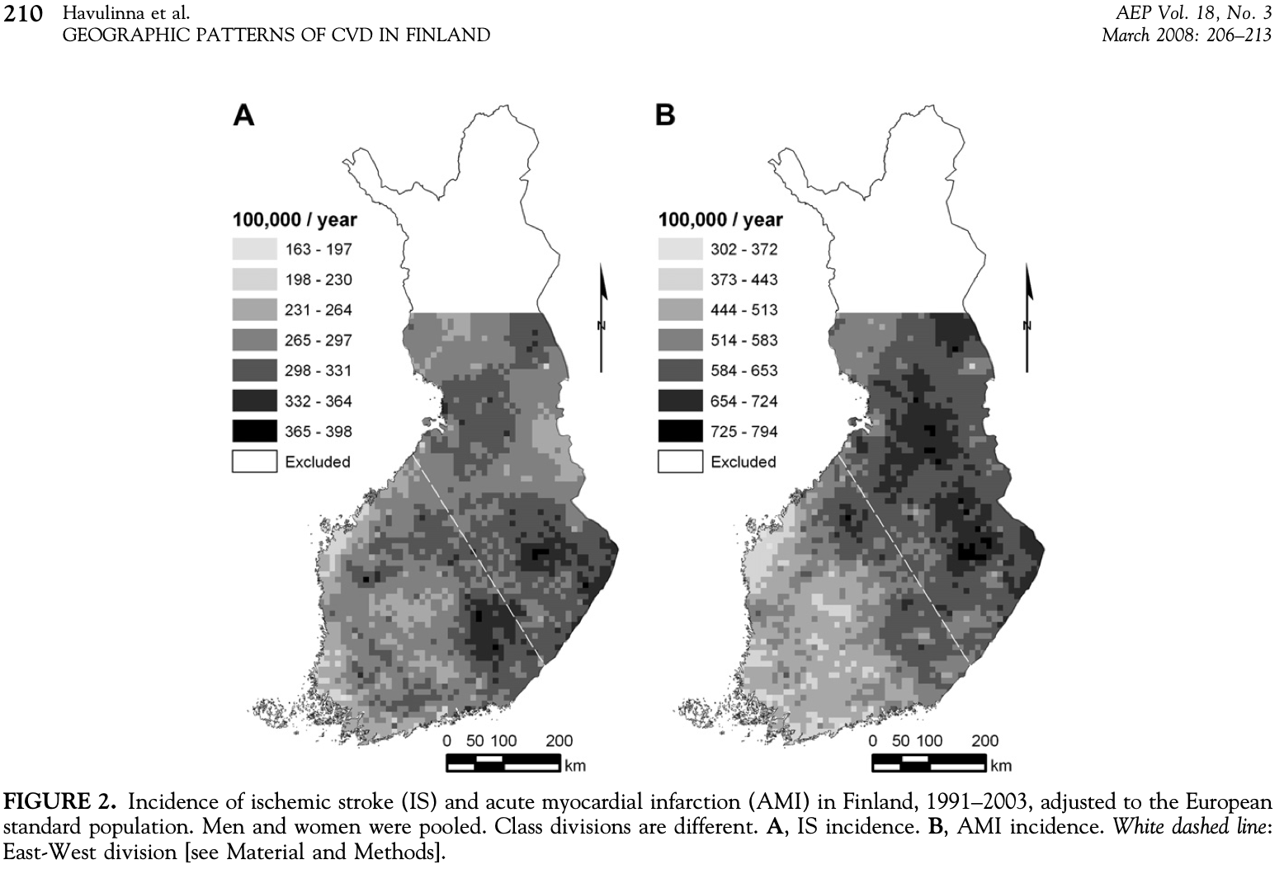
Stroke and AMI incidence

Slide 7
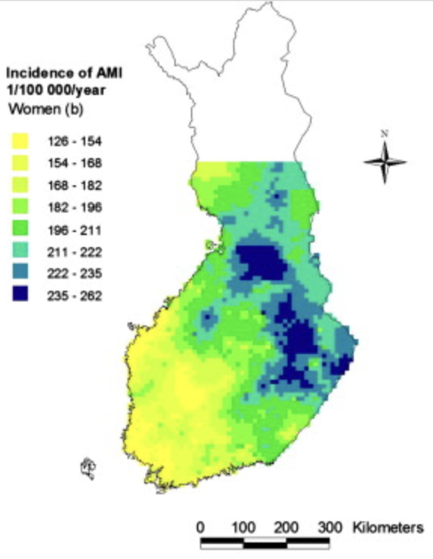
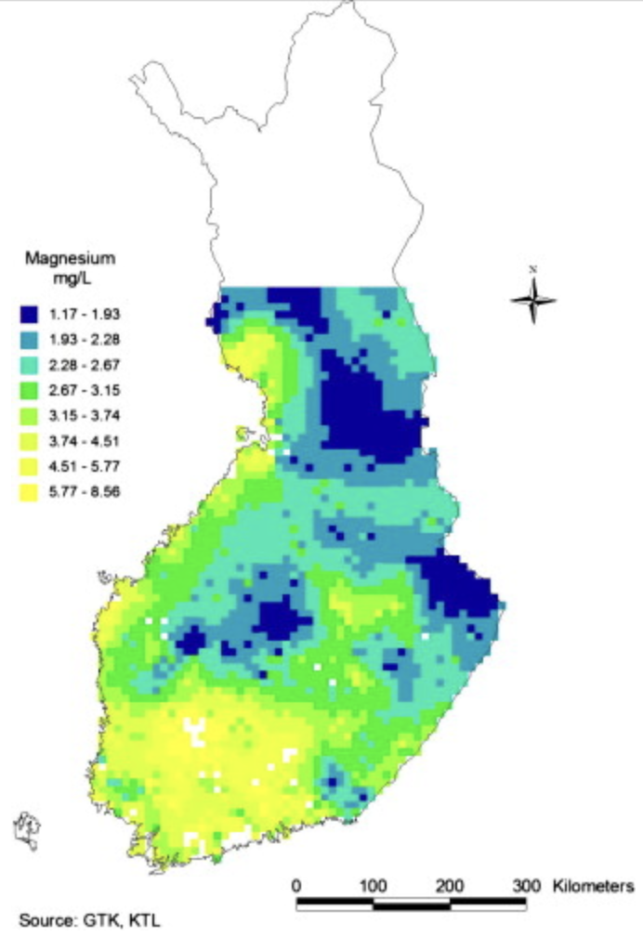
AMI vs. magnesium in well water
On average, 1 mg/L increment in Mg level in local ground water was associated with 2% decrease in incidence of AMI in the rural population.”
Also magnesium was interpolated with CAR model (log-linear).
Anything observed regionally could be smoothed / interpolated with similar models
Source: Kousa A, Havulinna AS, et al., 2008. Magnesium in well water and the spatial variation of acute myocardial infarction incidence in rural Finland, Appl. Geochem. 23(4): 632-640.

Slide 8
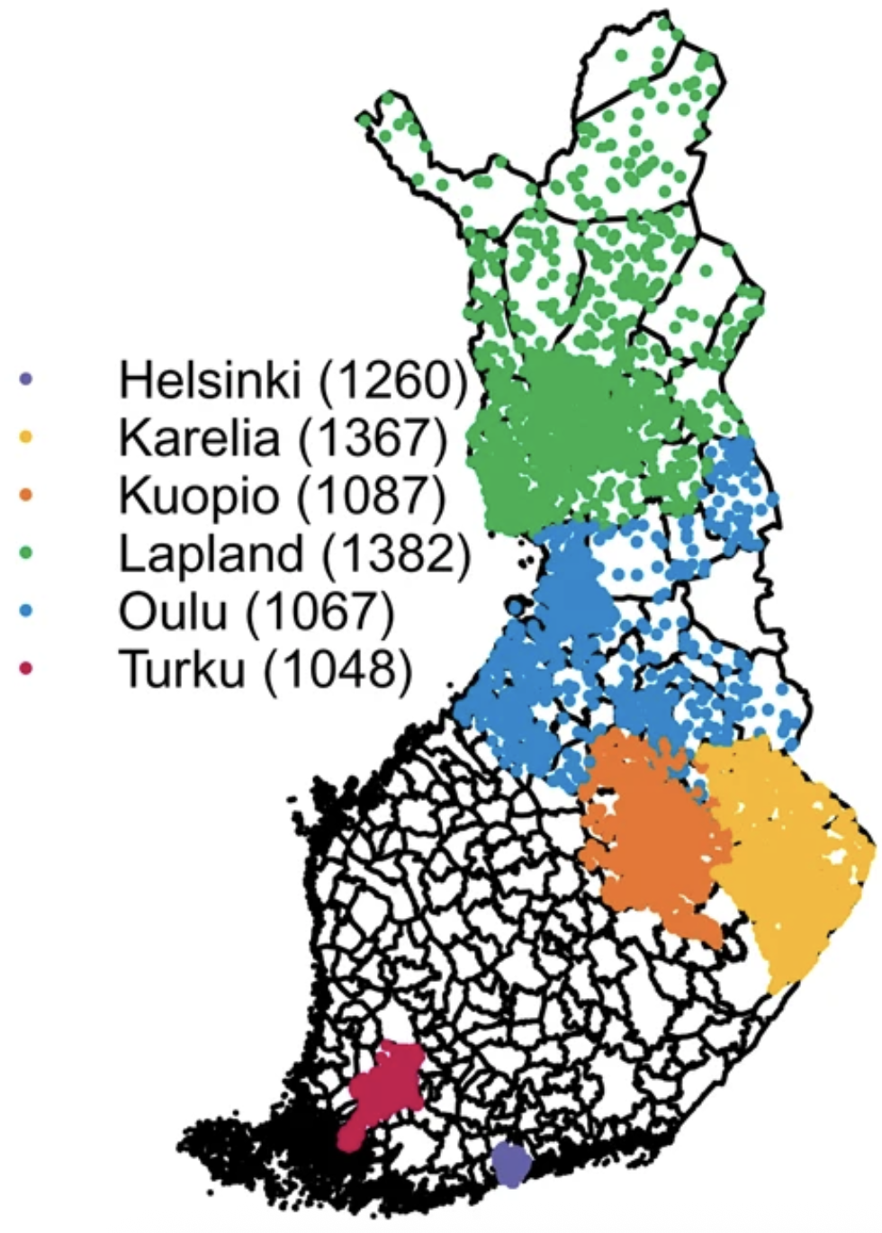
With our metagenome data
- The FINRISK 2002 metagenome project
Use a 10x10 km² grid over Finland
  Inst. of administrative regions
Only part of the cells have observations
  Observations on the map have been jittered
- Doing smooth interpolation is not enough
- Higher spatial resolution => higher uncertainty
  - Due to lower number of obs. per region
- Current data misses large part of Finland
Strategy: use spatial smoothing by Tobler’s
first law

Slide 9
Spatial smoothing interpolation
First law of geography: ”Everything is related to everything else, but near things are more related than distant things.”
- Waldo Tobler
Fundamental assumption of all spatial analysis methods.
Foundation for spatial interpolation and autocorrelation
Conventional in disease mapping: Conditional autoregression (CAR), Bayesian hierarchical modelling
The previous examples were done using such models

Slide 10
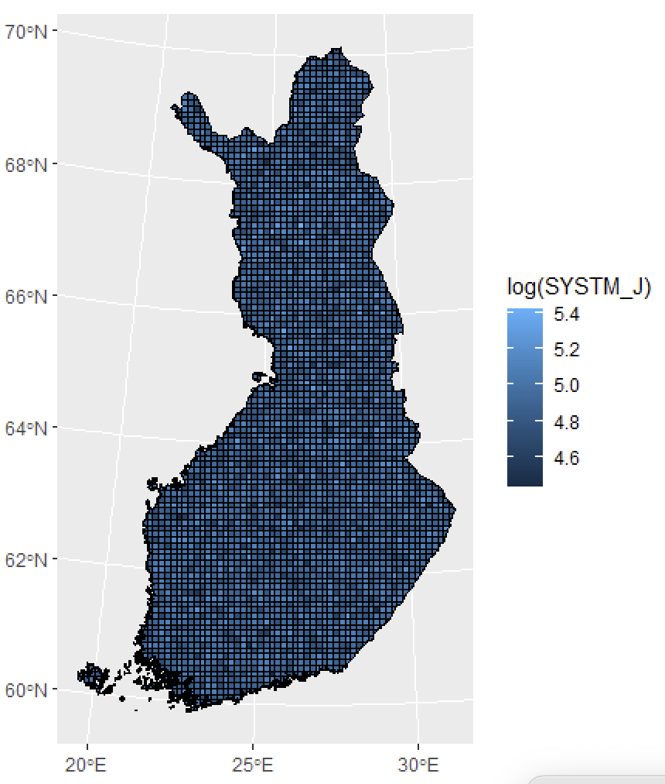
CELL average of SYST.
Blood pressure. Noise?
Plot shows average of systolic blood pressure
Unobserved cells imputed by random values, observed w/ jitter
  Due to participant privacy.
Regression models would produce a smoothed version
  Such models aim to omit random noise – which is inherent in high resolution

Slide 11
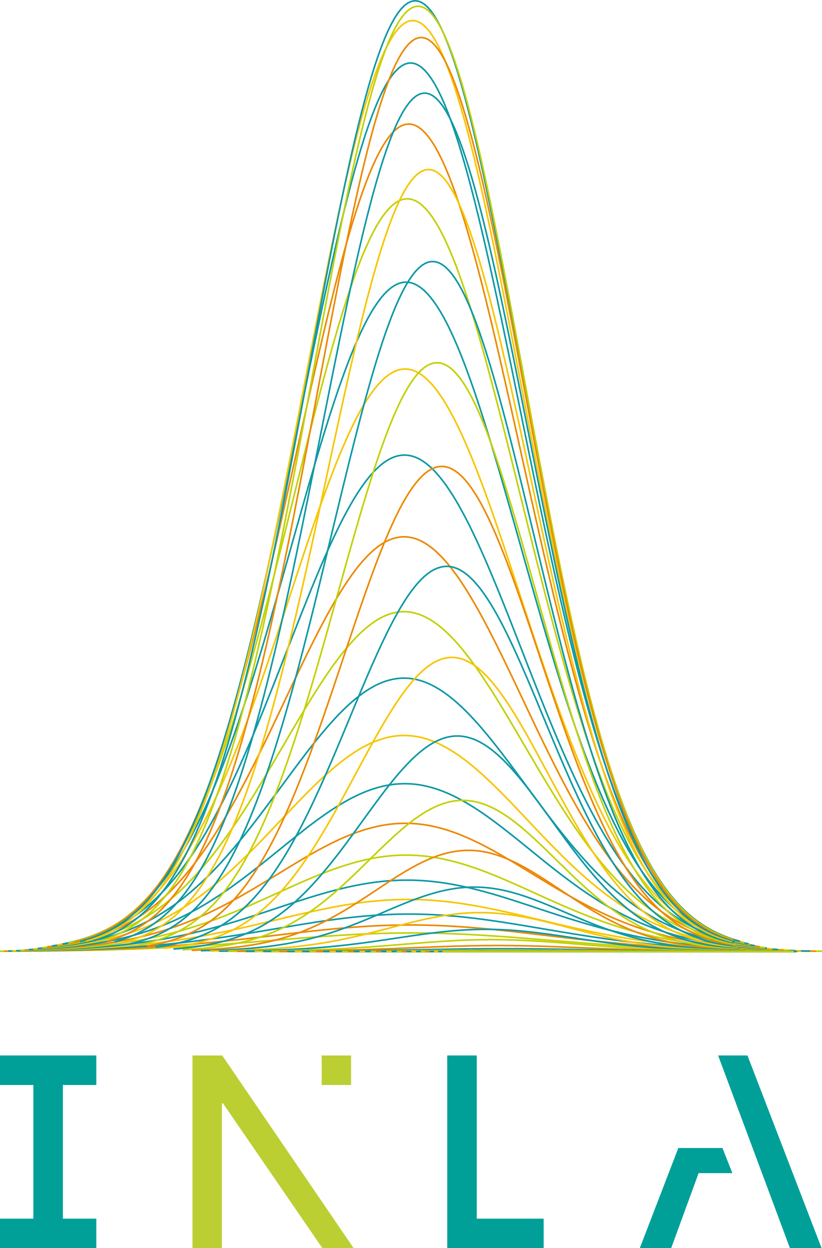
Our plan in Hologen
Produce smoothed maps of microbial variation
  Test different spatial regression models
  First option: conditional autoregression (CAR) in INLA
  Explore different aspects of microbiome, such as enterosignatures
If spatial variation is found does it explain any of the variation found on the variation in chronic diseases?
Implement/integrate the chosen regression models in the microbiome framework (MIA)

