Slide 1


www.hologen-network.org
Advancing the development and implementation of hologenomics in biological sciences
Funded by the European Union under Grant Agreement 101169005

Slide 2
www.hologen-network.eu
A PhD student’s voyage I
Purpose, motivation and environment
Antton Alberdi
University of Copenhagen
antton.alberdi@sund.ku.dk

Slide 3
www.hologen-network.eu
Why did you decide to pursue a PhD?

Slide 4
www.hologen-network.eu
McGregor 1960
Theory X
Theory Y
Job
Career
Calling
Bellah et al. 1985

Slide 5
www.hologen-network.eu
McGregor 1960
Theory X
Theory Y
People inherently dislike work and will avoid it if they can. Motivation is driven primarily by external factors, such as financial rewards (salary) or fear of repercussions (fines).
People enjoy meaningful work and are naturally motivated to succeed. Motivation comes from internal factors such as personal fulfillment, curiosity, and a sense of contributing to a greater good.

Slide 6
www.hologen-network.eu
Bellah et al. 1985
Job
Career
Calling
Interested in the material benefits from work and do not seek or receive any other type of reward from it
Seek advancement within the occupational structure. A stepping stone.
Work is inseparable from their life, brings fulfillment to the individual

Slide 7
www.hologen-network.eu
Bellah et al. 1985
Job
Career
Calling
Interested in the material benefits from work and do not seek or receive any other type of reward from it
Seek advancement within the occupational structure. A stepping stone.
Work is inseparable from their life, brings fulfillment to the individual
What is a PhD for you?

Slide 8
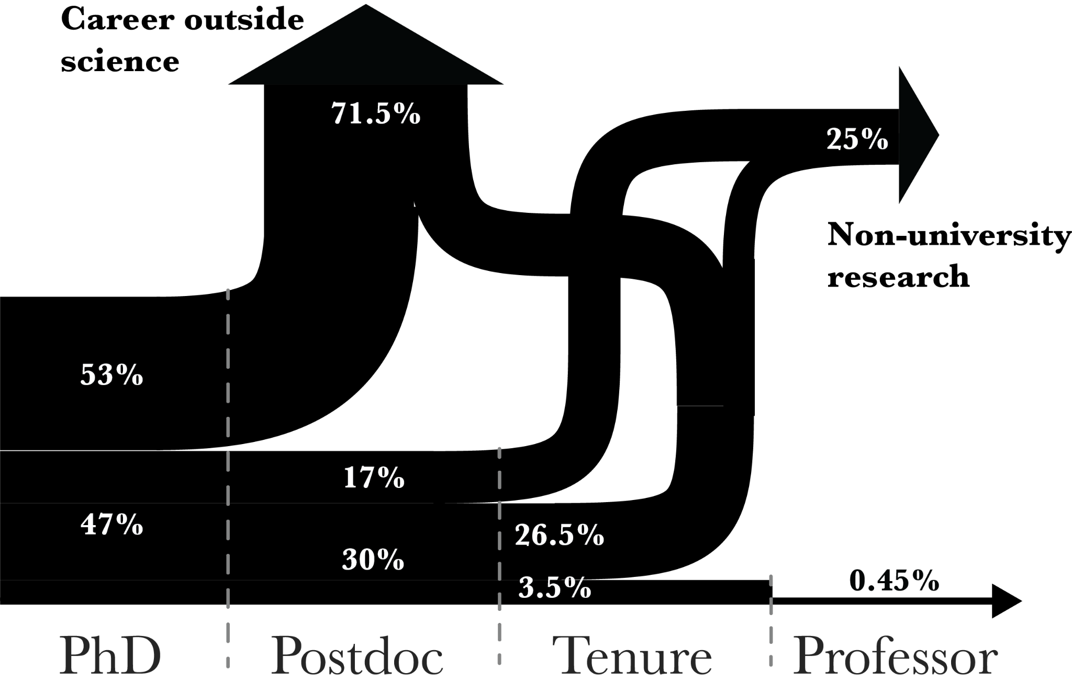
www.hologen-network.eu
Taylor et al. 2010

Slide 9
www.hologen-network.eu
What is that motivates
you to pursue PhD?

Slide 10
www.hologen-network.eu
Motivation
Ryan and Deci 2000
Extrinsic
Intrinsic
External incentives: salary, publications, recognition, awards.
Internal incentives: developing new skills, gaining autonomy, or achieving mastery, or to a broader sense of purpose and fulfilment.

Slide 11
www.hologen-network.eu
Mindset
Dweck 2006
Fixed
Growth
Abilities are innate and unchangeable
Abilities can develop incrementally through learning and effort

Slide 12
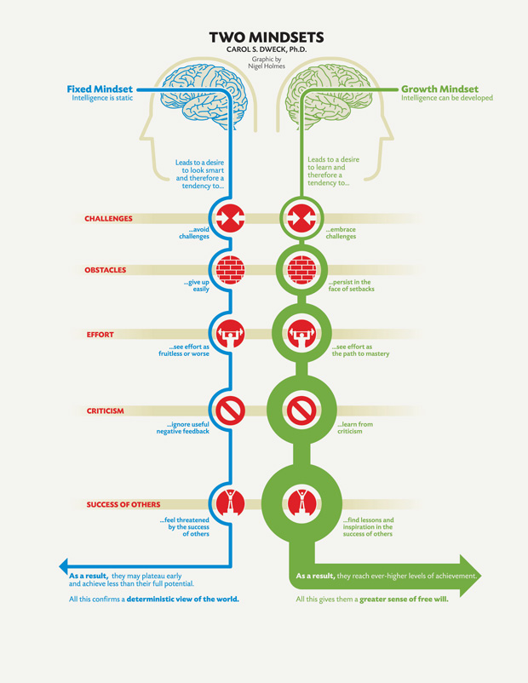
www.hologen-network.eu
Mindset
Dweck 2006

Slide 13
www.hologen-network.eu
Mindset
Dweck 2006

Slide 14
www.hologen-network.eu
Mindset
Dweck 2006

Slide 15
www.hologen-network.eu
Mindset
Dweck 2006

Slide 16
www.hologen-network.eu
How can you balance between
growth and deliverables?

Slide 17
www.hologen-network.eu
Academia game
Carse 1986, Sinek 2019
Finite game
Infinite game
Players, rules, phases, and possible outcomes are predetermined
Lack clear players and fixed rules; their phases shift, and outcomes are unpredictable

Slide 18
www.hologen-network.eu
Academia game
Carse 1986, Sinek 2019
Finite game
Infinite game
Players, rules, phases, and possible outcomes are predetermined
Lack clear players and fixed rules; their phases shift, and outcomes are unpredictable
Short-term
Long-term

Slide 19
www.hologen-network.eu
Infinite mindset
It is not about winning or loosing, it’s about surviving
It’s not about being the best, it’s about improving
It’s not about now, it’s about the future

Slide 20
www.hologen-network.eu
What is the culture of your
environment?

Slide 21
www.hologen-network.eu
Dimensions of culture
Hofstede 1980
Power distance
Individualism
Motivation towards success
Uncertainty avoidance
Time orientation
Indulgence

Slide 22
www.hologen-network.eu
Dimensions of culture
Power
Hofstede 1980
Does your supervisor maintain hierarchical authority or fosters egalitarian relationships with teammates?

Slide 23
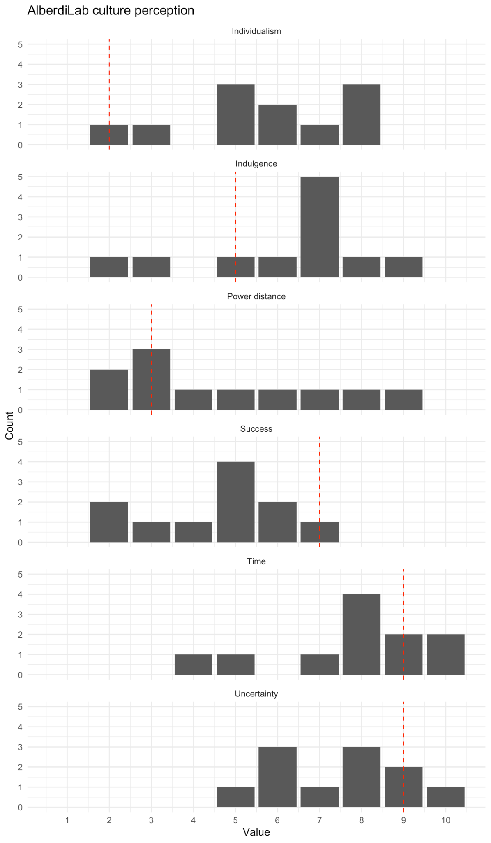
www.hologen-network.eu
Dimensions of culture
Power
Hofstede 1980
Egalitarian relationships
Hierarchical authority
Antton

Slide 24
www.hologen-network.eu
Dimensions of culture
Individualism
Hofstede 1980
Do your teammates integrate into a collective action of the group or does each researcher behave individualistically?

Slide 25
www.hologen-network.eu
Dimensions of culture
Individualism
Hofstede 1980
Collectivism
Individualism
Antton

Slide 26
www.hologen-network.eu
Dimensions of culture
Success
Hofstede 1980
Does your group prioritise productivity and impact or does it focus on well-being and inclusivity?

Slide 27
www.hologen-network.eu
Dimensions of culture
Success
Hofstede 1980
Wellbeing & Inclusivity
Prestige &
Competition
Antton

Slide 28
www.hologen-network.eu
Dimensions of culture
Uncertainty
Hofstede 1980
Does your group have well-defined protocols, procedures and performance metrics, or is ambiguity embraced as part of the work?

Slide 29
www.hologen-network.eu
Dimensions of culture
Uncertainty
Hofstede 1980
Ambiguous
structure/processes
Well-defined
structure/processes
Antton

Slide 30
www.hologen-network.eu
Dimensions of culture
Time
Hofstede 1980
Does your group prioritise strategic investments for significant future impact or focuses primarily on immediate objectives?

Slide 31
www.hologen-network.eu
Dimensions of culture
Time
Hofstede 1980
Short-term
objectives
Long-term
strategy
Antton

Slide 32
www.hologen-network.eu
Dimensions of culture
Indulgence
Hofstede 1980
Do you and your teammates feel the freedom to pursue personal interests and balance personal life, or is the environment tightly structured to achieve productive goals?

Slide 33
www.hologen-network.eu
Dimensions of culture
Indulgence
Hofstede 1980
Restrain-
oriented
Indulgent
Antton

Slide 34
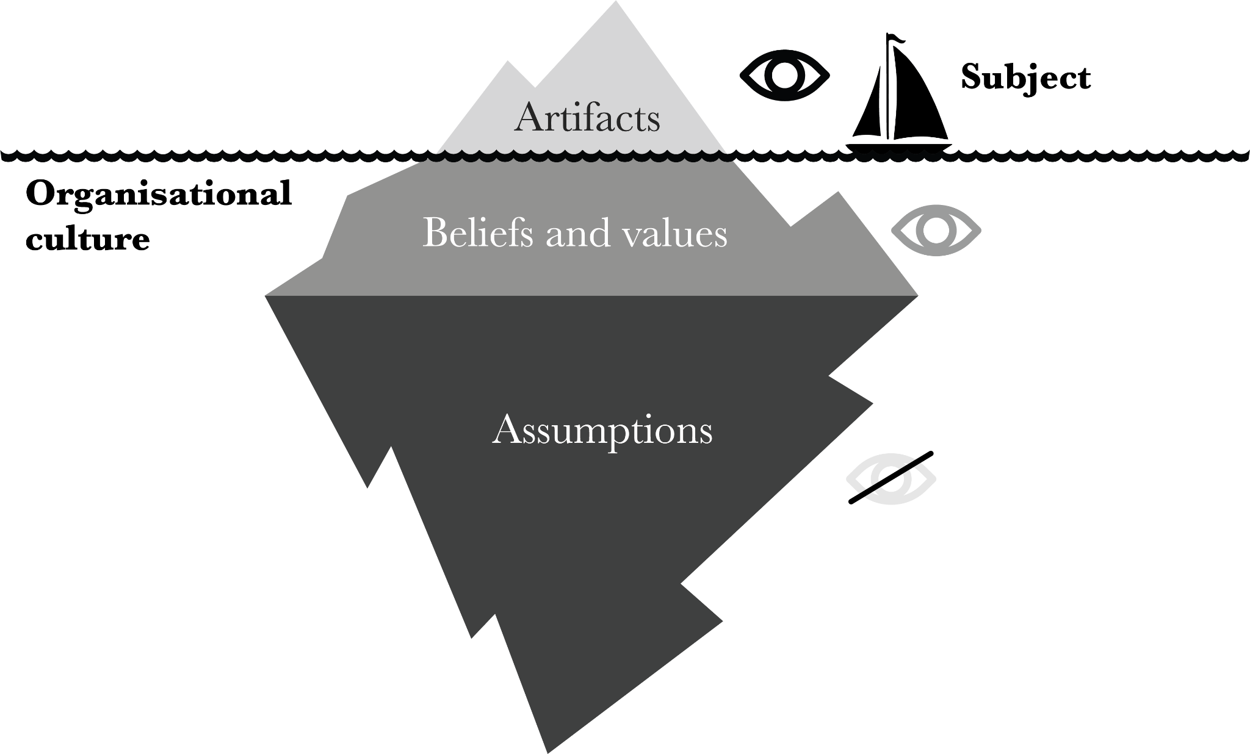
www.hologen-network.eu
Levels of culture
Schein 1985

Slide 35
www.hologen-network.eu
Levels of culture
Schein 1985
Artifacts
Values
Assumptions
Tangible or verbally identifiable elements within an organisation: dress code, protocols, meetings, procedures
Explicitly stated beliefs, goals, and philosophies that an organization formally communicates
Unspoken and often unconscious beliefs and values that shape the organisation’s culture and influence behavior at its core

