Slide 1


www.hologen-network.org
Advancing the development and implementation of hologenomics in biological sciences
Funded by the European Union under Grant Agreement 101169005

Slide 2
www.hologen-network.eu
Training and Networking Retreat 2
Barcelona
Torgeir R. Hvidsten
Norwegian University of Life Sciences
Notes:
REA (European Research Executive Agency)
Audrey Arfi

Slide 3
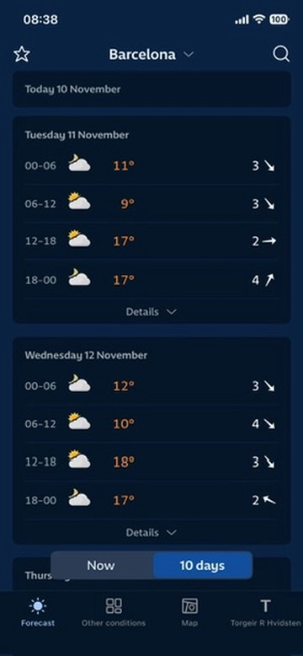
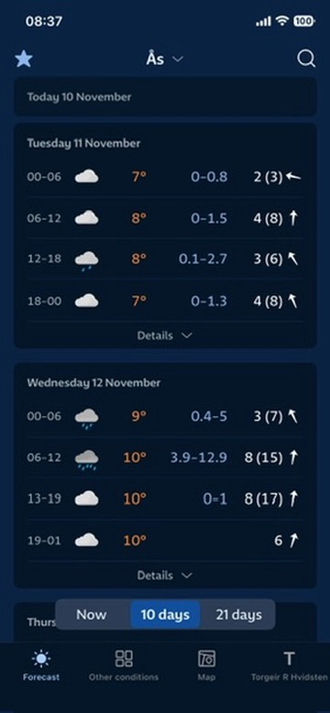

Slide 4
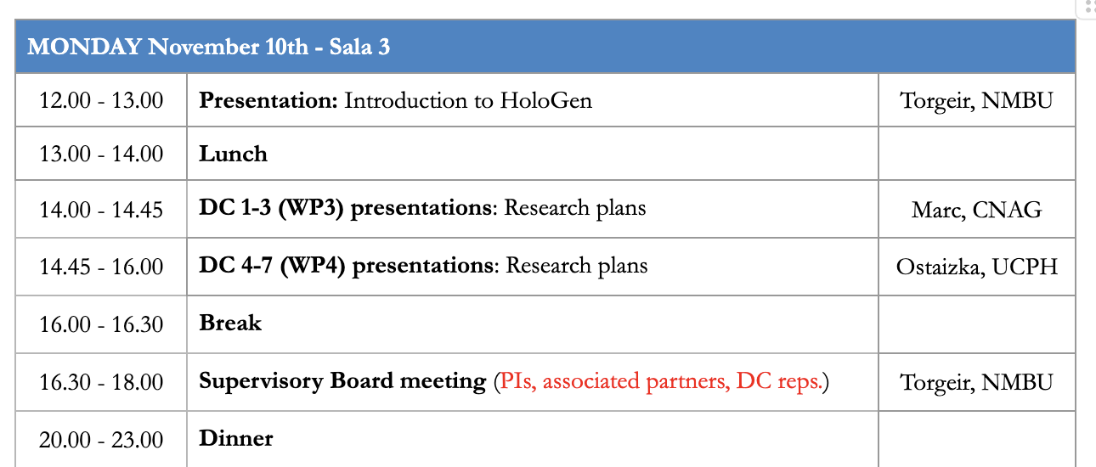
www.hologen-network.eu
Program
Notes:
Elsa, Emmanuel

Slide 5
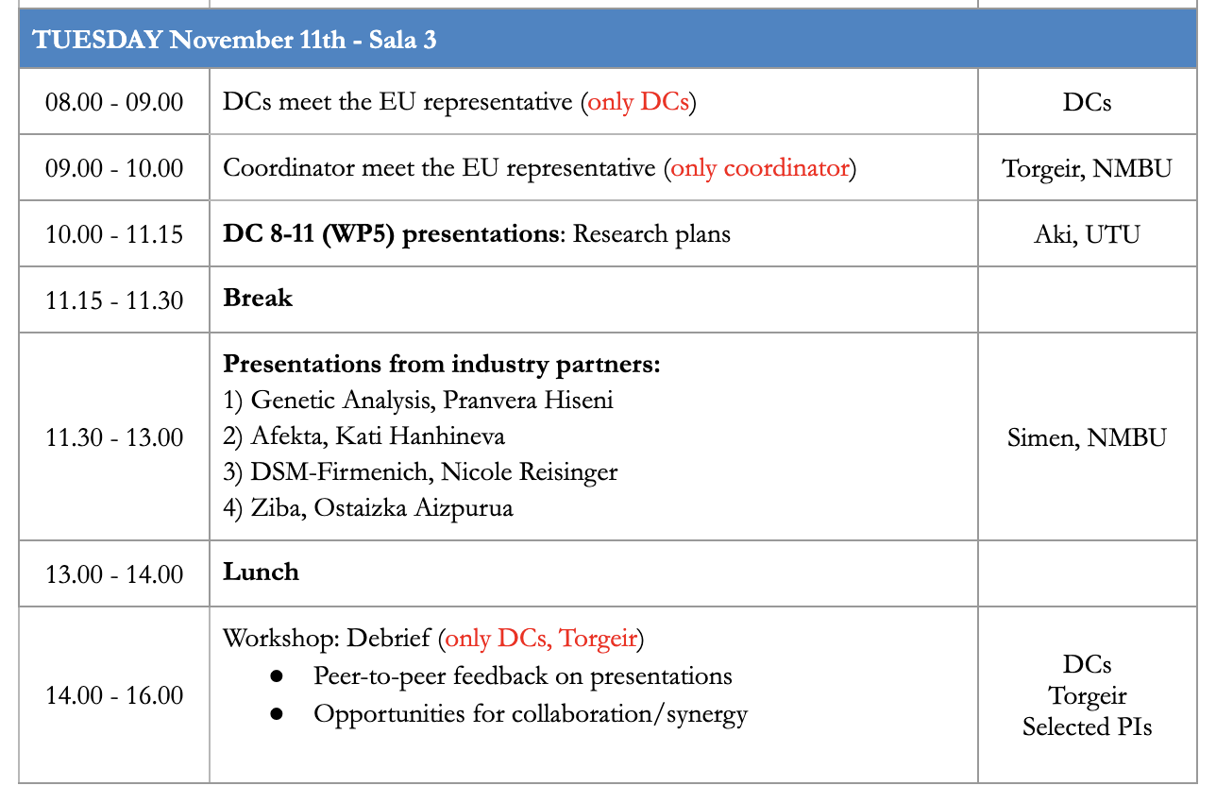

Slide 6
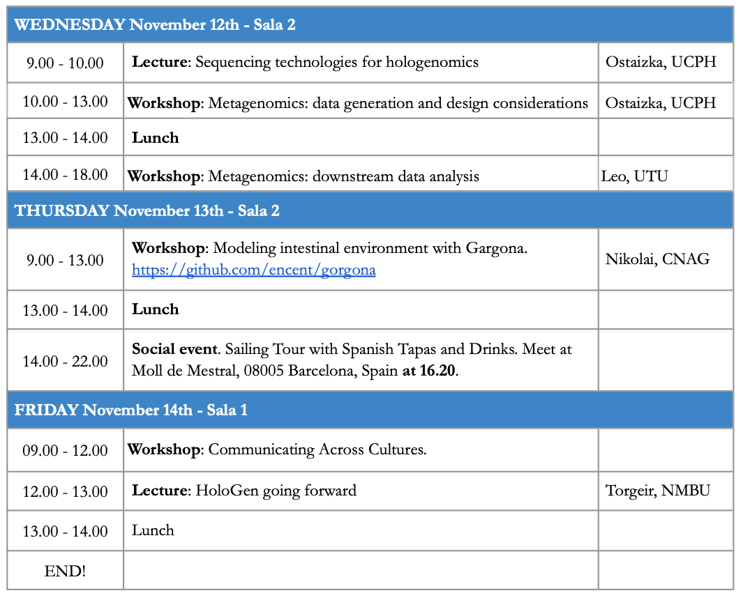

Slide 7
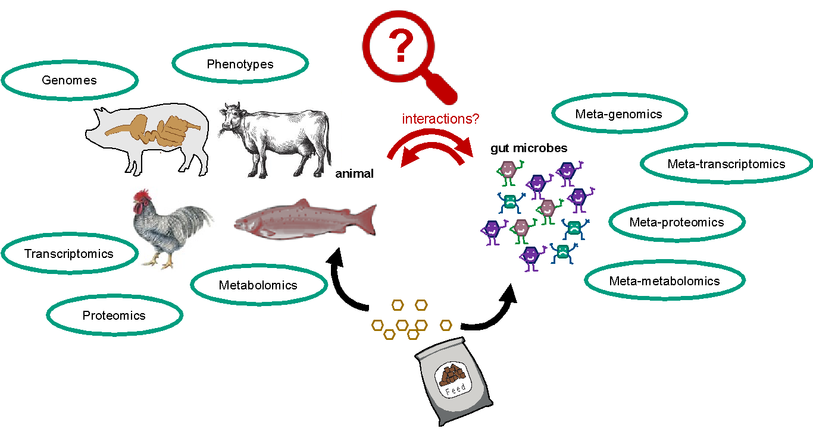


www.hologen-network.eu
Hologenomics

Slide 8
www.hologen-network.eu
HoloGen objectives
Strategic objectives
SO1 | Train the next generation of multidisciplinary scientists in hologenomics
SO2 | Strengthen both European industry and academia with a cohort of talent
SO3 | Produce a large number of high-profile publications
SO4 | Enable long-term transfer of technological gains to and from industry partners
Research objectives
RO1 | Develop novel computational approaches
RO2 | Understand fundamental principles of biochemical and ecological interplay
RO3 | Apply the hologenomic framework
Training objectives
TO1 | Understand the relevance and master the approaches of hologenomics
TO2 | Develop skills in quantitative analysis and data management
TO3 | Acquire the necessary transferable skills to succeed in academia and industry

Slide 9
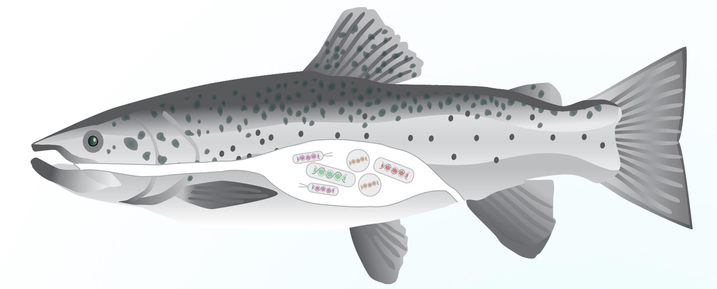







www.hologen-network.eu
    HoloGen stands on the shoulders of giant … projects
ImprovAFish
SuPAcow
Notes:
Large human population studies looking at the effects of geografic regions and families on the microbiota - and conseqeuncs on long term health
Studies in chicken, pigs, cow, salmon and other production animals looking to optimize feed conversion
Studying host-micorbiota in wild animals worldwide

Slide 10
www.hologen-network.eu
PhD projects
DC1 - Multi-omic data integration with network analysis
DC2 - Multi-omic data integration with latent variable models
DC3 - Hologenomic insights into host-microbiota three-dimensional organisation
DC4 - In vitro investigation of host-microbiota dynamics in the human gut
DC5 - Elucidating the effect of functional microbiome attributes in vertebrate dietary shifts
DC6 - Longitudinal hologenomic dynamics of host-microbiota interactions
DC7 - Hologenomic underpinnings of animal behaviour
DC8 - Linking gut microbial communities to feed efficiency in Atlantic salmon
DC9 - Feed-microbiome-host interactions in production animals
DC10 - Geospatial variation in human hologenomics profiles
DC11 - Early life microbiota-host interactions
Development
(WP3)
Fundamental
insigths (WP4)
Application
(WP5)

Slide 11
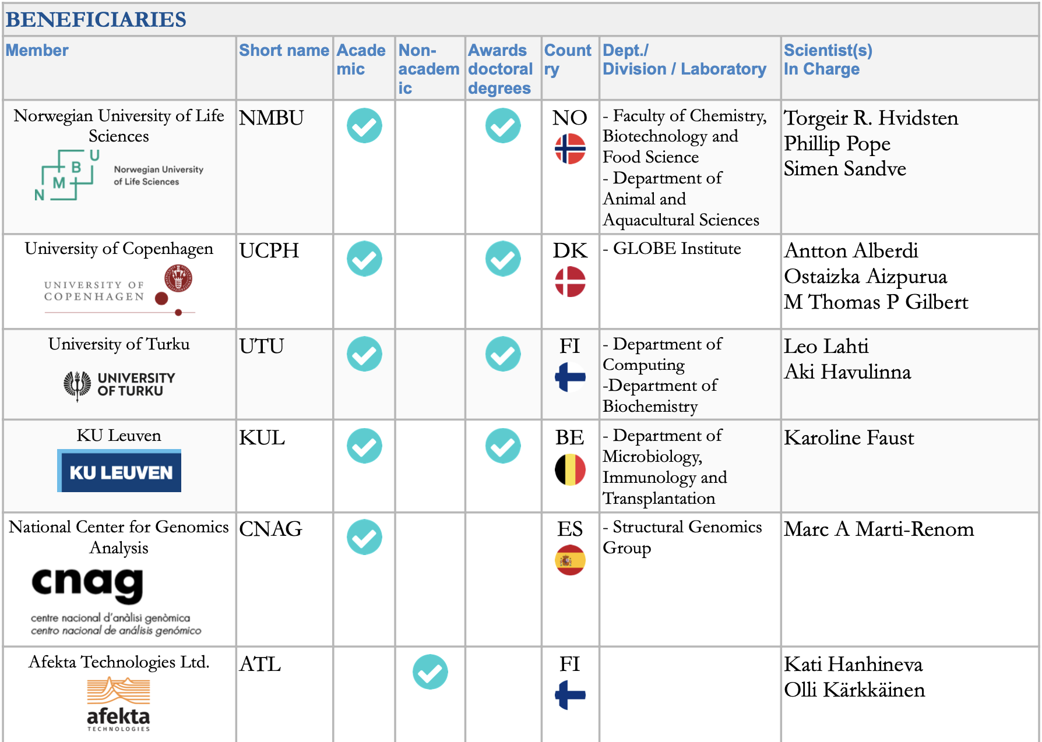

www.hologen-network.eu
Doctoral Candidate | Name | Beneficiary
DC1 | Veronica Quarato | NMBU
DC2 | Sneha Das | UTU
DC3 | Zoé Melanie Horisberger | CNAG
DC4 | Adedamola Godwin Daodu | KUL
DC5 | Lucas Padilha | UCPH
DC6 | Anh Vu Nguyen | ATL
DC7 | Elsa Brenner | UCPH
DC8 | Emmanuel Okoli Odah | NMBU
DC9 | Katerina Katirtzoglou | NMBU
DC10 | Joao Paulo Cassucci dos Santos | UTU
DC11 | Chujun Zhang | UB

Slide 12
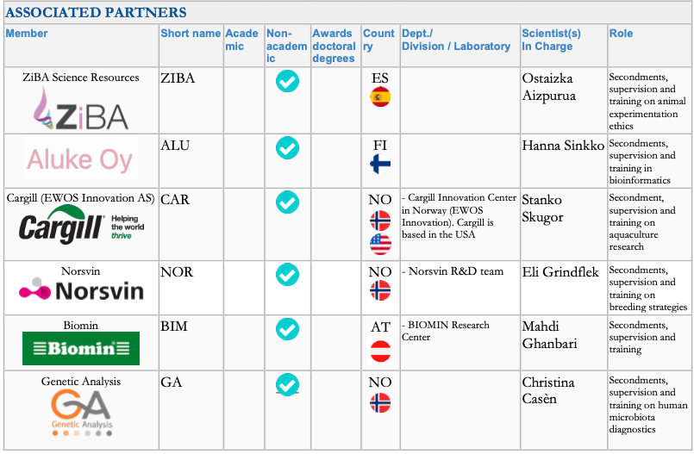

www.hologen-network.eu
Antti Karkman
Nicole Reisinger
Pranvera Hiseni

Slide 13
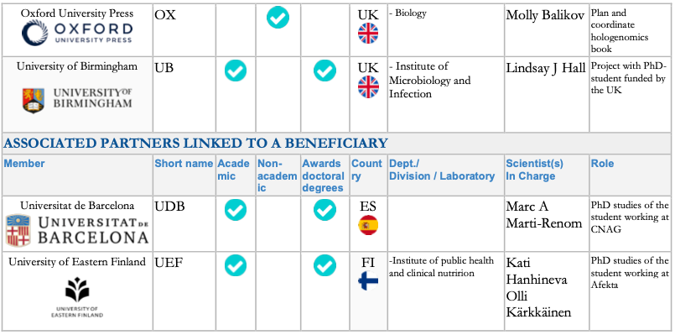
www.hologen-network.eu

Slide 14
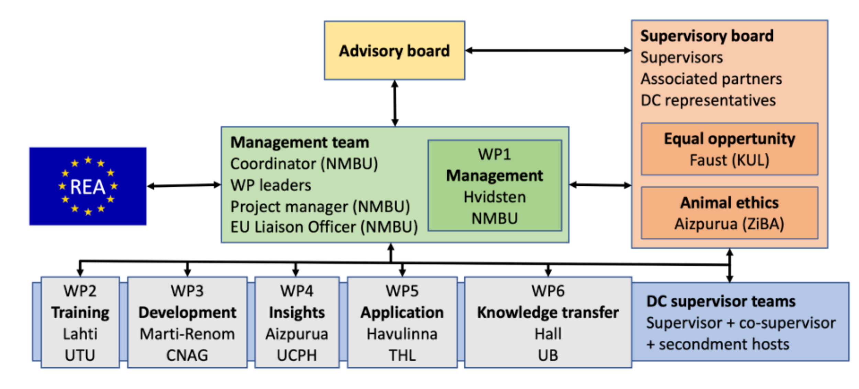
www.hologen-network.eu
Notes:
REA (European Research Executive Agency)

Slide 15

REA (European Research Executive Agency)
Audrey Arfi
Notes:
REA (European Research Executive Agency) is the part of the European Commission that manages and oversees your project on behalf of the EU.

Slide 16
www.hologen-network.eu
Organization
WP | Title | Leader | Beneficiary | Start | End
WP1 | Management | Hvidsten | NMBU | M1 | M48
WP2 | Training (TO1-3) | Lahti | UTU | M7 | M48
WP3 | Research: Development (RO1) | Marti-Renom | CNAG | M7 | M48
WP4 | Research: Fundamental insights (RO2) | Aizpurua | UCPH | M7 | M48
WP5 | Research: Application (RO3) | Havulinna | UTU | M7 | M48
WP6 | Knowledge transfer | Hall | UB | M1 | M48
 | Dissemination | Hanhineva | ATL
 | Exploitation | Sandve | NMBU
 | Communication | Hall | UB
WP7 | Ethics | Hvidsten | NMBU | M1 | M48

Slide 17
www.hologen-network.eu

Slide 18
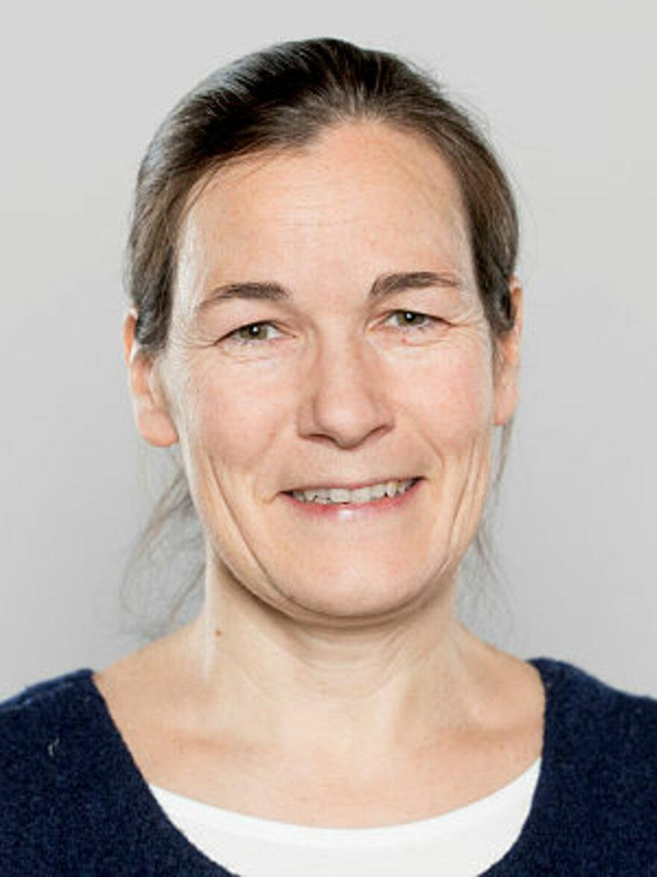
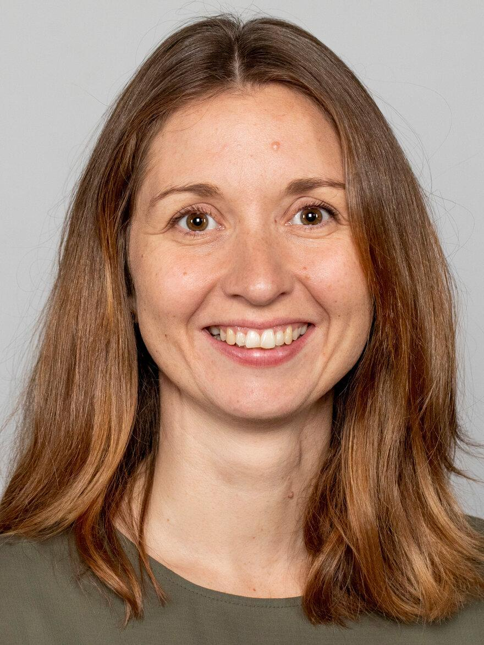
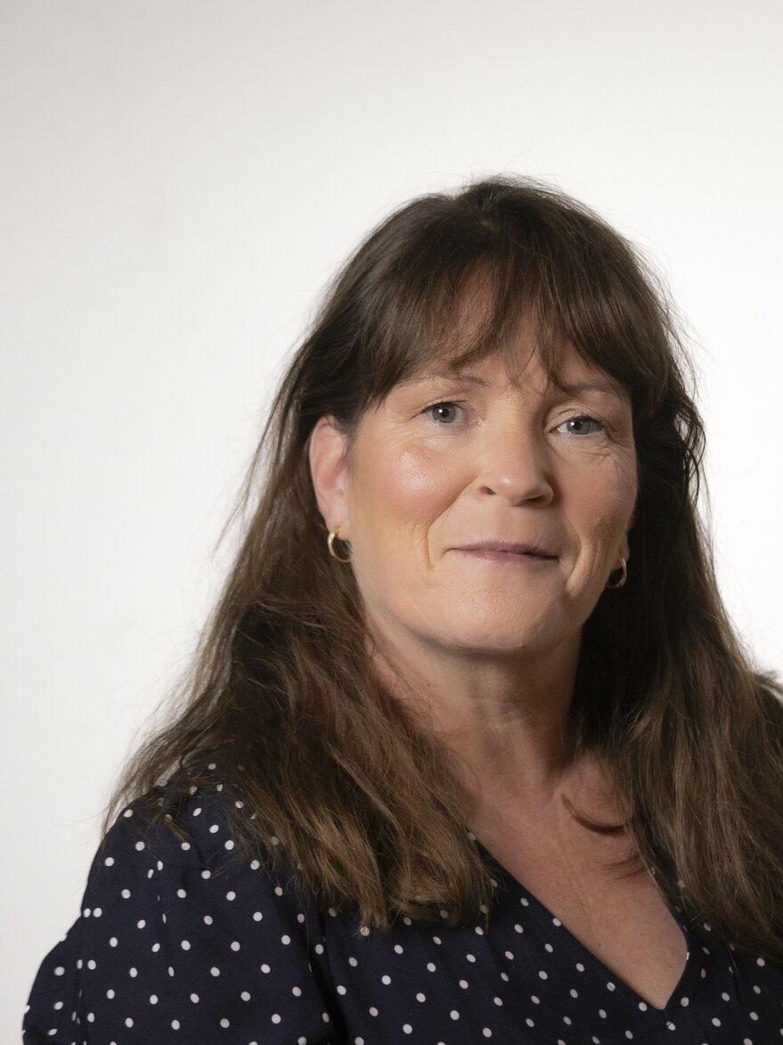
www.hologen-network.eu
  Janne Utåker. HoloGen manager.
  Trine Isaksen. HoloGen PhD-coordinator.
  Ann Kristin Øyen.
  (Kaija Hovland).
  Economy.

Slide 19

www.hologen-network.eu
HoloGen Drive
https://tinyurl.com/HoloGenDrive
Grant Agreement
Consortium Agreement
Folders
                Deliverables
                TrainingEvents
                MSCA documents
HoloGen in a nutshell

Slide 20
www.hologen-network.eu
Supervisors and secondments
WP | DC | Main supervisor | Co-supervisor | Secondment host | Month | Duration | Industry host
WP3 | DC1 | Hvidsten | Lahti | Gilbert | early 2nd year | 3 | Aluke Oy
 | DC2 | Lahti | Hvidsten | Hall | late 2nd or early 3rd year | 3 | Aluke Oy
 | DC3 | Marti-Renom | Alberdi | Hanhineva | 28-31 | 3 | Afekta
WP4 | DC4 | Faust | Pope | Hanhineva | 28-34 | 3-4 | Afekta
 | DC5 | Alberdi | Havulinna | Faust | 3rd year | 4 | Biomin
 | DC6 | Hanhineva | Sandve | Aizpurua | 1st year | 4 | ZiBA
 | DC7 | Aizpurua | Gilbert | Hanhineva | 2nd year | 3 | Afekta
WP5 | DC8 | Sandve | Hall | Alberdi |  | 3 | Cargill
 | DC9 | Pope | Hall | Marti-Renom | beginning of the second year | 4 | Norsvin
 | DC10 | Havulinna | Alberdi | Sandve | 25-28 | 4 | Genetic Analysis
 | DC11 | Hall | Lahti | Pope | 2nd year | 3 | Genetic Analysis

Slide 21
www.hologen-network.eu
Milestones
# | Title | WP | Beneficiary | Due
1 | Consortium agreement | 1 | NMBU | M2 | Oct-24
2 | Recruitment of DCs | 1 | NMBU (All) | M14 | Oct-25
4 | All recruited DCs enrolled in PhD programme | 3-5 | UTU (All) | M14 | Oct-25
8 | Project mid-term check | 1 | NMBU | M15 | Nov-25
3 | Completion of Career Development Plans | 2 | UTU (All) | M16 | Dec-25
5 | Novel hologenomics software - beta versions | 3 | CNAG (NMBU/UTU) | M23 | Jul-26
6 | Finished data generation | 4 | UCPH (KUL/ATL) | M23 | Jul-26
7 | Finished initial analysis of data | 5 | THL (NMBU/UB) | M23 | Jul-26
9 | Novel hologenomics associations discovered using novel software and new insights from HoloGen | 3-5 | All | M42 | Feb-28
10 | Hologenomics day | 6 | UB (All) | M42 | Feb-28

Slide 22
www.hologen-network.eu
WP3: Scientific deliverables
# | Title/Description | WP | Beneficiary | Level | Due
D3.1 | DC1-3: Individual Research Programmes | WP3 | CNAG (NMBU/UTU) | Public | M16 | Dec-25
D3.2 | DC1: Network analysis software: beta version in Git repo | WP3 | NMBU | Public | M23 | Jul-26
D3.3 | DC2: Latent variable software: beta version in Git repo | WP3 | UTU | Public | M23 | Jul-26
D3.4 | DC3: 3D-omics software: beta version in Git repo | WP3 | CNAG | Public | M23 | Jul-26
D3.5 | DC1-3: Novel hologenomics software v1.0 | WP3 | CNAG (NMBU/UTU) | Public | M42 | Feb-28
D3.6 | DC1-3: Secondment report | WP3 | CNAG (NMBU/UTU) | Sensitive | M48 | Aug-28
D3.7 | DC1-3: PhD thesis reports | WP3 | CNAG (NMBU/UTU) | Sensitive | M48 | Aug-28

Slide 23
www.hologen-network.eu
WP4: Scientific deliverables
# | Title/Description | Beneficiary | Level | Due
D4.1 | DC4-7: Individual Research Programmes | UCPH (KUL/ATL) | Public | M16 | Dec-25
D4.2 | DC4: Data set on microbial abundances in bioreactors connected in different network configurations | KUL | Public | M23 | Jul-26
D4.3 | DC5: Microbial metagenomic data from the captivity experiments | UCPH | Public | M23 | Jul-26
D4.4 | DC6: Multi-omics data ready for analysis | ATL | Public | M23 | Jul-26
D4.5 | DC7: Paired behavioural and hologenomic data generated | UCPH | Public | M23 | Jul-26
D4.6 | DC4: Mathematical model of microbial interactions | KUL | Public | M42 | Feb-28
D4.7 | DC5: Preprint on the impact of gut microorganisms in dietary shifts in lizards | UCPH | Public | M42 | Feb-28
D4.8 | DC6: Preprint on the impact of environment on microbes | ATL | Public | M42 | Feb-28
D4.9 | DC7: List of hologenomic associations with behaviour | UCPH | Public | M42 | Feb-28
D4.10 | DCs 4-7: Secondment report | UCPH (KUL/ATL) | Sensitive | M48 | Aug-28
D4.11 | DCs 4-7: PhD thesis reports | UCPH (KUL/ATL) | Sensitive | M48 | Aug-28

Slide 24
www.hologen-network.eu
WP5: Scientific deliverables
# | Title/Description | Beneficiary | Level | Due
D5.1 | DC8-11: Individual Research Programmes | UTU (NMBU/UB) | Public | M16 | Dec-25
D5.2 | DC8: Finish data generation of microbial genomics and feed efficiency | NMBU | Public | M23 | Jul-26
D5.3 | DC9: Preprint on analysis of hologenome reconstructions | NMBU | Public | M23 | Jul-26
D5.4 | DC10: Preprint on geographic differences in gut microbial profiles | UTU | Public | M23 | Jul-26
D5.5 | DC11: Finished analysis of PEARL data and sample selection for proteomics | UB | Sensitive | M23 | Jul-26
D5.6 | DC8-11: Lists of hologenomic associations with animal production and human health | UTU (NMBU/UB) | Public | M42 | Feb-28
D5.7 | DC8-11: Secondment report | UTU (NMBU/UB) | Sensitive | M48 | Aug-28
D5.8 | DC8-11: PhD thesis reports | UTU (NMBU/UB) | Sensitive | M48 | Aug-28

Slide 25
www.hologen-network.eu
Administrative deliverables
# | Title/Description | WP | Beneficiary | Level | Due
D1.1 | Supervisory Board of the network | WP1 | NMBU | Sensitive | M2 | Oct-24
D1.2 | Website | WP1 | NMBU | Public | M2 | Oct-24
D7.1 | Requirement no. 1: Ethics Advisor | WP7 | NMBU | Sensitive | M2 | Oct-24
D2.1 | Open online resource for training materials | WP2 | UTU | Public | M7 | Mar-25
D1.3 | Data Management Plan | WP1 | NMBU | Sensitive | M13 | Sep-25
D1.4 | Progress report | WP1 | NMBU | Sensitive | M13 | Sep-25
D6.1 | Plan for the dissemination and exploitation of results, including communication activities 1 | WP6 | UB | Sensitive | M13 | Sep-25
D2.2 | Career Development Plans | WP2 | UTU (All) | Sensitive | M16 | Dec-25
D2.3 | Mid-term training report | WP2 | UTU | Sensitive | M24 | Aug-26
D7.2 | Requirement no. 2 | WP7 | NMBU | Sensitive | M24 | Aug-26
D1.5 | Final report | WP1 | NMBU | Sensitive | M48 | Aug-28
D2.4 | Final training report | WP2 | UTU | Sensitive | M48 | Aug-28
D6.2 | Plan for the dissemination and exploitation of results, including communication activities 2 | WP6 | UB | Sensitive | M48 | Aug-28
D7.3 | Requirement no. 3 | WP7 | NMBU | Sensitive | M48 | Aug-28

Slide 26
www.hologen-network.eu
Training and networking events
Main training events and conferences | ECTS | Leader | Month | Time
Training and Networking Retreat 1: Introduction | 2 | UCPH | 7 | May-25
Training and Networking Retreat 2: High-Throughput Profiling | 2 | CNAG | 13 | Nov-25
Training and Networking Retreat 3: Data analysis and Open Science | 2 | UTU | 20 | Apr-26
Training and Networking Retreat 4: Dissemination, Exploitation and Communication | 2 | KUL | 26 | Oct-26
Training and Networking Retreat 5: Career Development | 2 | NMBU | 33 | May-27
Hologenomics Conference | 2 | UCPH | 36 | Aug-27
Hologenomics Day | 1 | UB | 42 | Feb-28
Final meeting: presentation of results and future prospects | 2 | UB | 42 | Feb-28

Slide 27
www.hologen-network.org
Advancing the development and implementation of hologenomics in biological sciences
Funded by the European Union under Grant Agreement 101169005

Slide 28
www.hologen-network.eu
Recruitment strategy
The following hiring procedure was used and is an adjustment from the procedure detailed in the Grant agreement.
Requirement procedure:
Each main supervisor must write announcements according to their institution’s templates and rules, advertise and collect applications through their institution’s normal system for hiring and also conduct the recruitment process according to their institution’s rules.
We will promote the positions through the HoloGen website and social media profiles. At the website, this will mean a description of the position and then a link to the announcement at the host institution (where applicants can submit applications).
Share the announcement text with the Supervisory board (SB) before posting to get feedback.
Involve at least the co-supervisor and the secondment host in the hiring process (interviews, selection, etc). See page 10-13 in the Grant agreement.
Make sure to encourage good candidates that are not selected to apply for some of the other positions (and if you are allowed by your host institution, circulate the CVs of the best candidates in the SB).
Include a description of HoloGen in the announcement.
Make sure that you include the MSCA mobility rule in the announcement: Applicants must not have resided or carried out their main activity (e.g., studies, work, research) in [Norway/Finland/…] for more than 12 months in the 3 years immediately prior to the call deadline.

Slide 29
www.hologen-network.eu
Recruitment strategy
DC | Name | Beneficiary | Where Advertized | Applications |  |  | Mobility Rule
 |  |  |  | No. | Country | Gender
DC1 | Veronica Quarato | NMBU | JobbNorge | 161 | EU: 15 Non-EU: 146 | Men: 86 Women: 74 Unknown: 1 | Y
DC9 | Aikaterini Katirtzoglou
DC2 | Sneha Das | UTU | EURAXESS, Academic positions, University of Turku website | 82 | EU: 3 Non-EU: 79 | Men: 48 Women: 34 | Y
DC3 | Zoé Melanie Horisberger | CNAG | EURAXESS, company webpage, LinkedIn | 18 | EU: 10 Non-EU: 8 | Men: 8 Women: 10 | Y
DC4 | Adedamola Godwin Daodu | KUL | KU Leuven job portal, EURAXESS, Belgian Society for Microbiology career board, LinkedIn | 135 | EU: 54 Non-EU: 81 | Not recorded | Y
DC5 | Lucas Padilha | UCPH | UCPH Job Portal, EURAXESS, LinkedIn, www.jobnet.dk, Work in Denmark | 93 | EU: 14 Non-EU: 79 | NA | Y
DC6 | Anh Vu Nguyen | ATL | EURAXESS, company webpage, LinkedIn | 70 | EU: 18 non-EU: 52 | Not recorded | Y
DC7 | Elsa Brenner | UCPH | UCPH Job Portal, EURAXESS, LinkedIn, www.jobnet.dk, Work in Denmark | 74 | EU:18 Non-EU:56 | Men: 44 Women: 30 | Y
DC8 | Emmanuel Okoli Odah | NMBU | JobbNorge | 42 | EU:7 Non-EU: 35 | Men: 26 Women: 16 | Y
DC10 | Joao Casucci dos Santos | UTU | EURAXESS, Academic positions, University of Turku website | 82 | EU: 3 Non-EU: 79 | Men: 48 Women: 34 | Y
DC11 | Chujun Zhang | AC UK | FindaPhD.com, LinkedIn and BlueSky | 27 | EU:3 Non-EU:24 | Men:17 Women: 10 | Y
Selection criteria and scoring system: Each announcement contained a set of well defined requirements, tailored to the specific projects. The candidates were first filtered according to these (Qualified) and then ranked according to how well these requirements were met.

Slide 30
www.hologen-network.eu
Training and Networking Retreat 1: Summary!
Copenhagen: May
Platform for communication between meetings: Discord
Journal club
…
Supervisory board meeting
Economy/Budget
Harmonisation of supervision
Upcoming deliverables/milestones
Student representatives on the supervisory board: Emmanuel and Elsa
Agreed on next meeting: Barcelona, November 10-14
ECTSs for retreats: diploma and course descriptions

