Slide 1
Metabolomics analytics in the study of the molecular fingerprint of gut microbiota
HoloGen symposium, Copenhagen, May 6th 2025
Prof Kati Hanhineva, Afekta Technologies, CoB
Food Sciences unit, Department of Life Technologies, University of Turku
Clinical Nutrition, School of Medicine, University of Eastern Finland, Kuopio

Slide 2
Content
Introduction to metabolomics
Case study of importance of gut microbiota-derived metabolites
Preliminary data in Hologenomics context

Slide 3
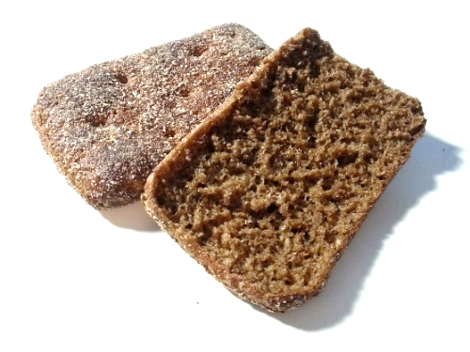
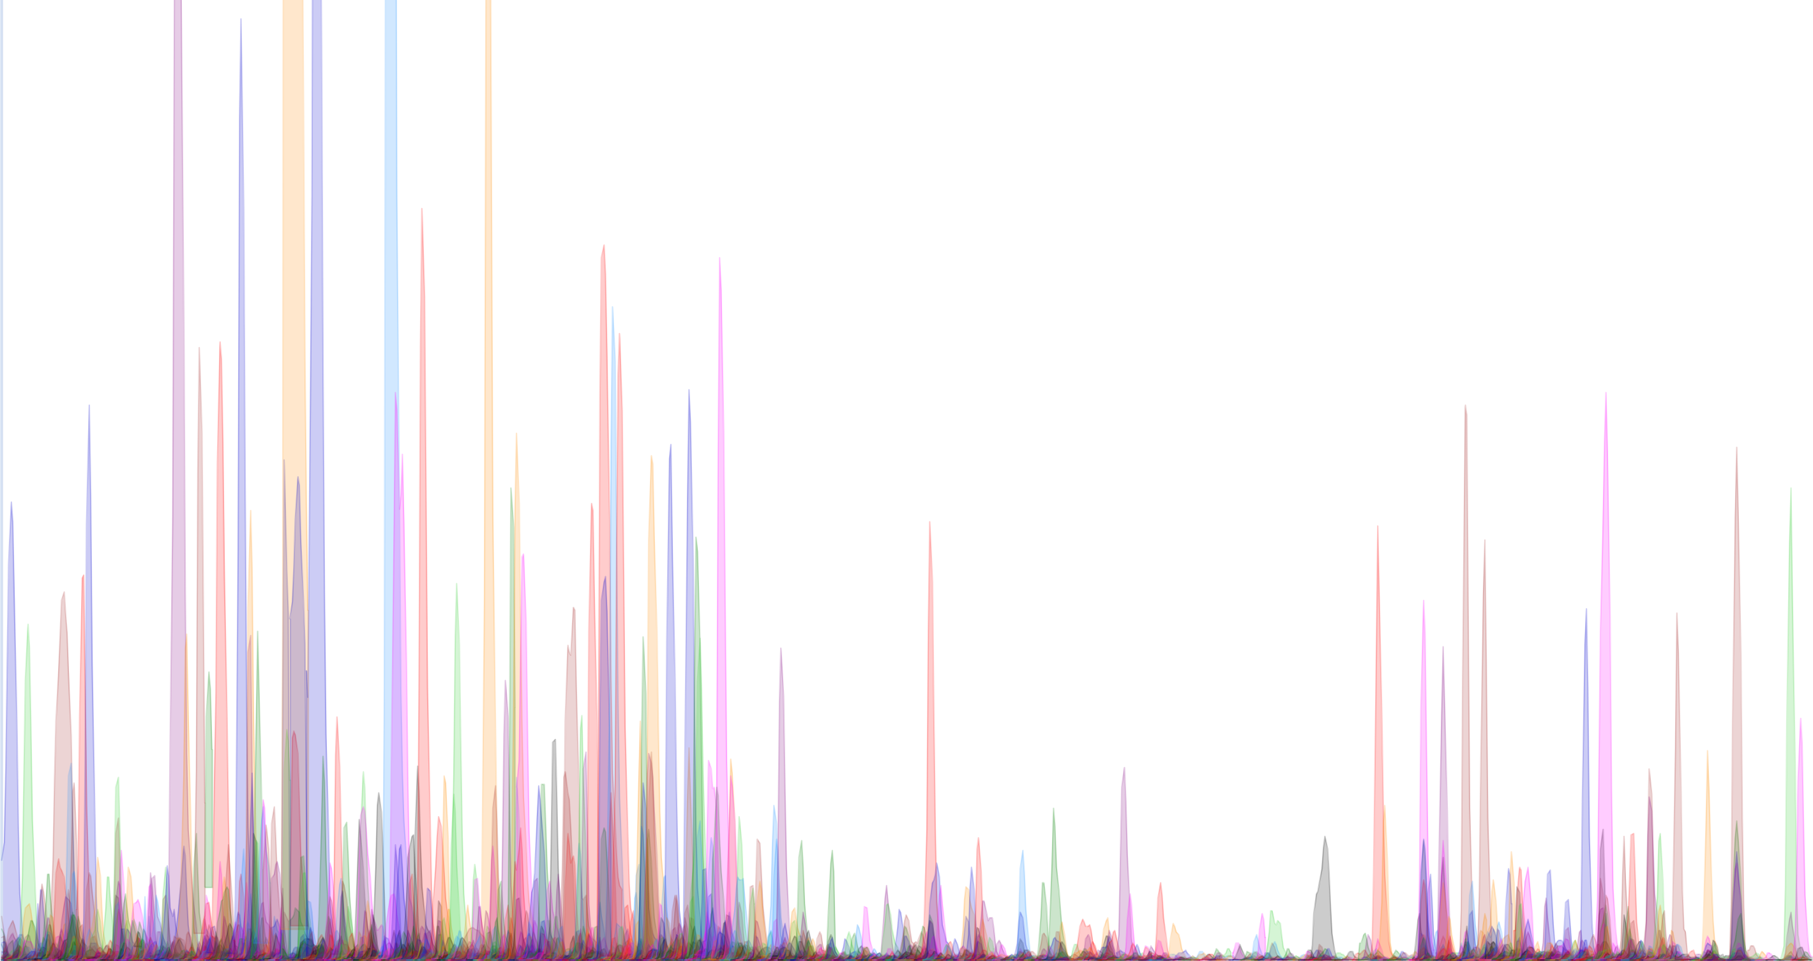
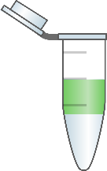
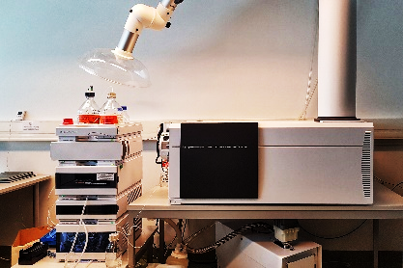
Metabolomics is a powerful tool in life sciences research
H
O
O
H
O
H
O
O
O
O
H
O
O
H
H
O
O
H
O
O
H
The study of all the metabolites produced by a cell, tissue, or whole organism
In food science and nutrition, it is a tool to study the metabolite composition of foods or the impact of nutrition on our metabolism, including the metabolic effect of gut microbiota
H
O
O
O
H
O
H
H
O
O
O
O
H
O
N
+
O
-
O
H
O
N
O
O
O
H
H
O
O
H
H
O
H
O
O
H
O
O
H
O
O
H
O
H
O
Non-targeted metabolite profiling
Collection of all the measurable signals in the sample
Generic sample preparation aiming at extracting as many compounds as possible
Semi-quantitative between control and treatment
Without focused pre-hypothesis
Enables novel, unexpected findings

Slide 4
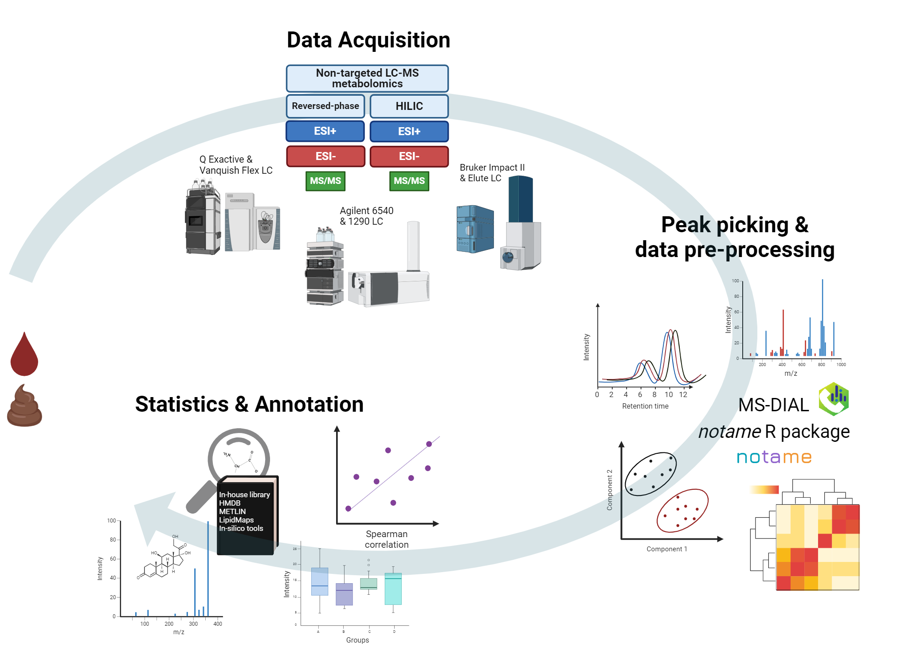
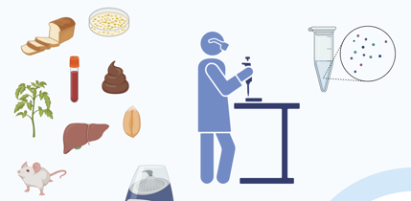
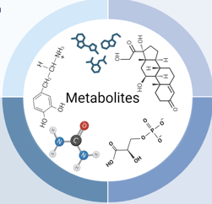
Workflow in non-targeted LC-MS metabolite profiling
Producing the experimental material
Sample preparation
Liquid chromatography–mass spectrometry analysis
Peak picking
Data preprocessing
Statistical analysis
Metabolite identification
Interpretation of the results

Slide 5




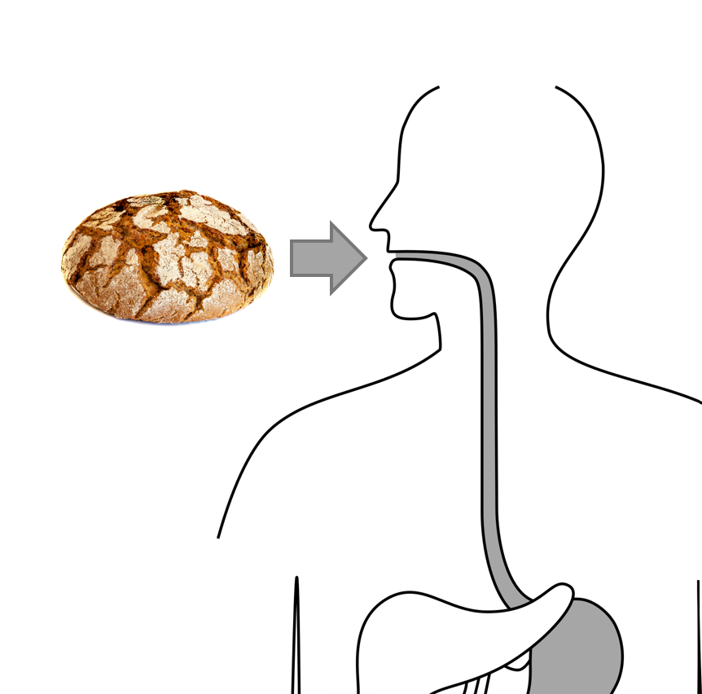
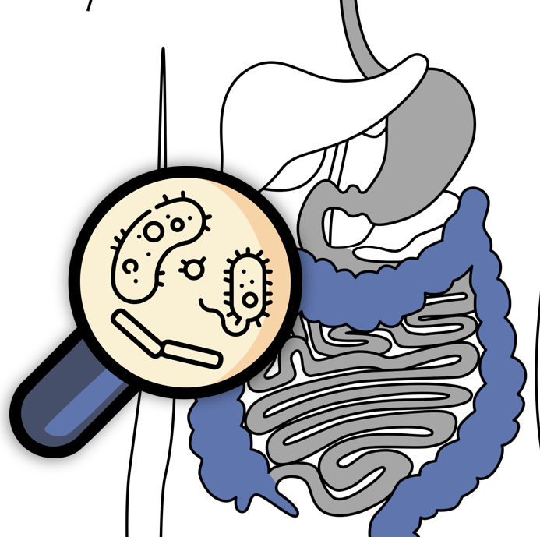
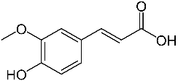
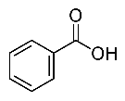
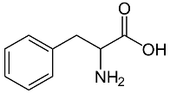
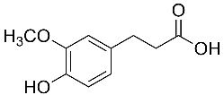

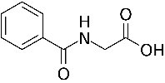
Metabolism of whole grain phytochemicals – from farm to fork and beyond
Malting
Brewing
A
D
M
E
De novo
synthesis
Harvesting
Grain milling
Processing
Sourdough
fermentation
Baking
Mastication
Stomach
Small intestine
Colonic
fermentation
Absorption
Distribution
Host
metabolism
Excretion
Shikimate pathway
Ferulic
acid
Ferulic
acid
Benzoic acid
Phenyl-
alanine
Liver enzymes
Dihydro-
ferulic
acid
DFA
3-(3-Hydroxyphenyl)-
propionic acid
Hippuric
acid
Ferulic
acid
Benzoic acid
Notes:
This is roughly what happens to whole grains on their joyrney from farm to fork and all the way to being digested. Highlighted are those steps where metabolism mostly happens for phytochemicals. Below is an example of one of the main phytochemicals found in whole grains, ferulic acid, and a simplified pathway how it’s metabolized in the different steps. In plants, the shikimate pathway is an important pathway for producing of polyphenols. The next potential metabolism happens in sourdough fermentation, where the lactic acid bacteria perform basic transformations. But the main site of bacterial metabolism is the colon, where a lot more can happen because of the wide variety of highly specialized bacteria. As a consequence, several different compounds are being absorbed into our body, some directly from whole grains and some metabolized on the way, and all of them can be bioactive.

Slide 6
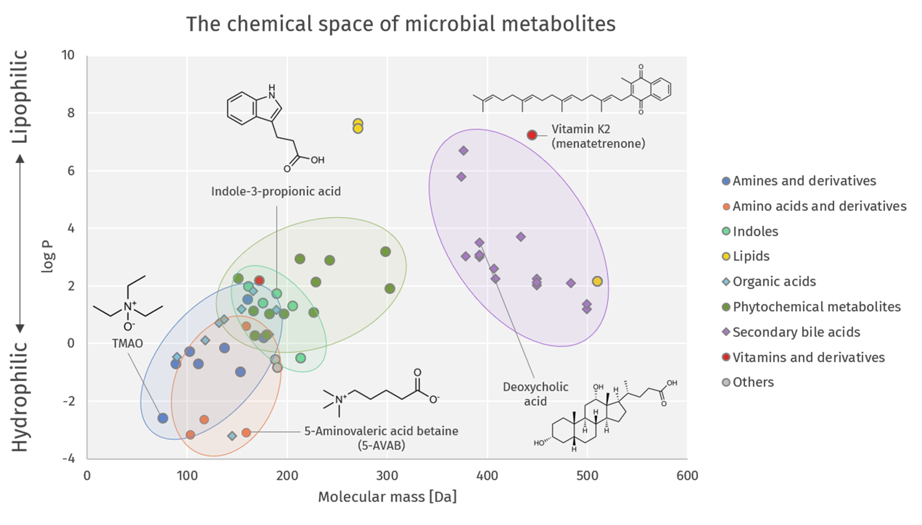
”Microbolome” Compehensive microbial metabolite analysis

Slide 7
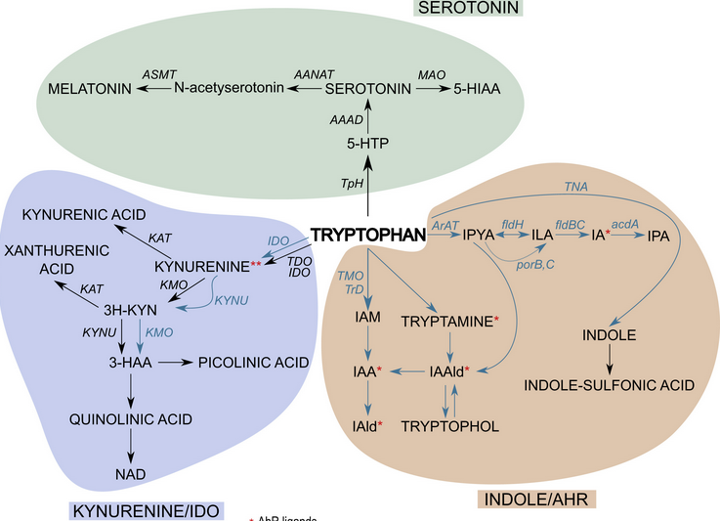
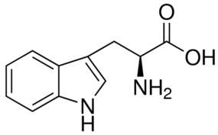
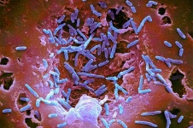
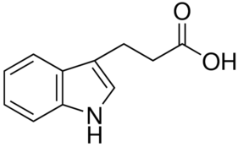
Indolepropionic acid (IPA)
Produced from dietary tryptophan by the colonic microbiota
Tryptophan is an essential amino acid that plays critical roles in human nutrition and metabolism
Dietary tryptophan is predominantly catabolized through the endogenous kynurenine pathway
The portion that is not absorbed can be used by the gut microbiota to produce indole or other derivatives, incl IPA
Minor fraction goes for serotonin production in the gut cell walls
IPA associated with various health benefits, indole with adverse impact
Agus et al (2018) Cell Host Microbe 23:716-724

Slide 8
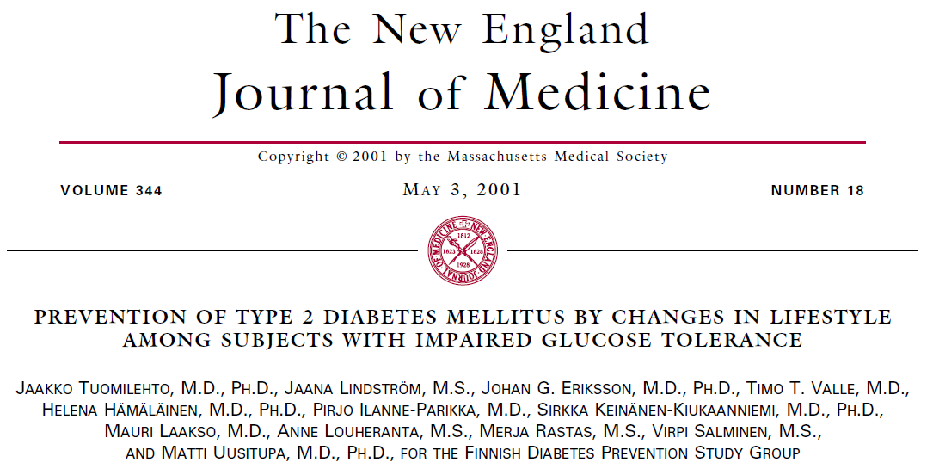

Finnish Diabetes Prevention Study:
assessment of early biomarkers for Type 2 Diabetes
265 intervention group
Individualized dietary counseling from a nutritionist
Circuit-type resistance training sessions
Advised to increase overall physical activity
Impaired glucose tolerance
257 control group
Non-targeted LC-MS metabolomics on the samples taken at year 1 after onset of the study
200 studied
96 diabetes cases
20, year 1
27, year 2
16, year 3
15, year 4
18, year 5
104 non-diabetes cases
48, year 12
31, year 13
24, year 14
1, year 15
Dr. Vanessa de Mello Laaksonen, Prof Matti Uusitupa

Slide 9
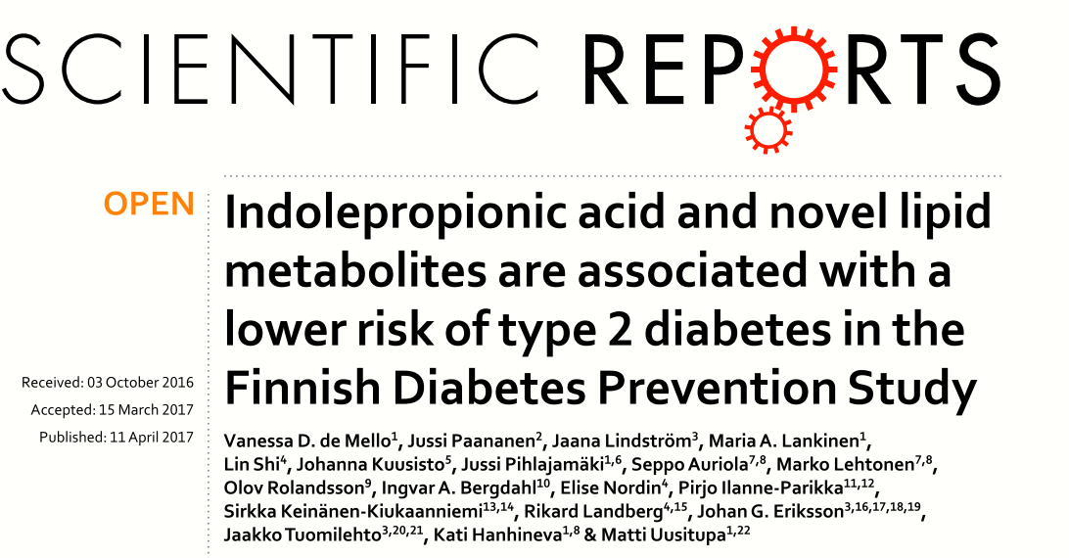
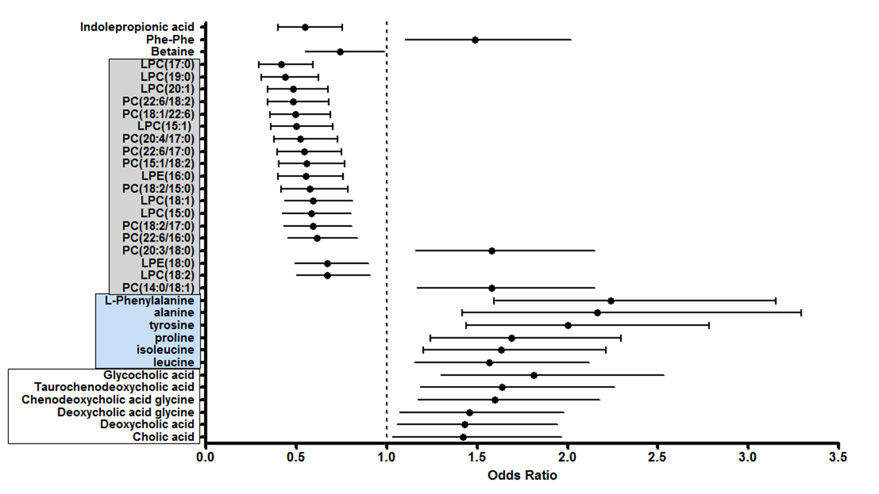
Identified metabolites and their association with the development of T2D

Slide 10
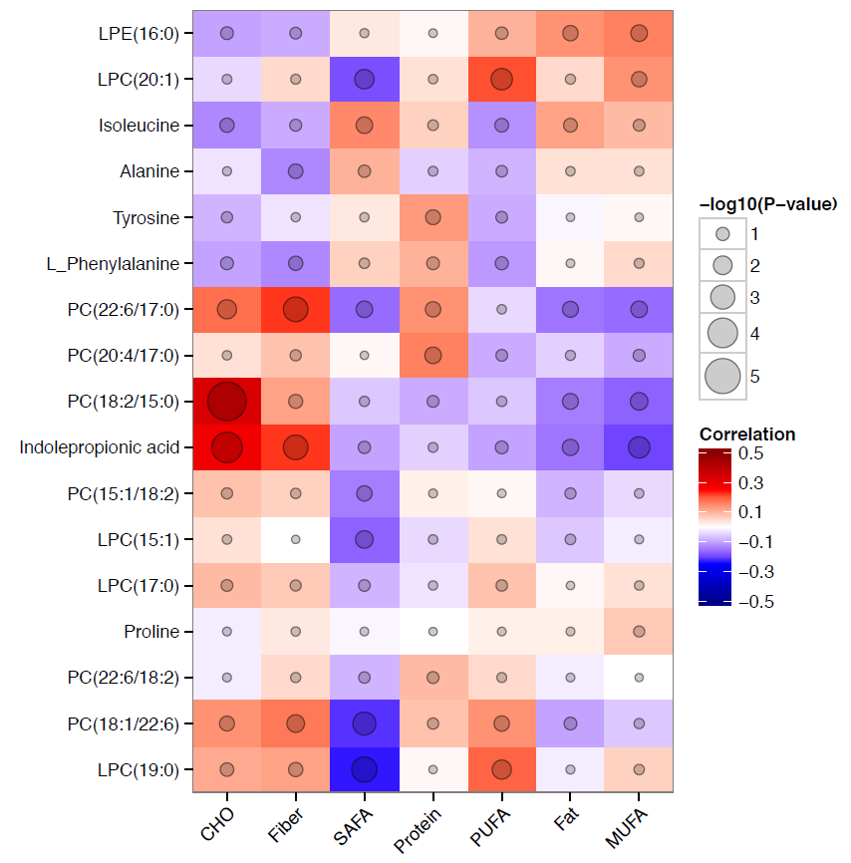
Correlations between metabolites and dietary components

Slide 11
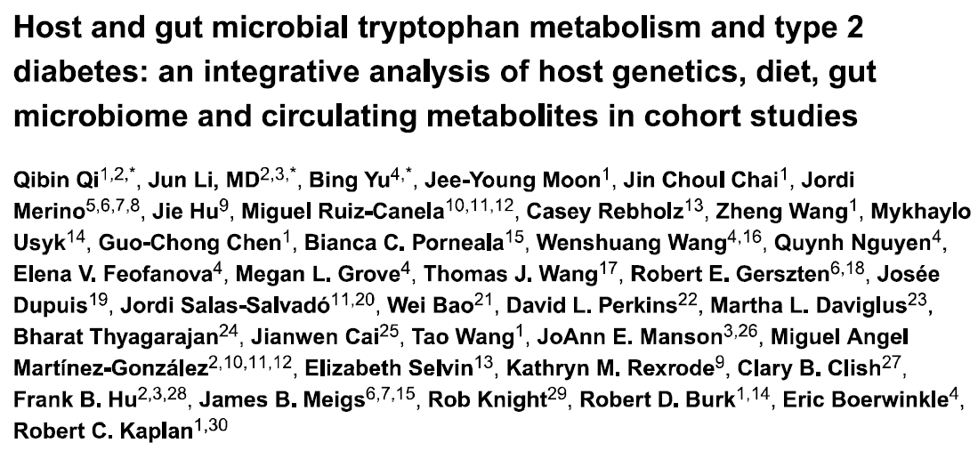
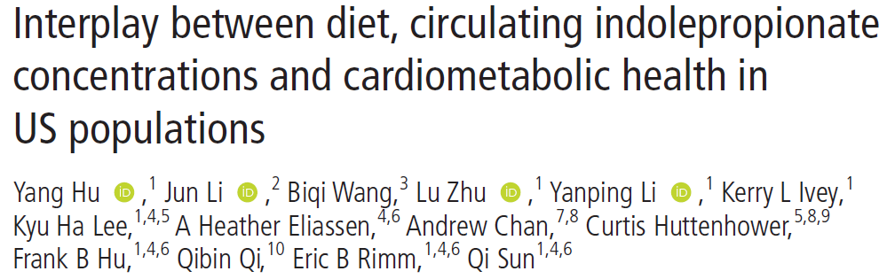
IPA has inverse association with T2D risk in epidemiological cohorts in USA
IPA inversely associated with T2D risk
Tryptophan and kynurenine-pathway metabolites were positively associated with T2D risk
Intakes of fibre-rich foods, but not protein/tryptophan-rich foods, were most strongly associated with IPA
Association between higher tryptophan intake and higher IPA concentrations was only observed among men who had higher fibre intake and a higher microbial diversity score
The fibre-indolepropionate association was partially explained by IPA-associated gut bacteria, like Firmicutes.
Hu et al (2023) Gut, 0:1-12
Qi et al (2022) Gut, 71:1095-1105
Notes:
1 Interestingly, the host and microbial tryptophan
catabolites appear to manifest divergent
associations with human health. While the increased
level of KP catabolites such as kynurenine has been
implicated in the development of cardiometabolic
diseases,2 3 higher circulating concentrations of
microbial tryptophan metabolites, most notably the indolepropionate (IPA), is associated with a lower risk of type
2 diabetes (T2D).4 5 Since dietary tryptophan is the only source
of tryptophan that can be converted to IPA, the gut microbiota
profiles are likely to play a pivotal role in modulating the IPA
production.

Slide 12
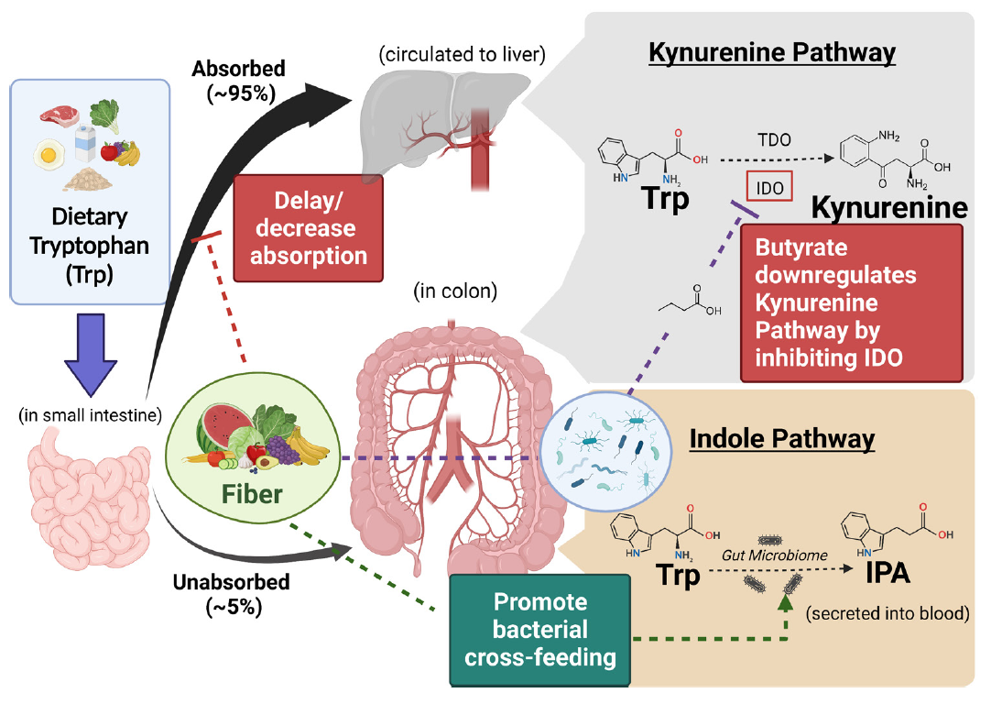
Hight consumption of tryptophan does not directly relate with higher IPA production, only if ingested with high fiber content and with specific microbiota
Having dietary tryptophan from fibre-rich sources may promote beneficial tryptophan metabolism
Hu et al (2023) Gut, 0:1-12
Notes:
Specific microbial species and dietary
fibre jointly predicted significantly higher circulating IPA
concentrations at higher tryptophan intake. Dietary and
plasma tryptophan, as well as its kynurenine pathway
metabolites, demonstrated divergent associations from
those for IPA, which was significantly predictive of lower
risk of T2D.
higher fibre intake were associated with a favourable profile of circulating tryptophan metabolites for T2D, potentially through the host-microbial cross-talk shifting tryptophan metabolism toward gut microbial indolepropionate production.

Slide 13
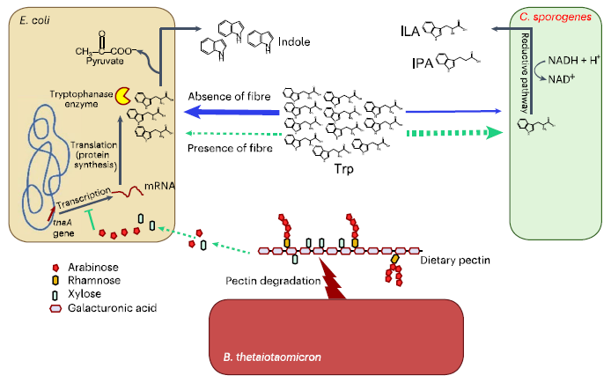
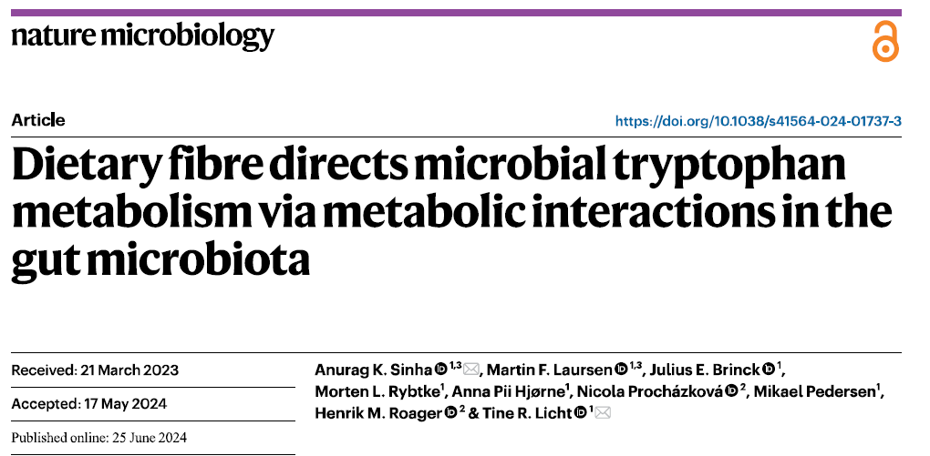
Gut microbial competition for tryptophan:
  indole (associated with chronic kidney disease) vs. indolelactic acid (ILA) and indolepropionic acid (IPA) (associated with various beneficial health effects)
Three gut bacteria involved:
  Fibre-degrading Bacteroides thetaiotaomicron affected the competition by cross-feeding monosaccharides to Eschericia coli
  Inhibition of indole production through catabolite repression
  More tryptophan available to Clostridium sporogenes, resulting in increased ILA and IPA production

Slide 14
Conclusions
Diet has massive impact on circulating metabolite composition
Affected by gut microbiota and endogenous metabolism
Dietary nutrient composition alone does not govern the metabolic effect, but how and which source the nutrients come from make the difference
Careful metabolomics examination enables detailed study on the metabolic fluctuations inside a certain compound class, that may tell us the actual metabolic- and hence health – relevance
Indolepropionic acid is one of the key microbiota-derived compounds increased with intake of whole grains with demonstrated health-protective role

Slide 15

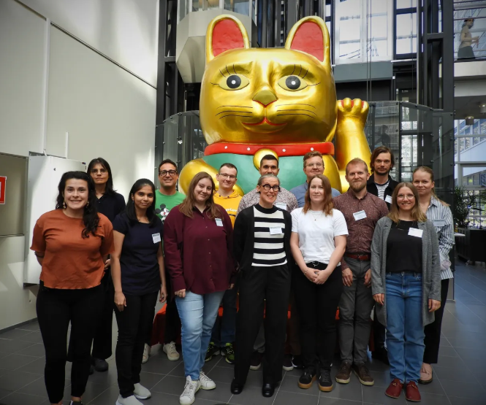











ACKNOWLEDGMENTS
Afekta Technologies
Olli Kärkkäinen
Topi Meuronen
Soile Rummukainen
Dennisse Avella
Atte Lihtamo
University of Turku, Finland
Ville Koistinen
Topi Meuronen
Hany Ahmed
Jasmin Raita
Sara Ferreira Rocha
Artur Sannikov
Shania Saini
University of Eastern Finland
Ville Koistinen
Iman Zarei
Marjo Tuomainen
Retu Haikonen
Ambrin Babu
Collaborators
University of Eastern Finland
University of Helsinki, Finland
Senson, Viking Malt, Finland
Chalmers University of Technology, Sweden
Umeå Universitetet, Sweden
Wageningen University & Research, Wageningen, Netherlands
Federico II University of Naples, Naples, Italy
VTT Technical Research Centre of Finland Ltd, Espoo, Finland
Montpellier SupAgro-INRA, Montpellier, France
Newcastle University, UK
IARC, France
https://hanhinevalab.com/

