Slide 1


TRAINING AND NETWORKING RETREAT 3
HoloGen in Turku
University of Turku · Finland
26 – 29 May 2026
Leo Lahti
Funded by the European Union under Grant Agreement 101169005 www.hologen-network.eu
Department of Computing · University of Turku
Notes:
Welcome everyone to Training and Networking Retreat 3 — Data analysis and Open Science — here in Turku, May 26 to 29. I'm Leo Lahti from the Department of Computing at the University of Turku, and I'll spend the next fifteen minutes orienting us: where we are in the program, what we'll do this week, and the practical bits you need to know.

Slide 2
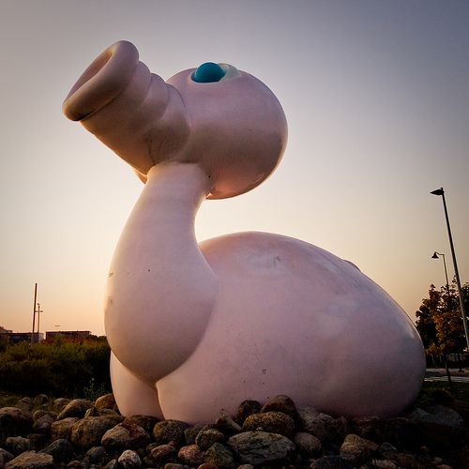
LOCAL LANDMARK
Posankka
Half pig, half rubber duck — the bright pink campus sculpture by Alvar Gullichsen, a Turku student-life icon since 1999.
TERVETULOA
Data analysis and Open Science.
Four days at the University of Turku — the oldest city in Finland, on the south-west coast where the Aura river meets the Baltic archipelago. We close the week in Helsinki at the Finnish Bioinformatics Days.
atlasobscura.com/places/posankka
www.hologen-network.eu
26 – 29 May 2026 · UTU
Notes:
Welcome to Turku — Finland's oldest city, on the south-west coast, with the Aura river running through the centre and the archipelago at the doorstep. Late May is the lightest time of year here. Note the structure: three days at Medisiina D in Turku, then we close the week together in Helsinki at the Finnish Bioinformatics Days at CSC.

Slide 3
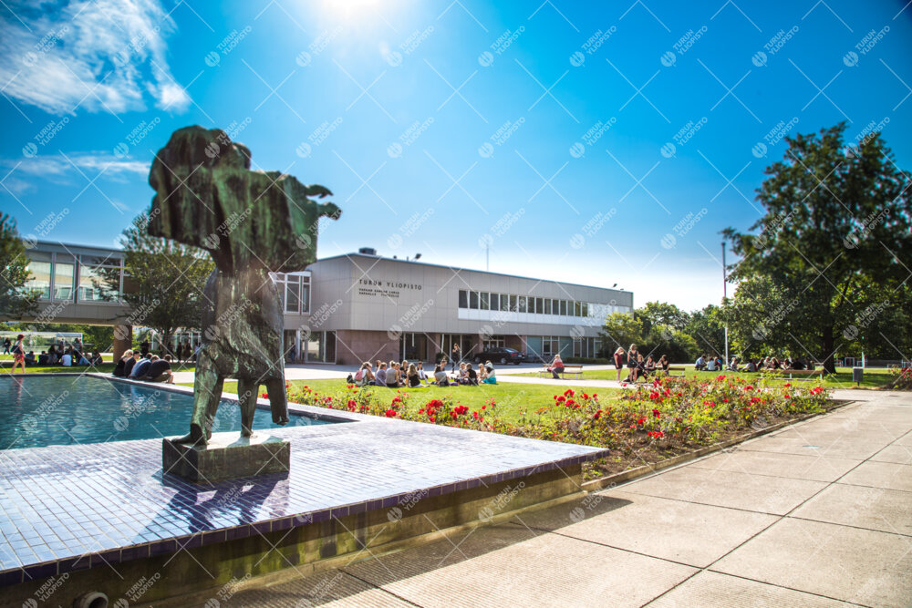
OUR HOST THIS WEEK
University of Turku.
Re-founded in 1920 by Finnish citizens — the first Finnish-language university. Today a research-intensive institution of ~20,000 students across seven faculties.
A SHORT HISTORY
1640
Royal Academy of Turku founded under Queen Christina of Sweden — Finland's first university.
1827
Great Fire of Turku; Academy moves to Helsinki the next year.
1920
University of Turku re-founded by private donations — the first Finnish-language university.
Today
Seven faculties · ~20k students · home to Medisiina D, our venue this week.
Yliopistonmäki
Kuvaaja: Hanna Oksanen
www.hologen-network.eu
utu.fi
Notes:
Our host this week is the University of Turku. Re-founded in 1920 by donations from Finnish citizens — it was the first Finnish-language university, after the original Royal Academy of Turku moved to Helsinki in 1828 following the Great Fire. Today it's a research-intensive institution of around twenty thousand students across seven faculties. We're here as guests of the Department of Computing and Medisiina D.

Slide 4
PROGRAM AT A GLANCE
Four days, one consortium.
TUESDAY
WEDNESDAY
THURSDAY
FRIDAY
26 May
27 May
28 May
29 May
13:00Lunch & meet at lobby
09:00DC 6–11 presentations
09:00 Lecture: Methods for studying host-microbiota interactions — Karoline Faust, KUL
09:00Bioinformatics Days
14:00Welcome & introduction
12:00 DC secondment & collaboration discussions
CSC · Helsinki
14:30DC 1–5 presentations
17:00Day close
17:00Supervisory Board
14:00 Comms & storyboarding — Lindsay Hall, UB
10:30DC interaction & planning
18:00Optional evening
19:00
Dinner
Sign up!
16:00 Data management — Susanna Repo, ELIXIR
12:30Wrap-up
tinyurl.com/hologen-events
13:00Move to Helsinki
18:00DC social event
Any questions on the program?
www.hologen-network.eu
Medisiina D · Kiinamyllynkatu 10 D · Turku
Notes:
Here's the four days at a glance. Tuesday afternoon kicks off with the welcome and the first DC presentations. Wednesday is the dense day — second DC round, then Lindsay's communications session and Susanna Repo from ELIXIR on data management. Thursday morning is Karoline's lecture and the wrap-up, then we travel to Helsinki. Friday is Finnish Bioinformatics Days at CSC.

Slide 5
DAY 1 — TUESDAY 26 MAY
Welcome & first DC round.
AFTERNOON
LATE AFTERNOON & EVENING
13:00
Lunch (optional) at university restaurant
17:00
Supervisory Board meeting
Meet at the Medisiina D lobby at 13:00
PIs, associated partners, DC reps · chair: Torgeir, NMBU
14:00
Welcome & introduction
17:00
DC collaboration discussions
Leo Lahti, UTU
In parallel with Supervisory Board
14:30
DC 1–3 (WP3) presentations
19:00
Dinner
Ongoing work, 15 + 5 min · chair: Marc, CNAG
16:00
DC 4–5 (WP4) presentations
Ongoing work, 15 + 5 min · chair: Ostaizka, UCPH
www.hologen-network.eu
Skooppi 1+2, Medisiina D · 13–18
Notes:
Tuesday — we start at lunch. Meet at the Medisiina D lobby at one o'clock; lunch is optional at the university restaurant. Welcome and introduction at two, then DC 1 to 3 from WP3 chaired by Marc, and DC 4 to 5 from WP4 chaired by Ostaizka. At five the PIs and associated partners go into the Supervisory Board meeting; DCs in parallel run collaboration discussions. Dinner at seven.

Slide 6
DAY 2 — WEDNESDAY 27 MAY
DC round, comms, data management.
MORNING
AFTERNOON & EVENING
09:00
DC 6–7 (WP4) presentations
14:00
Communication activities & storyboarding
15 + 5 min · chair: Ostaizka, UCPH
Lindsay, UB
10:00
DC 8–11 (WP5) presentations
16:00
Data management & database resources in life sciences
15 + 5 min · chair: Aki, UTU
Susanna Repo, ELIXIR
12:00
PhD topics, secondments & collaborations
18:00
Social event
Each DC with relevant host & collaborator team
Organised by the DCs · until 23:00
13:00
Lunch
www.hologen-network.eu
Upokas, Medisiina D · 9–14
Notes:
Wednesday is the densest day. We finish the DC round in the morning — DC 6 to 7 with Ostaizka, then DC 8 to 11 with Aki. At noon each DC sits down with their host and collaborator team to plan secondments and collaborations. After lunch, Lindsay leads communication activities and storyboarding, then Susanna Repo from ELIXIR on data management and database resources in life sciences. Evening is the DC-organised social event.

Slide 7
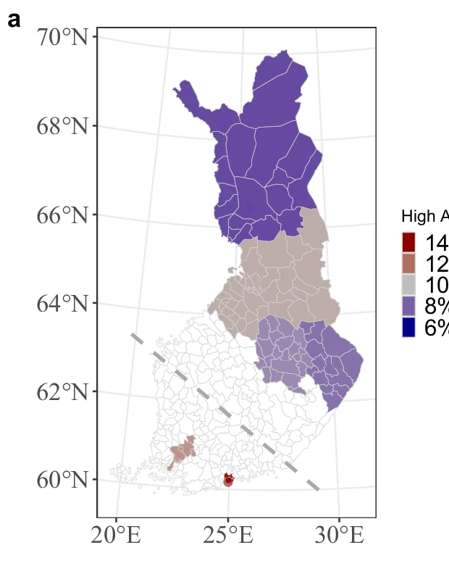
DAY 3 — THURSDAY 28 MAY
Lecture, wrap-up, move to Helsinki.
MORNING
Turku → Helsinki
09:00
Lecture — Methods for studying host-microbiota interactions
~165 km · ~2 h by train
Karoline Faust, KUL
10:30
DC interaction — secondments & collaborative problem-solving
Workflows, plans within WPs · chair: Leo, UTU
12:30
Wrap-up & close of the Turku retreat
AFTERNOON
13:00
Lunch
13:00–17:00
Move to Helsinki for the Bioinformatics Day
Train recommended · ~2 h Turku → Helsinki
Turku
Helsinki
Pärnänen et al., Nat. Commun. (2025)
www.hologen-network.eu
Upokas, Medisiina D · 9–17
Notes:
Thursday morning, Karoline opens with a lecture on methods for studying host-microbiota interactions. Then we continue the DC interaction — secondments, workflows, collaborative problem-solving within WPs; each DC summarises their plan. Wrap-up at half past twelve, lunch, and from one o'clock we move to Helsinki — the train takes about two hours.

Slide 8
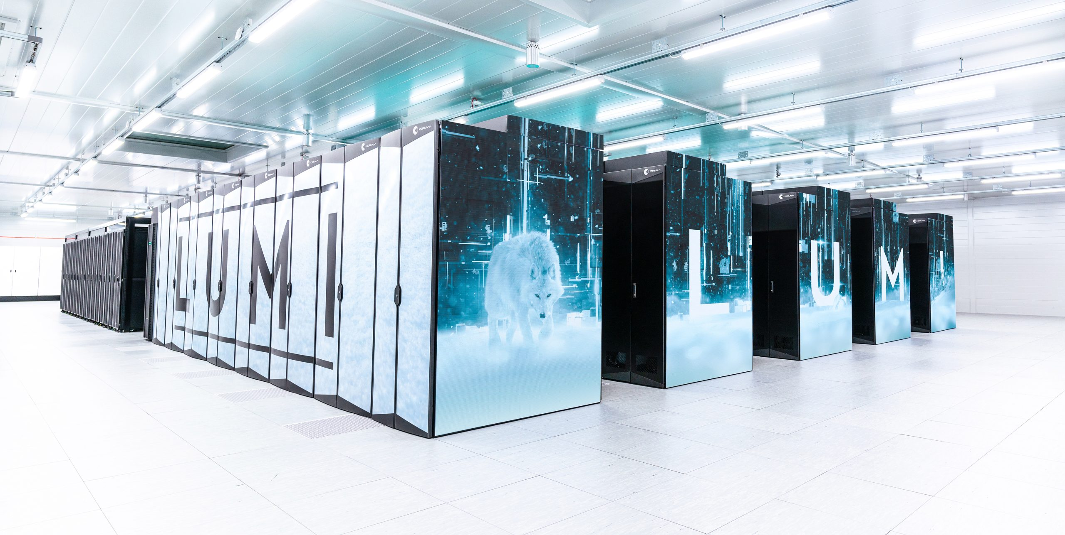
DAY 4 — FRIDAY 29 MAY · HELSINKI
Finnish Bioinformatics Days at CSC.
DAY PROGRAMME
09:00–17:00
Finnish Bioinformatics Days
CSC, Helsinki · Leo, UTU · bioinf.fi
EVENING
18:00–24:00
Optional evening program
© CSC — IT Center for Science
DCs continuing Friday onward in Helsinki
OUR FRIDAY HOST
CSC
— IT Center for Science
Finland's national centre for high-performance computing and research IT — home to LUMI, the EuroHPC pre-exascale supercomputer in Kajaani, among Europe's most powerful and 100% hydro-powered.
www.hologen-network.eu
CSC, Helsinki · csc.fi · lumi-supercomputer.eu
Notes:
Friday in Helsinki — we head to CSC, Finland's IT Center for Science, the national high-performance computing centre. CSC hosts LUMI, the EuroHPC pre-exascale supercomputer in Kajaani — one of the most powerful systems in Europe and a real resource for HoloGen down the line. The day itself is Finnish Bioinformatics Days, nine to five. Optional evening program after, for those continuing into the weekend.

Slide 9
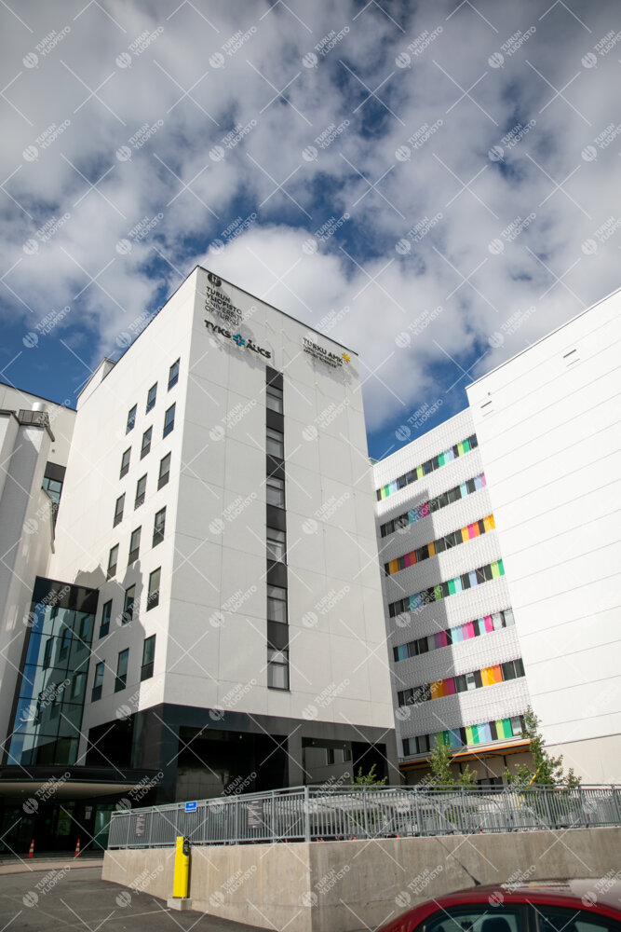
PRACTICAL INFO
Venue, travel, who to call.
GETTING HERE
ON-SITE CONTACTS
Helsinki often easier by air
Sneha Das · sneha.s.das@utu.fi
Bus or train onward to Turku, ~2 h
WhatsApp +91 87770 23913
FRIDAY
JP · WhatsApp +44 9314 186
Kuvaaja: Suvi Harvisalo
Travel together to CSC, Helsinki for the Finnish Bioinformatics Days
Leo · +358 50 436 4626
VENUE
Medisiina D building Turku University Hospital
Kiinamyllynkatu 10 D, Turku
ROOMS
Tue · Skooppi 1+2
Wed – Thu · Upokas
www.hologen-network.eu
utu.fi/en/how-to-get-to-turku-move-around-in-the-city
Notes:
Practical points. The venue is Medisiina D at the Turku University Hospital site — Kiinamyllynkatu 10 D. Tuesday is in Skooppi 1+2, Wednesday and Thursday in Upokas. Recommended hotels are Sokos Kupittaa or Holiday Club Caribia, both close. If your flight goes via Helsinki, the bus or train onward is about two hours. On-site contacts: Sneha, JP, and me. Numbers on the slide.

Slide 10
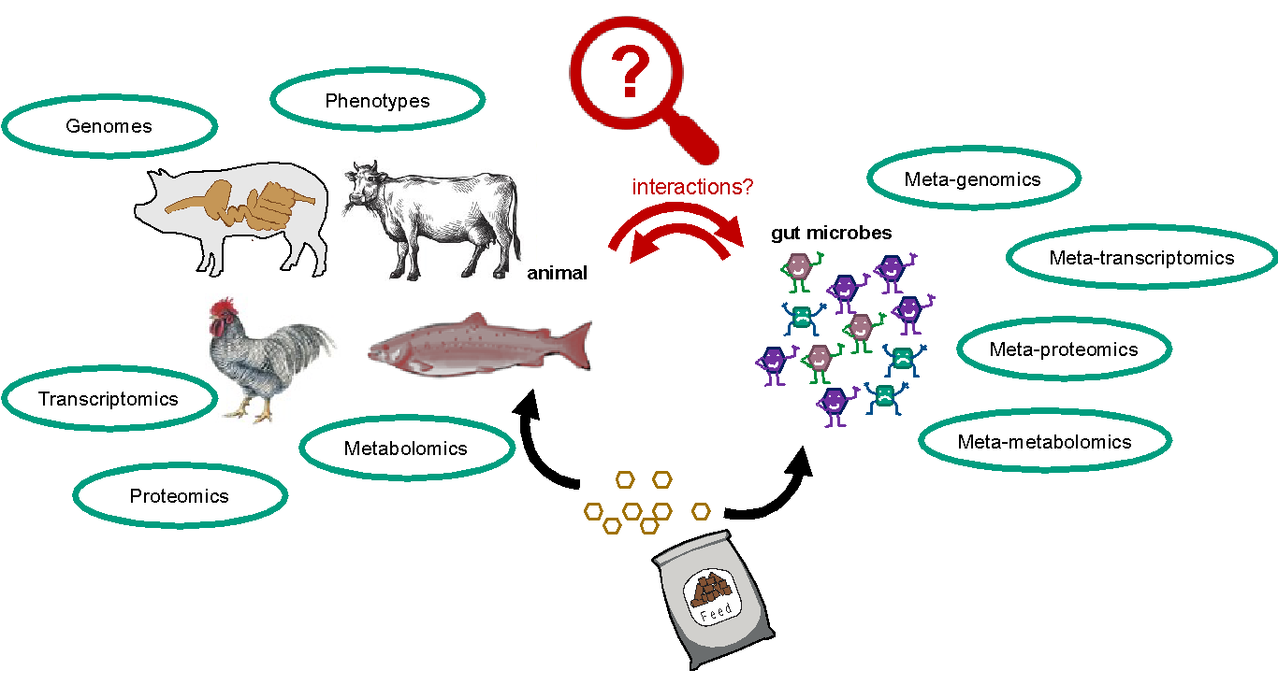
RECAP
HoloGen in a nutshell.
An MSCA Doctoral Network
Hologenomics
The MSCAs are the European Union's flagship programme for doctoral education and postdoctoral training — built around excellence, mobility, supervision, career guidance, and open science.
HoloGen brings together academic and non-academic partners to train the next generation of hologenomics scientists.
11
9
48
DOCTORAL CANDIDATES
BENEFICIARIES
MONTHS
The integrated study of host and microbiome — genomic, transcriptomic, proteomic and metabolomic data, paired with meta-omics of gut microbes, to detect interactions and their biological impact.
www.hologen-network.eu
Background
Notes:
Quick recap of what HoloGen is, mostly for our non-academic and industry partners joining for parts of the week. HoloGen is an MSCA Doctoral Network — eleven doctoral candidates across nine countries, training the next generation of hologenomics scientists.

Slide 11
OBJECTIVES
Strategic, research, training.
STRATEGIC
RESEARCH
TRAINING
SO1
Train the next generation of multidisciplinary scientists.
RO1
Develop novel computational approaches.
TO1
Master the relevance of host-microbiota interactions and hologenomics.
SO2
Strengthen European industry and academia with a cohort of talent.
RO2
Understand fundamental principles of biochemical and ecological interplay.
TO2
Build skills in quantitative analysis and big-data management.
SO3
Produce a large number of high-profile publications.
RO3
Apply the hologenomic framework.
TO3
Acquire transferable skills for academia and industry.
SO4
Enable long-term transfer of technological gains to and from industry.
www.hologen-network.eu
SO · RO · TO
Notes:
These are our objectives — four strategic, three research, three training. Nothing changes here, this is the contract with the Commission. The point this week is to keep making progress against RO1 development, RO2 fundamental insights, and RO3 application.

Slide 12
PROGRESS SINCE OSLO
Past mid-term, heading to M23.
M2 · Oct-24 Consortium agreement signed
M12 · Aug-25 All 11 DCs recruited & enrolled in PhD programme
M13 · Sep-25 Career Development Plans submitted
M21
M15 · Nov-25 Mid-term check completed
M21 · May-26 · we are here Retreat 3 — Data analysis & Open Science (Turku)
21 months into a 48-month programme
M23 · Jul-26 Software beta versions · data generation complete · initial analyses
Two months from the M23 milestone cluster
M26 · Oct-26 Retreat 4 — KU Leuven · Dissemination & Exploitation
www.hologen-network.eu
Status
Notes:
Where we are. We're now twenty months in, well past mid-term check. Recruitment closed, Career Development Plans submitted. We're heading toward the M23 milestone in July — beta versions of the three novel software packages, finished data generation, and finished initial analyses. That's the next big checkpoint, and a lot of this week's DC presentations and discussions feed into it.

Slide 13
REFERENCE
Supervision & secondments.
WP
DC
DOCTORAL CANDIDATE
MAIN SUPERVISOR
CO-SUPERVISOR
SECONDMENT HOST
MONTHS
INDUSTRY HOST
WP3
DC1
Veronica Quarato
Hvidsten
Lahti
Gilbert
3
Aluke Oy
WP3
DC2
Sneha Das
Lahti
Hvidsten
Hall
3
Aluke Oy
WP3
DC3
Zoé Horisberger
Marti-Renom
Alberdi
Hanhineva
3
Afekta
WP4
DC4
Adedamola Daodu
Faust
Pope
Hanhineva
3 – 4
Afekta
WP4
DC5
Lucas Padilha
Alberdi
Havulinna
Faust
4
Biomin
WP4
DC6
Anh Vu Nguyen
Hanhineva
Sandve
Aizpurua
4
ZiBA
WP4
DC7
Elsa Brenner
Aizpurua
Gilbert
Hanhineva
3
Afekta
WP5
DC8
Emmanuel Odah
Sandve
Hall
Alberdi
3
Cargill
WP5
DC9
Katerina Katirtzoglou
Pope
Hall
Marti-Renom
4
Norsvin
WP5
DC10
JP Cassucci dos Santos
Havulinna
Alberdi
Sandve
4
Genetic Analysis
WP5
DC11
Chujun Zhang
Hall
Lahti
Pope
3
Genetic Analysis
SUPERVISION
REMINDER
At least two meetings with the HoloGen co-supervisor each year.
Career Development Plans — deadline in August, postponed to December.
www.hologen-network.eu
If your secondment is < 12 months away — flag it this week
Notes:
Quick reference on supervision and secondments — main supervisor, co-supervisor, and the secondment host for each DC. If your secondment is in the next twelve months, please flag it with your supervisor this week so we can lock dates. The Wednesday noon block is exactly for that.

Slide 14
WHAT'S DUE NEXT
M23 cluster — July 2026.
ID
TITLE
WP / BENEFICIARY
LEVEL
DUE
M5
Novel hologenomics software — beta versions
WP3 · CNAG (NMBU/UTU)
Milestone
M23 · Jul-26
M6
Finished data generation
WP4 · UCPH (KUL/ATL)
Milestone
M23 · Jul-26
M7
Finished initial analysis of data
WP5 · THL (NMBU/UB)
Milestone
M23 · Jul-26
D3.2
DC1 — Network analysis software, beta in Git repo
WP3 · NMBU
Public
M23 · Jul-26
D3.3
DC2 — Latent variable software, beta in Git repo
WP3 · UTU
Public
M23 · Jul-26
D3.4
DC3 — 3D-omics software, beta in Git repo
WP3 · CNAG
Public
M23 · Jul-26
D4.2 – D4.5
DC4–7 — Datasets & multi-omics data ready for analysis
WP4 · UCPH / KUL / ATL
Public
M23 · Jul-26
D5.2 – D5.5
DC8–11 — Preprints & finished initial analyses
WP5 · NMBU / THL / UB
Public · Sensitive
M23 · Jul-26
D2.3
Mid-term training report
WP2 · UTU
Sensitive
M24 · Aug-26
www.hologen-network.eu
Full list — HoloGen Drive · tinyurl.com/HoloGenDrive
Notes:
The deliverables and milestones table you've seen before — flagging the ones due before October. M23 cluster in July is the big one. WP3 software beta versions, WP4 datasets, WP5 preprints — all need to land on time.

Slide 15
RETREATS & EVENTS AHEAD
The calendar through 2028.
NOW · RETREAT 3
NEXT · RETREAT 4
Turku — Data analysis & Open Science
KU Leuven — Dissemination, Exploitation & Communication
26 – 29 May 2026 · UTU
19 – 23 October 2026 · KUL
T4 · 2 ECTS
T6 · 2 ECTS
Aug 2026
Oct 2026
May 2027
Aug 2027
Feb 2028
Feb 2028
T5 · ECCB 2026 · hologenomics session
T6 · Retreat 4 · KUL
T8 · Retreat 5 · Career Development · CNAG
T9 · Hologenomics Conference · UCPH
T10 · Hologenomics Day · UB
T11 · Final meeting · UB
FEEDBACK WELCOME
On training activities — current and future plans. The network is here to help.
www.hologen-network.eu
Plus ESEB 2027 session on hologenomics
Notes:
Next retreats. KU Leuven in October, Dissemination, Exploitation and Communication. Then CNAG in May 2027 for Career Development. Plus the Hologenomics Conference in August 2027, and the Hologenomics Day in February 2028. So the calendar is getting busier.

Slide 16
REMINDER
MSCA Green Charter.
01 Reduce, reuse, recycle
05 Use low-emission transport — train over flight when feasible
MSCA GREEN CHARTER
Best- effort basis.
02 Green purchasing for project-related materials
06 Promote teleconferencing where possible
03 Ensure the sustainability of project events
07 Use sustainable, renewable forms of energy
All participants are expected to minimise the environmental impact of our research activities.
04 Share rides — airport, station, venue
08 Develop awareness and share best practice
www.hologen-network.eu
Funded by the European Union · GA 101169005
Notes:
And finally a reminder on the MSCA Green Charter. We are expected to minimise the environmental footprint of our activities on a best-effort basis. Train rather than fly when feasible, share rides from the airport, vegetarian options at consortium meals. We are tracking this for the final reporting. That's it — let's get into the week. Thank you.

Slide 17
WHAT'S NEXT
Let's get into the week.
A reminder of the four days ahead — Turku and Helsinki, 26 – 29 May.
TUESDAY
WEDNESDAY
THURSDAY
FRIDAY
26 May
27 May
28 May
29 May
13:00Lunch & meet at lobby
09:00DC 6–11 presentations
09:00 Lecture — Karoline Faust, KUL
09:00Bioinformatics Days
14:00Welcome & introduction
12:00Secondment discussions
CSC · Helsinki
14:30DC 1–5 presentations
14:00Comms — Lindsay Hall, UB
10:30DC interaction & planning
17:00Day close
17:00Supervisory Board
16:00Data mgmt — Susanna Repo
12:30Wrap-up
18:00Optional evening
19:00Dinner
18:00DC social event
13:00Move to Helsinki
1.
Confirm permission to share your slides openly online (Copenhagen, Barcelona & Turku).
EVENT FOLDERS
TODO
2.
Sign up for dinner tonight — any special diets?
tinyurl.com/hologen-events
www.hologen-network.eu
Kiitos — thank you
Notes:
Quick reminder of the four days ahead. Tuesday afternoon we open with the welcome and DC 1 to 5. Wednesday is the big day — second DC round, Lindsay on communications, Susanna Repo from ELIXIR on data management, then the DC social. Thursday morning Karoline lectures and we wrap, then we travel together to Helsinki. Friday is Bioinformatics Days at CSC. Kiitos — looking forward to a great week.

