Slide 1

Multiscale associations between diet and the gut microbiome in a nationwide French cohort
Julien Tap
INRAE MICALIS – Paris Saclay University
KU LEUVEN 2026

Slide 2
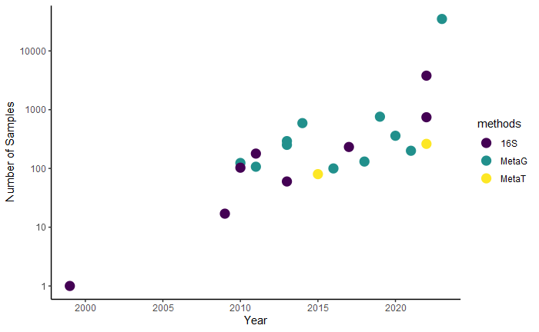
Gut microbiome studies: exponential growth of sample numbers
n>35,000 samples
1st Human gut catalog
(n=124)
Suau et al, 1999
Every 10 years,
number of samples analyzed per study
is multiplied by 100

Slide 3
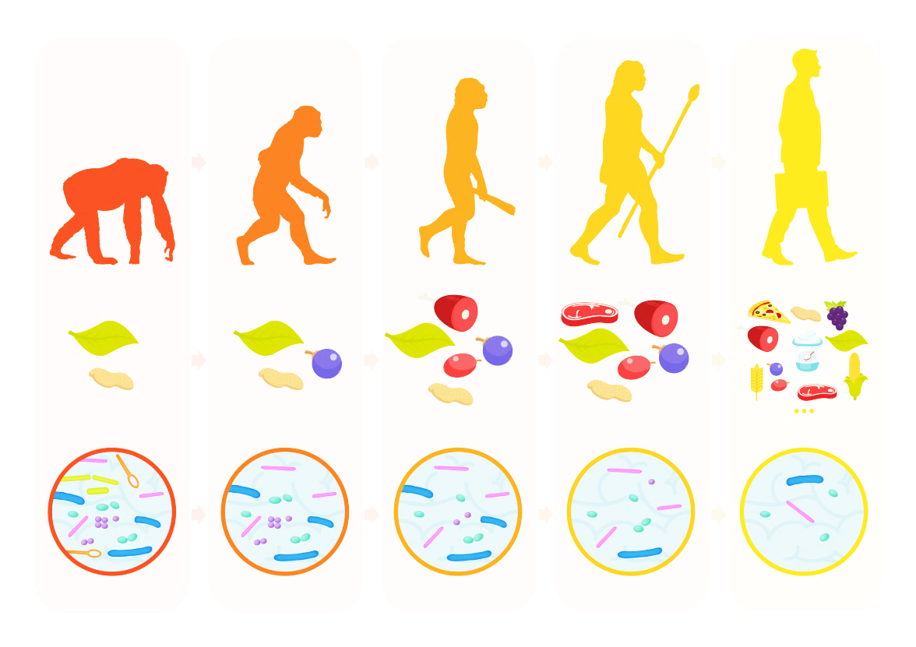
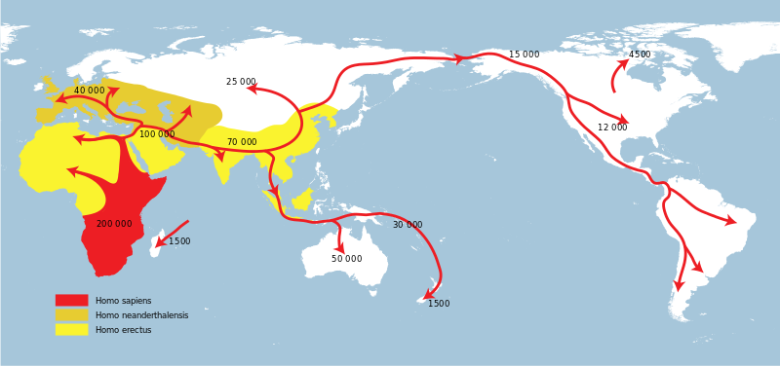
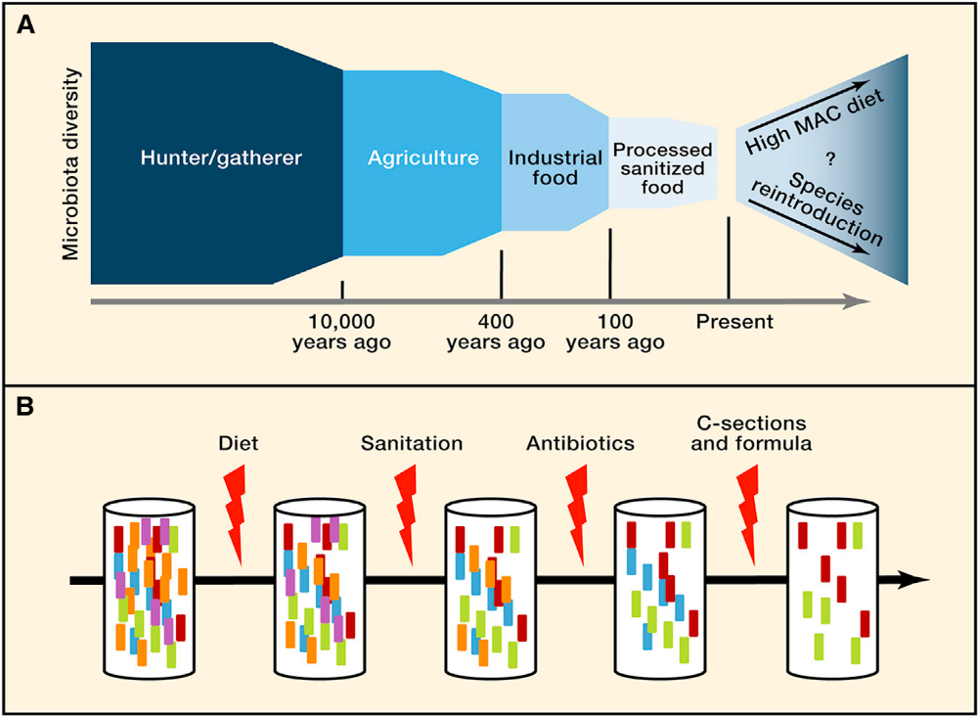
Host microbiome symbiosis co-evolution uncoupled?
Hunter-gatherer
Sedentarization
Crop and farming
Hygiene and antibiotics
Refined products and
Vanished* microbes
*Sonnenburg.2022.BioRxiv
Notes:
Gut microbiome is shaped by genetics, external and internal host factors and ecological forces. While our lifestyle and diet change, our genomes did not change and we may uncouple the relation between our gut microbiome and our genes. This result in a few association (except bifide/lactase deficiency) between genes polymorphism and microbiome structure.

Slide 4
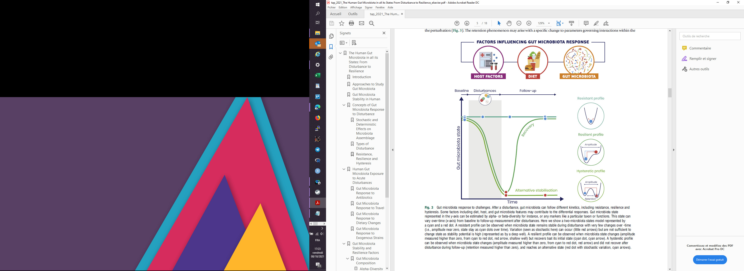

Gut microbiome state affected by external and intrinsic factors
External factor ~20 %
Intrinsic factor 80 % ?

Slide 5
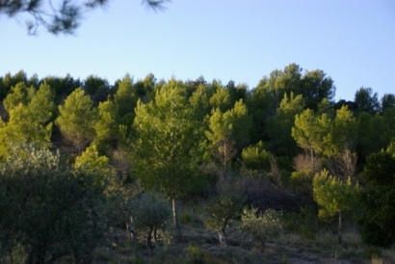


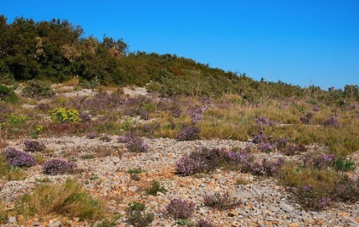
Microbiome states resilience as key factor
Healthy state
Healthy state
Resistance
Recovery
Resilience
Degraded state
Notes:
In addition to all these factors responsible for the variation of the microbiota, there are ecological phenomena that govern the microbiota, such as resilience/resistance to external perturbation. Depending on those ecological phenomenon, there may be a shift from one state to another.

Slide 6
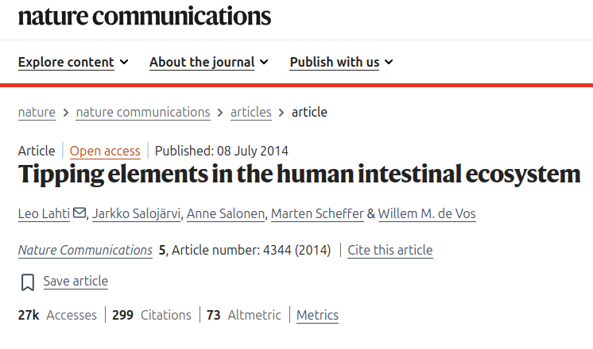
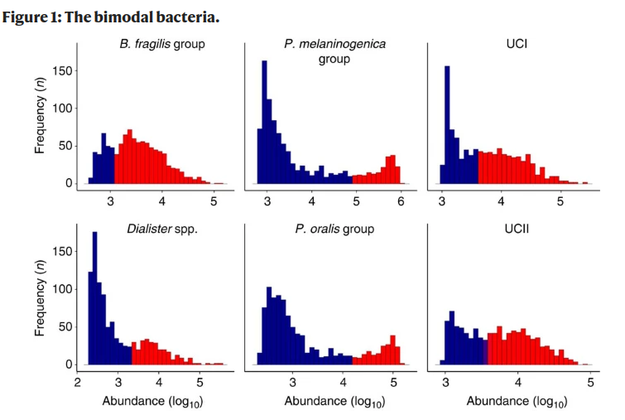
Finding tipping elements

Slide 7
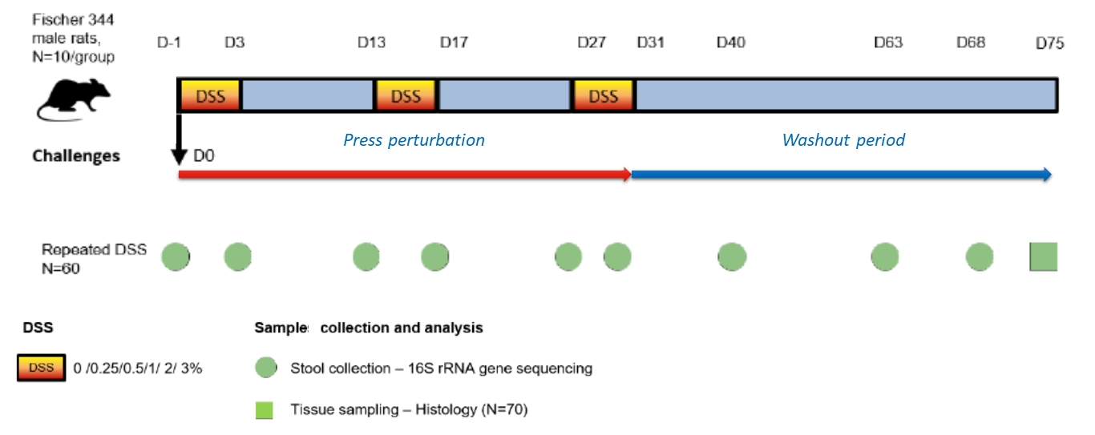
How to model hysteresis? An in vivo study

Slide 8
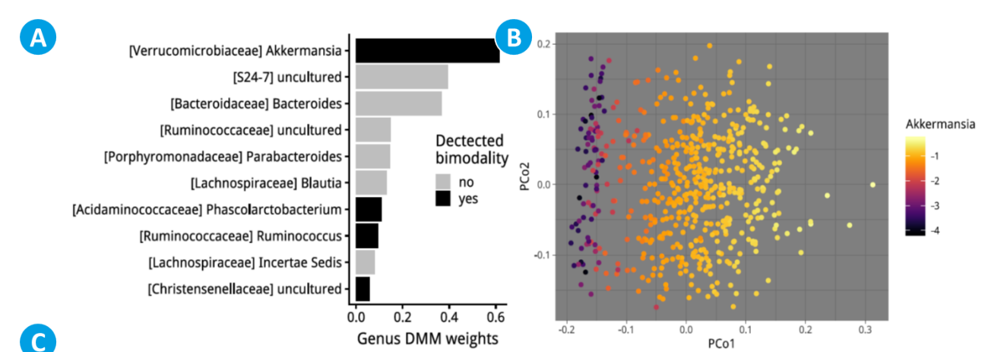
Akkermansia as tipping element in rat models

Slide 9
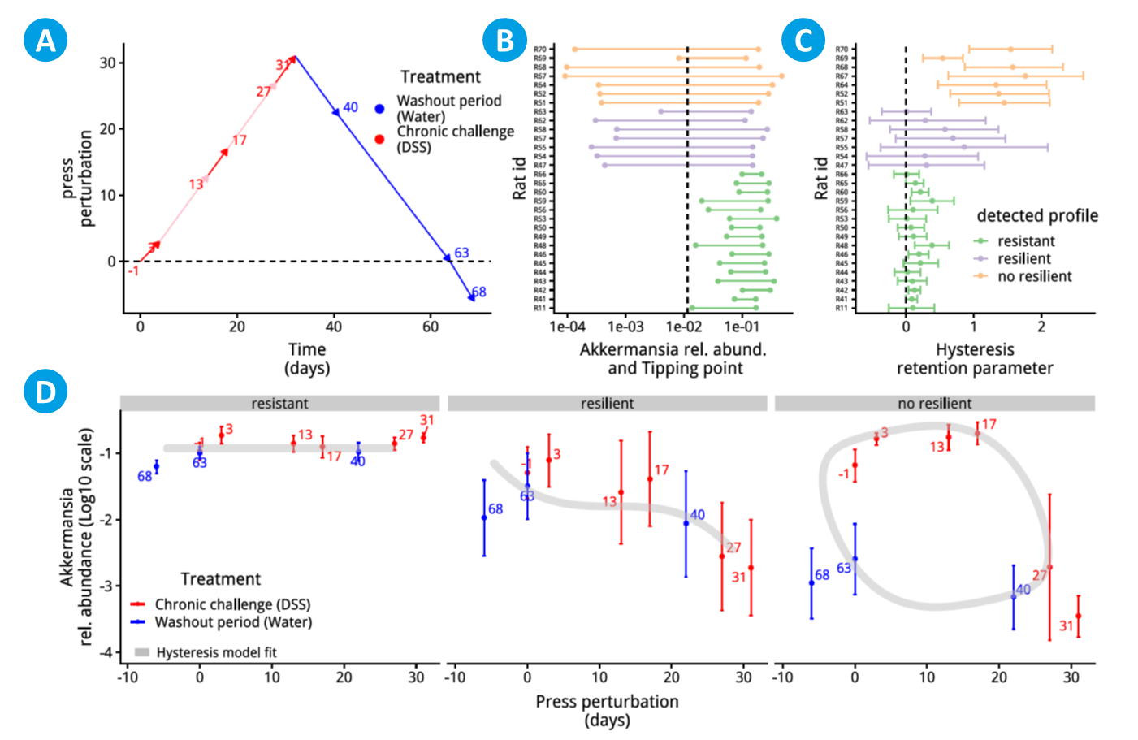
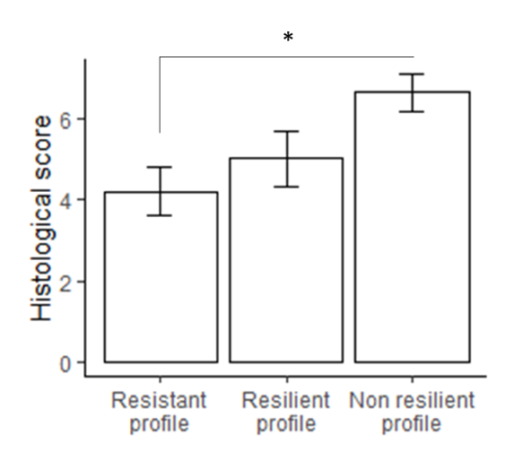
Akkermansia as tipping element in rat models

Slide 10
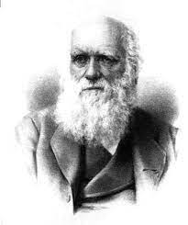


How to define gut microbiome state?
Are You A SPLITTER or LUMPER?
Darwin (1857)
SPLITTER point of view
LUMPER point of view

Slide 11
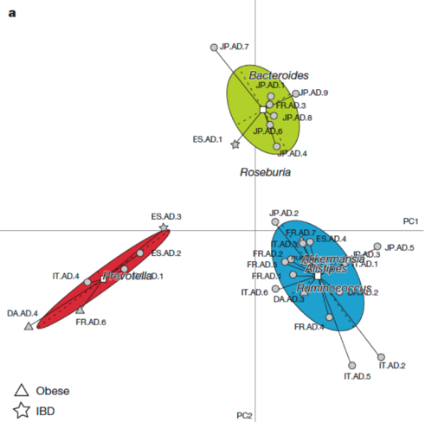
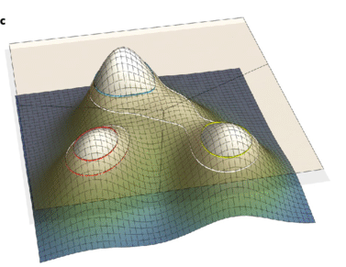
Several attempts to decipher the microbiome structure
Costea et al (2017)
Dirichlet Multinomial Mixture (DMM) modeling
Arumugam, Raes et al (2010)
Limits:
Few association with diet
Few stability assessment (e.g. with time-series)
Notes:
Several attempts have been made in the past to understand the structure of the gut microbiome, but with limitations. Here I show the enterotypes with few stability assessment.

Slide 12
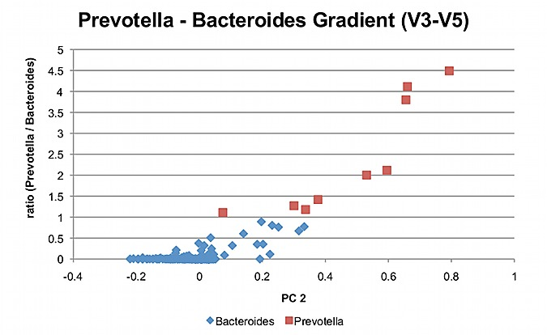
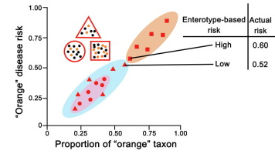
Several attempts to deciper the microbiome structure
LUMPER
Huse et al (2012)
Cheng et al (2019)
Limits:
Still no mathematical formulation to treat microbiota composition as a gradient
“there is no structure in the human gut and everything should be treated as a gradient”

Slide 13
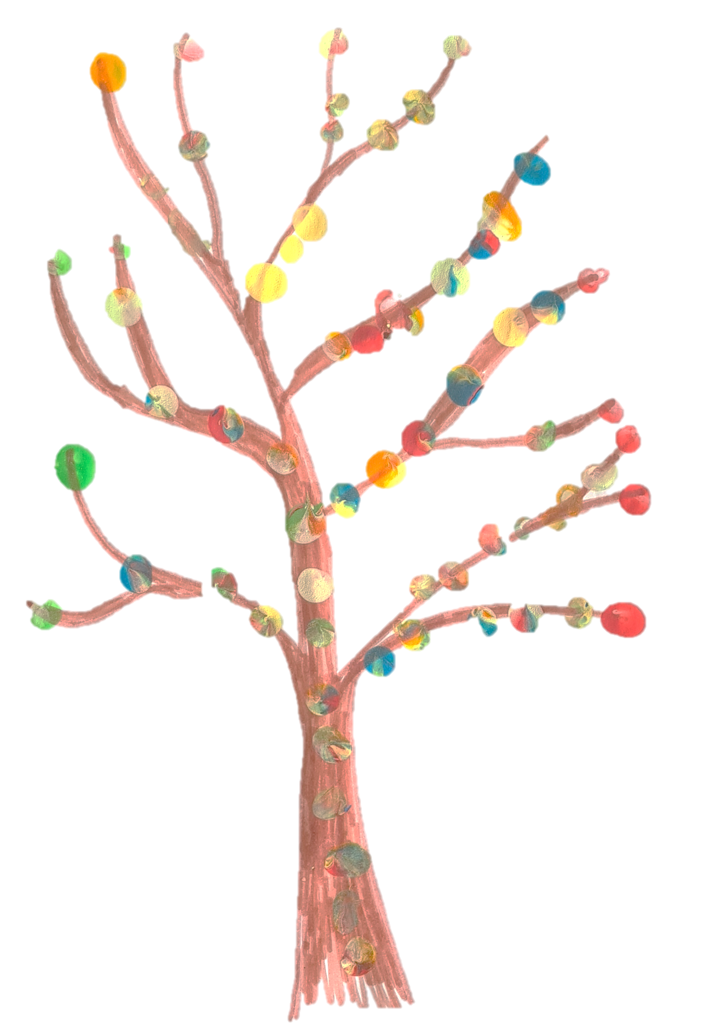

« It is good to have splitters and lumpers »
Darwin, 1857
My son, 2020
“School at home”

Slide 14
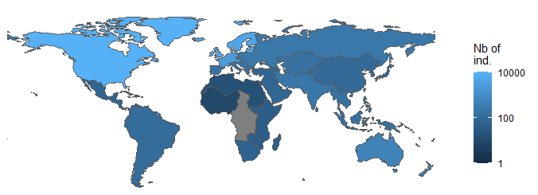
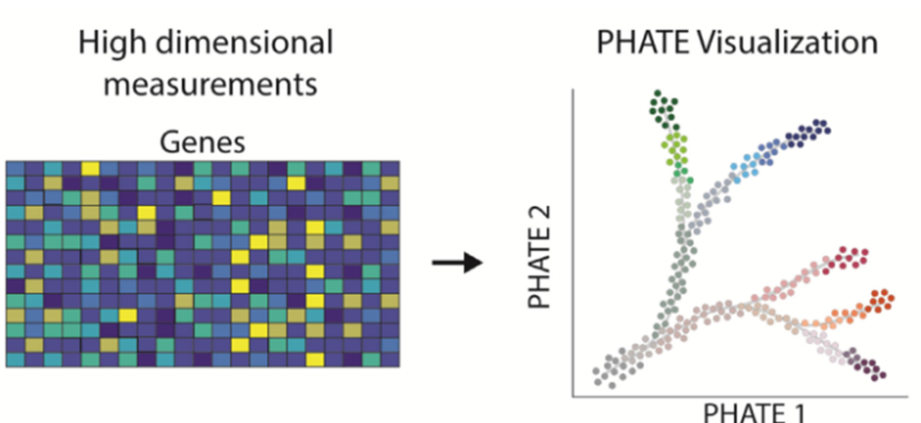
35,000 human gut microbiome samples analyzed
New computational method that help observe global and local structure at the same time
and DMM partitioning
microbial taxa
Time-series analysis to detect microbiome states
fecal samples
Region of birth, Lifestyle, diet, and health modelization
Notes:
We have tried to go further by analyzing the available data from 35,000 samples from several regions of the world and reusing recent methodologies for classification and visualization of data, allowing us local and global exploration of the microbiota. Moreover, we have time series data that will give us stability estimates. The collected metadata will allow us to model these different states.

Slide 15
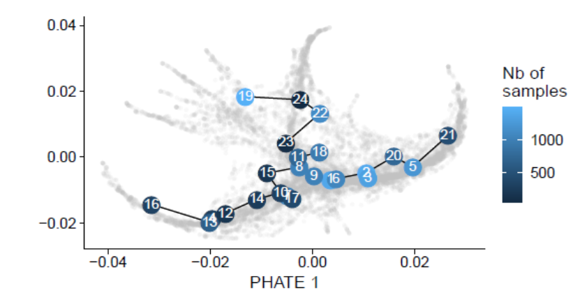
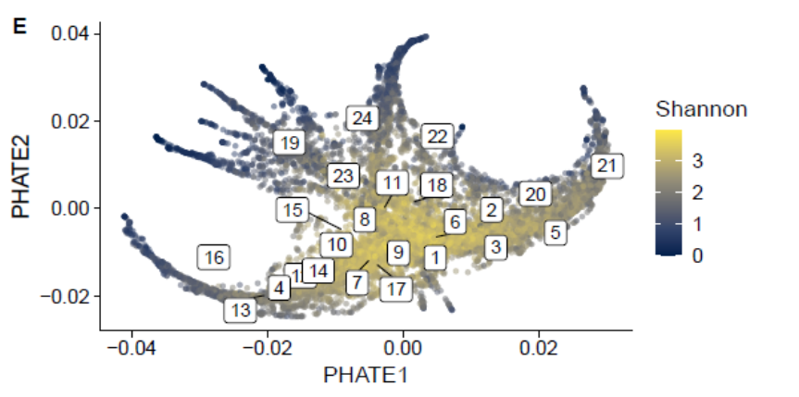
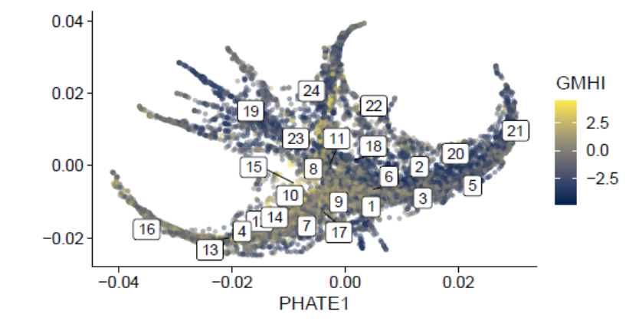
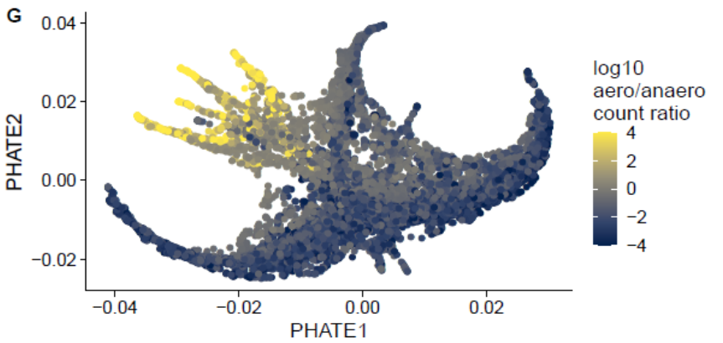
Human Gut microbiome structured as branches
Alpha-diversity
« Healthy index »
« Aerobiosis »
Notes:
Here, I present a recent way of representing the microbiota with such large dataset. And as you can see, we can visualize the samples distributed in branches and represent the different partitions on these branches. If we look at diversity, it is maximal at the center of the structure, while it drops at tips
If we use a GMHI algorithm, it shows that the core and a branch are healthier. Another score allows us to calculate how oxygen-tolerant bacteria are distributed on the branches. Again, we see a separation that occurs with the branches.

Slide 16
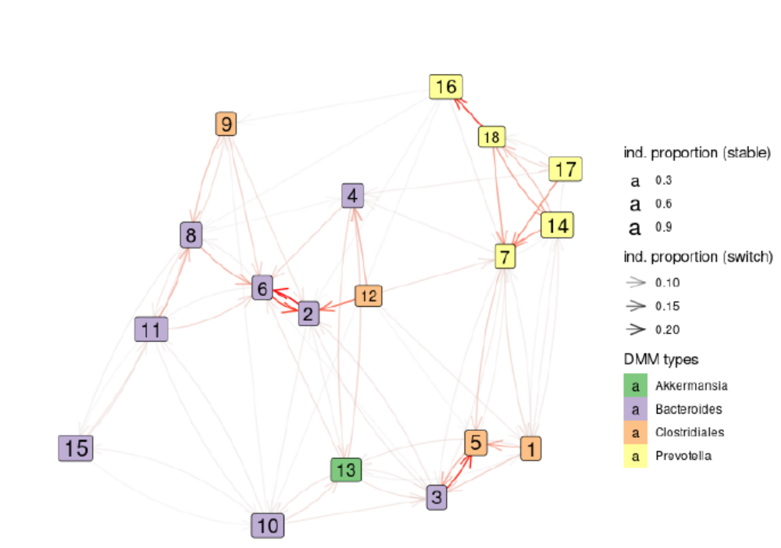
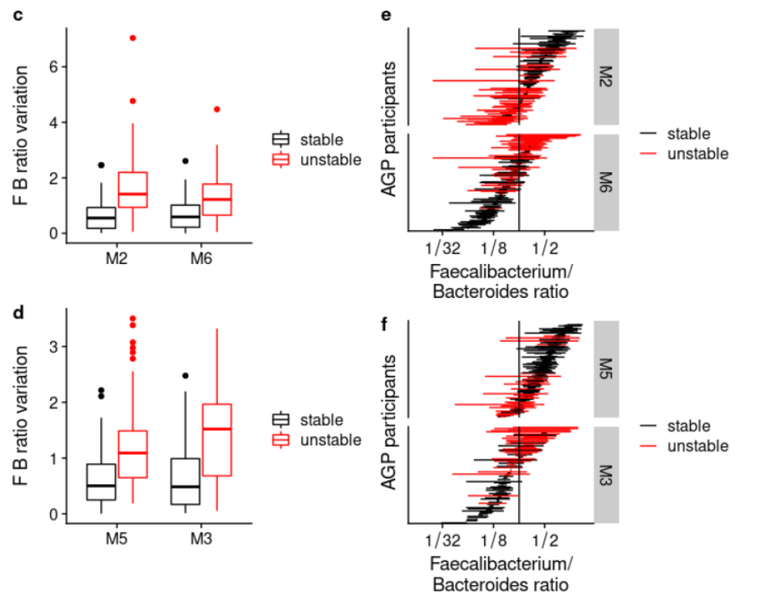
Dynamics between partitions are associated to branches
827 participants
2,998 samples
2,171 time-pairs
Feacalibacterium/Bacteroides as a tipping element
explaining the switch between some states
Notes:
The time series data we have collected have allowed us to assess what is the preferred path of microbiota dynamics between partitions, and we see that it first occurs within the branches. The states thus observed are more or less stable. Some states are like ecological traps.
We detected that the faecalibacterium.bacteroides ratio could be considered as a biomarker of certain switches.

Slide 17
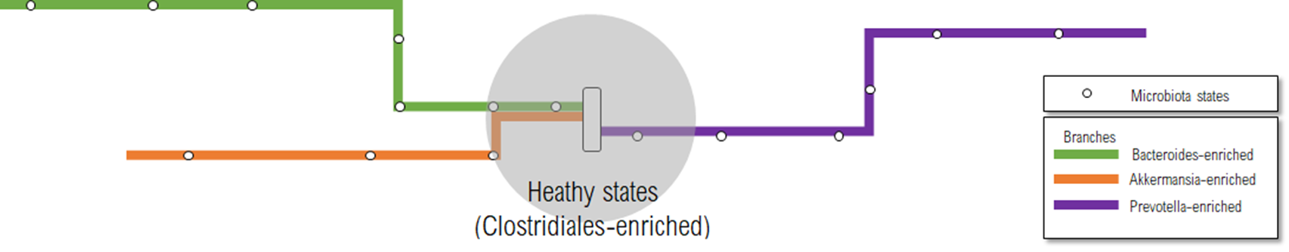
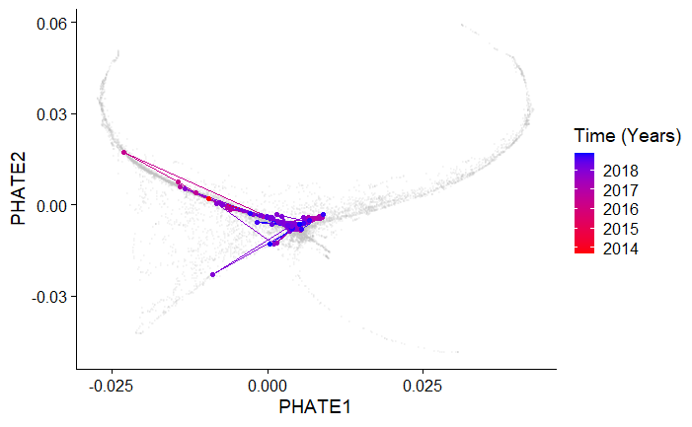

Branches help to monitor gut microbiome recovery
Bowel surgery (IBD)

Slide 18
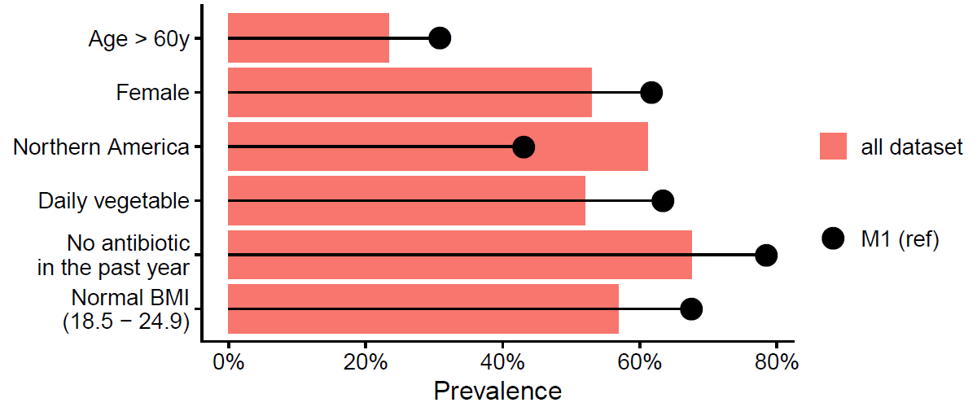
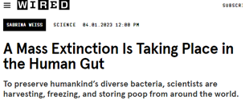
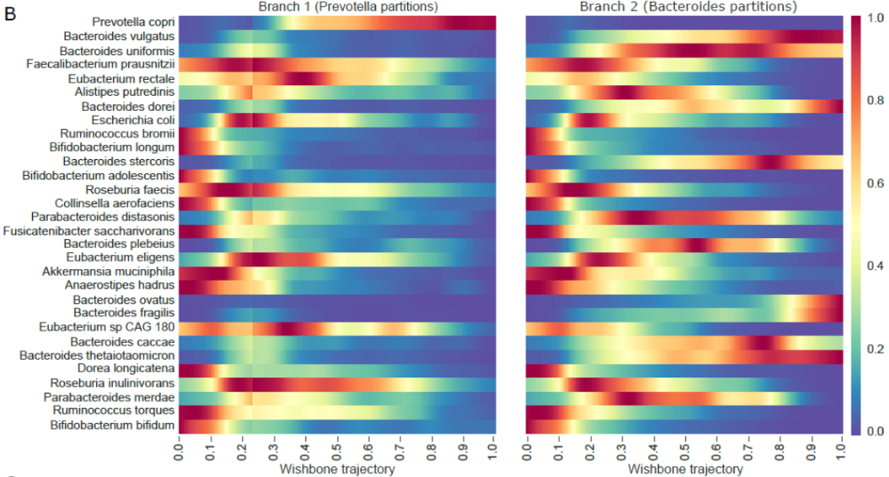
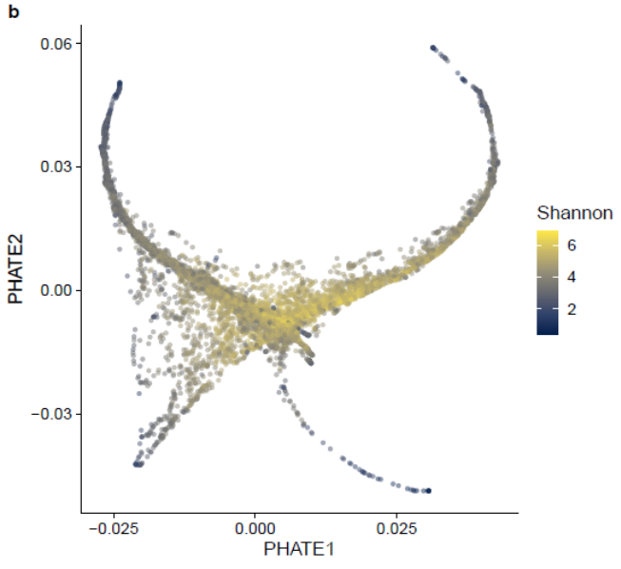

Do we already observe a intergenerationally mass extinction ?
Older and healthy diet and lifestyle
younger
younger
younger
younger
Pseudo-time
Pseudo-time
Tap et al., Nature Comm. 2023
Notes:
Another observation surprised me. At the center of the tree, the average identity card is a Southeast Asian elderly woman who eats healthily. On the ends of the branches, we find the youngest adults. Are we not already observing a shift in intergenerational diversity? Here, you see a pseudo-time analysis on the branches, and we see species that disappear step by step along the branches.

Slide 19
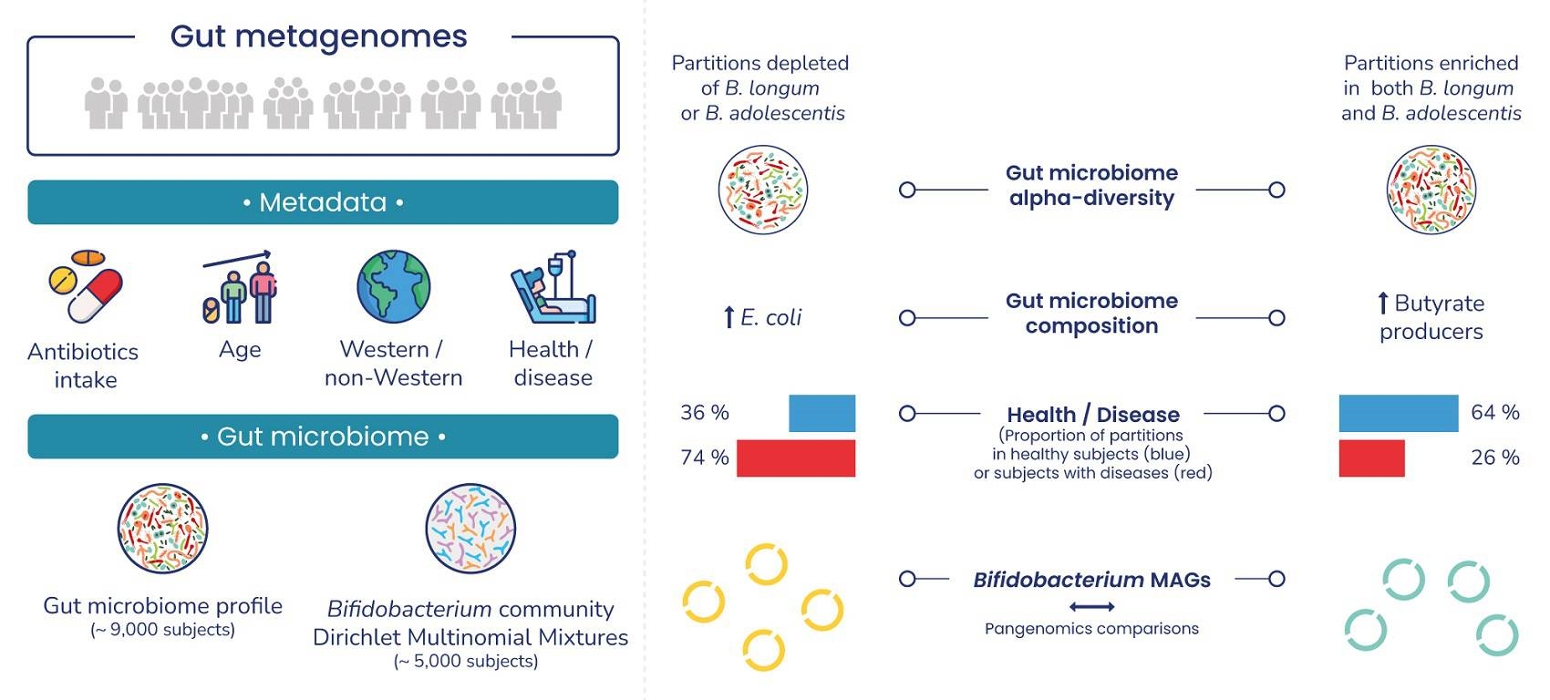
What about Bifidobacterium Ecology in Adult Gut Microbiome?

Slide 20
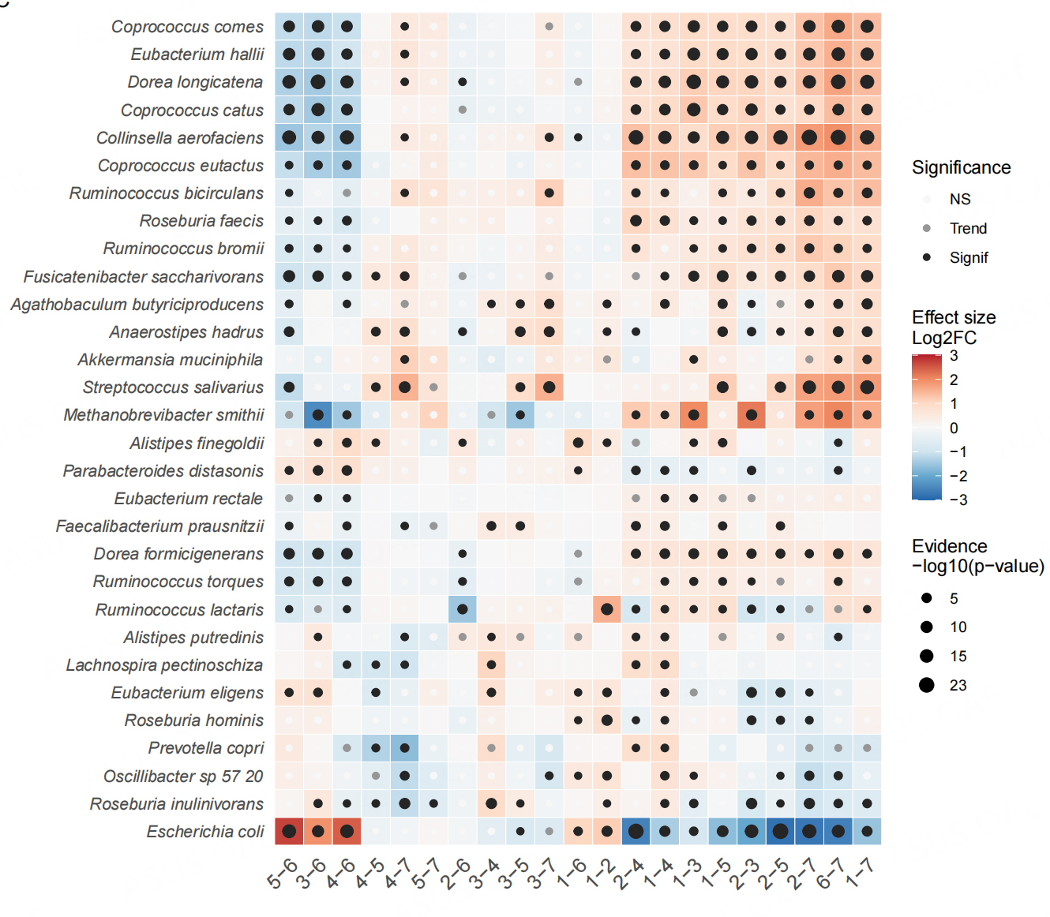
High SCFA producers in gut microbiome with High abundant B.adolescentis
SCFA producers
High B.ado gut microbiome versus others
➡️ « Healthy-like states »

Slide 21

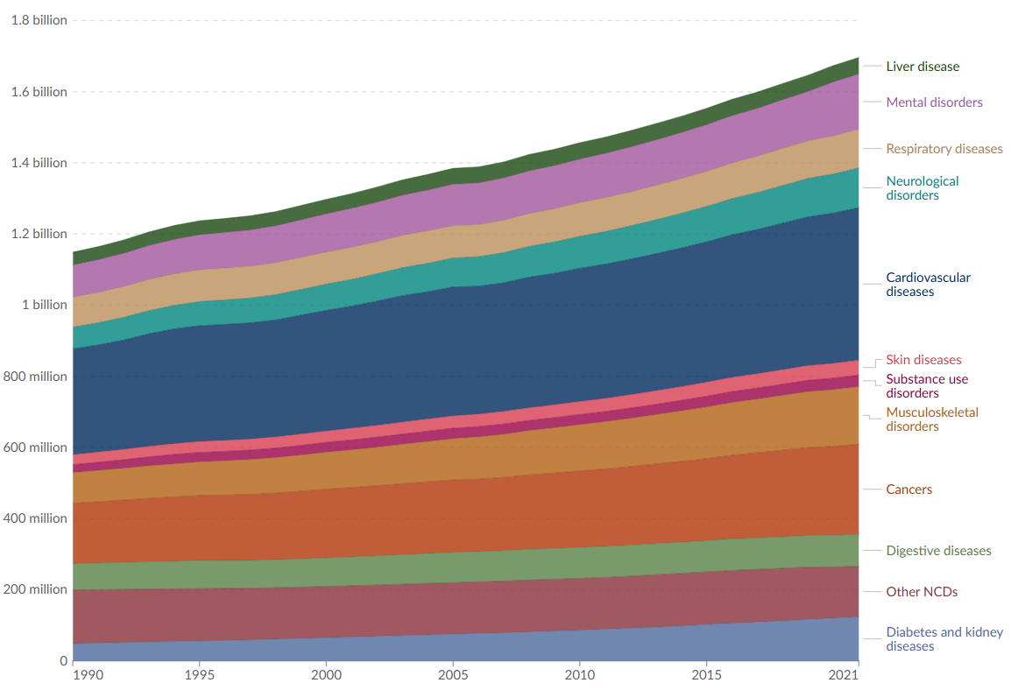

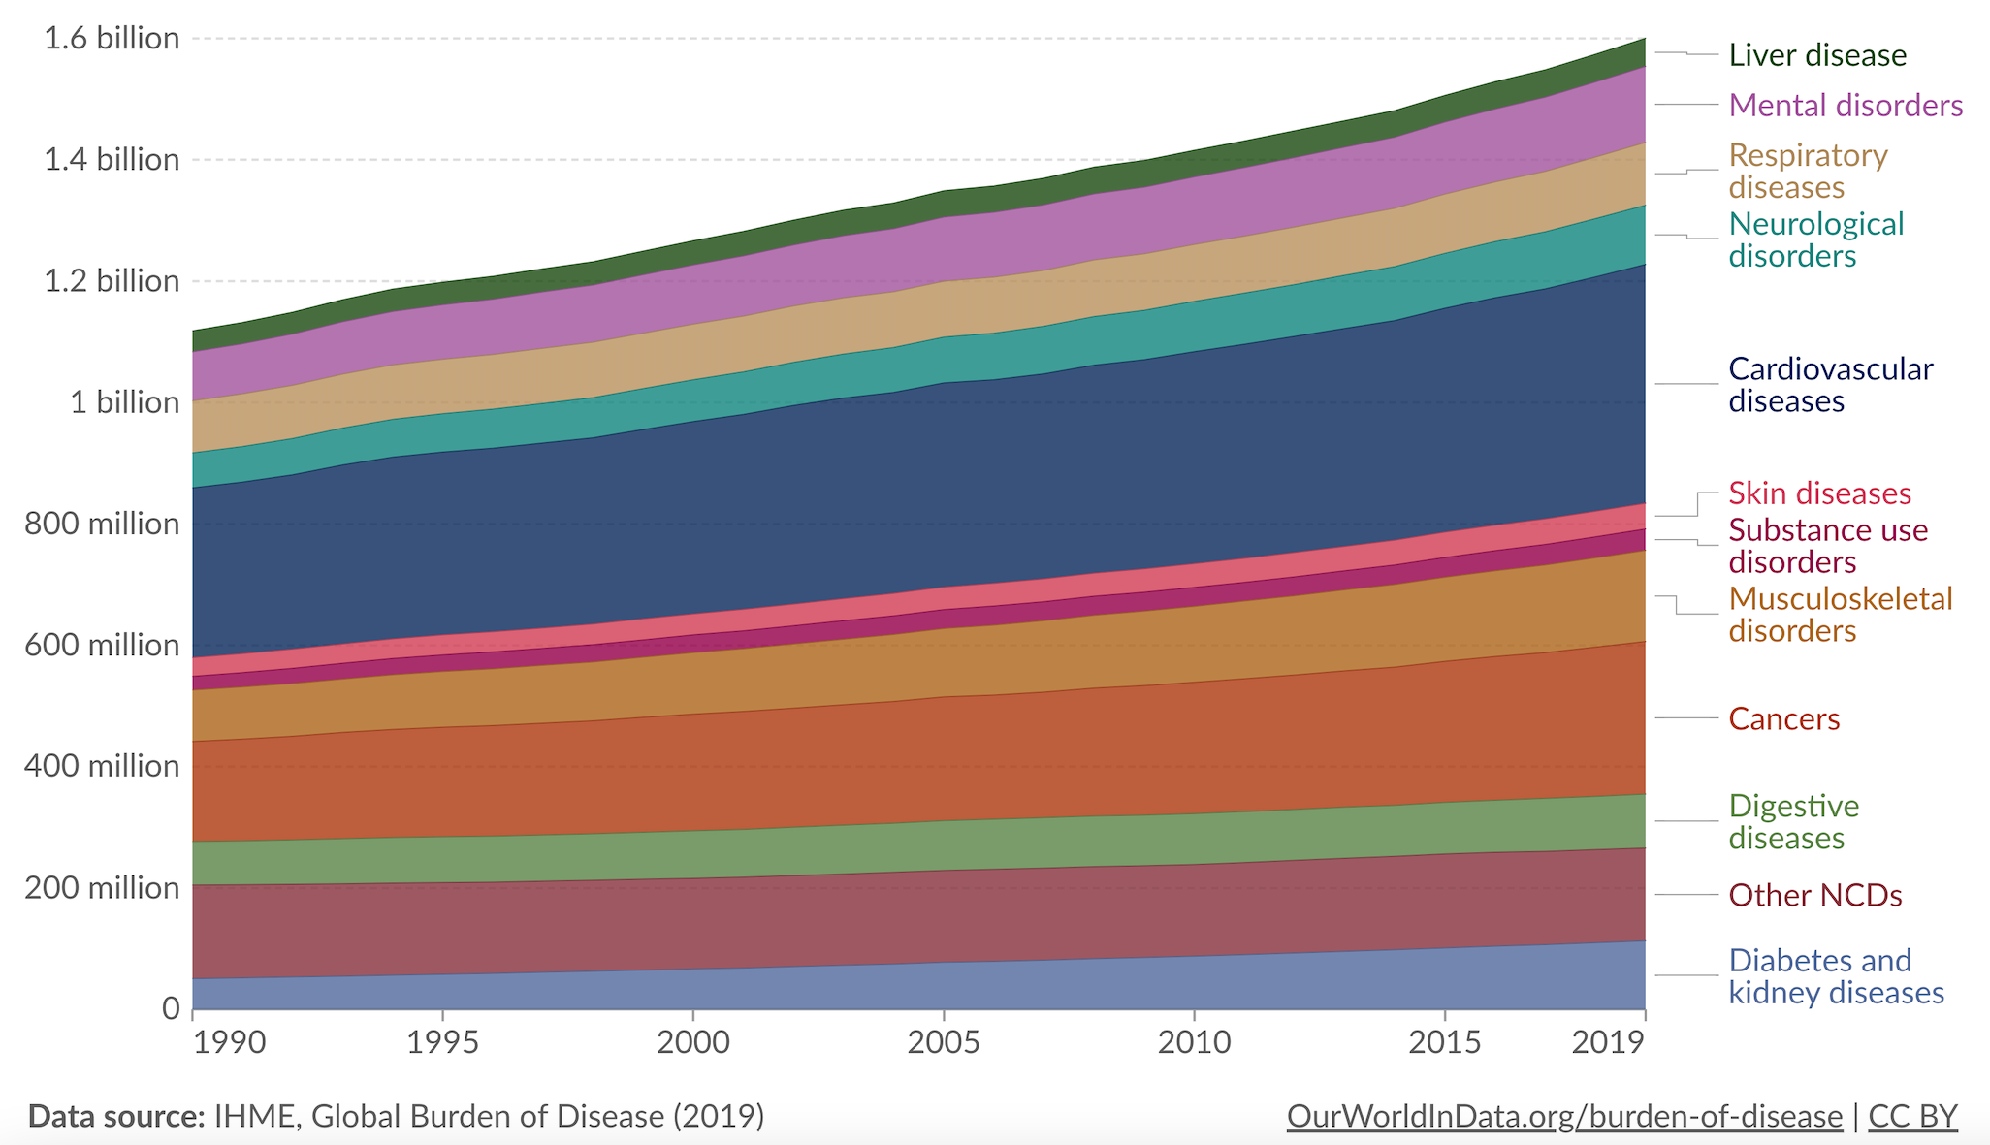
Le French Gut: reveal full gut microbiome diversity from healthy individuals to those at risk
An urgent public health issue : 25% in 2025 (OMS)
Strong association between altered microbiota and the development of chronic diseases

Slide 22

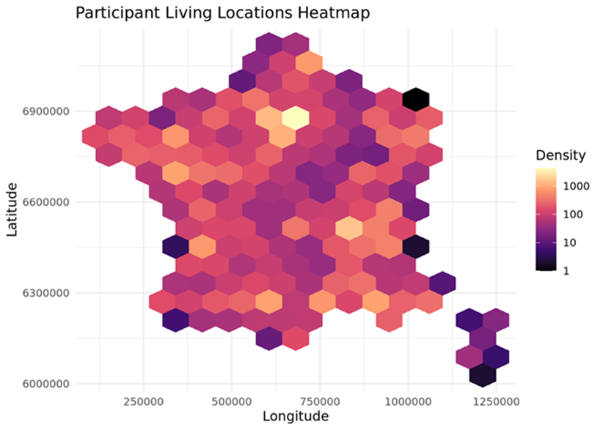
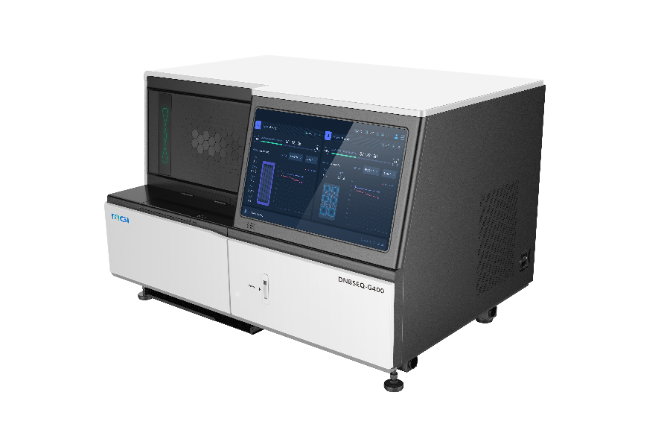
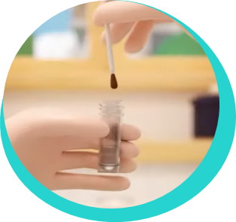
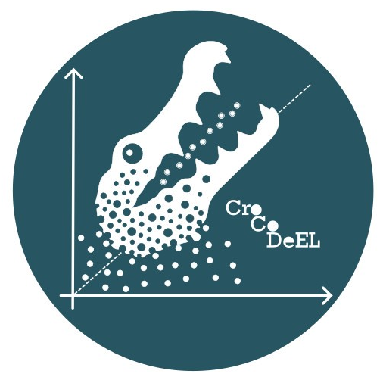

A nationwide cohort
Questionnaires
Facultative /Specialists
Long FFQ
PIMENTO-FF
Polyphenol
MOS-36
IPAQ-SF
SCOFF
BFI-10
PHQ-9
GAD-7
GSRS
IBS-SSS
Mandatory/Generalists
Anthrometric
Lifestyle
Health
Nutrition
High Quality Shotgun MetaG (40M reads min.)
Multiscale : diet patterns → gut diversity → species/strains → in situ food exposome

Slide 23

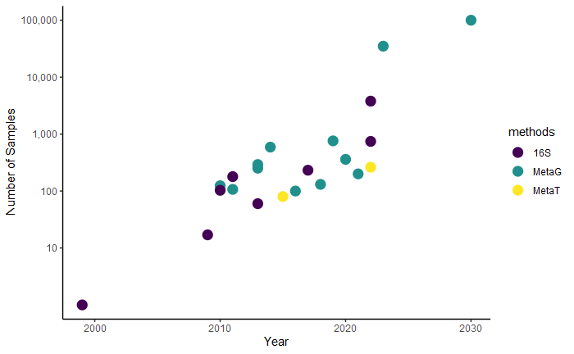

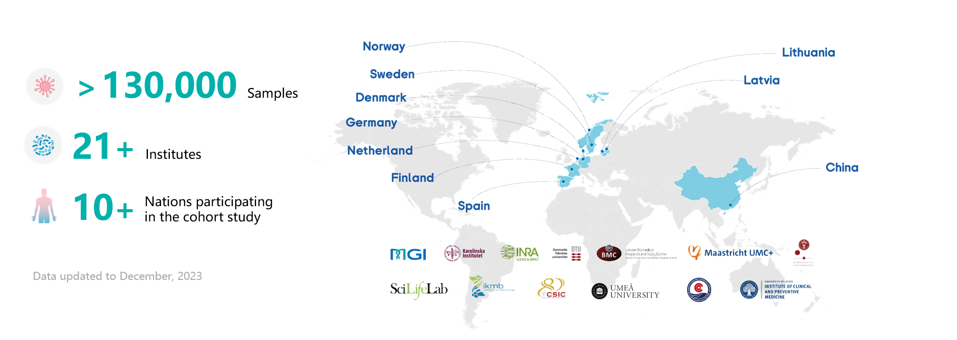
Gut microbiome studies: exponential growth of sample numbers
n>35,000 samples
🎯
French Gut n = 100k
By 2030
1st Human gut catalog
(n=124)
Suau et al, 1999
Every 10 years,
number of samples analyzed per study
is multiplied by 100

Slide 24
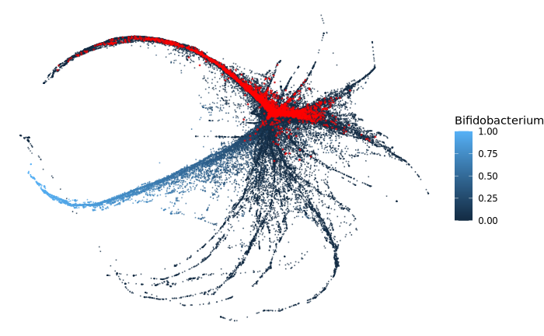
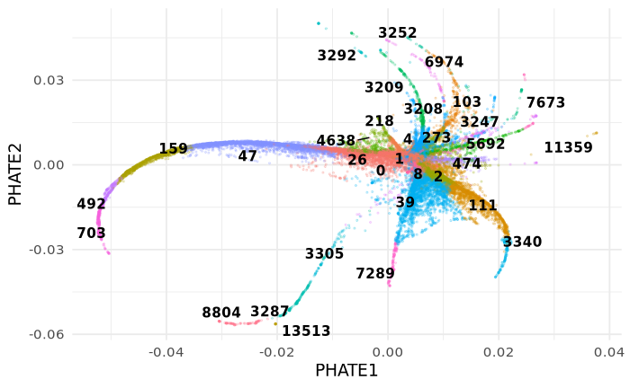
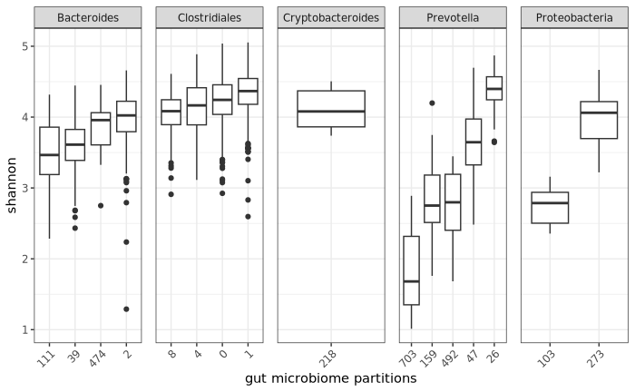
Gut Branches validated in the French Gut Project
Several gut partitions in adults pop
Adult branches
Infants branches
(map onto >60k Metalog)
Classical adult Gut microbiome branches are found
Branches tip associated with low diversity

Slide 25
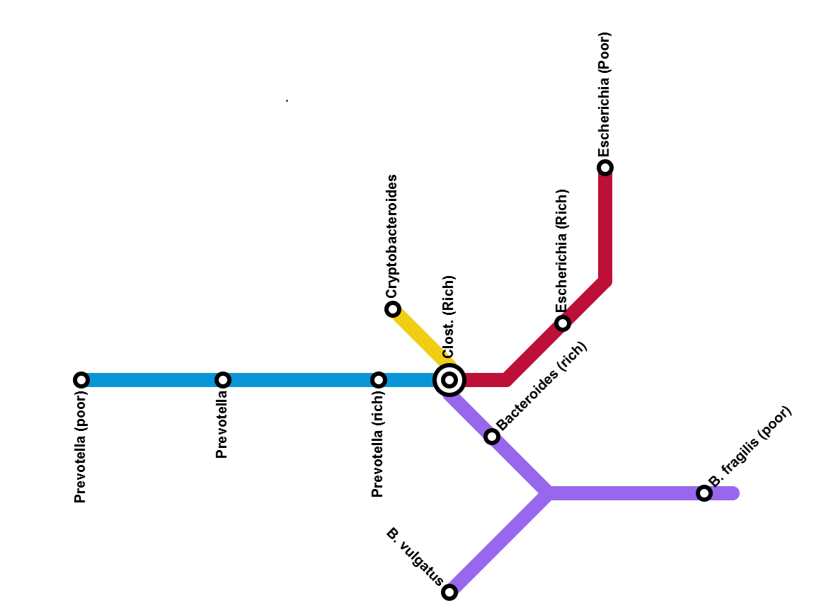
Branches seen as metro line and partitions as stations
A ecological conceptual view for
microbiome personalization…
How does it connect with dietary habits ?

Slide 26

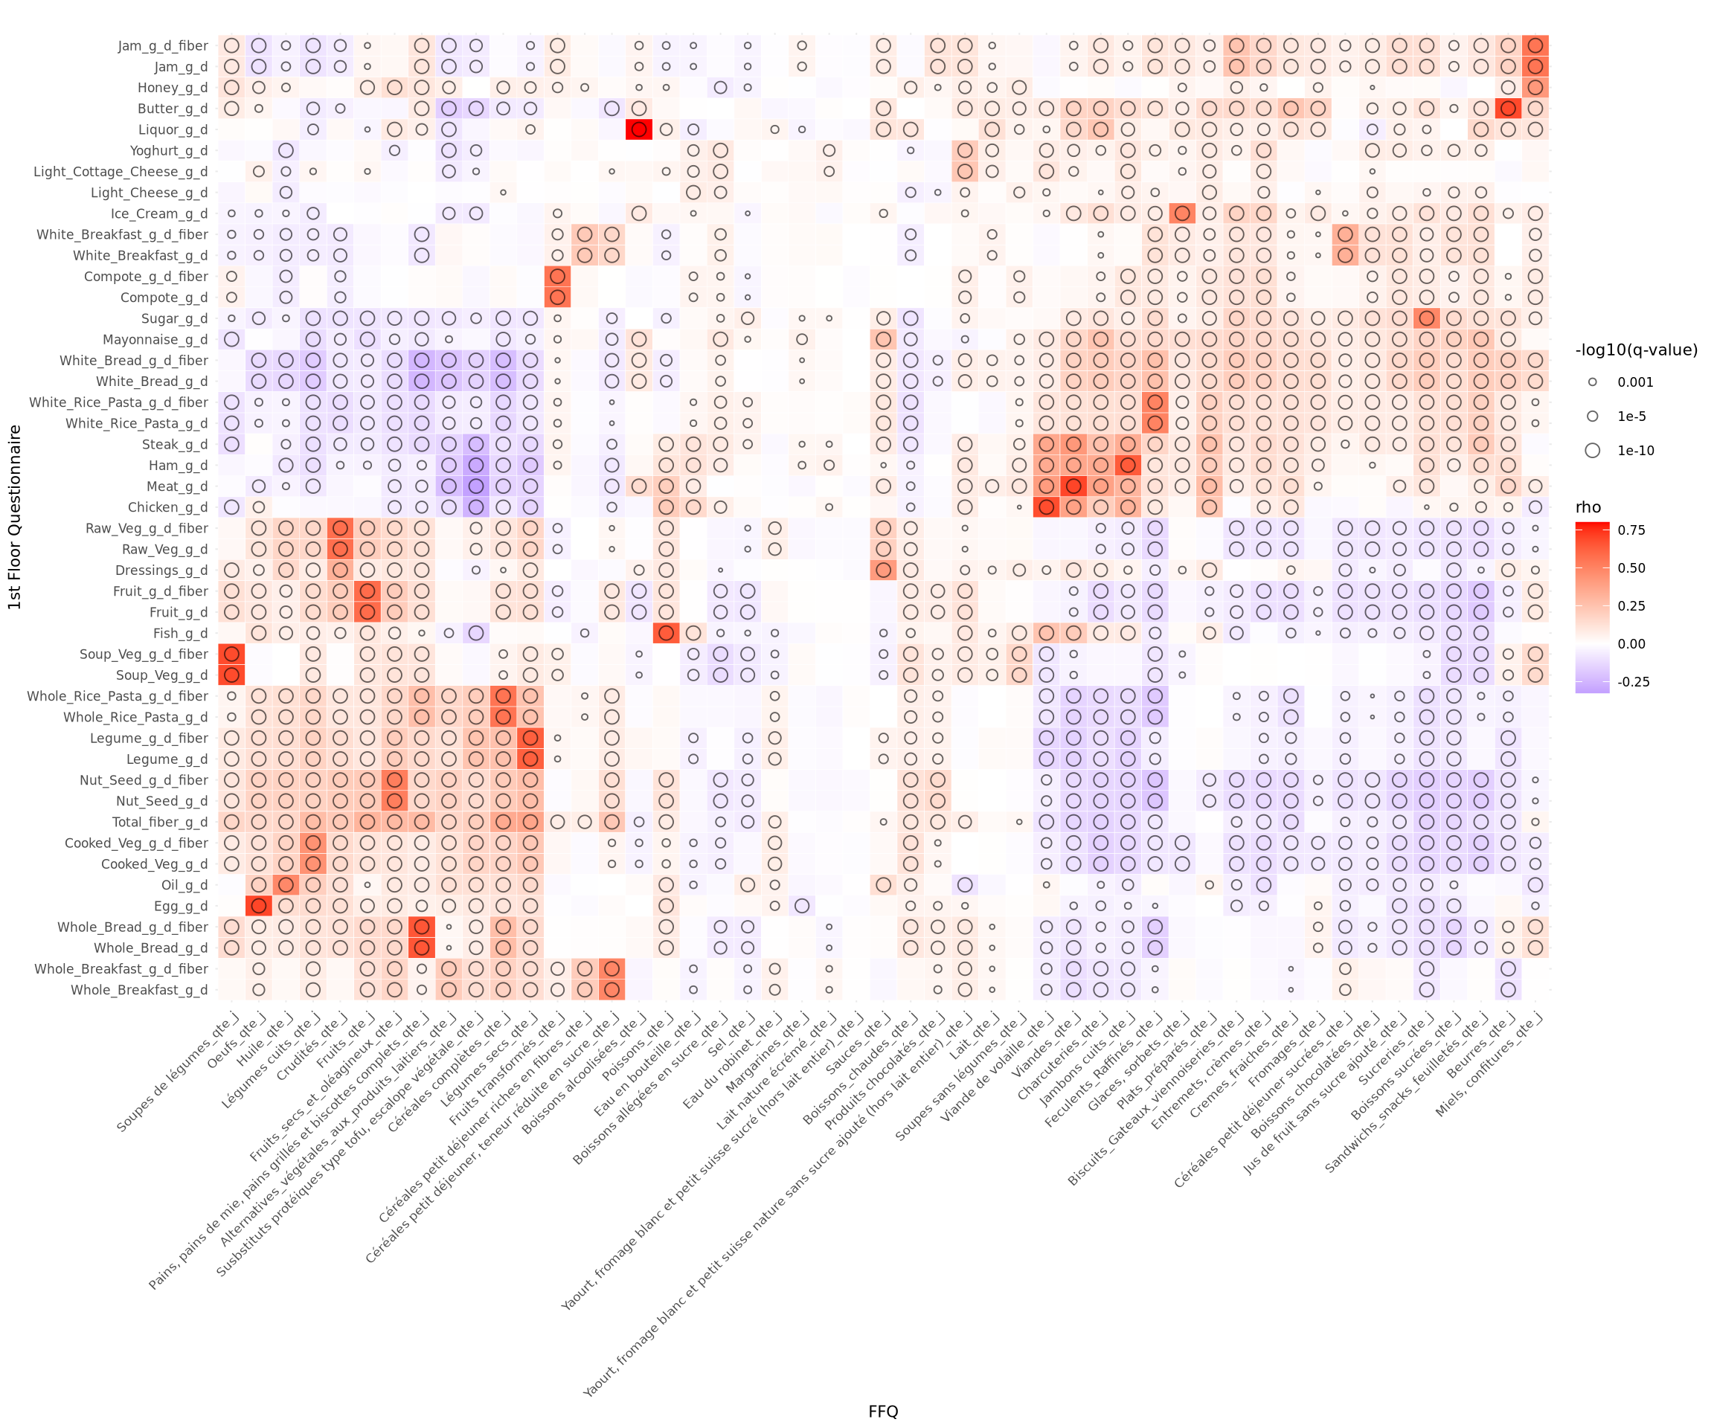
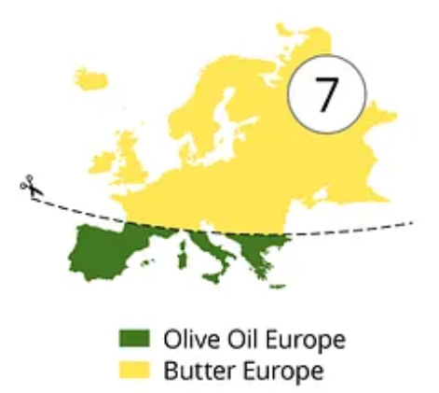
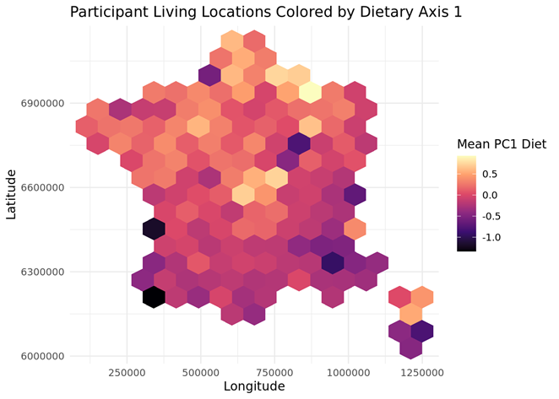


Long FFQ co-variate nicely with nutrition table derived from the general questionnaire
Anne Hiol
Nutritional Epidemiology
Butter
Oil

Slide 27





Diet profile is associated with French Gut living location
Coinertia analysis

Slide 28



Correlation is not causation #ohwait?!
Bourdieu
Related work
“taste is distate of the taste of others”

Slide 29




Toward gut microbiome alternative stable states hypothesis
Notes:
These observations reinforce the hypothesis that there are indeed alternative ecological states in the gut microbiome

Slide 30

Harnessing the microbial potential of fermented foods to avoid the point of no return
Notes:
How to avoid the point of no return?
Our belief is that fermented foods can play a role.

Slide 31

How fermented foods and dietary fiber can fit precision nutrition for health?
Fermented foods valuable solution in countering the decreased microbiome diversity
Personalized immune as function of gut microbiota baseline
Wastyk et al., 2021
Notes:
They may even play a role in precision nutrition. They can be a good complement to fibers, with, for example, in this study, specific effect on diversity. How about interaction between food and gut microbiome?

Slide 32







Take home messages
Gut microbiome ecological landscape is made of local states that are dynamically linked within “branches” where critical transition occurred
Gut microbiomes states can be discordant with dietary profile and can be associated with health
Objective markers of gut microbiome states are needed to guide personalized nutritional recommendations.
Notes:
Here are the take-home messages

