Slide 1

Beyond site index
FIA's classification disagrees with site index but agrees with a composite measure of forest productivity
Aaron R. Weiskittel
University of Maine | Center for Research on Sustainable Forests
Collaborators briefing | 13 June 2026 | CSPI v2.0.0 release
Data concept 10.5281/zenodo.20515034 | Analytical chain 10.5281/zenodo.20693106 | v2.0.0 10.5281/zenodo.20663652

Slide 2
What changed since v1.0.0
The release line shifted from a single-metric predicted site index to a multi-metric composite.
v1.0.0 (June 2026)
v2.0.0 (June 2026)
v0.10 manuscript reframe
Single-metric CSPI v3 and v4 at 30 m and 1 km
Multi-metric composite of ESI + BGI + Asym
Site productivity is empirically multi-dimensional
Predicted site index from FIA SICOND target
Unified North America height-and-age target
Single-metric studies miss species, age, regime structure
Still available at 10.5281/zenodo.20515035
Each component ships as a standalone layer
FIA SITECLCD tracks biomass growth, not site index
The release is the composite. The conceptual paper says productivity is multi-dimensional.

Slide 3
Headline empirical finding
FIA's own seven-class productivity rating (SITECLCD) tracks biomass growth, not site index.
0.808
0.751
+0.06
BGI alone
ESI alone
BGI advantage
OOB R² predicting FIA SITECLCD
OOB R² predicting FIA SITECLCD
Six percentage-point gap
Random forest at 63,310 FIA plots. NPP alone reaches only R² = 0.13.
FIA's classification has been measuring biomass growth, not height growth potential. For seven decades.
Single-metric site index studies have been carrying biomass-growth structure unlabeled.

Slide 4
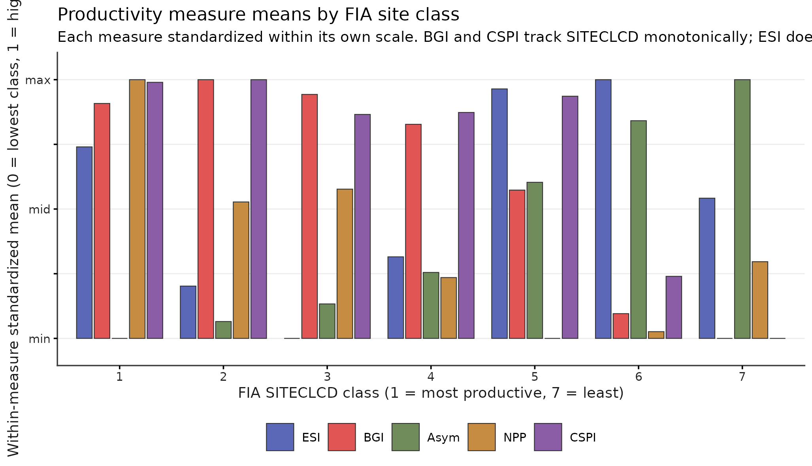
Mean productivity by FIA site class
ESI is flat across the seven classes. BGI drops by a factor of 2.3. The composite tracks the classification.
If site index were what FIA SITECLCD measures, the ESI line would tilt with the classes.

Slide 5
Hierarchical ecoregion weighting boosts SITECLCD recovery
Equal-weight + ecoregion composite reaches R² = 0.832 vs 0.812 alone (CI non-overlapping).
R² 0.832
50 L3
equal + hier composite
EPA Level III ecoregions
Bootstrap 95% CI [0.829, 0.835]; +0.020 over equal alone
Mean w_ESI=1.77, w_BGI=0.21, w_Asym=0.34 across regions
Per-region PC1 captures 48% to 84% of variance; Western ESI-dominated, Eastern Asym-dominated.
When you swap SICOND for the unified-target ESI in growth-and-yield work, expect the calibrations to shift. The shift will be in the direction of less biomass-growth information and more pure height-growth-potential information. Whether that shift is desirable depends on your application.
Multilevel ecoregion: +0.020 R² gain (CI non-overlapping); SITECLCD result remains the headline anchor.

Slide 6
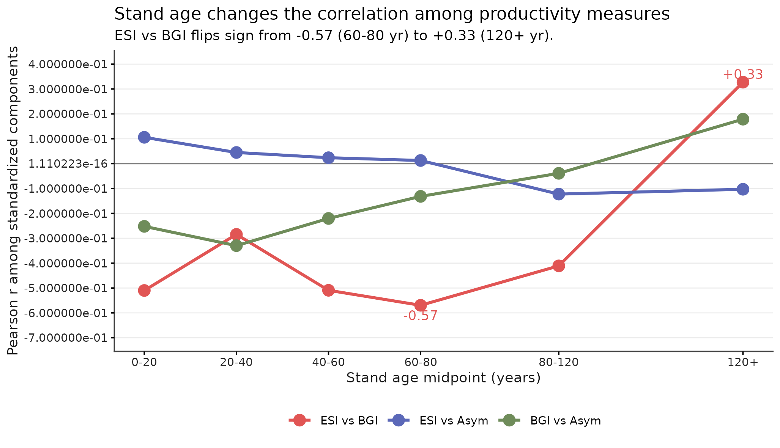
The relationship flips at 120 years
ESI–BGI correlation goes from −0.57 in middle-age stands to +0.33 in old growth.
A productivity surface trained pooled across stand ages is wrong in opposite directions in young vs old stands.

Slide 7
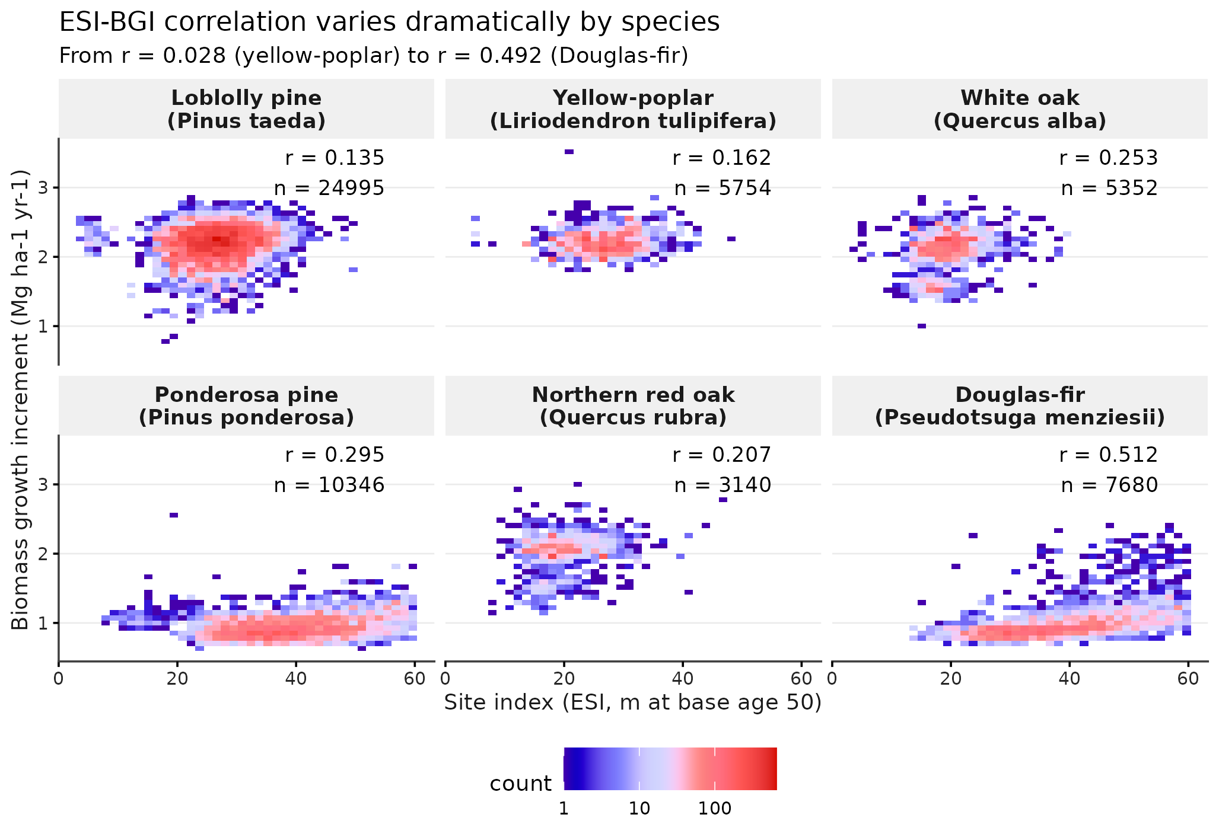
Species range from 0.028 to 0.492
Yellow-poplar essentially independent (r = 0.028); Douglas-fir strongly positive (r = 0.492).
A national productivity ranking implicitly assumes one ESI–BGI relationship. Six species say otherwise.

Slide 8
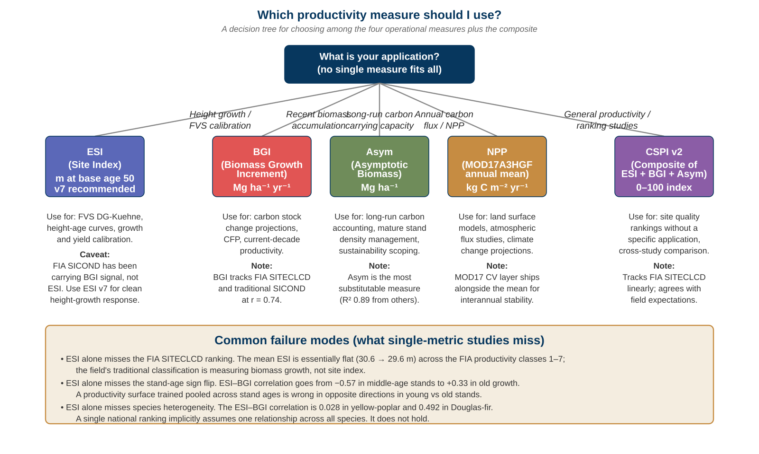
Which productivity measure should you use?
Five operational measures, five primary applications. Pick by what you actually want to know.
If your application is not a clean match for one measure, the composite is the recommended default.

Slide 9
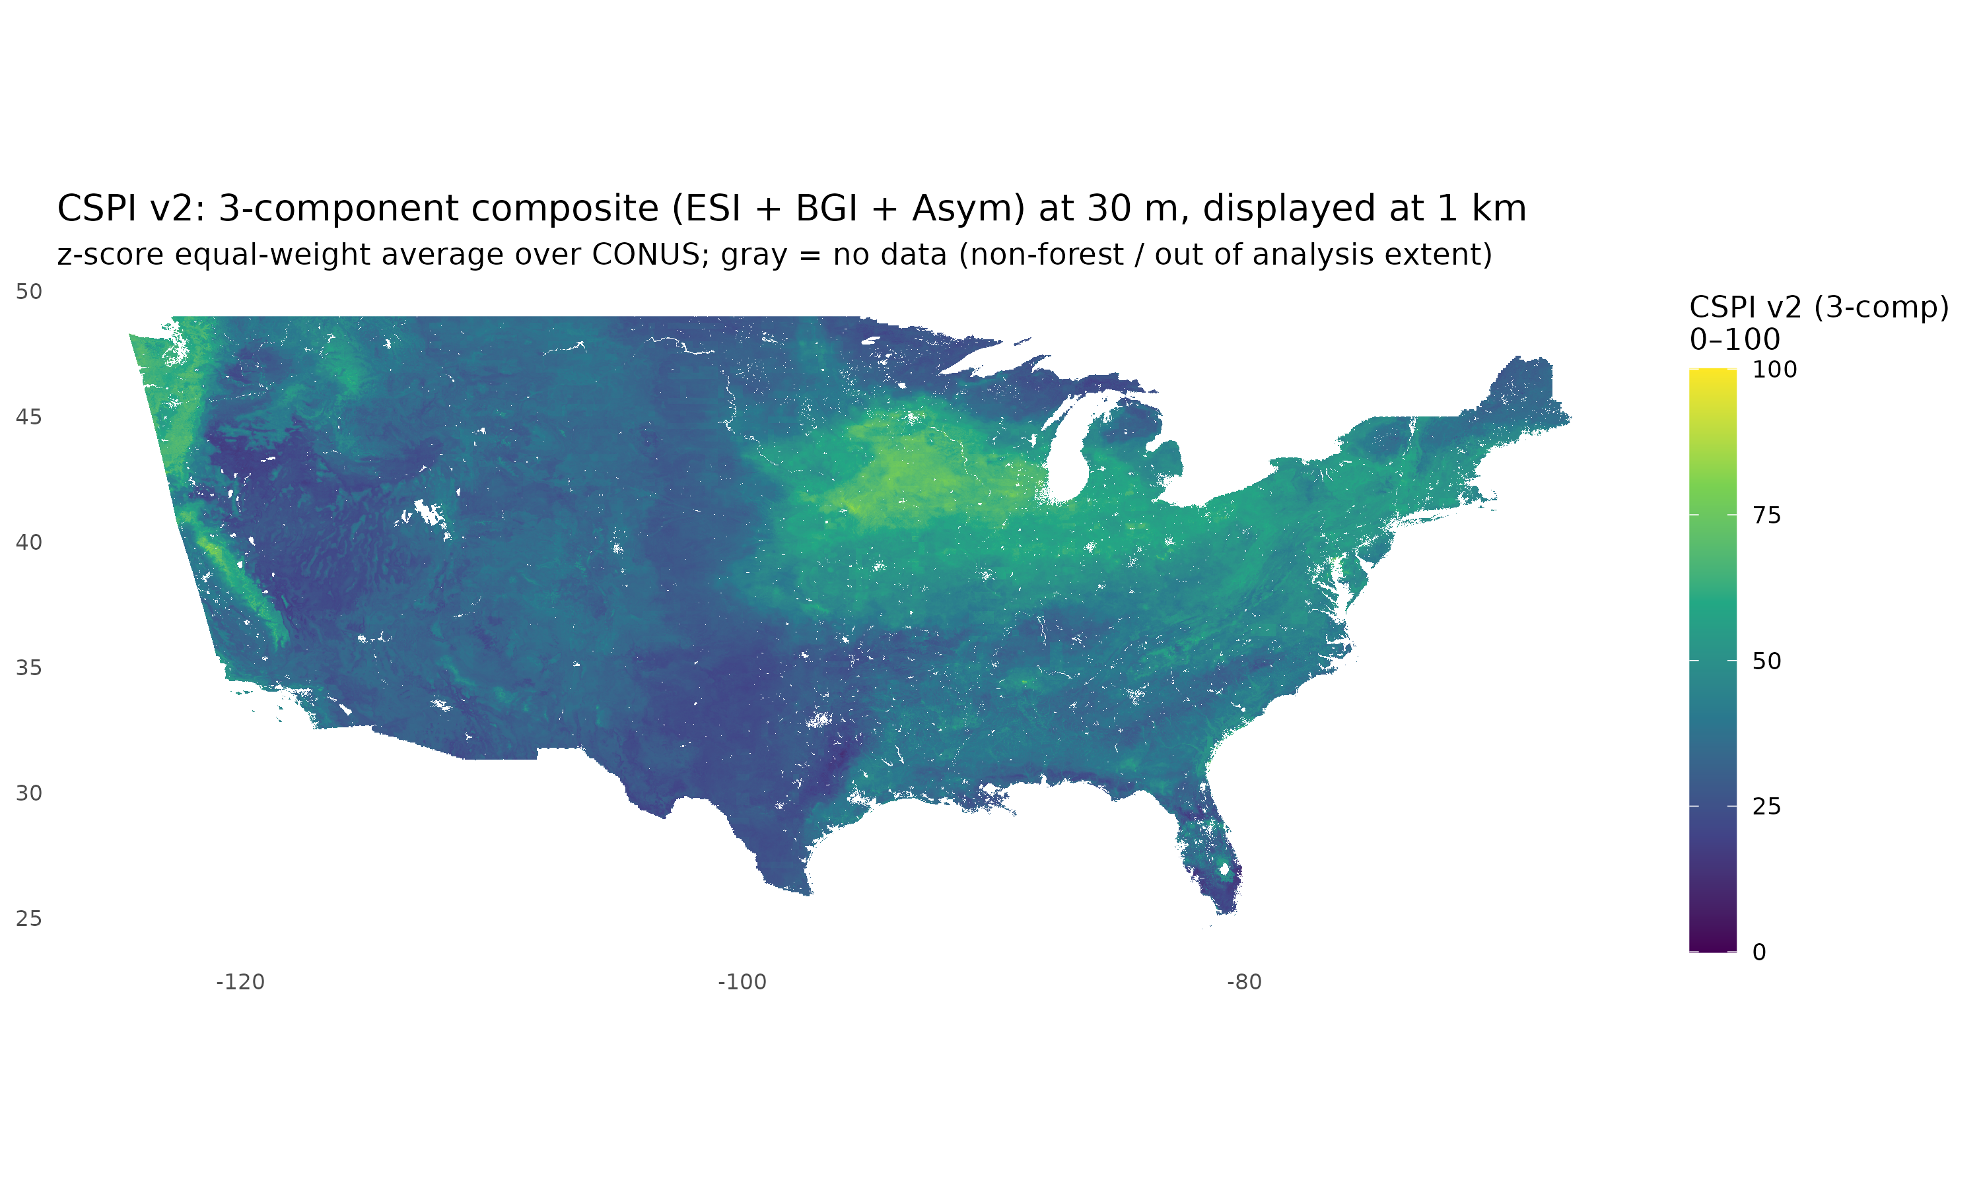
CSPI v2 spatial pattern over CONUS
30 m grid, z-score equal-weight average of ESI v7 + BGI + Asym, rescaled to 0–100.
Pacific Northwest coastal forest band highest; southwestern desert margin lowest; central hardwoods intermediate.

Slide 10
What you get when you cite the v2 deposit
Zenodo concept 10.5281/zenodo.20515034 always resolves to the latest version. v2.0.0 lightweight files are live now.
ESI v6
Recommended 1 km predicted site index
38 MB
CSPI v2
Multi-metric composite metadata + dictionary
30 KB
MOD17 NPP mean
Annual NPP 2017–2023, 500 m
130 MB
MOD17 NPP CV
Interannual stability layer
149 MB
Documentation
README, dictionary, NEWS, CITATION.cff
few MB
v2.1.0 follow-up
30 m surfaces, awaiting Zenodo quota
pending
v1.0.0 SICOND-target surfaces remain available at 10.5281/zenodo.20515035 for legacy use.
Component layers ship separately so you can decompose the composite or use the single measure you need.

Slide 11
How to cite for your work
Cite the concept DOI for stability across versions; the version DOI for a specific snapshot.
If you used the composite
If you used a single component
Weiskittel, A.R. (2026). Composite Site Productivity Index (CSPI) v2.0.0 for the conterminous United States. Zenodo. https://doi.org/10.5281/zenodo.20663652 Or, for a version-stable reference: Weiskittel, A.R. Composite Site Productivity Index (CSPI). Zenodo concept. https://doi.org/10.5281/zenodo.20515034 Also cite the v0.10 multi-dimensional paper once it is in press at FEM.
Cite the same record but specify the band you used: ...ESI v7 layer from CSPI v2.0.0 ...BGI 30 m layer from CSPI v2.0.0 ...Asym 30 m layer from CSPI v2.0.0 ...MOD17 NPP 500 m layer from CSPI v2.0.0 For SICOND, cite the FIA Phase 2 condition table directly, not this release.
Concept DOI for stability; version DOI for snapshot; the manuscript for the conceptual reframe.

Slide 12
What is next and how to engage
v2.0.1 and v2.1.0 are queued behind Cardinal compute; the manuscript is targeted at Forest Ecology and Management.
1
Now
FEM submission preparation
Final v0.10 polish, internal review, then submit. Outreach package staged at CRSF news + UMaine Comms.
2
Next 2 weeks
v2.0.1 release
Adds 30 m quantile-RF uncertainty raster for ESI v7. Cardinal job 11553490 is mid-array (4 of 40 running).
3
Next 1–2 months
v2.1.0 release
30 m wall-to-wall surfaces (composite + components) once Zenodo quota expansion approved. NPP upgrade to MOD17 500 m baked in.
4
Ongoing
Collaborator integrations
FVS DG-Kuehne calibrations, CFRU growth-and-yield benchmarks, Carbon Field Pilot validation, ForCAST applications.
Engage: aaron.weiskittel@maine.edu | GitHub: holoros/fvs-conus | Zenodo concept 10.5281/zenodo.20515034

Slide 13
Questions, applications, collaborations?
aaron.weiskittel@maine.edu
Center for Research on Sustainable Forests | University of Maine
github.com/holoros/fvs-conus | 10.5281/zenodo.20515034 | v0.10 manuscript in revision for FEM

Slide 14
v0.10j extensions
Parent material, FORTYPCD, Asym v9 corrective surface

Slide 15
§3.14 Parent material as a fourth stratification axis
Volcanic 39.9 m vs Organic 19.2 m mean ESI; SITECLCD reverses the ranking
gSSURGO copmgrp.pmgroupname grouped into 10 classes at FIA plot mukeys (n = 110,494)
Mean ESI ranges 19.2 m (Organic) to 39.9 m (Volcanic); SITECLCD ranking goes the other way
Volcanic: highest mean ESI (39.9 m) but lowest FIA productivity rating (SITECLCD = 5.69 of 7)
Organic: lowest mean ESI (19.2 m) but highest BGI (2.04 Mg/ha/yr), highest FIA productivity
Same opposite-sign structural pattern as East/West, per-species heterogeneity

Slide 16
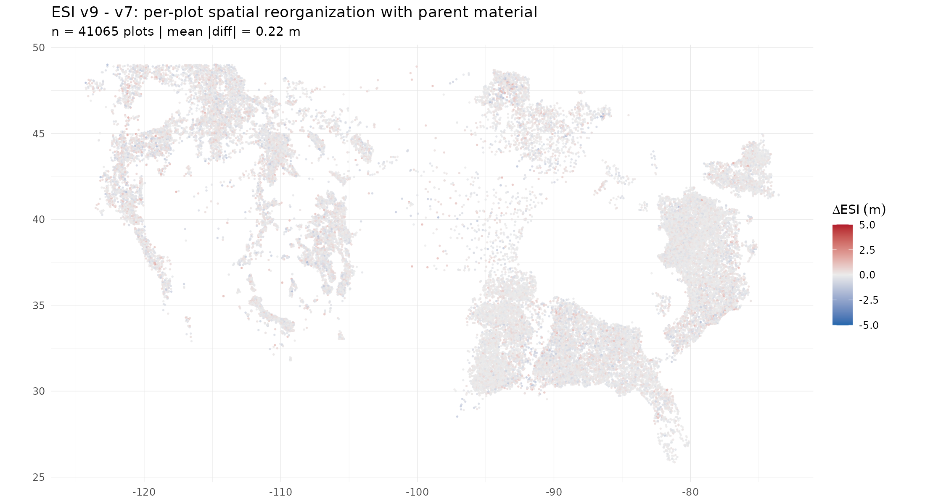
Figure 12: ΔESI = v9 - v7 at plot level
PM contributes no spatial reorganization for height-growth productivity
Mean |ΔESI| = 0.22 m on 28 m scale | 1.1% of plots shift > 1 m | pm_factor rank: 35 of 35

Slide 17
§3.15 PM-aware composite weighting
Optimal ESI/BGI/Asym weights vary by substrate but global pattern holds
Equal-weight composite OOB R² = 0.800 (current baseline)
Free 3-component composite OOB R² = 0.817 (+0.016, matches §3.9 ecoregion result)
Add pm_factor on top: OOB R² = 0.817 (no operational gain)
Per-PM stratified weights: 0.774 (overfits small categories)
Per-PM weight heterogeneity (impurity importance):
Alluvial: BGI dominates (6943 > ESI 2702)
Residuum: BGI dominates (5962 > ESI 3246)
Marine: ESI ≈ Asym > BGI (2511, 2595, 2099)
Colluvium + Glacial: ESI dominates

Slide 18
§3.16 Forest type group strengthens the case
r(ESI,BGI) ranges -0.555 to +0.591 across forest type groups
Disturbance, treatment, forest type group, stand size class — all stratified
Forest type group adds +0.052 R² to SITECLCD recovery (0.801 → 0.853)
Comparable to L1/L2/L3 ecoregion result (+0.054)
Per-FORTYPCD heterogeneity:
Spruce-Fir (n = 26,730): r(ESI,BGI) = +0.398
Maple-Beech-Birch (n = 7,276): r(ESI,BGI) = -0.311
Oak-Gum-Cypress (n = 602): r(ESI,BGI) = -0.555
Longleaf-Slash pine (n = 1,656): r(ESI,BGI) = +0.591
Stand size class: r(ESI,BGI) ranges only -0.43 to -0.51
Robust to stocking level — operationally meaningful for the composite

Slide 19
§3.17 Asym v9: where parent material does matter
Long-run carrying capacity is the dimension PM informs
Same v9 refit (env + PM, no LAT/LON) on three productivity measures:
ESI v9 (height growth): ΔR² = +0.001, pm rank 35 of 35 (climate-saturated)
BGI v9 (current growth): ΔR² = +0.001, pm rank 12 of 17 (soil-saturated)
Asym v9 (carrying capacity): ΔR² = +0.008, pm rank 8 of 12 (PM matters)
Refit on v3 30 m predictor stack: OOB R² 0.828 → 0.836, RMSE 8.40 → 8.21 Mg/ha
~6x larger marginal gain than for ESI or BGI
Ecological reading: deep substrate (rooting depth, bedrock chemistry, drainage)
influences carrying capacity more than short-run growth dynamics
v3.0.0 release direction: ship ESI v7 baseline + Asym v9 corrective surface

Slide 20
v3.0.0 release in progress
Three new products + LAT/LON exclusion methodological convention
Asym v9 30 m corrective surface
Tile predict array running on Cardinal (240 tiles, 8 concurrent)
Post-surface pipeline auto-fires on tile completion (forest mask + delta layer)
Parent material 30 m CONUS overlay
1.4 billion pixels, 255 MB compressed, 10 categories
Reprojected to EPSG:4326 matching the v3 aligned grid
Delta Asym = v9 - v7 layer
Shows where geology reorganizes asymptotic biomass predictions
Largest over Organic peatlands and Volcanic substrates
Zenodo metadata staged at zenodo/v3.0.0_metadata.json
Concept DOI 10.5281/zenodo.20515034 | v2.0.0 at 10.5281/zenodo.20663652

